Slide 1



FREE PRESENTATION TEMPLATE BY EATEMP
Patriotism
EaTemp

Slide 2


Welcome to the world of fantasy! Join us on a journey to explore the mystical creatures, enchanted lands, and magical wonders that exist beyond our reality. Discover the wonders and secrets of this exciting realm and unlock the power of imagination.
Welcome
EaTemp

Slide 3


Table of Contents
01
03
Introduction
Wonders
The Extraordinary Realm
Wishes Granted
02
04
Encounters
Magic
EaTemp
Unicorn Sightings
Spellcasting

Slide 4

the Extraordinary
Welcome to the Fantasy World, a realm of wonder and enchantment where anything is possible. Here, dragons breathe fire, unicorns prance through meadows, and rainbows shine brightly. This world is a place where wishes come true, where potions can be cursed and spells are cast. It's a place of treasure and adventure, where the impossible becomes possible. But the greatest treasure of all is the one that lies within.
The world of fantasy is a reflection of our deepest desires, our fondest dreams, and our wildest imaginations. It's a place where we can let go of the constraints of reality and explore the boundless possibilities of the human mind. In this introduction, we will delve into the mysteries of this realm, uncovering the magic and wonder that lies within. So come with us and let's embark on a journey through the Fantasy World.
EaTemp

Slide 5



Unicorn Sightings
Dragon Taming
A record of the number of unicorns spotted in the fantasy realm and the beauty and mystery that surrounds these enchanting creatures.
A closer look at the art of taming dragons and the brave adventurers who dare to take on these fearsome creatures.
EaTemp

Slide 6

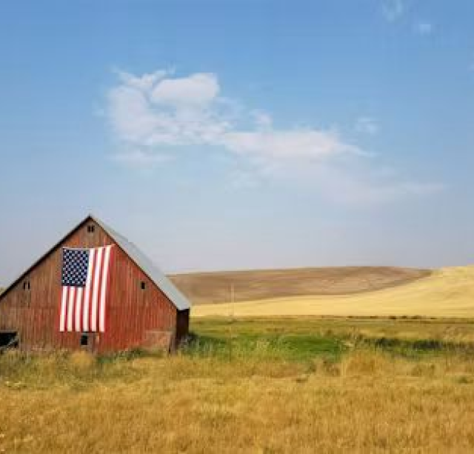
Unicorn
Dragon
EaTemp
A record of the number of unicorns spotted in the fantasy realm and the beauty and mystery.
A closer look at the art of taming dragons and the adventurers who take on these creatures.

Slide 7

Fantasy is the gateway to the impossible, the land where the ordinary becomes extraordinary, and the impossible becomes possible. It is the realm of the imagination, where anything can happen and everything is possible.
The Dream Weaver
EaTemp

Slide 8



The Magic of Dragons
"The Art of Archery": Discover the intricacies of the Art of Archery .
6.7M
4.4M
"The Music of the Elves": Immerse yourself in the enchanting music of the elves.
2.3M
EaTemp
"The Life of an Elf": Learn about the customs and daily life of the elves.

Slide 9



Pricing Plan
Basic
Elite
Legendary
Access to the entry-level dungeons.
A limited number of quests and battles per month.
Ability to form a small party with fellow adventurers.
Access to the intermediate and advanced dungeons.
A greater number of quests and battles
Ability to form larger parties with adventurers.
Access to the most challenging dungeons.
Unlimited quests and battles per month.
The ability to form the largest parties.
$10/month
$50/month
$100/month
EaTemp

Slide 10




S
W
O
T
Eclipse
Eclipse
Eclipse
Eclipse
Rare event causes unpredictable magic.
Rare event causes unpredictable magic.
Rare event causes unpredictable magic.
Rare event causes unpredictable magic.
Quest
Quest
Quest
Quest
Adventurers seek immortal artifact.
Adventurers seek immortal artifact.
Adventurers seek immortal artifact.
Adventurers seek immortal artifact.
EaTemp

Slide 11

Some Data
70%
Creatures
possess the ability to cast spells.
60%
Individuals
practice the art of illusions.
90%
Spells
are dark magic, foretelling danger.
EaTemp

Slide 12
234,567
UNICORN SIGHTINGS
A tally of the number of unicorns spotted in the fantasy realm.
EaTemp

Slide 13
233 Coins
85%
Treasure Found
Wished Granted
456 H
674 Km
Duration of Spell Casting
Journey Distance
EaTemp

Slide 14






Some Graph
100
90
80
70
60
50
34.574
40
Total
30
20
10
0
1
2
3
4
5
6
7
8
Progress
Treasure Found
A record of the number of spells cast per year
A record of the amount of treasure found per month
EaTemp

Slide 15


Portal to Adventure
A web application
A web application designed for discovering the world of fantasy
EaTemp

Slide 16


The Future
An mobile app
An app designed for exploring and experiencing the enchanting realm of fantasy
Explore a magical world
Experience fantasy firsthand
Immerse in a realm of magic
Discover untold wonders
Live your fantasy dreams
EaTemp

Slide 17

A Magic Picture
EaTemp

Slide 18

Fantasy Realm at a Glance
The Forest
A magical forest filled with animals and enchanted creatures.
The Caves
A network of underground caves filled with gems and crystals.
The Lair
A dangerous and mysterious place where dragons reside.
EaTemp

Slide 19




The Timeline
May
July
Shimmering City, conquest, Unicorn Crystal
Kingdom invaded, betrayal, brave hero's festival
Eclipse
Quest
Found
form
April
June
Eclipse, quest for artifact, volcano disaster
War, curse from artifact, magic discovery
EaTemp

Slide 20



Our Team
Eldruin
Element
Lunaria
The Fire Mage
The Guardian
The Moon Priestess
EaTemp

Slide 21

The Mystery
2023
The Forbidden Forest: A place of mystery and wonder, where mystical creatures roam and flora flourishes.
2024
The Crystal Caves: A network of glittering caves filled with precious gems and minerals, guarded by fierce beasts.
2025
The Enchanted Garden: A place of pure beauty and tranquility, where the colors of the flowers are vibrant.
2026
EaTemp

Slide 22
The List
Dragons
Fire-breathing creatures that are often powerful and dangerous
Medieval-like Settings
Worlds with castles, knights, and feudal systems
Chosen One Trope
A hero chosen by destiny to save the world
Magic
An integral part of fantasy stories, can take many forms
The Best Curse
A curse that is unique, creative, and fits within the story
Unique Creatures
A variety of fantastical beings that inhabit the world
EaTemp

Slide 23









The Organization
Chloe Ng
The Mage
Valtorin
Aurielle
Theronis
Dariana
The Assassin
The Priestess
The Warrior
The Shaman
Lucian
Elvina
The Conjurer
The Oracle
Cedric
Seraphina
The Timekeeper
The Lightbringer
EaTemp
To download more editable chart, click here

Slide 24

Thank you for
choosing EaTemp
Yes, you can use this for both personal and commercial projects.
No, you don't have to credit us.
No, you can't resell or redistribute it, including uploading this template online.
And you can support us by sharing our site, EaTemp.com, with others.
Credit | Image: Unsplash
EaTemp

