Slide 1
COLORFUL EDUCATION
Powerpoint Template
www.freepptbackgrounds.net

Slide 2
COMPANY
01
Budget
02
Buy
03
Calculate
04
Cancel

Slide 3
01
BUDGET

Slide 4

Comparison
Certification
A complex idea can be conveyed with just a single still image, namely making it possible to absorb large amounts of data quickly.
Show and explain your web, app or software projects using these gadget templates
Commission
Choose
Show and explain your web, app or software projects using these gadget templates
A complex idea can be conveyed with just a single still image, namely making it possible to absorb large amounts of data quickly.

Slide 5
Complete
Complain
Competition
I hope and I believe that this
Easy to change colors, photos and Text.
I hope and I believe that this

Slide 6

You have to be signed in to your Google account.
Get a modern PowerPoint Presentation
Customer
Convince
Date
Confirm
Get a modern PowerPoint Presentation
You have to be signed in to your Google account.

Slide 7
Decide
Decision
Google account. in PowerPoint. Remember to download
Add or delete slides. You have to be signed in to your
Decision
Decide
In the spectrum of visible light, yellow is found between green and orange.
Google account. in PowerPoint. Remember to download
Deadline
Deadline
Add or delete slides. You have to be signed in to your
In the spectrum of visible light, yellow is found between green and orange.

Slide 8
Dismiss
Develop
Department
Deliver
This allows us to achieve high quality outcomes and full transparency towards.
We use well-known development methodologies to create a customized approach
This allows us to achieve high quality outcomes and full transparency towards.
We use well-known development methodologies to create a customized approach
汇报：张三

Slide 9


Dispatch
We use well-known development methodologies to create a customized approach for each of the projects.
Distribute
We use well-known development methodologies to create a customized approach for each of the projects.

Slide 10
02
BUY

Slide 11
Moving from creative ideas to solid strategy and execution
We press play on your digital story. Using conceptual, digital design
01
02
We press play on your digital story. Using conceptual, digital design
04
Moving from creative ideas to solid strategy and execution
03

Slide 12
Employ
When you get them, they will get you, quicker. We leverage digital tools, design and words, to become even more relevant.
78%
62%
38%
Education
Simple & Smooth, exactly how purchasing experiences should be. We align with your users need to build and evolve a flowing shopping interface, one that slots easily into place with each step.
15%
01
02
03
04

Slide 13

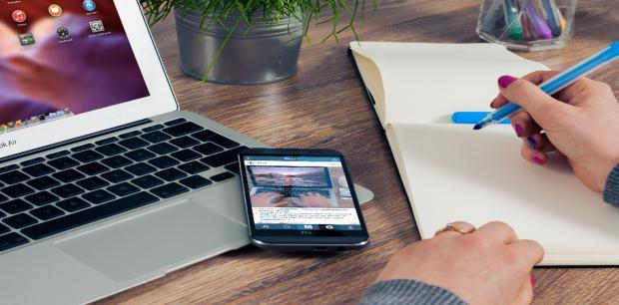
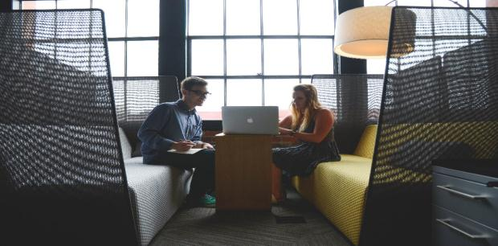
Equipment
Sometimes it's easier to go old school, our copywriters prefer
Encourage
Your audience relate and absorb information on different sensory levels. We know visual stories are amplified with the right words.

Slide 14
Feedback
The user can demonstrate on a projector or computer, or print the presentation and make it into a film to be used in a wider field. Using PowerPoint
Explanation
Facilities
Fix
We know visual stories are amplified with the right words. Sometimes it's easier to go old school, our copywriters prefer a good ball.
Exchange
Experience

Slide 15
03
CALCULATE

Slide 16
Hearing
The user can make a presentation on a projector or computer, or print out the presentation to make a film. The user can make a presentation on a projector or computer, and can also make a presentation. You can also print out the presentation to make a film
Fund
Goal
Growth
Fund
Growth
Goal
16
7
10
20
17
30

Slide 17
Inform
Increase
It is a very sad thing that nowadays there is so little useless information.
Enter the comprehensive description of the above chart here
Industry
Improve
Enter the comprehensive description of the above chart here
It is a very sad thing that nowadays there is so little useless information.

Slide 18




Inventory
Instructions
It is, perhaps, our fate rather than our merit. We cannot help
We certainly do not forget you as soon as you forget us.
Invoice
Install
We certainly do not forget you as soon as you forget us.
It is, perhaps, our fate rather than our merit. We cannot help

Slide 19
04
Cancel

Slide 20
21%
Join
52%
Knowledge
11%
Tech
36%
Startup

Slide 21


Public
I believe that people would be alive today if there were a death penalty.
NGO
You can do nothing to change the past, and the future will never come exactly as you plan or hope for.
Education
I believe that people would be alive today if there were a death penalty.

Slide 22
Fashion
1
5
Fashion
Woe be to him that reads but one book. George Herbert
Genius hath electric power which earth can never tame. Lydia M. Child
Culture
Arts
2
6
I feel very strongly that change is good because it stirs up the system.
A large income is the best recipe for happiness I ever heard of.
Finance
Arts
Culture
3
7
I feel very strongly that change is good because it stirs up the system.
A large income is the best recipe for happiness I ever heard of.
Fashion
Fashion
4
8
Woe be to him that reads but one book. George Herbert
Genius hath electric power which earth can never tame. Lydia M. Child

Slide 23
THANK YOU !
Colorful Education
Powerpoint Template
www.freepptbackgrounds.net

