Slide 1
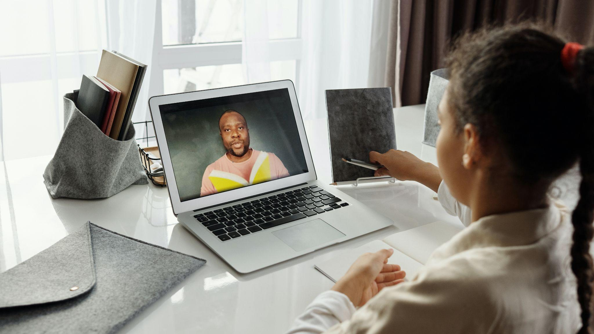


7 Self discipline
Victory begins with self-discipline
Over the next week…
Find someone to work with you as your accountability partner.
Plan to use some strategies that will help improve your self-discipline when working on school assignments.
Check in with your accountability partner several times this week to reflect on your progress.

