Slide 1





Fradel and Spies
Social Media
Optimization
Marketing Team

Slide 2


Agenda
Our Team
Advantages
Definition
The Tools
Objectives
The Tools
Implementation

Slide 3



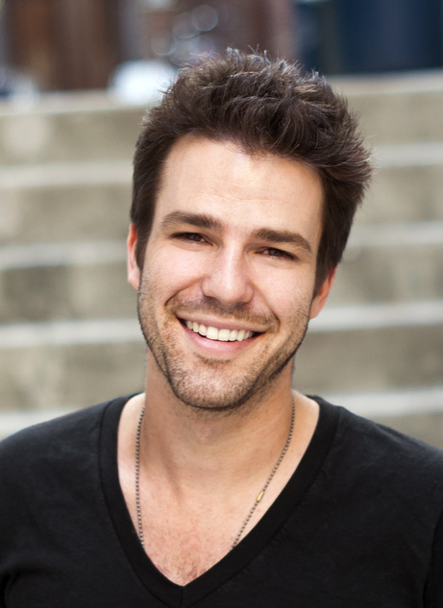



Our Team
Bailey Dupont
Drew Feig
Marketing Manager
Supervisor
Helene Paquet
Harumi Kobayashi
Staff
Staff

Slide 4


Definition
This paragraph provides a brief overview of the subject. To give a clear understanding, the issue will be explained in further detail.
The topic under discussion has a number of features and dimensions that all contribute to its overall grasp. Let's get right to the point in order to provide a thorough understanding.

Slide 5

Objectives
Write your explanation of the topic here. Make sure to express your ideas clearly and write them down in as much detail as possible.
  Enhance social media strategy
  Create content timetables
  Monitor social media performance
  Use insight metrics.
  Optimize social media
  Optimize profiles
  Improve contents
  Optimize hashtags

Slide 6




Implementation
This method may be one of several existing strategies to increase online traffic directed at social media activity. The goal of this activity is to prove that the method could provide the most significant change to the brand. The training of this method for other teams will focus on social media management in order to improve the optimization and performance of social media.

Slide 7

Advantages
  Improve profile ranking
  Attract potential customers
Write your explanation of the topic here. Make sure to express your ideas clearly and write them down in as much detail as possible.
Write your explanation of the topic here. Make sure to express your ideas clearly and write them down in as much detail as possible.
  Increasing social media followers
  Improve social media visibility
Write your explanation of the topic here. Make sure to express your ideas clearly and write them down in as much detail as possible.
Write your explanation of the topic here. Make sure to express your ideas clearly and write them down in as much detail as possible.

Slide 8


The Tools
Tool A
Tool B
Write your explanation of the topic here.
Write your explanation of the topic here.
Tool C
Tool D
Write your explanation of the topic here.
Write your explanation of the topic here.

Slide 9

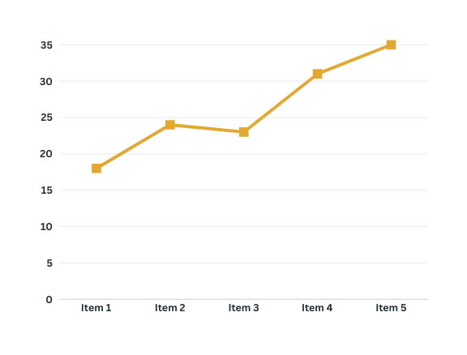
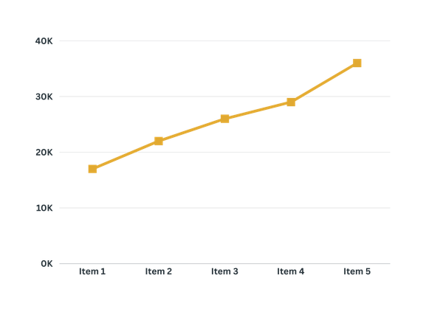
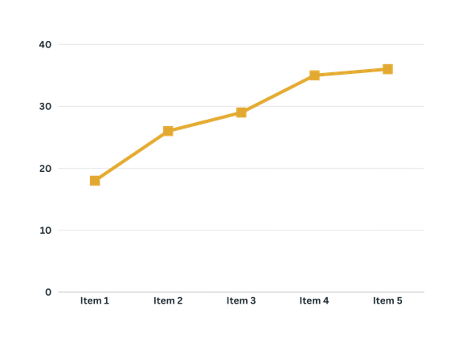

Results
Write your explanation of the topic here. Make sure to express your ideas clearly and write them down in as much detail as possible.
Brand Awareness
Social Media Followers
Sales

Slide 10




Fradel and Spies
+123-456-7890
hello@reallygreatsite.com
123 Anywhere St., Any City, ST 12345

