Slide 1
Measuring stream flow: continuous gauging
1
NOTE: Slides for each module are numbered for easier cross-referencing with class notes
NOTE: My slides have TONS of animations and building graphics. These do not translate well to D2L, so it is best to download the power point to work through the logic behind the animations

Slide 2
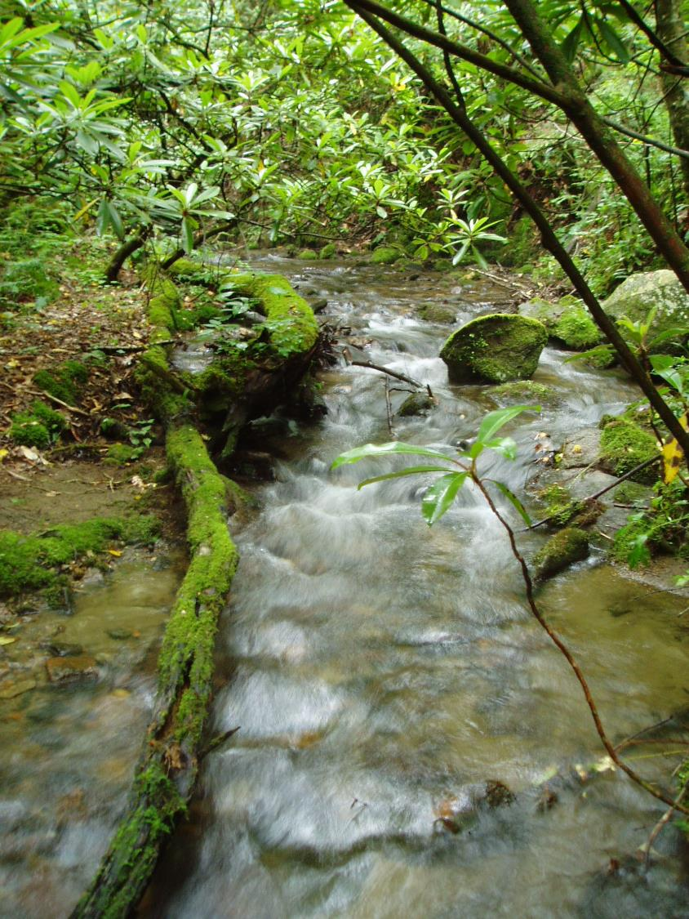
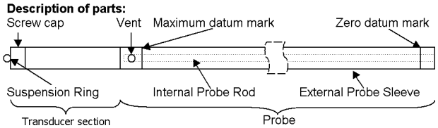
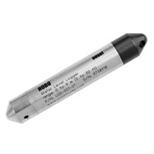
Measuring flow over time: How?
21
Bubble
pressure
AIR
Capacitance
rod
Pressure transducers

Slide 3
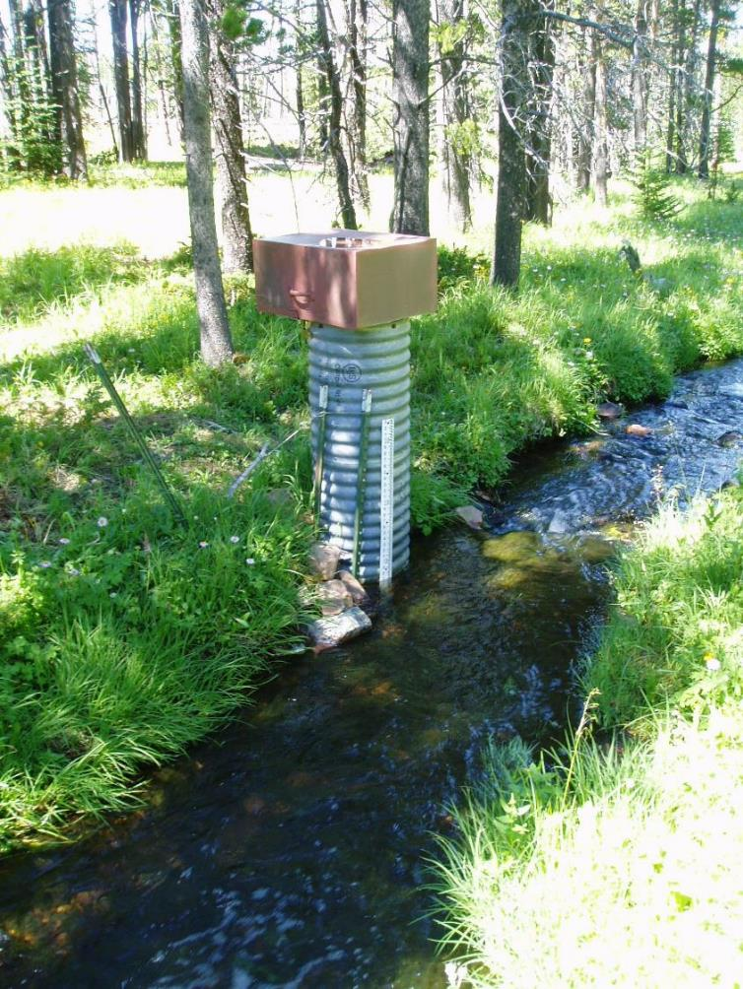
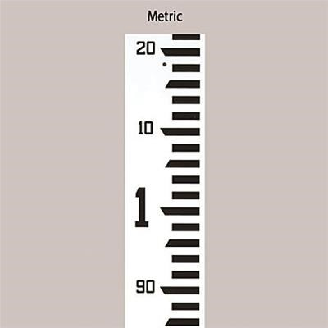
Measuring flow over time: natural channels
22
Data logger
Stilling well
Staff gauge

Slide 4

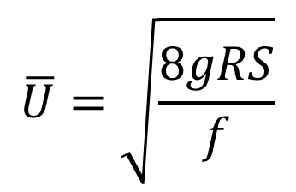





Stream hydraulics: flow and depth (or stage)
23
$$\overline{U}$$
$$A$$
What determines the relationship between velocity and area?
$$Q=\overline{U}A$$
$$Intuition?$$
$$\overline{U}$$
$$A$$
Constant
$$\overline{U}=\sqrt{\frac{8gRS}{f}}$$
Darcy-Weisbach

Slide 5
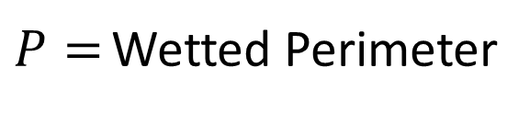
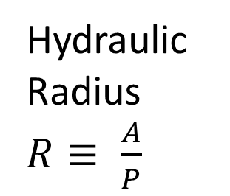

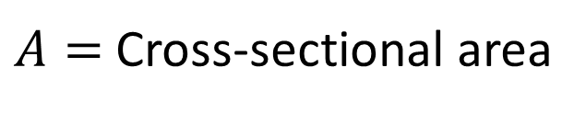
Stream hydraulics: flow and depth (or stage)
24
$$\overline{U}$$
$$A$$
What determines the relationship between velocity and area?
$$Q=\overline{U}A$$
$$\overline{U}$$
$$A$$
Constant
Hydraulic Radius
$R≡ \frac{A}{P}$
$A=$ Cross-sectional area
$\frac{\left[L^{2}\right]}{[L]}=\left[L\right]$
$P=$ Wetted Perimeter
For streams that are much wider than they are deep, the hydraulic radius is approximately the same as the average depth of a cross-section

Slide 6




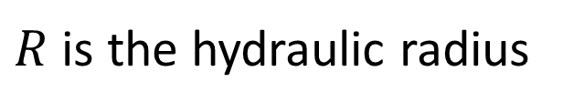

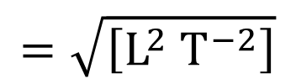
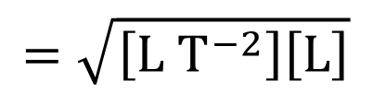

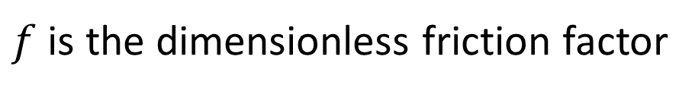
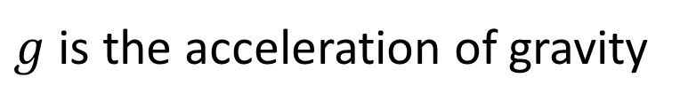
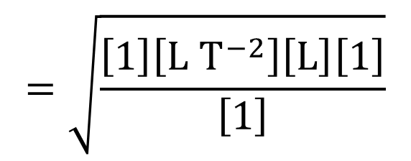

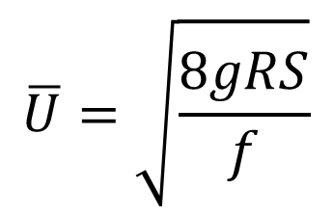
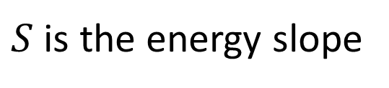

Stream hydraulics: dimensional analysis
25
$$\overline{U}=\sqrt{\frac{8gRS}{f}}$$
Darcy-Weisbach
$$Q=\overline{U}A$$
Constant
$g$ is the acceleration of gravity
Dimensions?
$$\left[L T^{−2}\right]$$
$R$ is the hydraulic radius
$$\left[L\right]$$
$S$ is the energy slope
$$\left[L L^{−1}\right]=\left[1\right]$$
$f$ is the dimensionless friction factor
$$\left[1\right]$$
$$=\sqrt{\frac{\left[1\right]\left[L T^{−2}\right]\left[L\right]\left[1\right]}{\left[1\right]}}$$
$$\left[L T^{−1}\right]$$
$$=\sqrt{\left[L T^{−2}\right]\left[L\right]}$$
$$=\sqrt{\left[L^{2} T^{−2}\right]}$$
$$=\left[L T^{−1}\right]$$
$$\overline{U}$$

Slide 7
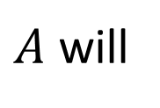
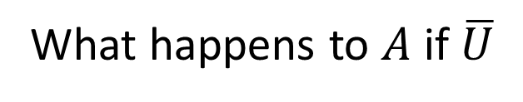
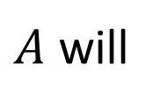

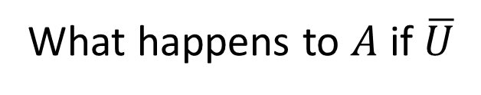
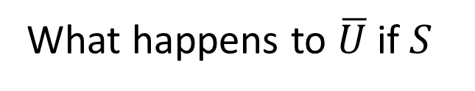
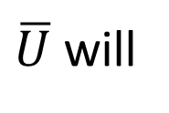
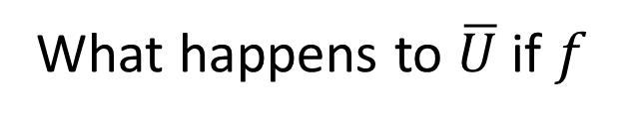
Stream hydraulics: sensitivity analysis
26
$$\overline{U}=\sqrt{\frac{8gRS}{f}}$$
Darcy-Weisbach
$$Q=\overline{U}A$$
Constant
What happens to $\overline{U}$ if $S$
?
$\overline{U}$ will
Higher energy slopes lead to faster and shallower flows
What happens to $A$ if $\overline{U}$
?
$A$ will
What happens to $\overline{U}$ if $f$
?
$\overline{U}$ will
Higher resistance to flow leads to slower and deeper flows
What happens to $A$ if $\overline{U}$
?
$A$ will

Slide 8
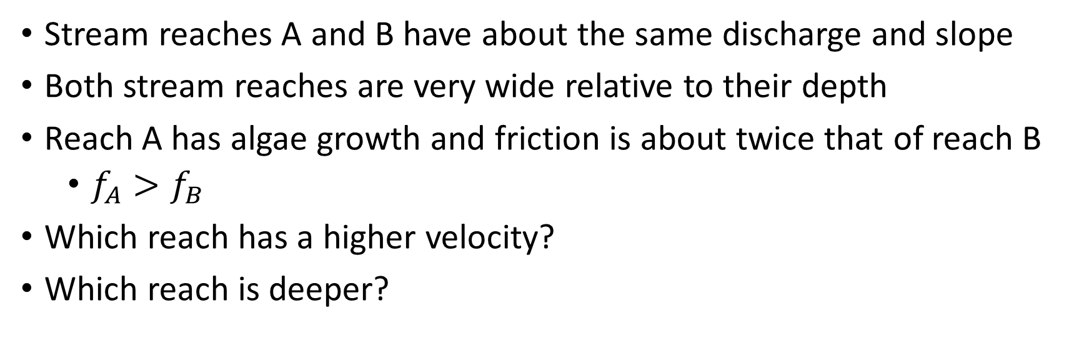
Stream hydraulics: thought exercises
27
$$\overline{U}=\sqrt{\frac{8gRS}{f}}$$
Darcy-Weisbach
$$Q=\overline{U}A$$
Stream reaches A and B have about the same discharge and slope
Both stream reaches are very wide relative to their depth
Reach A has algae growth and friction is about twice that of reach B
  $f_{A}>f_{B}$
Which reach has a higher velocity?
Which reach is deeper?
Reach B
Reach A

Slide 9
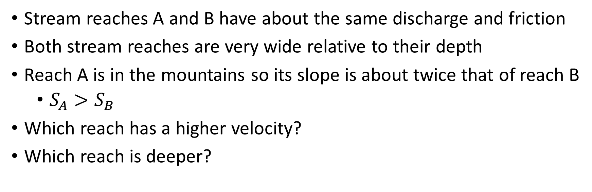
Stream hydraulics: thought exercises
28
$$\overline{U}=\sqrt{\frac{8gRS}{f}}$$
Darcy-Weisbach
$$Q=\overline{U}A$$
Stream reaches A and B have about the same discharge and friction
Both stream reaches are very wide relative to their depth
Reach A is in the mountains so its slope is about twice that of reach B
  $S_{A}>S_{B}$
Which reach has a higher velocity?
Which reach is deeper?
Reach A
Reach B

Slide 10
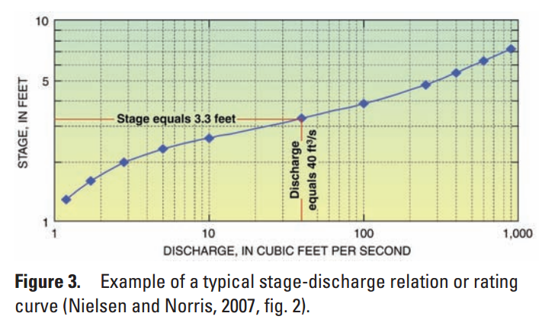
Measuring flow over time: rating curves
29
Data logger
Manual
measurement
Interpolation
function
Stilling well
Manual stage
USGS Fact Sheet 2011-3001

Slide 11
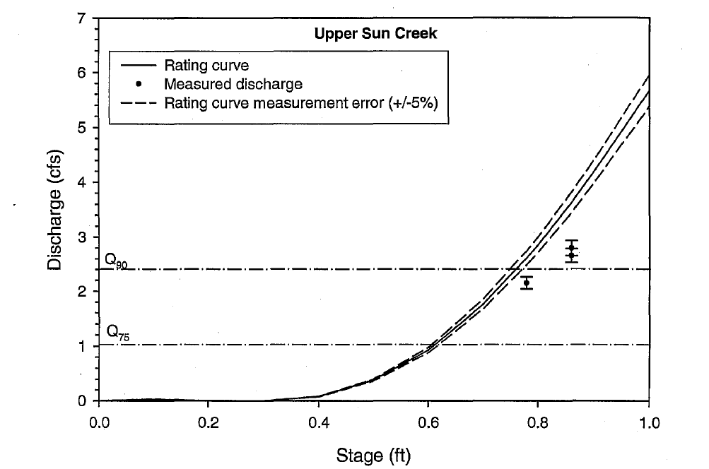
Measuring flow over time: rating curves
30
$$Q=1.1065H−9.79070H^{2}+20.39369H^{3}−2.79459H^{4}−3.25692H^{5}$$
USDA Report for Joint Venture Agreement No. 02-JV-11222022-183

Slide 12

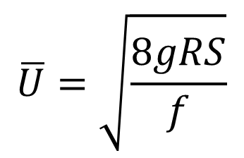
Stream hydraulics: thought exercise
31
$$\overline{U}=\sqrt{\frac{8gRS}{f}}$$
$$Q=\overline{U}A$$
Darcy-Weisbach
At the same stage, discharge is now lower than it used to be.
What is a change to the stream geometry that can explain this?
  Bank failure may have created a narrower channel
What is a change to the resistance to flow that can explain this?

Slide 13
Measuring flow over time: rating curves
32
$$Q=1.1065H−9.79070H^{2}+20.39369H^{3}−2.79459H^{4}−3.25692H^{5}$$
USDA Report for Joint Venture Agreement No. 02-JV-11222022-183

Slide 14
Stream hydraulics: thought exercise
33
$$\overline{U}=\sqrt{\frac{8gRS}{f}}$$
$$Q=\overline{U}A$$
Darcy-Weisbach
At the same stage, discharge is now lower than it used to be.
What is a change to the stream geometry that can explain this?
  Bank failure may have created a narrower channel
At the same discharge, stage is now higher than it used to be.
What is a change to the resistance to flow that can explain this?
  Change in bed material or aquatic vegetation may have increased friction

Slide 15
Measuring flow over time: rating curves
34
Open channel gauges are more likely to lose calibration of their rating curves due changes in channel structure
$$Q=1.1065H−9.79070H^{2}+20.39369H^{3}−2.79459H^{4}−3.25692H^{5}$$
USDA Report for Joint Venture Agreement No. 02-JV-11222022-183

Slide 16
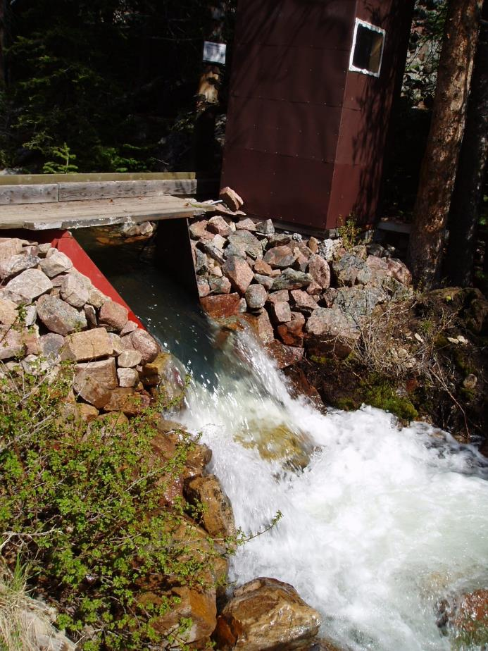
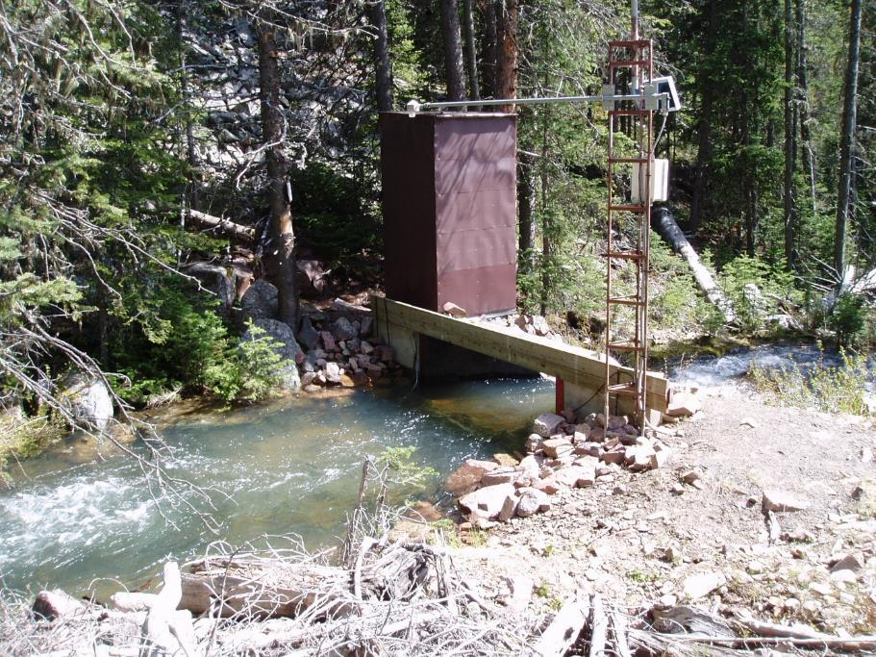
Measuring flow over time: H flumes
35
Sonic water level
Stilling well

Slide 17
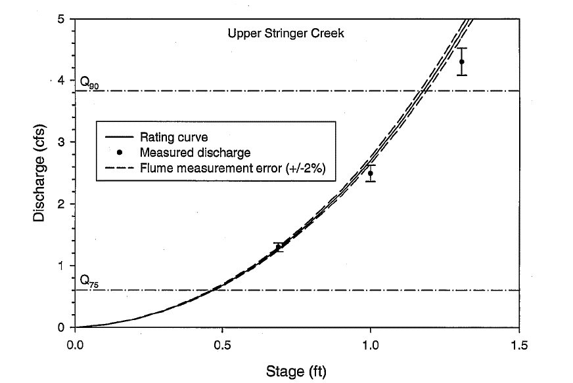
Measuring flow over time: H flumes
36
$$Q=0.22921H+2.04595H^{2}+0.40881H^{3}+0.02321H^{4}−0.00245H^{5}$$
USDA Report for Joint Venture Agreement No. 02-JV-11222022-183

Slide 18
Stream hydraulics: thought exercise
37
$$\overline{U}=\sqrt{\frac{8gRS}{f}}$$
$$Q=\overline{U}A$$
Darcy-Weisbach
At the same discharge, stage is now higher than it used to be.
What is a change to the energy slope that can explain this?
  The flume structure may have settled over time resulting in the flume having a lower slope.

Slide 19
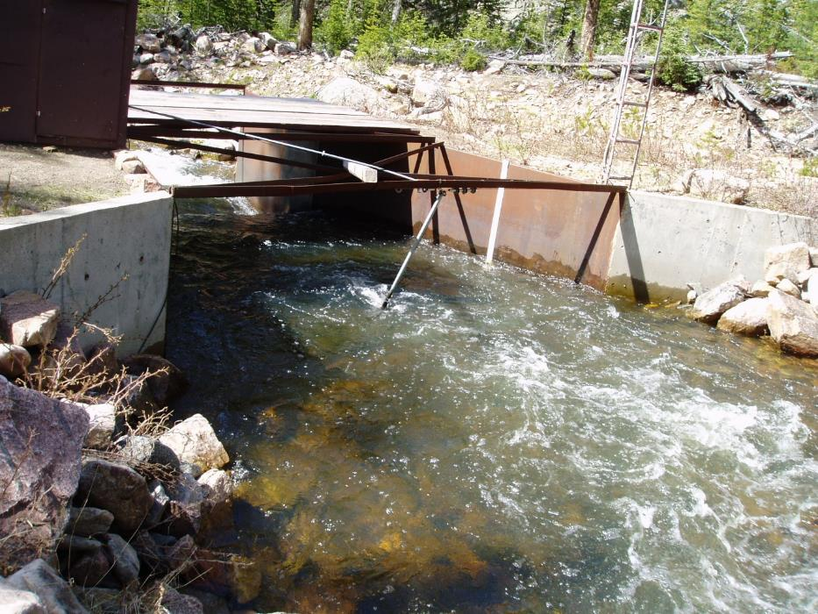
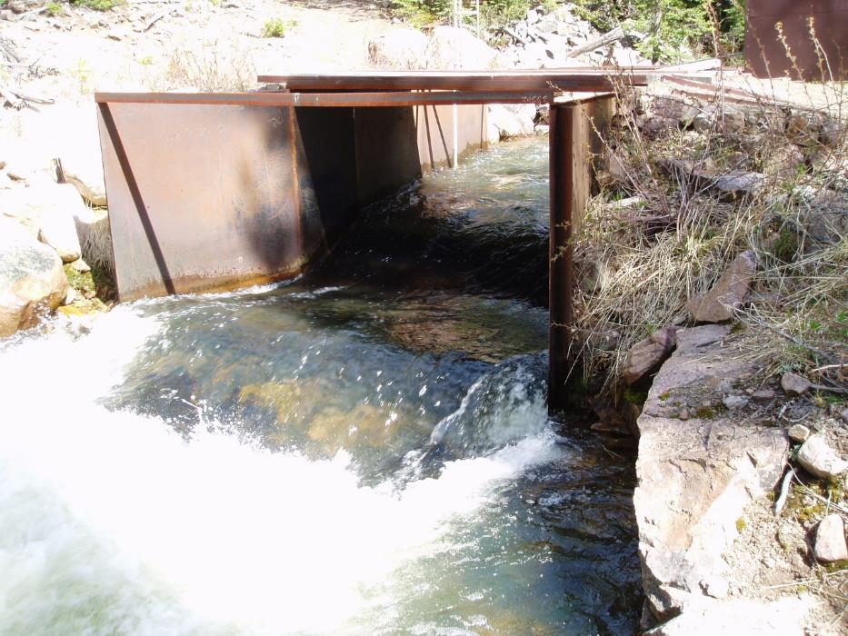
Measuring flow over time: Parshall flumes
38
Stilling well
Manual stage

Slide 20
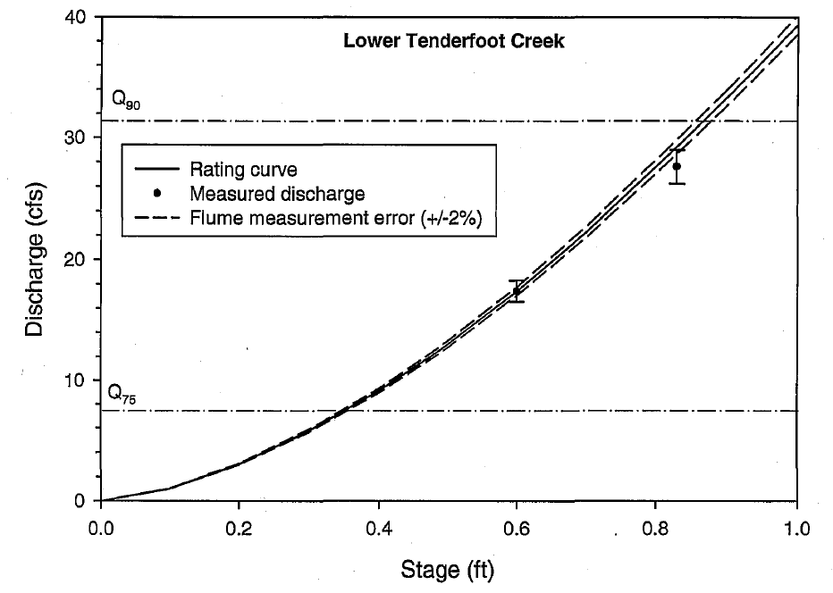

Measuring flow over time: Parshall flumes
39
$$Q={39.375H}^{1.6}$$
USDA Report for Joint Venture Agreement No. 02-JV-11222022-183

Slide 21
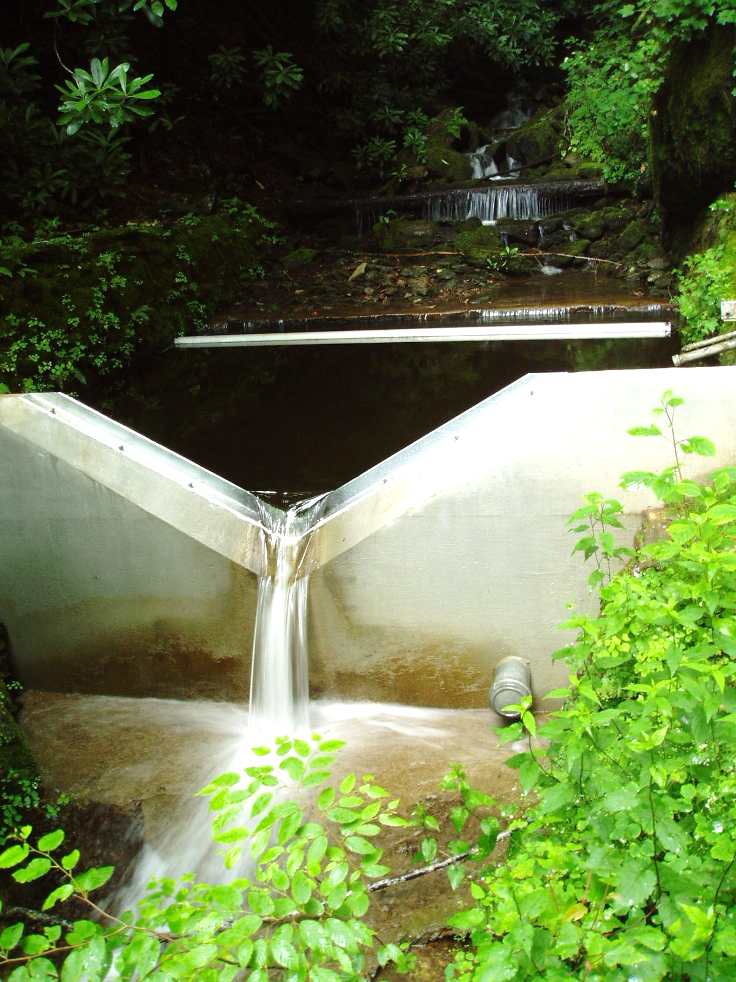
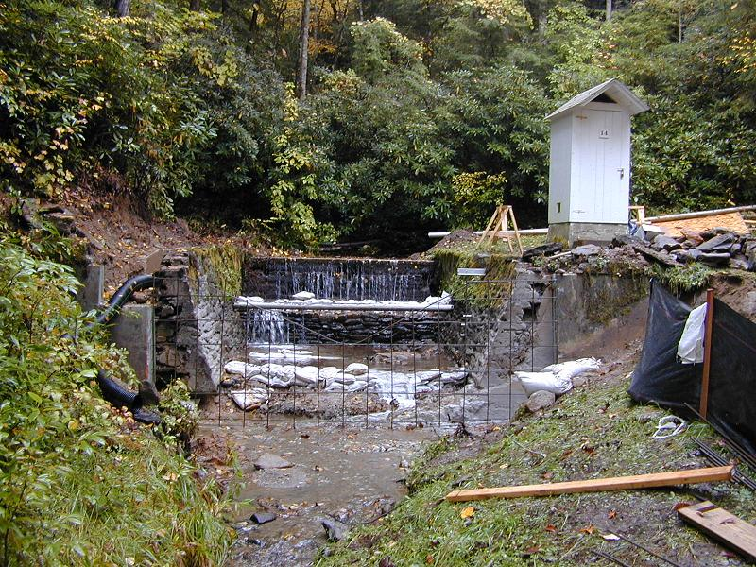
Measuring flow over time: Weirs
40

Slide 22
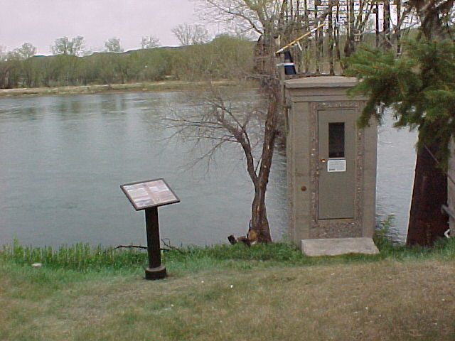
Measuring flow over time: Rivers
41
Missouri River
Fort Benton, MT
Gauge house over
stilling well
From USGS public domain

Slide 23
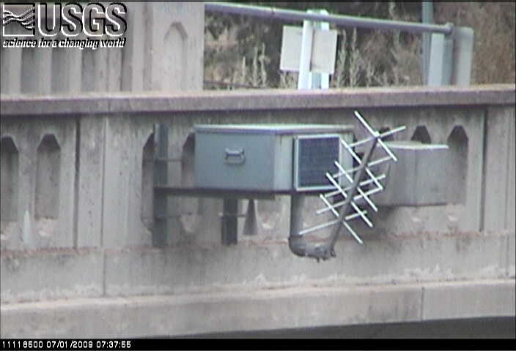
Measuring flow over time: Rivers
42
Ventura River, CA
Water depth by radar,
telemetry
From USGS California Water Center webcam

Slide 24

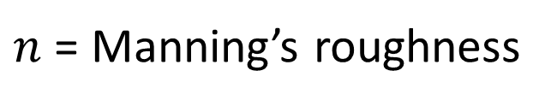
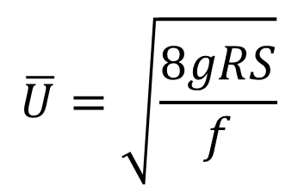
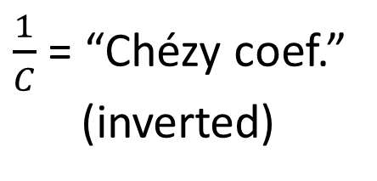
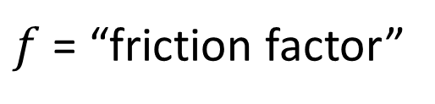

Stream hydraulics: flow and depth (or stage)
43
$$\overline{U}=\sqrt{\frac{8gRS}{f}}$$
Darcy-Weisbach
$f$ = “friction factor”
$\frac{1}{C}$ = “Chézy coef.”
(inverted)
Resistance to flow
Chézy
$$\overline{U}=C\sqrt{RS}$$
$\overline{U}=\frac{k}{n}R^{\frac{2}{3}}S^{\frac{1}{2}}$
$n$ = Manning’s roughness
Manning
Manning’s equation and manning’s roughness
are by far the most common in applied hydraulics

