Slide 1
Measuring stream flow
1
NOTE: Slides for each module are numbered for easier cross-referencing with class notes
NOTE: My slides have TONS of animations and building graphics. These do not translate well to D2L, so it is best to download the power point to work through the logic behind the animations

Slide 2
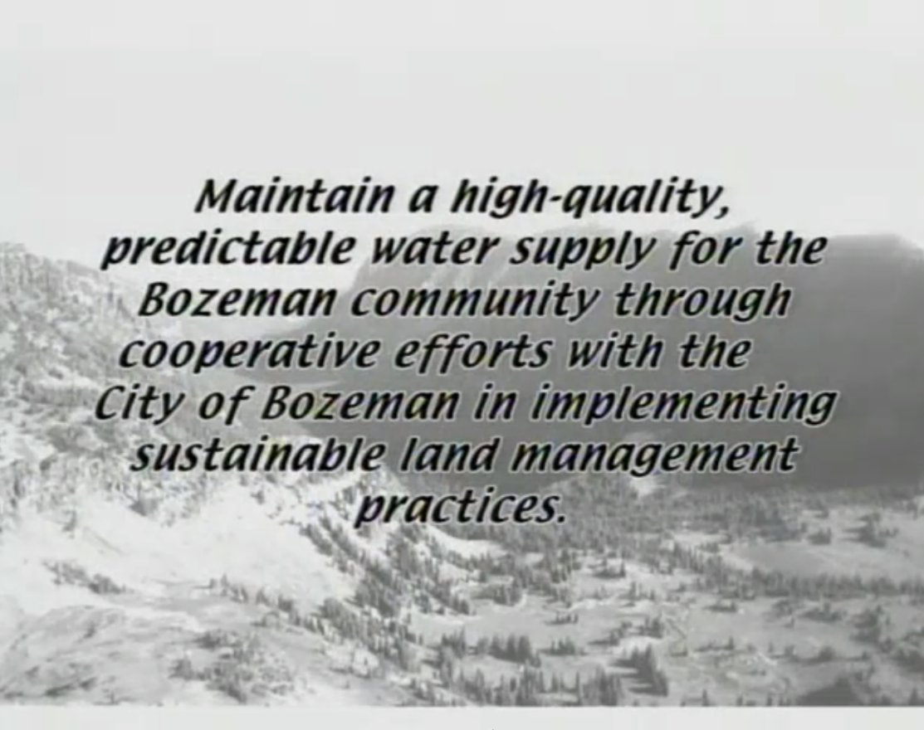
2
Notes:
Last time, we talked about the goals of watershed management driving the need for watershed science.
Specifically, we talked about the common goal of having a predictable water supply, meaning that we want to know the quantity of water that is available.
We also talked about needing a high-quality water supply, meaning that we need to manage solutes dissolved in the water, or particles suspended in the water, in such a way that we can use the water without a cost-prohibitive treatment processes.
The key to managing a high quality, predictable water supply from a natural landscape then becomes recognizing the link between the landscape and the water supply, and this is the foundation of watershed hydrology as a scientific discipline.
So how do we get started?

Slide 3
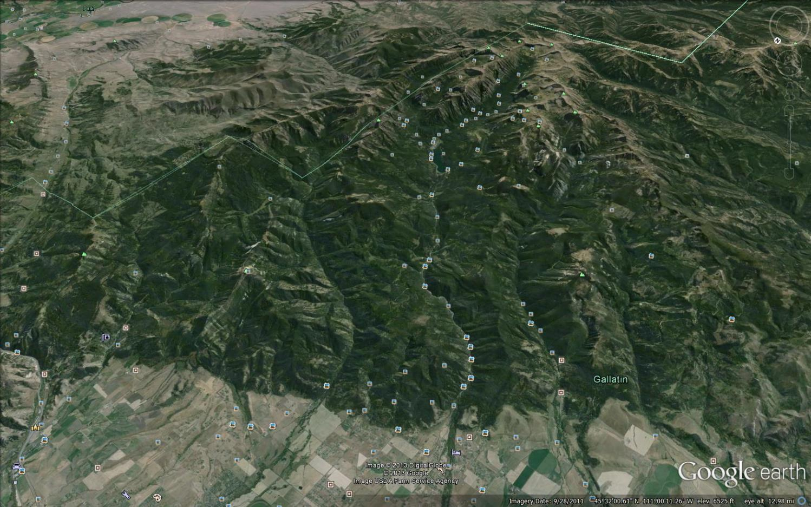
Stream flow measurement
3
Gallatin Range
?
Mt. Blackmore
?
Hyalite Creek Watershed
Bozeman Creek Watershed
Q
Q
Bozeman (Sourdough) Creek
Hyalite Creek
Bozeman
Notes:
Well, we can start by defining the fundamentals of hydrology as an environmental science. That means that we are trying to understand some aspect of causality in earth systems. In other words, we want to understand how some aspect of an earths system controls some other aspect of earths system. For the basic scientific method, we call the controllING variable the “independent variable” and the controllED variable the “dependent variable”
If you remember last time, we loosely defined what a watershed was, and we talked about the watersheds that provide the Bozeman city water supply.
Going back to the context of the need to manage the landscape to maintain the quantity and quality of our water supply, what do you suppose are the main independent and dependent variables for scientific study that would help us understand more effective management?
The foundation of watershed hydrology turns out to be a relatively simple question. How to elements of the landscape influence the quantity and quality of water in runoff?
Of course, the attempt to answer that question ends up getting quite complicated. As you might imagine, there can be tremendous variation in landscape characteristics across a watershed, and a seemingly infinite number of flow paths that water might take in the process of moving from precipitation to runoff. But we have to start somewhere.
I choose to start the course by getting you up to speed on our dependent variable as quickly as possible. The quintessential dependent variable for a watershed hydrologist is called a “hydrograph”, which simply means a graph of the variation in stream flow over time. Before you can interpret a hydrograph, however, you have to know something about how it was generated. That means you need to know how we think about stream flow, how we measure it, and how we monitor it over time. We’ll be spending the next couple lectures and labs covering that material.

Slide 4
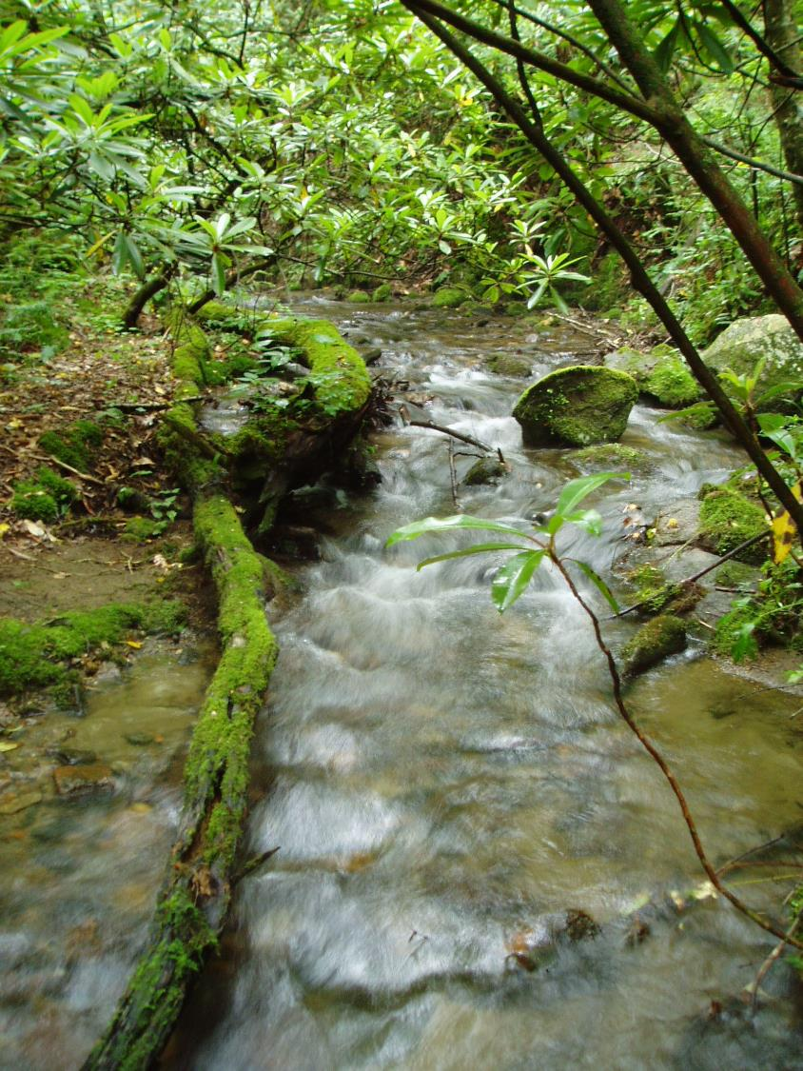
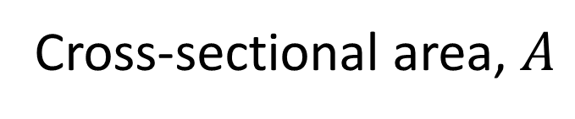
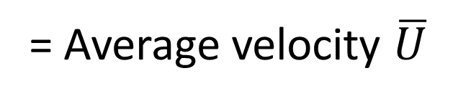
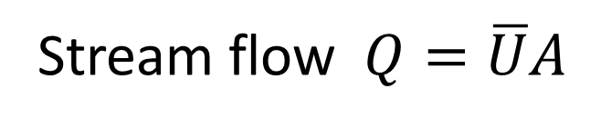
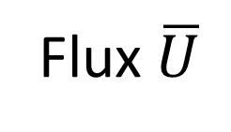
Stream flow measurement
4
Volumetric flux – volumetric flow normal (perpendicular) to an area
Cross-sectional area, $A$
[L²]
Flux $\overline{U}$
[L³ L⁻² T⁻¹]
Be
careful!
= Average velocity $\overline{U}$
[L T⁻¹]
Stream flow $Q=\overline{U}A$
[L³ T⁻¹]
Notes:
This is a stream, and as environmental scientists, we are interested in measuring how much water is in this stream.

Slide 5
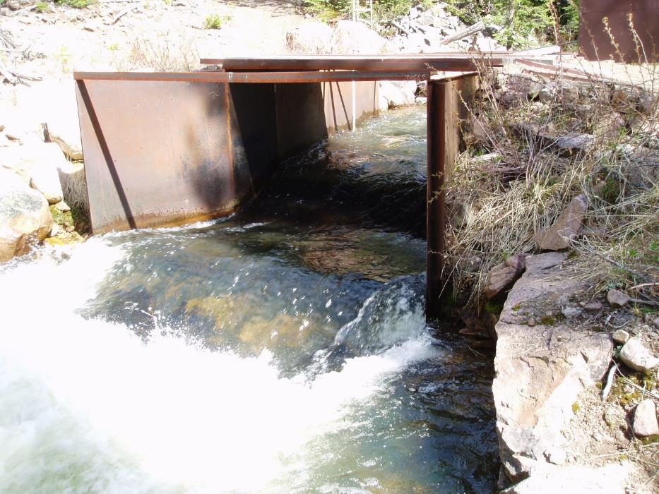

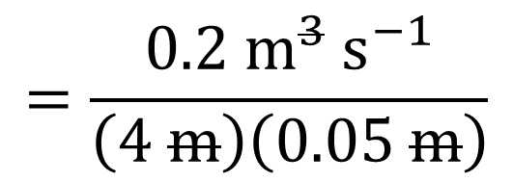

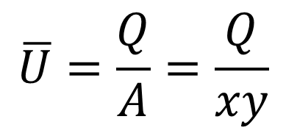




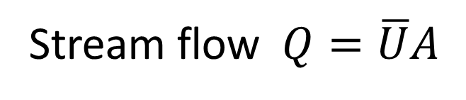

Stream flow measurement
5
Stream flow $Q=\overline{U}A$
$$Q=0.2 m^{3} s^{−1}$$
$$x$$
$$x=4 m$$
$$y$$
$$\overline{U}$$
$$y=0.05 m$$
$$\overline{U}=\frac{Q}{A}=\frac{Q}{xy}$$
$$=\frac{0.2 m^{3} s^{−1}}{\left(4 m\right)\left(0.05 m\right)}$$
$$=1 m s^{−1}$$
Notes:
This is a stream, and as environmental scientists, we are interested in measuring how much water is in this stream.

Slide 6
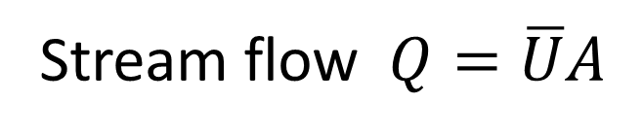
Stream flow measurement
6
Flux – flow normal (perpendicular) to an area
Stream flow $Q=\overline{U}A$
Notes:
This is a stream, and as environmental scientists, we are interested in measuring how much water is in this stream.

Slide 7
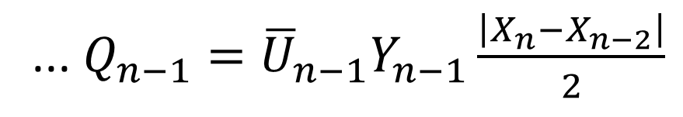
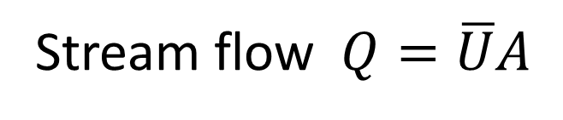
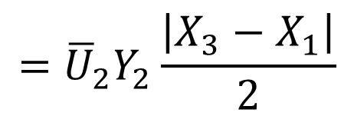
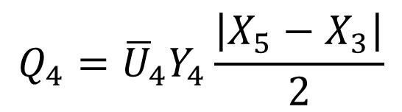
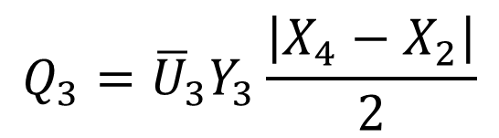

Stream flow measurement: Velocity-area method
7
X₁
X₂
X₃
X₄
X₅
X_{n-1}
X_{n}
Measuring tape
Y₂
Y_{n-1}
Y₃
Stream
Y₄
Y₅
U_{n-1}
U₂
A_{n-1}
A₂
A₃
U₃
A₄
U₄
$$={\overline{U}}_{2}Y_{2}\frac{\left|X_{3}−X_{1}\right|}{2}$$
$$Q_{3}={\overline{U}}_{3}Y_{3}\frac{\left|X_{4}−X_{2}\right|}{2}$$
$$Q_{4}={\overline{U}}_{4}Y_{4}\frac{\left|X_{5}−X_{3}\right|}{2}$$
$$Q_{2}={\overline{U}}_{2}A_{2}$$
Stream flow $Q=\overline{U}A$
[L³ T⁻¹]
... $Q_{n−1}={\overline{U}}_{n−1}Y_{n−1}\frac{\left|X_{n}−X_{n−2}\right|}{2}$
Notes:
This is a stream, and as environmental scientists, we are interested in measuring how much water is in this stream.

Slide 8

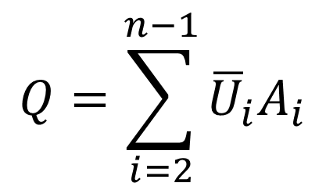
Stream flow measurement: Velocity-area method
8
X_{n-1}
X_{n}
X₁
X₂
X₃
X₄
X₅
X_{n}
Measuring tape
Y₂
Y_{n-1}
Y₃
Stream
Y₄
Y₅
U_{n-1}
U₂
A_{n-1}
A₂
A₃
U₃
A₄
U₄
Width of a section
$$Q=\sum_{i=2}^{n−1}{{\overline{U}}_{i}A_{i}}$$
$$=\sum_{i=2}^{n−1}{{\overline{U}}_{i}Y_{i}\frac{\left|X_{i+1}−X_{i−1}\right|}{2}}$$
Stream flow
[L³ T⁻¹]
Notes:
This is a stream, and as environmental scientists, we are interested in measuring how much water is in this stream.

Slide 9
Stream flow measurement: Velocity-area method
8
X_{n-1}
X_{n}
X₁
X₂
X₃
X₄
X₅
X_{n}
Measuring tape
Y₂
Y_{n-1}
Y₃
Stream
Y₄
Y₅
U_{n-1}
U₂
A_{n-1}
A₂
A₃
U₃
A₄
U₄
Height of a section
$$Q=\sum_{i=2}^{n−1}{{\overline{U}}_{i}A_{i}}$$
$$=\sum_{i=2}^{n−1}{{\overline{U}}_{i}Y_{i}\frac{\left|X_{i+1}−X_{i−1}\right|}{2}}$$
Stream flow
[L³ T⁻¹]
Notes:
This is a stream, and as environmental scientists, we are interested in measuring how much water is in this stream.

Slide 10
Stream flow measurement: Velocity-area method
8
X_{n-1}
X_{n}
X₁
X₂
X₃
X₄
X₅
X_{n}
Measuring tape
Y₂
Y_{n-1}
Y₃
Stream
Y₄
Y₅
U_{n-1}
U₂
A_{n-1}
A₂
A₃
U₃
A₄
U₄
Area of a section
$$Q=\sum_{i=2}^{n−1}{{\overline{U}}_{i}A_{i}}$$
$$=\sum_{i=2}^{n−1}{{\overline{U}}_{i}Y_{i}\frac{\left|X_{i+1}−X_{i−1}\right|}{2}}$$
Stream flow
[L³ T⁻¹]
Notes:
This is a stream, and as environmental scientists, we are interested in measuring how much water is in this stream.

Slide 11
Stream flow measurement: Velocity-area method
8
X_{n-1}
X_{n}
X₁
X₂
X₃
X₄
X₅
X_{n}
Measuring tape
Y₂
Y_{n-1}
Y₃
Stream
Y₄
Y₅
U_{n-1}
U₂
A_{n-1}
A₂
A₃
U₃
A₄
U₄
Discharge of a section
$$Q=\sum_{i=2}^{n−1}{{\overline{U}}_{i}A_{i}}$$
$$=\sum_{i=2}^{n−1}{{\overline{U}}_{i}Y_{i}\frac{\left|X_{i+1}−X_{i−1}\right|}{2}}$$
Stream flow
[L³ T⁻¹]
Notes:
This is a stream, and as environmental scientists, we are interested in measuring how much water is in this stream.

Slide 12
Stream flow measurement: Velocity-area method
8
X_{n-1}
X_{n}
X₁
X₂
X₃
X₄
X₅
X_{n}
Measuring tape
Y₂
Y_{n-1}
Y₃
Stream
Y₄
Y₅
U_{n-1}
U₂
A_{n-1}
A₂
A₃
U₃
A₄
U₄
Discharge of the stream
$$Q=\sum_{i=2}^{n−1}{{\overline{U}}_{i}A_{i}}$$
$$=\sum_{i=2}^{n−1}{{\overline{U}}_{i}Y_{i}\frac{\left|X_{i+1}−X_{i−1}\right|}{2}}$$
Stream flow
[L³ T⁻¹]
Notes:
This is a stream, and as environmental scientists, we are interested in measuring how much water is in this stream.

Slide 13
Stream flow measurement: Velocity-area method
9
X_{n-1}
X_{n}
X₁
X₂
X₃
X₄
X₅
X_{n}
Measuring tape
Y₂
Y_{n-1}
Y₃
Stream
Y₄
Y₅
U_{n-1}
U₂
A_{n-1}
A₂
A₃
U₃
A₄
U₄
Calculus?
$$Q=\sum_{i=2}^{n−1}{{\overline{U}}_{i}A_{i}}$$
$$=\sum_{i=2}^{n−1}{{\overline{U}}_{i}Y_{i}\frac{\left|X_{i+1}−X_{i−1}\right|}{2}}$$
Stream flow
[L³ T⁻¹]
Notes:
This is a stream, and as environmental scientists, we are interested in measuring how much water is in this stream.

Slide 14
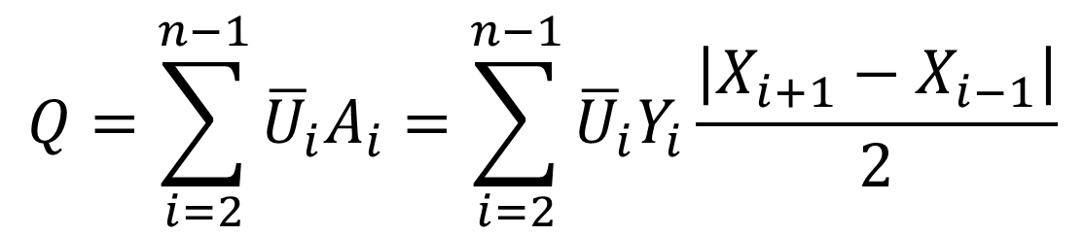
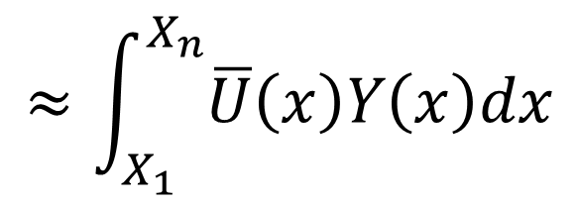
Stream flow measurement: Velocity-area method
9
X_{n-1}
X_{n}
X₁
X₂
X₃
X₄
X₅
X_{n}
Measuring tape
Y₂
Y_{n-1}
Y₃
Stream
Y₄
Y₅
U_{n-1}
U₂
A_{n-1}
A₂
A₃
U₃
A₄
U₄
$$≈\int_{X_{1}}^{X_{n}}{\overline{U}\left(x\right)Y\left(x\right)dx}$$
$$Q=\sum_{i=2}^{n−1}{{\overline{U}}_{i}A_{i}}=\sum_{i=2}^{n−1}{{\overline{U}}_{i}Y_{i}\frac{\left|X_{i+1}−X_{i−1}\right|}{2}}$$
Stream flow
[L³ T⁻¹]
Notes:
This is a stream, and as environmental scientists, we are interested in measuring how much water is in this stream.

Slide 15
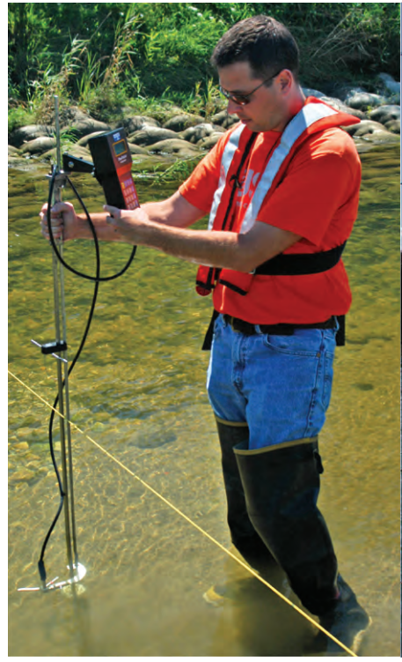
Stream flow measurement: average velocity
10
Tape – Measures location across the stream
USGS Report, Techniques and Methods 3-A8, 2010

Slide 16
Stream flow measurement: average velocity
10
Wading rod – Measures depth and sets the depth of velocity probe
USGS Report, Techniques and Methods 3-A8, 2010

Slide 17
Stream flow measurement: average velocity
10
Velocity probe (and computer) – Measures water velocity (and may track data for whole transect)
USGS Report, Techniques and Methods 3-A8, 2010

Slide 18
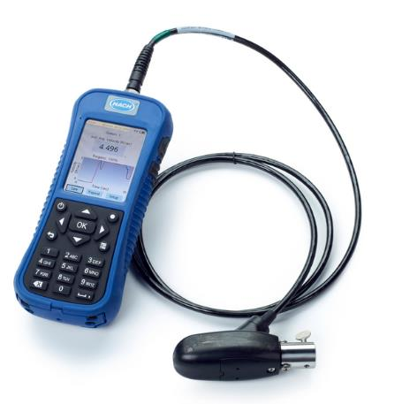
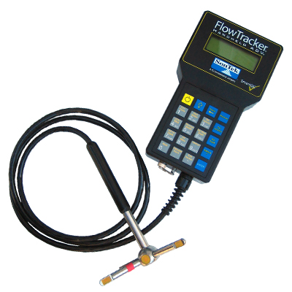
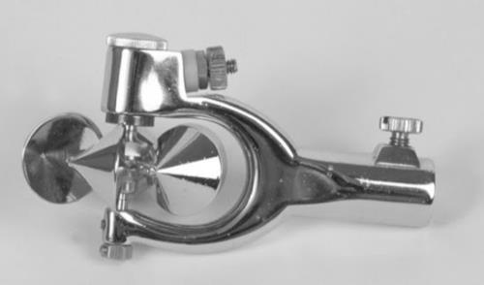
Stream flow measurement: average velocity
10
Electromagnetic
Acoustic
Doppler
(Sonar)
Mechanical
USGS Report, Techniques and Methods 3-A8, 2010

Slide 19

Stream flow measurement: average velocity
11
FLOW
u_{i}(y_{i})
0.6Y_{i}
Y_{i}
0.4Y_{i}
$${\overline{U}}_{i}=u_{i}\left(0.4Y_{i}\right)$$
Assuming ideal flow conditions.
Careful! Also called “6/10 depth” (from surface)
USGS Report, Techniques and Methods 3-A8, 2010

Slide 20
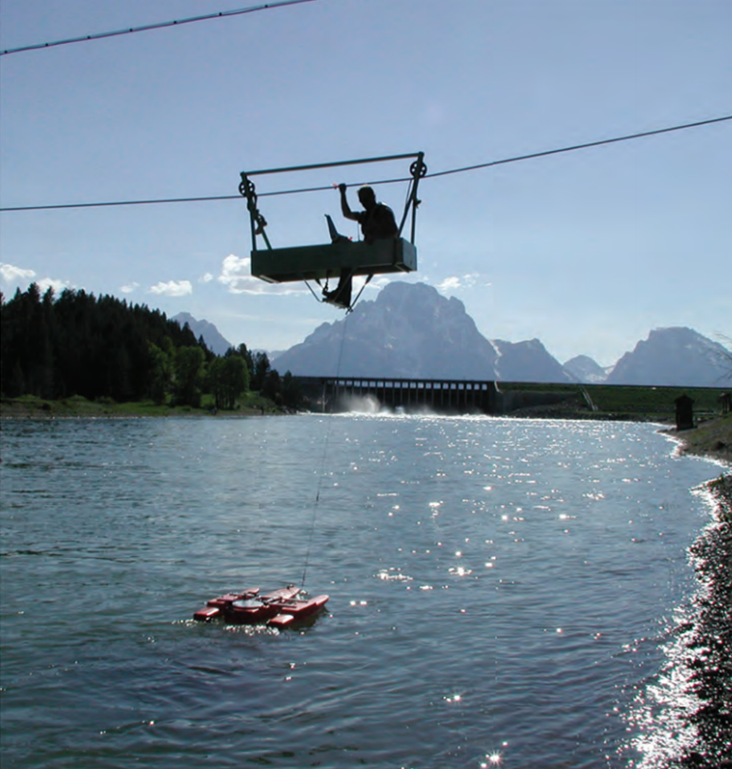
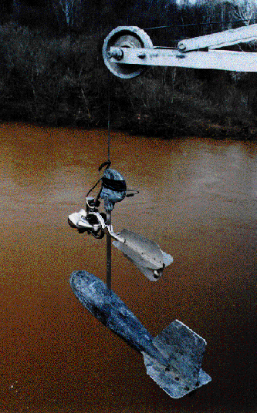
Stream flow measurement: Rivers
12
Weighted
velocity
meter
3D
Acoustic
Doppler
(Sonar)
USGS circular,
http://pubs.usgs.gov/circ/circ1123/collection.html
USGS Report, Techniques and Methods 3-A8, 2010

Slide 21
Stream flow measurement: Velocity-area method
13
X_{n-1}
X_{n}
X₁
X₂
X₃
X₄
X₅
X_{n}
Measuring tape
Y₂
Y_{n-1}
Y₃
Stream
Y₄
Y₅
U_{n-1}
U₂
A_{n-1}
A₂
A₃
U₃
A₄
U₄
$$Q=\sum_{i=2}^{n−1}{{\overline{U}}_{i}A_{i}}$$
$$=\sum_{i=2}^{n−1}{{\overline{U}}_{i}Y_{i}\frac{\left|X_{i+1}−X_{i−1}\right|}{2}}$$
Stream flow
[L³ T⁻¹]
Notes:
This is a stream, and as environmental scientists, we are interested in measuring how much water is in this stream.

Slide 22
Example of velocity-area gauging (spreadsheet)
14

Slide 23
Stream flow measurement: dilution gauging
15
NaCl
Specific electrical conductivity

Slide 24
Stream flow measurement: dilution gauging
16
NaCl
Step 1:
Correct for background
Specific electrical conductivity
C_{BG}
Time [T]
Tracer breakthrough curve analysis

Slide 25
Stream flow measurement: dilution gauging
17
NaCl
Step 2:
Calculate concentration
(1 mg L⁻¹ = 2 μS cm⁻¹)
Background corrected conductivity [C]
Concentration of NaCl [M L⁻³]
Time [T]
Tracer breakthrough curve analysis

Slide 26

Stream flow measurement: dilution gauging
18
NaCl
Step 3:
Calculate area under
curve
Concentration of NaCl [M L⁻³]
$$[M L^{−3} T]$$
$$≈\int_{t_{0}}^{t_{BG}}{C_{NaCl}dt}$$
Time [T]
Tracer breakthrough curve analysis

Slide 27


Stream flow measurement: dilution gauging
19
NaCl
Step 4:
Mass of NaCl divided by
Area under curve
Concentration of NaCl [M L⁻³]
$$\frac{[M]}{[M L^{−3} T]}$$
$$=[L^{3} T^{−1}]$$
Time [T]
Tracer breakthrough curve analysis

Slide 28
Example of dilution gauging (spreadsheet)
20

