Slide 1
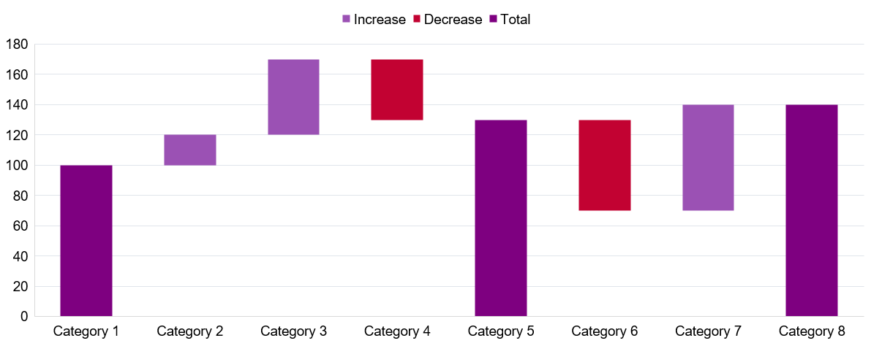
Waterfall
Chart Title

