Slide 1


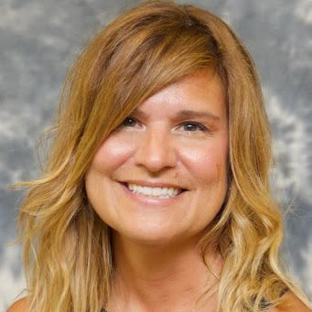






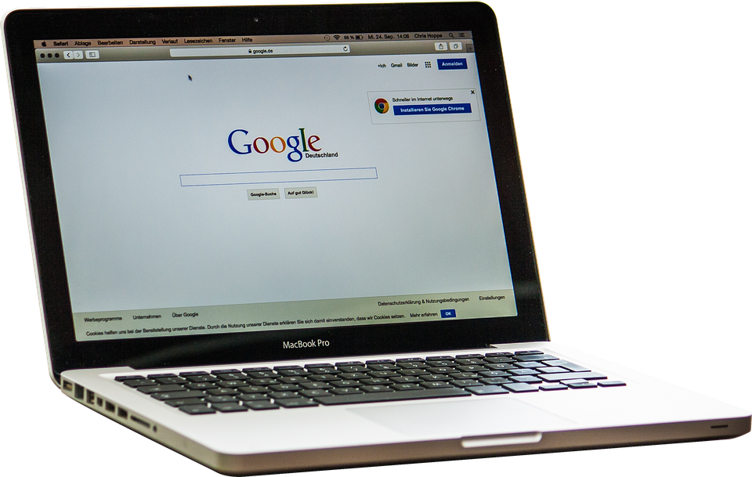

Replace this image with your own & use onlinevoicerecorder.com to record an audio message that provides a brief overview of the lesson.
💡
Use Flipgrid to record a video short too, if you want, but be sure to caption it!
VIRTUAL STATION ROTATION
Type a quick message
here.
Also, record an audio clip for non-readers and ELLs.
💡
Include a translated version of your overview!
[date and subject/topic]
MEETING TIMES & BREAKOUT ROOMS | TEACHER-LED STATION | ONLINE STATION | OFFLINE STATION | EXTENSION ACTIVITY
CLICK HERE to join our meeting room. | Small-group instruction Skill-building Troubleshooting Feedback Bring your questions! | Personalized practice Research & exploration Online collaboration Multimedia lessons Edpuzzle videos Start SOLE | Labs / experiments Active reading Writing Creating Old School / Non-Tech options | Work for early finishers Passion projects Further exploration Games
Notes:
BEFORE SHARING THIS SLIDE DECK WITH STUDENTS:
👉 Delete the arrow boxes outside of the slides
👉 Publish to the web (File > Publish to Web)

Slide 2

BREAKOUT ROOMS
Don’t forget to review our TIPS for successful video calls!
GROUP 1 10:00 - 10:15 | GROUP 2 10:20 - 10:35 | GROUP 3 10:40 - 10:55 | GROUP 4 11:00 - 11:15
Abigail Britney Charles David Ellen | Fiona Gregory Hannah Isabelle Jack | Katie Liam Matthew Nora Oliver | Peter Robbie Stephanie Tyler Veronica
Your choice: create separate links for each room OR simply create one room for kiddos to rotate into.
Notes:
💡Click HERE to get some concrete ideas of the activities and structure of station rotations from Marilyn McAlister and Jordy Tollefson.

Slide 3

TEACHER-LED STATION
Objectives or
Standards or
I Can Statements go HERE
Share with students ahead of time what they need to bring to the video call.
Please come prepared with the following:
ITEM
ITEM
ITEM
To make your video call go smoothly, link to a Google Doc or Padlet where students can ask questions they may still have or think of after this station.
Notes:
💡 Consider recording at least ONE video call to post later for missing students.

Slide 4

ONLINE STATION
OBJECTIVE goes here
DIRECTIONS & LINKS
[Students: Use the question link to post any questions you have while working at this station.]
MATERIALS NEEDED
ACTIVITY DESCRIPTION
TEXT
TEXT
💡
In addition to typed directions, why not record yourself in Screencastify and insert the video?
Provide a link to the same resource you used in the teacher-led station.
Notes:
💡 Again, provide an online place for students to post questions. But also encourage classmates to help answer those questions. This frees you up to focus on your small-group instruction, it fosters community, AND it encourages student agency!

Slide 5
OFFLINE STATION
OBJECTIVE goes here
DIRECTIONS & LINKS
[Students: Use the question link to post any questions you have while working at this station.]
MATERIALS NEEDED
ACTIVITY DESCRIPTION
TEXT
TEXT
Provide a link to the same resource you used in the teacher-led station.
Notes:
🤯 Looking for some AMAZEBALLS offline ideas? Check out THESE IDEAS from Karyn Fillhart and THESE ONES from Dan Ryder!

Slide 6
EXTENSION ACTIVITY
OBJECTIVE goes here
DIRECTIONS & LINKS
[Students: Use the question link to post any questions you have while working at this station.]
MATERIALS NEEDED
ACTIVITY DESCRIPTION
TEXT
TEXT
Provide a link to the same resource you used in the teacher-led station.

Slide 7
CREDITS
We are the sum of all the people we meet, and I’ve been lucky to meet some inspirational people who read my every email, answer my never-ending DMs, and reply to my incessant tweets so that I can always get better.
THANK YOU TO:
Amanda Sandoval for helping me up my design game, especially because she always shares her stuff.
Catlin Tucker for her ingenious ideas about blended learning, especially the one that inspired this slide deck.
Rayna Freedman for her tireless efforts in advocating for accessibility.
Matt Miller for his constant support and his selfless belief that we should create free materials for teachers.
Karyn Fillhart and Dan Ryder for reminding us all to strike a balance with online learning.
Stephanie DeMichele | @sdemichele |stephaniedemichele.org
Please feel free to reach out with any questions or any ideas to make this slide deck better. Thanks!
#DistanceLearning is about #Flexibility | #StudentAgency | #Collaboration | #Creativity

