Slide 1


MAP LOCATIONS

Slide 2
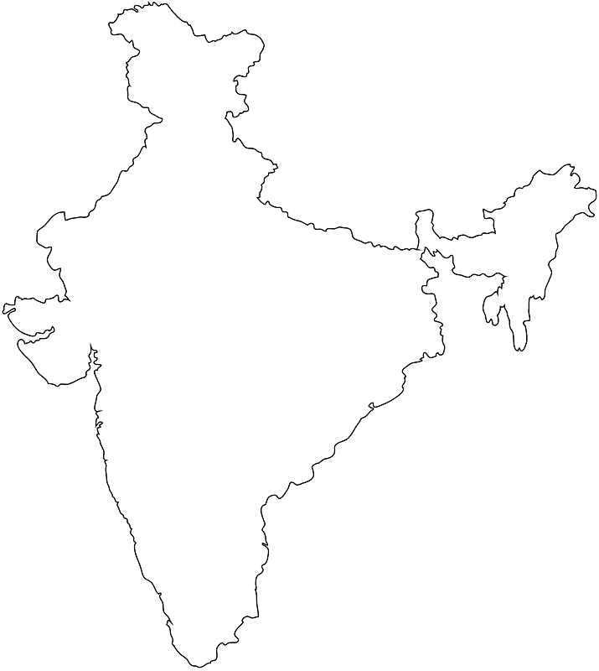
Tropic of cancer
82.5E

Slide 3

Mount Everest
Indira point
Indira col
Kanyakumari

Slide 4

Palk strait
K2

Slide 5

Konkan coast
Utkal coast
Malabar coast
Coramandal coast

Slide 6


Western ghat
Eastern ghat

Slide 7

Aravali
Deccan plateau
East coast
West coast

Slide 8
Malwa plateau
Vindya-satpur hills
Anamudi
Chota Nagpur plateau

Slide 9
Royli
Mangrove forest

Slide 10
Gulf of kachch
Chilka lake
Pulicat lake

Slide 11
Delhi
Mumbai
Goa
Kolkata
Vishakhapatnam
Bangaluru

Slide 12
Bhakra Nangal
Rihand
Kosi dam
Tungabhadra
Damodar valley
Hirakud

Slide 13
Kandla
Amrutsar
Guwahati
Kochi
Chennai

Slide 14
Rana pratapsagar
Bombay high
Kalpakam
Hatti gold mine

Slide 15
Narmada
Mahanadi
Kaveri
Nagarjun sagar

Slide 16
Tarapura
Narora
Kaiga

Slide 17
Surat
Durgapur
Salem
Bhadravati

Slide 18

Thank you
Prepared by:
Praveen Banakar

