Slide 1
Culture, Context, & Connections
Wing Institute
April 24-25, 2014
George Sugai
ACKNOWLEDGEMENT: Tony Biglan, Gwen Cartledge, Lindsay Fallon, Steven Hayes, Dan Losen, Kent McIntosh, Breda O’Keeffe, Russ Skiba, BFS, Claudia Vincent…many others
University of Connecticut
Center on Positive Behavioral Interventions & Supports
Center for Behavioral Education & Research
www.pbis.org www.cber.org

Slide 2
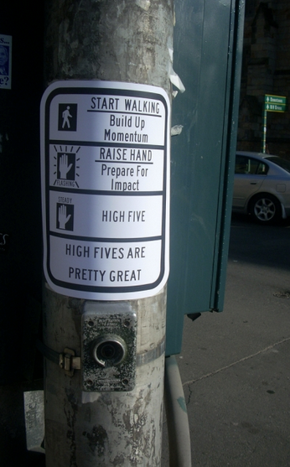


S^{r+}
Wing Institute: Randy, Ronnie, Jack
Co-presenters: Karen & Arthur
Institute “regulars” & “irregulars”
PBIS & SISEP partners
Schools
Researchers & disseminators

Slide 3
PURPOSE
Enhance our appreciation of culture & implementation of effective practices & systems
DISCLAIMERS
HF, mouse, 94/88/88/88
Fundamentals & redundancy builds fluency
Interrupt….briefly
ORGANIZER
Theory of Action
PBIS Features
Culture
Conclusions
Notes:
TITLE: Culture, Context, and Making Connections
DESCRIPTION: The purpose of this presentation is to describe a SWPBS conceptualization of culture and how and why culture might be considered as a way to enhance connections, communications, and outcomes. The context includes closing achievement gaps, reducing disproportional outcomes, making access and opportunity equitable, and improving data for decision making.

Slide 4
“Wicked”
(Wikipedia)
PBIS “truths”
= (1) “evil, morally wrong; sinful, immoral, wrong, wrongful, bad iniquitous(?), corrupt, base, mean, vile”
Steal, get attention, implement, make outcomes overt
Surround with competence
“Wicked Problems” = (4) “incomplete, contradictory, changing requirements, complex interdependencies”
“As members of the judiciary tasked w/intervening to carry out the guarantee of equal protection,” Justice Sotomayor concluded in her dissent, “we ought not sit back & wish away, rather than confront, the racial inequality that exists in our society.”
“Wicked Pictures” = pornographic studio
20,000 “trained,” 40-60% with fidelity….70,000 schools to go!

Slide 5
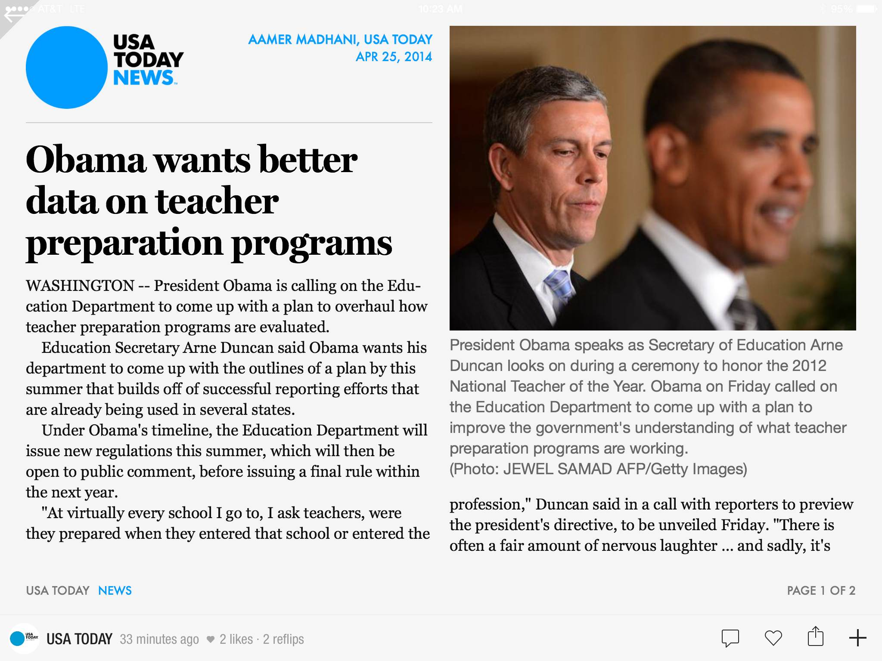

Slide 6
Reinforce importance of THEORY OF ACTION as basis for defendability & efficiency.
Re-specify CORE FEATURES of PBIS FRAMEWORKto address misconceptions, improve precision of implementation, & maximize student benefit.
Increase specificity, precision, features of PBIS framework by reconceptualizing CULTURE from behavior analytic theory of action.

Slide 7
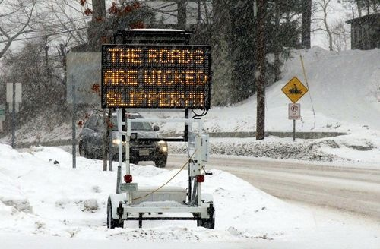
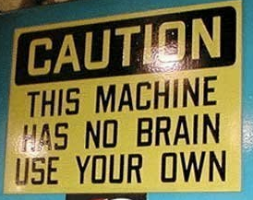
Disclaimers (Easy for you to say!)
Notes:
Important to remember that practices, data, systems are ONLY AS GOOD AS their IMPLEMENTATION QUALITY
Descriptions often SOUND SIMPLE until we try to IMPLEMENT in REAL CONTEXTS.

Slide 8
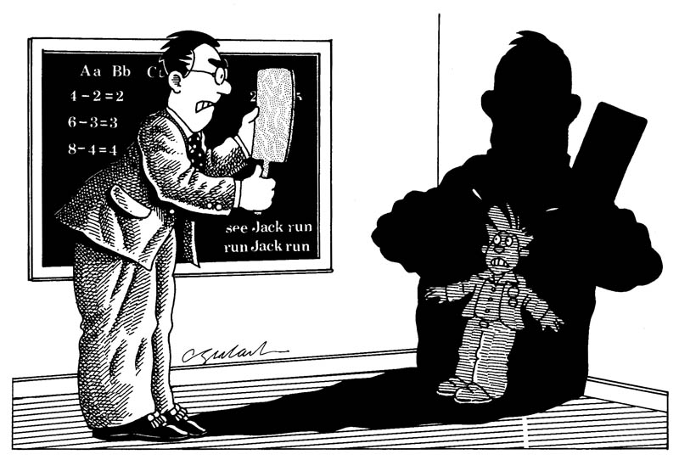
High rates of reactive management

Slide 9
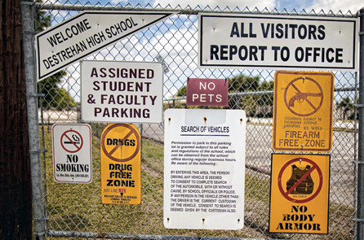
Increasingly negative school climates/cultures

Slide 10
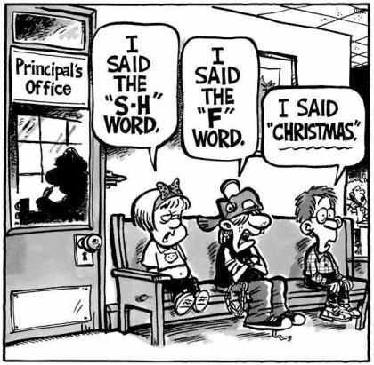
Minor problem behavior linked to major consequences

Slide 11
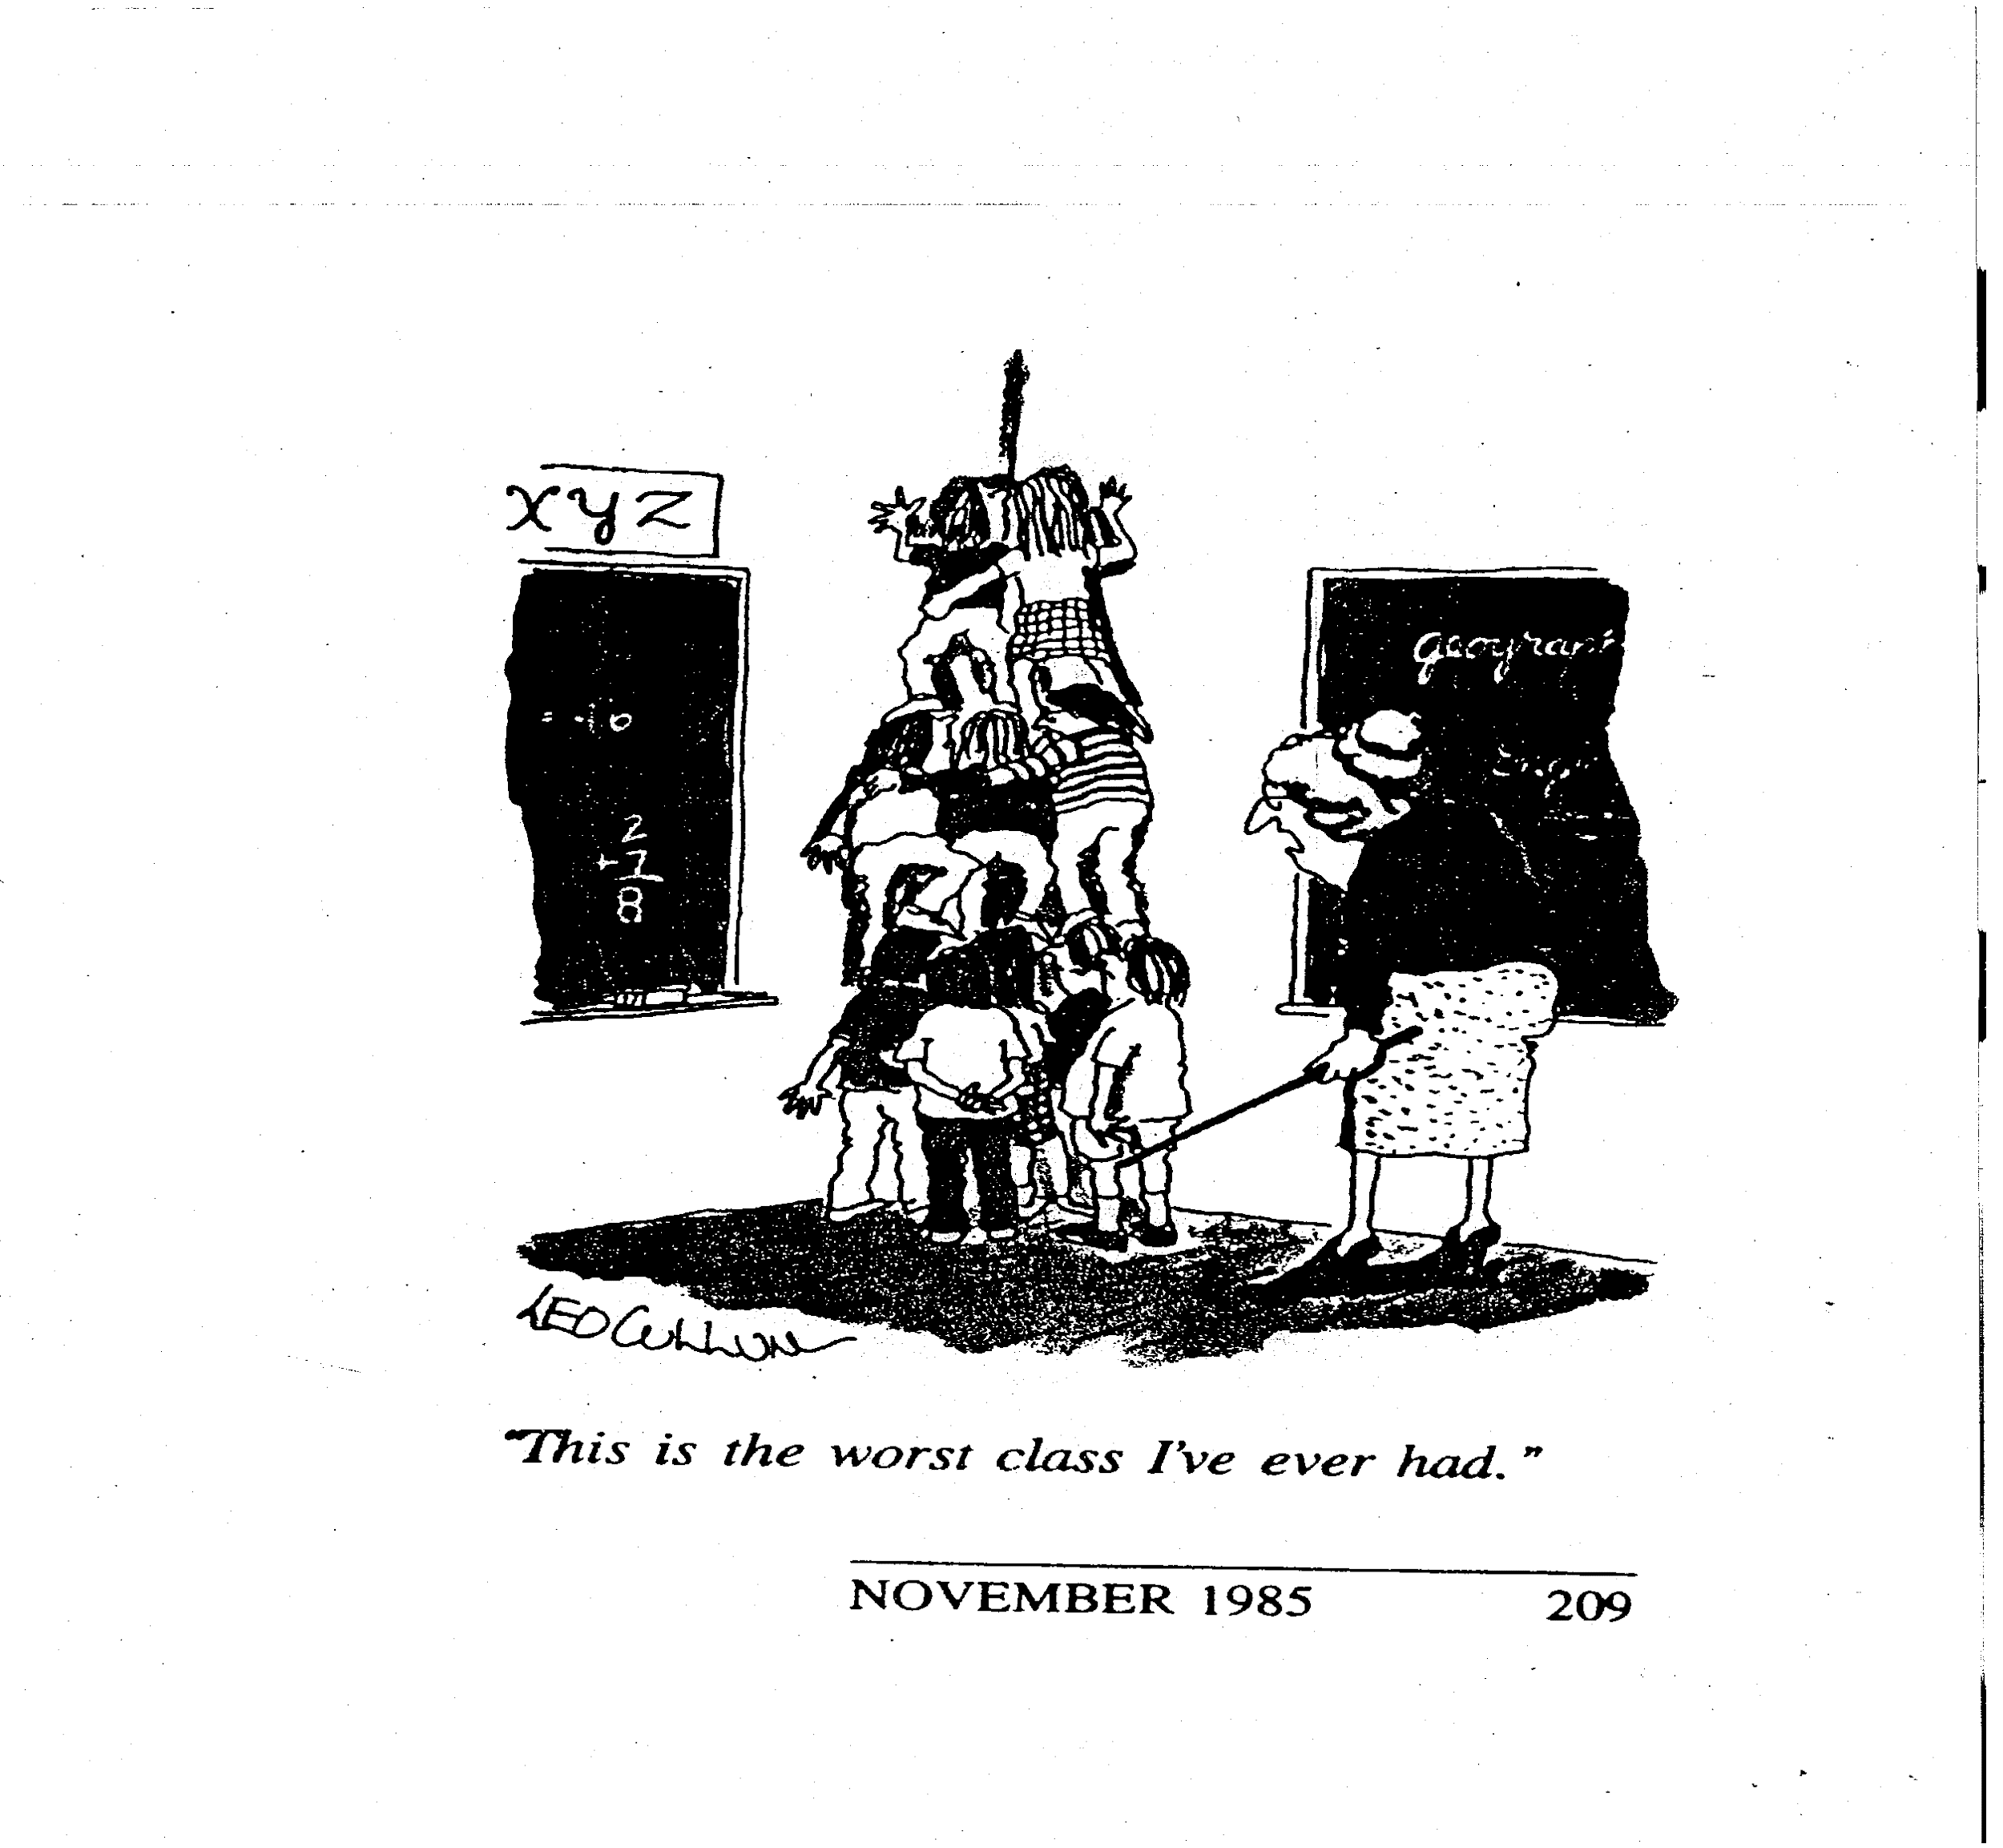
Nov 1985 Kappan
Getting Tough
School Discipline Challenge:
Academic & behavior success (failure) are linked!
Teaching to Corner

Slide 12
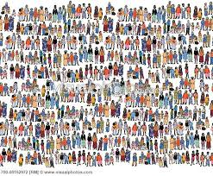




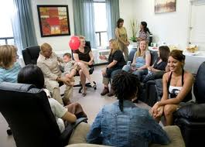

Schools are diverse, interesting, & multi-cultural!

Slide 13
“Coach Wooden’s goal: learn the fundamentals, master the fundamentals, teach the fundamentals to others, & apply the fundamentals in every area of our lives. Mastering the fundamentals is one of a lot of little things done well that make a big difference in our pursuit of success.”
Coach John Wooden’s Greatest Secret Pat Williams, 2014.
“Success is the natural consequence of consistently
applying the basic fundamentals.”
Jim Rohn

Slide 14
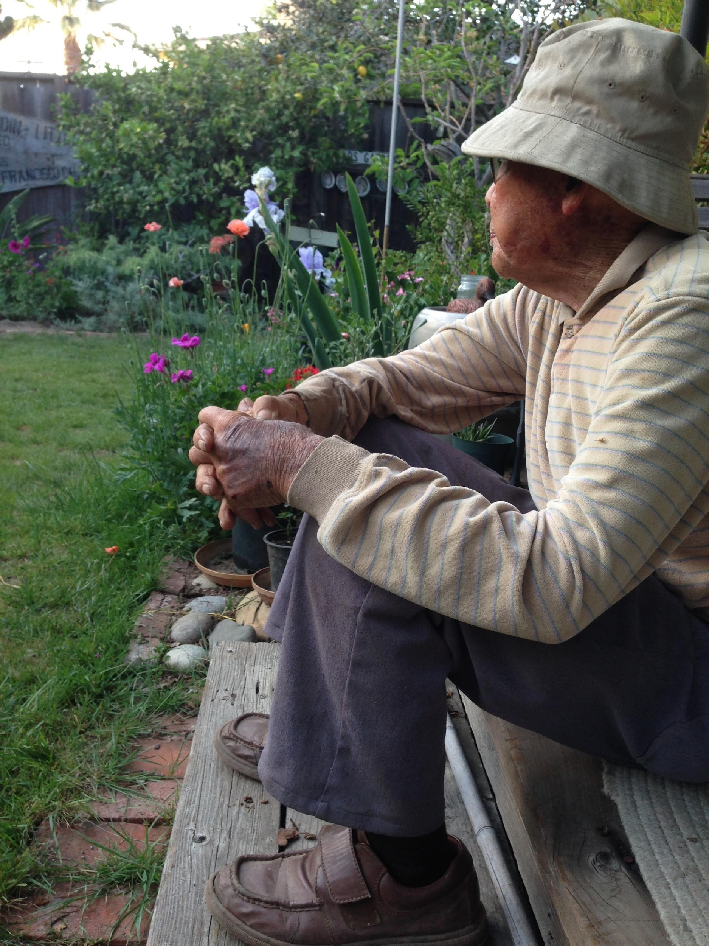

Slide 15

Colorado Data
Colorado Data 2012-13

Slide 16
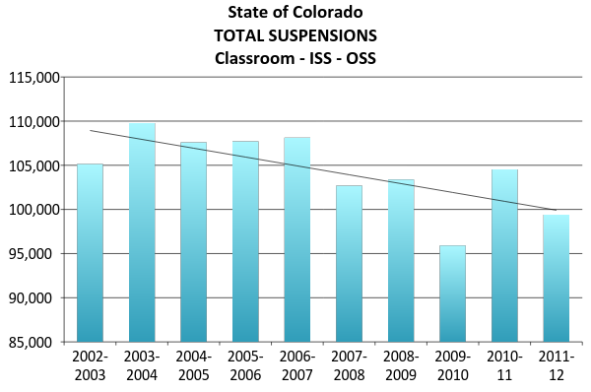
2001-2012
Decreasing SUSPENSIONS trend
Notes:
Data as reported to CDE from districts. Theses are all schools not just PBIS as are the rest of the slides in this presentation.

Slide 17
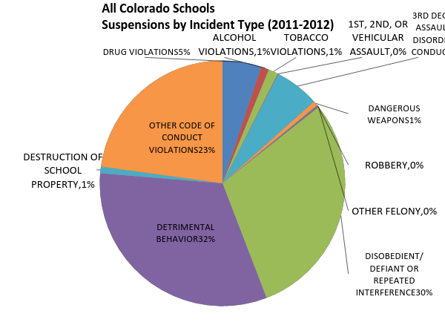
12%
“SERIOUS”
85%
“Conduct, Detrimental, Defiance, Disobedience”

Slide 18
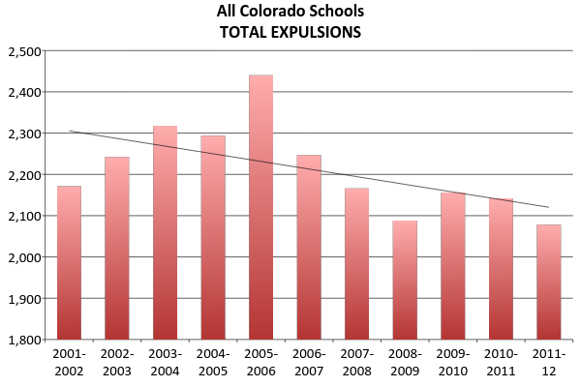
2001-2012
Decreasing expulsions trend

Slide 19
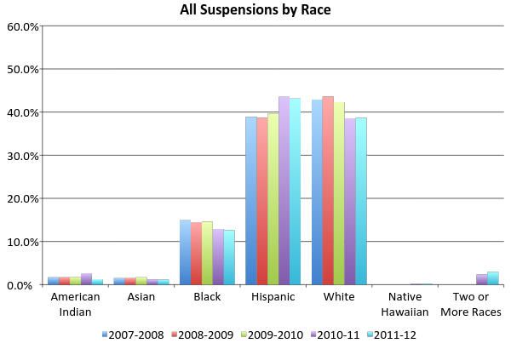
Black & Hispanic SUSPENSIONS overrepresented based on enrollment
= % of total school enrollment
Notes:
Total Enrollment:
American Indian = 0.8%
Asian = 3.1%
Hispanic = 31.9%
White = 56.1%
Native Hawaiian = 0.2%
Two or More Races = 3.1%
Native Hawaiian and Two or More Races did not become federal categories until 2010 census.

Slide 20
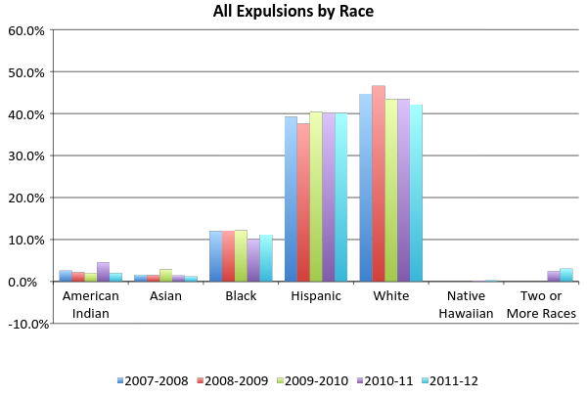
Black & Hispanic EXPULSIONS overrepresented based on enrollment
= % of total school enrollment
Notes:
Total Enrollment:
American Indian = 0.8%
Asian = 3.1%
Hispanic = 31.9%
White = 56.1%
Native Hawaiian = 0.2%
Two or More Races = 3.1%
Native Hawaiian and Two or More Races did not become federal categories until 2010 census.

Slide 21
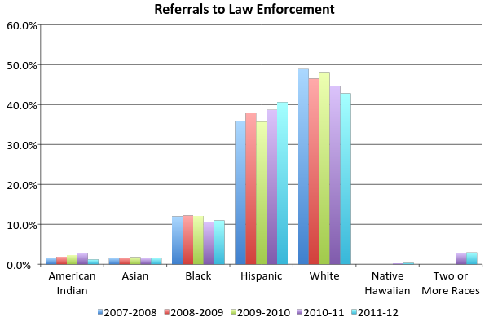
Black & Hispanic LAW REFERRALS overrepresented based on enrollment
= % of total school enrollment
Notes:
Total Enrollment:
American Indian = 0.8%
Asian = 3.1%
Hispanic = 31.9%
White = 56.1%
Native Hawaiian = 0.2%
Two or More Races = 3.1%
Native Hawaiian and Two or More Races did not become federal categories until 2010 census.

Slide 22
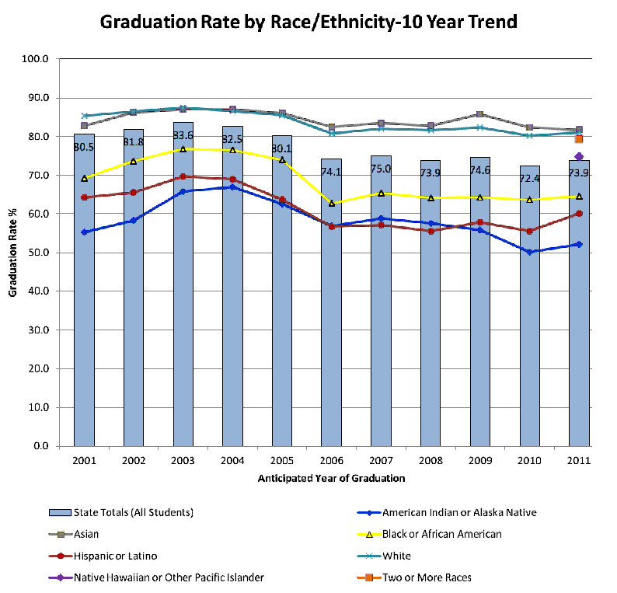
2001-2011
American Indian, Hispanic, & Black GRADUATION RATES UNDERrepresented based on enrollment

Slide 23
“Students w/ disabilities are almost 2x as likely to be suspended from school as nondisabled students, w/ the highest rates among black children w/ disabilities.”
NYTimes, M. Rich Aug 7 2012
13% w/ v. 7% w/o
1 in 4 black K-12 students
>1 Susp. 1 Year
1 in 6 black
1 in 13 Amer Indian
1 in 14 Latinos
1 in 20 Whites
Not correlated w/ race of staff
High suspension correlated w/
Low achievement
Dropout
Juvenile incarceration
Dan Losen & Jonathan Gillespie
Center for Civil Rights Remedies at UCLA

Slide 24
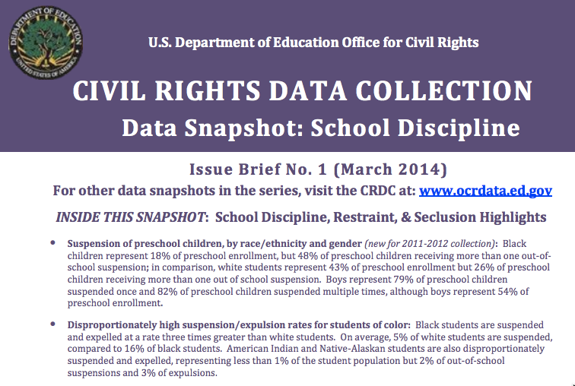
Black students represent 16% (v. 51% white) of student enrollment but 27% (v. 41% white) of students referred to law enforcement & 31% (v. 39% white) of students subjected to school-related arrest
>1 of 4 boys of color w/ disabilities & >1 of 5 girls of color receives out of school suspension
Students w/ disabilities represent 12% of student population, but 58% placed in seclusion or involuntary confinement & 75% restrained.
Students w/ disabilities >2x likely to receive out of school suspension than nondisabilities (13% v. 6%)
Students w/ disabilities represent 12% of student population, but 25% of arrested and referred to law enforcement
Black students are suspended/expelled 3x rate of whites.
5% white v. 16% Black
Black students w/ disabilities represent 19% of student population, but 36% restrained.
Black children = 18% (43% white) of preschool enrollment, but 48% (26% white) receiving >1 out of school suspension.
Boys receive >2 out of 3 suspensions.
Black girls (12%) are suspended at higher rates than any other race

Slide 25
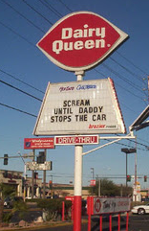
How do we increase soft ice cream sales?

Slide 26
Theory of Action

Slide 27
Theory of Action
“Roadmap” that (a) charts causal pathway between strategies needed to answer specific question & to achieve desired outcomes (i.e., “To address X, we must do Y.”) & (b) is based on set of underlying & supporting testable hypotheses (i.e., “addressing X with Y will produce Z.”) (aka probability logic model).

Slide 28
Defendable
Theory of
Action
Theory-based explanation of phenomenon
Data based confirmation of explanation
Implementation of explanation-based actions
Data based confirmation of effect
Parsimonious
Comprehensive
Confirmable
Repeatable

Slide 29
W/ defendable theory of action, you can…
Describe & understand conditions under which behavior occurs.
Use that understanding to develop strategy to affect likelihood that it will occur.
Explain results that you achieve & make adjustments if needed.

Slide 30
Behavior Analytic Approach
Biology is important
Behavior is learned
Behavior & environment are functional related
Behavior is lawful, therefore understandable & influence-able
Adjust environment to influence & teach behavior
A Theory of Action
Setting Conditions | Antecedents | Behaviors | Consequences
Notes:
My work is based on THEORETICAL FRAMEWORK called BEHAVIOR ANALYSIS,
And it serves as the FOUNDATION FOR OUR PBIS THEORY OF ACTION.
We emphasize the above points in our work

Slide 31
School Reform Problem Context
School violence
Under-achievement
Suspension & expulsions
Disability
Disproportionality & Equity
Restraint & seclusion
Bullying
School completion & dropping out
Delinquency
Substance use
School Climate
. . . . . . .
Notes:
The PROBLEMS have been described IN A VARIETY OF WAYS BY MANY
But these PROBLEM LABELS are NOT EQUAL

Slide 32
Problem Context
School violence
Under-achievement
Suspension & expulsions
Disability
Disproportionality & Equity
Restraint & seclusion
Bullying
School completion & dropping out
Delinquency
Substance use
School Climate
. . . . . . .
NOT Equal
Notes:
The PROBLEMS have been described IN A VARIETY OF WAYS BY MANY
But these PROBLEM LABELS are NOT EQUAL

Slide 33
Desired
Alternative
Typical
Consequence
Summary Statement
& Competing Behavior
Logic
Maintained
by different consequence than problem behavior
Setting Events
Triggering
Antecedents
Problem
Behavior
Maintaining
Consequences
Acceptable
Alternative
Maintained
by same
consequence as
problem behavior

Slide 34
Setting Event
Manipulations
Antecedent
Manipulations
Behavior
Manipulations
Consequence
Manipulations
Neutralize
setting
event
Make problem
behavior
inefficient.
Make
consequences
ineffective.
Make triggers
irrelevant.

Slide 35
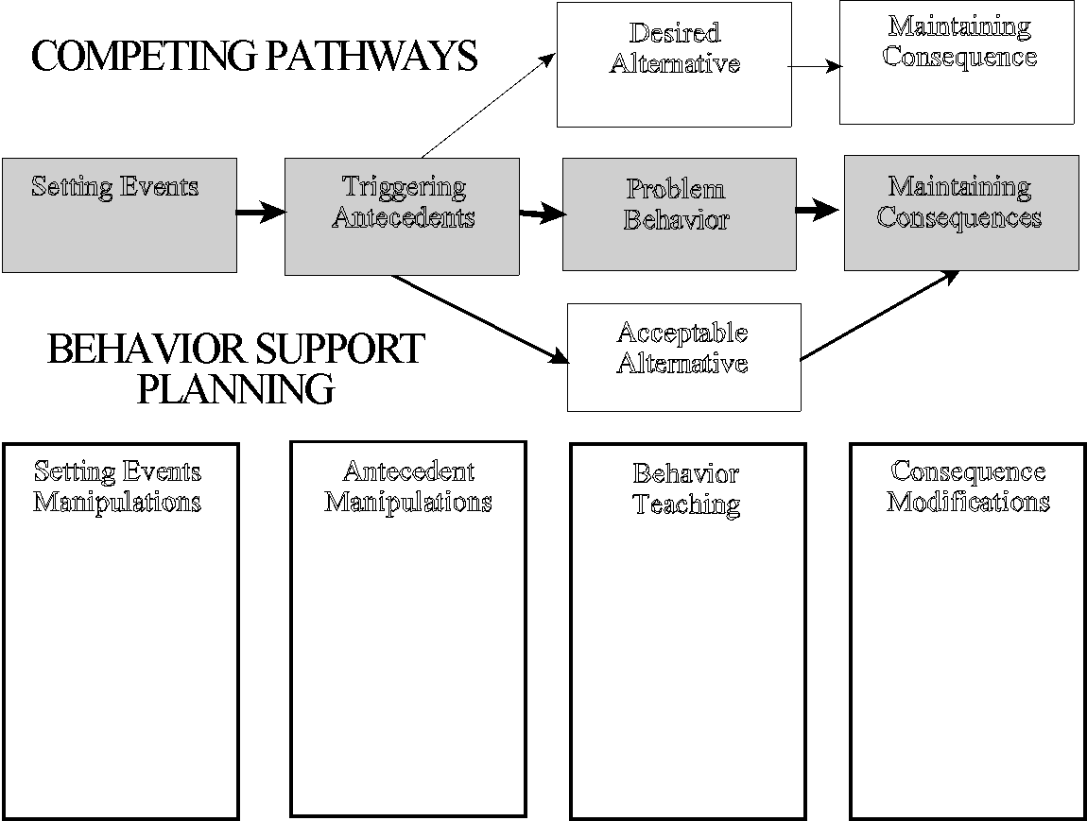
Function-based Logic
Neutralize
setting
event
Make triggers
irrelevant.
Make problem
behavior
inefficient.
Make
consequences
ineffective.

Slide 36
Antecedents | Behaviors | Consequences
STUDENT BEHAVIOR | ADULT BEHAVIOR | OUTCOMES
Aggression Bullying behavior Non-compliance Insubordination Social w/drawal Truancy Law/norm violations Substance use Weapon possession Harassment Self-injury | Office referral In school detention Out of school suspension Probation & parole Arrests & incarceration Restraint & seclusion Mental health referral | Disproportionality Dropping out School failure Mental illness School-to-prison pipeline Achievement gap Unemployment Delinquency
Apply Behavior Analytic Logic
Notes:
When BEHAVIOR ANALYSIS is applied to UNDERSTANDING PROBLEM BEHAVIOR, we can organize the previous topics so they are MORE EQUAL.
Instead of trying to TREAT ALL TOPICS AS EQUAL, we have ORGANIZED them by
WHAT THE STUDENT DOES
WHAT THE ADULT DOES
AND WHAT THE BAD OUTCOME COULD BE.

Slide 37
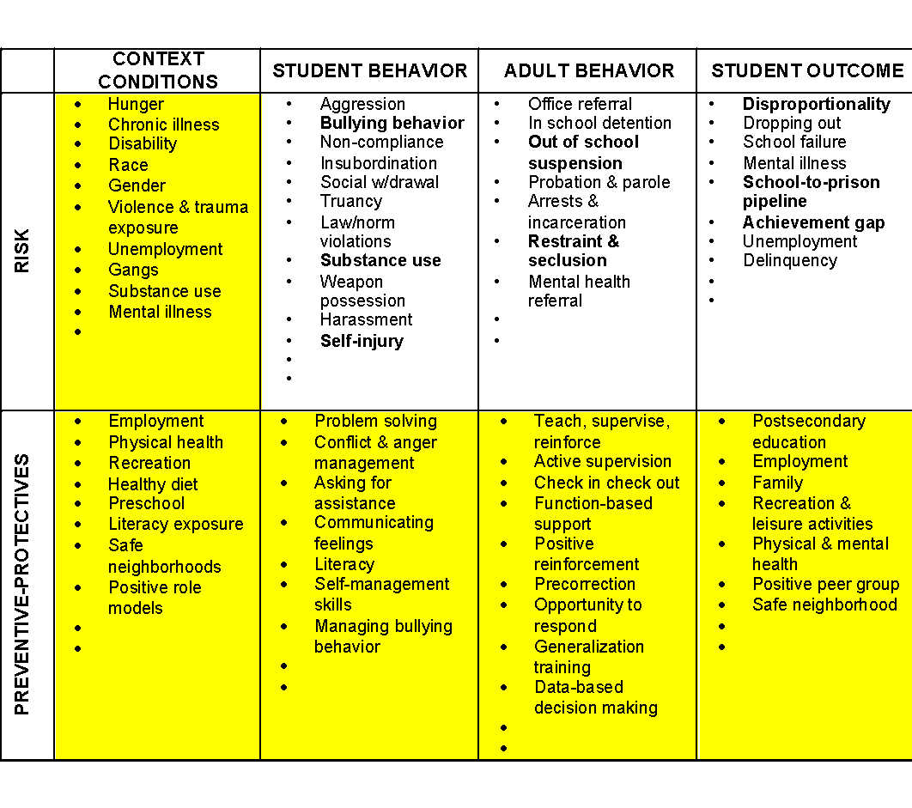
Setting Conditions | Antecedents | Student Behaviors | Consequences
Setting Conditions | Antecedents | Adult Behaviors | Consequences
Notes:
When BEHAVIOR ANALYSIS is applied to UNDERSTANDING PROBLEM BEHAVIOR, we can organize the previous topics so they are MORE EQUAL.
Instead of trying to TREAT ALL TOPICS AS EQUAL, we have ORGANIZED them by
WHAT THE STUDENT DOES
WHAT THE ADULT DOES
AND WHAT THE BAD OUTCOME COULD BE.

Slide 38
Prevention Logic for All
Redesign of teaching environments…not students
Decrease development of new problem behaviors
Prevent worsening & reduce intensity of existing problem behaviors
Eliminate triggers & maintainers of problem behaviors
Add triggers & maintainers of prosocial behavior
Teach, monitor, & acknowledge prosocial behavior
Prevention Objectives
Prevention Actions
INCIDENCE
PREVALENCE
Antecedents & Consequences
Behavior
Biglan, 1995; Mayer, 1995; Walker et al., 1996
Notes:
This same THEORY OF ACTION OR APPLICATION OF BEHAVIOR ANALYSIS can be use to describe PREVENTION.
We focus on REDESIGING OUR TEACHING ENVIRONMENTS so that we can reduce INCIDENCE AND PREVALENCE RATES by
Engaging in ACTIONS that affect the occurrence OF PROBLEM AND ACCEPTABLE BEHAVIORS.

Slide 40
Four players for every ODR data point
School establishes policy for norm violating behavior
Kid caught engaging in norm-violating behavior
Educator opts to complete discipline referral
Administrator opts to formalize incident

Slide 41
1. School establishes policy for norm violating behavior
2. Kid caught engaging in norm-violating behavior
3. Educator opts to complete discipline referral
4. Administrator opts to formalize incident
ODR Data Point
4 considerations!

Slide 42
Setting Conditions | Antecedents | Behaviors | Consequences
Policy makers
Administrator
Educator
Student
Educator
Administrator
Antecedent
Antecedent
Behavior
Antecedent
Behavior
Consequence
Behavior
Consequence
Antecedent
Consequence
Behavior
Antecedent
Consequence
Behavior
Consequence

Slide 43
Selected PBIS Features

Slide 44
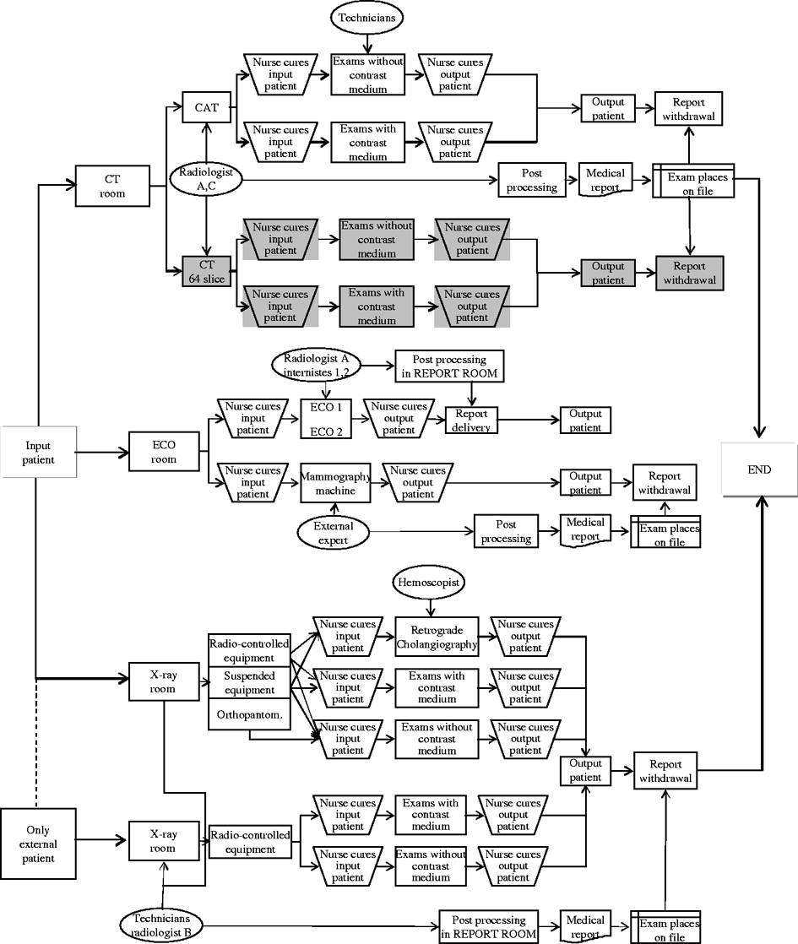
State Dept. of _______
SIG/SPDG
Restorative Systems
PBIS Initiative
Social Emotional Learning
RtI/MTSS
Outcome
Improve School Climate
SSHS/SDFS
Organization?
Character Education
School Climate
Alternative Schools
Turnaround

Slide 45
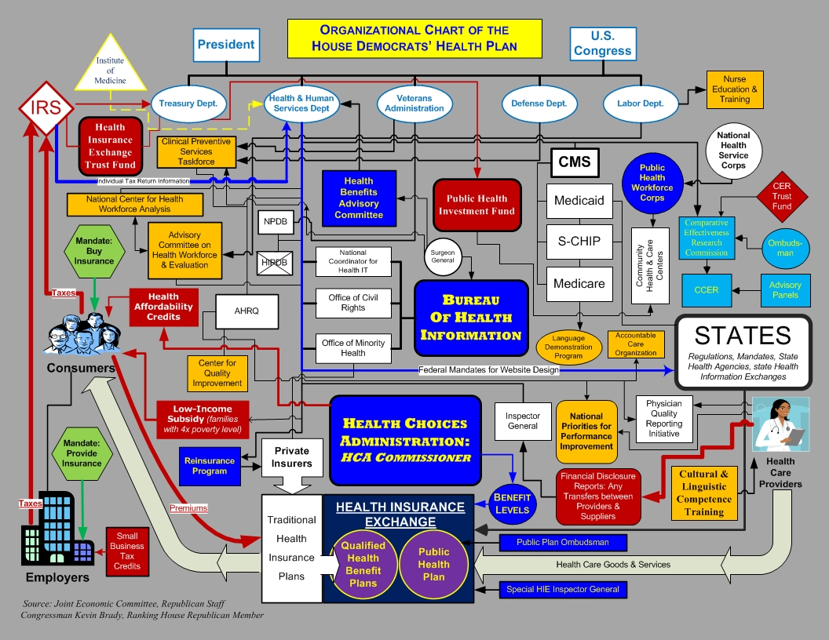
Dept. of _____
Organization?

Slide 46
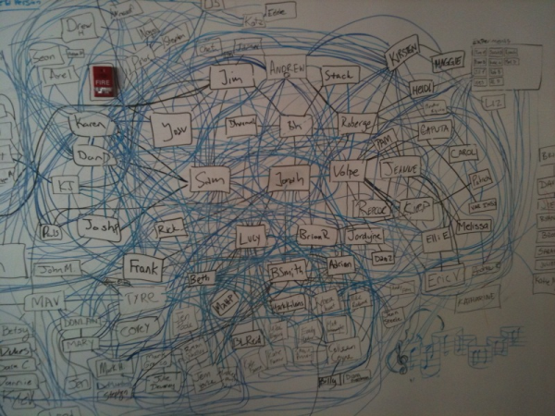
Real Implementation Framework!

Slide 47
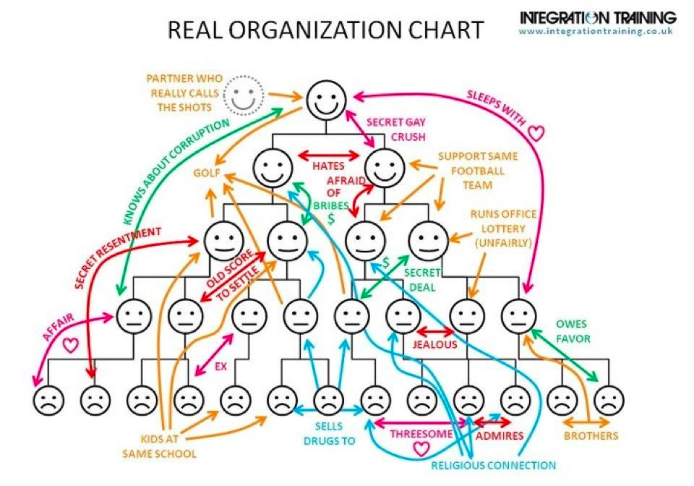
Real Organizational Chart!

Slide 48
SWPBS (aka PBIS RtI-B, MTSS-B, EBS) is
for enhancing adoption & implementation of
Continuum of evidence-based interventions to achieve
Academically & behaviorally important outcomes for
All students
Framework

Slide 49
Supporting Social Competence &
Academic Achievement
OUTCOMES
Supporting
Decision
Making
Supporting
Staff Behavior
SYSTEMS
DATA
PRACTICES
Supporting
Student Behavior
Notes:
To focus the implementation process, PBIS emphasizes
USE OF DATA for GUIDING ALL DECISIONS related to EXPECTED OUTCOMES, PRACTICES, AND IMPLEMENTATION SUPPORT SYSTEMS
SELECTION OF EVIDENCE BASED PRACTICES that are ALIGNED WITH DESIRED OUTCOMES
OUTCOMES that are important to the STUDENTS AND FAMILY AND SCHOOL COMMUNITIES
And SYSTEMS that enable educators to IMPLEMENT with the HIGHEST DEGREE OF INTEGRITY

Slide 50
Effective Social & Academic School Culture
GOAL to create safe, respectful, effective, & relevant social culture where successful teaching & learning are possible & problem behaviors are prevented
Common Language
PBIS
Wing Institute
Common Experience
Common Vision/Values

Slide 51
Effective Organizations
“Organizations are groups of individuals whose collective behaviors are directed toward a common goal & maintained by a common outcome”
(Skinner, 1953, Science of Human Behavior)
Common vision & objectives
Common language
Common experiences & routines
Quality leadership & coaching

Slide 52
Evidence-based Practices
EFFECTIVE
Works
Repeatable
Dependable
EFFICIENT
Doable
Manageable
Fit
RELEVANT
Context
Culture
Adaptable

Slide 53
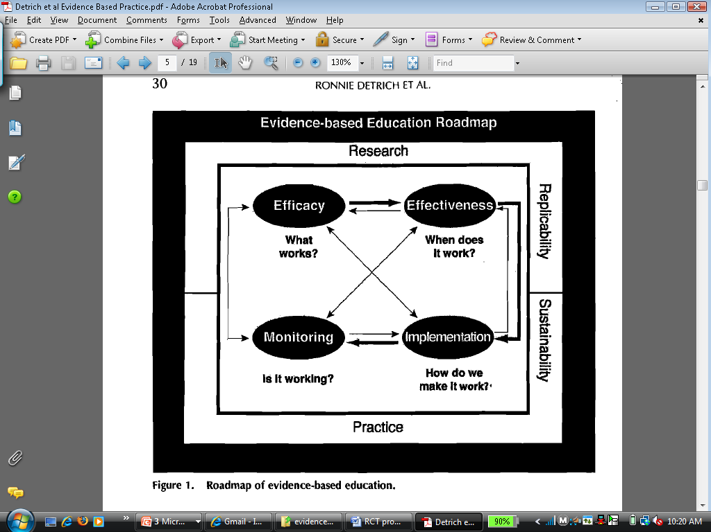
Start
w/
What Works
Focus on Fidelity
Detrich, Keyworth, & States (2007). J. Evid.-based Prac. in Sch.
Notes:
Research to Practice is dependent on good research.

Slide 54
Biglan, Colvin, Mayer,
Patterson,
Reid, Walker
A FUNDAMENTAL
HOW?
Establish positive school climate
Maximizing academic success
Teaching important social skills
Recognizing good behavior
Modeling good behavior
Active supervision
Communicating positively

Slide 55
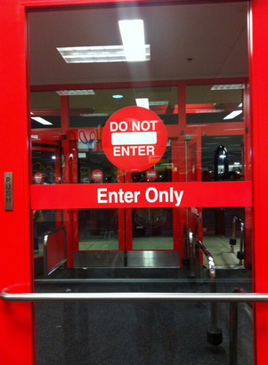
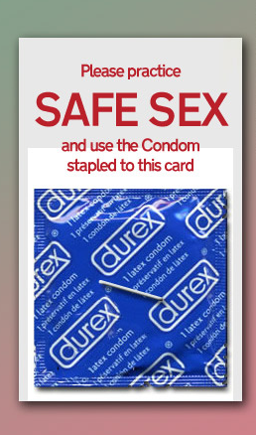
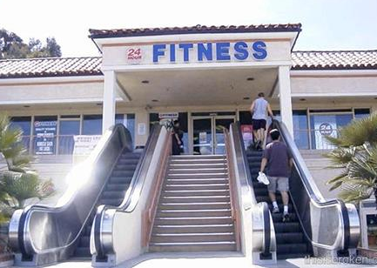
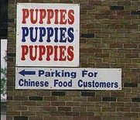
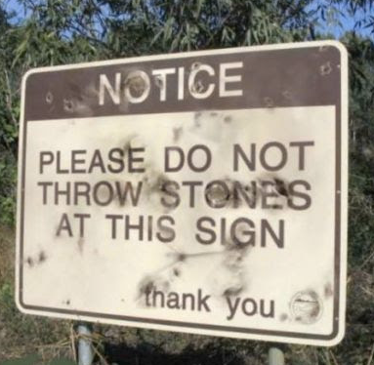
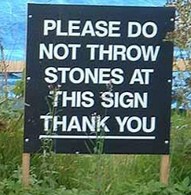
“Don’t Throw Stones!” |  | IMPLEMENTATION
 |  | Effective | Not Effective
PRACTICE | Effective
 | Not Effective
Maximum Student Benefits
Fixsen & Blase, 2009

Slide 56
 |  | IMPLEMENTATION
 |  | Effective | Not Effective
PRACTICE | Effective | Maximum Student Benefit | Reduced Probability of Student Benefit
 | Not Effective | Low Probability for Student Benefit | Low Probability for Student Benefit
Implementation Fidelity
Fixsen & Blase, 2009

Slide 57

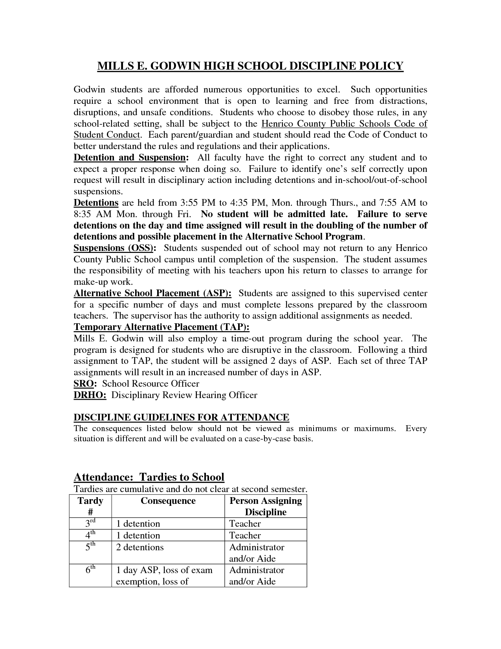
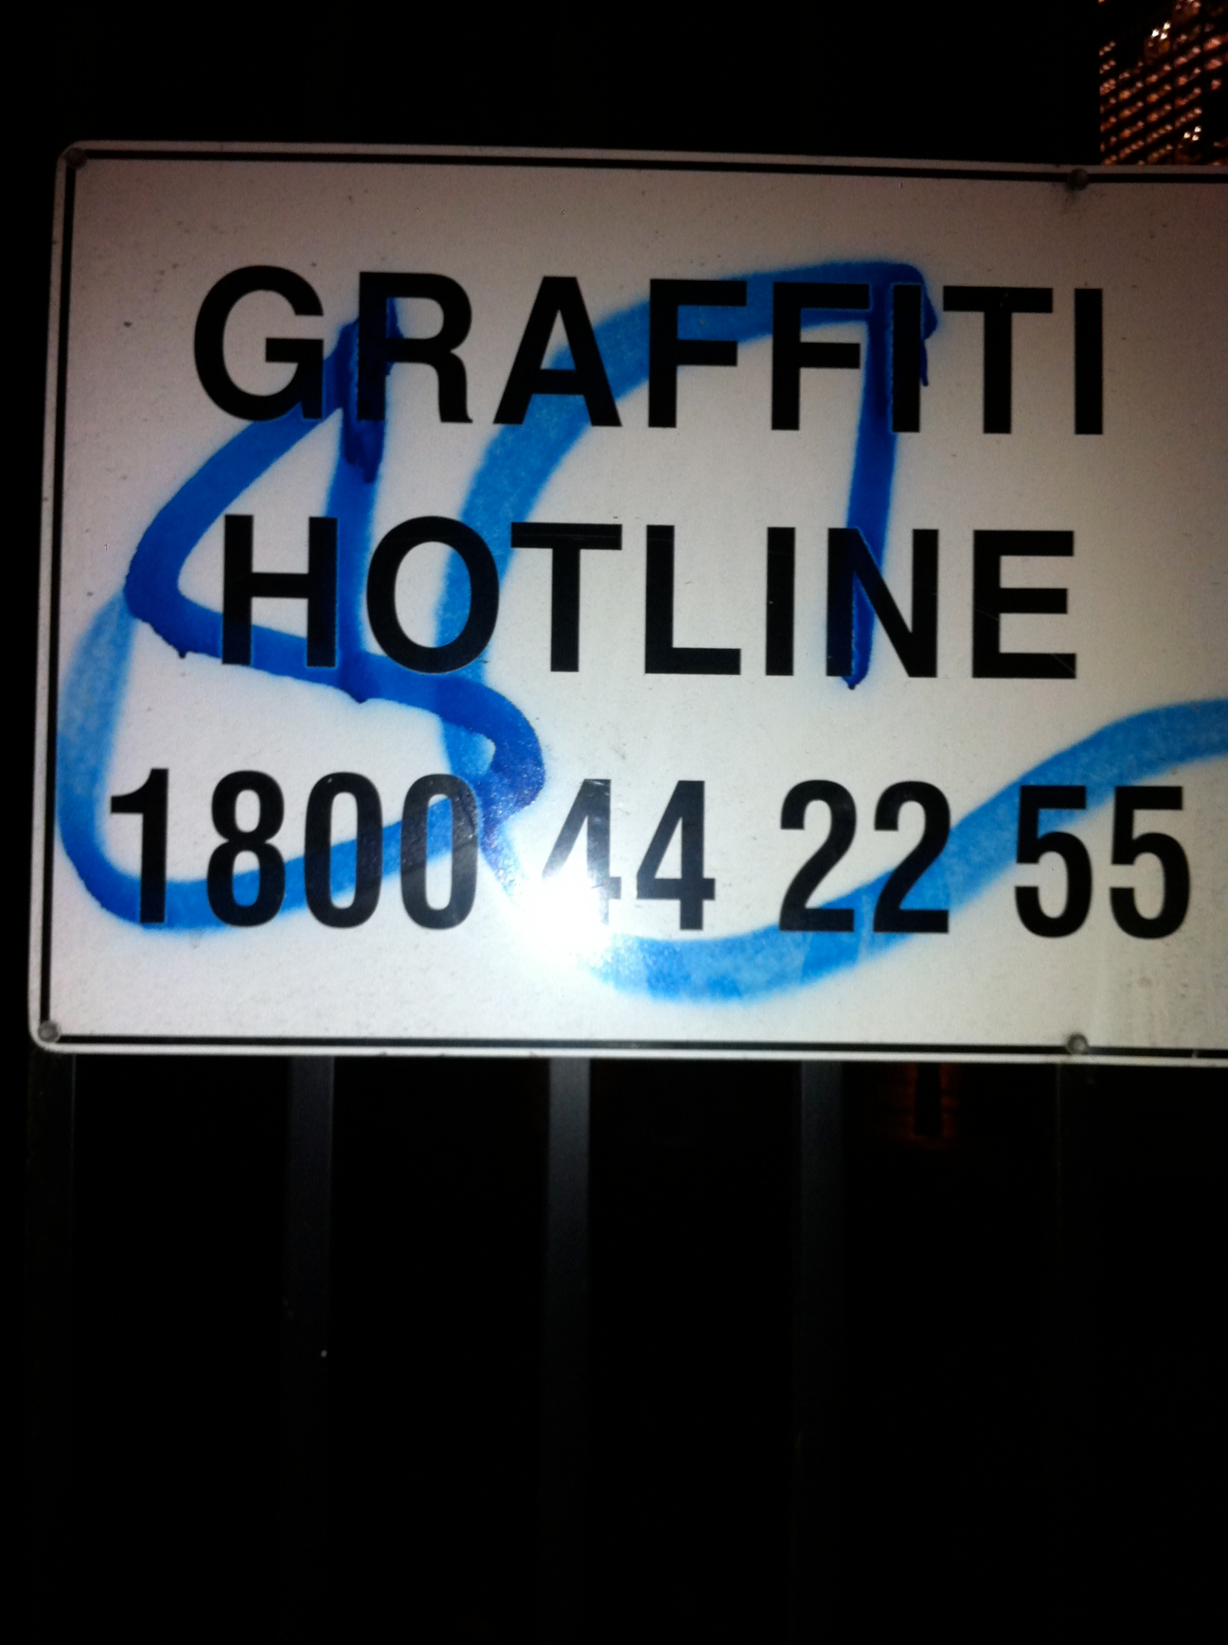
Discipline Handbook
Mismatch between problem & intervention
Functional Equivalent of “Graffiti Hotline!”

Slide 58
Universal
Targeted
Intensive
Continuum of Support for All
Few
Some
All
Dec 7, 2007
Notes:
NOTICE GREEN GOES IS FOR “ALL”

Slide 59
Universal
Targeted
Intensive
Continuum of Support for ALL:
“Molcom”
Anger man.
Behavior Support
Prob Sol.
Technology
Ind. play
Adult rel.
Attend.
Self-assess
Homework
Coop play
Peer interac
Supports for all students w/ disabilities are multi-tiered
Dec 7, 2007
Notes:
NOTICE GREEN GOES IS FOR “ALL”
Baker, 2005 JPBI

Slide 60
Universal
Targeted
Intensive
Continuum of Support for ALL:
“George”
Dutch
Statistics
Expressing
Emotions
Technology
Lawn Mowing
Tennis
Reading
Comprehension
Cooking
Billiards
Teaching
Bicycle Touring
Label behavior…not people
Dec 7, 2007
Notes:
In this example, student with EMOTIONAL AND BEHAVIORAL DISRODERS has TWO areas requiring VERY SPECIALIZED SUPPORTS,
But, he also has MANY AREAS OF STRENGTH, and areas requiring LESS SPECIALIZED or MORE NORMALIZED SUPPORTS.

Slide 61
Universal
Targeted
Intensive
Continuum of Support for ALL:
“________”
__________
__________
__________
_________
_________
________
_______
________
___________
_________
_________
Dec 7, 2007
Notes:
In this example, student with EMOTIONAL AND BEHAVIORAL DISRODERS has TWO areas requiring VERY SPECIALIZED SUPPORTS,
But, he also has MANY AREAS OF STRENGTH, and areas requiring LESS SPECIALIZED or MORE NORMALIZED SUPPORTS.

Slide 62
Universal
Targeted
Intensive
Continuum of Support for ALL
“IFB School”
Literacy
Professional
Development
School Climate
Technology
Numeracy
Attendance
Social Studies
Writing
Crisis Prevention
Specials
Science
Supports fo schools are multi-tiered
Dec 7, 2007
Notes:
NOTICE GREEN GOES IS FOR “ALL”
Baker, 2005 JPBI

Slide 63
Homework
ESTABLISHING CONTINUUM of SWPBS
TERTIARY PREVENTION
Function-based support
Wraparound
Person-centered planning
TERTIARY PREVENTION
SECONDARY PREVENTION
SECONDARY PREVENTION
Check in/out
Targeted social skills instruction
Peer-based supports
Social skills club
PRIMARY PREVENTION
PRIMARY PREVENTION
Teach SW expectations
Proactive SW discipline
Positive reinforcement
Effective instruction
Parent engagement
Notes:
This TIERED LOGIC can be illustrated by a schools that has ALIGNED its BEHAVIOR SUPPORT INTERVENTIONS OR PRACTICES BY THREE GENERAL TIERS
TIER 1 PRACTICES ARE FOR ALL STUDENTS ACROSS ALL SCHOOL SETTINGS
TIER 2 PRACTICES ARE FOR STUDENTS WHO REQUIRE SUPPLEMENTAL SPECIALIZED (SMALL GROUP) SUPPORTS
TIER 3 PRACTICES ARE HIGHLY SPECIALIZED AND INTENSIVE FOR INDIVIDUAL STUDENTS.
It is important to notice that these practices are
SMALL IN NUMBER
CONCEPTUALLY ALIGNED
AND WOULD HAVE DATA RULES FOR MOVEMENT UP AND DOWN THE CONTINUUM

Slide 64
Universal
Targeted
Intensive
Continuum of Support for ALL
“District: Literacy”
Trek E.S.
Technical
Assistance
Bianchi M.S.
Jamis E.S.
Masi H.S.
Serrota E.S.
Look M.S.
Schwinn M.S.
Davidson M.S.
Ridley H.S.
LeMond. E.S.
Supports for districts are multi-tiered
Dec 7, 2007
Notes:
NOTICE GREEN GOES IS FOR “ALL”
Baker, 2005 JPBI

Slide 65
Universal
Targeted
Intensive
Continuum of Support for ALL
“State”
State 12
Technical
Assistance
State 44
State 29
State 15
State 8
State 12
State 21
State 37
State 44
State 26
Supports for states are multi-tiered
Dec 7, 2007
Notes:
NOTICE GREEN GOES IS FOR “ALL”
Baker, 2005 JPBI

Slide 66
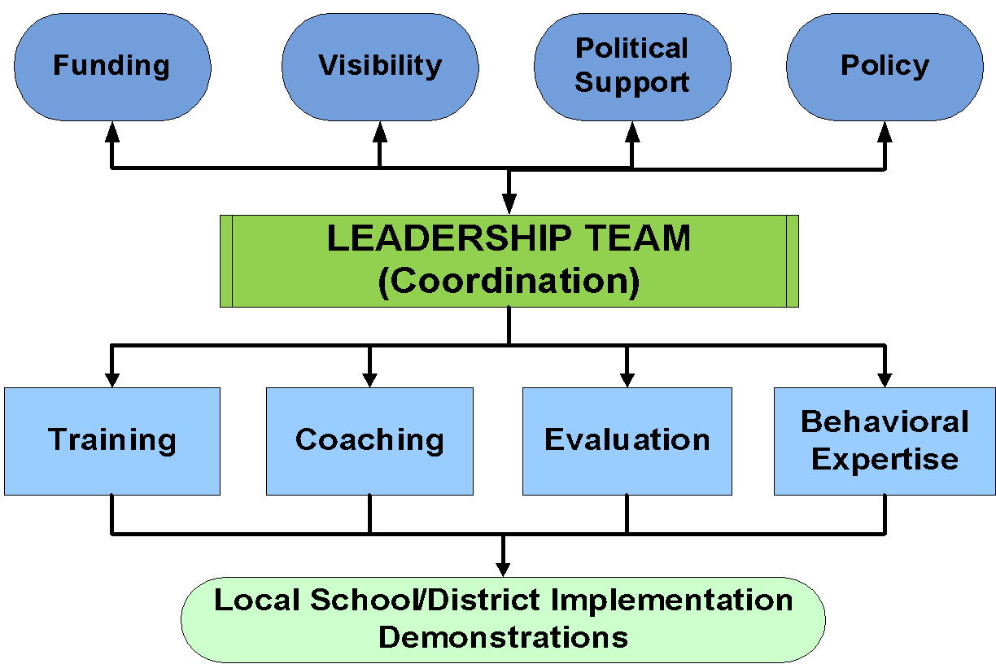
Implementation Drivers

Slide 67
CORE FEATURES:
School-Wide PBS (Tier 1)
Leadership team
Behavior purpose statement
Set of positive expectations & behaviors
Procedures for teaching SW & classroom-wide expected behavior
Continuum of procedures for encouraging expected behavior
Continuum of procedures for discouraging rule violations
Procedures for on-going data-based monitoring & evaluation

Slide 68
CORE FEATURES
School-Wide PBS (Tier 2)
Team & data driven
Behavior expertise
Increased social skills instruction & practice
Increased adult supervision
Increased opportunity for positive reinforcement
Continuous progress monitoring
Increased precorrection

Slide 69
IMPLEMENTATION W/ FIDELITY
CONTINUUM OF EVIDENCE-BASED
INTERVENTIONS
CONTENT EXPERTISE & FLUENCY
TEAM-BASED
IMPLEMENTATION
CONTINUOUS
PROGRESS MONITORING
UNIVERSAL SCREENING
DATA-BASED
DECISION MAKING & PROBLEM SOLVING
CORE FEATURES
MTSS/RtI

Slide 70
RCT & Group Design PBIS Studies
6 Nov 2013
Bradshaw, C.P., Koth, C. W., Thornton, L. A., & Leaf, P. J. (2009). Altering school climate through school-wide Positive Behavioral Interventions and Supports: Findings from a group-randomized effectiveness trial. Prevention Science, 10(2), 100-115
Bradshaw, C. P., Koth, C. W., Bevans, K. B., Ialongo, N., & Leaf, P. J. (2008). The impact of school-wide Positive Behavioral Interventions and Supports (PBIS) on the organizational health of elementary schools. School Psychology Quarterly, 23(4), 462-473.
Bradshaw, C. P., Mitchell, M. M., & Leaf, P. J. (2010). Examining the effects of School-Wide Positive Behavioral Interventions and Supports on student outcomes: Results from a randomized controlled effectiveness trial in elementary schools. Journal of Positive Behavior Interventions, 12, 133-148.
Bradshaw, C. P., Pas, E. T., Goldweber, A., Rosenberg, M. S., & Leaf, P. J. (2012). Integrating school-wide positive behavioral interventions and supports with tier 2 coaching to student support teams: The PBISplus model. Advances in School Mental Health Promotion 5, 177-193.
Bradshaw, C. P., Reinke, W. M., Brown, L. D., Bevans, K. B., & Leaf, P. J. (2008). Implementation of school-wide Positive Behavioral Interventions and Supports (PBIS) in elementary schools: Observations from a randomized trial. Education & Treatment of Children, 31, 1-26.
Bradshaw, C. P., Waasdorp, T. E. & Leaf, P. J. (2012). Effects of School-Wide Positive Behavioral Interventions and Supports on child behavior problems. Pediatrics, 130(5), 1136-1145.
Goldweber, A., Waasdorp, T. E., & Bradshaw, C. P. (in press). Examining the link between forms of bullying behaviors and perceptions of safety and belonging among secondary school students. Journal of School Psychology.
Horner, R., Sugai, G., Smolkowski, K., Eber, L., Nakasato, J., Todd, A., & Esperanza, J., (2009). A randomized, wait-list controlled effectiveness trial assessing school-wide positive behavior support in elementary schools. Journal of Positive Behavior Interventions, 11, 133-145.
Horner, R. H., Sugai, G., & Anderson, C. M. (2010). Examining the evidence base for school-wide positive behavior support. Focus on Exceptionality, 42(8), 1-14.
Waasdorp, T. E., Bradshaw, C. P., & Leaf, P. J. (2012). The impact of School-wide Positive Behavioral Interventions and Supports (SWPBIS) on bullying and peer rejection: A randomized controlled effectiveness trial. Archives of Pediatrics and Adolescent Medicine, 116(2), 149-156
Reduced major disciplinary infractions
Improvement in aggressive behavior, concentration, prosocial behavior, & emotional regulation
Improvements in academic achievement
Enhanced perception of organizational health & safety
Reductions in teacher reported bullying behavior & peer rejection
Improved school climate

Slide 71
(Re)Conceptualization of Culture

Slide 72
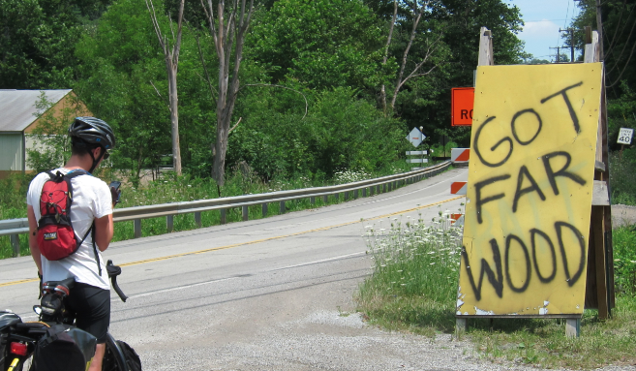
“How far away is the wood, Dad?”
Maryland
Considering Culture, Context, & Learning History

Slide 73
Systems Implementation Logic
Effective
Achieve desired outcome?
Efficient
Doable by implementer?
Relevant
Contextual & cultural?
Durable
Lasting?
Scalable
Transportable?
Logical
Conceptually Sound?

Slide 74
Local context defined by……
Racial
Identity
Nationality
Generation
Immigrant Status
Values & Beliefs
Disability
Political
Affiliation
Recreation
Neighborhood
Sexual Orientation
Work
Language
Family Structure
SES
Religion
Gender
Ethnicity
Career

Slide 75
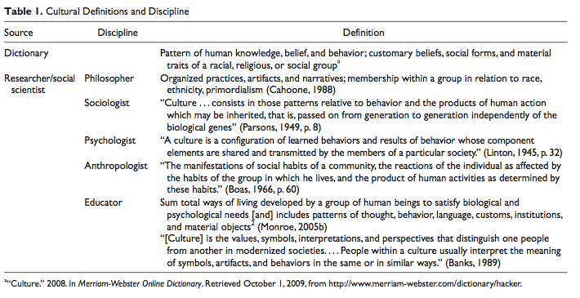
Define culture differently
Philosophers
Sociologists
Psychologists
Anthropologists
Political Scientists
Historians
Educators

Slide 76
Culture is central in discussions related to
Diversity,
Disproportionality,
Inequity/disparity,
School discipline,
Academic achievement, &
Disability.
However, education community struggles w/conceptualization of culture that enhances our
Understanding of culture,
Effective communications & expressions of our unique experiences, &
Actions that realize meaningful benefits for all students.

Slide 77
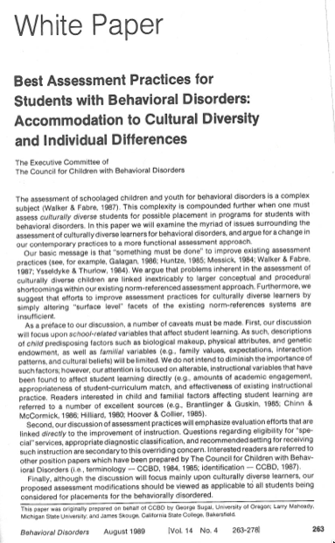


Slide 78
Our Challenge
Is SWPBS “culturally relevant”?
Can SWPBS become more culturally relevant?
What does culturally relevant SWPBS implementation look like?
How do we measure impact of a culturally relevant implementation of SWPBS?
Fallon, O’Keeffe, & Sugai 2012

Slide 79
Early Conclusion #1
Many students & adults do not experience schools as culturally & contextually relevant, & as a result, are at high risk of lower academic achievement, more frequent & negative disciplinary consequences, & more deleterious social behavioral outcomes.
Currently, the use of SWPBS practices & systems is increasing as a viable approach to improving the social & behavioral culture of schools through the use of constructive & preventive strategies

Slide 80
Early Conclusion #2
Nothing is inherently biased or culturally irrelevant about practices & systems PBIS implementation.
However, we can improve kid outcomes by making those practices & systems more reflective of norms, expectations, & learning histories of kids & family, community & staff members
Sugai, O’Keeffe, & Fallon 2012

Slide 81
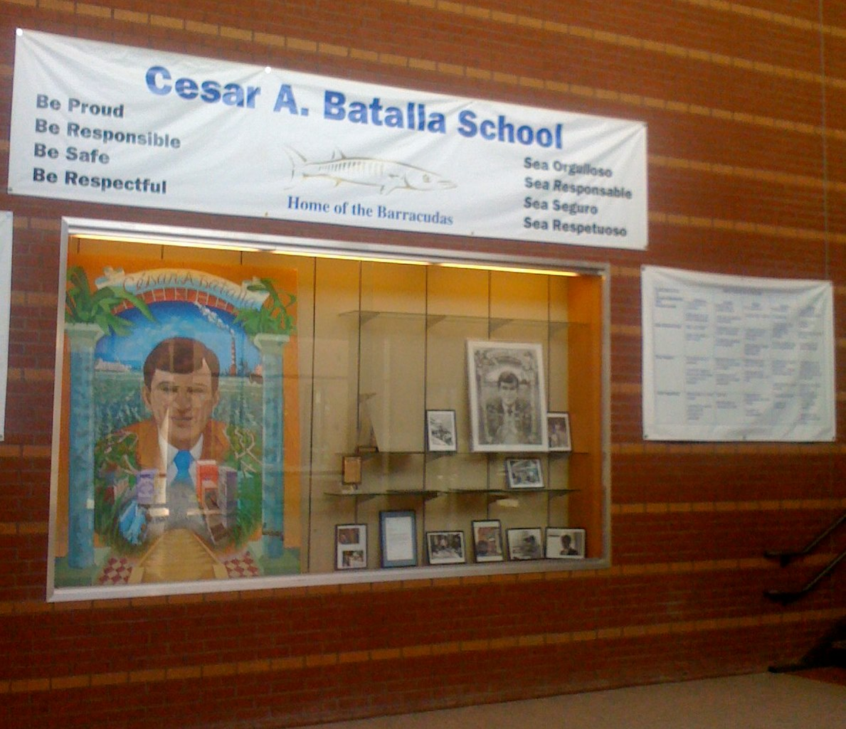
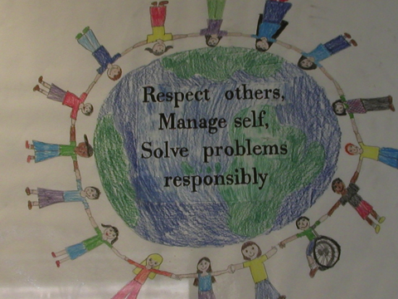
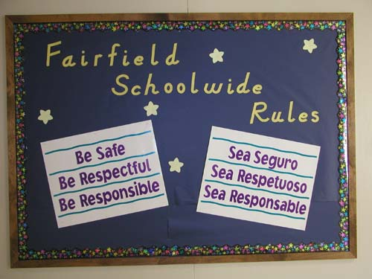
Eugene OR
2005
Bridgeport CT
2009

Slide 82
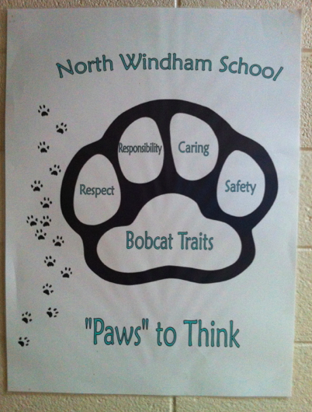
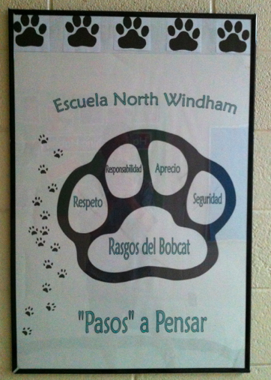
North Windham School CT

Slide 83
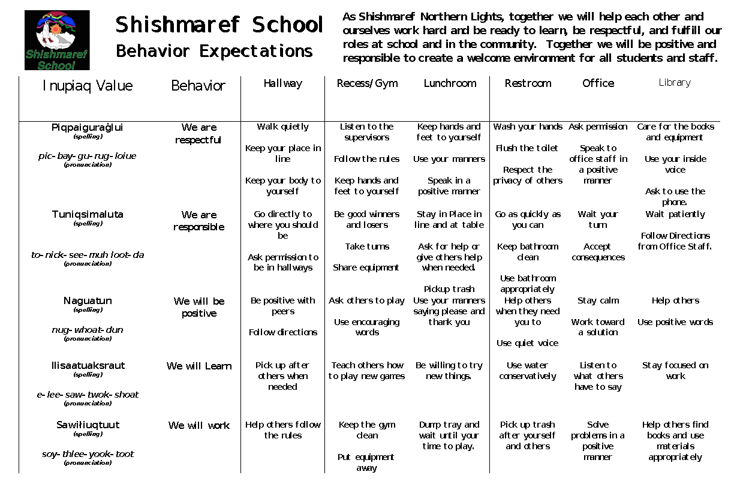
Shishmaref School AK, Lyon Johnson, Aug 9, 2011

Slide 84
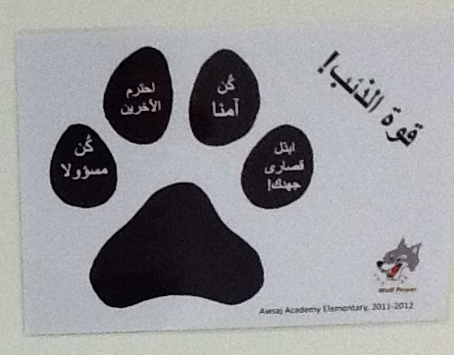
Arabic Expectations at Awsaj Academy Elementary 2011-2012
S. Thomas

Slide 85

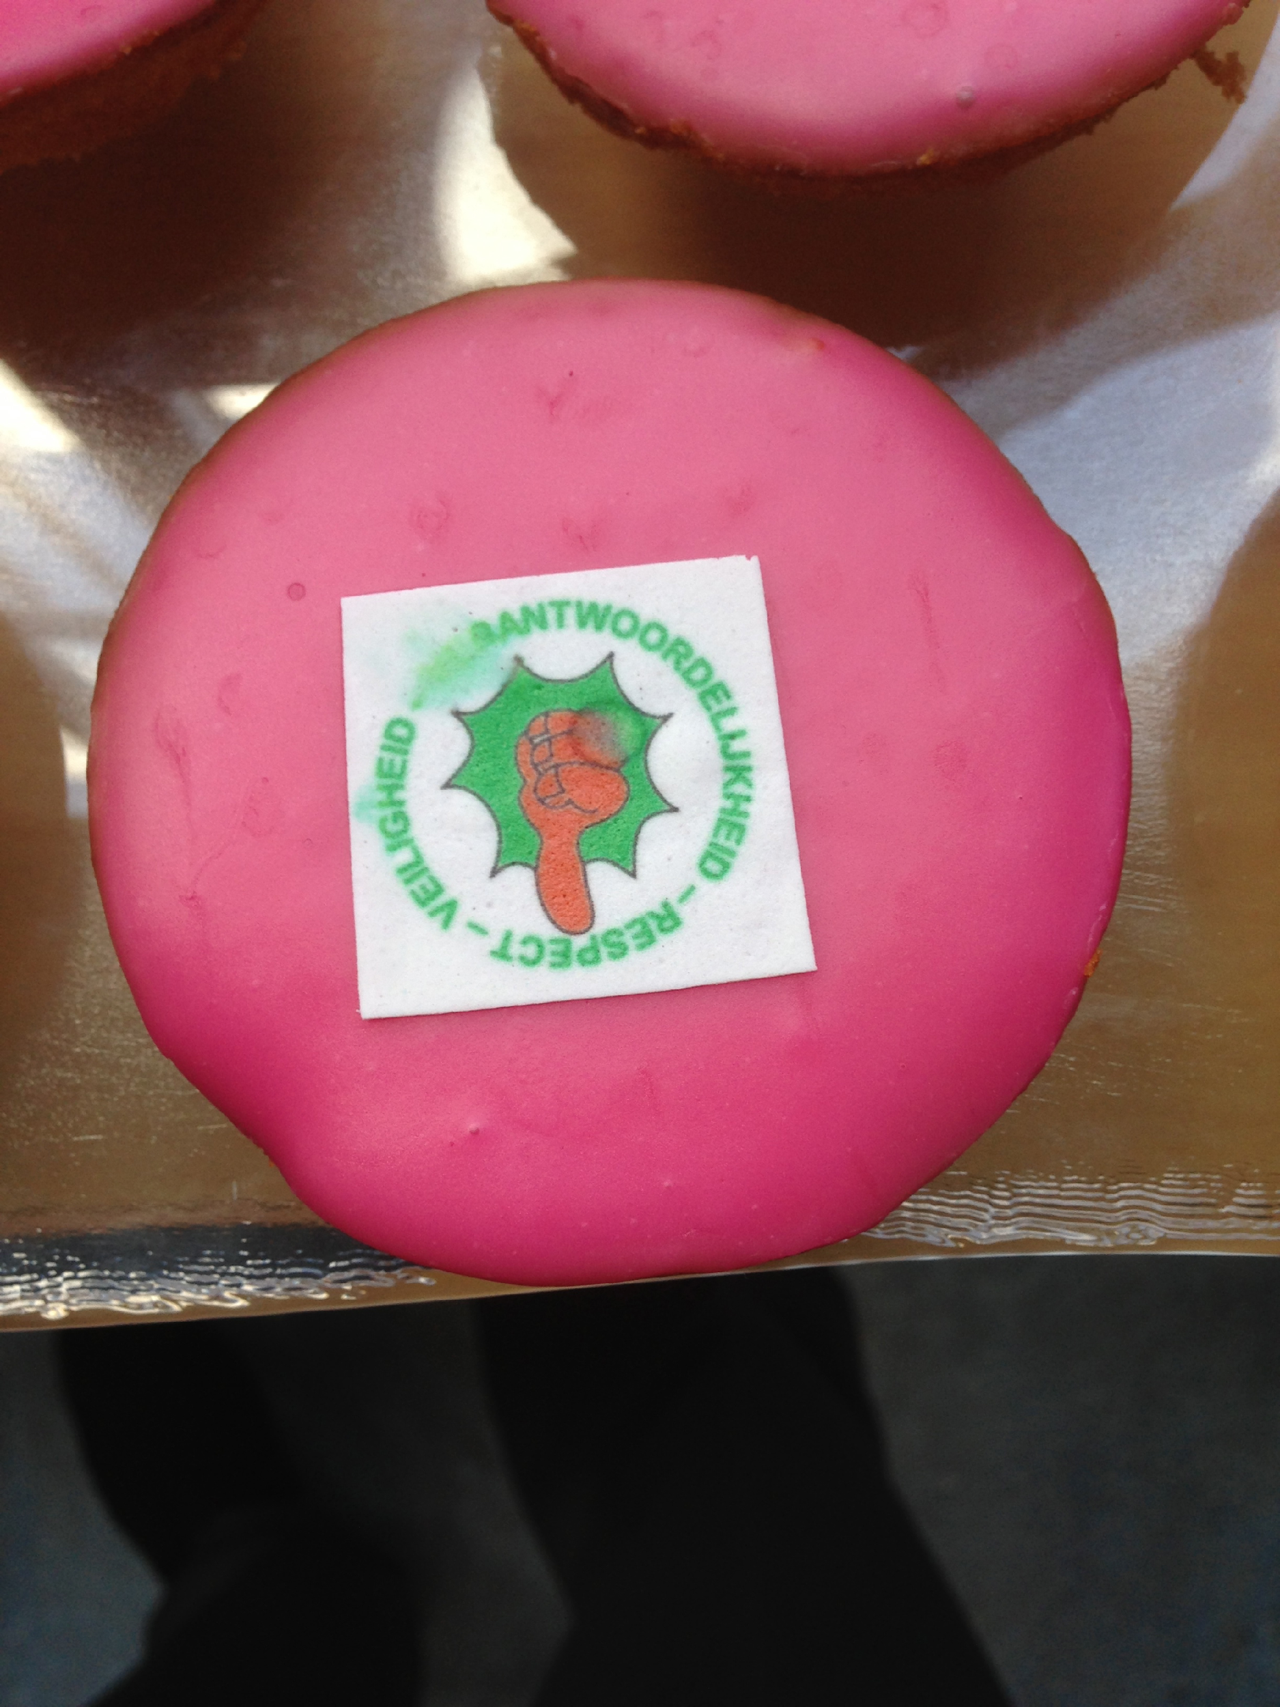
Netherlands Sep 2013

Slide 86
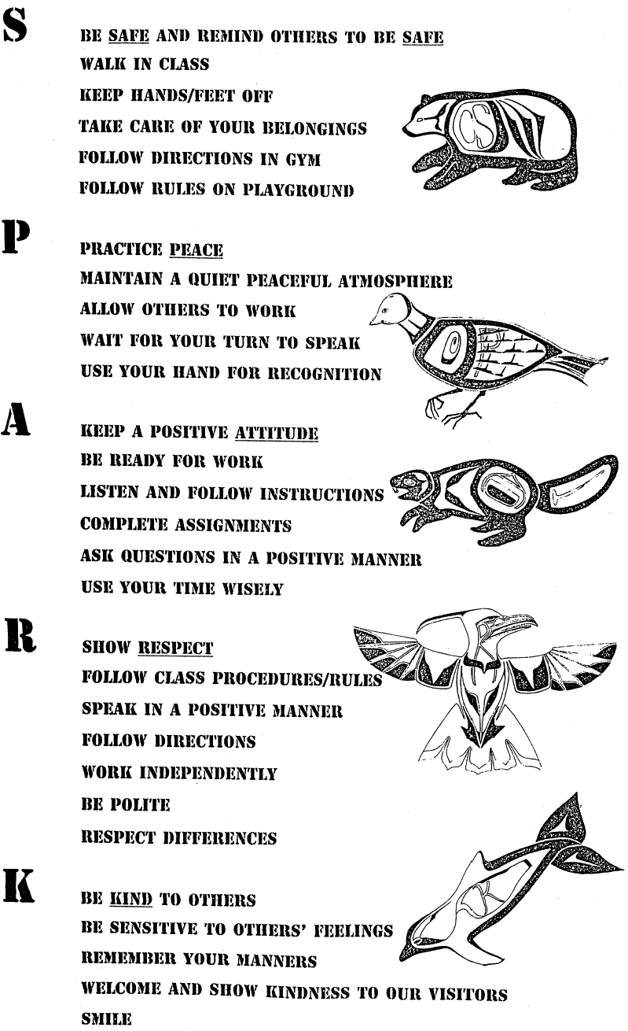
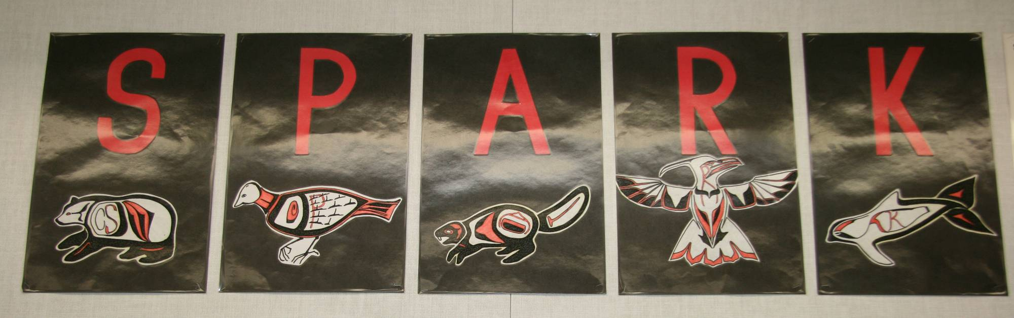
Bernard Elementary, Chilliwack, BC K. McIntosh, Oct 2013 PBIS Forum

Slide 87
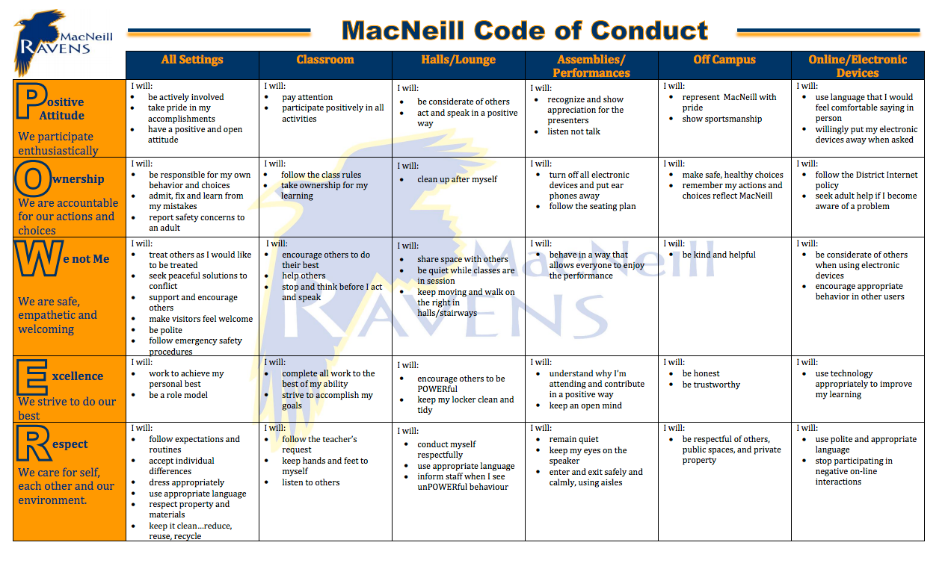
MacNeill Secondary School, Richmond, British Columbia 4 Nov 2013

Slide 88

Wyndham Park P.S. Victoria, Australia 14Feb 2014
• Actively listen
• Allow others to learn
• Cooperate
• Full school uniform
• Mind your tone
• Right words right place
• Take turns
• Be water wise
• Include others
• Listen to staff
• Right words right place
• Allow personal space
• Move quietly
• MYOB
• Right words right place
• Ask before using their image
• Appropriate sound level for learning
• Care for equipment
• Piracy is illegal
• Hands and feet to self
• Leave nature alone
• Sunsmart (T1 and T4)
• Travel in pairs
• Be cybersafe
• Food/drink free zone
• Own username
• Sign devices in/out
• Be where you should be
• Care for equipment
• Hands and feet to self
• Hand to hand
• Travel in pairs
• Walk on the left
• Wear Out of Class pass
• Learning time to learn
• Use Chill Out Space
• Use toilets appropriately
• Music means moving
• Nude food only
• Plan for play
• Tell the truth
• Use Wheel of Choice
• Devices charged for learning
• Minimize sharing to prevent viruses
• USBs for schoolwork
• Use devices with permission
• Music means moving
• On time to line

Slide 89
Our Starting Point
Sugai, O’Keeffe, & Fallon 2012

Slide 90
Literature Review Research Questions
How is culture defined in research focused on behavior management, discipline, & improving problem behavior in schools?
What culturally & contextually relevant strategies are documented in research focused on behavior management, discipline, & improving problem behavior in schools?
Definition of culture
Focus on problem behavior(s)
Focus on behavior management &/or discipline
Suggestions for culturally, contextually relevant beh man strategies
Fallon, O’Keeffe, & Sugai 2012

Slide 91
Findings 1991-2010 (n=297)
n = 297
Qualitative
Total | Intervention Description | Reviews/ Current Issues | Case Studies | Other
21 | 9 | 8 | 2 | 2
Quantitative
Total | Records Reviews | Case Studies | Experimental
7 | 4 | 2 | 1
Fallon, O’Keeffe, & Sugai 2012
Notes:
Lo and Cartledge (2006) conducted a single subject study with four African American boys in elementary school to determine if functional behavior assessment and behavior intervention plans (tier 3) were effective to help students reduce off-task behavior in class. The function of the inappropriate behavior for these students was adult attention. The intervention included teaching students to recruit adult attention appropriately, reinforcing students when they did, and teaching students to self-monitor their use of this strategy. Experimental control was established and the intervention was effective for all participants in reducing off-task behavior to levels near or below peer off- task behavior while increasing students’ use of appropriate attention recruiting.
Across the seven quantitative articles, the need to reorganize behavior management in schools, particularly to meet the needs of students from nondominant cultural groups, becomes readily apparent. Although the body of quantitative studies is relatively small, the results support and reinforce the general results from the qualitative and descriptive literature base.
Studies suggest teachers’ praise rates & quality of praise differ depending on students’ race & gender (Bullara, 1993). To prevent this, positive & negative consequences should be planned, reasonable, & delivered consistently across students’ social & academic behaviors.
While several authors made this recommendation (Include students’ culture & language), suggestions were made on a continuum of less to more inclusion of students’ culture in instruction. These recommendations ranged from learning about students’ home culture (Day-Vines & Day-Hairston, 2005; Green, 2005) to matching students’ language & cultural styles in the classroom (e.g., “cultural synchronicity;” Monroe, 2005a; Monroe, 2005b).

Slide 92
Literature Review Summary
Fallon, O’Keeffe, & Sugai 2012
Notes:
Note limitations of literature review:
Not an exhaustive search
Did not include all studies in which an intervention was tested with CLD students (however, other research shows that these continue to be limited in number).
Narrative Reviews can suffer confirmation bias.

Slide 93


Table 3. SWPBS Examples & Suggestions for Enhancing Cultural & Contextual Relevance

Slide 94


Slide 95
“What’s the mechanism?”
Behavior Analysis
Learned & purposeful
Biologically influenced
Contextual or environmental
Manipulable & Teachable

Slide 96
What do behaviorists say about culture?
“No degree of knowledge about the characteristics of groups or cultures can substitute for the analysis of the actions of a given individual in their historical & situational context because no two members of any group are socialized in exactly the same way”
Hayes & Toarmino, 1995
“A culture evolves when practices… contribute to the success of the practicing group in solving its problems”
Skinner, 1981

Slide 97
Early Conclusion…
Nothing is inherently biased or culturally irrelevant about practices & systems PBIS implementation.
However, we can improve kid outcomes by making those practices & systems more reflective of norms, expectations, & learning histories of kids & family, community & staff members
Sugai, O’Keeffe, & Fallon 2012

Slide 98
“George Sugai?” Learning History
1951 Sansei Santa Cruz, CA. Parents born Watsonville
Buddhism v. “Elks” little league baseball
Ex Order 9066: Mom interned, Dad moved to UT
No Japanese, fork v. hashi, soy sauce v. shoyu
Only 2 JA, 1 AA @ LGHS, Stones v. Beatles
BF: Dale, Jim, Lansing, “Molly,” Roger
UCSB, hippies, BoA
Nature director in ESC, “Gary” v. toilet
CA, WA, CO, KY, NH, OR, CT
Bi-racial: Fernandez
Hapa: Sugai-Fernandez
Shaped into “damn behaviorist!”
PBIS, SpEd & Kids w/ BD
Sugai-Fernandez
CA Sansei JA
“Damn behaviorist”

Slide 99
Individual Learning History & Context | Indicate 10 key life events/influences (you, students, parents, staff, etc.) Summarize in 4 descriptors. Describe how learning history affects how you describe & act on what you experience.
________________
Your Name
1.
5.
4.
3.
2.
6.
7.
8.
9.
10.
2.
3.
4.
1.

Slide 100
Culture =
Flexible, dynamic, & changed/shaped over time & across generations & setting.
Group of individuals
Overt/verbal behavior
Shared learning history
Differentiates 1 group from others
Predicting future behavior
Collection of learned behaviors, maintained by similar social & environmental contingencies
Sugai, O’Keeffe, & Fallon 2012

Slide 101
LEARNING HISTORY is
Collection of experiences
Shaped by place, people, & time
If important, predicts future behavior
CULTURE is
Group of individuals
Verbal & overt behavior
Shared learning history
Differentiates one group from another
Predicts future behavior

Slide 102
Your learning history & culture shapes
How you are likely to act.
How you are likely to react.
How you are likely to be perceived.
How others are likely to act.
In a given context, setting, environment

Slide 103
What could happen if you I don’t know your or other learning history?
Misinterpret communication or behavior
React inappropriately
Develop stereotype (rule-governed)
Say/do something hurtful
Engage in action aversive to family or culture
Other

Slide 104
Supporting Social Competence &
Academic Achievement
OUTCOMES
Supporting
Decision
Making
Supporting
Staff Behavior
SYSTEMS
DATA
PRACTICES
Supporting
Student Behavior

Slide 105

SWPBS & Cultural Responsive Practices Vincent, Randall, Cartledge, Tobin, & Swain-Bradway 2011

Slide 106
Supporting Important Culturally Equitable Academic & Social Behavior Competence
Kid Benefit
OUTCOMES
Supporting Culturally Knowledgeable Staff Behavior
Supporting Culturally Valid Decision Making
SYSTEMS
DATA
PRACTICES
Vincent, Randall, Cartledge, Tobin, & Swain-Bradway 2011; Sugai, O’Keeffe, & Fallon, 2012ab
Supporting Culturally Relevant Evidence-based Interventions
Notes:
CULTURE is one our major considerations, and CULTURAL INFLUENCE is reflected in high attention toward
CULTURAL EQUITY of expectations
CULTURAL VALIDITY of data
CULTURAL RELEVANCE of practices
CULTURAL KNOWLEDGE of implementers

Slide 107
RESEARCH: Quantifiable Measures? Observable Indicators? Effective Interventions?
Culturally relevant DATA
Q: “How do we measure “culture” in a manner that shapes instruction that enhances student outcomes?”
Culturally equitable OUTCOMES
Culturally knowledgeable SYSTEMS
Culturally relevant PRACTICES

Slide 108
JUST AN IDEA: Assessing Culture Considerations
SWPBS Feature
SW expectations
SW acknowledgements
Problem behavior definitions & consequences
Classroom management routines
Data decision making rules & procedures
Culturally Valid Data
2 1 0
2 1 0
2 1 0
2 1 0
2 1 0
2 1 0
2 1 0
Culturally Equitable Outcomes
2 1 0
2 1 0
2 1 0
2 1 0
2 1 0
2 1 0
2 1 0
Culturally Knowledgeable Systems
2 1 0
2 1 0
2 1 0
2 1 0
2 1 0
2 1 0
2 1 0
Culturally Relevant Practices
2 1 0
2 1 0
2 1 0
2 1 0
2 1 0
2 1 0
2 1 0

Slide 109
Research Questions
What does Cultural Relevance & Responsiveness look like? IV v. DV?
How would we measure status of & change in Cultural Relevance & Responsiveness? IF v. DV
What research designs should be used to evaluate interventions (or outcomes) for their Cultural Relevance & Responsiveness?

Slide 110

Eugene Oregon

Slide 111
Potential for cultural exchange & conflict
Student
Teacher
Administrator
Family
Community

Slide 112
References
Fallon, L. M., O’Keeffe, B. V., & Sugai, G. (2012). Consideration of culture and context in School-wide Positive Behavior Support: A review of current literature. Journal of Positive Behavior Interventions, 14, 209-219, doi: 10.1177/1098300712442242
Sugai, G., O’Keeffe, B. V., & Fallon, L. M. (2012). A contextual consideration of culture and school-wide positive behavior support. Journal of Positive Behavior Interventions, 14, 197-208, 10.1177/1098300711426334
Vincent, C. G., Randall, C., Cartledge, G., Tobin, T. J. & Swain-Bradway, J. (2011). Toward a conceptual integration of cultural responsiveness and school-wide positive behavior support. Journal of Positive Behavior Interventions, 13, 219-229.

Slide 113
“Every organization should adopt one little thing, one seemingly small but pivotal behavior that symbolizes the organization’s values & purpose. It should be an action that takes less than a minute to perform, something that anyone & everyone in the organization can easily do, something that everyone can hold others accountable for, & something for which there are no excuses for not doing it.”
Lisa Earle McLeod in Coach John Wooden’s Greatest Secret Pat Williams, 2014.

Slide 114

Factors Directly & Indirectly Contributing To Student Learning
Student/ Family Background
School Conditions
School Leadership
Teachers
Classroom Conditions
Louis, Leithwood, Wahlstrom, & Anderson (2010).

Slide 115
Common Language &
Behaviors
Effective Organizations
Common Experience
Common
Vision/Values
Quality
Leadership

Slide 116
“The way to achieve dauntingly high goals is through a relentless focus on achieving optimal performance in a lot of seemingly little things. Those little things accumulate over time & make a big difference.”
Coach John Wooden’s Greatest Secret Pat Williams, 2014.

Slide 117
Cultural/Context Considerations
BASIC PBIS LOGIC
SYSTEMS
DATA
Start w/ effective, efficient, & relevant, doable
Maximum
Student
Outcomes
PRACTICES
Implementation
Fidelity
Training
+
Coaching
+
Evaluation
Prepare & support implementation
Improve “Fit”
Notes:
Putting the everything together, we get this picture…

Slide 118

Horner, 2014

Slide 119
“Coach Wooden’s goal: learn the fundamentals, master the fundamentals, teach the fundamentals to others, & apply the fundamentals in every area of our lives. Mastering the fundamentals is one of a lot of little things done well that make a big difference in our pursuit of success.”
Coach John Wooden’s Greatest Secret Pat Williams, 2014.
“Success is the natural consequence of consistently
applying the basic fundamentals.”
Jim Rohn

Slide 120


Context matters,…don’t leave behavior success to chance!!
Use defendable theory of action (ABA) to support approach (PBIS) based on need (data).
Leslie Krupa & Jessica Daly
Dark Horse in Boulder
15 Sep 2013
Competing Stimulus Control

Slide 121
“Well, the truth is, there are simple answers; they just are not easy ones.”
Ronald Reagan in Coach John Wooden’s Greatest Secret Pat Williams, 2014.

Slide 122



Dad: "let's go prune your sister's apple tree."
Me: "Glad to do it for you."
Dad: "I know how to prune...you don't."
Me: "Right. I'll spot you on ladder, but you can't go higher than two steps."
Dad: "Right." (pic 1)
Me: "Get down now!" (pic 2)
Dad: "No, you don't know how to prune."
Me: "You're gonna fall & be sorry."
Dad: "No. If I was your age and fell, yes, I'd be sorry. But I'm 94(!), & when I fall, I'll die....& I'll die doing something I love & want to do! So, hand me the pruning saw!"
Pic 3: new gangsta style....he also cut the bill off a baseball cap...."because it felt better"

Slide 123




Lewistj@missouri.edu
RobH@oregon.edu
George.sugai@uconn.edu
www.pbis.org

Slide 124




