Slide 1


Using District Instructional Tools and Resources based on Instructional Goals
Principal Professional Learning
October, 2023
Notes:
Noelle-slides 1-20

Slide 2

Shared Norms
Be on time and prepared
Stay engaged - Signal for coming back
Respect all voices
Assume best intent
Notes:
Noelle
Under 1 min

Slide 3
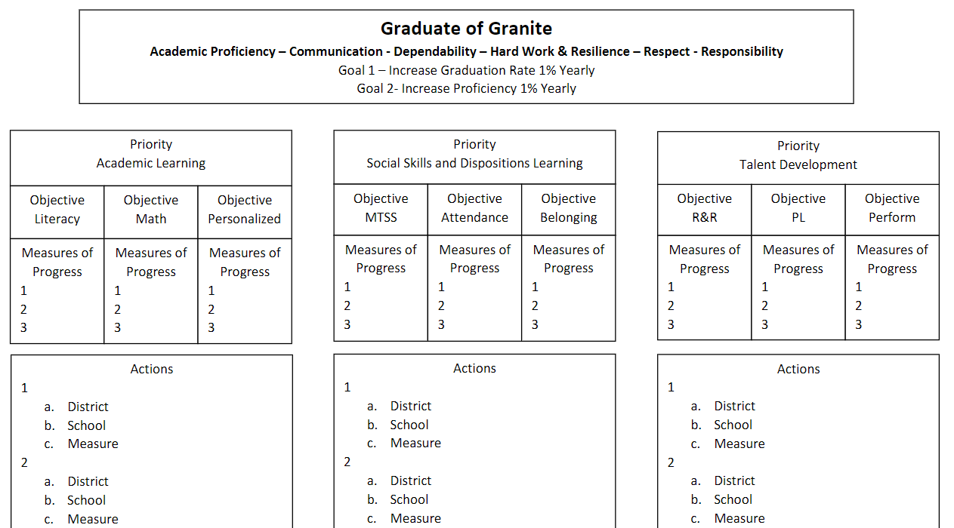
Notes:
Noelle
Under 1 min

Slide 4

Quick Review of our Principal Professional Learning (PPL) 3-Year Cycle
Year 1- The “What” is good/great in Instruction
Year 2- The “What” is good/great in Learning Environment
Year 3- The “How” to Build Principal Capacity based on your
understanding of what is good/great
Notes:
Noelle

Slide 5
Domain 2: Collective Commitment to Learning
Domain 2: An educational leader promotes and is accountable for student success by advocating, nurturing, assessing and sustaining a school focused on teaching the Utah Core Curriculum. An educational leader provides a learning environment conducive to student, faculty, and staff growth through collaboration within a culture of learning.
2C. Instructional Practice
Works with individuals and a variety of groups to ensure the use of Utah Core Standards, the district provided tools, data in assessing student learning, collaborative problem solving, and adjustment to evidence-based instruction to meet student learning needs.
2D. Differentiated Instruction
Assists and monitors the effective use of the district’s framework for instruction and system of support for providing differentiated instructional strategies and appropriate resources to address a variety of student learning needs.
Leadership Standards
Click Here
Notes:
Noelle-I min

Slide 6
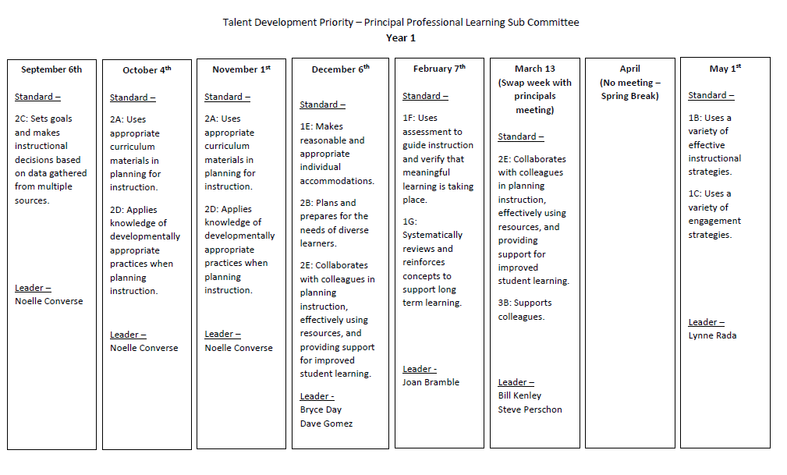
Notes:
Noelle-Under 1 min

Slide 7
Connection to Granite Educator Standards
Domain 2A- Planning and Preparation
Educator Standard 2.A. October Focus
A. The educator uses appropriate curriculum materials in planning for
instruction. Includes, but not limited to:
Using the prescribed concepts from the Utah
State Core Curriculum, Board of Education Goals,
and Granite School District curriculum guidelines
to define instructional content;
Consistently using materials adopted by Granite
School District;
Using adopted materials in accordance with
district guidelines.
Notes:
Noelle-1 min

Slide 8
Connection to Granite Educator Standards
Domain 2.A- Planning and Preparation
Effective
Uses the prescribed concepts from the
Utah State Core Curriculum, Board of
Education Goals, and Granite School
District curriculum guidelines to define
instructional content.
Consistently uses materials adopted by
Granite School District.
Uses adopted materials in accordance
with district guidelines.
Highly Effective
Uses approved state and district
guidelines and standards as the foundation
for key concepts and underlying themes
within and across the curriculum.
Actively uses and models core
curriculum and district approved
materials.
Uses adopted materials and adds
supplementary materials, in accordance
with district guidelines, in response to
individual student needs.
Notes:
Noelle-1 min

Slide 9
Connection to Granite Educator Standards
Domain 2.D- Planning and Preparation
Educator Standard 2.D. November Focus
D. The educator applies knowledge of developmentally appropriate practices when planning instruction.
Includes, but not limited to:
Maximizing student time on task;
Establishing performance outcomes;
Using differentiated instructional strategies.
Notes:
Noelle-1 min

Slide 10
Connection to Granite Educator Standards
Domain 2.D- Planning and Preparation
Highly Effective
Supports students in maximizing their
own time on task behavior.
Uses student input to establish
performance outcomes.
Incorporates differentiated instructional
strategies in response to student needs.
Effective
Maximizes student time on task.
Establishes performance outcomes.
Uses differentiated instructional
strategies.
•
Notes:
Noelle-1 min

Slide 11


Objectives
Administrators will be able to self-assess where their teachers and PLCs are relative to Educator Standard 2A and 2D.
Administrators will increase their ability to support teachers in their use of GSD instructional tools and resources.
Notes:
Noelle-1 min

Slide 12
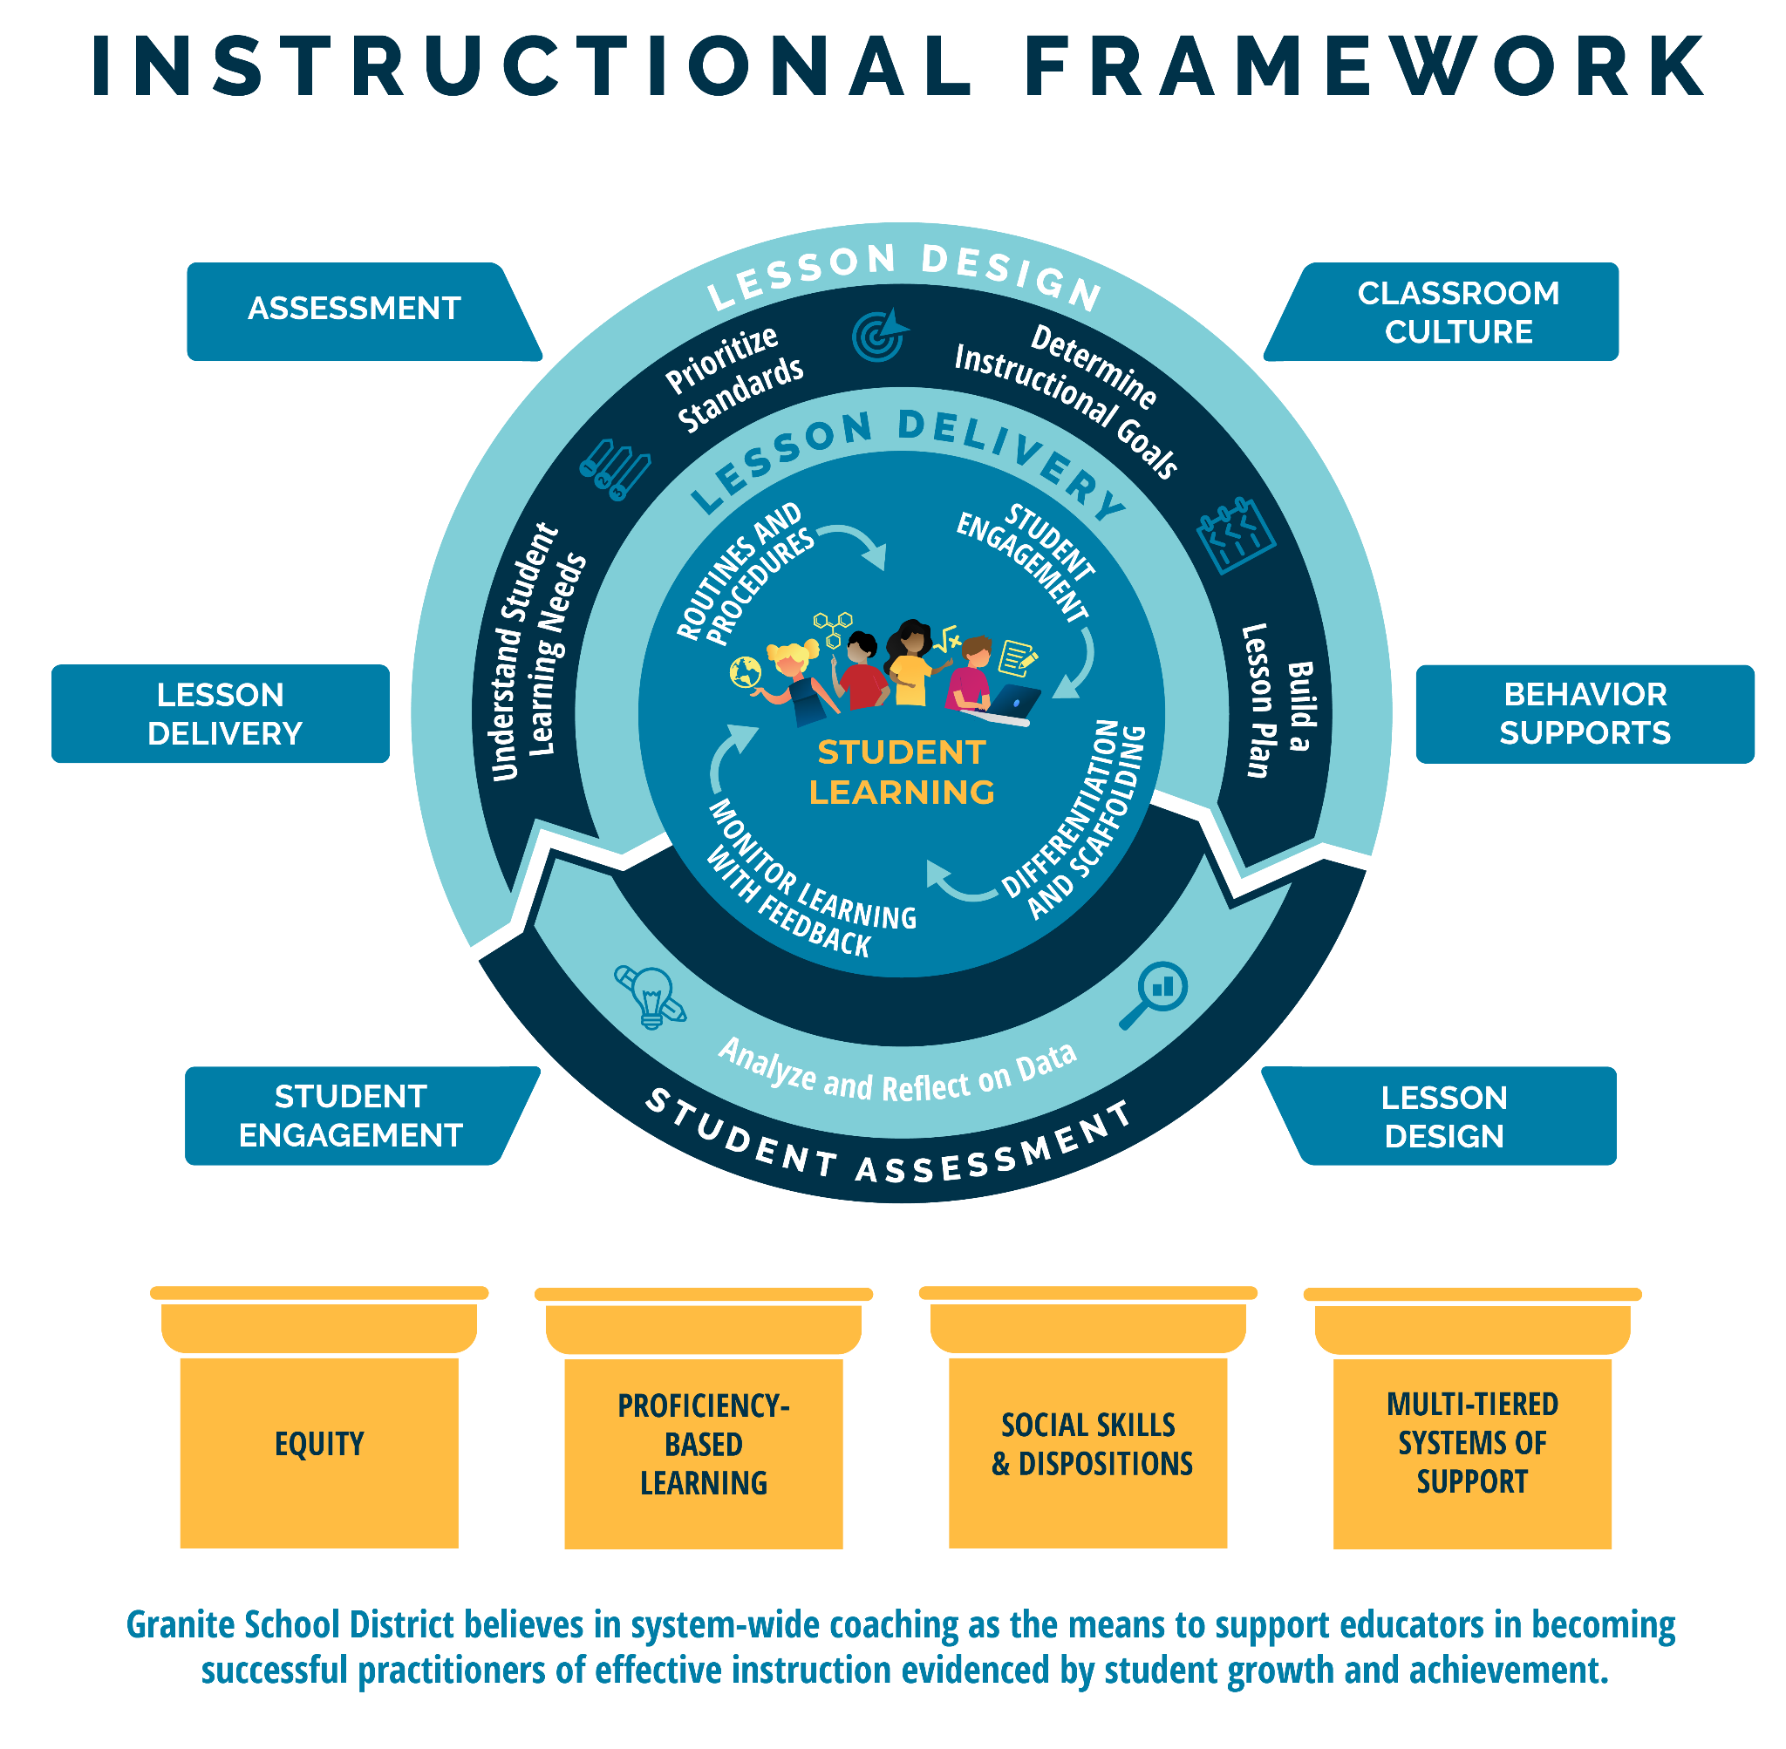
Notes:
Noelle-1 min. This is the Granite School District Instructional Framework. This framework is based on the evidence-based instructional practices embedded in the GSD Strategic Plan and represents all of Granite School District’s priorities. You will notice student learning is at the heart of the framework as it represents our commitment to student learning around which everything else is built. The framework features the basic elements of a high quality instructional cycle including Lesson Design, Lesson Delivery, and Student Assessment. You will notice the evidence-based practices at the lesson delivery level that we expect to see in what the teacher and the student are doing during the lesson. The high quality instructional cycle components are reinforced through ongoing, job-embedded coaching in: lesson design, student engagement, lesson delivery, assessment classroom culture and behavior supports, all of which contribute to meaningful learning and career and college readiness. The framework rests on the foundational pillars of Granite School District’s commitment to Equity, Proficiency-Based Learning, Social Skills and Dispositions and Multi-Tiered Systems of Support. Today we will be learning about the tools and resources in alignment with the instructional framework that will help you in your specific content areas.

Slide 13
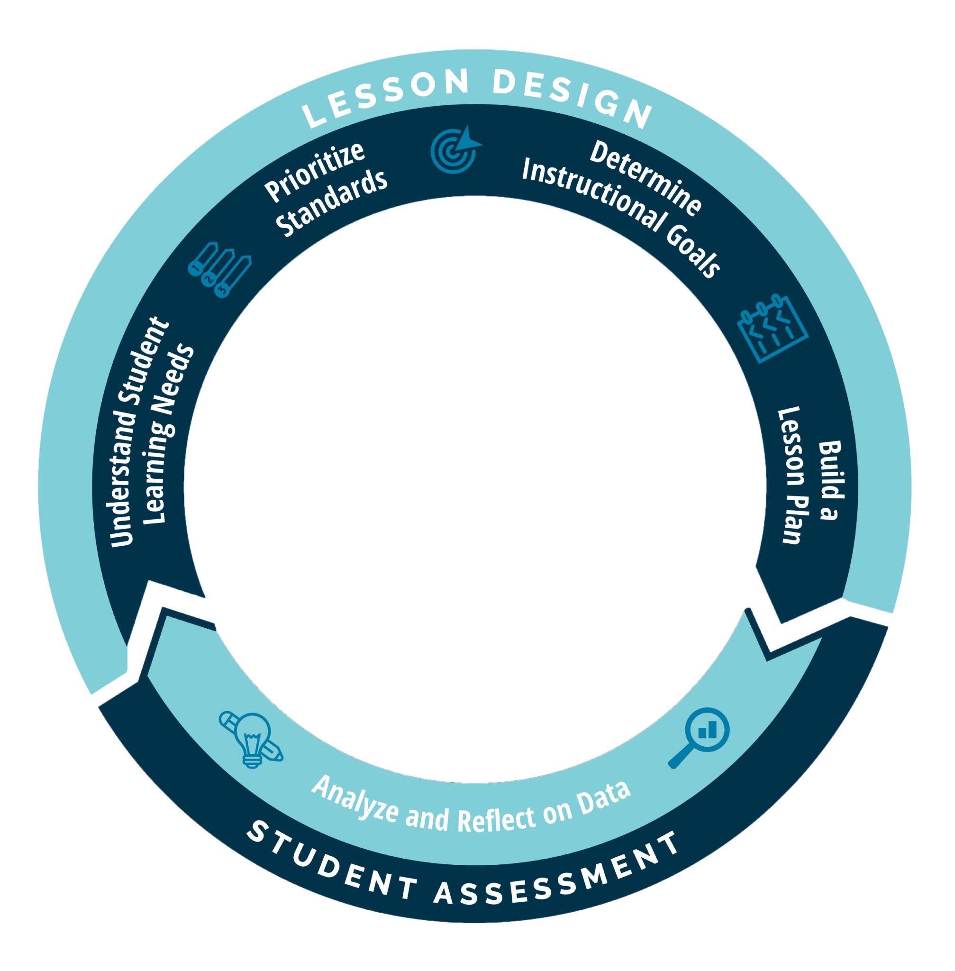
Notes:
Noelle-1 min. For the purpose of this presentation, we will be focusing primarily on the Lesson Design and Student Assessment components, and specifically within those, we will discuss Understand Student (and School) Learning Needs and Analyze and Reflect on Data

Slide 14




Determine
Instructional
Goals
Understand Student
Learning Needs
Prioritize
Standards
Build a
Lesson
Review student and school data
Scan the year’s curriculum maps to orient lesson(s) within the year’s scope and sequence
Review curricular resources from the learners’ perspective
Understand essential standards
Access proficiency scales
Organize concepts and skills from the standard into lesson(s)
Identify learning intentions
Identify success criteria
Identify the relevance of the learning
Determine design approach
Determine evidence to support learning
Develop learning tasks
Organize the components of the lesson
Lesson Design Guide
Curriculum and Instruction 2023
Notes:
Noelle-1 min. Here you see the components of lesson design. Lesson design is more than just facilitating a learning activity, It starts with a strong understanding of student and school data, followed by prioritizing core standards and determining instructional goals before the actual building of the lesson occurs. Following all of the steps allows teachers to be sure they establish clarity about the “Why, What and How” of the lessons they facilitate. It is important to know that knowledge and skill of evidence based lesson design comes with time, practice, reflection and collaboration in PLCs.

Slide 15
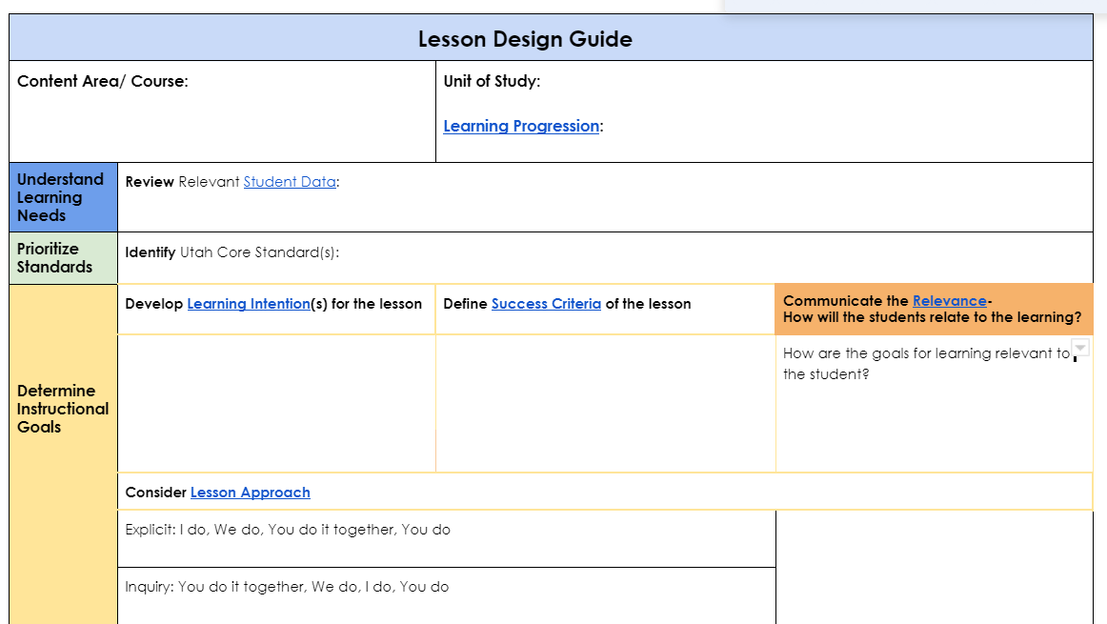
Granite School District Lesson Design Guide
September
Use of data from multiple sources to inform instruction
October
Use of district instructional tools and resources based on instructional goals
Notes:
Noelle-You have this guide as a handout. Teachers can use this to design lessons and you can use it when coaching on lesson design. Can every principal recognize when/if a teacher has well established learning intentions and goals based on what they see in a teacher observation or in a coaching conversation?
How to identify the specific evidences of good lesson design …how can you be sure it is appropriate; technology as a mask because the way it looked versus the content and the clarity of the teacher goals

Slide 16
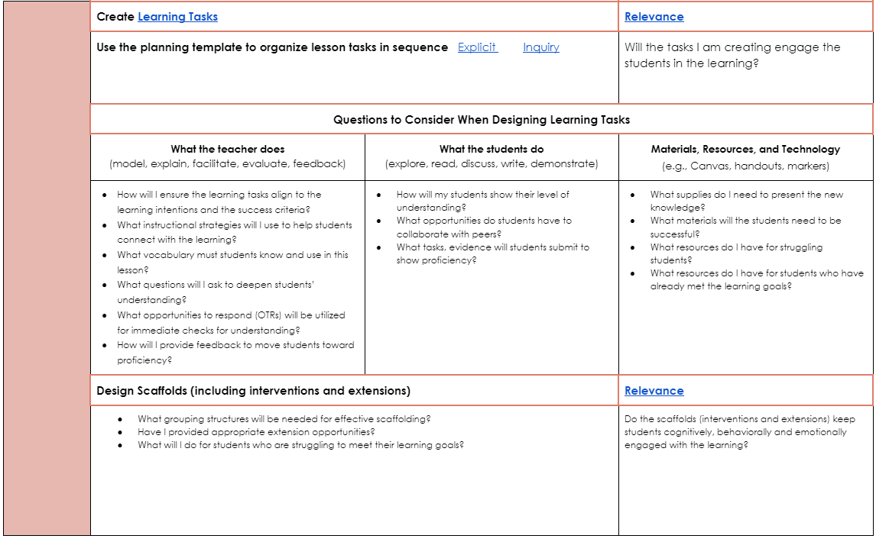
Granite School District Lesson Design Guide
November
Design of lesson using developmentally appropriate practices based on instructional goals
Notes:
Noelle-Can every principal recognize when/if a teacher has well established learning intentions and goals based on what they see in a teacher observation or in a coaching conversation?
How to identify the specific evidences of good lesson design …how can you be sure it is appropriate; technology as a mask because the way it looked versus the content and the clarity of the teacher goals

Slide 17
Structured Reflection Journal
Click Here…Principal Reflection Journals
Click on the link and find your school folder
Click on the folder with your name.
Open the reflection journal and scroll to the September reflection.
Notes:
Noelle-1 min. As part of each month’s learning, you are going to engage in reflecting on teachers and teacher teams and record using your own reflection journal. Point out, for the purpose of the journaling you need to use current staff so if you are not sure, you will have time between now and next session to complete the journal….Logistics around the structured journal; only the admin assigned to the school and the PPL team have access. The info is completely confidential but if you are concerned about the use of the info feel free to use a pseudonym. We access the info only to manage the content.
If you are new to your school, you may need to think a little about the teacher/PLC you will be targeting. Take some initial notes and then complete between now and October session

Slide 18
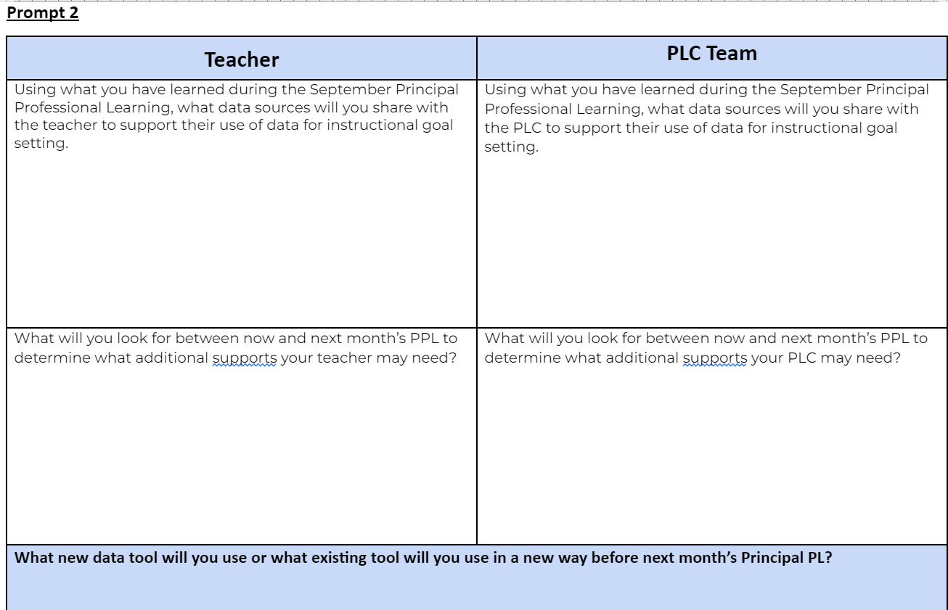
Reflect on September
Notes:
Noelle-1 min. Think about your September reflections

Slide 19
Turn and Talk- September Reflection Prompts
Discuss your reflections and any actions you took…
“What will I look for between now and next month’s PPL to determine what additional supports my teacher may need?
What will I look for between now and next month’s PPL to determine what additional supports my PLC may need?
What new data tool will I use or what existing tool will I use in a new way before next month’s Principal PL?”
Notes:
Noelle-5 min

Slide 20
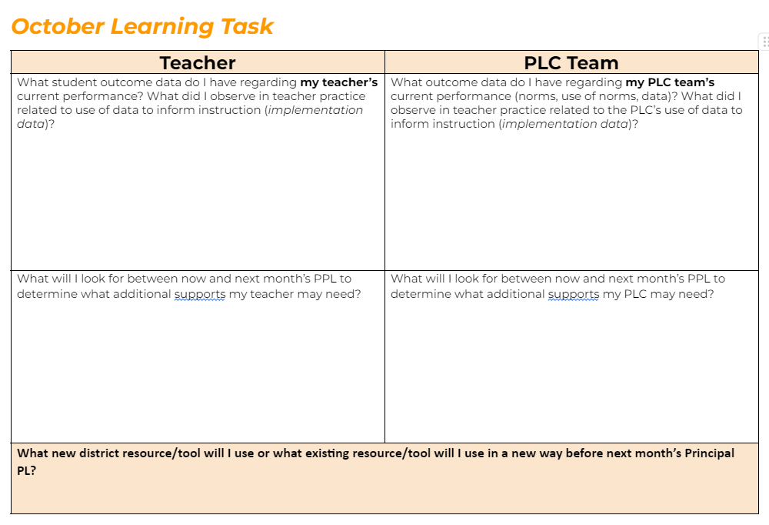
Reflection Journal Time-October
Notes:
Noelle-5 min. You will now have time to complete the top rows in your October Reflection Journal. Keep in mind we will be revisiting your reflections at the start of the November PPL

Slide 21
Content Focus for 3 months
Math Content
SCI Content
OCT
SEPT
NOV
ELA Content
Notes:
Lynne-1 min. Rationale for switching from math to ELA…using these as examples but applies to any content
Lynne presents slides 21-32

Slide 22
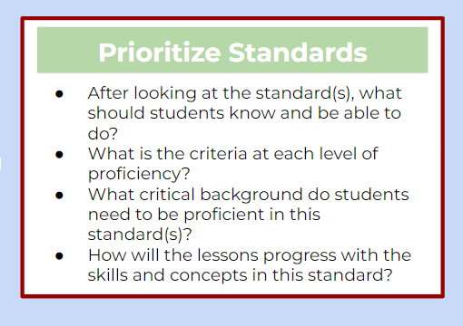
Granite School District Lesson Design Guide
Notes:
1 min- Talking specifically about ELA- The new standards have been reduced and the state considers all standards Essential Standards.

Slide 23
Prioritize the Standard-Secondary
What should the students be able to know and do?
What critical background do they need to become proficient?
How will the lessons progress over time?
Curriculum and Instruction Intranet Page
PBL Library (Proficiency Scales)
ELA Core Standards
ELA Curriculum Maps
Vertical Alignment
Notes:
2 min. Understand that all of the Prof Scales, curr maps, etc were built based on the DuFour’s model of unpacking standards and prioritizing standards. These resources are there for teachers to understand and adjust to meet their needs. Teachers need to be aware of these resources, where to find them and use them to be able to answer the above three key questions.

Slide 24
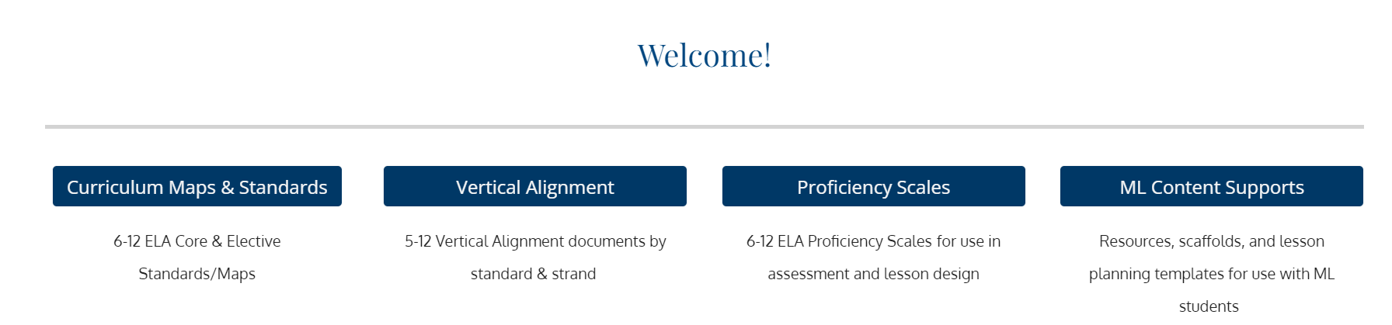
Secondary ELA Curriculum Forage Activity
Go to the Intranet and click Old Intranet Site
Click on Departments, and Curriculum and Instruction
Click on Secondary Pages, then English Language Arts
Below the page name, you will see four BLUE four tabs
GSD Secondary ELA Resources
Notes:
15 min next 4 slides On the following slides you will complete or compete (if that’s in your nature) in a foraging activity on the Curriculum and Instruction Intranet site to find the answers to specific questions about the crosswalk and vertical alignment for the 3.R.8 standard:

Slide 25
ELA Resource Forage Activity-Group Work
Directions
Identify the fastest phone app loader in your group.
The phone app loader will load the app and be your answer recorder in the activity.
Only the app loader at the table follows the directions on the next page.
Team members will each use your computers to FORAGE for the answers on the ELA Intranet Page.
Team members will let the recorder know when they find an answer so the recorder can add the answer in the app.
Notes:
Identify the fastest phone app loader at your table
This person will also be your recorder in the activity
The app loader at the table follows these directions
Team members will use your computers to FORAGE for the answers.
Let your recorder know what you find so they can take a pic or enter the info into the app.

Slide 26

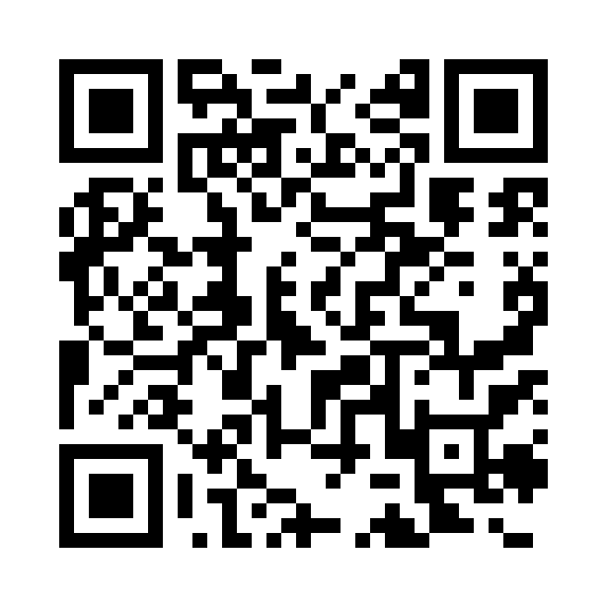
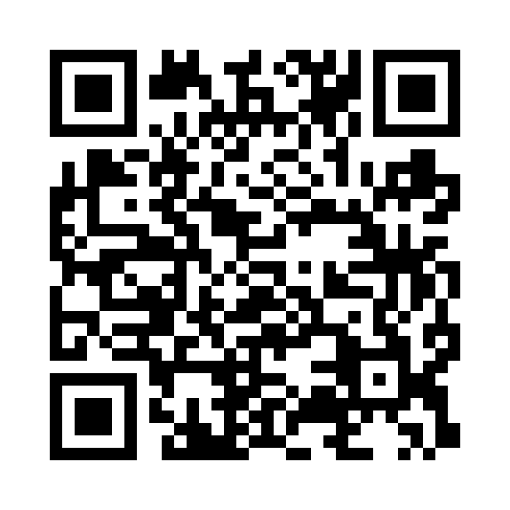


ELA Resource Forage Activity
App Loader/Recorder: Download the app- Goosechase
Apple Phones Android Phones
Join as a Guest 2. Enter Join Code: P869J1
3. Create Team Name 4. Hold up phone when ready

Slide 27
Quick think…
Thinking of the activity we just completed, how will these resources help you better support your teachers in their lesson design?
How could you use the Goosechase tool with your staff and students?
Notes:
1 min. Activity Debrief
Purpose for using the crosswalk - to know the changes in the updated core and how that may impact their planning.

Slide 28
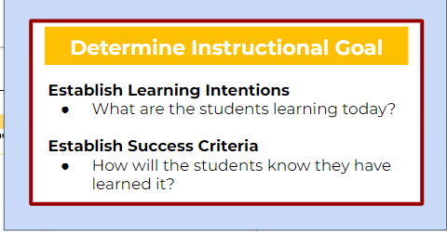
Granite School District Lesson Design Guide
Notes:
2 min Discussion:
These curriculum resources shoulds help our teachers implement clear learning intentions and success criteria in their daily teaching.
Makes giving feedback easier and more efficient

Slide 29
Basic Elements of Lesson Design
Develop
Learning Intentions
A statement developed by the teacher to clearly describe what they want students to know and be able to do.
Based on one or more core standards.
Helps the teacher establish clarity about what students will learn during the learning tasks within lesson.
Sometimes Called:
Learning Objectives
Learning Goals
Learning Targets
Essential Questions
Content Objectives
Notes:
Lynne - 2 minutes
So important to establish clarity about what you are going to teach. This guides all of the other elements and the clearer the teacher is about intentions, the more targeted, intentional and relevant the rest of the lesson will be. There are a variety of synonyms for learning intentions and success criteria. What are some others? Learning Targets/Essential questions, This is our Granite Common Vocabulary derived from Fisher and Frey and Karin Hess work. What matters is not the title but the purpose of each. The intentions help the teacher to establish clarity about the lesson in the scope of the learning progression, unit of study so that he/she can be more intentional about developing success criteria, learning tasks and strategies. Success criteria give the students access to clearly understand the learning intention in easy language step by step or in smaller incremental expectations.
What does this do for students? Hattie effect size…more focused for longer periods of time • more motivated and active in their learning • better able to take responsibility for their own learning
Learning goals vs no goals: .68
Feedback: .70

Slide 30
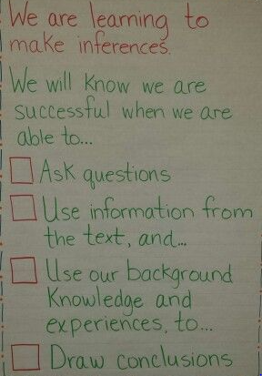
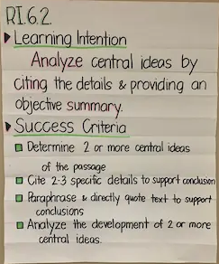
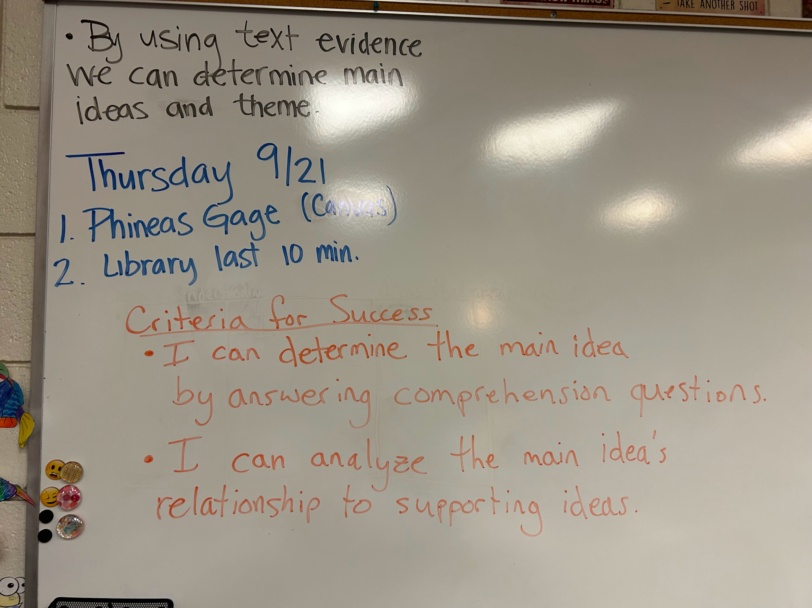
Learning Intention Examples
Notes:
2 min Can be a simple statement about what learning is about to happen

Slide 31
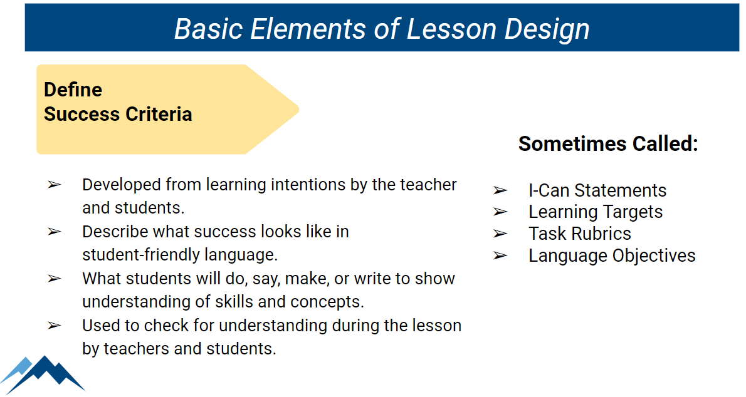
Notes:
2 min Success criteria give the students access to clearly understand the learning intention in easy language step by step or in smaller incremental expectations.
Noelle presents slide 33-end

Slide 32
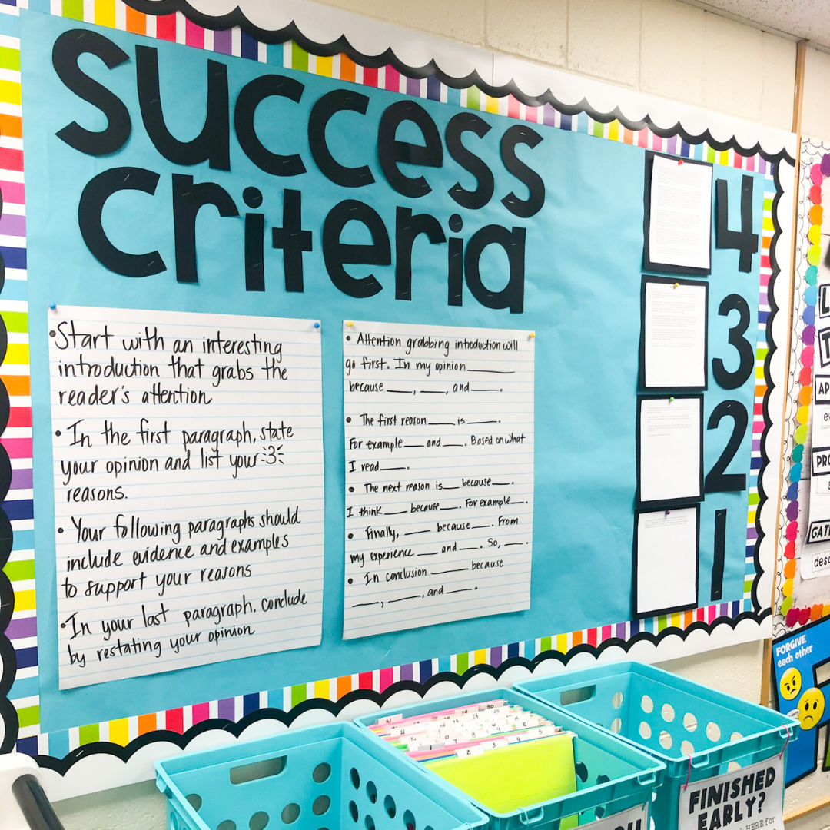
Success Criteria Can Look Like:
Common understanding developed from learning intentions by teacher and students
Teacher or student model
I can statement
Rubric
Exemplar
Developing Success Criteria
Notes:
2 min No matter what form it takes, it should define what success looks like. (for the lesson, task, evidence, standard, etc.)

Slide 33
Granite School District Lesson Design Guide
What is the best approach for your lesson?
Where are the students at in the learning stages?
Determine Lesson Approach
Notes:
2 min What are the advantages of having this kind of clarity in your daily teaching?
Clarity for grade-level teams on expectations
Clarity for students to be able to self-assess
Makes giving feedback easier and more efficient

Slide 34
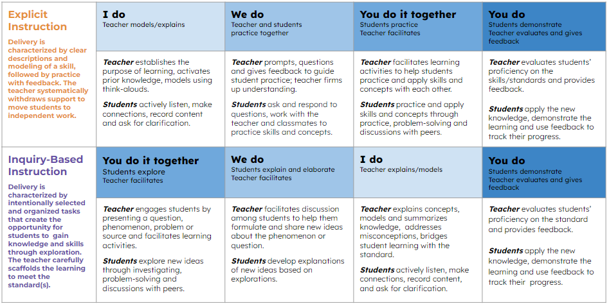
Based on the standard(s) and goals of the lesson
Selected to best meet students’ immediate learning needs
Flexible based on needs
Consider
Lesson Approach
Notes:
2 min Use the graphic to explain simplicity of each style, and how you can weave in and out within a single lesson based on student response and need.
After teachers are clear on learning intentions and success criteria, they start to think about the actual lesson and how to approach it and these are things to keep in mind when determining which approach is best for the goals of the lesson.

Slide 35
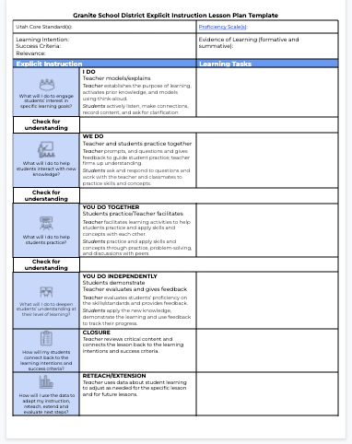
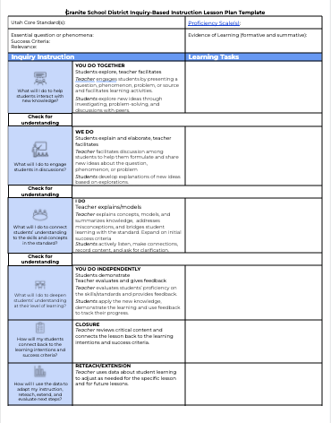
Inquiry & Explicit Templates
Notes:
2 min Two general approaches - value in both… Talk about the differences , commonalities, when/how do you determine which one is appropriate for which lesson

Slide 36
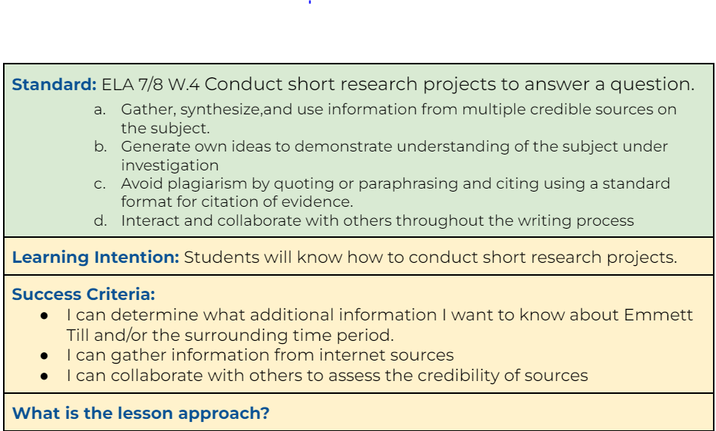
Identify the Lesson Approach: Is it Explicit, Inquiry or Blended?
Look at the features of Example 1 what does it tell you about the lesson approach?
INQUIRY
What is the value of using an inquiry-based approach in general?
What value does it provide for students in relation to this standard and learning intention?
Notes:
15 min next 4 slides Questions-Why do teachers shy away from inquiry-based instruction?
How can we support teachers in their selection of lesson approach?

Slide 37
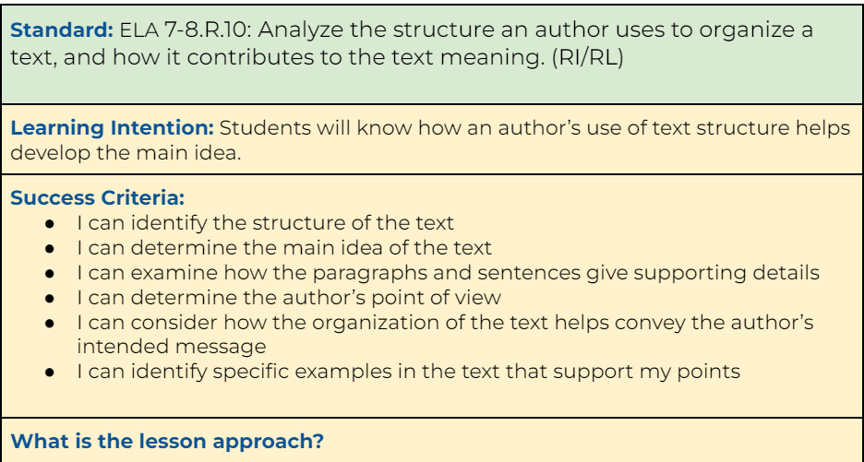
Identify the Lesson Approach: Is it Explicit, Inquiry or Blended?
Look at the features of Example 2, what does it tell you about the lesson approach?
EXPLICIT
What is the value of using an explicit approach in general?
What value does it provide for students in relation to this standard and learning intention?

Slide 38
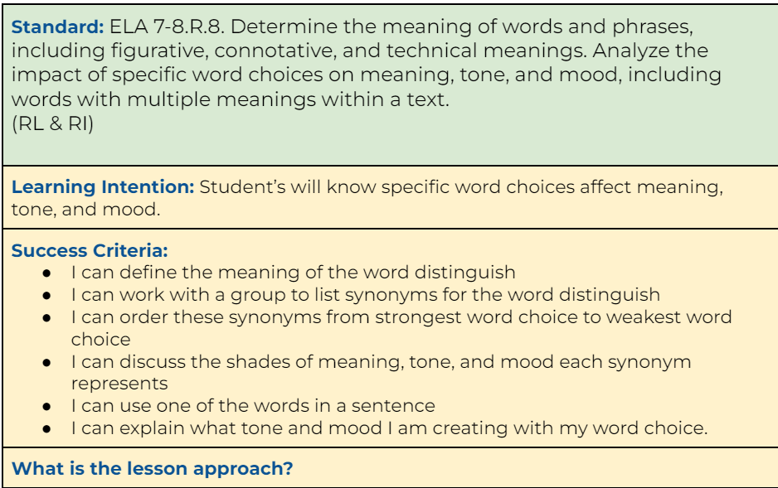
Identify the Lesson Approach: Is it Explicit, Inquiry or Blended?
Look at the features of Example 3, what does it tell you about the lesson approach?
BLENDED
What is the value of using an blended approach in general?
What value does it provide for students in relation to this standard and learning intention?

Slide 39
Structured Reflection Journal
Click Here…Principal Reflection Journals
Click on the link and find your school folder
Click on the folder with your name.
Open the reflection journal and scroll to the October reflection.

Slide 40
Reflection Journal Time-October
Notes:
10 min journal You will now have time to complete the top rows in your October Reflection Journal. Keep in mind we will be revisiting your reflections at the start of the November PPL

Slide 41

Principal Professional Learning Survey
Please give us your feedback:
Survey
Notes:
3 min

Slide 42

Links to Tools and Resources
Reflection Journal Link
Instructional Framework
Lesson Design Model
Lesson Design Website
Lesson Design Guide
Lesson Approaches
Student Learning Stages
Lesson Design Professional Learning Opportunities

