Slide 1
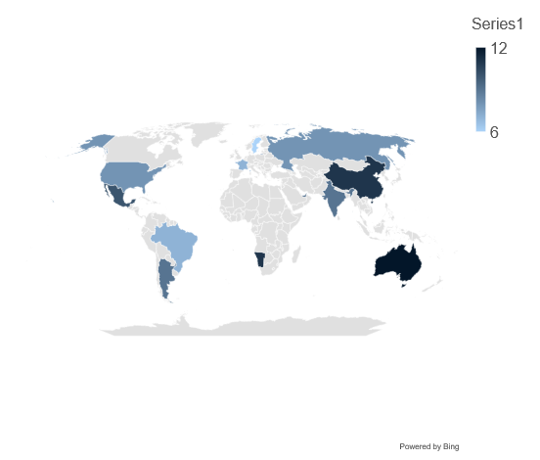
Map / Stacked Column Chart
Click to edit Header text styles
Click to edit Header text styles
Source: Complete if required

