Slide 1
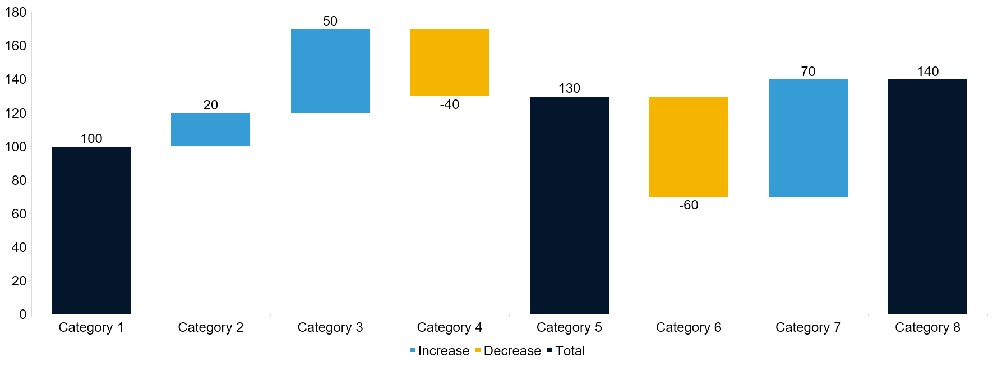
Waterfall Chart
Chart Title

