Slide 1
Programmatic analysis
1
Using a programming language to analyze data

Slide 2
What does a computer program do?
2
Load data from permanent memory or other inputs to RAM
(I/O read)
Manipulate or generate new data in RAM
(automated or with human interaction)
Show results to user ...or...
Save derived data from RAM back to permanent memory
(I/O write)

Slide 3
R: programmatic data analysis
3
Scripting language: Programs are interpreted line by line and executed by a runtime environment (e.g. through a console interface)
Examples: R, Matlab, python, perl, javascript
Compiled language: Programs are translated into a machine language that is subsequently executed by an operating system
Examples: C, C++, C#, Fortran, Java (but uses a virtual processor)
Is there a difference:
In what you can accomplish? Not really...
In how it is accomplished? Definitely

Slide 4
R: programmatic data analysis
4
c
Scripting language: Programs are interpreted line by line and executed by a runtime environment (e.g. through a console interface)
Higher level: more can be done with fewer lines of code.
Good for step-by-step processes.
Compiled language: Programs are translated into a machine language that is subsequently executed by an operating system
Lower level: can be optimized for faster performance for specific tasks
Good for complex multitasking or event based computing.

Slide 5
5
R: software stack for using RStudio
RStudio Integrated Development Environment (IDE)
Console
Environment
Files
Plots
R Console
Workspace
RStudio text editor
RStudio file manager
Rstudio graphics viewer
R Runtime Environment
Operating system (Windows, OSX (BSD))
File system (NTFS, HFS+)

Slide 6
6
R: setting up the runtime environment
Calling functions and the help() function or ? Operator. (F1 on Windows)
RStudio Integrated Development Environment (IDE)
Console
Environment
Files
Plots
Installing and using packages and libraries: install.packages() and library() functions
R Console
Workspace
RStudio text editor
RStudio file manager
Rstudio graphics viewer
R Runtime Environment
Using the ‘swirl’ training packages for R: http://swirlstats.com/
Operating system (Windows, OSX (BSD))
File system (NTFS, HFS+)

Slide 7
7
R: writing scripts
Avoiding bugs with rm(list = ls()) at the beginning of your script
Comments in R scripts start with a ‘#’ character
Running code from the script editor in RStudio
Running code with the source() function
R markdown
RStudio Integrated Development Environment (IDE)
Console
Environment
Files
Plots
R Console
Workspace
RStudio text editor
RStudio file manager
Rstudio graphics viewer
R Runtime Environment
Operating system (Windows, OSX (BSD))
File system (NTFS, HFS+)

Slide 8
8
R: organizing the workspace
The workspace has a global environment where you will define a list of ‘variables’ that reference assigned ‘objects’
RStudio Integrated Development Environment (IDE)
Console
Environment
Files
Plots
R Console
Workspace
RStudio text editor
RStudio file manager
Rstudio graphics viewer
R Runtime Environment
A big part of software science and engineering is finding the best ontological strategy for organizing objects.
Operating system (Windows, OSX (BSD))
You save a lot of time in the long run if you first take the time to learn the details of data structure for a new programming language
File system (NTFS, HFS+)

Slide 9
Managing variables in R
9
Variables organized within environments allow you to give a name to
space in RAM
Use <- to assign an object to a variable (the operator = also works, but means something different in select situations). Typing the variable name in the console provides a summary of the associated object.
The function ls() lists the variables in the current environment, which is by default the global environment
The function rm() will remove a variable from the global environment. The function exists() allows you to check if a variable is present in an environment.

Slide 10
Data types in R: the fundamentals
10
Atomic vector of mode “double”
The runtime engine has to know the type or class of an object to know how to make space for it in RAM.
If not defined specifically, R will assume a type for the variable based on the value being assigned (not all languages are like this). Convenient for fast coding, but dangerous for creating bugs that are hard to find.
The irreducible data type in R is an atomic vector, or a ‘vector’ of a given ‘atomic’ type (e.g., ‘double’, ‘integer’, ‘logical’, ‘character’)
The typeof() function applied to an atomic vector will return the primitive type of the vector elements.
[1]
Real number
[2]
Real number
[3]
Real number
[n]
Real number

Slide 11
R Internal types: creating atomic vectors
11
The c() function will combine an arbitrary list of values into a vector
  If not of same type, R will force to the most abstract type
Colon operator <from value>:<to value> is a quick way to create a sequential integer vector
The seq() function will create regular sequences of numeric vectors
For allocating memory for a vector without defining values
  Formal constructor function is vector(mode=<atomic type>,...)
  Convenience constructors numeric(), integer(), logical(), character()

Slide 12
R Internal types: indexing vectors
12
Numerical indexing using single square brackets [<index>], and R indices start with ‘1’ (not ‘0’ like many other languages, x[0] has other meaning in R)
The index is expecting a vector, so a vector of any number integers can be used to return multiple elements
  e.g. x[3:5] would return the 3rd through 5th elements of the vector
  or x[c(3,5)] would return the 3rd and 5th elements of the vector
A vector of logical values can be used to mask a vector and return only the elements with a TRUE value in the index
  e.g. ‘x[c(FALSE, FALSE, TRUE, TRUE, TRUE)]’ is the same as ‘x[3:5]’
Indices can be named. Use the names() function to access names for the indices.

Slide 13
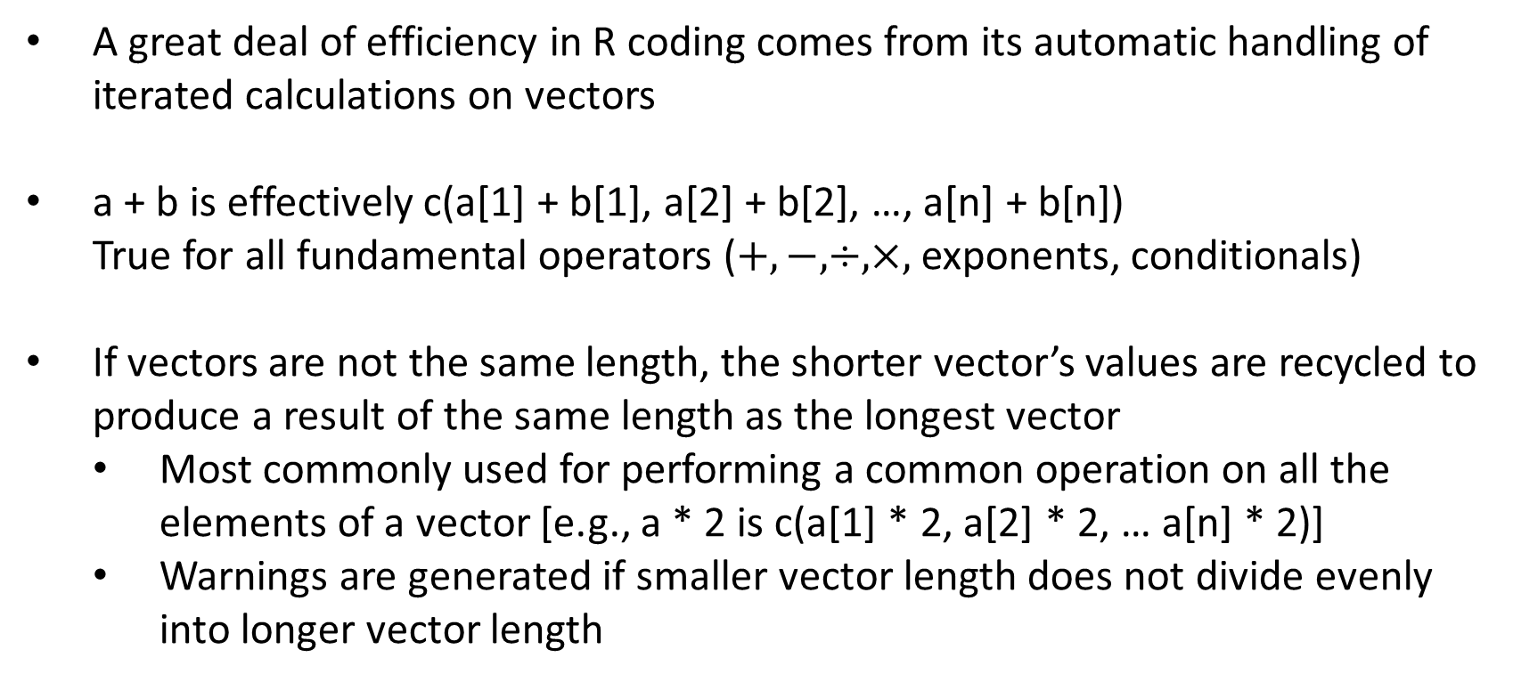
R Internal types: operations with vectors
13
A great deal of efficiency in R coding comes from its automatic handling of iterated calculations on vectors
a + b is effectively c(a[1] + b[1], a[2] + b[2], …, a[n] + b[n])
True for all fundamental operators ($+, −, ÷,×,$ exponents, conditionals)
If vectors are not the same length, the shorter vector’s values are recycled to produce a result of the same length as the longest vector
  Most commonly used for performing a common operation on all the elements of a vector [e.g., a * 2 is c(a[1] * 2, a[2] * 2, … a[n] * 2)]
  Warnings are generated if smaller vector length does not divide evenly into longer vector length

