Slide 1

The Granite Way
Professional Learning
Ability to differentiate the application of equitable practices.
Ability to additionally differentiate instruction and structure the learning environment toward diverse learning preferences, learning histories and social-emotional needs of our students.
February 2022 Instructional/Student Learning Process
Expanded Instruction and Support
Notes:
Link to Folder with all materials and resources in this presentation:
https://drive.google.com/drive/folders/1KWxU4FYah9drt_53z4mt2BXd7YMdFOl8?usp=sharing
We have created this presentation for administrators to take and adapt to their school situation. Each part of this presentation could be an entire PD and we will not be able to cover everything you need to know about these objectives.

Slide 2

Go to graniteway.org to follow along and access all current and previous materials
Notes:
Invite participants to visit this website for the materials they need for today’s presentation as well as those for their own presentation to staff.

Slide 3
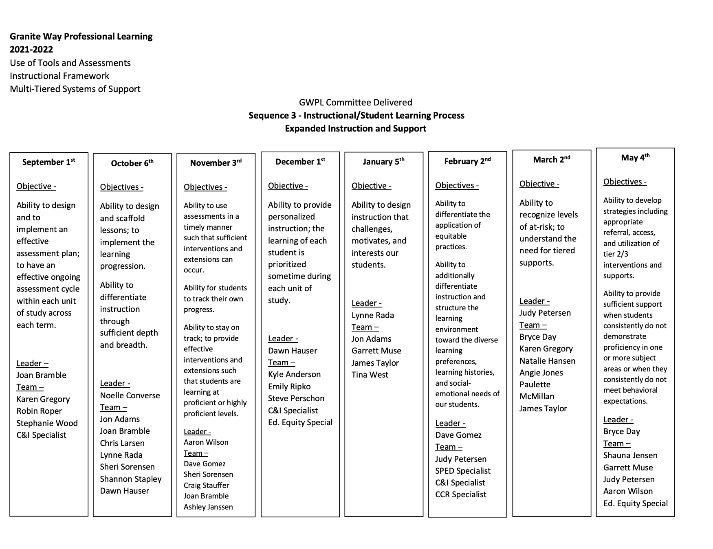
Leader: Dave Gomez
Team:
Rebecca Ibarra - Ed Eq
Brooke Holyoak - Ed Eq
Ashley Janssen - Ed Eq
Shannon Stapert - Ed Eq
Marnie Bertoch - C&I
Christine Christensen - Admin
Angela Jones - MTSS
Sheri Kennedy - SpEd
Jodi Lusty - FACE
Alaina Wilcock - FACE
Notes:
Time: 1 minute
Speaker notes: As you likely just discussed with your partner, last month we explored engagement and the challenges, motivations of students.
If we go a month back to our December training, we will recall that we discussed differentiation. We looked at resources to personalize the learning based on students interests and needs. We looked at an example of how we can support learners during a learning task. We are going to continue building on personalized learning by looking at equitable practices.
I’m excited to introduce today’s learning objectives which continues this year’s goal of providing students multi-tiered systems of support….

Slide 4


Our work centers on five essential practices that promote student achievement.
Our commitment to student achievement is non-negotiable.
Notes:
Time: 1 minute
Speaker notes: The Granite Way professional learning topics stem from Our Charge and Responsibility from the Granite Board of Education and our Superintendent. Several years ago, the District established the Granite Way as the 5 essential practices that must be evident in our daily work and outcomes. These demonstrate our non-negotiable commitment to student success. This month, we are focusing on Instructional Framework and MTSS.

Slide 5

Objectives
Learning Target:
Participants will understand how to differentiate the application of equitable practices.
Participants will understand how to differentiate instruction and structure the learning environment to meet the needs of diverse learners.
Success Criteria:
Participants will be able to define equity.
Participants will be able to identify and apply appropriate evidence-based strategies to ensure equitable practices in the classroom and school.
Notes:
Read individually or have a person in the group read it.

Slide 6
January Revisited
Students must feel safe and be held to high expectations. Student engagement occurs when students make a psychological investment in learning.
Notes:
Time: 5 minutes
Share with a partner at your table how you have applied the objectives from the January GWPL. Discuss why some students are not ready to be engaged with learning. Tie into the concepts of this PD that we will look at ideas to increase student engagement in learning. Elementary principals may not have conducted a GWPL presentation due to LETRS - if this is the case, respond to how you incorporated or highlighted the topic and objectives with your faculty.
Invite pairs to share out.

Slide 7
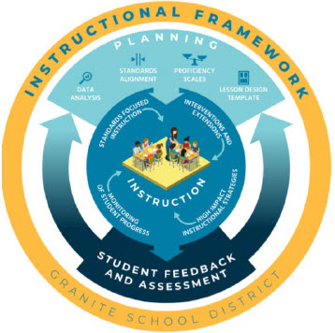
Granite’s Instructional Framework
Planning and Instruction for Equitable Practices
Planning
High Impact Instructional Strategies
Notes:
Time: 1 minute
Presenter notes: The two stated objectives are embedded in our GSD Instructional Framework. In order to create a culture of learning and effectively motivate and engage our students, we must first start with planning which includes high impact instructional practices. As principals, we support teachers in their planning with this professional development and district provided resources.

Slide 8
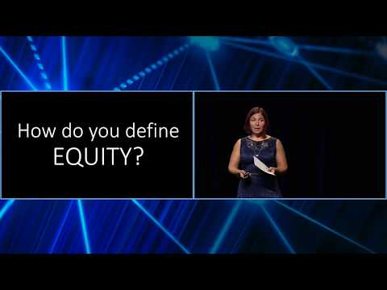


Definition of Equity
Elena Aguilar is a best-selling author, speaker, consultant and trainer who has worked across the United States and internationally in the field of adult learning.
Notes:
Video Clip: 4:24-9:24
Pause during video to do the quickwrite (4:50). Take just a moment to think for yourself about how you define equity. Let a few words or phrases come to mind. (1 minute to write down your thoughts and definition of equity).
After watching this clip is there anything you would like to change about your definition of equity? One minute to reflect any changes.

Slide 9
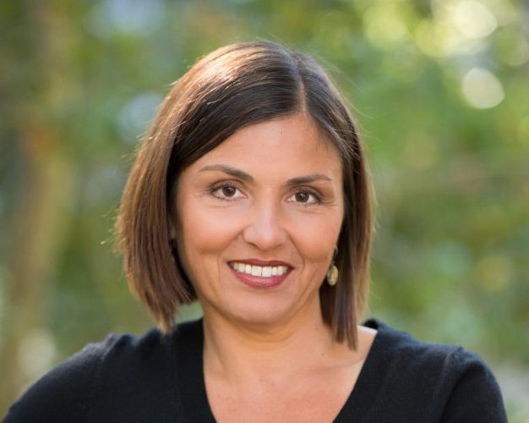
What is Equity?
Equity means that every child gets whatever they need in order to be successful and to thrive in school EVERY day.
Every Child, Every Day!
Regardless of race or ethnicity
Regardless of socioeconomic status
Regardless of languages spoken at home
Regardless of gender or sexual orientation or religion or ability
Every Child, Every Day. Period.
Elena Aguilar 2017
Notes:
Read as a group.
Other Discussion Points from Aguilar:
“Students need to thrive academically, as well as social emotionally. And they need and they deserve to feel loved for and cared for and that they belong to a community.”
“Equity is about belonging. And in order to belong we must be seen for who we are…Being seen in our entirety.”

Slide 10
What is Equity About?
Equity is about individuals, relationships, and systems. An organization that is equitable is one in which we value and honor each person for who they are and provide the structures, environment, and resources each person needs to fully participate and reach their greatest potential. Equitable organizations see their role in, and contribute to, the long-term impact of creating a more just world.
For equity initiatives to succeed, we believe that educators must focus on shaping inclusive environments intentionally designed to foster a sense of belonging by honoring the dignity of each and every person.
Cobb and Krownapple, 2019
Notes:
Table Talk - How does your definition compare Elena Aguilar and Cobb and Krownapple? What can you take from these definitions including your own? What stands out to you that would align and fit within your current continual improvement plan? (CIP) 5 minutes
Discussion Points:
Consider different aspects of equitable practices, not just race and language. Think religion, values and beliefs, socio-economic, gender, sexual orientation, etc.
Equal Outcomes = Christmas gifts/parties, High School Graduation, PBL - proficiency on grade level core
“Equity is about outcomes…But also belonging. Look for indicators of inequity in test scores and graduation rates and also look in the less obvious places like in the christmas gift exchange when the student who can't afford the $5 gift feels like she doesn’t belong. And the muslim child feels that in order for him to belong he needs to celebrate christmas.” Elena Aguilar
“Define Equity. What does it mean in your classrooms and your schools? In order to create something, you have to have a vision for that.” Elena Aguilar
Possible ways to facilitate this discussion with your staff: Padlet, Socrative, Graffiti Wall, T Chart

Slide 11
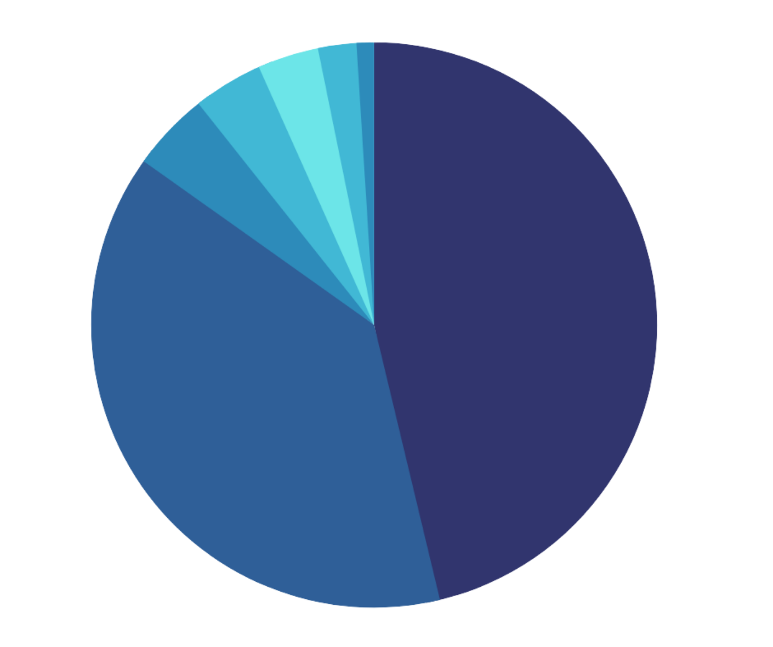



Snapshot of
Multiple Race 2%
American Indian 1%
African American/ Black 3.5%
Asian 4%
Pacific Islander 4.5%
White 46%
Hispanic 39%
21-22
Student Demographics
District Enrollment
60371
Notes:
The following data builds the case for why equity is important and demonstrates the need for it in our district. We’re going to look through a little bit of data and then we’ll pass out some more for your data discussion, as well as taking a chance to pull up some of your own schools data.
Principals are encouraged to adapt these slides to represent the data at their schools.
Use of this data may be helpful when deciding the focus of the equity taxonomy to follow.

Slide 12
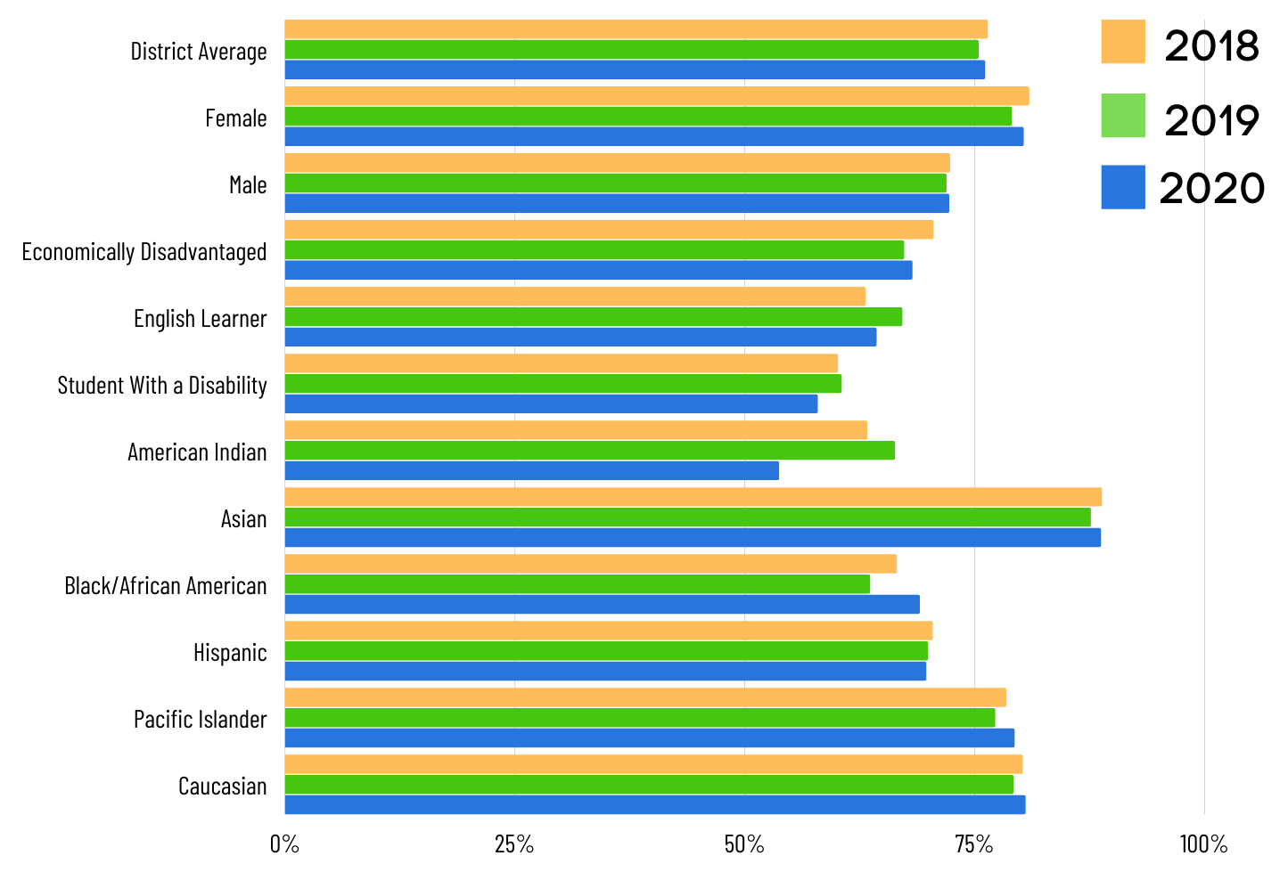
Graduation Rates
Notes:
Elementary: How does our work in elementary school affect graduation rates?

Slide 13
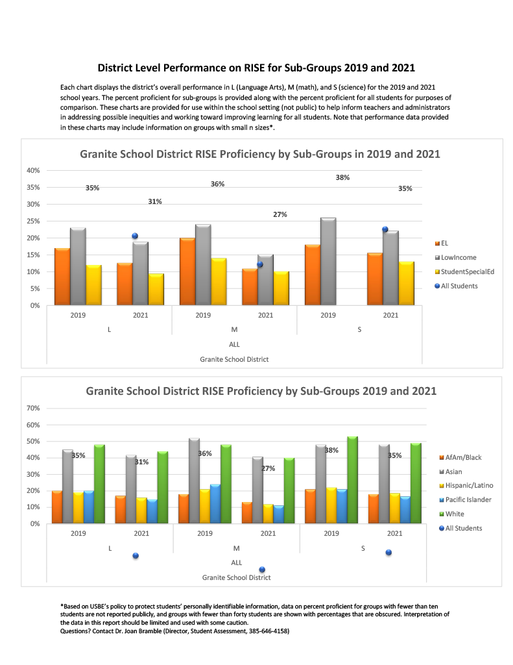
RISE Proficiency
Notes:
Each chart displays the district’s overall performance in L (Language Arts), M (math), and S (science) for the 2019 and 2021 school years. The percent proficient for sub-groups is provided along with the percent proficient for all students for purposes of comparison. These charts are provided for use within the school setting (not public) to help inform teachers and administrators in addressing possible inequities and working toward improving learning for all students. Note that performance data provided in these charts may include information on groups with small n sizes*.

Slide 14

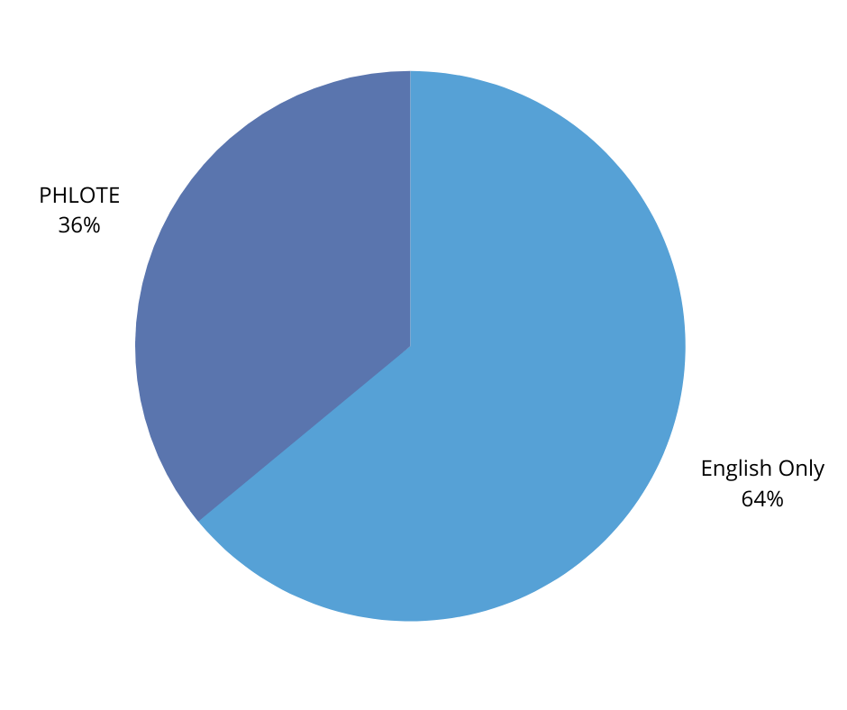
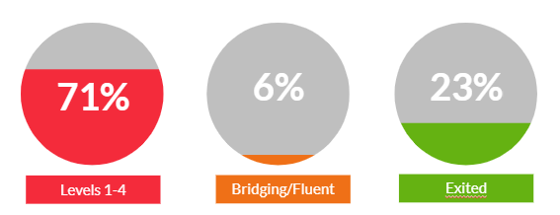
Student Statistics 2021-2022
PHLOTE = Primary Home Language Other Than English
Exited 7%
Total Multilingual Learners
19327
Bridging/Fluent 2%
MLs Receiving ELD Services 23%
PHLOTE
32%
Primary Language of English
68%
60371
District Enrollment
Notes:
Nearly ⅓ of our district enrollment are classified as MLs
English Learner or English Language Learner continue to be commonly recognized terms when discussing students that are learning English. In a conscious effort to shift our focus to asset-based thinking we have shifted to the use the term multilingual learner or ML. Laws written as ELs
The term multilingual learner helps us recognize and appreciate the benefits of students becoming literate in multiple languages and encourages us to consider the assets our students bring to the classroom.

Slide 15
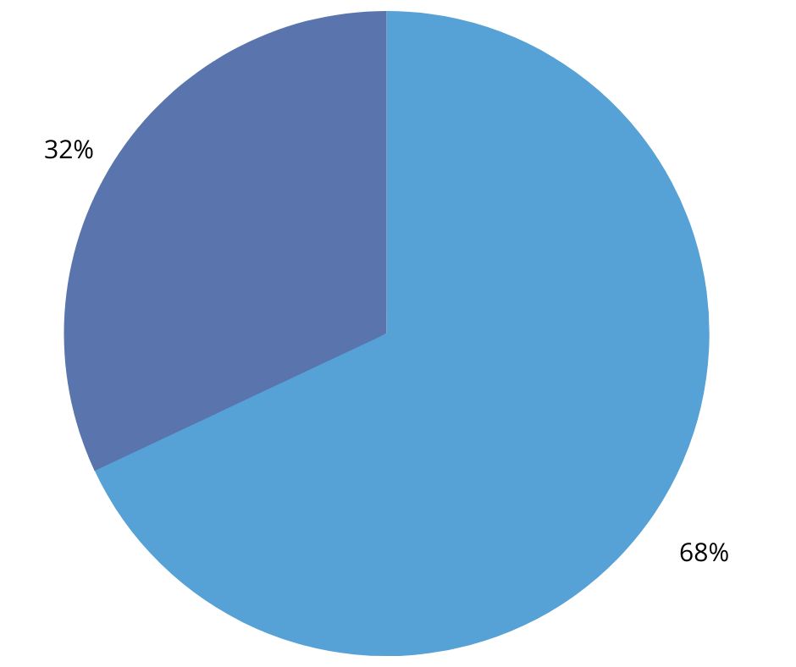
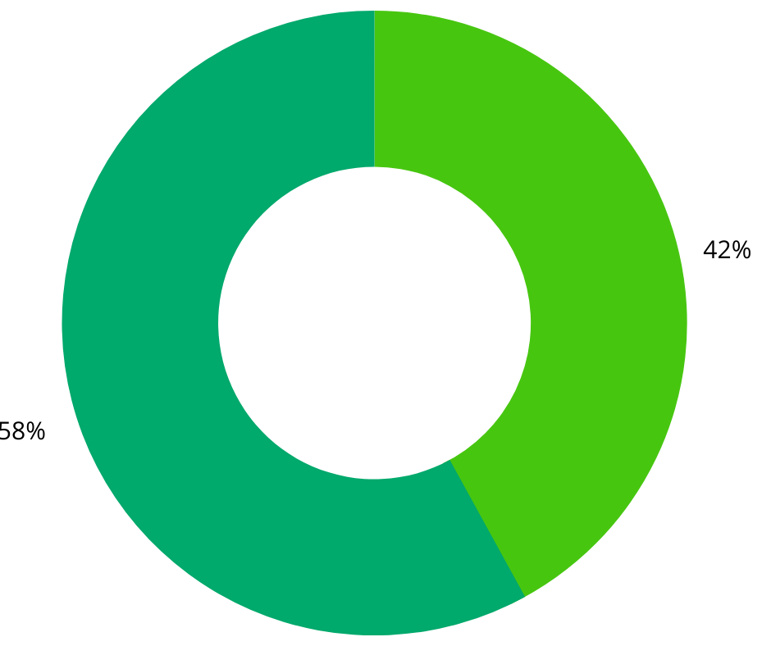
Long Term English Learners (LTELs)
have been in US schools for 6+ years and have not exited from Language Assistance Services
68% of Secondary MLs receiving language services are Long Term English Learners
(Grades 6-12)
68%
4942
42%
MLs in grades 6-12 have exited
Language Assistance Services
*of 11649 total
Notes:
68% of secondary MLs receiving services are LTELs
So 39% of all 6th to 12th grade ML students are Long term ML.
What are the implications of our current equitable practices if almost 40% of our MLs haven’t demonstrated proficiency in English over the course of 6 or more years?

Slide 16

Suspensions
Office Referrals
Source: Discovery
Source: Educator’s Handbook
as of | 1/24/22 | 20-21 | 19-20 | 18-19
Total Suspensions | 972 | 863 | 1588 | 2369
Female | 35% | 28% | 26% | 27%
Male | 65% | 71% | 74% | 73%
Economically Disadvantaged | 63% | 63% | 63% | 67%
English Learners | 34% | 31% | 27% | 27%
Special Education | 27% | 29% | 26% | 29%
African American | 12% | 9% | 8% | 10%
American Indian | 3% | 3% | 2% | 3%
Asian | 3% | 3% | 2% | 2%
Caucasion/White | 35% | 39% | 42% | 41%
Hispanic | 41% | 41% | 39% | 38%
Pacific Islander | 6% | 6% | 7% | 5%
as of | 1/24/22 | 20-21 | 19-20
Total Office Referrals | 11833 | 14210 | 24084
Female | 3344 | 4011 | 6790
Male | 9036 | 10922 | 18361
IEP | 3596 | 4361 | 7688
504 | 701 | 891 | 1335
ELL | 4303 | 5190 | 8142
African American | 1407 | 1698 | 2886
American Indian | 326 | 297 | 688
Asian | 423 | 419 | 786
Caucasion/White | 5705 | 7021 | 11484
Hispanic | 4797 | 5847 | 9689
Pacific Islander | 727 | 770 | 1596
Notes:
African American students make up 3.5% of district enrollment but 12% of all suspensions

Slide 17
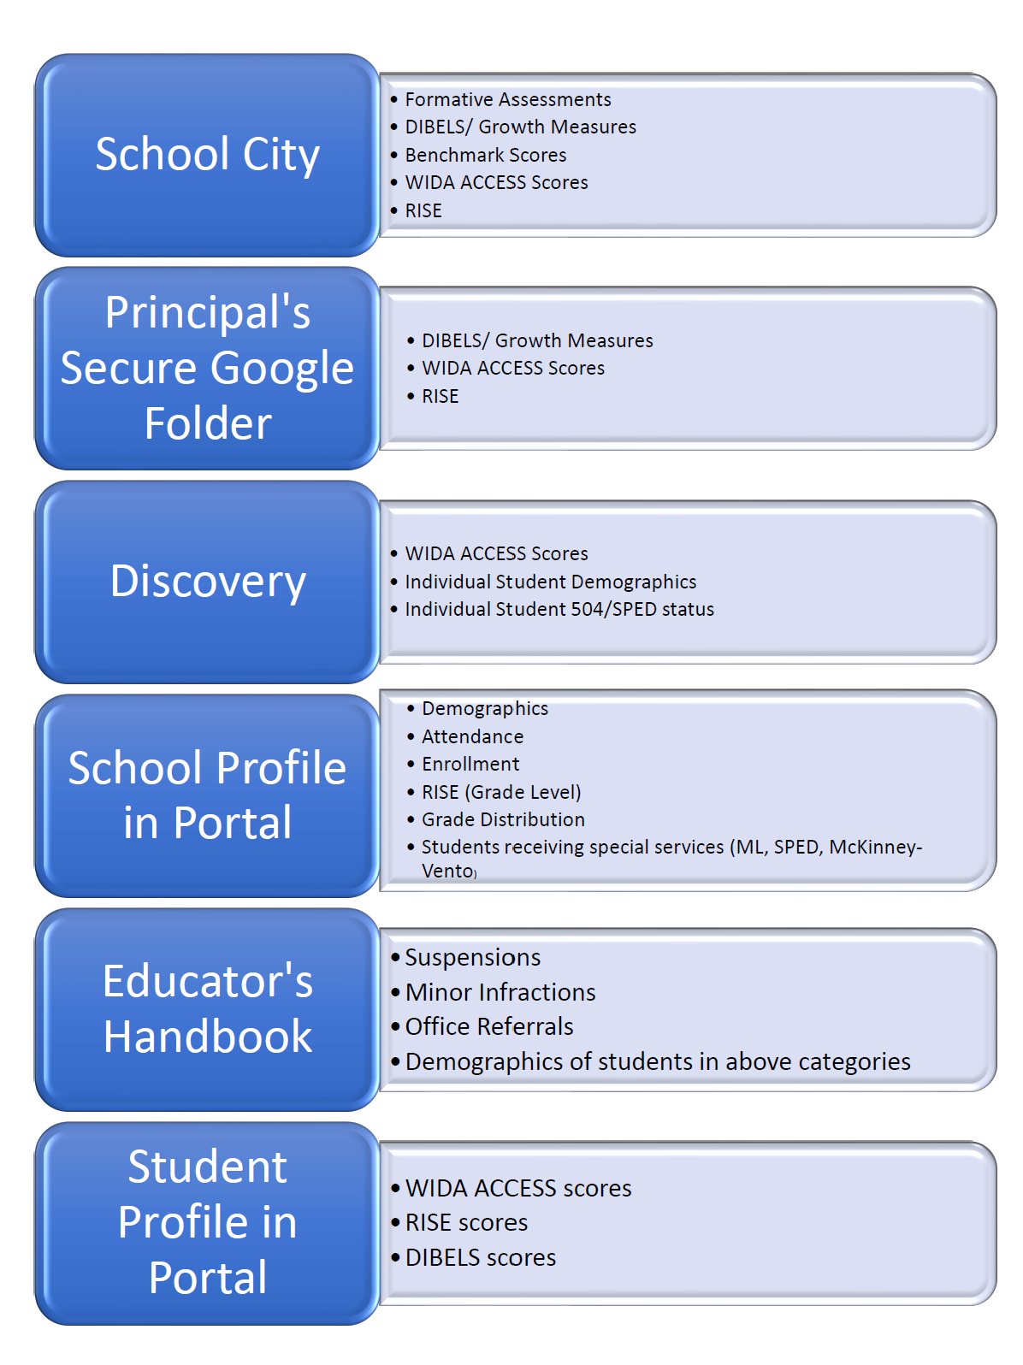
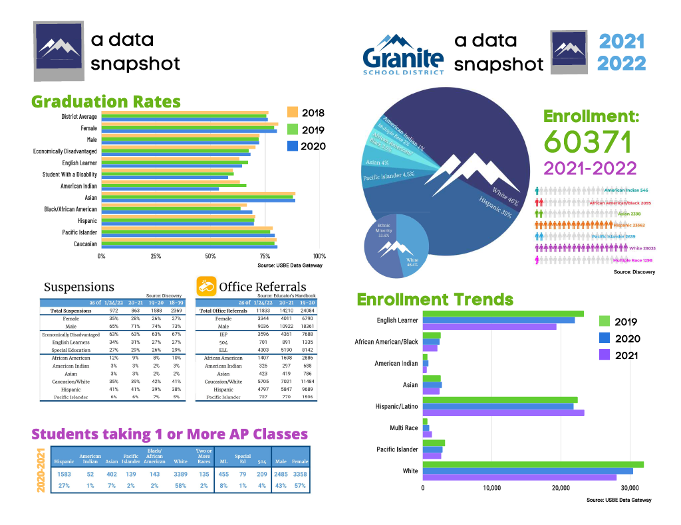
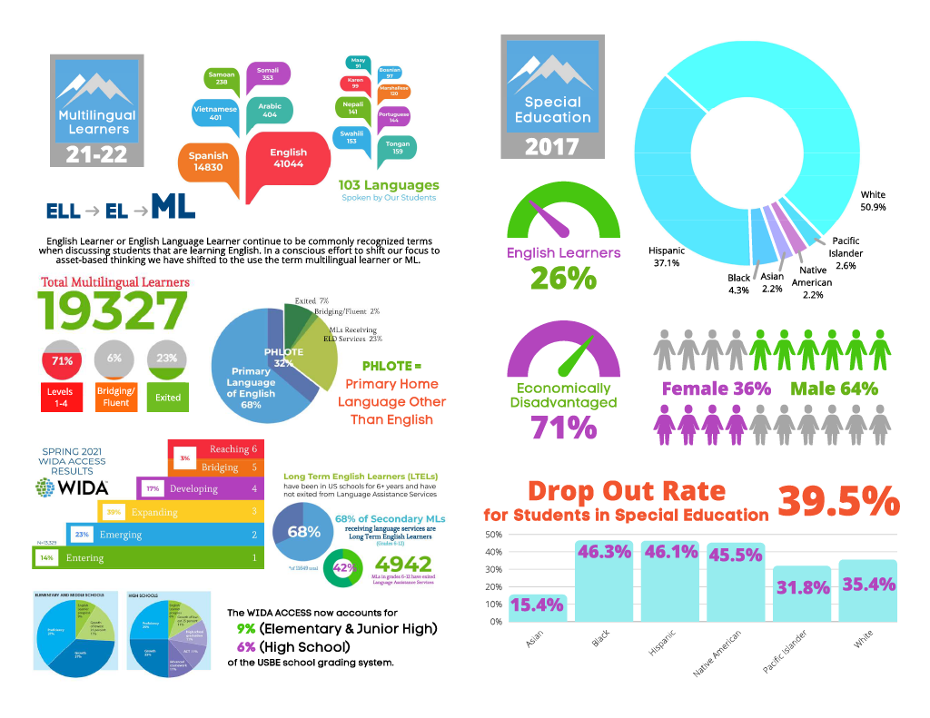
Notes:
Pass out handouts pictured on slide
Other Data Sources:
State Resource: USBE Data Gateway Look here for your school report card, historical data for RISE and WIDA
SOAR Report - Counselors and Social Workers - This data can be pulled by administrators for your school

Slide 18

Data Discussion
Review the data charts with your table. Discuss the patterns, trends or concerns you notice.
Does this information correspond with your school or classroom data?
How does this data reflect equitable or inequitable practices in our schools/ classrooms?
Patterns and trends in the data: What am I seeing across time, across the grade level or department, or across the school?
Changes in identified students: How have increased interactions impacted students and their learning? How has this changed the teacher experience?
Actions and next steps: Based on the data, what do still need to do?
(p.57)
Notes:
5 minutes to discuss at your table
2 minutes to share out answers
School Data - Go in RIGHT NOW to your data folder. There is a folder titled CIP Results which has demographic data.
S: Student Assessment/Secure/{School}/2021 CIP Results/RISE Results by SubGroup
Principals will need to determine which data they want to have available to their staff.
Remember to think about different aspects of equitable practices, not just race and language. Think religion, values and beliefs, socio-economic, gender, sexual orientation, etc.

Slide 19
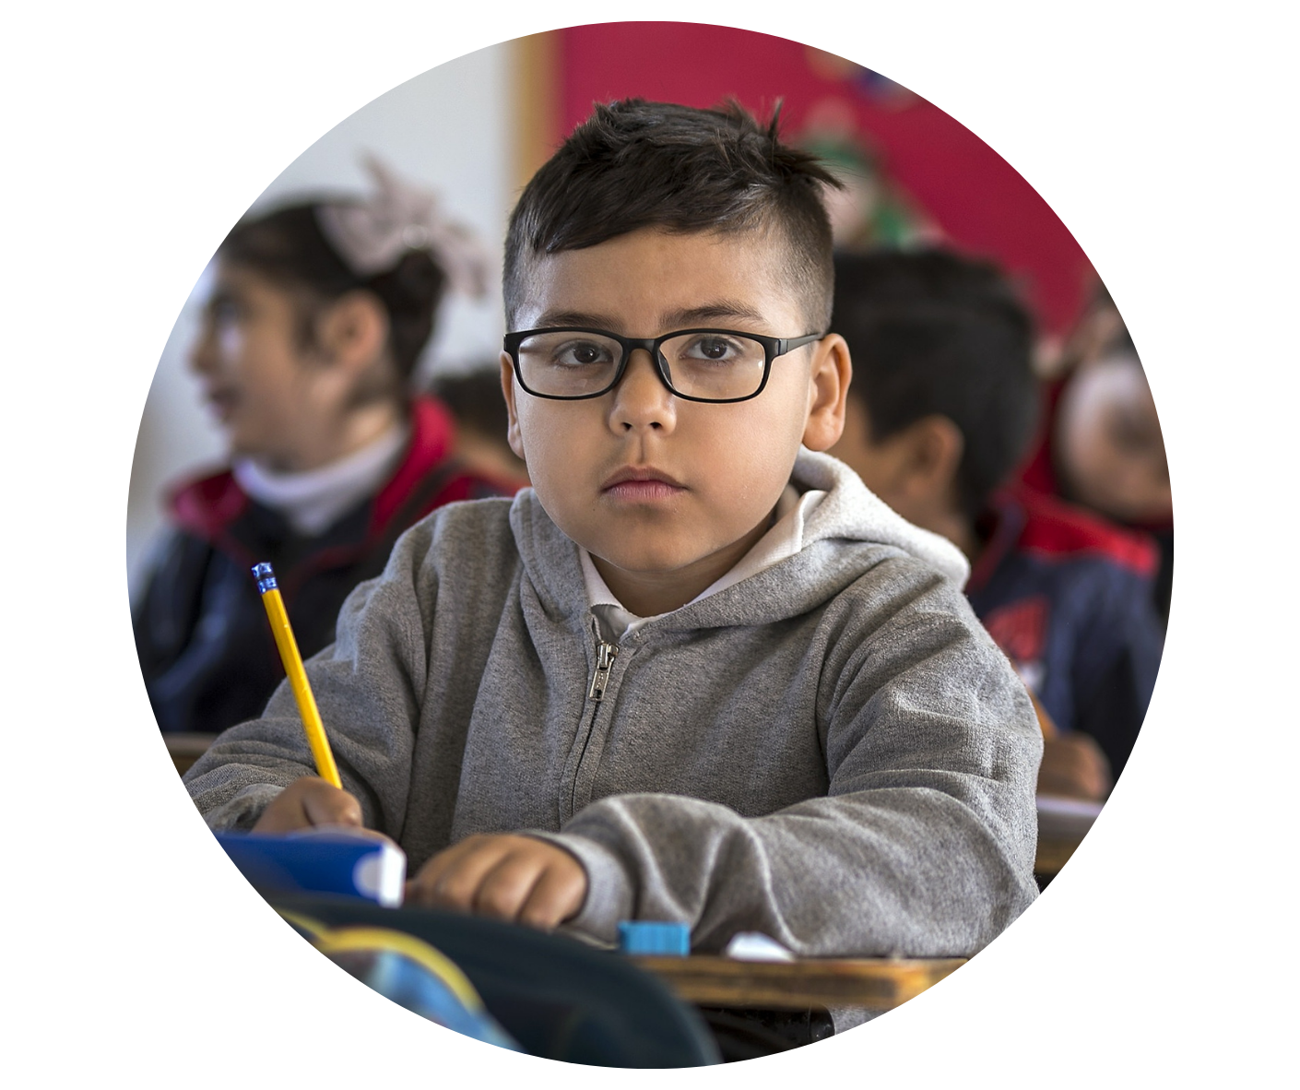

Meaningful and Equal Access
Providing Language Assistance to EL students
EL students are entitled to appropriate language assistance services to become proficient in English and to participate equally in the standard instructional program within a reasonable period of time.
Providing Meaningful Access to All Curricular and Extracurricular Programs
EL students must have access to their grade-level curricula so that they can meet promotion and graduation requirements.
https://www2.ed.gov/about/offices/list/ocr/docs/dcl-factsheet-el-students-201501.pdf
Notes:
You will recognize this as new/different in your CIP this year.
According to the law we MUST provide meaningful and equitable access to both curricular and extracurricular programs, ie: sports, AP courses, performing arts, honors, student government
https://www2.ed.gov/about/offices/list/ocr/docs/dcl-factsheet-el-students-201501.pdf
Identifying and Assessing All Potential EL Students
Providing Language Assistance to EL Students
Staffing and Supporting an EL Program
Providing Meaningful Access to All Curricular and Extracurricular Programs
Avoiding Unnecessary Segregation of EL Students
Evaluating EL Students for Special Education and Providing Dual Services
Meeting the Needs of Students Who Opt Out of EL Programs or Particular Services
Monitoring and Exiting EL Students from EL Programs and Services
Evaluating the Effectiveness of a District’s EL Program

Slide 20
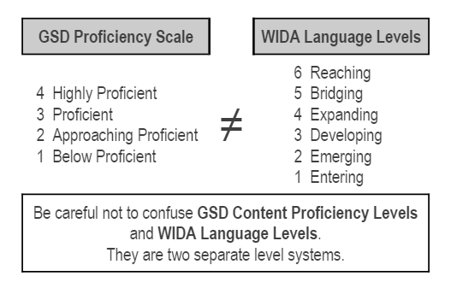
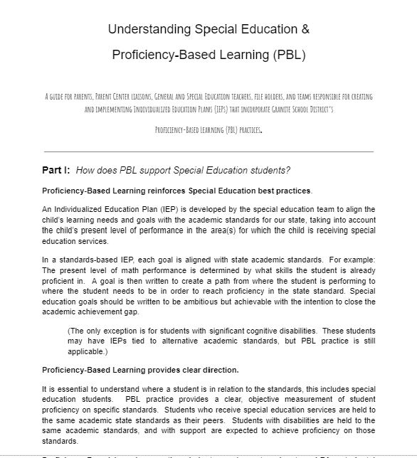
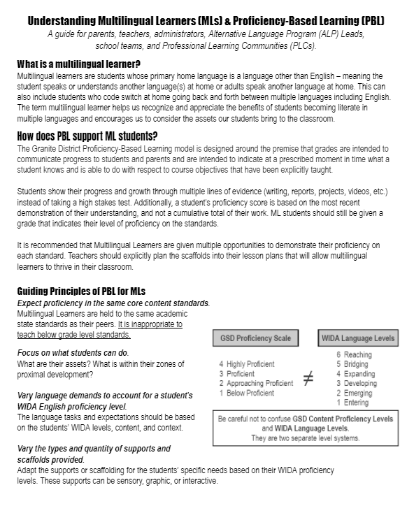
PBL Guides
Expect proficiency in the same core content standards.
Focus on what students can do.
Vary language demands to account for a student’s WIDA English proficiency level.
Vary the types and quantity of supports and scaffolds provided.
PBL for SPED Guide
PBL for MLs Guide
Notes:
PBL is another way to ensure all students are demonstrating proficiency on state standards to the same level of rigor, but through different modalities.
You maybe have seen the Understanding Special Education and PBL document, and this is the debut of the Understanding MLs and PBL. Both are linked here and are a great guide to gain a deeper understanding of proficiency based learning for these specific student populations.
Proficiency levels for PBL are not equivalent to WIDA Levels.
Teachers can provide scaffolding to help all levels of MLs achieve proficiency.
Can do Descriptors are a tool that can be used to develop assessments
Proficiency- Based learning holds ALL students to the sam standard, but how the student demonstrates the proficiency may vary by student needs/strengths.

Slide 21

Providing Equal Access For Families Experiencing Poverty
“In homes of those from poverty, children commonly get twice as many reprimands as positive comments, compared with a 3:1 ratio of positive to negatives in middle class home.”
Risley & Hart, 2006
Families experiencing poverty are more likely to have children who struggle in school because they are exposed to:
Less Health & Nutrition
Limited Vocabulary
Lack of Hope & Optimism
Disruptive Home Relationships
Families in Distress
What can you do as a Teacher to help?
Provide movement & encourage healthy snacks.
Teach vocabulary daily
Build positive relationships with students
Teach by showing not telling.
Provide opportunities for responsibility & leadership.
GSD Family Engagement Website
Notes:
How Poverty Affects Classroom Management - Eric Jensen
Eric Jensen writes about how to support children experiencing poverty in the classroom.
The Science of Scarcity - Cara Feinberg
Feinberg reports on recent studies that cognition can suffer when you are experience poverty because you literally can’t think beyond your immediate needs.

Slide 22
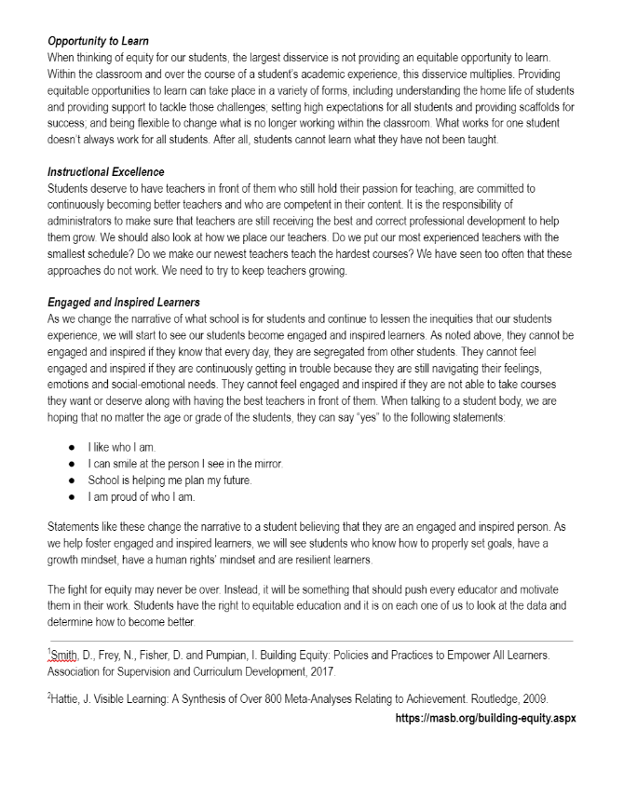
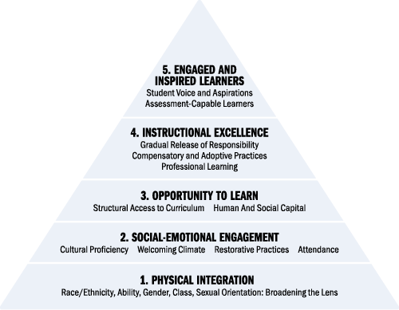
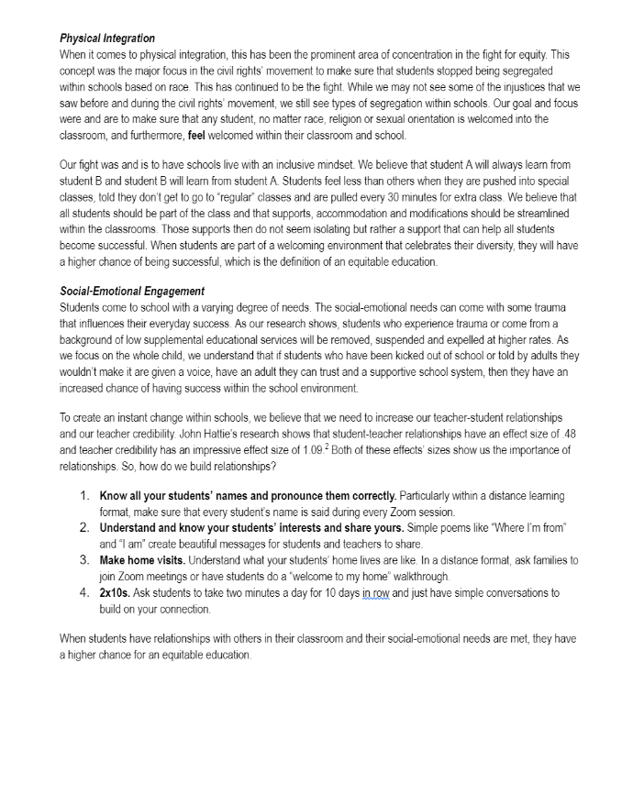
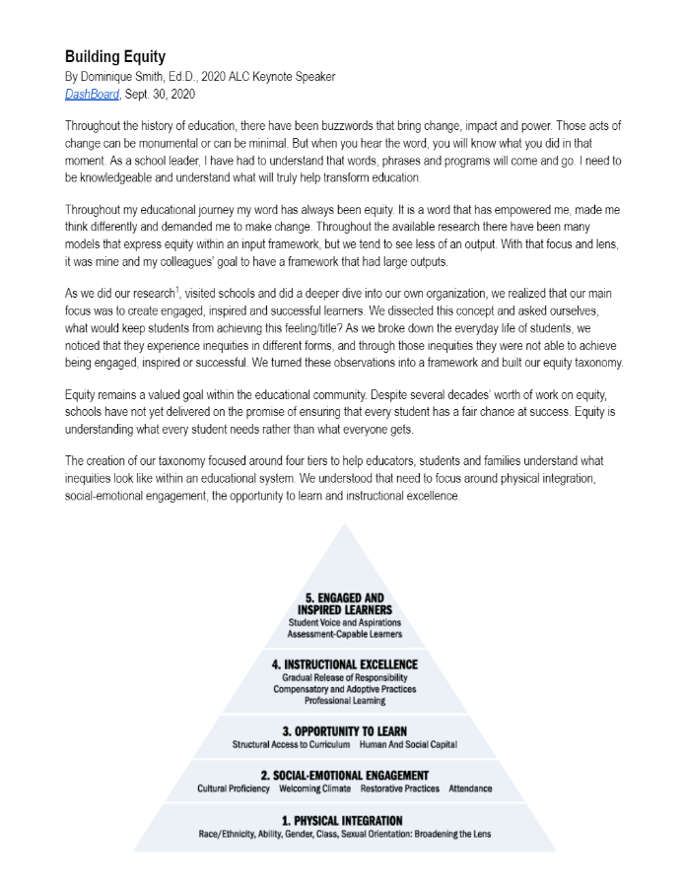

Building
Equity
Taxonomy
Read “Building Equity”
Star items going well in your school.
Circle items that might be areas for growth in your school.
Smith, Frey, Pumpian and Fischer. (2017). Building equity: policies and practices to empower all learners. Alexandria, VA: ASCD.
Notes:
The book Building Equity includes this taxonomy.
Read the 3 page article in your handouts. Star items you do well at your school and circle items that show areas where improvements can be made.
We will look at each of the 5 areas on the taxonomy and observe areas of strength that fit into our work at each level of the taxonomy. Finally, we will determine our next steps toward building equitable practices through choosing a focal point(s) based on the data.
Link to Article - https://masb.org/building-equity.aspx
Printable Version - https://docs.google.com/document/d/1U8n4Cb12u-modutriIIl1PU1k2e89u66QDLK6Kcjx3M/edit#heading=h.qmbzzug1bpib
Discussion Points from Article:
Note - “Throughout the available research there have been many modes that express equity within an INPUT Framework, but we tend to see less of an OUTPUT.
Focus is to create engaged, inspired and successful learners.
The creation of this taxonomy is focused around four tiers to help educators, students and families understand what inequities look like within an educational system. We need to focus on the four tiers to reach Engaged and Inspired Learners.

Slide 23
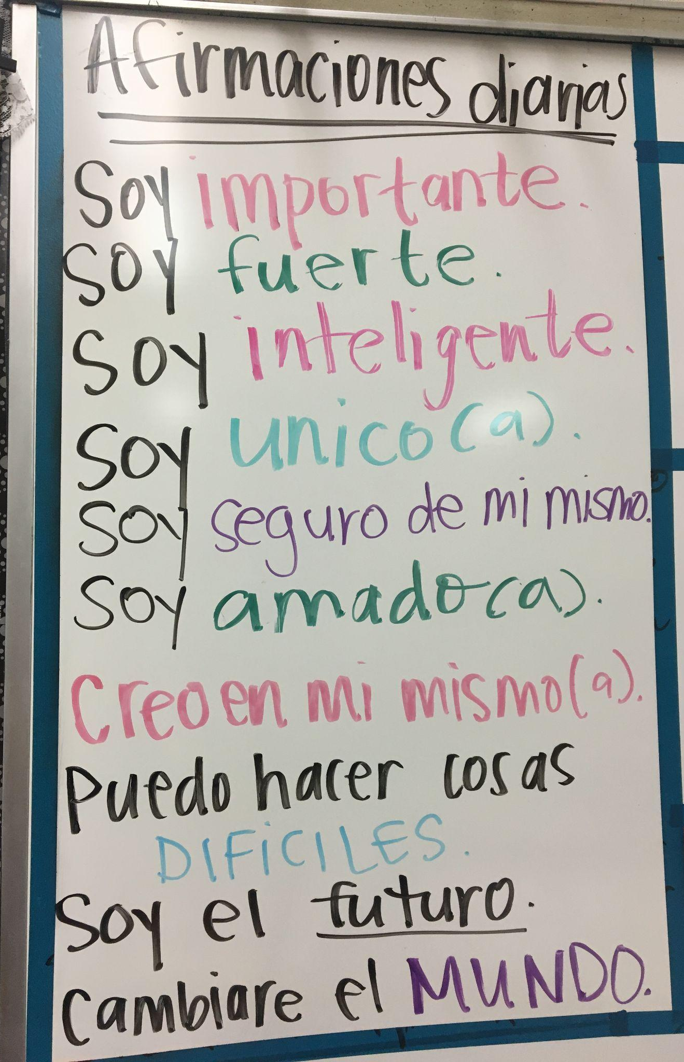
Indicators of Physical Integration
Race/Ethnicity, Ability, Gender, Class, Sexual Orientation: Broadening the Lens
The classroom is welcoming and celebrates the diversity of the learners.
I make efforts to promote students’ respecting, and interacting with, students from different backgrounds.
Supports are streamlined within the classroom.
Notes:
What examples of Physical Integration are currently occurring in your school? Record your answers on the pyramid taxonomy paper. 1-2 minutes

Slide 24
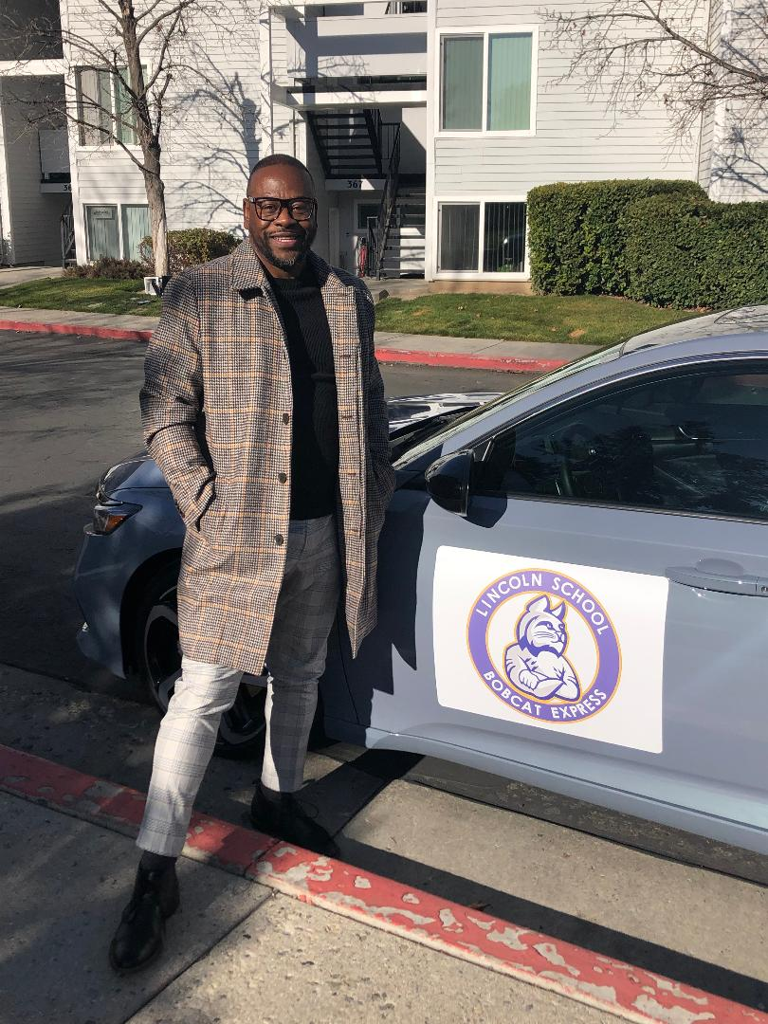
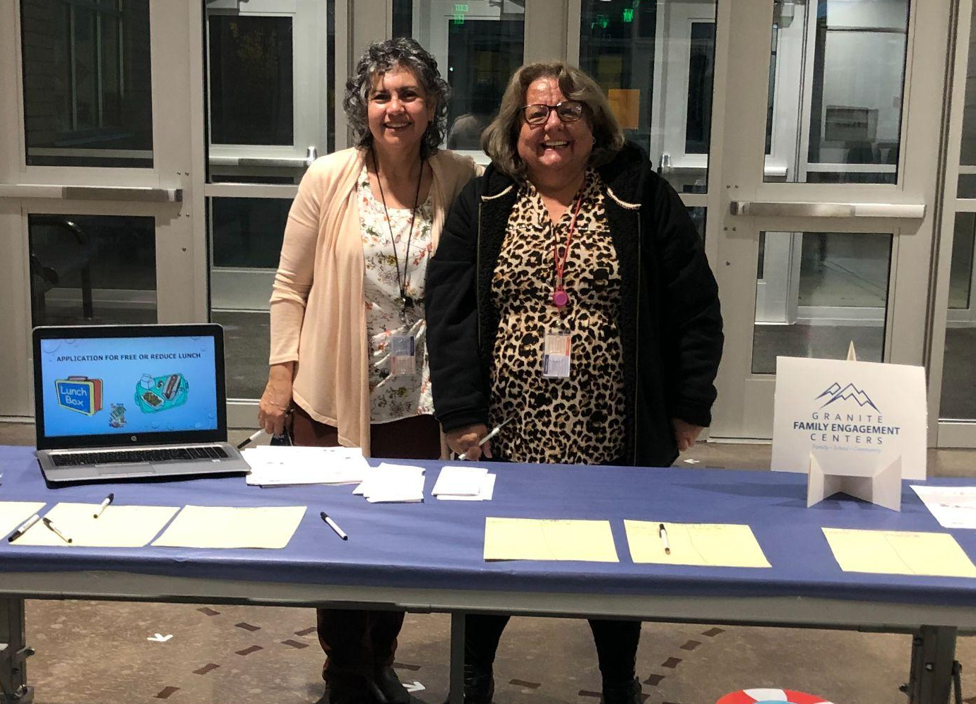
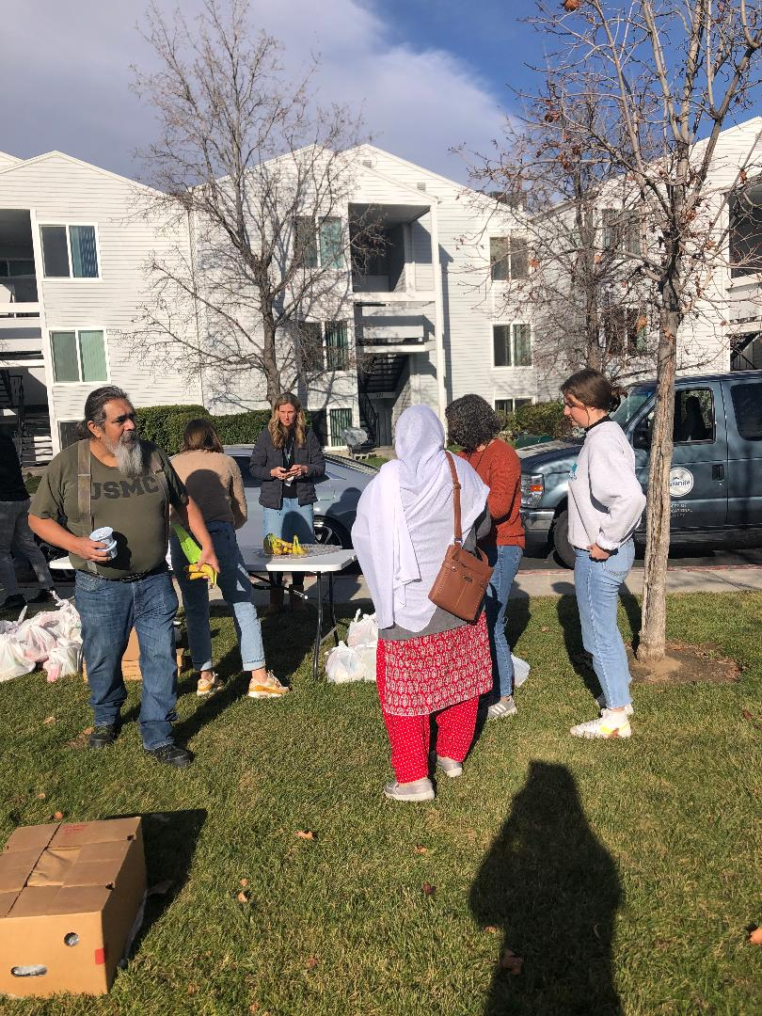
Physical Integration
South Kearns - Family Center
reaching out to families of different backgrounds to sign up for many different classes!
Lincoln Elementary - Bobcat Bus

Slide 25
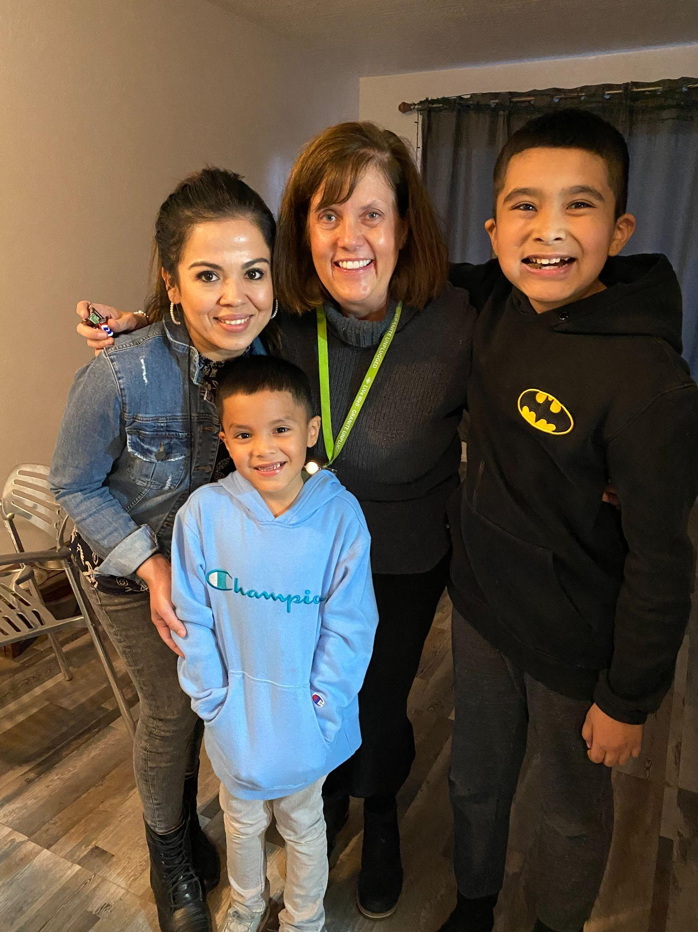
2. Indicators of Social-Emotional Engagement Cultural Proficiency - Welcoming Climate - Restorative Practices - Attendance
Students feel safe at school.
Students have at least one adult in school who cares about, supports, and mentors them.
Know all students’ names and pronounce them correctly.
Get to know your students’ interests.
Build relationships with families.
Home Visits - Stansbury
Notes:
What examples of Social-Emotional are currently occurring in your school? Record your answers on the pyramid taxonomy paper.

Slide 26
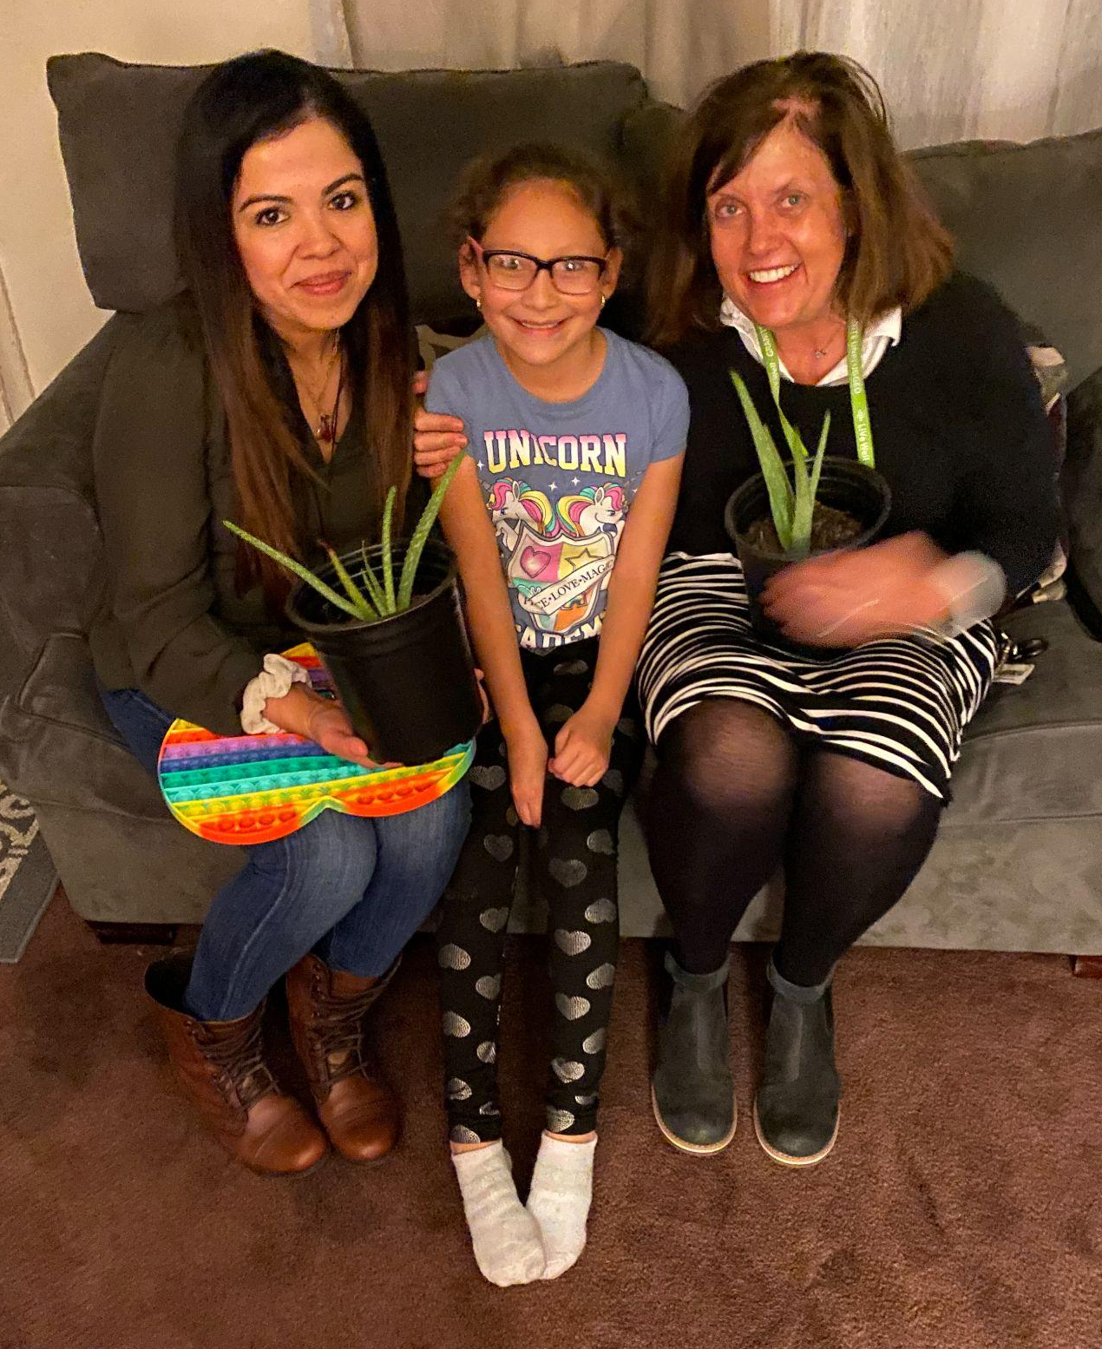

Social-Emotional Engagement
Stansbury - Home Visits
Hillside Elementary -
Math Family Engagement Night
Notes:
Play video as time allows (7:30)

Slide 27
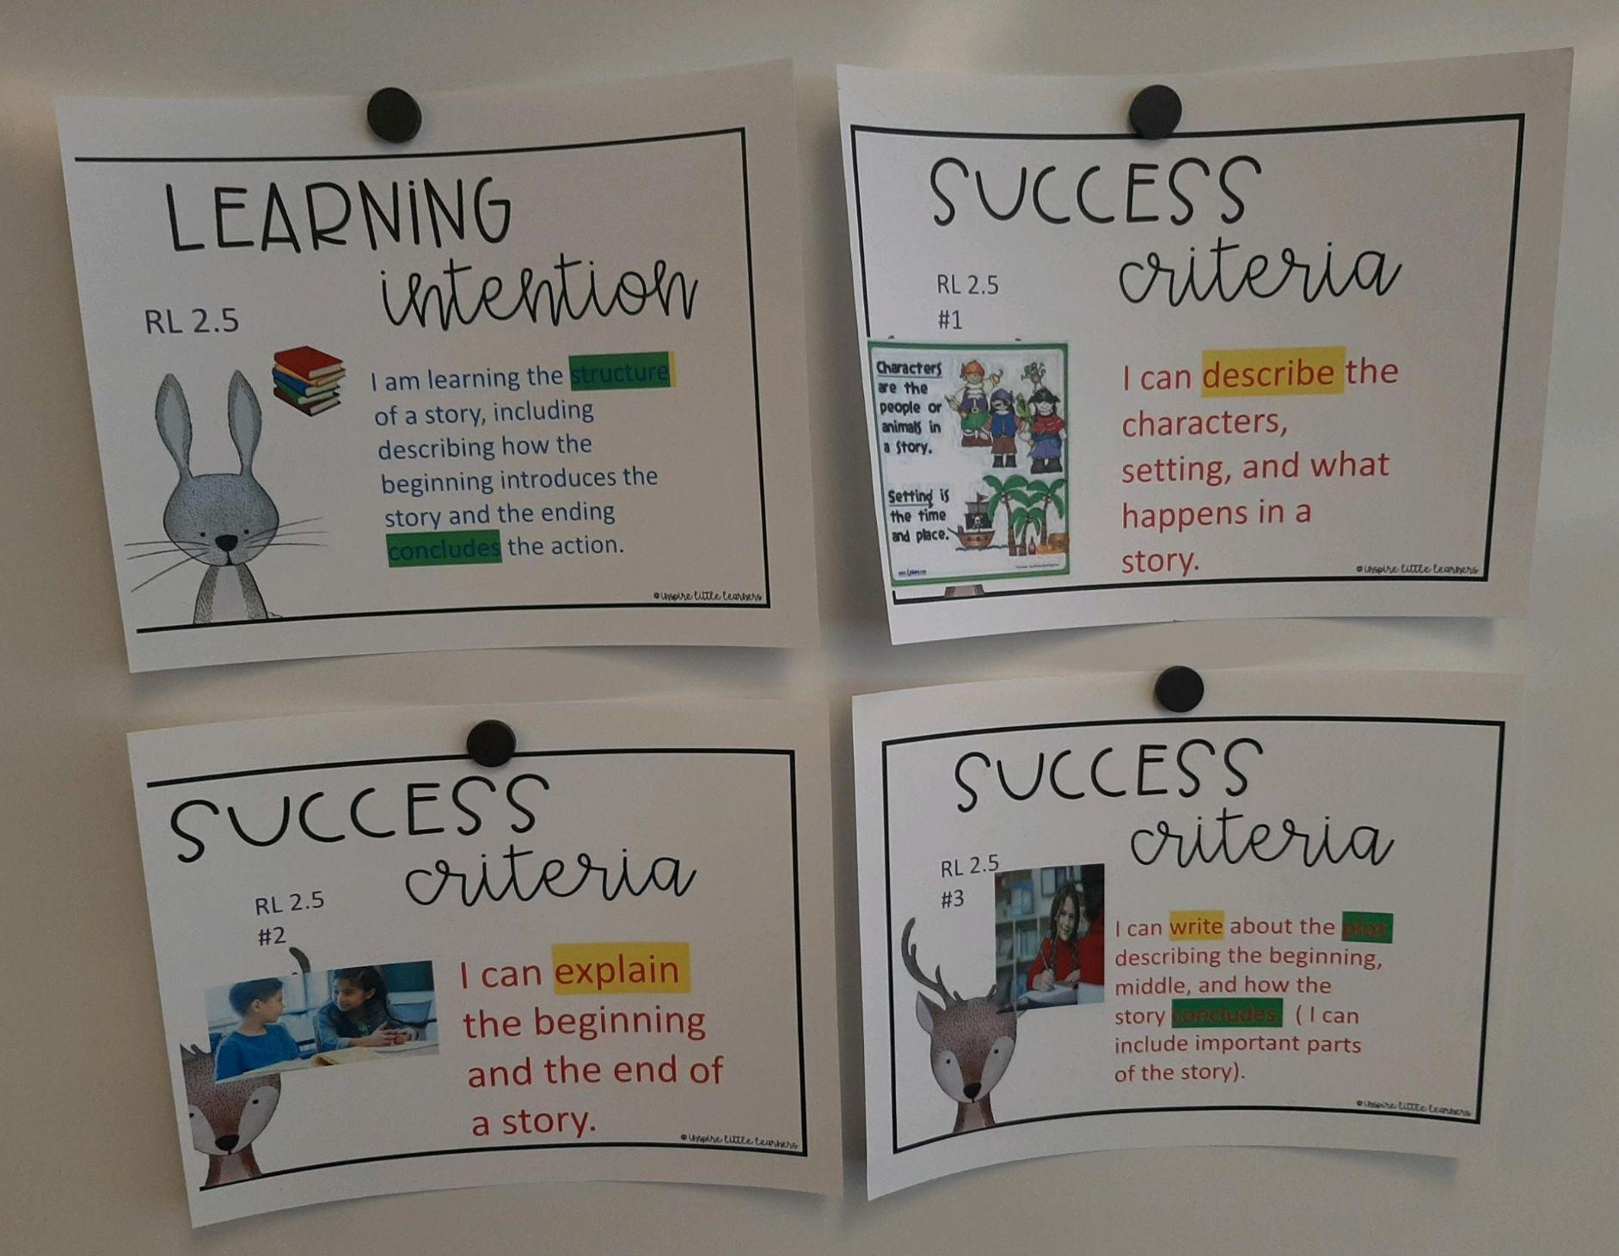
3. Indicators of Opportunity to Learn
Structural Access to Curriculum - Human and Social Capital
I am flexible to change what is not working to meet the needs of the students.
I have high expectations for all students and provide scaffolds.
I have active working relationships between home and school to support students.
Notes:
What examples of Opportunities to Learn are currently occurring in your school? Record your answers on the pyramid taxonomy paper.

Slide 28
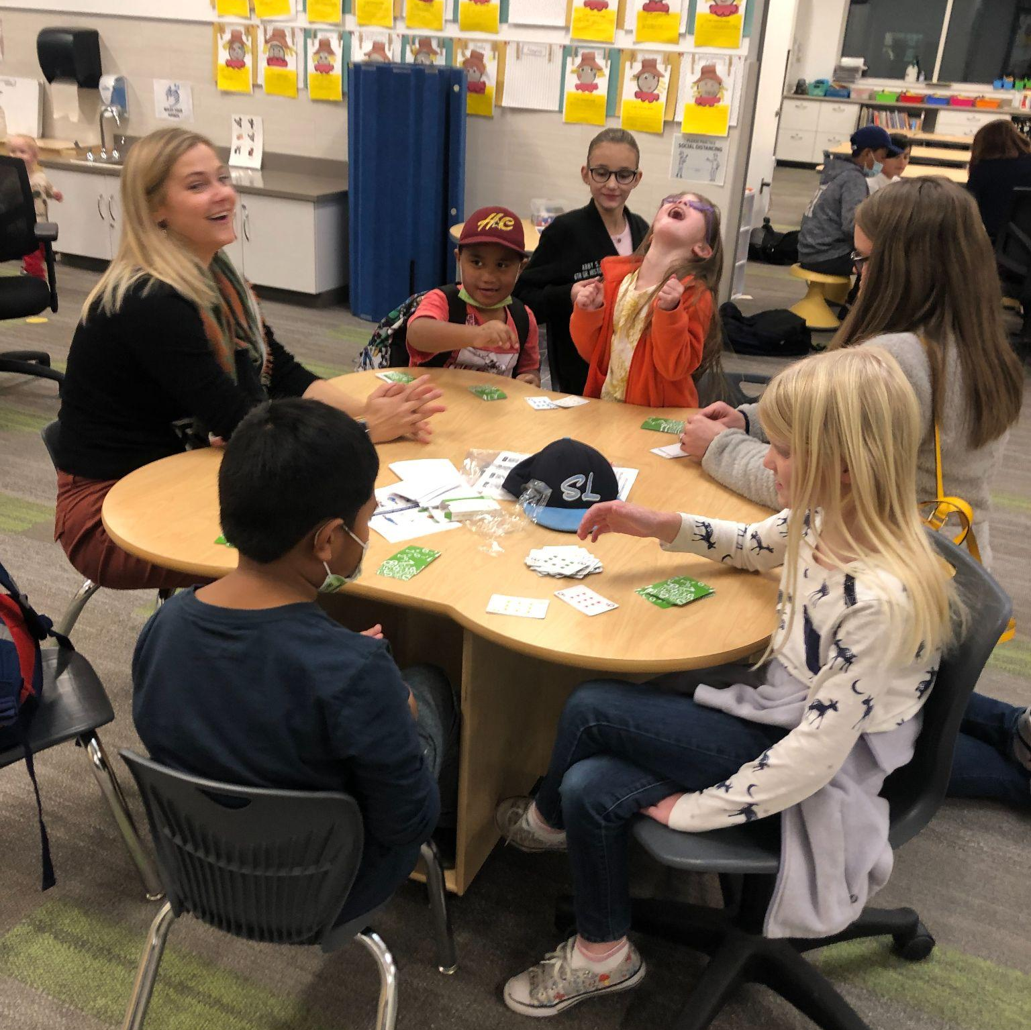
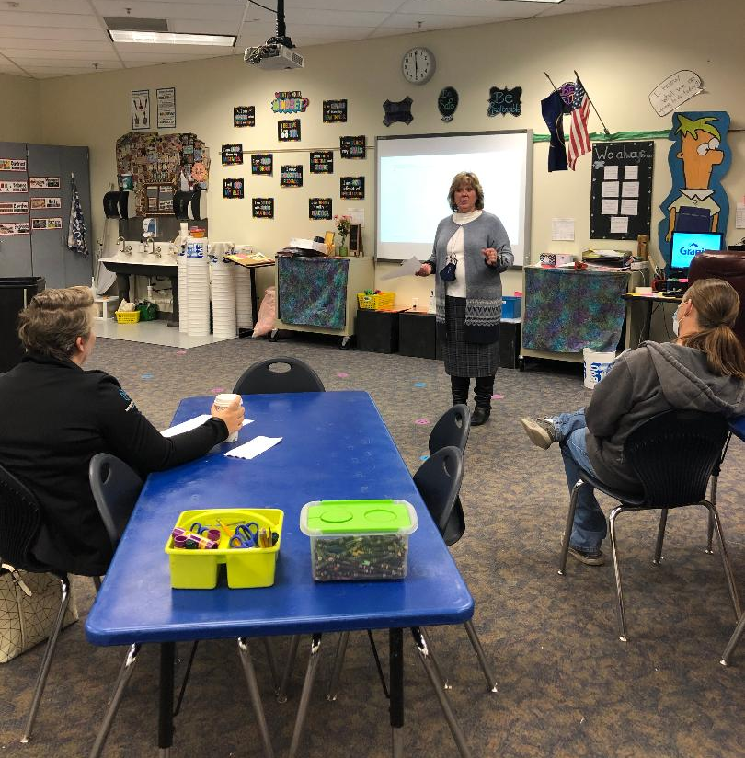
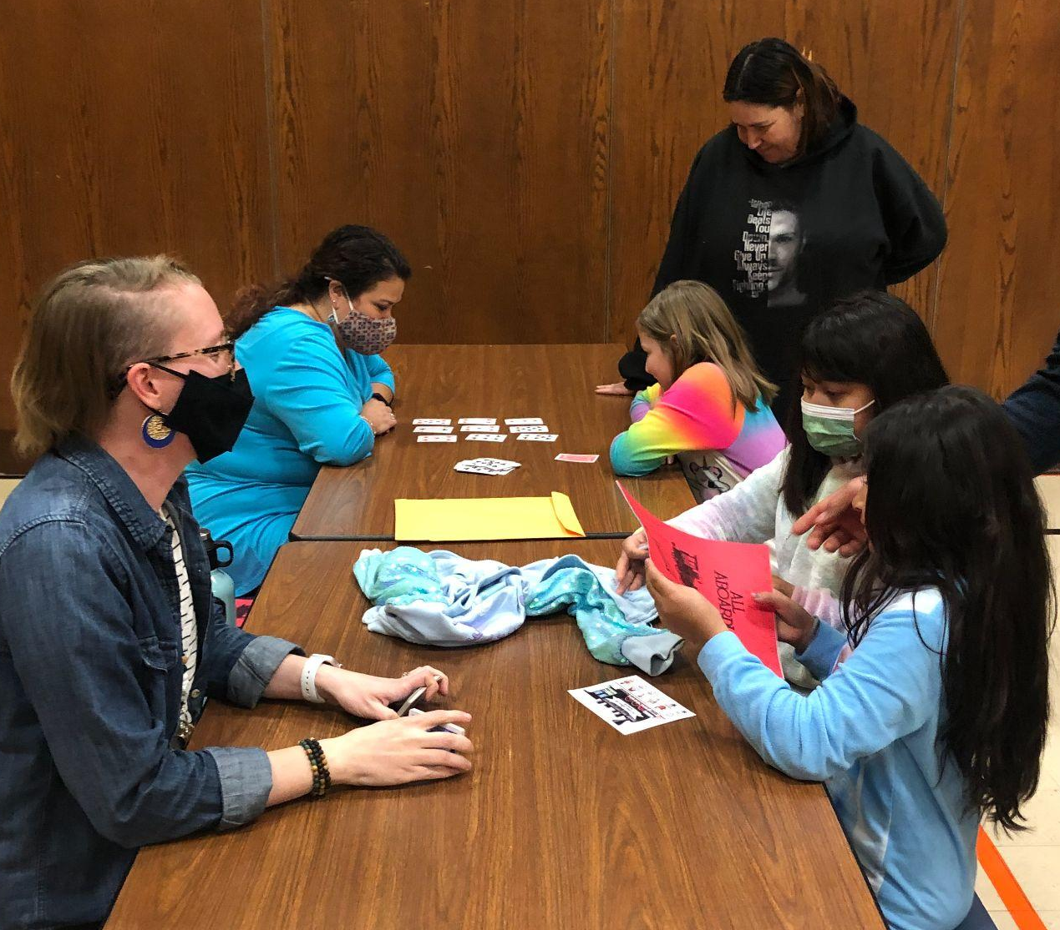
Opportunity to Learn
South Kearns - Math Night
families involved in classroom and school events
Woodrow Wilson - Parent Cafe
Farnsworth - STEM Night

Slide 29
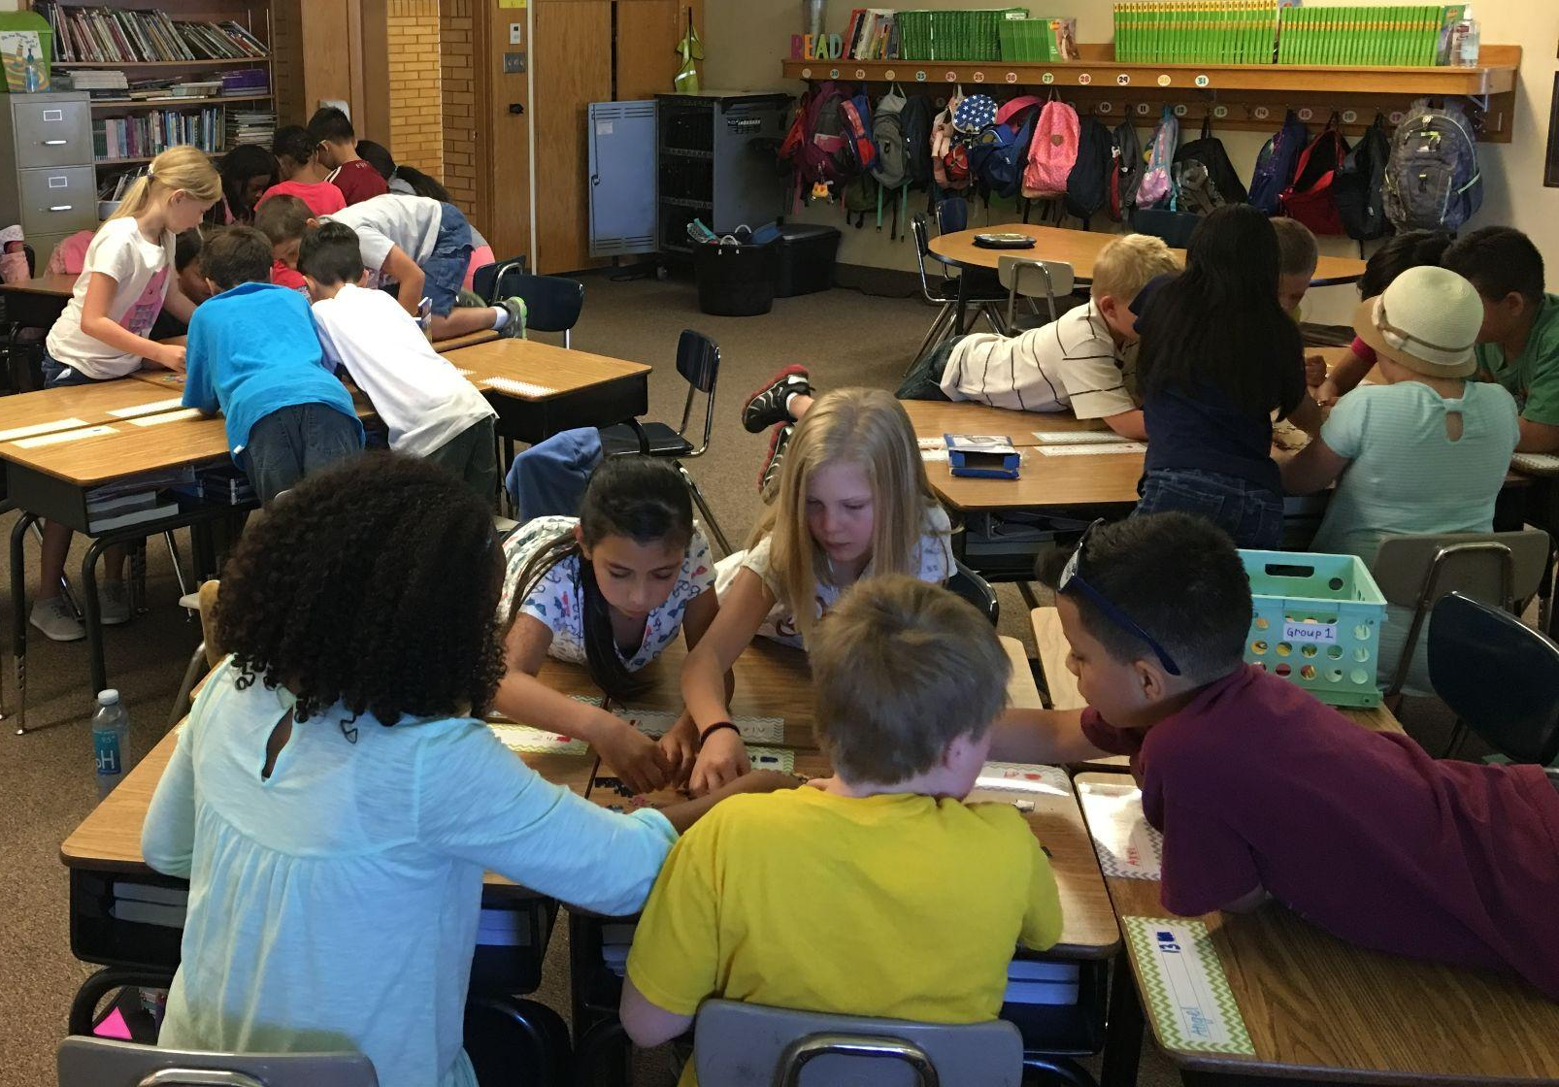
4. Indicators of Instructional Excellence
Gradual Release of Responsibility - Compensatory & Adoptive Practices - Professional Learning
I have growth mindset and continue to improve my practice.
My grading and progress reports focus on proficiency-based learning.
I notice students’ individual needs and have systems in place to differentiate.
Notes:
What examples of Instructional Excellence are currently occurring in your school? Record your answers on the pyramid taxonomy paper.

Slide 30


Instructional Excellence
Kearns Jr. High
An FA teacher set up a coffee and hot chocolate cart for teachers on Friday morning. Students in the class learn job skills including money, social skills, and making coffee. Non-verbal students have a button to push to communicate with the teachers.
Skyline High
An AA teacher created a soccer team for her students so they could participate in sports. She coached them and arranged for transportation so they could compete at other schools. The school supported them by going to games and purchasing team shirts. The students were able to participate in a championship game at Rio Tinto stadium.

Slide 31
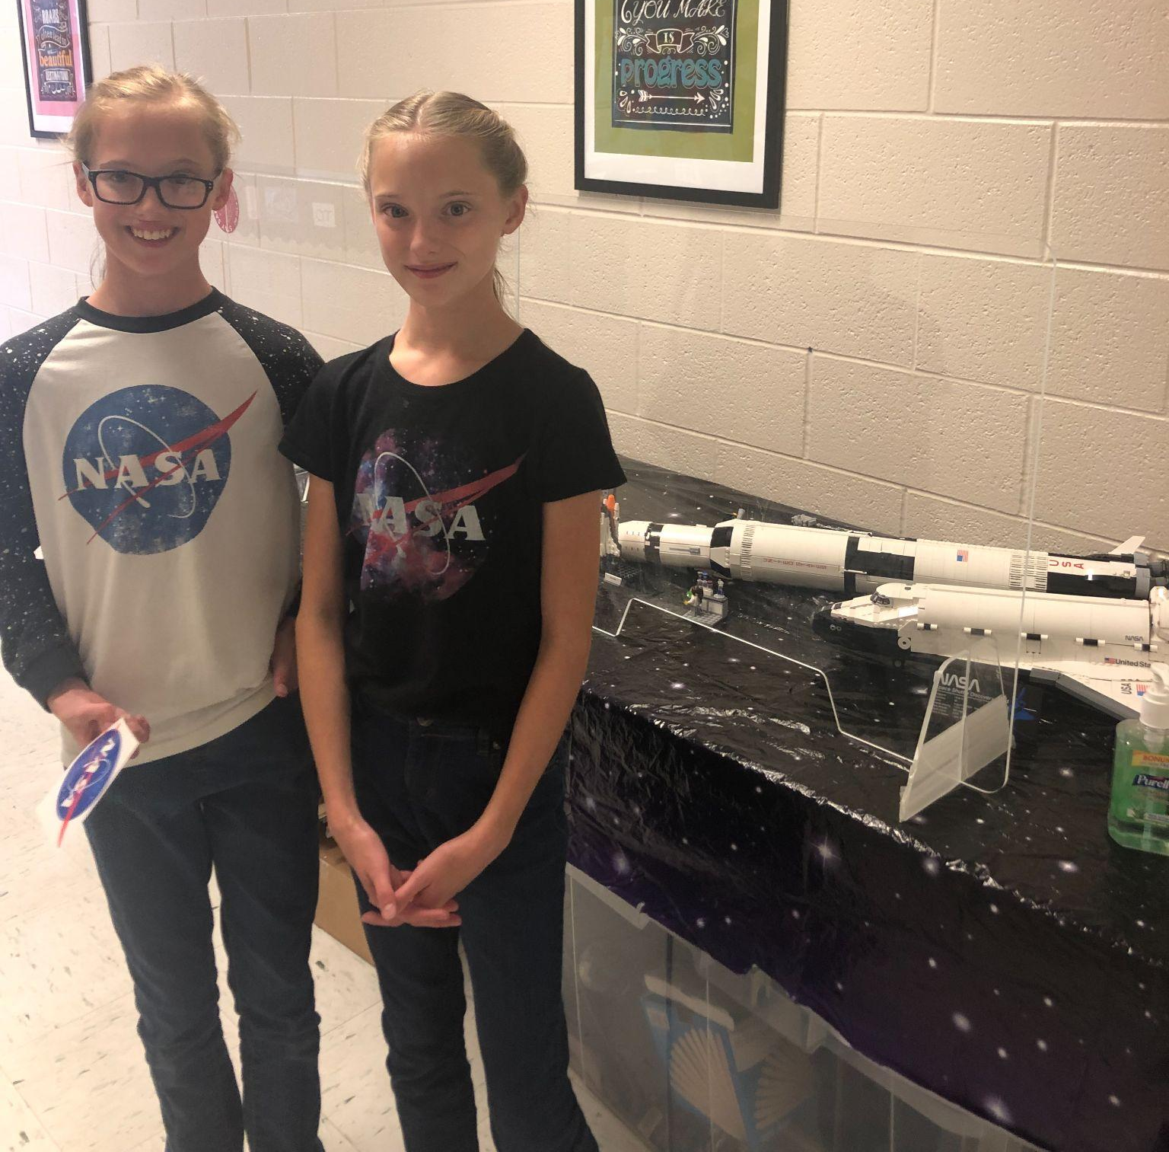
5. Indicators of Engaged and Inspired Learners
Student Voice & Aspirations - Assessment-Capable Learning
Students are engaged in a wide range of leadership activities within our school/classroom.
Students select learning opportunities related to their interests.
Students are inspired by their goals to achieve greatness.
Magna Elementary - NASA Family Literacy Night
authentic learning experiences linking goals and aspirations
Notes:
What examples of Engaged and Inspired Learners are currently occurring in your school? Record your answers on the pyramid taxonomy paper.

Slide 32
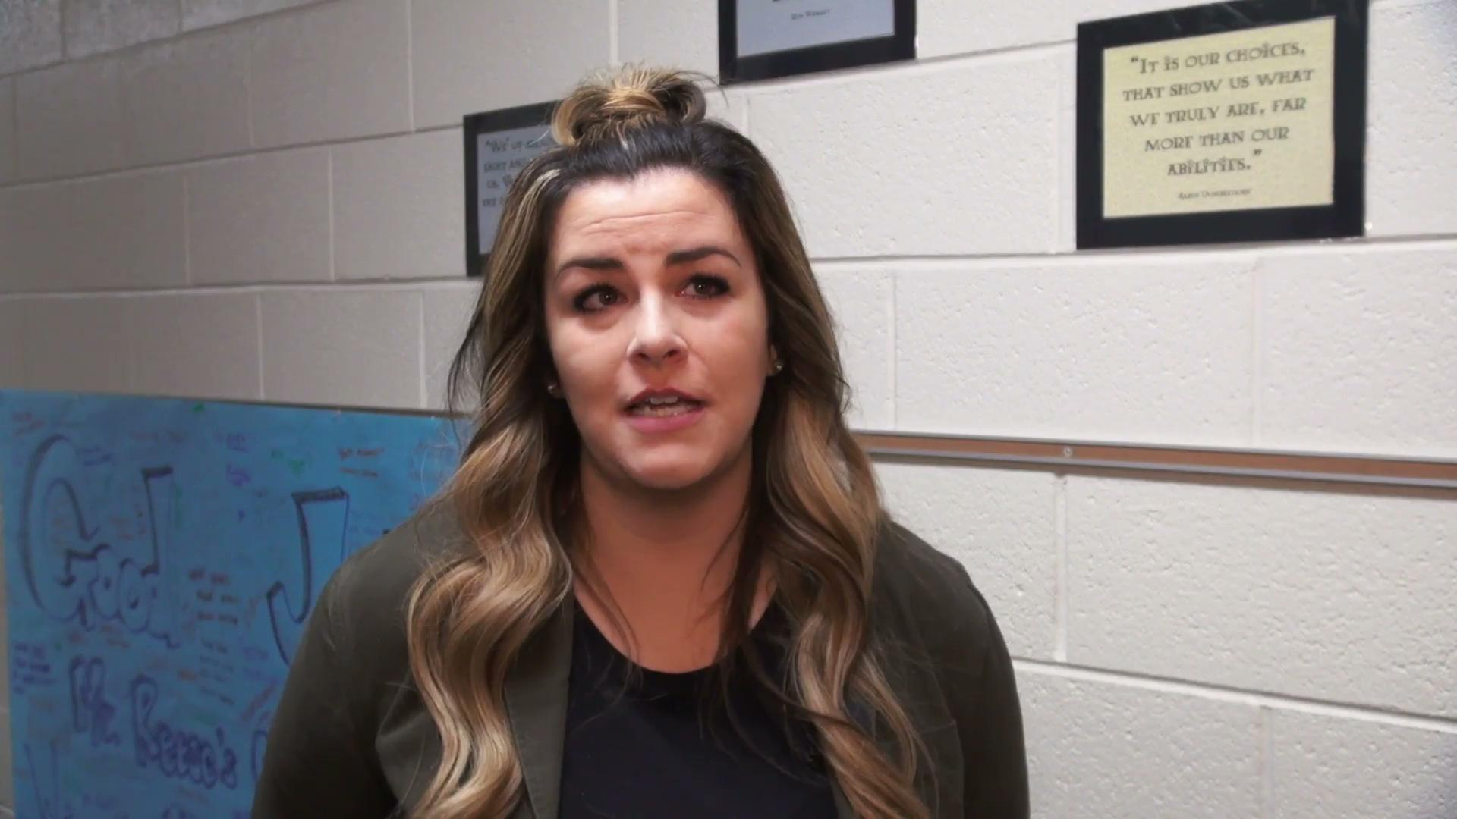
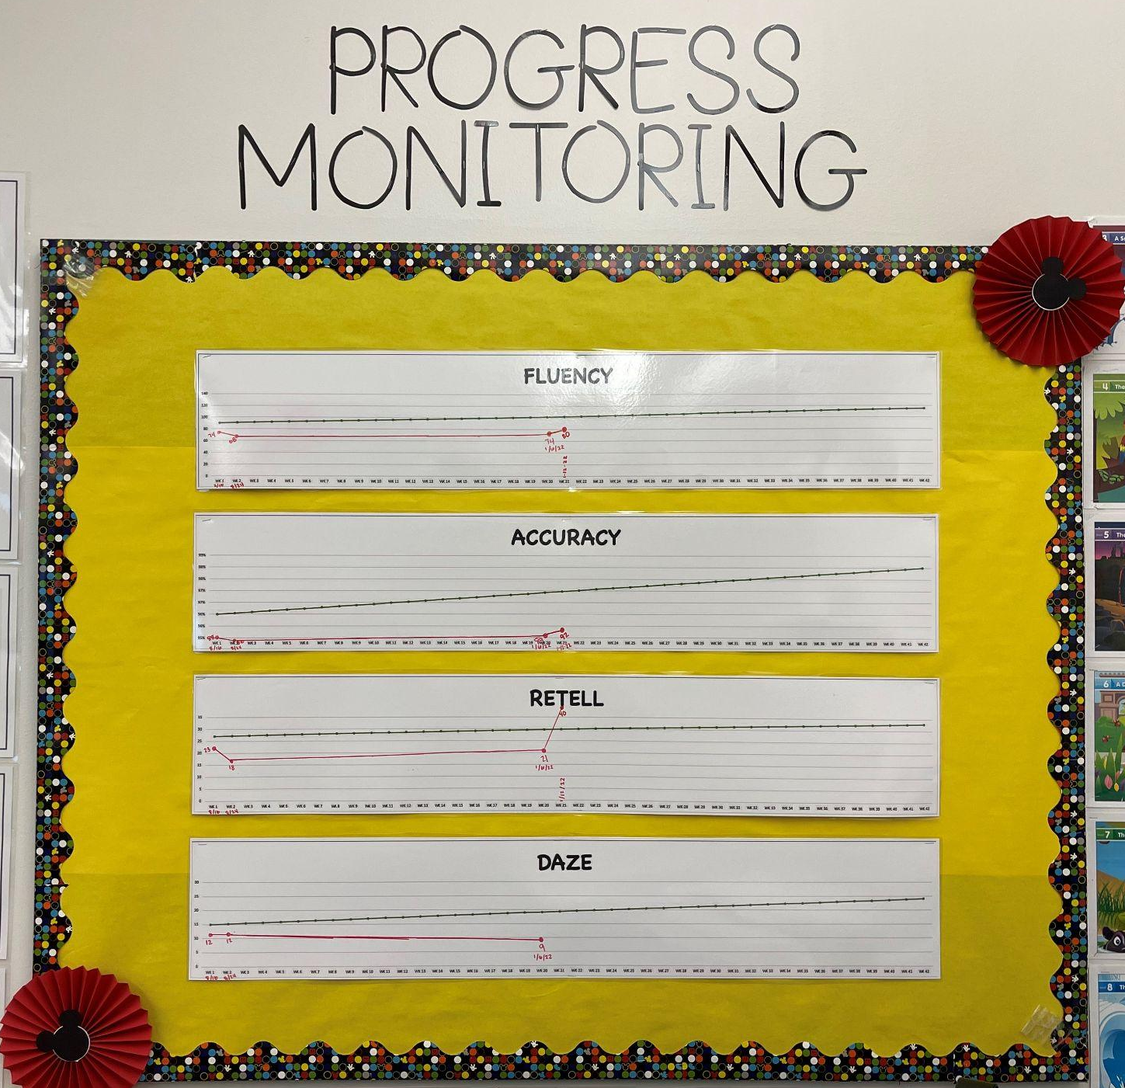
Engaged and Inspired Learners
Student Voice & Aspirations - Assessment-Capable Learning
Robert Frost - Student Engagement

Slide 33
In which levels of the taxonomy are your school’s strengths and areas of growth?
On which level of the taxonomy do we want to focus?
Which strategies might we want to incorporate into our school and classrooms to move toward a more equitable system?
Discuss
On the taxonomy pyramid, circle which area you would like to focus on as a school.

Slide 34
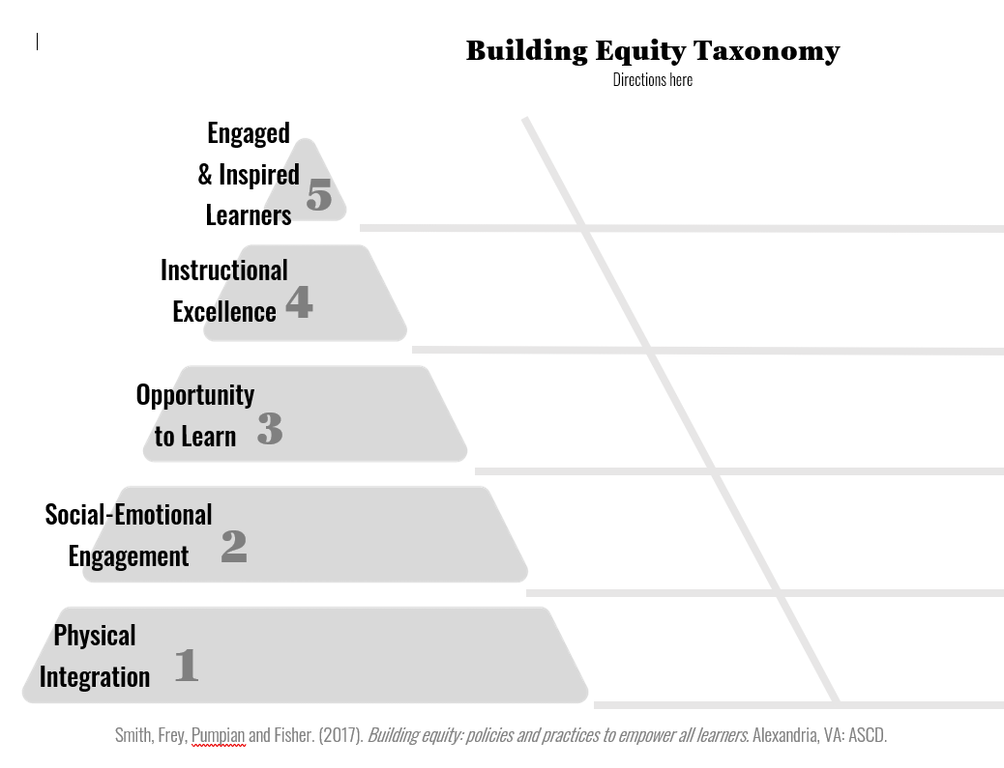

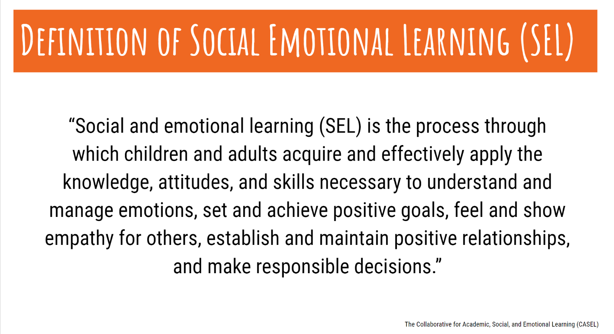
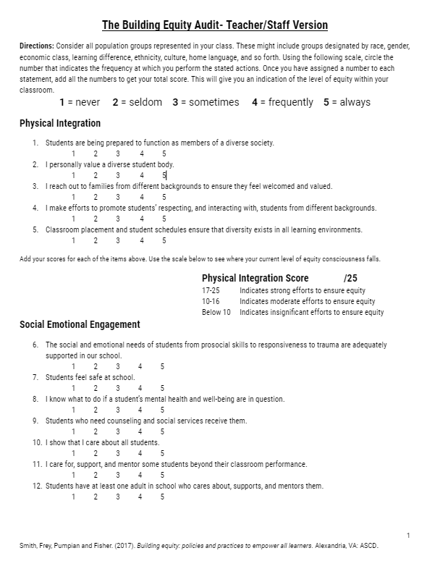
Explore
Strategies and Practices
ML Engagement Strategies
tinyurl.com/GSDMLstrategies
Building Equity: Teacher/Staff
Equity Audit
Google Doc for Printing
Google Forms (Make a copy for your school)
SEL Strategies
tinyurl.com/GSD-SEL-strategies
SE
S
SE
SE
Notes:
5-10 minutes: Explore the resources. How might they be valuable for improving equitable practices in your school? Record strategies that you want to try on the pyramid sheet.
These are resources that we will only briefly touch on during this presentation, but could be a valuable resource as you have discussions surrounding equity and work to create more equitable systems and practices in your school.

Slide 35
Host Honest Performance Conversations
Do your current observations reflect a stance on equity?
“What does make sense is collecting artifacts about the impact of the teacher on learning, analyzing them, and identifying areas of strength and opportunities for growth.” (p. 83)
Notes:
The book Leading the Rebound has a module (p. 58) pertaining to how to host an honest performance conversation. This could be used to begin a conversation around equitable practices in the classroom and schools.

Slide 36

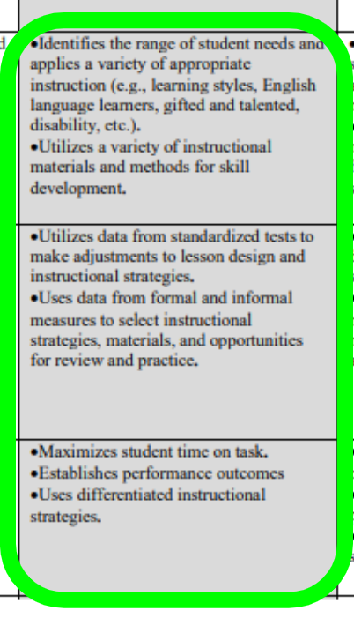
Notes:
The discussions from Leading the Rebound, as well as the Tools for Equity Conversations led by Principals could connect to educator standards to emphasize the importance of today’s topic and how principals can look for evidence of differentiation when observing in the classroom.

Slide 37
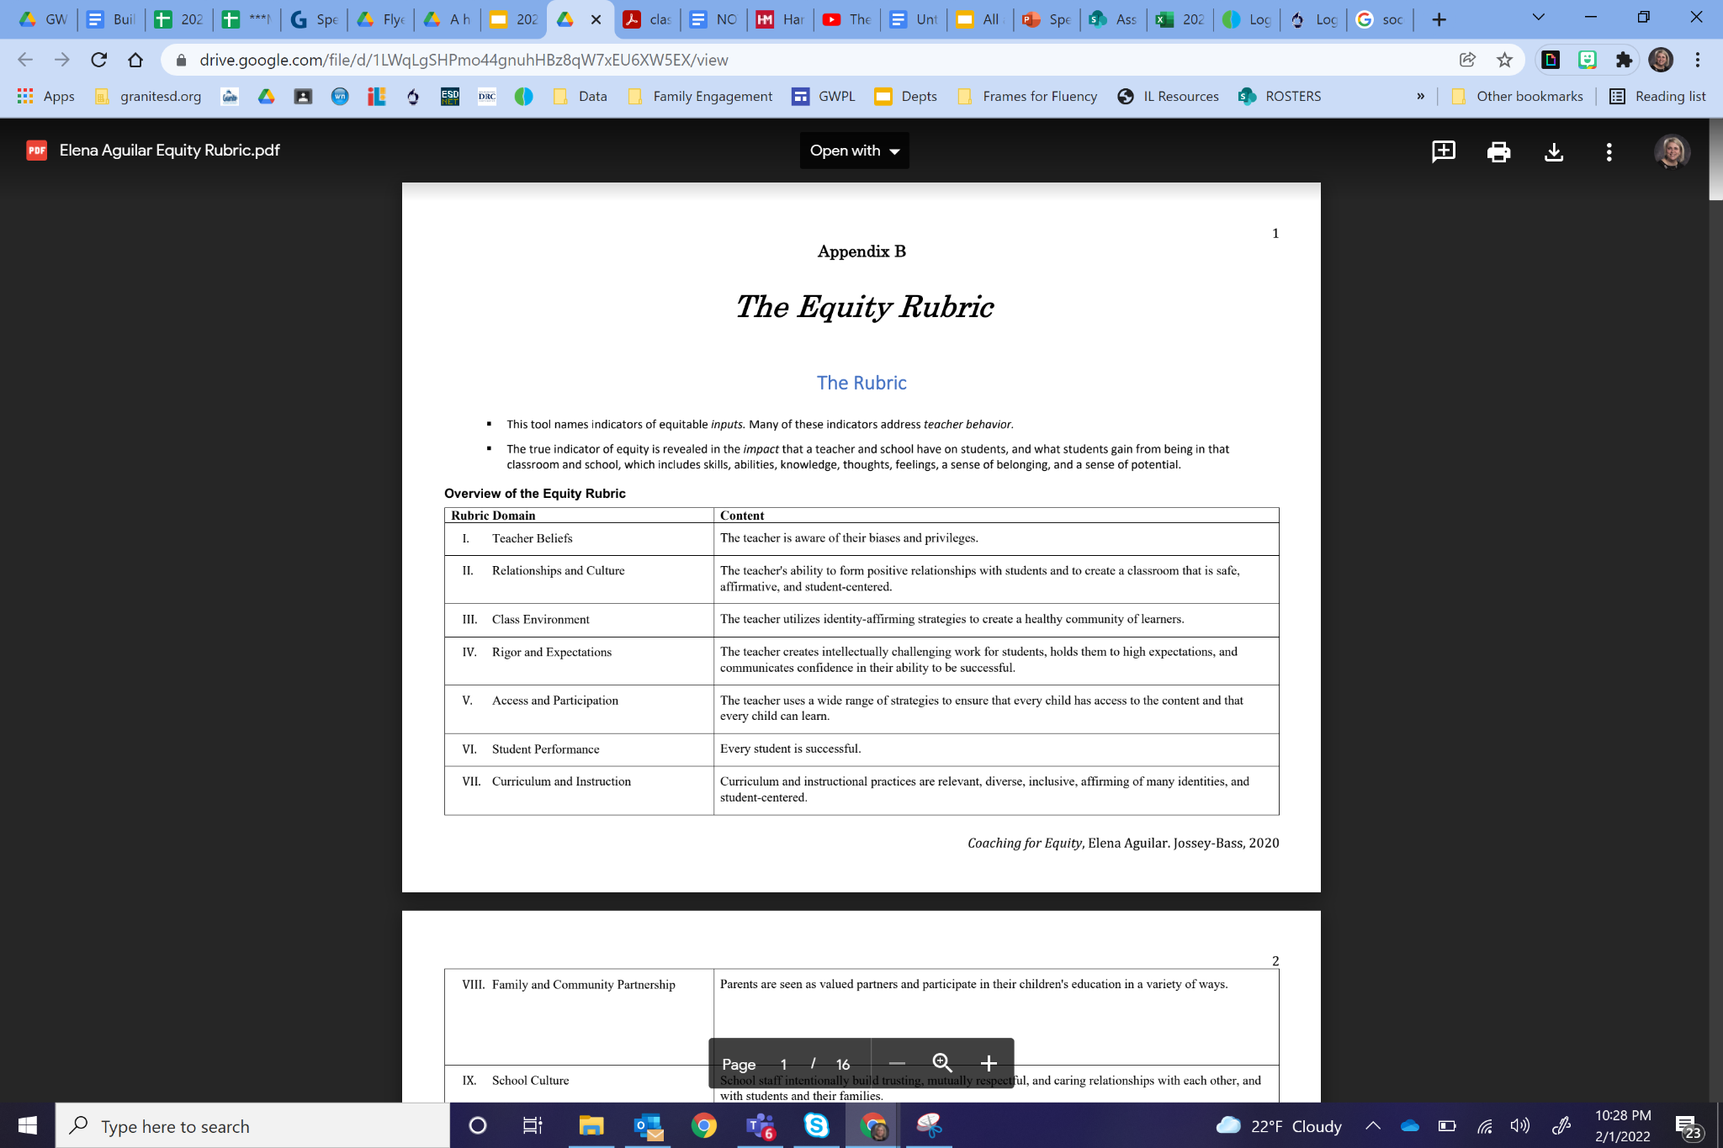

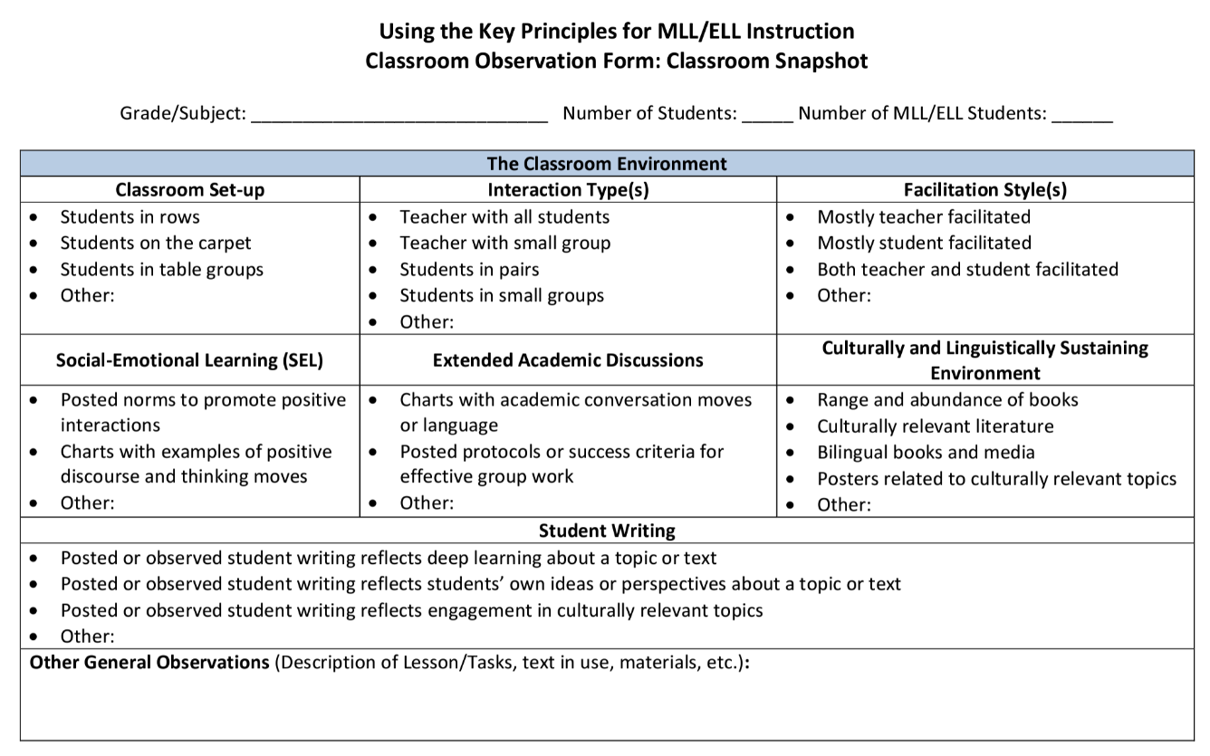

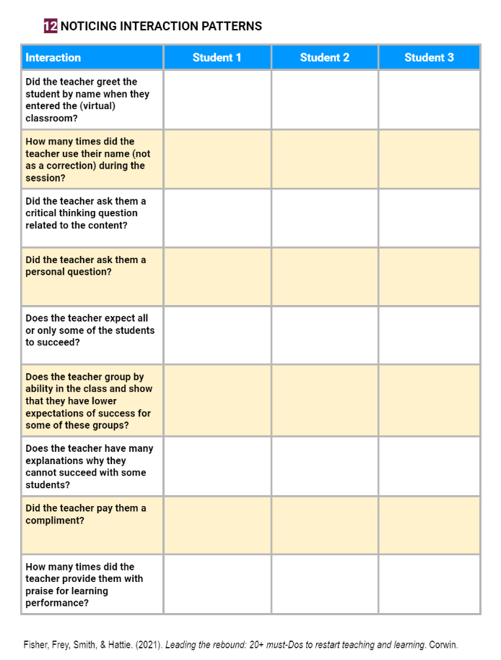

Tools for Equity Conversations led by Principals
Coaching For Equity
Elena Aguilar's Equity Rubric
New York ML/ELL Classroom Observation Tool
Classroom Observation Tool
Leading the Rebound
Teacher - Student Interactions
How Poverty Affects Classroom Management - Eric Jensen
The Science of Scarcity
- Cara Feinberg
Notes:
Spend 5 minutes looking through these tools. What do you see that could help move your school toward equitable practices?
https://brightmorningteam.com/coaching-for-equity-tools/
http://www.nysed.gov/common/nysed/files/programs/bilingual-ed/classroom-observation-tool-appendix-b-final-a.pdf
How Poverty Affects Classroom Management - Eric Jensen
Eric Jensen writes about how to support children experiencing poverty in the classroom.
The Science of Scarcity - Cara Feinberg
Feinberg reports on recent studies that cognition can suffer when you are experience poverty because you literally can’t think beyond your immediate needs.

Slide 38
Objectives
Learning Target:
Participants will understand how to differentiate the application of equitable practices.
Participants will understand how to differentiate instruction and structure the learning environment to meet the needs of diverse learners.
Success Criteria:
Participants will be able to define equity.
Participants will be able to identify and apply appropriate evidence-based strategies to ensure equitable practices in the classroom and school.
Notes:
Read individually or have a person in the group read it.

Slide 39


Please fill out the survey:
graniteway.org
Direct Link to Survey
Notes:
Please budget in five minutes towards the beginning of your presentation (rather than at the end) for principals to take this new survey.
As a reminder (because principals may ask):
-We are no longer asking principals to take post-GWPL surveys on the training they just barely experienced; moving forward we will ask principals to reflect on the training they gave last month.
-The intent of the change is to not only get information about the training, but how the training was operationalized in their schools.
-The survey is anonymous, unless they would like to include their names in one of their responses.

Slide 40
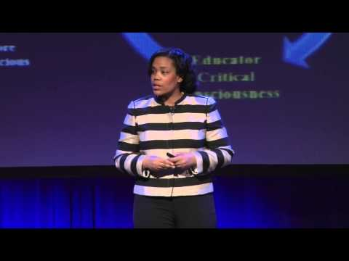
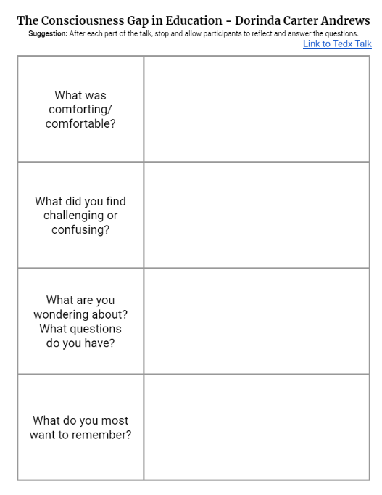
The consciousness gap in education - an equity imperative
Dorinda Carter Andrews
Handout
including full transcript and discussion guide
Notes:
If you feel that your staff has an understanding of what equity is and are ready to look at causes of achievement and opportunity gaps, this video could be used instead of the video to define equity with Elena Aguilar. Another possibility if you work through defining equity and would like to go deeper, this discussion guide can help you lead a discussion with your leadership team, full faculty, etc.

