Slide 1




Welcome
To Your Onboarding Journey
Notes:
A warm welcome to onboarding in our Toastmasters club, dear new member. My name is XY and I am the current Vice President Education / Vice President Membership of our club.
As a guest, you attended our club meetings for the first time, perhaps a little excited and unsure, but full of curiosity and enthusiasm. The warm atmosphere, the friendly welcome and the engaging contributions from our speakers clearly made a positive impression on you – because you have gone from guest to member. My heartfelt congratulations – that is a great decision! I can assure you of that wholeheartedly as a (long-standing) Toastmasters member. Now it is my task to give you an initial insight into how our club works and into the Pathways education program. This will help you to participate actively in club meetings and in Pathways as quickly as possible, and to turn that first spark of curiosity and enthusiasm into a lasting passion for our club.

Slide 2
Understanding the Onboarding Process
Notes:
To begin, I’d like to give you an overview of what you can expect in this presentation and what onboarding is all about.

Slide 3

Understanding the Onboarding Process
01
What isToastmasters?
Notes:
In the first part, I will explain who Toastmasters are and what Toastmasters do, so that you get to know the organization as a whole, beyond our club.

Slide 4

Understanding the Onboarding Process
01
What isToastmasters?
Select a learning path, deliver speeches, and participate in club roles
02
  Base Camp
  EasySpeak
Notes:
In the second part, I will show you how to choose a learning path, give speeches, and take on roles in club meetings. The main platforms for this are Base Camp and EasySpeak, which I will also explain in more detail.

Slide 5

Understanding the Onboarding Process
01
What isToastmasters?
Select a learning path, deliver speeches, and participate in club roles
02
  Base Camp
  EasySpeak
03
More information
Notes:
To conclude, I will give you some further information about the special characteristics of our club (such as our mentoring program, any hybrid meetings we may hold, recurring special events, and similar activities).

Slide 6
Understanding the Onboarding Process
01
What isToastmasters?
Select a learning path, deliver speeches, and participate in club roles
02
  Base Camp
  EasySpeak
03
More information
Notes:
Let’s start with the first topic: Who are Toastmasters and what is Toastmasters?

Slide 7




01
What is Toastmasters?
– nonprofit educational organization –
&
Rhetoric
Leadership
Improving Public Speaking: Speaking convincingly and entertainingly in front of people.
Developing leadership skills
Notes:
Toastmasters International, or TMI for short, is a global, non-profit educational organization dedicated to developing communication and leadership skills.

Slide 8

01
What is Toastmasters?
Founded: October 22, 1924, in the USA
Members worldwide: 270,000+
Clubs: 13.800+
Countries: 148
Members can visit other Toastmasters clubs as guests.
As of: 03/2026
Source: www.toastmasters.org/about
https://www.toastmasters.org/membership/why-toastmasters#
Notes:
The organization was founded in 1924 by Dr. Ralph Smedley and is therefore over 100 years old. It is called “International” because there are more than 13,800 clubs in nearly 150 countries with over 270,000 members. As a member, you can visit any Toastmasters club worldwide and take part in its meetings – a great opportunity to build a network both internationally and within Germany.

Slide 9







01
What is Toastmasters?
District 95
  Denmark, Faroe Islands, Germany, Greenland, Iceland, Norway & Sweden
  143 Clubs
  6 Divisions → A, B, C, D, E, G
As of: 03/2026
Notes:
As a member of a club in Germany, you belong to District 95 together with members from Denmark, Norway, Sweden, Greenland, Iceland and the Faroe Islands. From July 2026 onwards, Finland and Estonia will also be part of our district. At the moment, District 95 consists of 143 clubs in 6 divisions.

Slide 10
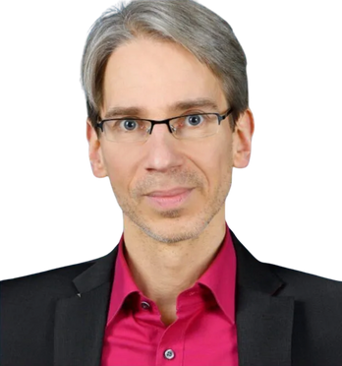
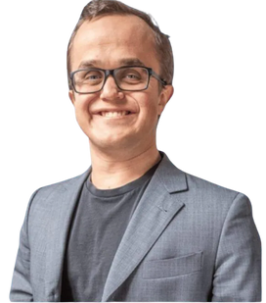
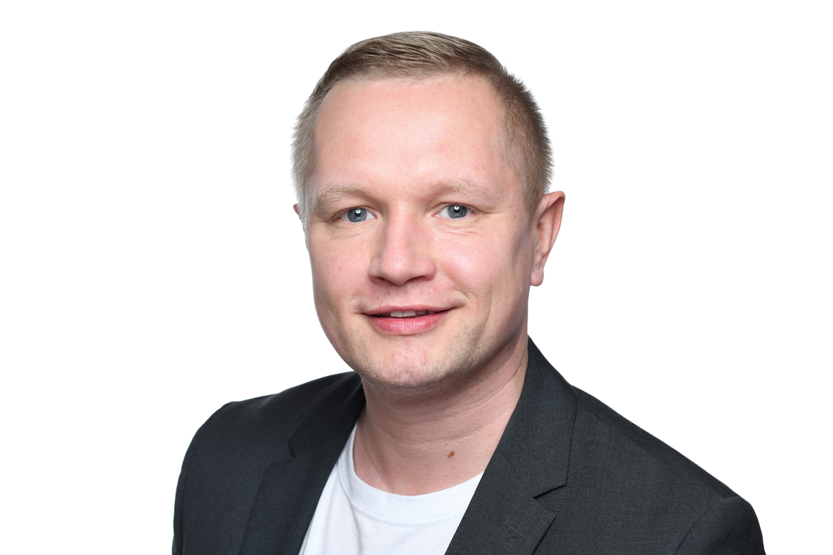
01
What is Toastmasters?
District 95 - TRIO
Tim Speer
Peter Ratko
Gustaf Winberg
District Director
Program Quality Director
Club Growth Director
Notes:
The district is led by the so‑called Trio – three experienced members who change every year and are supported by a core team and helpers like me as Pathways Lead. The District Director Tim Speer is comparable to a President, the Program Quality Director Peter Radko to a Vice President Education, and the Club Growth Director Gustav Winberg to a Vice President Membership at district level.

Slide 11

01
What is Toastmasters?
Core Values of Toastmasters International
Integrity:
Align actions with words, demonstrate honesty and trustworthiness, communicate with sincerity and consideration, acknowledge mistakes, and strive to do what is right.
Respect:
Treat everyone with dignity, welcome diverse perspectives, acknowledge all contributions, believe in positive intentions, take mutual responsibility, and offer criticism without belittling.
Service:
Provide high-quality, exceptional support by fulfilling individual and organizational duties with responsiveness, attentiveness, and passion.
Excellence:
Always strive to meet or exceed expectations by honoring the Toastmasters Promise, fostering a collaborative environment, developing creative solutions, and optimizing quality to deliver outstanding service.
Notes:
Toastmasters and our district are guided by four core values: integrity, respect, service, and excellence. These values apply to all members – including you. We aim to communicate honestly and respectfully, treat others with respect, and serve our club. This is the only way meetings can be both valuable and enjoyable for everyone. We also strive for high quality in our meetings and in all leadership roles.

Slide 12

01
What is Toastmasters?
Your Toastmasters Promise
As a member of Toastmasters International and my club, I promise
  To attend club meetings regularly
  To prepare all of my projects to the best of my ability, basing them on the Toastmasters education program
  To prepare for and fulfill meeting assignments
  To provide fellow members with helpful, constructive evaluations
  To help the club maintain the positive, friendly environment necessary for all members to learn and grow
  To serve my club as an officer when called upon to do so
  To treat my fellow club members and our guests with respect and courtesy
  To bring guests to club meetings so they can see the benefits Toastmasters membership offers
  To adhere to the guidelines and rules for all Toastmasters education and recognition programs
  To act within Toastmasters’ core values of integrity, respect, service and excellence during the conduct of all Toastmasters activities
Notes:
You may not have read the Toastmasters Promise very closely when you signed your membership application. In it, you commit to attending meetings regularly and, in the long term, to taking on leadership roles. Only if members adopt this mindset can a volunteer-run club function – everyone needs to contribute. Please do not see the Toastmasters Promise as pressure, but as a guide to help you get the most out of your membership.

Slide 13






01
What is Toastmasters?
Toastmasters Education Program - “Pathways”
Six learning paths, each consisting of five levels
Each path consists of speech projects, roles, and tasks that members perform in the club.
Dynamic Leadership
Persuasive
Influence
Motivational Strategies
Engaging Humor
Visionary Communication
Presentation Mastery
Notes:
Alongside meeting participation, a key element of Toastmasters is the Pathways education program. It is highly individualized and offers you a choice of six different learning paths. These paths cover a wide range of topics, such as “Dynamic Leadership,” “Persuasive Influence,” “Motivational Strategies,” “Engaging Humor,” “Visionary Communication,” and “Presentation Mastery.”

Slide 14



01
What is Toastmasters?
Toastmasters Education Program - “Pathways”
Six learning paths, each consisting of five levels
Each path consists of speech projects, roles, and tasks that members perform in the club.
1
2
3
4
5
Master the basics
Recognize your own style
Expand your knowledge
Develop skills
Demonstrate expertise
Path Completion
Icebreaker
2 required projects
1 required project
1 required project
1 required project
(1–2 speeches)
Evaluation & Feedback
Introduction to Toastmasters Mentoring
1 speech
2 elective projects
1 elective project
1 elective project
Writing a Speech with Purpose
Introduction to Vocal Variety and Body Language
Notes:
Each path consists of five consecutive levels with corresponding modules, called projects. In total, you complete 15 projects per path. We will return to this in more detail later.

Slide 15

Sample
01
What is Toastmasters?
Our Club
Please insert your club's information here
and remove this note.
The club "Insert Club Name" is the oldest public speaking club in Cologne.
(Insert brief description)
Founded in Cologne: 01/01/2001
Current members: 62
Meetings hybrid: Every Tuesday & every 4th Tuesday in English
As of: 05/2025
Notes:
Every club is unique. Our club, XY Toastmasters, is the newest / oldest / only club in Z. We meet every (weekday), and our meetings are held in English.

Slide 16











Sample
01
What is Toastmasters?
Our Club
Please insert your club's information here and
remove this note.
Roles at “Insert Club Name”
Toastmaster of the Evening
Ah-Counter
Time Keeper
Grammarian
Word of the Day
General Evaluator
Tip of the Day
Ballot Counter
Prepared Speeches
Hybrid Assistant
Evaluator
Guest Manager
Table Topicsmaster
Table Topics Speaker
Notes:
Clubs differ not only in their names and formats, but also in some of their meeting roles. In our club we have the following special roles: (name the roles). Other roles are the same in all clubs, such as Toastmaster, Table Topicsmaster, Evaluator and General Evaluator.

Slide 17

Sample
01
What is Toastmasters?
Our Club
Please insert your club's information here
and remove this note.
The board of “Insert Club Name” (01.07.2025 - 30.06.2026)
President
VP Education
VP Membership
VP Public Relations
Treasurer
Name
Name
Name
Name
Name
Secretary
Sergeant at Arms
Immediate Past President
Mentorship Manager
Name
Name
Name
Name
Notes:
Here you can see who the club officers are in our club. Different roles are responsible for different areas of club life (list the individual roles with names and functions). This concludes our first section, about Toastmasters in general and our club in particular.

Slide 18
Understanding the Onboarding Process
01
What is Toastmasters?
Select a learning path, deliver speeches, and participate in club roles
02
  Base Camp
  EasySpeak
03
More information
Notes:
In the second part, we will now turn to two important platforms that you need in order to participate actively in our club and to use the Pathways education program. If you want to take an active role in our club, it is essential that you know how to choose a learning path, work on your Pathways projects, give speeches, and take on meeting roles.

Slide 19

02
Procedures
Select a learning path, deliver speeches, and participate in club roles
To...
… deliver a speech
at the club
Notes:
One of the most common reasons why guests become members is the opportunity to give speeches in the club. Perhaps that is also true for you.

Slide 20

02
Procedures
Select a learning path, deliver speeches, and participate in club roles
You must first...
...start and work on a speech project
Notes:
To give a speech, you first start and work on a Pathways project, because prepared speeches are always based on the individual projects within the Pathways learning paths.

Slide 21

02
Procedures
Select a learning path, deliver speeches, and participate in club roles
For that, you need a...
...learning path
Notes:
So the first thing you need is a learning path, so that you can work on the projects it contains.

Slide 22
02
Procedures
Select a learning path, deliver speeches, and participate in club roles
As a Toastmasters club member, you need access to two portals with different purposes:
Notes:
To select and work on your learning path, and to take on meeting roles, you need to understand the two most important Toastmasters portals. Especially at the beginning of your membership, these two systems often cause confusion. Only when you use them confidently can you fully participate in Toastmasters activities.

Slide 23

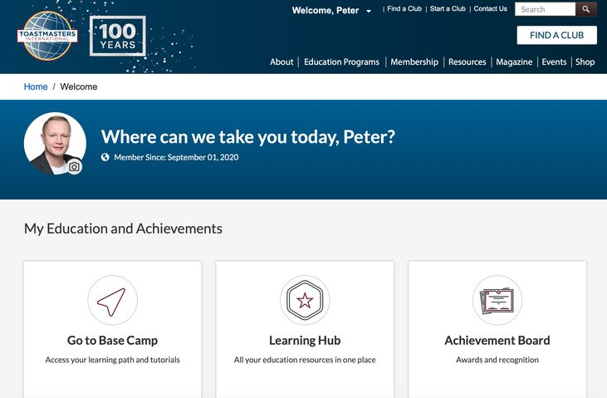
02
Procedures
Select a learning path, deliver speeches, and participate in club roles
As a Toastmasters club member, you need access to two portals with different purposes:
BaseCamp
This is where your Toastmasters speaking journey is managed.
Here you can:
Select your learning path
Start & complete speech projects
Notes:
The first portal is called Base Camp. This is where all aspects of your “speaking career” are managed. Here you have access to all theoretical resources, you work through the individual projects in your learning path, and you complete them. Base Camp is therefore the portal for the Pathways education program.

Slide 24
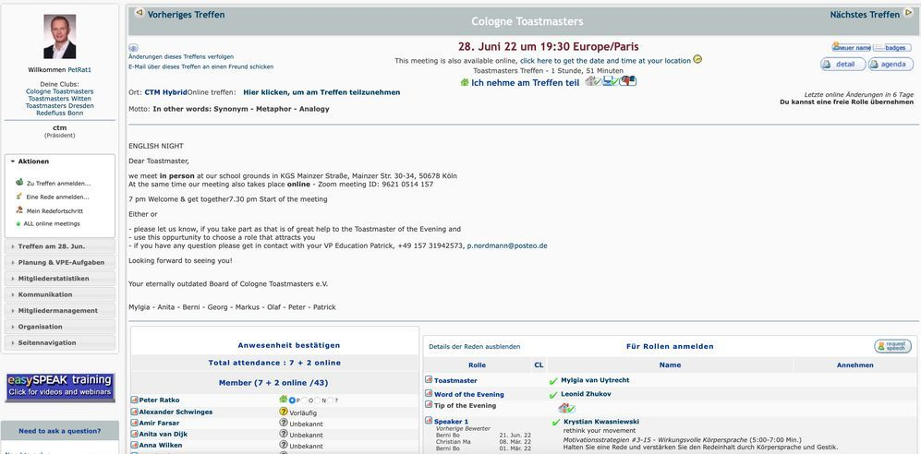
02
Procedures
Select a learning path, deliver speeches, and participate in club roles
As a Toastmasters club member, you need access to two portals with different purposes:
BaseCamp
EasySpeak
This is where your Toastmasters speaking journey is managed.
Platform for communication and club management
Here you can:
Here you can:
Select your learning path
Confirm or decline your attendance for the club meeting
Start & complete speech projects
Sign up for speeches or take on roles at the club meeting
Notes:
In contrast, EasySpeak is the portal used to organize club meetings. Here you can confirm your attendance, request speaking slots, and take on meeting roles. EasySpeak can also be used for communication among members. It is very important to know that these two portals are not connected. This means that one portal does not “know” what you are doing in the other. You therefore need a clear understanding of what to do in each portal – and this onboarding is designed to give you exactly that.

Slide 25

02
Procedures
Choose a learning path
Choose a
learning path
Notes:
To reach your most important goal – giving a speech in your club – you first need to choose a learning path. As mentioned earlier, there are several paths to choose from, which makes your learning experience at Toastmasters highly individualized.

Slide 26

02
Procedures
Choose a learning path
Open the TMI homepage in your browser
https://www.toastmasters.org
Log in on the TMI homepage
Select the "Education Programs" tab
Scroll down to "More Information"
Click on "Choose a Path"
Notes:
To select a learning path, first go to the Toastmasters International website. This is also where you will later access Base Camp. The web address is: toastmasters.org.

Slide 27
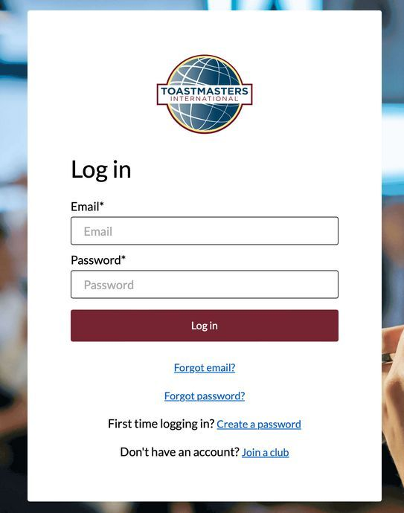

02
Procedures
Choose a learning path
Open the TMI homepage in your browser
Log in on the TMI homepage
Login:
Username: The email address you provided on the membership application form
Password: You will create your own
Select the "Education Programs" tab
Scroll down to "More Information"
Click on "Choose a Path"
Notes:
To log in, use the email address you provided on your membership application as your username. The first time you log in, you create your password by clicking “First time logging in? Create a password” in the login area and then setting your own password.

Slide 28
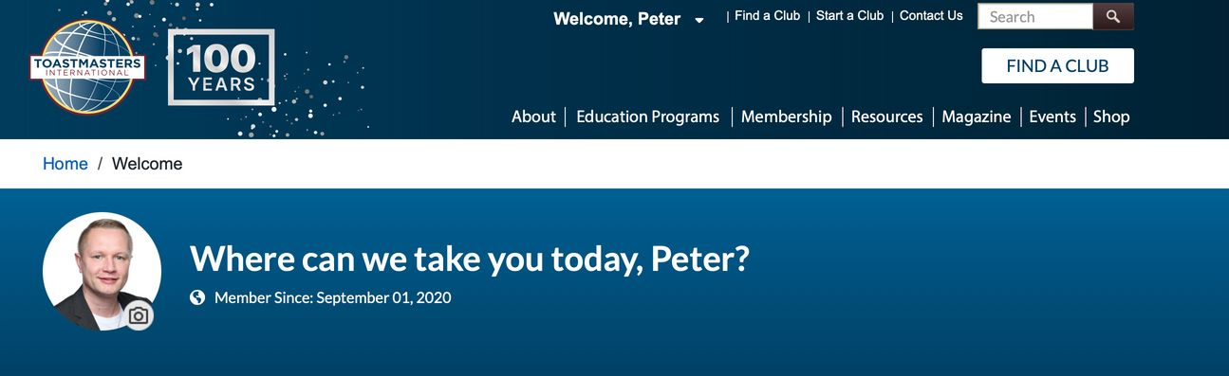
02
Procedures
Choose a learning path
After a successful "login", you will see your name.
Open the TMI homepage in your browser
Log in on the TMI homepage
Select the "Education Programs" tab
Scroll down to "More Information"
Click on "Choose a Path"
Notes:
Once you have successfully logged in, your name will appear at the top of the page.

Slide 29
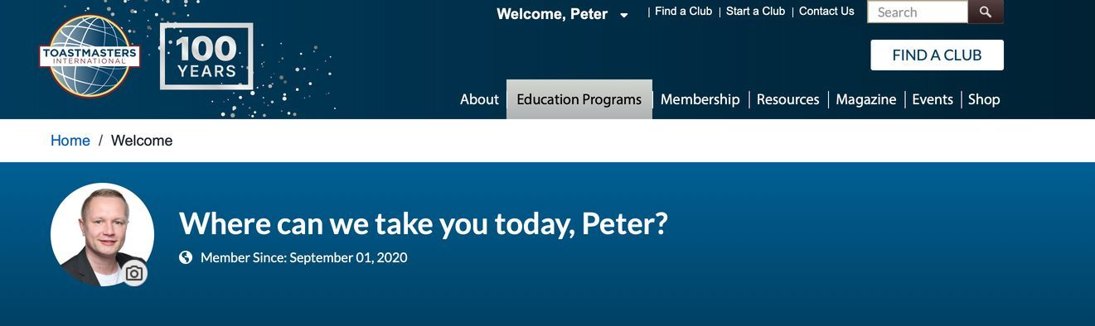
02
Procedures
Choose a learning path
Open the TMI homepage in your browser
Log in on the TMI homepage
Select the "Education Programs" tab
Scroll down to "More Information"
Click on "Choose a Path"
Notes:
To choose your first learning path, click on the “Education Programs” tab.

Slide 30
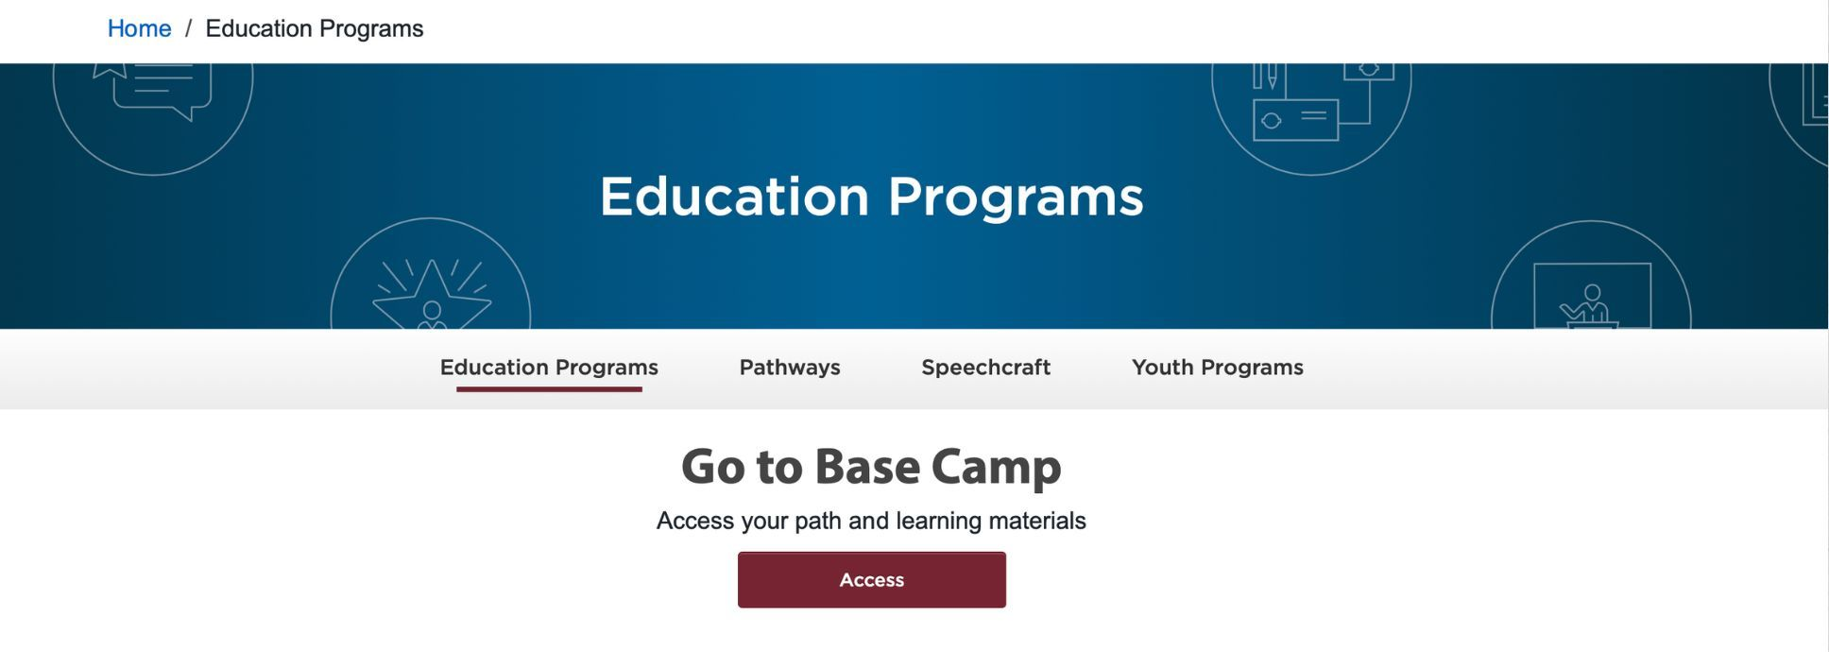
02
Procedures
Choose a learning path
"Education Programs" subpage
Open the TMI homepage in your browser
Log in on the TMI homepage
"Education Programs" subpage
Scroll down to "More Information"
Click on "Choose a Path"
Notes:
This screen will then appear.

Slide 31
02
Procedures
Choose a learning path
"Education Programs" subpage
Open the TMI homepage in your browser
Log in on the TMI homepage
Select the "Education Programs" tab
Scroll down to "More Information"
Click on "Choose a Path"
Scroll down
Notes:
Scroll further down on this page to the very bottom.

Slide 32
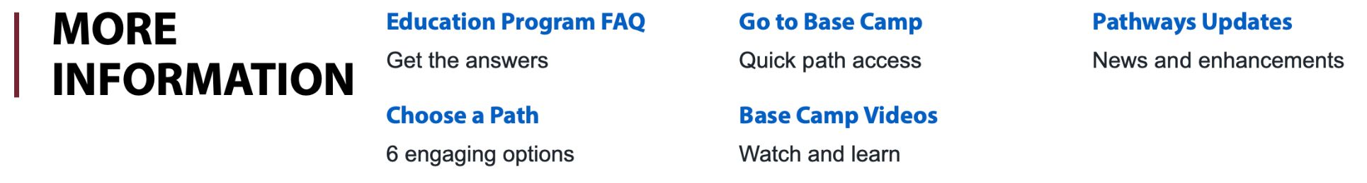
02
Procedures
Choose a learning path
"Education Programs" subpage
Open the TMI homepage in your browser
Log in on the TMI homepage
Select the "Education Programs" tab
“More Information”
Click on "Choose a Path"
Notes:
There, under the section “More Information”, you will find general information about Pathways…

Slide 33

02
Procedures
Choose a learning path
"Education Programs" subpage
Open the TMI homepage in your browser
Log in on the TMI homepage
Select the "Education Programs" tab
Scroll down to "More Information"
Click on "Choose a Path"
First learning path is free and included in the registration fee.
Notes:
…and also the section “Choose a Path,” where you can select your first learning path. Your first path is already included in the registration fee, so you do not have to pay anything here.

Slide 34
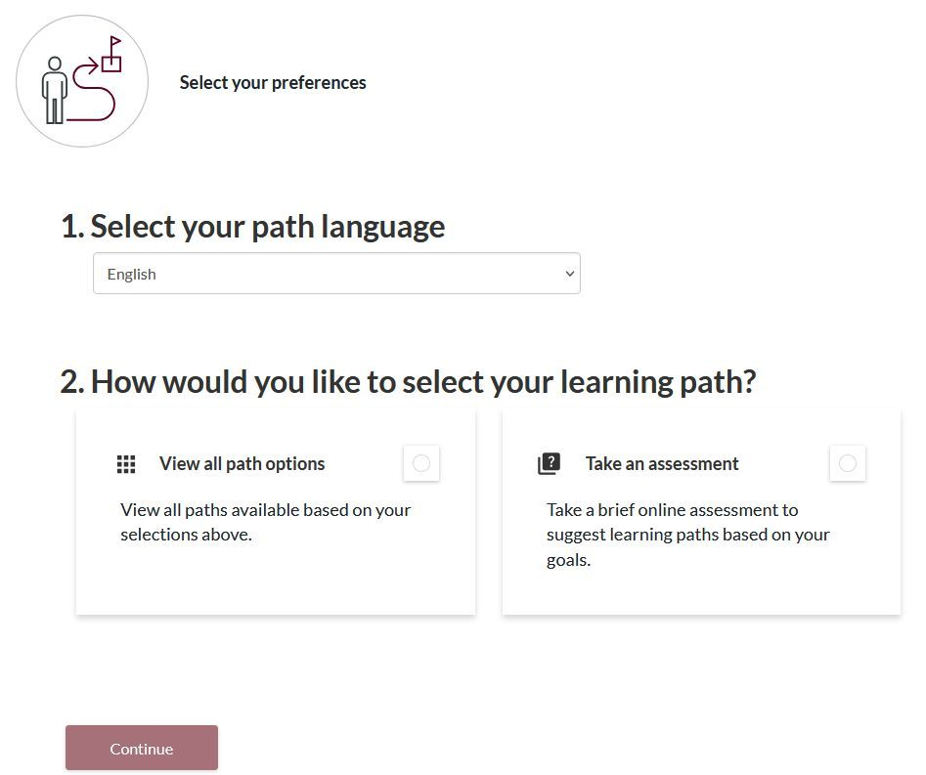
02
Procedures
Choose a learning path
Select language
Notes:
The first step in choosing a learning path is to select the language in which you want to read and work with your path content. Choosing the correct language here is crucial, because you can only change both the language and the path itself within the first 30 days.

Slide 35
02
Procedures
Choose a learning path
Select language
See all learning paths
Notes:
You can now either read the descriptions of all learning paths or…

Slide 36
02
Procedures
Choose a learning path
Select language
See all learning paths
Online self-assessment
Notes:
…complete an online self‑assessment questionnaire. You will be asked a few questions about your interests and existing skills, as well as your specific goals for your personal development with Toastmasters.

Slide 37
02
Procedures
Choose a learning path
Select language
See all learning paths
Online self-assessment
Continue
Notes:
Once you have decided how you want to choose your learning path, click on “Continue.”

Slide 38
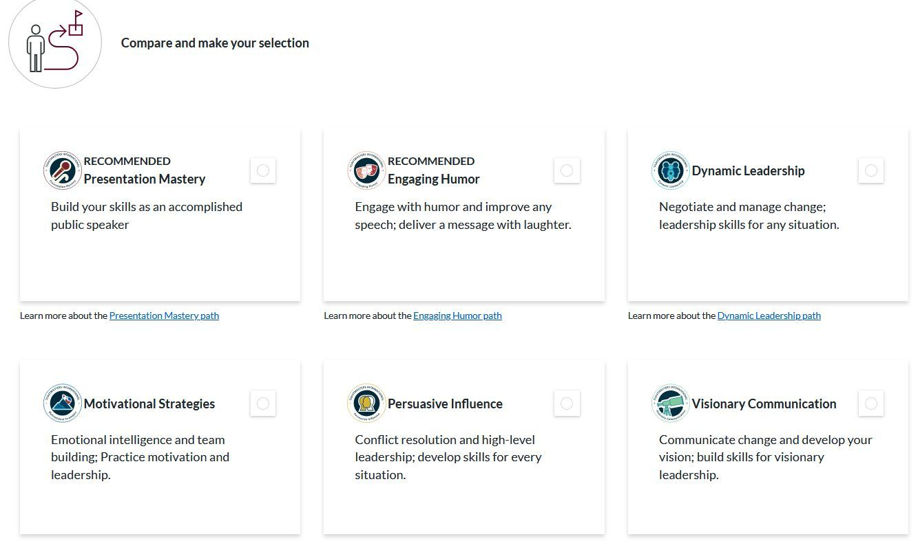
02
Procedures
Choose a learning path
Choose a learning path
Learning path information
Notes:
You can also find more detailed information about each path below the tiles that represent the different learning paths.

Slide 39

02
Procedures
Choose a learning path
Choose a learning path
Notes:
Based on your answers in the self‑assessment, the paths that best match your needs will be suggested. You can select one of these recommended paths, but you are not obliged to follow the recommendations if another path interests you more. Once you have made your choice, click on that path.

Slide 40
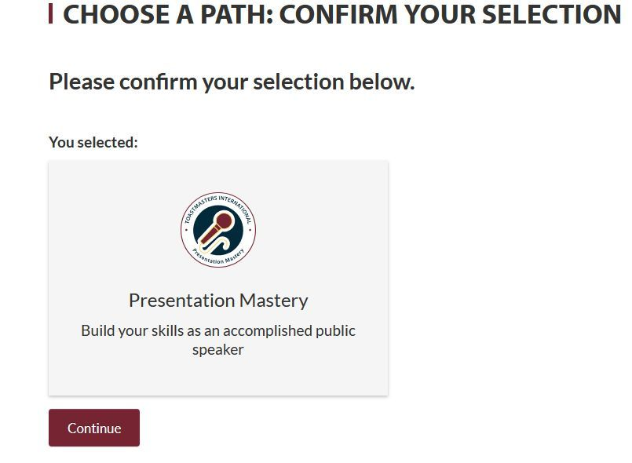

02
Procedures
Choose a learning path
Chosen path
Continue
Notes:
For confirmation, you will then be asked once again to verify your selection.

Slide 41
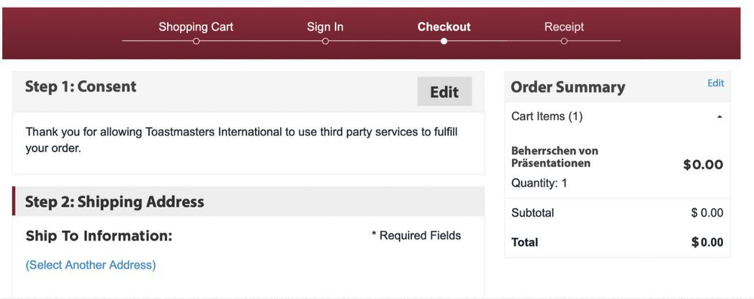

02
Procedures
Choose a learning path
Complete the order process
It may take up to 24 hours for the learning path to be activated.
Notes:
An invoice will then appear, but for your first learning path the amount is 0 euros – you do not have to pay anything at this point. Each additional path costs 20 USD plus tax. The path you selected will be available to you within 24 hours.

Slide 42

02
Procedures
Start, edit, and complete speech project
…Learning Path
…start and work on a speech project
Notes:
You have now successfully completed the first important step towards working on your speech projects and giving speeches in our club. Congratulations!

Slide 43
02
Procedures
Start, edit, and complete speech project
Open the TMI homepage in the browser
Log in on the TMI homepage
Select "Go to Base Camp'"
https://www.toastmasters.org
View the learning dashboard
Open your learning path
Start your speech project
Edit your speech project
Submit a speech request in "EasySpeak"
Close your speech project
Finish your level
Notes:
To access your chosen learning path and its speech projects, go to the TMI homepage again…

Slide 44
02
Procedures
Start, edit, and complete speech project
Open the TMI homepage in the browser
Login on the TMI homepage
Select "Go to Base Camp'"
View the learning dashboard
Login:
Username: xxx
Password: xxx
The data you know
Open your learning path
Start your speech project
Edit your speech project
Submit a speech request in "EasySpeak"
Close your speech project
Finish your level
Notes:
…and log in once more using the login details you now know.

Slide 45
02
Procedures
Start, edit, and complete speech project
Open the TMI homepage in the browser
Login on the TMI homepage
After a successful "login", you will see your name.
Select "Go to Base Camp'"
View the learning dashboard
Open your learning path
Start your speech project
Edit your speech project
Submit a speech request in "EasySpeak"
Close your speech project
Finish your level
Notes:
After a successful login, your name will again appear at the top of the page.

Slide 46
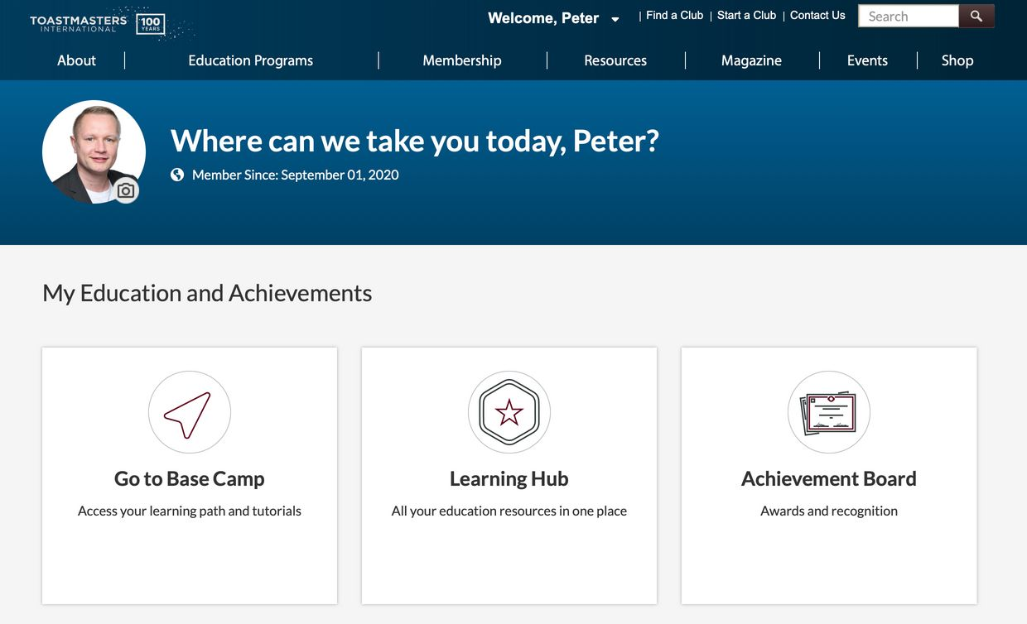
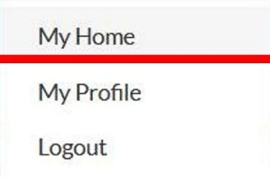
02
Procedures
Start, edit, and complete speech project
Open the TMI homepage in the browser
Log in on the TMI homepage
Select "Go to Base Camp'"
View the learning dashboard
Open your learning path
Start your speech project
Edit your speech project
Submit a speech request in "EasySpeak"
Close your speech project
Finish your level
Notes:
Either the “My Education and Achievements” area appears immediately, or you select “My Home” from the dropdown menu next to your name to get there. After choosing your path, you will now see the tile “Go to Base Camp,” which takes you from the general TMI homepage to the Base Camp portal.

Slide 47
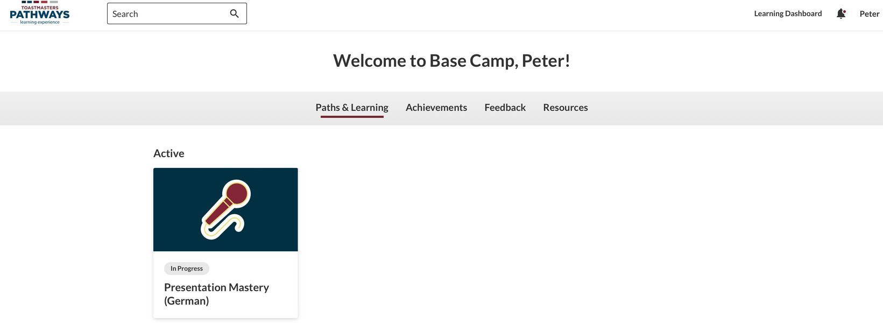
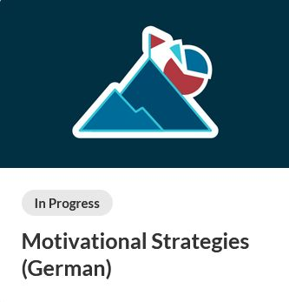
02
Procedures
Start, edit, and complete speech project
Open the TMI homepage in the browser
Welcome to BaseCamp
Log in on the TMI homepage
Select "Go to Base Camp'"
View the „Learning dashboard"
Open your learning path
Start your speech project
Edit your speech project
Your learning paths
Submit a speech request in "EasySpeak"
Close your speech project
Finish your level
Notes:
You will now see your learning dashboard with various tabs. Under the “Paths & Learning” tab you will find your learning path. Click on the path tile to open it.

Slide 48
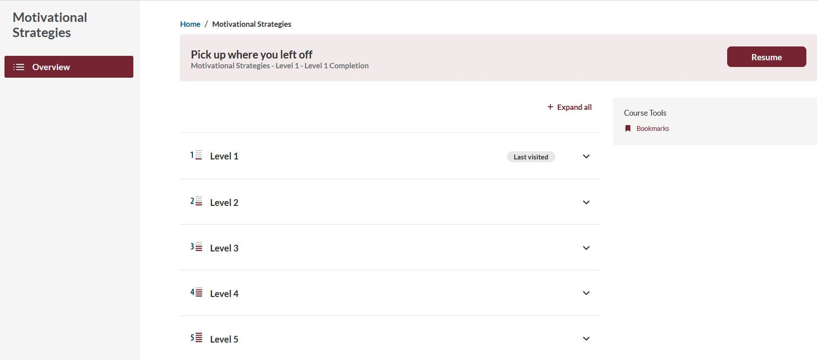
02
Procedures
Start, edit, and complete speech project
Motivational Strategies
Open the TMI homepage in the browser
Log in on the TMI homepage
Select "Go to Base Camp'"
View the learning dashboard
Open your learning path
Start your speech project
Edit your speech project
Submit a speech request in "EasySpeak"
Close your speech project
Finish your level
Notes:
An overview page of all five levels of your path will now appear. You can expand the levels on the right.

Slide 49
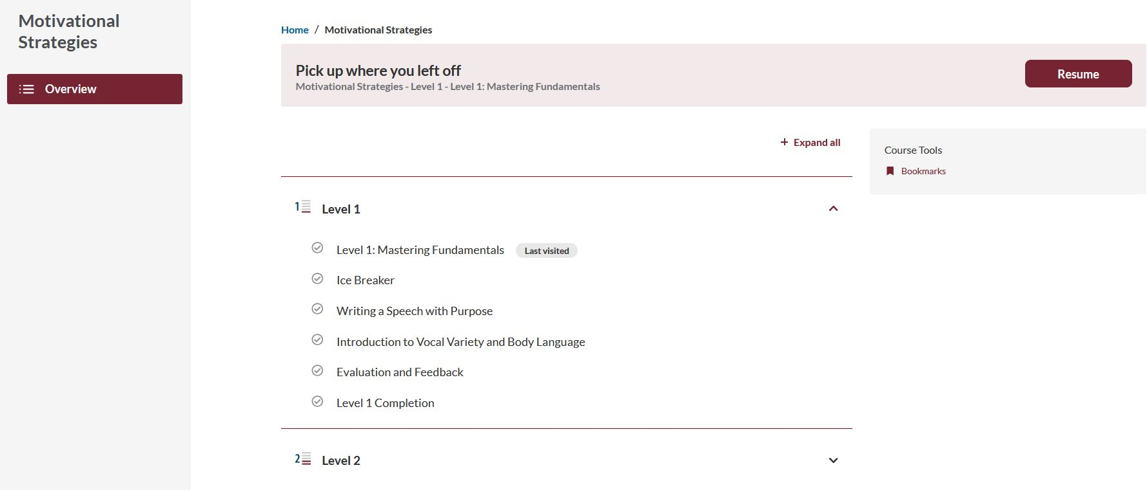
02
Procedures
Start, edit, and complete speech project
Motivational Strategies
Open the TMI homepage in the browser
Log in on the TMI homepage
Select "Go to Base Camp'"
View the learning dashboard
Open your learning path
Open your learning path
Start your speech project
Edit your speech project
Open level requirements
Submit a speech request in "EasySpeak"
Close your speech project
Finish your level
Notes:
When you expand a level, you will see a dedicated section with all requirements for that level, including all projects.

Slide 50
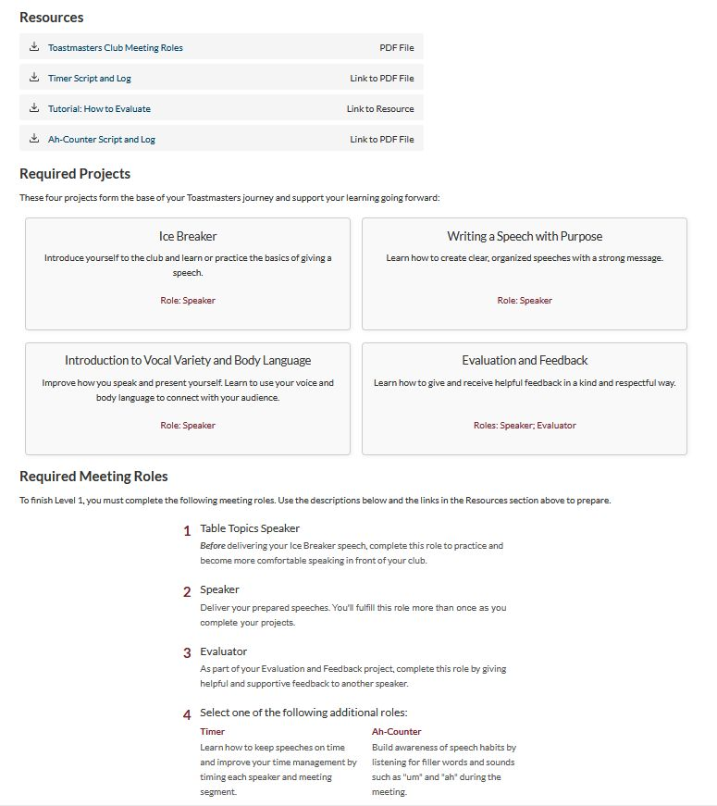
02
Procedures
Start, edit, and complete speech project
Motivational Strategies
Open the TMI homepage in the browser
Log in on the TMI homepage
Select "Go to Base Camp'"
View the learning dashboard
Open your learning path
Open your learning path
Start your speech project
Edit your speech project
Submit a speech request in "EasySpeak"
Close your speech project
Finish your level
Notes:
In this overview of all level requirements, you will first see downloadable resources for the level. Below that, all projects associated with the level are listed, followed by the meeting roles that must be completed for that level. In higher levels, presentations from the Educational Series are also added.

Slide 51
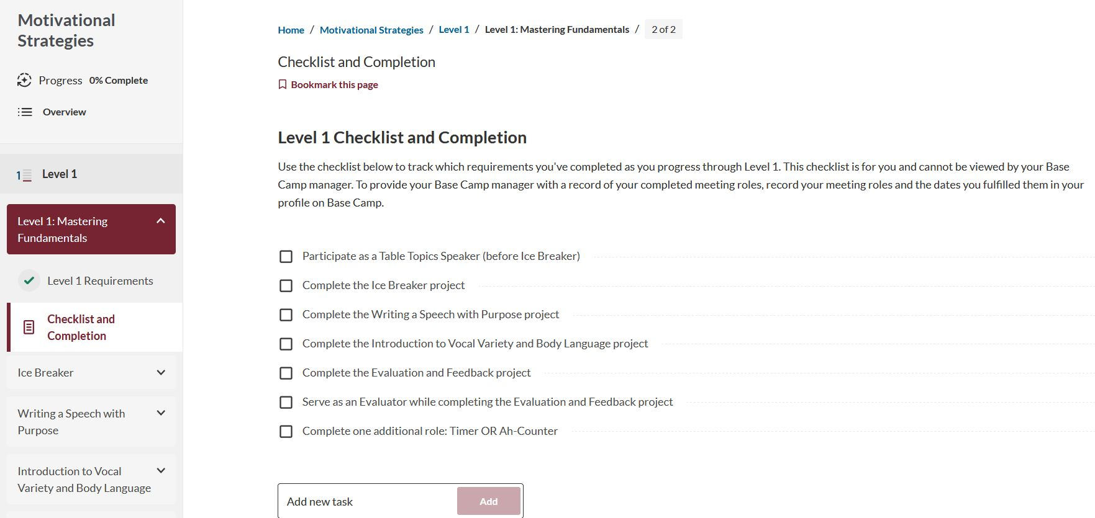
02
Procedures
Start, edit, and complete speech project
Motivational Strategies
Open the TMI homepage in the browser
Log in on the TMI homepage
Select "Go to Base Camp'"
View the learning dashboard
Open your learning path
Open your learning path
Start your speech project
Check off level requirements
Edit your speech project
Submit a speech request in "EasySpeak"
Close your speech project
Finish your level
Notes:
A second page provides a checklist where you must mark all requirements you have completed. Only then will you be able to request level completion later on.

Slide 52
02
Procedures
Start, edit, and complete speech project
Motivational Strategies
Open the TMI homepage in the browser
Log in on the TMI homepage
Select "Go to Base Camp'"
View the learning dashboard
Open your learning path
Start your speech project
Open the project
Edit your speech project
Submit a speech request in "EasySpeak"
Close your speech project
Finish your level
Notes:
The overview page also shows all projects in each level. Your first project is usually the Icebreaker, in which you introduce yourself to our club. This is your easiest task because you are talking about someone you know very well – yourself. As a rule, you can complete the projects within a level in any order you like – so follow your personal interests here. The levels themselves, however, can only be completed in numerical order from 1 to 5. To open a project, simply click on its name.

Slide 53
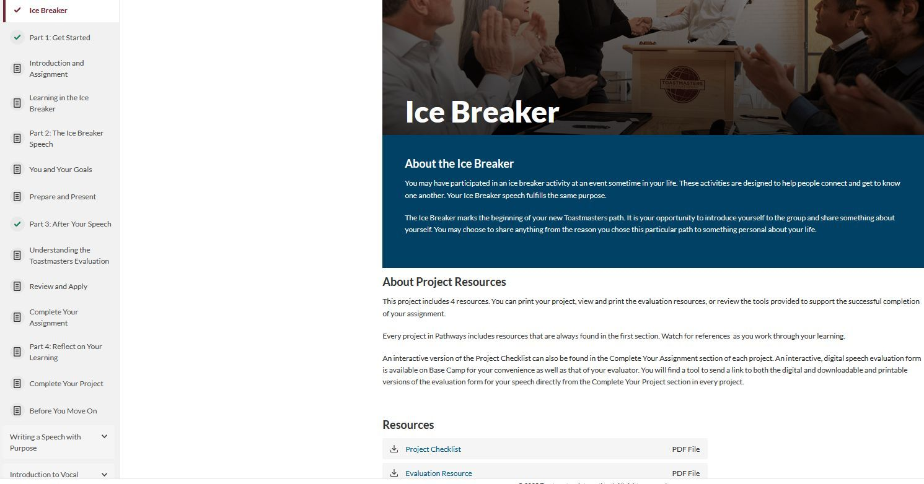
02
Procedures
Start, edit, and complete speech project
Edit your speech project
Open the TMI homepage in the browser
Log in on the TMI homepage
Select "Go to Base Camp'"
Navigation bar
View the learning dashboard
Open your learning path
Start your speech project
Edit your speech project
Submit a speech request in "EasySpeak"
Close your speech project
Finish your level
Notes:
A side navigation bar on the left shows you the table of contents for the project as well as a list of the other projects in the selected level. You can use this navigation bar to jump easily to any page within the project. Of course, you can also use the “Next” button at the bottom of each page to move forward step by step. On the first page of the project, in addition to a brief introduction to the topic, you will find the “Resources” section further down. Here you can download helpful documents such as the project checklist, the evaluation form for your speech evaluator, the full project content, and other useful materials. It is best to print the evaluation form right away so you can hand it to your evaluator before the meeting.

Slide 54
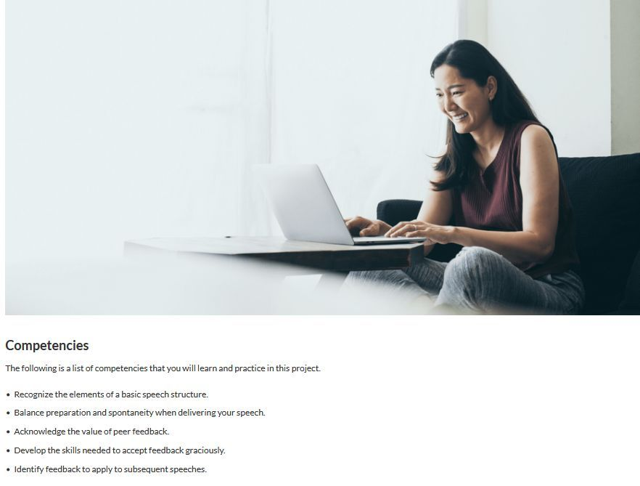
02
Procedures
Start, edit, and complete speech project
Edit your speech project
Open the TMI homepage in the browser
Log in on the TMI homepage
Select "Go to Base Camp'"
View the learning dashboard
Open your learning path
Start your speech project
Edit your speech project
Submit a speech request in "EasySpeak"
Close your speech project
Finish your level
Notes:
On one of the following pages, you will find the competencies you can develop by working through the project.

Slide 55
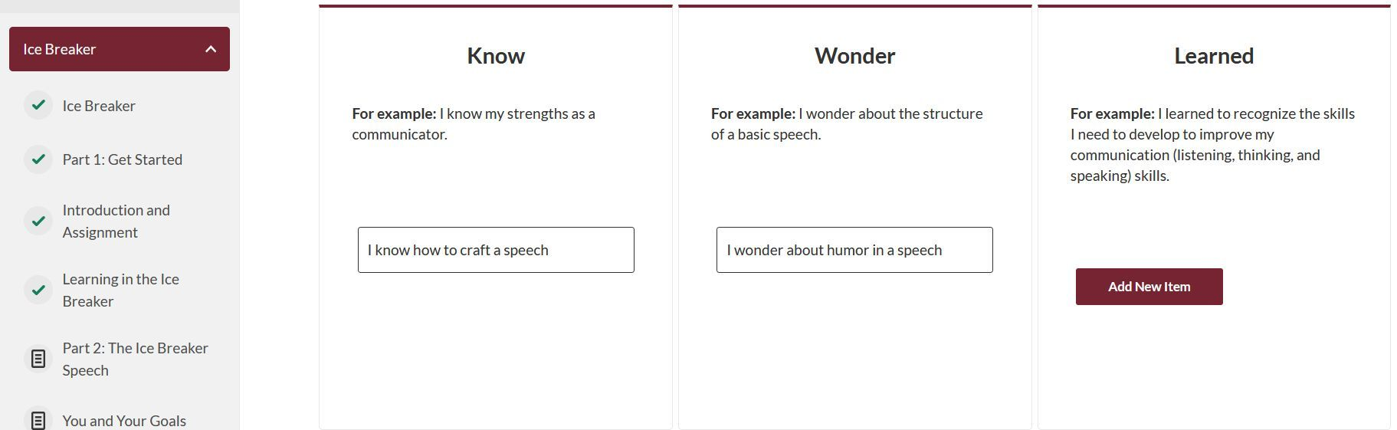
02
Procedures
Start, edit, and complete speech project
Edit your speech project
Open the TMI homepage in the browser
Log in on the TMI homepage
Select "Go to Base Camp'"
View the learning dashboard
Open your learning path
Start your speech project
Edit your speech project
Submit a speech request in "EasySpeak"
Close your speech project
Finish your level
Notes:
At the beginning of the project, you also have the option to record your prior knowledge of the topic and any open questions in a free‑text field. After completing the project, you can use the last column in this overview to note what you have learned. Using this function is completely optional. You are not strictly required to read all of the theory in the project, but it is highly recommended. The theory provides a solid foundation to help you develop step by step and deliver your speeches with a clear goal and focus.

Slide 56
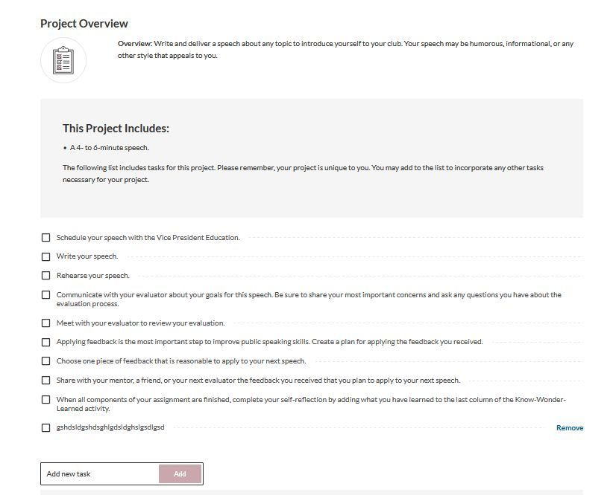

02
Procedures
Start, edit, and complete speech project
Submit a speech request in "EasySpeak"
Open the TMI homepage in the browser
Log in on the TMI homepage
Select "Go to Base Camp'"
View the learning dashboard
Open your learning path
Start your speech project
Edit your speech project
Submit a speech request in "EasySpeak"
Close your speech project
Finish your level
Submit a speech request in EasySpeak
Notes:
At the end of the theoretical part of the project, as at the beginning, you will find a description of the project assignment. This describes the minimum requirements you must meet in order to complete your project. Below that you will also find an interactive checklist, where you can add, tick off, or delete items and adapt it in this way to your individual needs. The checklist helps you keep track of all the steps you need to take to finish your project. One of these steps is to request your project speech. Once your project speech is fully developed and rehearsed, it is time to request a speech slot for a meeting in EasySpeak. I will explain how to do this in more detail later.

Slide 57
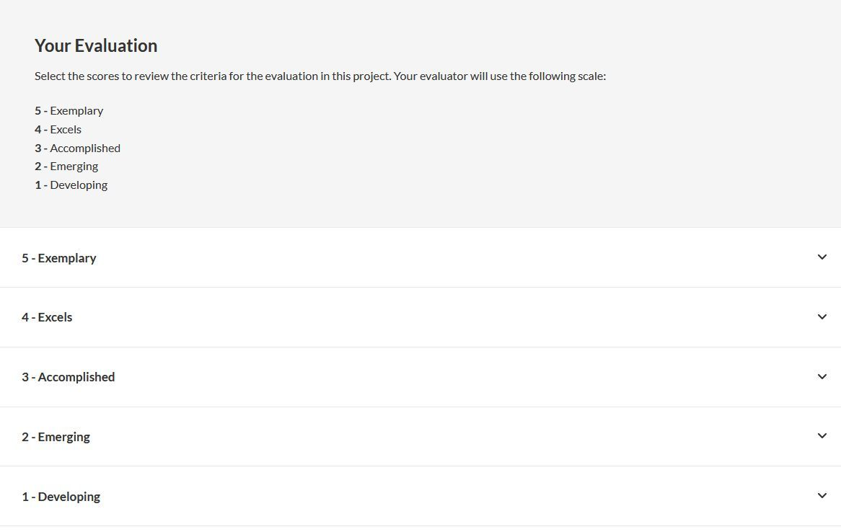
02
Procedures
Start, edit, and complete speech project
Evaluation form
Open the TMI homepage in the browser
Log in on the TMI homepage
Select "Go to Base Camp'"
View the learning dashboard
Open your learning path
Start your speech project
Edit your speech project
Evaluation form
Close your speech project
Finish your level
Notes:
Below the checklist you will also find a description of your evaluator’s criteria. These become visible when you expand each item. If you give your evaluator the evaluation form, they can focus very specifically on the project assignment and on the objectives, you had when prepared your speech. This makes their feedback more targeted than if they only commented on general aspects.

Slide 58
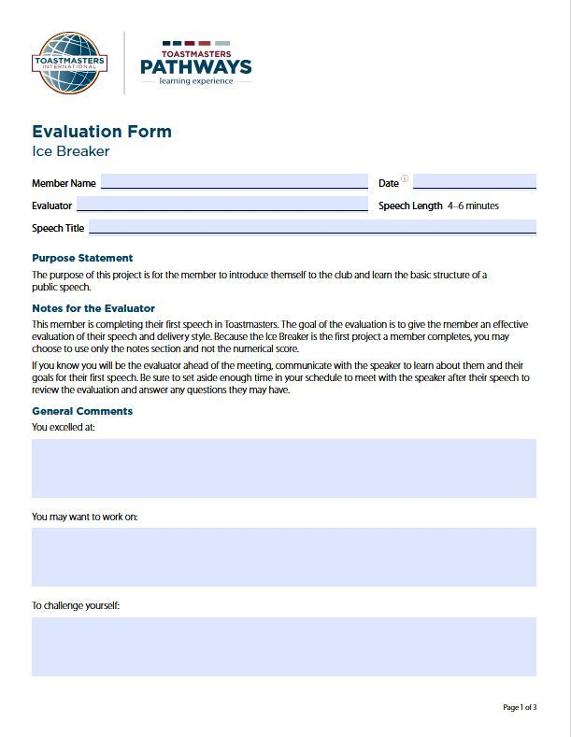
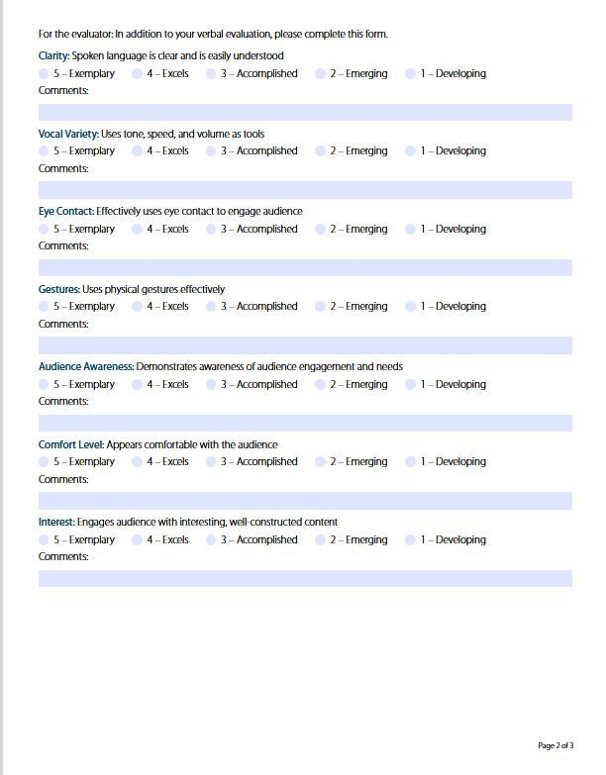
02
Procedures
Start, edit, and complete speech project
Evaluation form
Open the TMI homepage in the browser
Log in on the TMI homepage
Select "Go to Base Camp'"
View the learning dashboard
Open your learning path
Start your speech project
Edit your speech project
Evaluation form
Close your speech project
Finish your level
Notes:
The evaluation form consists of several pages. On the first page, your evaluator can enter, as free text, your existing strengths, areas for improvement, and areas in which you can particularly challenge yourself. On the second page, they award points from 1–5 for various aspects of a good presentation. An explanation of what each point value means is provided on the third page, or in the description of the evaluation criteria in Base Camp that I showed you earlier.

Slide 59
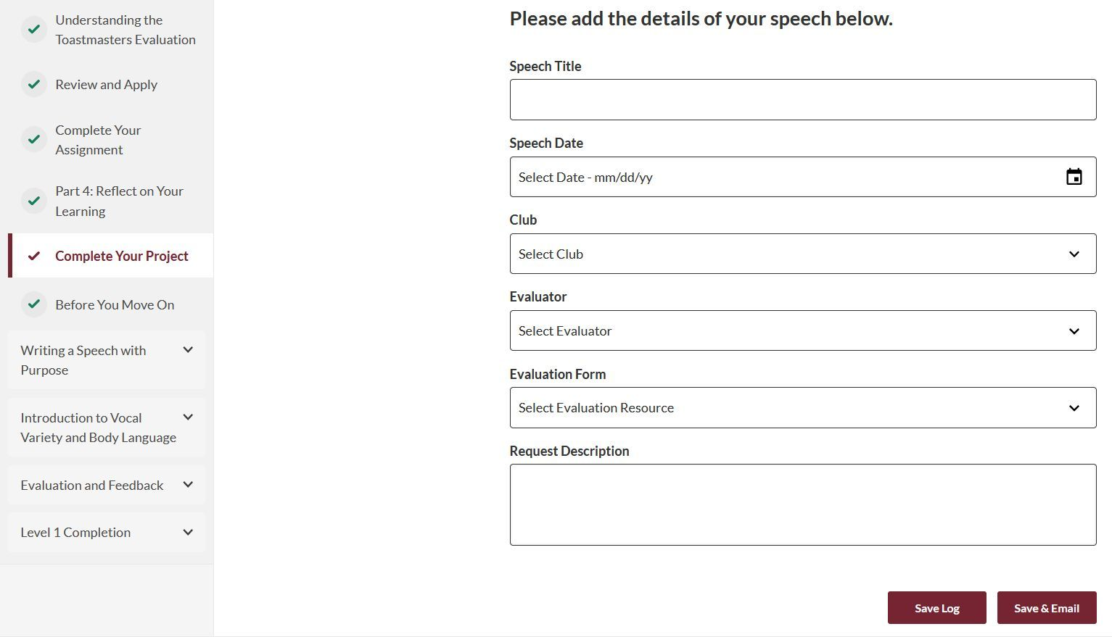
02
Procedures
Start, edit, and complete speech project
Evaluation form
Open the TMI homepage in the browser
Log in on the TMI homepage
Select "Go to Base Camp'"
View the learning dashboard
Open your learning path
Start your speech project
Edit your speech project
Evaluation form
Close your speech project
Finish your level
Notes:
If you already know who your evaluator will be, you can send them the evaluation form directly from Base Camp via email. After selecting our club, you will see all club members and can choose your evaluator. Below that, select the evaluation form that belongs to your project. You can also use the text field to give your evaluator notes on what they should pay particular attention to in your speech. When you click “Save & Send Email,” the evaluation form is automatically sent to your evaluator. At the same time, the speech title and date are saved, if you enter them here, so your speech is recorded within your project in Base Camp. If you prefer, you can also save only the title and date of the planned speech without sending the evaluation form to your evaluator – to do this, click “Save Log”.

Slide 60
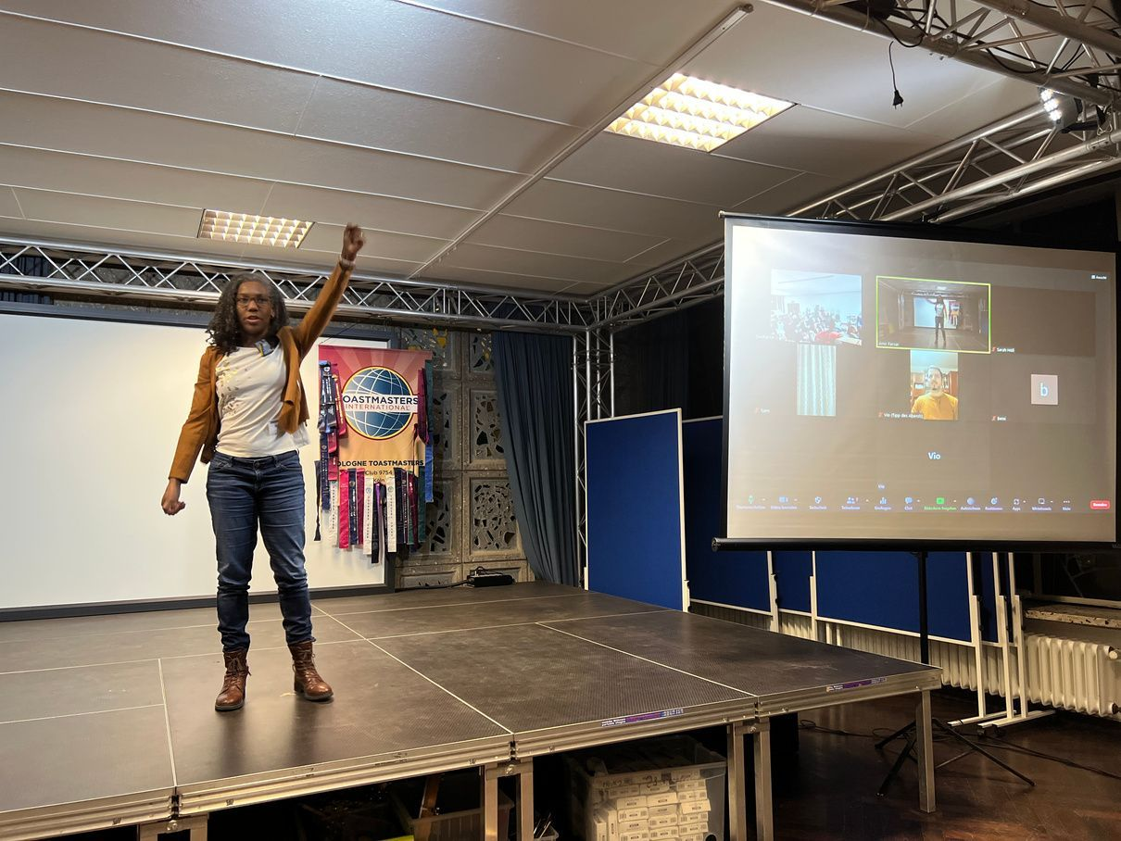
02
Procedures
Start, edit, and complete speech project
Open the TMI homepage in the browser
Log in on the TMI homepage
Select "Go to Base Camp'"
View the learning dashboard
Open your learning path
Start your speech project
Edit your speech project
Submit a speech request in "EasySpeak"
Close your speech project
Give a speech at the club & receive an evaluation
Finish your level
Notes:
You are now well prepared to give your speech in the club and to receive focused, project‑specific feedback.

Slide 61
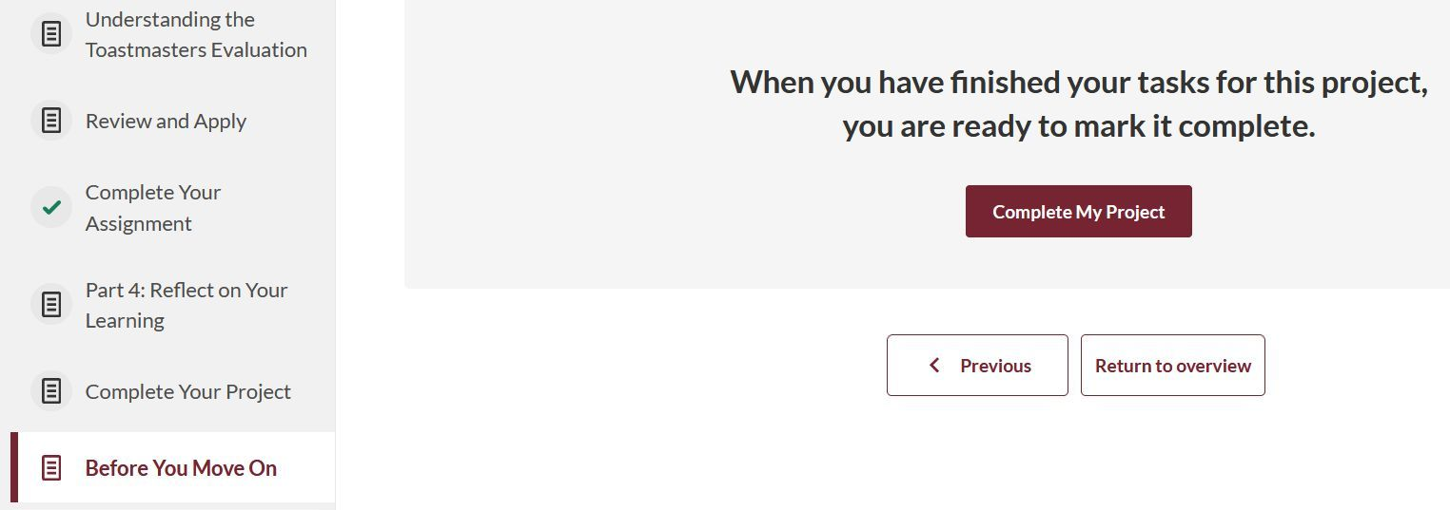
02
Procedures
Start, edit, and complete speech project
After your speech: Return to the speech project
Open the TMI homepage in the browser
Log in on the TMI homepage
Select "Go to Base Camp'"
View the learning dashboard
Open your learning path
Start your speech project
Edit your speech project
Submit a speech request in "EasySpeak"
Close your speech project
Finish your level
Notes:
Registering your speech for a club meeting in EasySpeak does not mean that you have completed your project. You still need to explicitly complete the project in Base Camp after your speech! To do this, go in Base Camp to the “Before You Continue” page….

Slide 62
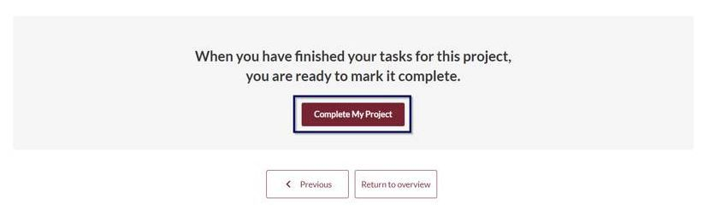
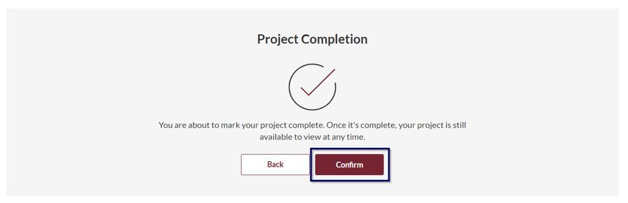
02
Procedures
Start, edit, and complete speech project
Close your speech project
Open the TMI homepage in the browser
Log in on the TMI homepage
Select "Go to Base Camp'"
View the learning dashboard
Open your learning path
Start your speech project
Edit your speech project
Submit a speech request in "EasySpeak"
Close your speech project
Stufe abschließen
Notes:
….and confirm twice, that you have met all the requirements for the project. If you have done everything correctly…

Slide 63
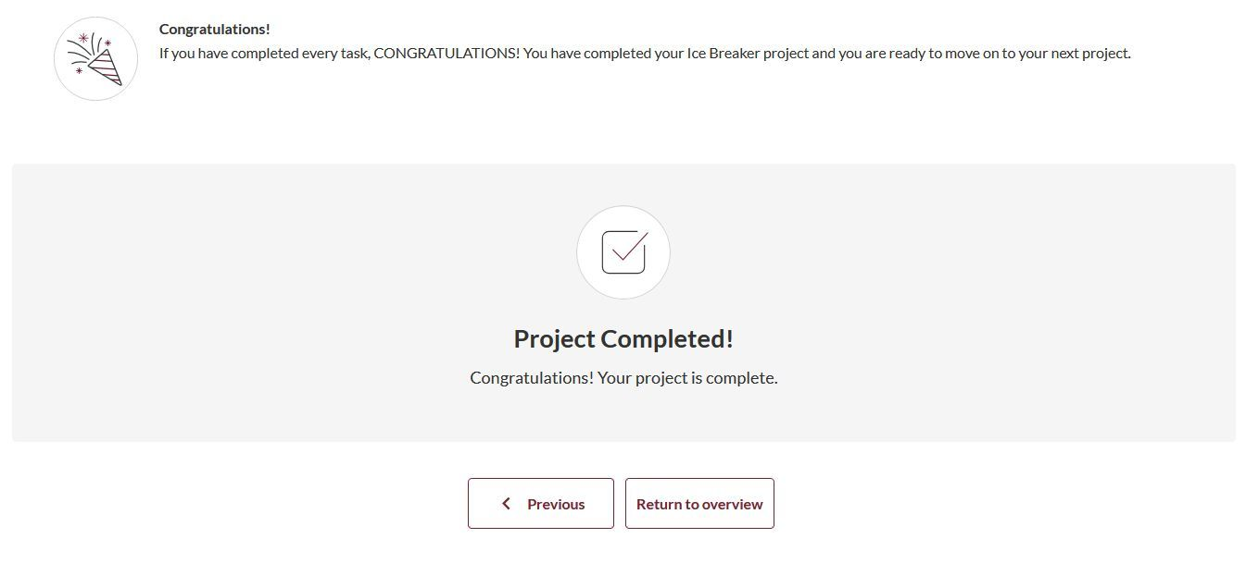

02
Procedures
Start, edit, and complete speech project
Speech project completed
Open the TMI homepage in the browser
Log in on the TMI homepage
Select "Go to Base Camp'"
View the learning dashboard
Open your learning path
Start your speech project
Edit your speech project
Submit a speech request in "EasySpeak"
Close your speech project
Stufe abschließen
Notes:
…a confirmation will appear stating that your project has been completed.

Slide 64
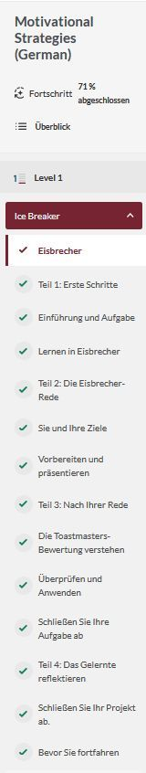
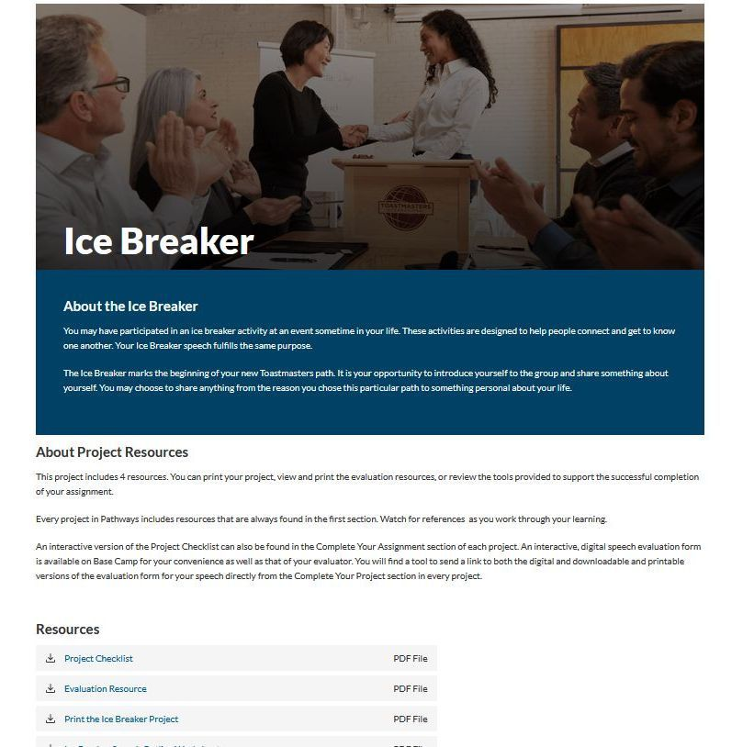
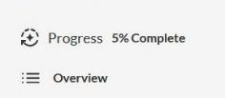
02
Procedures
Start, edit, and complete speech project
Finish your level
Open the TMI homepage in the browser
Log in on the TMI homepage
Select "Go to Base Camp'"
View the learning dashboard
Open your learning path
Start your speech project
Edit your speech project
Submit a speech request in "EasySpeak"
Close your speech project
Finish your level
Notes:
Once you have completed a project, the percentage shown in the progress indicator at the top left automatically increases.

Slide 65
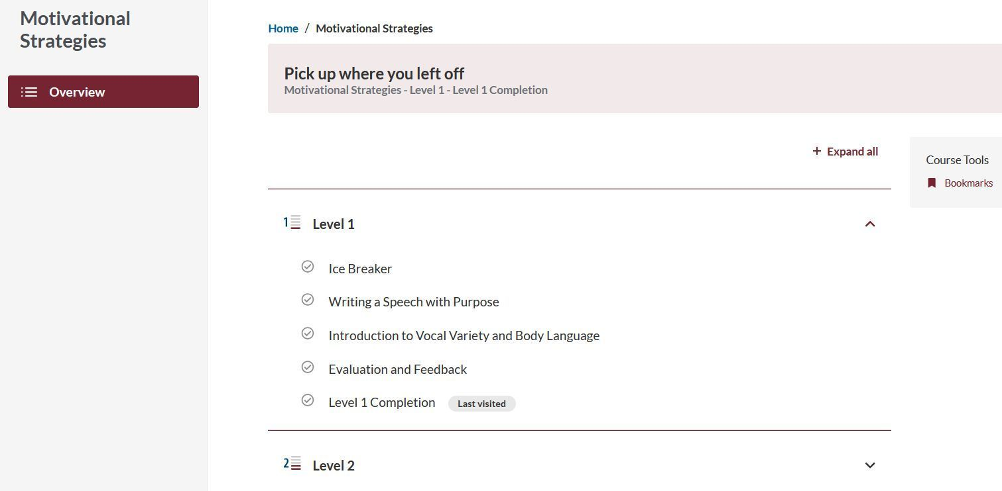

02
Procedures
Start, edit, and complete speech project
Finish your level
Open the TMI homepage in the browser
Log in on the TMI homepage
Select "Go to Base Camp'"
View the learning dashboard
Open your learning path
Start your speech project
Edit your speech project
Start next project
Submit a speech request in "EasySpeak"
Finish your level
Finish your level
Notes:
You can also see that you have completed your first project by the green check mark in front of the completed project on the overview page. You can now work on and complete the remaining projects in the level in a similar way.

Slide 66
02
Procedures
Start, edit, and complete speech project
Finish your level
Open the TMI homepage in the browser
Log in on the TMI homepage
Select "Go to Base Camp'"
View the learning dashboard
Open your learning path
Start your speech project
Edit your speech project
Submit a speech request in "EasySpeak"
Finish your level
Finish your level
Notes:
Once you have completed all projects in the level, you can apply for level completion.

Slide 67
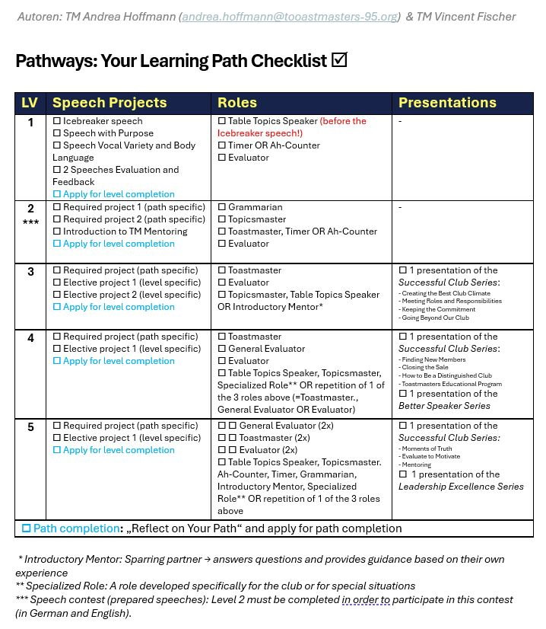
02
Procedures
Start, edit, and complete speech project
All requirements of the level fulfilled
Open the TMI homepage in the browser
Log in on the TMI homepage
Select "Go to Base Camp'"
View the learning dashboard
Open your learning path
Start your speech project
Edit your speech project
Submit a speech request in "EasySpeak"
Finish your level
Finish your level
Notes:
Please note: in addition to the learning path projects, there are further requirements for level completion, namely the performance of specific meeting roles. These vary from level to level. From Level 3 onwards, longer presentations from various educational series are also included. To keep track of all requirements for a level, I recommend printing the Pathways checklist and using it to monitor whether you have fulfilled everything. Once all requirements are met, you can apply for level completion. You will find this Pathways checklist on the Pathways page of District 95 – you will hear more about this later.

Slide 68
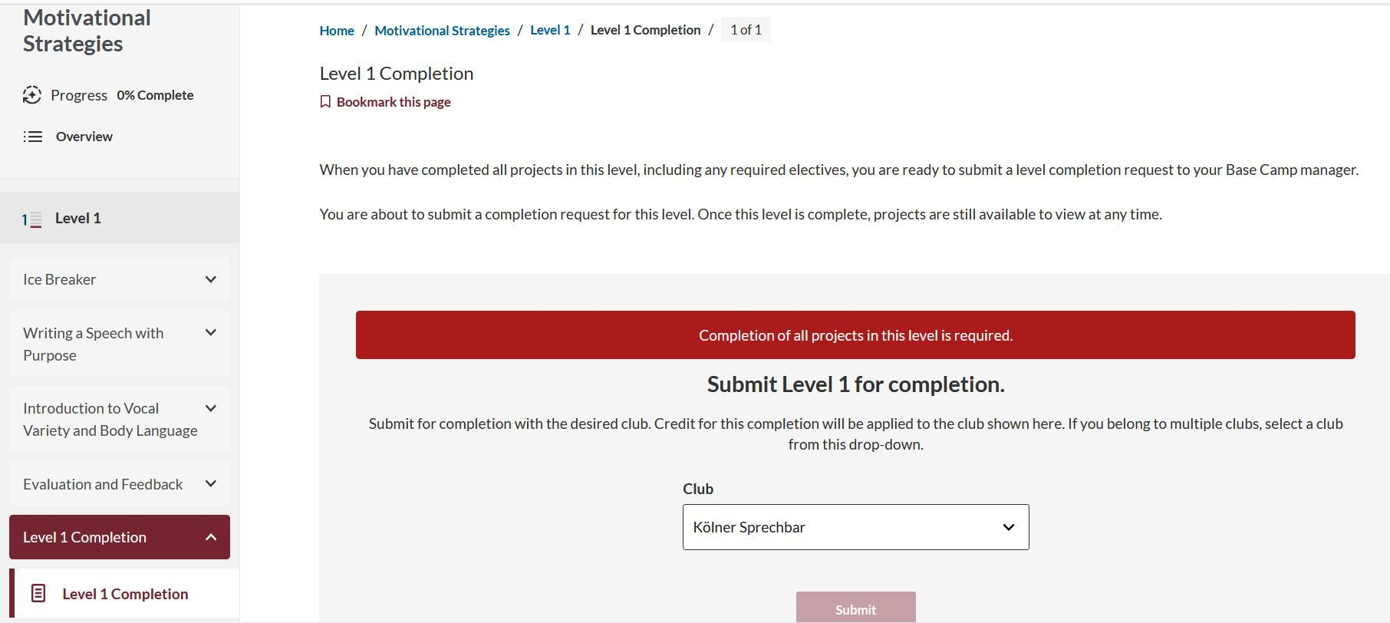
02
Procedures
Start, edit, and complete speech project
Finish your level
Open the TMI homepage in the browser
Log in on the TMI homepage
Select "Go to Base Camp'"
View the learning dashboard
Open your learning path
If not all requirements for the level are completed
Start your speech project
Edit your speech project
Submit a speech request in "EasySpeak"
Finish your level
Finish your level
Notes:
If you have not marked all projects and other requirements as completed in Base Camp, a red warning message will appear, and you will not be able to submit a level completion request. In that case, simply go through all projects in the level again, complete any remaining ones, and make sure you have checked off all requirements in the level checklist at the beginning of the level.

Slide 69
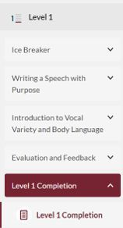
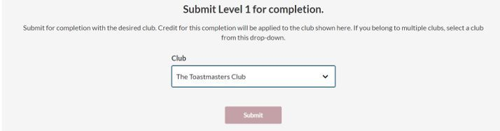
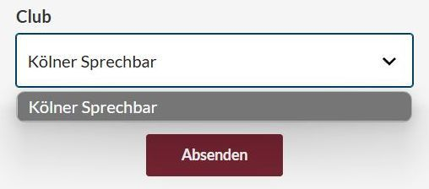
02
Procedures
Start, edit, and complete speech project
Finish your level
Open the TMI homepage in the browser
Log in on the TMI homepage
Select "Go to Base Camp'"
View the learning dashboard
Open your learning path
Start your speech project
Edit your speech project
Submit a speech request in "EasySpeak"
Finish your level
Finish your level
Notes:
If no red warning notice appears, you can submit your application for level completion.

Slide 70
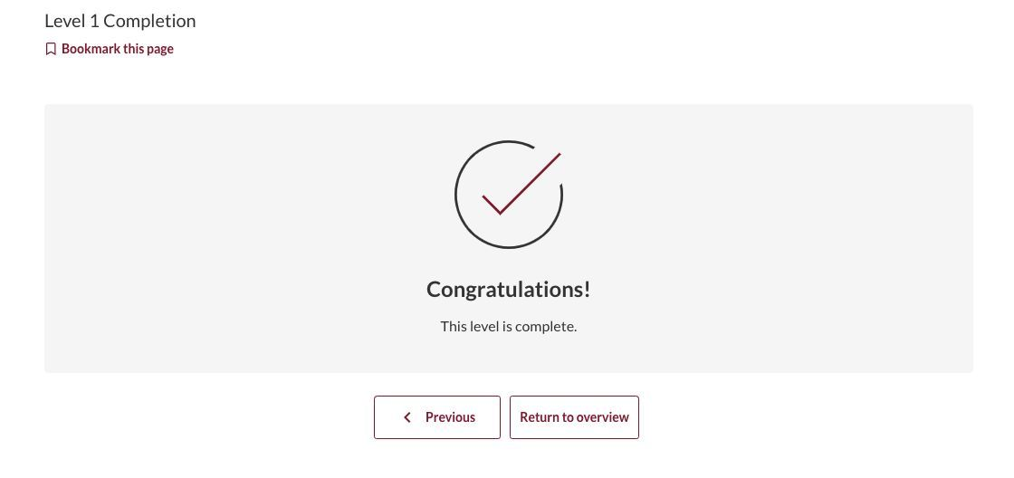
02
Procedures
Start, edit, and complete speech project
Level finished
Open the TMI homepage in the browser
Log in on the TMI homepage
Select "Go to Base Camp'"
View the learning dashboard
Open your learning path
Start your speech project
Edit your speech project
Submit a speech request in "EasySpeak"
Finish your level
Level finished
Notes:
The Vice President Education will then receive an email informing them of your level completion request and will approve it if you have indeed met all the requirements. After their approval, you will receive confirmation of the level completion in Base Camp as well as a corresponding email. (or in the first person as Vice President Education)

Slide 71
02
Procedures
Give speeches & take on roles
...start and work on a speech project
...to be able
to give a speech
in the club
...Lernpfad
Notes:
By now, you should have all the essential information you need to use your path, your projects, and Base Camp. Next, I’d like to explain how you can request and deliver your speech in the club.

Slide 72
02
Procedures
Give speeches & take on roles
As a Toastmasters club member, you need access to two portals with different purposes:
BaseCamp
EasySpeak
This is where your Toastmasters speaking journey is managed.
Platform for communication and club management
Here you can:
Here you can:
Select your learning path
Confirm or decline your attendance for the club meeting
Start & complete speech projects
Sign up for speeches or take on roles at the club meeting
Notes:
For this step you will use EasySpeak, your second key portal. This platform is used to organize club meetings.

Slide 73
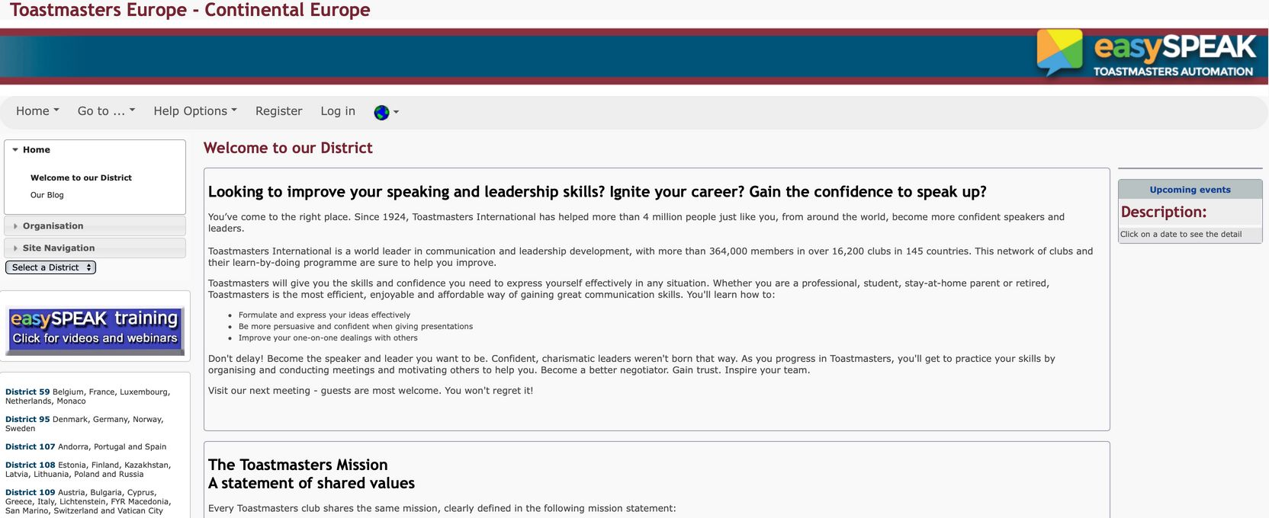
02
Procedures
Sign up for a speech at the club
https://tmclub.eu/login.php
Open EasySpeak in the browser
Log in to EasySpeak
Wähle den Reiter "Eine Rede anmelden"
Notes:
Go to the EasySpeak website at tmclub.eu. This is important because there are several different EasySpeak sites.

Slide 74
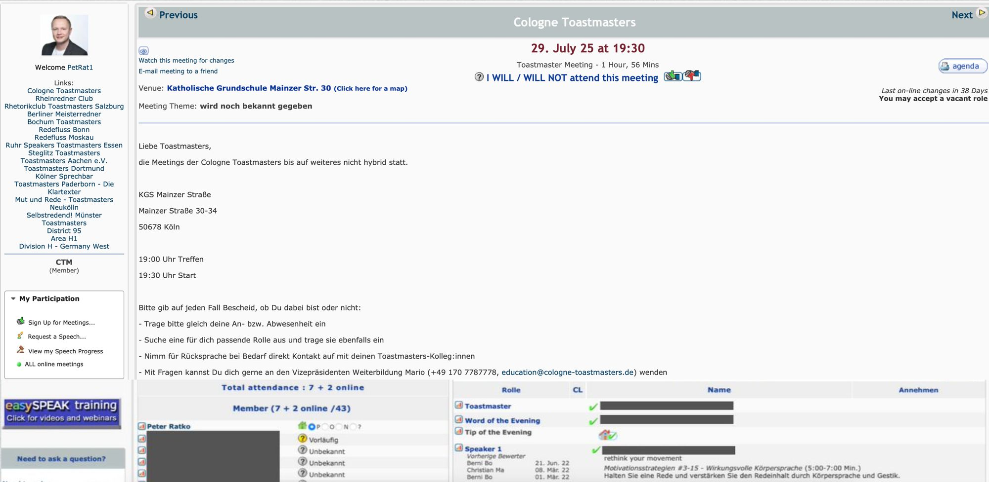

02
Procedures
Sign up for a speech at the club
https://tmclub.eu/login.php
Open EasySpeak in the browser
Login to EasySpeak
Wähle den Reiter "Eine Rede anmelden"
Notes:
Log in with the access data you should have received from your Vice President Education or Vice President Membership (from me) soon after you joined the club.

Slide 75
02
Procedures
Sign up for a speech at the club
https://tmclub.eu/login.php
EasySpeak im Browser aufrufen
Open EasySpeak in the browser
Log in to EasySpeak
Click on the "Request a Speech" tab
Notes:
On the left-hand side, under “Actions,” click on “Request a Speech.”

Slide 76
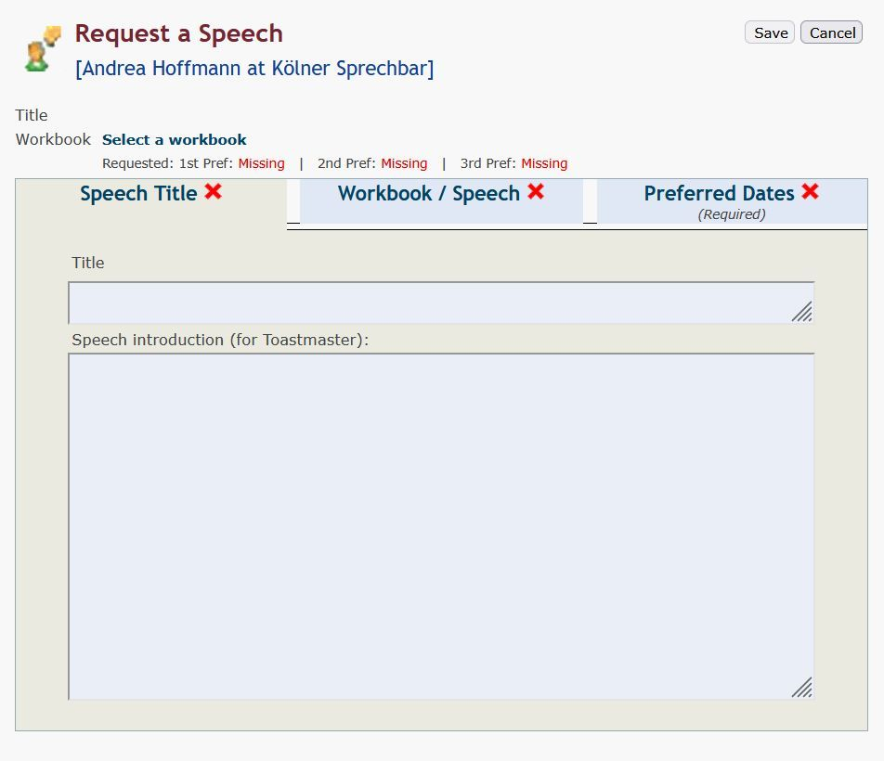
02
Procedures
Sign up for a speech at the club
Enter speech title
Open EasySpeak in the browser
Log in to EasySpeak
Click on the "Request a Speech" tab
Speech Title
Notes:
Now enter the title of your speech and, if you wish, a brief explanation for the Toastmaster of the Evening, so they can introduce your speech effectively and set the right tone.

Slide 77
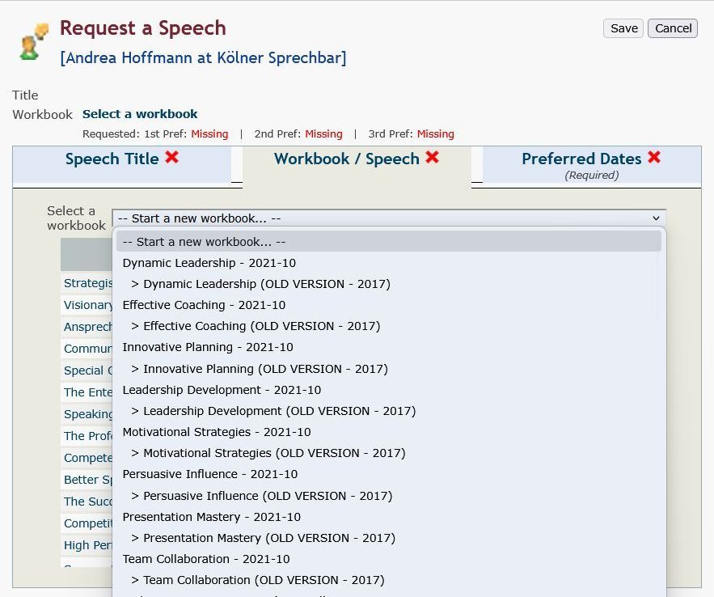
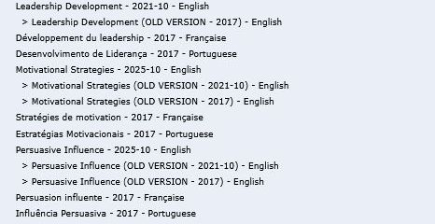

02
Procedures
Sign up for a speech at the club
Select workbook and speech
Open EasySpeak in the browser
Log in to EasySpeak
Click on the "Request a Speech" tab
Speech Title
Workbook / Speech
Notes:
Next, select the path (called “manual” in EasySpeak) to which your speech project belongs. It is important that you choose the English path in the most recent version. Currently, this is version 2025-10. The latest version ensures that all updates are included.

Slide 78

02
Procedures
Sign up for a speech at the club
Select workbook and speech
Open EasySpeak in the browser
Log in to EasySpeak
Click on the "Request a Speech" tab
Speech Title
Workbook / Speech
New projects in level 1
Notes:
This also allows you to select the two newer Level 1 projects…

Slide 79

02
Procedures
Sign up for a speech at the club
Select workbook and speech
Open EasySpeak in the browser
Log in to EasySpeak
Click on the "Request a Speech" tab
Presentations of the Educational Series
Speech Title
New meeting roles
Workbook / Speech
Notes:
…as well as presentations from the educational series and the new meeting roles that have only been part of Pathways since October 2025.

Slide 80

02
Procedures
Sign up for a speech at the club
Preferred Dates
Open EasySpeak in the browser
Log in to EasySpeak
Click on the "Request a Speech" tab
Speech Title
Workbook / Speech
Preferred Dates
Notes:
To complete the request, enter your preferred dates for the speech. (Since our club has many members and speech slots fill up quickly, it’s best to enter three different dates here.) Icebreaker speeches are usually given priority.

Slide 81
02
Procedures
Sign up for a speech at the club
Save
Open EasySpeak in the browser
Log in to EasySpeak
Click on the "Request a Speech" tab
Speech Title
Workbook / Speech
Preferred Dates
Notes:
Don’t forget to save your entries. The Vice President Education will then receive an email that you wish to give a speech and on which dates. They will schedule it for a meeting on the agenda. (or in the first person as Vice President Education) You must then confirm your attendance at that meeting and your speech.

Slide 82
02
Procedures
Confirm your speech at the club
https://tmclub.eu/login.php
Open EasySpeak in the browser
Log in to EasySpeak
Confirm your speech
Rede ist bestätigt
Notes:
To do this, go again to the EasySpeak website tmclub.eu.

Slide 83


02
Procedures
Confirm your speech at the club
https://tmclub.eu/login.php
Open EasySpeak in the browser
Login to EasySpeak
Confirm your speech
Rede ist bestätigt
Notes:
Log in again or ensure you stay logged in by ticking the “Remember me” box.

Slide 84

02
Procedures
Confirm your speech at the club
Your speech is not confirmed
Open EasySpeak in the browser
Log in to EasySpeak
Your speech is not confirmed
Confirm your speech
Notes:
If you have not yet confirmed your speech, you will see a question mark in a circle in front of your name.

Slide 85

02
Procedures
Confirm your speech at the club
Confirm your speech
Open EasySpeak in the browser
Log in to EasySpeak
Rede ist bestätigt
Confirm your speech
Notes:
Click on the green thumbs‑up icon to confirm that you will actually give your speech.

Slide 86

02
Procedures
Confirm your speech at the club
Your speech is confirmed
Open EasySpeak in the browser
Log in to EasySpeak
Confirm your speech
Your speech is confirmed
Notes:
A green check mark will then appear in front of your name, showing that you have successfully confirmed your speech.

Slide 87
02
Procedures
Confirm your attendance
Select the correct date
Select the correct date
Choose: On-site / Online / No participation
Selection of available roles / Role description
Notes:
Even if you are not planning to give a speech, you should still confirm your attendance or absence for every meeting. First select the date of the next meeting…

Slide 88

02
Procedures
Confirm your attendance
Confirm your attendance
Select the correct date
Choose: Participation/ No participation/ Perhaps
Selection of available roles / Role description
Notes:
…then indicate whether you will attend – click “yes” – or will not attend – click “no.” If you are still unsure, click the question mark. This makes it much easier for the Toastmaster to organize the meeting and also helps you commit to your own plans.

Slide 89
02
Procedures
Select your role
Selection of available roles
Select the correct date
Choose: On-site / Online / No participation
Selection of available roles / Role description
Notes:
In meetings where you are not speaking, it is very helpful if you take on other meeting roles. This allows you to regularly practice your communication and leadership skills and build self‑confidence. If you want to know what a specific role involves or how best to prepare, click on the role name. A general description of the role will appear. (Then a role description tailored specifically to the practices of our club will appear.) Then click “Yes” next to the role you would like to take on.

Slide 90

02
Procedures
Document your roles
Confirm and assign role
Confirm role on meeting agenda
Assign roles
Role documentation successful
Notes:
If everything has worked correctly, a green check mark will appear in front of your name, and a pencil icon will also appear next to it.

Slide 91

02
Procedures
Document your role
Assign roles to the levels
„Confirm role on meeting agenda
Assign roles
Role documentation successful
Notes:
When you click on the pencil icon, a window opens in which you can assign the role to your current level – provided that this role is one of the requirements for that level. Assigning the role to the correct Pathways level is important so that all your efforts are documented in EasySpeak and (me as) your Vice President Education can see, at level completion, that you have fulfilled all requirements.

Slide 92
02
Procedures
Document your role
Choose “View my speech progress”
EasySpeak im Browser aufrufen
„Confirm role on meeting agenda
Assign roles
Role documentation successful
Notes:
You can find an overview of all your meeting activities on the left under “Actions” by clicking on “ “View my Speech Progress”.

Slide 93

02
Procedures
Document your role
Role has been documented for the level
EasySpeak im Browser aufrufen
„Confirm role on meeting agenda
Assign roles
Role documentation successful
Notes:
This opens your workbook matrix, where your meeting roles, all your speeches, and later your presentations from the educational series are documented.

Slide 94
02
Procedures
Select a learning path, give speeches & take on roles
Summary
BaseCamp
EasySpeak
This is where your Toastmasters speech journey is managed.
Platform for club communication and management
Choosing your learning path
Confirm your attendance at a club meeting
Start & complete speech projects
Sign up for speeches or roles
Notes:
Let me summarize once more: to select your path and to start and complete your speech projects, you log in to the TMI homepage and go to the Base Camp portal. Your learning materials are stored there. The organization of club meetings, on the other hand, takes place in the second portal, EasySpeak. There you can confirm your attendance or absence and sign up for speeches and meeting roles. You now know the most important basics to participate actively in meetings and to work with your Pathways learning materials.

Slide 95


02
Pathways Workshop
With Andrea Hoffmann – Pathways Lead, District 95
For more information and dates, visit:
https://toastmasters-95.org/toastmasters-pathways-learning/
or scan the QR code
Andrea.hoffmann@toastmasters-95.org
Notes:
District 95 has created its own Pathways page where you can find many important materials on Pathways. Enter the web address shown. Here you can, for example, download the starter handbook for new members. It contains additional information specifically for you as a new member. You will also find all the offers from the District 95 Pathways Lead, Andrea Hoffmann, including her monthly intensive workshops on Pathways and Base Camp. These are an excellent second step to deepen your knowledge of Pathways and Base Camp. The date and registration link for the next workshop are also listed on this page. If you have questions about Pathways that I (your VP Education) cannot answer, you can contact Andrea at any time at the email address shown here, or join her on Zoom during her office hour every second Tuesday of the month at 7:00 p.m. In the download area at the bottom of the page, you will also find many additional helpful resources and manuals, which she updates and expands regularly. So take a close look at this page – and feel free to return to it from time to time.

Slide 96
Understanding the Onboarding Process
01
What isToastmasters?
Select a learning path, deliver speeches, and participate in club roles
02
  Base Camp
  EasySpeak
03
More information
Notes:
Let’s now move on to some information that is specific to our club.

Slide 97

More information
03
Template
Additional information, such as mentorship, can be shared on the page.
If there is no further information, the page can be deleted.
Please remove item 3 from the overview (slides 5, 6, 18) and delete slide 5 and 89.

Slide 98
Do You Have Any Questions?
Notes:
Do you have any questions about what I’ve explained so far – or any additional questions beyond that?

Slide 99

Thank you
Notes:
Dear new member, after attending your first Toastmasters meeting full of curiosity and enthusiasm and moving from guest to member, we now want to use this timely onboarding to ignite a lasting passion for Toastmasters and for our club. Your active participation in meetings and in Pathways will help you achieve your goals and will also move our entire club forward. Thank you for taking the time to familiarize yourself with the first steps and the most important tools. Now nothing stands in the way of successfully developing your communication and leadership skills!

