Slide 1
How to plan for the world of work
This session is aimed at Key Stage Four (recommended for Year 10)

Slide 2
Having a respectful learning environment
We will listen to each other respectfully
We will avoid making judgements or assumptions about others
We will comment on what has been said, not the person who has said it
We won’t put anyone on the spot and we have the right to pass
We will not share personal stories or ask personal questions
If there is a question that you do not wish to ask aloud, you can write it on a post-it note which will be collected throughout the session and answered at the end

Slide 3
4
Session 2:
Apprenticeships

Slide 4
By the end of the session, I will be able to:
Explain what an apprenticeship is
Compare apprenticeships to alternative post-16 options
Assess the advantages and disadvantages of apprenticeships compared to other options

Slide 5
Unit outline
Session 1 | Session 2 | Session 3 | Session 4 | Session 5 | Session 6
Careers in the City | Apprenticeships | Entrepreneurship | Understanding gig work and employment rights | Speaking up at work | Creating a career plan
Notes:
Teacher delivery
Students should be invited to ask questions and they should be provided with an opportunity to ask questions anonymously. It is useful to have a question box or allocated space on the whiteboard for students to share questions.
It is suggested that students are provided with post-its or slips to write their questions on and as the teacher circulates throughout the lesson these questions can be collected and answers throughout the session or using an allocated ‘question time’ at the end of the session.
Students can be invited to respond to questions asked by their peers. If responses to questions are based on personal preference or opinion, the teacher should be clear to preface any answers with this.

Slide 6
Recap starter | City-based jobs
Think back to the last lesson and complete each question for one of the roles in the mind map.
Identify a key task of the job
Identify a skill required for the job
Write a short description of the job
(no more than two sentences)
Investment Analyst
Accountant
Auditor
Careers in the city
Underwriter
PR Manager
Management consultant
Personal assistant
Stretch: Can you think of any other City-based jobs?
What are the key tasks the job might involve?
What skills might be required?
Investment analyst
Resource - Starter
Notes:
Teacher delivery
2 minutes of students working independently. A further 2 minutes for feedback

Slide 7






Discussion | Apprenticeships
What do you know about apprenticeships?
Write down a list of things that you know about apprenticeships.
Use the pointers below for some guidance
Age
Levels
Fee
Income
Training
Time
Qualifications
Notes:
Teacher delivery
Allow 2 minutes for students to write down bullet points of things they know about apprenticeships.
Gather feedback from a handful of students.
The lesson will address each of the pointers.

Slide 8

What are apprenticeships?
Questions
What three things will you do at the same time on an apprenticeship?
Do apprenticeships result in a qualification?
What is a degree apprenticeship?
What are the benefits of apprenticeships to employers?
Video (watch to 01:45) - Apprenticeships vs university: which is best? | FT Schools
Notes:
Teacher delivery
Video to stop at 01:45.
Allow a further 5 mins to answer questions

Slide 9

Apprenticeship levels
Each apprenticeship has a level, as well as an equivalent educational level.
You can start an apprenticeship at any level, but some require previous qualifications.
Level 2
Level 3
Level 4
Level 5
Level 6
Level 7
Intermediate
Advanced
Higher
Degree

Slide 10
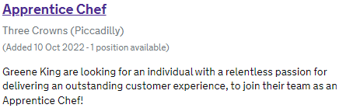

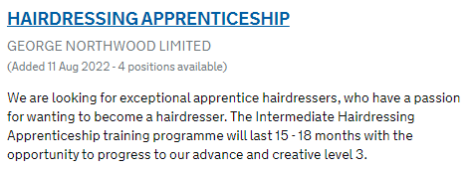

Intermediate (Level 2)
Intermediate apprenticeships are designed to be entry-level roles
They:
  provide skills needed to begin a career
  generally last 1-2 years
  tend to be more vocational
Entry Requirements
Age 16 and above
English & Maths GCSE at grade E or 2
Equivalent to
5 GCSEs
Notes:
Additional context
https://apprenticeshipguide.co.uk/which-apprenticeship-level-is-right-for-you/
https://apprenticeshipguide.co.uk/what-are-the-entry-requirements-for-apprenticeships/

Slide 11



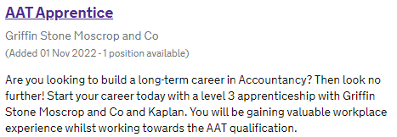
Advanced (Level 3)
Advanced apprenticeships offer an alternative to A levels. They:
  are suitable if you have any skill or experience in a particular sector already
  tend to last between 18 and 24 months
  usually delve into more technical detail of the chosen career
  can result in professional recognition by a relevant professional body
Entry Requirements
Completion of a Level 2 apprenticeship or
5 GCSEs including English & Maths
Equivalent to
2 A levels
Notes:
Additional context
https://apprenticeshipguide.co.uk/which-apprenticeship-level-is-right-for-you/
https://apprenticeshipguide.co.uk/what-are-the-entry-requirements-for-apprenticeships/

Slide 12
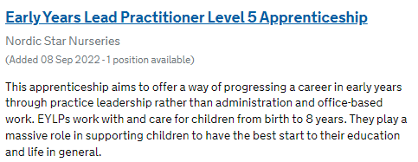



Higher (Level 4 and 5)
Level 4
Entry Requirement
Completion of an advanced apprenticeship or
A level 3 qualification (e.g. A levels)
Equivalent to
A foundation degree
Usually takes between 1-3 years to complete
They are the equivalent to higher education, with added work-based experience
The level of the qualification gained depends on the level of the apprenticeship
Level 5
Entry Requirement
Same as level 4 but with higher minimum grades
Requires some relevant experience
Equivalent to
The first year of a bachelor’s degree
Notes:
Additional context
https://apprenticeshipguide.co.uk/which-apprenticeship-level-is-right-for-you/
https://apprenticeshipguide.co.uk/what-are-the-entry-requirements-for-apprenticeships/

Slide 13



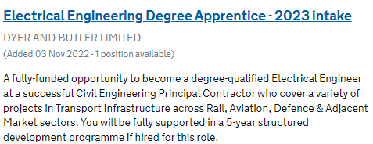
Degree Apprenticeships (Level 6 and 7)
Level 6
Entry Requirement
Same as level 5 but with higher minimum grades
Requires some relevant experience
Equivalent to
A bachelors degree
Degree apprenticeships allow someone to earn a full bachelors (level 6) or masters degree (level 7)
They mix learning with working, meaning candidates often split their time between a workplace and training provider
Employers cover the cost of the degree
Usually takes between 3-6 years to complete
Level 7
Entry Requirement
A bachelor’s degree or equivalent level 4 qualification
A number of years of relevant experience
Equivalent to
A masters degree
Notes:
Additional context
https://apprenticeshipguide.co.uk/which-apprenticeship-level-is-right-for-you/
https://apprenticeshipguide.co.uk/what-are-the-entry-requirements-for-apprenticeships/

Slide 14
Other things to know…
Applicants must be at least 16 years old to do an apprenticeship. There is no upper age limit
Apprentices are paid at least the minimum wage (for your age).
Remember, higher pay can always be negotiated!
Wage band | Rate (from 1 April 2025)
Age 21 or over | £12.21
Age 18 to 20 | £10
Under 18 | £7.55
Apprentice | £7.55
Minimum wages vary over time so it’s important to double check for yourself!
Notes:
UK Gov National Minimum Wage and National Living Wage rates
NB: Consider mentioning the Living Wage here: “The real Living Wage remains the only UK Wage rate calculated on the real cost of living. It is voluntarily paid by over 16,000 UK businesses.”

Slide 15

Which apprenticeship?
Beverley is just about to finish her GCSEs.
She’s predicted to gain 6 grade 9-5s. She’d quite like to start earning money, and doesn’t currently want to go to university, although she may change her mind in the future. In the summer she gained work experience at her local nursery.
What apprenticeship should she apply for?
Level 2 Apprentice Chef
Level 3 Childcare Apprenticeship
Early Years Level 5 Lead Practitioner Apprenticeship

Slide 16
Which apprenticeship?
Beverley is just about to finish her GCSEs.
She’s predicted to gain 6 grade 9-5s. She’d quite like to start earning money, and doesn’t currently want to go to university, although she may change her mind in the future. In the summer she gained work experience at her local nursery.
What apprenticeship should she apply for?
Level 2 Apprentice Chef
Level 3 Childcare Apprenticeship
Early Years Level 5 Lead Practitioner Apprenticeship
Notes:
Teacher explanation
As Beverley is about to finish her GCSEs, she could consider an Intermediate (L2) or Advanced (L3) apprenticeship. As she is likely to get over 5 good GCSEs, she’ll meet the entry requirements for an Advanced (L3) apprenticeship. Her work experience at her local nursery improves her chances of a success application to a childcare apprenticeship
Furthermore, all apprenticeships leave the option of going to university open, if she changes her mind about it in the future.

Slide 17

Which apprenticeship?
Thomas is about to complete his A levels. He’d like to gain a degree, but is concerned about gaining a high level of student debt. He’s on track to gain good grades in maths and economics, and really enjoyed the time he spent shadowing investment analysts at Barclays.
What apprenticeship should he apply for?
Level 3
Financial Services Administrator Apprenticeship
Level 4 Construction Site Supervisor Apprenticeship
Level 6
Finance Graduate Apprenticeship

Slide 18
Which apprenticeship?
Thomas is about to complete his A levels. He’d like to gain a degree, but is concerned about gaining a high level of student debt. He’s on track to gain good grades in maths and economics, and really enjoyed the time he spent shadowing investment analysts at Barclays.
What apprenticeship should he apply for?
Level 3
Financial Services Administrator Apprenticeship
Level 4 Construction Site Supervisor Apprenticeship
Level 6
Finance Graduate Apprenticeship
Notes:
Teacher explanation
As Thomas is about to complete his A levels, an Advanced Level 3 apprenticeship won’t be suitable.
As he’d like to gain a degree, the Degree (Level 6) apprenticeship is the only option here that will give him that opportunity.
His time shadowing investment analysts provides him with some useful experience in a related field.

Slide 19
Post 16 Options - the choice is yours
Think-Pair-Share
What post-16 options are available to you?
Remain in full-time education
Start an apprenticeship or traineeship*
Spend 20 hours a week working or volunteering alongside part time education or training
*A traineeship is a course with work experience that gets you ready for work or an apprenticeship
Notes:
Teacher delivery
Students get 2 minutes to discuss post 16 options with their partner.
Teacher will get feedback from the class.
Emphasis should be placed on the fact that all post 16 options involve some level of education or training.
A traineeship is a course with work experience that gets you ready for work or an apprenticeship.

Slide 20
Becoming a Solicitor
Route 1
Route 2
Complete A levels
Gain a Bachelor in Law qualification
Study law at university
Complete a Level 7
Solicitor Apprenticeship
Required to complete the next stage. Can be done through placements at university
Gain 24 months work experience
Gains a Bachelor in Law qualification, as well as solicitors qualification exams. Lasts 6 years, in which 4 days a week are spent working, and 1 day is spent studying
Tests legal knowledge and practical legal skills
Complete the
Solicitors Qualifying Examinations (SQE)
Why might someone choose Route 1?
Why might someone choose Route 2?
Apply to be a solicitor
Notes:
Teacher delivery
The first two questions are to get students to start thinking about the advantages and disadvantages of the various post 16 options. Students should be able to identify personal preferences that make one option more appealing than others. Gather student’s answers in a whole class discussion.
Maths moments - stretch
Students can then complete the maths moment individually.
Answer: The apprentices will earn £72,000 over the three years of the apprenticeship whilst the university student will pay a total of £30,980. In total, the apprentice would be £102,980 better off.
Answer: University offers the chance to pursue a broader range of careers later in life; it might also offer the potential to earn more money in a career
This is a useful time to assess some further advantages and disadvantages of post 16 routes. In this case, whilst both can lead to the same career, route 2 may take twice as long, especially if university students manage to gain work experience whilst studying.

Slide 21
Becoming a Solicitor: Maths Moment
Maths Moment: stretch
There are two possible routes to becoming a solicitor:
Route 1: University – A law degree costs about £9,000 per year for three years, plus around £4,800 for the SQE exams.
Route 2: Apprenticeship – A solicitor apprenticeship pays a salary of about £24,000 per year for three years, and the employer covers the SQE exam costs.
After 3 years, what is the difference in how much money you would have earned or owed if you chose the apprenticeship route instead of the university route?
Given this, why might somebody still choose Route 1?
Notes:
Teacher delivery
The first two questions are to get students to start thinking about the advantages and disadvantages of the various post 16 options. Students should be able to identify personal preferences that make one option more appealing than others. Gather student’s answers in a whole class discussion.
Maths moments - stretch
Students can then complete the maths moment individually.
Answer: The apprentices will earn £72,000 over the three years of the apprenticeship whilst the university student will pay a total of £30,980. In total, the apprentice would be £102,980 better off.
Answer: University offers the chance to pursue a broader range of careers later in life; it might also offer the potential to earn more money in a career
This is a useful time to assess some further advantages and disadvantages of post 16 routes. In this case, whilst both can lead to the same career, route 2 may take twice as long, especially if university students manage to gain work experience whilst studying.

Slide 22
Becoming a Marketing executive
Route 1
Route 2
Complete GCSEs
What challenges might someone face if they started on Route 1, but decided they no longer wanted a career in digital marketing?
Would these challenges be the same for someone who started on Route 2?
Complete a Level 3 Apprenticeship in Digital Marketing
Study for
A Levels
Specific A levels won't necessarily be required for a career in digital marketing
Complete a Level 5 Marketing Executive Apprenticeship
Complete a university degree
A range of degrees could be useful for a position in digital marketing
Apply to become a
marketing executive
Notes:
Teacher delivery
The first two questions are to get students to start thinking about the advantages and disadvantages of the various post 16 options. Students should be able to identify personal preferences that make one option more appealing than others. Gather student’s answers in a whole class discussion.
This is a useful time to assess some further advantages and disadvantages of post 16 routes. In this case, whilst both can lead to the same career, route 2 may take twice as long, especially if university students manage to gain work experience whilst studying.

Slide 23


Advantages and Disadvantages
Group 1: Advanced (L3) apprenticeships or A levels
Group 2: Higher (L3 and 4) apprenticeships or university
Group 3: Degree (L6 and 7) apprenticeships or university
What are the advantages and disadvantages of doing an apprenticeship compared to the alternative listed for your group?
Notes:
Teacher delivery
Split the class up into 3 or 6 groups depending on the number of students in the class.
Students will then have 5 minutes to identify advantages and disadvantages.
Allow a further 5 minutes for feedback and to go through the next three slides.

Slide 24
Advance (L3) Apprenticeships vs A Levels
Group 1
Advantages of doing a Level 3 Apprenticeship | Disadvantages of doing a Level 3 Apprenticeship
Receive a wage while gaining a qualification Gain work experience that A level students may not receive Gain the opportunity to progress within an industry at a young age Can work up the apprenticeship ladder at a later stage | Doing an apprenticeship instead of A levels may narrow career opportunities in the future Some people may not feel ready to enter the world of work at the age of 16

Slide 25
Higher (L3 and 4) Apprenticeships vs University
Group 2
Advantages of doing a Higher Apprenticeship | Disadvantages of doing a Higher Apprenticeship
Start earning an income at least three years earlier than studying for a degree Gain valuable work experience Have the opportunity to progress through a career while peers are studying No tuition fees | Completing a degree should leave career more open ended Missing out on a valuable university experience

Slide 26
Higher (L6 and 7) Apprenticeships vs University
Group 3
Advantages of doing a Higher Apprenticeship | Disadvantages of doing a Higher Apprenticeship
All of the advantages of the previous slide, plus Could come out with the same degree as going down the university route, only with no student debt | Not all degrees are available through a degree apprenticeship May miss out on aspects of university life despite acquiring a degree

Slide 27
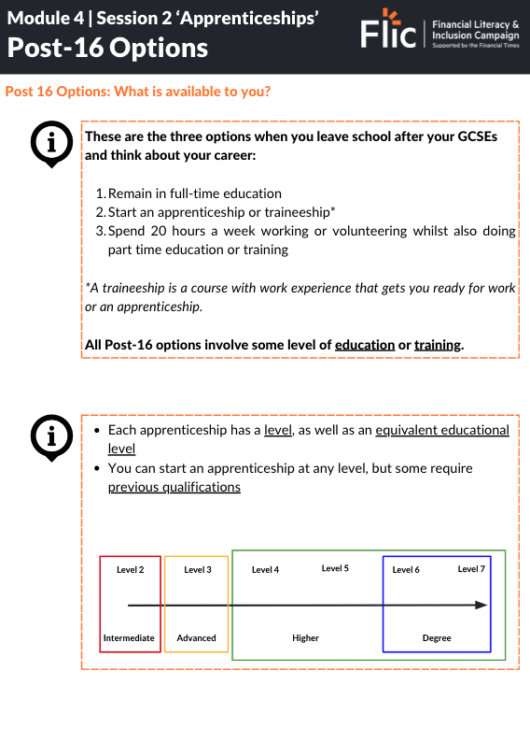
Optional print-out resource:
Optional resource: Post-16 Options

Slide 28
Plenary
What are the three most important messages that you’ll take away from this lesson?

Slide 29
By the end of the session, I will be able to:
Explain what an apprenticeship is
Compare apprenticeships to alternative post-16 options
Assess the advantages and disadvantages of apprenticeships compared to other options

Slide 30
Any questions?
?

Slide 31



Services available for young people exploring their career options
Get personalised careers advice and information
Events and experiences that grow young people’s strengths to become world-ready and work-ready
UK-wide youth volunteering programme that provides young people aged 14-30 with access to thousands of opportunities
Gov UK
National Careers Service
National Citizens Service
V-inspired
At school, you can speak with an adult you trust.
This could be your form tutor, head of year or the school’s safeguarding officer.
Notes:
https://careers.startprofile.com/page/home-page

Slide 32
Links to learn more!
Articles to extend learning
Please visit the FLIC learning hub for further resources
National Careers Service
Search & Apply for an Apprenticeship (UCAS)
Apprenticeships: How do they work? (Gov UK)

