Slide 1

PASTEL MAKEUP
Presentation Template
www.freepptbackgrounds.net

Slide 2
CONTENTS
What we do?
Annual
Meeting
Conferences

Slide 3
0NE
WHAT WE DO?
Show and explain your web, app or software projects using these gadget templates

Slide 4
70%
50%
90%
80%
Suggest
Success
Split
Skills
Easy to change colors, photos and Text.
I hope and I believe that this Template will your Time, Money and Reputation.
Easy to change colors, photos and Text.
I hope and I believe that this Template will your Time, Money and Reputation.

Slide 5
Signature
Add or delete slides. You have to be signed in to your Google account. in PowerPoint. Remember to download and install the fonts used in this presentation (you’ll find the links to the font files needed in the Presentation design slide)
Share
Add or delete slides. You have to be signed in to your Google account. in PowerPoint. Remember to download and install the fonts used in this presentation (you’ll find the links to the font files needed in the Presentation design slide)

Slide 6
60%
Send
Click on the button under the presentation preview that says "Use as Google Slides Theme. You will get a copy of this document on your Google Drive and will be able to edit, add or delete slides. You have to be signed in to your Google account.
50%
30%
45%

Slide 7
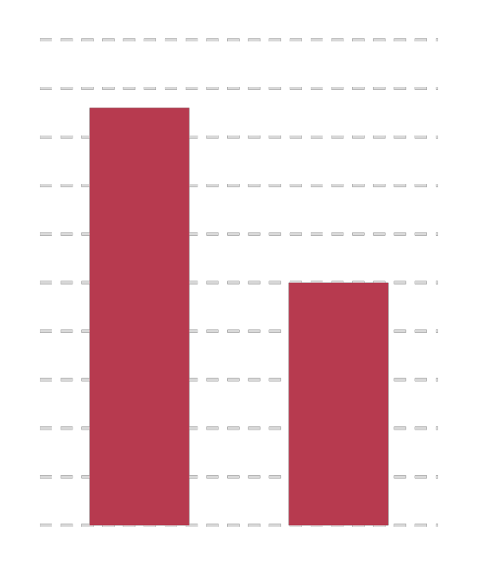

Schedule
Lower
Lanage
Your Vision Moving from creative ideas to solid strategy and execution, we help your target market resonate fully with your brand. When you get them, they will get you, quicker. We leverage digital tools, design and words, to become even more relevant.Pleasant Shopping Simple & Smooth, exactly how purchasing experiences should be. We align with your users need to build and evolve a flowing shopping interface, one that slots easily into place with each step.

Slide 8
TWO
ANNUAL
Show and explain your web, app or software projects using these gadget templates

Slide 9
Split
Suggest
The user can make a presentation on
The user can demonstrate on a projector
Success
Transport
The user can demonstrate on a projector
Your audience relate and absorb information on different sensory levels.

Slide 10
70%
40%
30%
60%
Share
Skills
Your audience relate and absorb information on different sensory levels.
Your audience relate and absorb information on different sensory levels.
The user can demonstrate on a projector or computer, or print the presentation and make it into a film to be used in a wider field. Using PowerPointThe user can make a presentation on a projector or computer, or print out the presentation to make a film. The user can make a presentation on a projector or computer, and can also make a presentation. You can also print out the presentation to make a film

Slide 11

Your audience relate and absorb information on different sensory levels. We know visual stories are amplified with the right words. Sometimes it's easier to go old school, our copywriters prefer a good ball.

Slide 12
The user can make a presentation on a projector or computer
The user can demonstrate on a projector or computer, or print the presentation and PowerPoint
It is a very sad thing that nowadays there is so little useless information. Oscar Wilde
The user can make a presentation on a projector or computer
The user can demonstrate on a projector or computer, or print the presentation and PowerPoint
It is a very sad thing that nowadays there is so little useless information. Oscar Wilde

Slide 13
We certainly do not forget you as soon as you forget us.
It is, perhaps, our fate rather than our merit.

Slide 14
1
We cannot help ourselves. We live at home, quiet, confined, and our feelings prey upon us. You are forced on exertion.
2
3

Slide 15
THREE
MEETİNG
Show and explain your web, app or software projects using these gadget templates

Slide 16



Send
I believe that people would be alive today if there were a death penalty. Nancy Reagan
Signature
The time is now, the place is here. Stay in the present. You can do nothing to change the past, and the future will never come exactly as you plan or hope for. Dan Millman

Slide 17
Genius hath electric power which earth can never tame. Lydia M. Child
Genius hath electric power which earth can never tame. Lydia M. Child
I feel very strongly that change is good because it stirs up the system. Ann Richards

Slide 18



A large income is the best recipe for happiness I ever heard of. Mansfield Park
Schedule
Everyone wants, happiness. No one wants pain. But you can’t have a rainbow without a little rain.

Slide 19
Occupation
Add
Always give your best never worry for results.
Be an encourager, the world has enough critics already.
Lower
Be an encourager, the world has enough critics already.
Accept
Always give your best never worry for results.
Lanage
Woe be to him that reads but one book. George Herbert

Slide 20
FOUR
CONFERENCES
Show and explain your web, app or software projects using these gadget templates

Slide 21
02
Agenda
01
Be an encourager, the world has enough critics already.
Advise
01
03
02
Always give your best never worry for results.
Advertisement
03
Education is the most powerful weapon which you can use to change the world.

Slide 22
1
2
STEP
STEP
Apply
Approve
Everyone wants, happiness. No one wants pain. But you can’t have a rainbow without a little rain.
Enjoy the little things in life, because one day you will look back and realize they were the big things.

Slide 23
Everyone wants, happiness. No one wants pain. But you can’t have a rainbow without a little rain.
Enjoy the little things in life, because one day you will look back and realize they were the big things.
Do you wonder what the difference between ignorance and genius is? A Genius has limits but an ignorant doesn’t have any.

Slide 24
You can’t change what’s going on around you until you start changing what’s going on with you.
Everybody has three chars ; the one is come out ,the one is owned ,the one is thought to have.
Authorize
Bill
Brand
Budget
You can’t change what’s going on around you until you start changing what’s going on with you.
Everybody has three chars ; the one is come out ,the one is owned ,the one is thought to have.

Slide 25


Calculate
You can’t change what’s going on around you until you start changing what’s going on with you.
Buy
Be not afraid of going slowly, be afraid only of standing still

Slide 26
THANK YOU
Pastel Makeup PTT Template
www.freepptbackgrounds.net

