Slide 1

Appendicectomy versus switching to a JAK inhibitor in inducing remission in patients with active ulcerative colitis after biologic therapy failure (COSTA): 1-year results of a multicentre, prospective, cohort study
Eva Visser, Maud A Reijntjes, Lianne Heuthorst, Merle E Stellingwerf, Rachel West, Koen van Dongen, Rogier M P H Crolla, Susan van Dieren, Jarmila D W van der Bilt, Willem A Bemelman, Geert R D’Haens, Christianne J Buskens

Slide 2


Risk of Colectomy in UC Over Time
UC is a chronic relapsing inflammatory disease of the rectum and colon with increased stool frequency and rectal bleeding
Despite advances, 10–30% of UC patients require colectomy
Colectomy is definitive but impacts quality of life
Long-term therapy risks:
Infections
Cardiovascular events
Malignancy
There is a need for alternative strategies to reduce colectomy risk
UC = Ulcerative Colitis
Le Berre C et al. Lancet 2023; Dai N et al. Dig Liver Dis 2023; Lasa JS et al. Lancet Gastroenterol Hepatol 2022

Slide 3
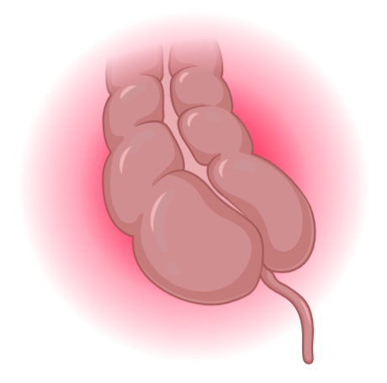
Immune Regulatory Function of the Appendix
The appendix is rich in gut-associated lymphoid tissue and houses a concentration of immune cells interacting with the colonic microbiome
Source of regulatory T-cells and IL-10–producing cells for anti-inflammatory signalling
May modulate mucosal immune responses in UC
May help maintain gut microbiota diversity and immune tolerance
Appendicectomy may alter disease course
UC = Ulcerative Colitis; Created with BioRender
Collard MK et al. Cell Mol Gastroenterol Hepatol 2023

Slide 4
Epidemiologic Data:
Appendectomy and UC Incidence
Prior appendectomy
associated with:
↓ Risk of developing UC
↓ Disease severity
Some data suggest more extensive disease at diagnosis
Overall signal:
Appendix plays immunologic role in UC
This epidemiologic signal reflects appendectomy performed before UC onset
  Distinct from studies (including COSTA) testing appendicectomy as treatment after UC is established
Limitations of the epidemiologic literature:
  Appendicitis itself may mark a different immune phenotype, heterogeneous outcome definitions, and residual selection bias
UC = Ulcerative Colitis
Andersson RE et al., N Engl J Med 2001; Frisch M et al., BMJ 2009; Myrelid P et al., BMJ 2009 Am J Gastroenterol 2017; Welsh S et al., Inflamm Bowel Dis 2023

Slide 5
Prior Non-Randomized Evidence
Study (Year) | Population | n | Key finding
Bolin (2009) | Refractory ulcerative proctitis | 30 | 40% complete remission after appendicectomy
PASSION Trial (2019) | Therapy-refractory UC referred for colectomy | 30 | ~1/3 clinical response; pathological improvement
Stellingwerf (2019) | Therapy-refractory UC, prospective cohort | 28 | 18% endoscopic remission at 12 months
Reijntjes (2024) | Long-term follow-up of prior cohort | — | 24% endoscopic improvement at median 8 year
Common limitations across these studies: retrospective or single-arm design, small samples, heterogeneous endpoints, and no direct comparator against current advanced therapies.
  This gap set up the case for ACCURE and COSTA
Bolin TD et al. Am J Gastroenterol 2009; Sahami S et al. J Crohns Colitis 2019; Reijntjes MA et al. Br J Surg 2024; Stellingwerf ME et al. Br J Surg 2019

Slide 6
Summary of ACCURE Trial
Design/setting | Pragmatic, open-label, international, randomized trial
Population | Patients with UC in remission; addressing maintenance of remission, not induction in active disease
Intervention Arm | Laparoscopic appendicectomy plus standard medical therapy
Control Arm | Standard medical therapy alone
Primary Finding | Appendicectomy plus medical therapy was superior to medical therapy alone for maintaining remission, reducing relapse rates
Safety Profile | Favorable, laparoscopic appendicectomy was well tolerated
Significance for COSTA:
Established appendicectomy can modify disease course in UC within a randomized framework,
but leaves unanswered its efficacy vs modern therapy in active, biologic-refractory disease
ACCURE Study Group. Lancet Gastroenterol Hepatol 2025

Slide 7
JAK Inhibitors in Biologic-Exposed UC
Benchmark efficacy that COSTA's comparator arm was expected to deliver
OCTAVE (Tofacitinib)
Week 8 induction
Across biologic-exposed patients, JAK-inhibitor remission rates are modest
  → Highly dependent on agent, timepoint, and depth of prior failure
Long-term safety concerns with JAK inhibitors include thromboembolism, serious infections, potential malignancy
This efficacy–safety profile frames the rationale for a non-pharmacologic alternative in refractory disease
Remission:
12.2% (60/488)
Selection (Filgotinib)
Week 52 maintenance
Remission:
23.0% (22/92)
U-ACHIEVE (Upadacitinib)
Week 8 induction
Remission:
32.1% (104/324)
UC = Ulcerative Colitis
Sandborn WJ et al. N Engl J Med 2017; Feagan BG et al. Lancet 2021; Danese S et al. Lancet 2022; Lasa JS et al. Lancet Gastroenterol Hepatol 2022

Slide 8
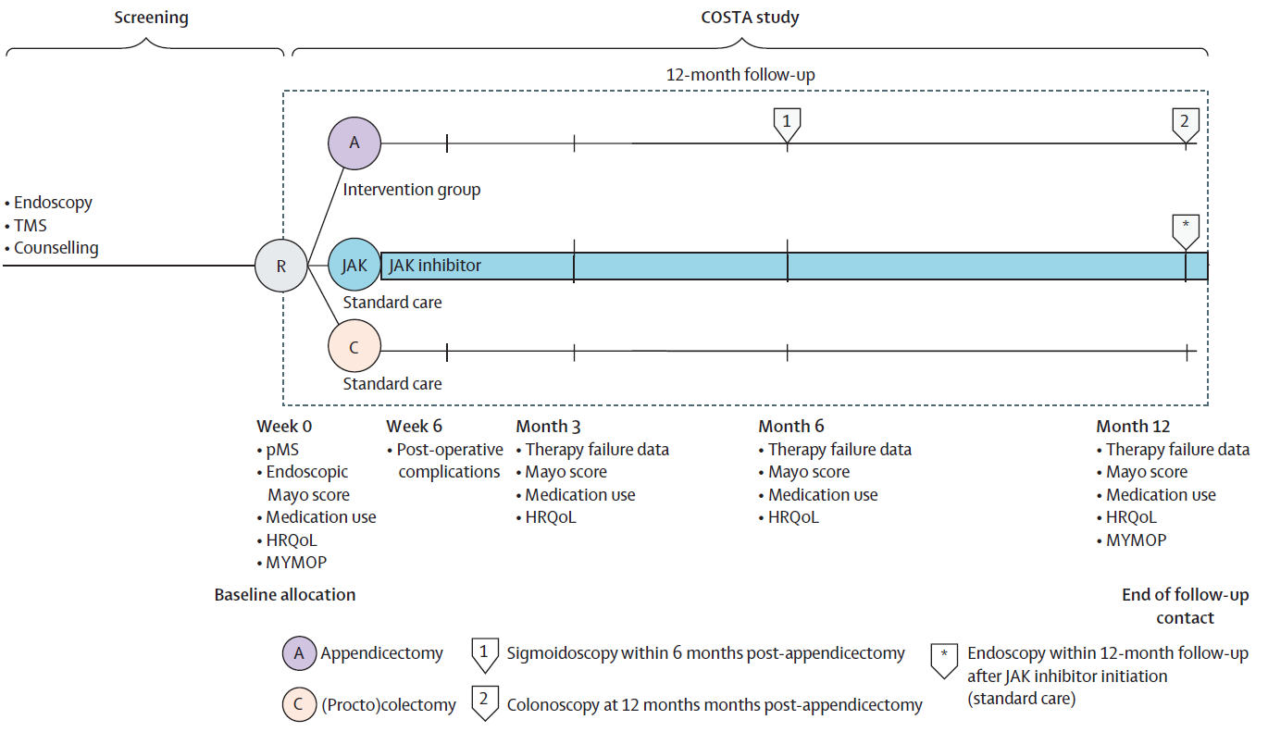
Study Design
Notes:
Research question: In patients with moderately to severely active ulcerative colitis despite optimized advanced therapy (biologic failure), does laparoscopic appendicectomy, added to ongoing advanced therapy, induce clinical remission at 12 months more effectively than switching to a JAK inhibitor?

Slide 9
Baseline Characteristics
Modified intention-to-treat population (n = 116)
Characteristic | Appendicectomy (n=67) | JAK Inhibitor (n=49) | p
Age, median (years) | 39.0 | 42.0 | 0.10
Female, n (%) | 42 (62.7%) | 23 (46.9%) | 0.091
Disease duration, median (years) | 6.6 | 7.8 | 0.54
Duration of current exacerbation, median (months) | 8.4 | 5.4 | 0.047
Pancolitis (E3), n (%) | 29 (43.3%) | 29 (59.2%) | 0.18
Endoscopic Mayo 3, n (%) | 29 (43.3%) | 24 (49.0%) | 0.15
Total Mayo score, median | 9.0 | 9.0 | 0.37
On oral corticosteroids at baseline, n (%) | 18 (26.9%) | 22 (44.9%) | 0.044
Anti-TNF at screening, n (%) | 32 (47.8%) | 13 (26.5%) | 0.020
Prior advanced therapies, median number | 2.0 | 2.0 | 0.90
Groups were broadly similar in disease severity (TMS 9, Mayo 3, prior advanced therapy count),
but JAK-inhibitor group entered with significantly more baseline steroid use (45% vs 27%)
→ Feature of more refractory disease that independently predicted lower remission (OR 0.27; p=0.042)

Slide 10
Primary Outcome
Appendectomy was associated with significantly higher clinical remission at 12 months without therapy failure
Δ=20·6 percentage points
(95% CI 6·1–35·1); p=0·010
Adjusted Difference:
22.9 percentage points
(95% CI 6.1 – 39.8); p = 0.016
Logistic regression adjusted for sex, age, disease extent, endoscopic Mayo 3, baseline steroid use, prior advanced therapies
Clinical remission: TMS ≤2, no subscore >1. Therapy failure: steroid start/restart, switch of advanced therapy, trial therapy, or colectomy.

Slide 11
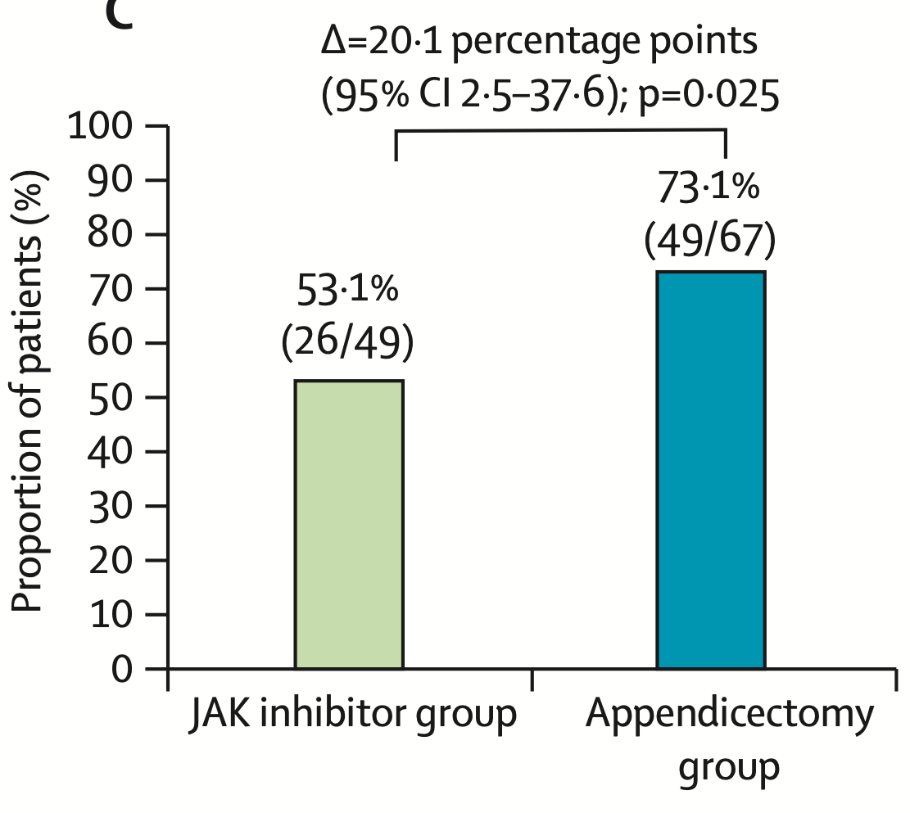
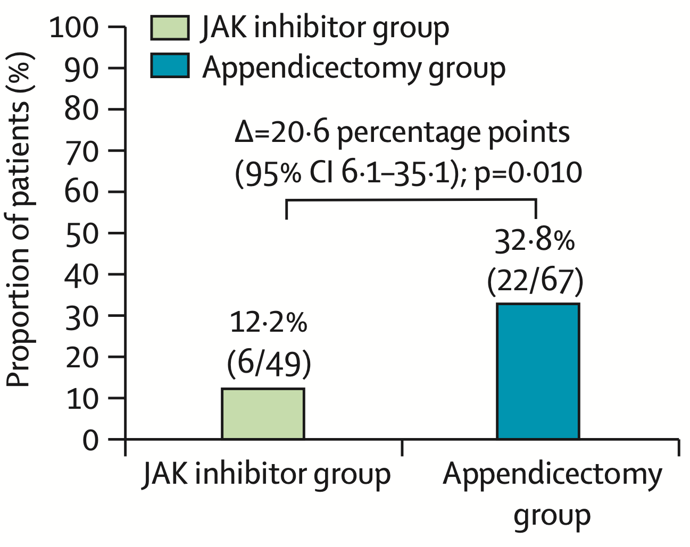
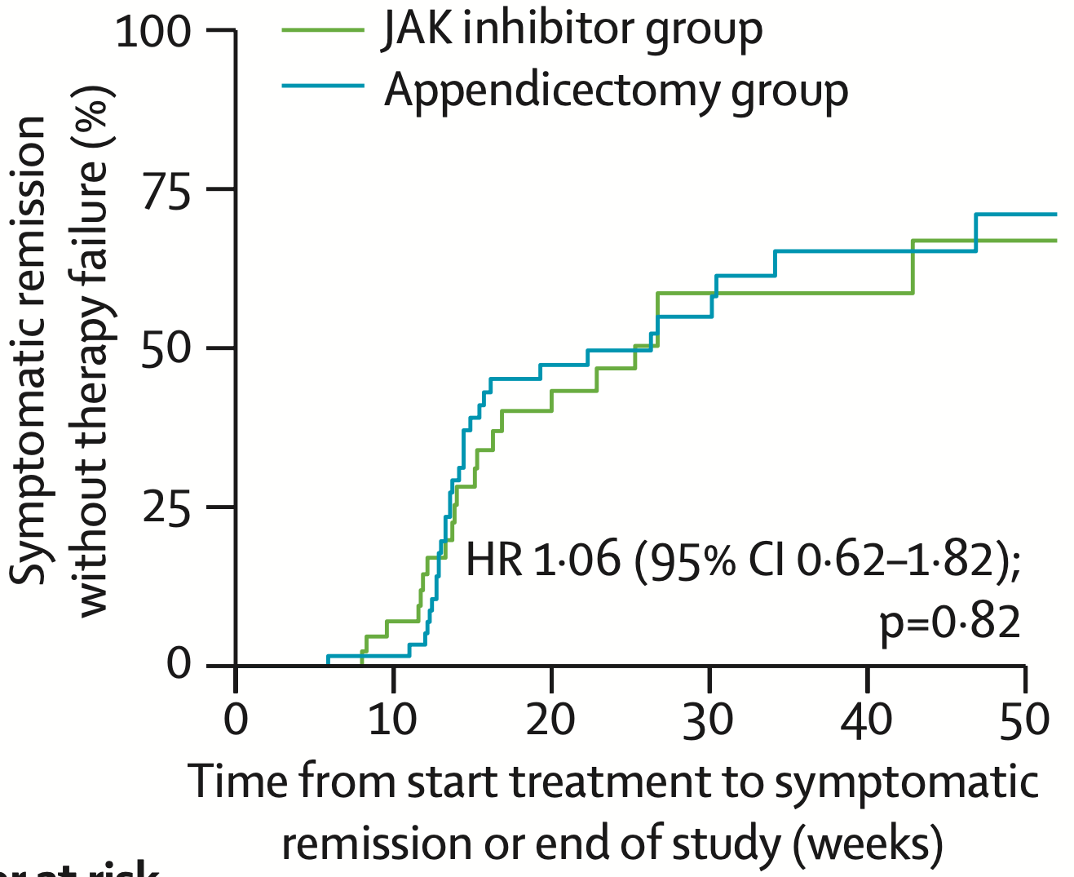
Secondary Outcomes: Clinical Endpoints
Corticosteroid-free remission
Time to remission
Clinical response
Clinical benefit favors appendicectomy, but no difference in disease trajectory endpoints

Slide 12
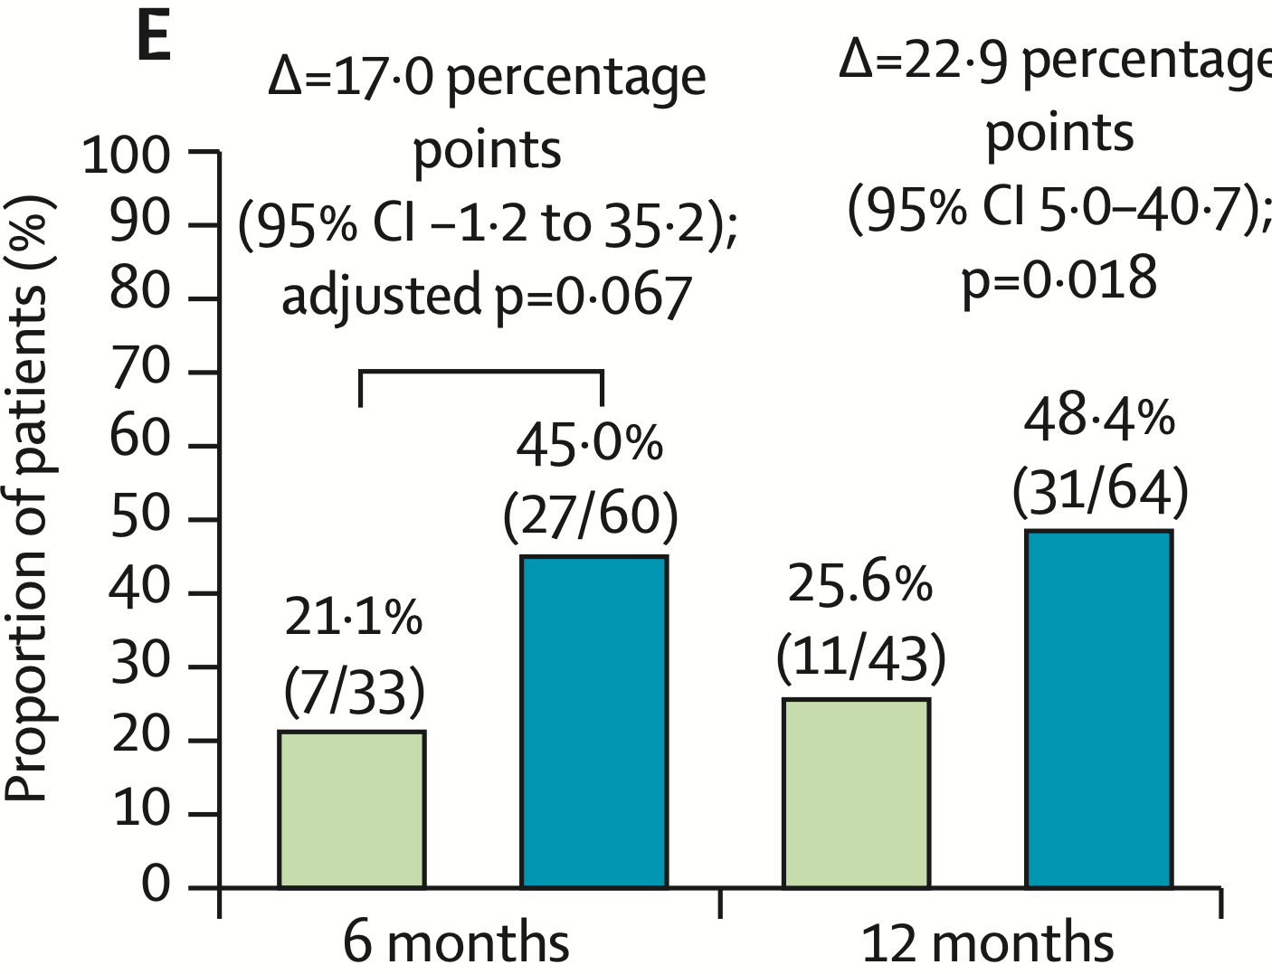
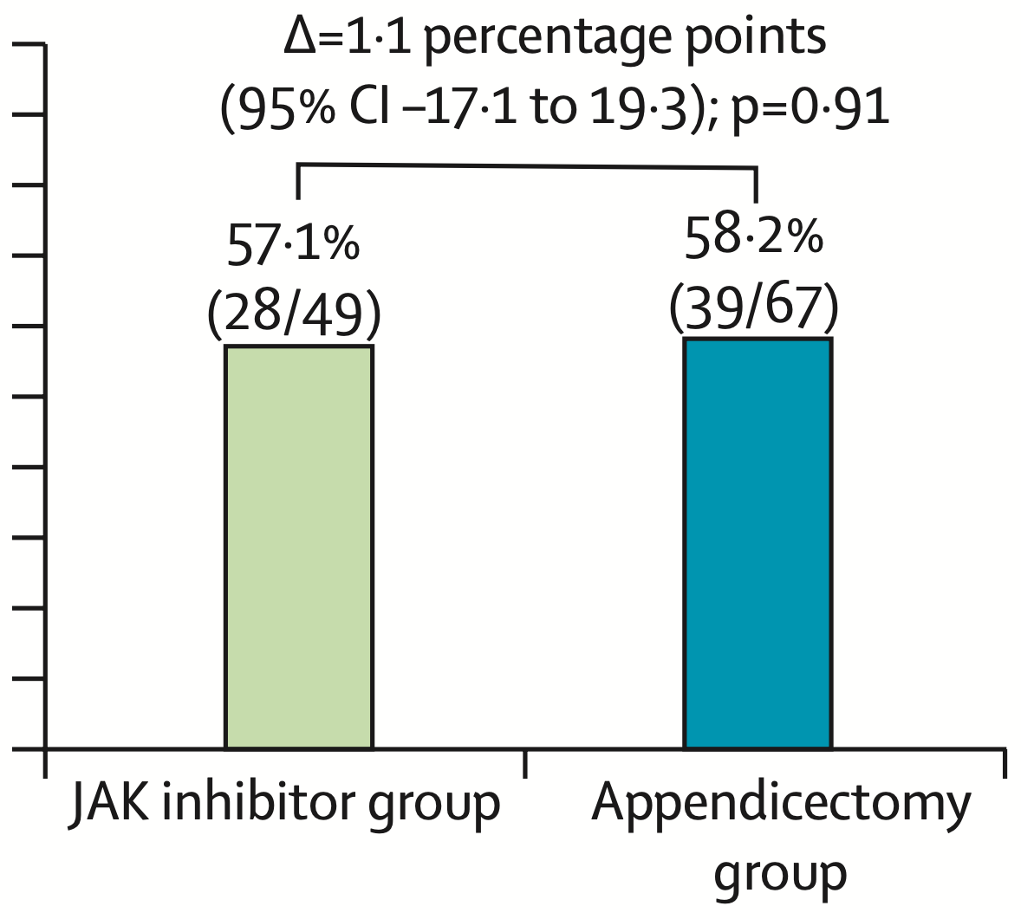
Secondary Outcomes: Clinical Endpoints
Therapy failure
Colectomy
Clinical benefit favors appendicectomy, but no difference in disease trajectory endpoints

Slide 13
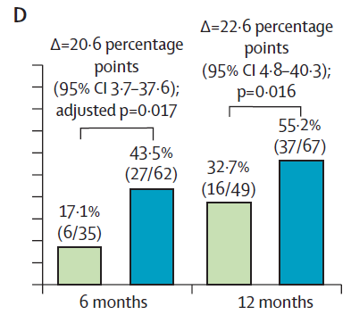
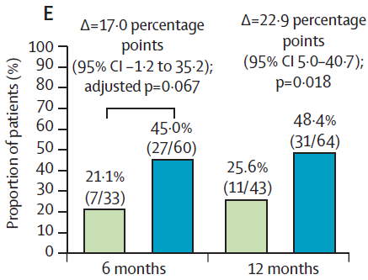
Secondary Outcomes: Endoscopic Endpoints
Endoscopic improvement
Endoscopic response
Higher endoscopic improvement with appendicectomy

Slide 14
Safety
Event | Appendicectomy (n=69) | JAK inhibitor (n=50) | p
Any adverse event | 39 (56.5%) | 30 (60.0%) | 0.70
Serious adverse event | 12 (17.4%) | 6 (12.0%) | 0.42
Hospitalization for UC | 8 (11.6%) | 4 (8.0%) | —
Hospitalization, non-UC | 4 (5.8%) | 2 (4.0%) | —
Post-operative surgical complications (all Clavien-Dindo ≤ II) | 3 (4.3%) | — | —
Incidental grade I appendiceal NET | 2 (2.9%) | 0 | —
Adverse event rates were similar between groups
Appendicectomy-related complications were infrequent and minor: 1 postoperative urinary retention, 1 suspected early abscess managed with oral antibiotics, 1 superficial wound infection
No major (Clavien-Dindo ≥ IIIa) surgical complications
Two patients had an incidentally diagnosed grade I appendiceal neuroendocrine tumor, requiring no further treatment after appendicectomy

Slide 15
Limitations & Unanswered Questions
From the trial itself
Patient-preference, non-randomized design; residual confounding cannot be excluded
Structural asymmetry
  appendicectomy added to ongoing advanced therapy vs JAK-i as monotherapy
Higher baseline steroid use in JAK-i group
  → independently linked to lower remission
6-month endoscopy protocolized only in appendicectomy group
Medical therapy escalation after failure was not standardized
Modest sample size and few colectomy events limit interpretation of surgical sparing
Open clinical questions
Role of an active cecal patch
  Is visibly inflamed appendiceal orifice a predictor of response?
  Should it guide patient selection?
Generalizability into real-world practice
  → Identifying surgical colleagues willing and able to offer timely elective laparoscopic appendicectomy as IBD-directed therapy
Preclinical data suggest altered mucosal immunosurveillance; human data remain limited
Optimal timing within the treatment algorithm
  → Early vs after multiple biologic failures

Slide 16
Recommendations to Practice
Consider appendicectomy in:
Active, biologic-refractory UC
Patients facing next biologic or colectomy
Frame expectations:
~1 in 3 achieve remission at 12 months
Endoscopic healing achievable
Low, minor complication rates
Establish access:
Collaborate with colorectal surgeons
Ensure timely elective appendicectomy
Peri-operative management:
Continue advanced therapy
Taper steroids >20 mg before surgery
Surveillance:
Continue colorectal cancer screening
Pathology:
~3% incidental appendiceal NETs
No further treatment if fully resected
Requires patient counseling

Slide 17





Key Takeaways
What COSTA showed:
Remission at 12 months: 32.8% (appendicectomy) vs 12.2% (JAK inhibitor); adjusted Δ ~23% (p=0.016)
Clinical and endoscopic endpoints consistently favored appendicectomy
Therapy failure and colectomy rates were similar between groups
Safety:
Low surgical complication rate (~4%), all minor; overall AE profile comparable to JAK inhibitors
Clinical implication:
Supports appendicectomy as an adjunct option in refractory UC
Key caveats:
Non-randomized, patient-preference design
Residual confounding possible
Questions remain (selection, timing, long-term safety)

