Slide 1
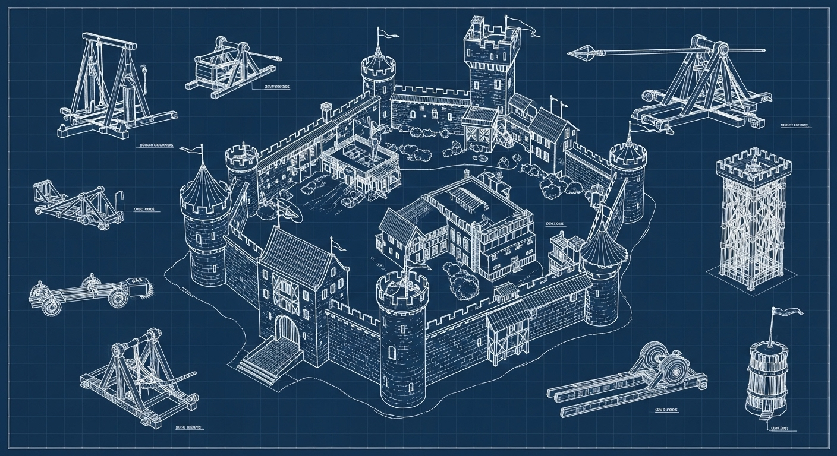


Take out your Christendom 3 notes. Make sure you have 3 study questions on them, then answer this:
What do you think makes a good castle?
IF YOU ARE MISSING ANY OF LAST WEEK’S WORK YOU WLL NOT PARTICIPATE.
Notes:
Welcome: What makes a good castle?
Add lightning flashes at some point? Takes a lot of work honestly…

Slide 2
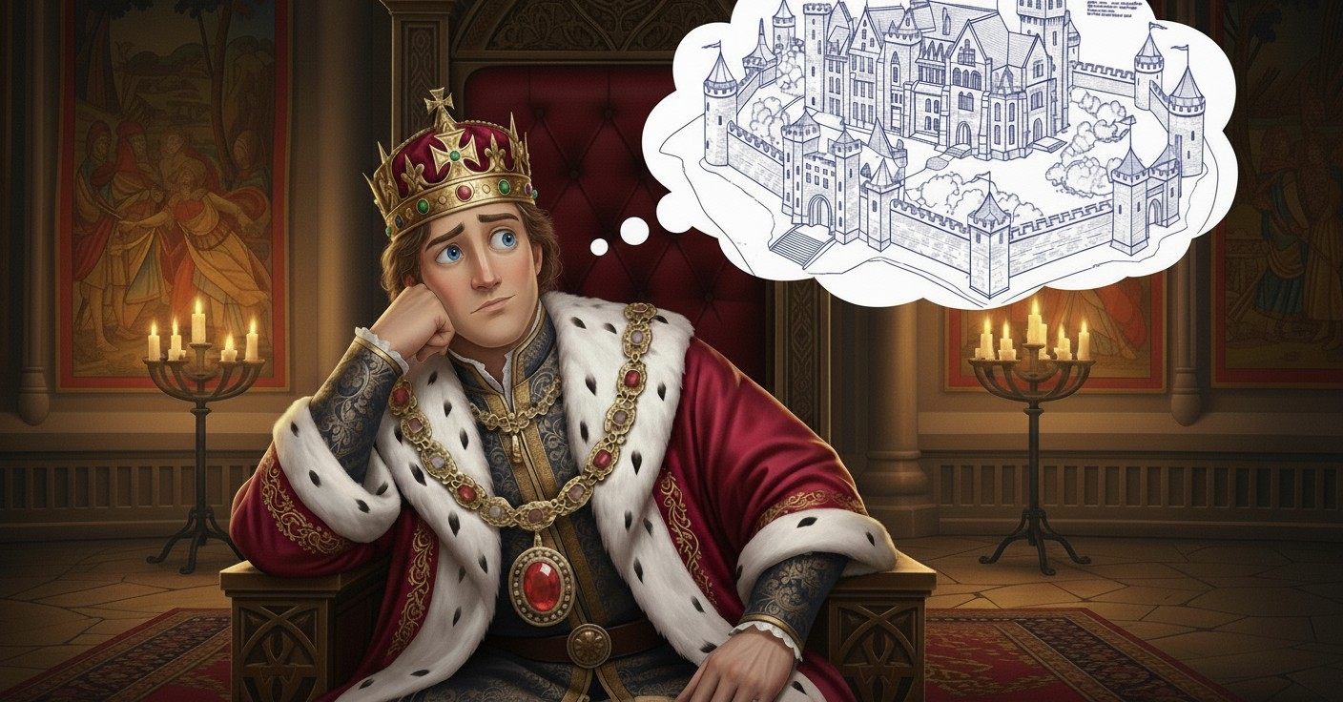

Notes:
Set up: You are the new king. You’ve inherited a castle owned by your father, grandfather and great grandfather. You want to get a clear picture of your defenses

Slide 3
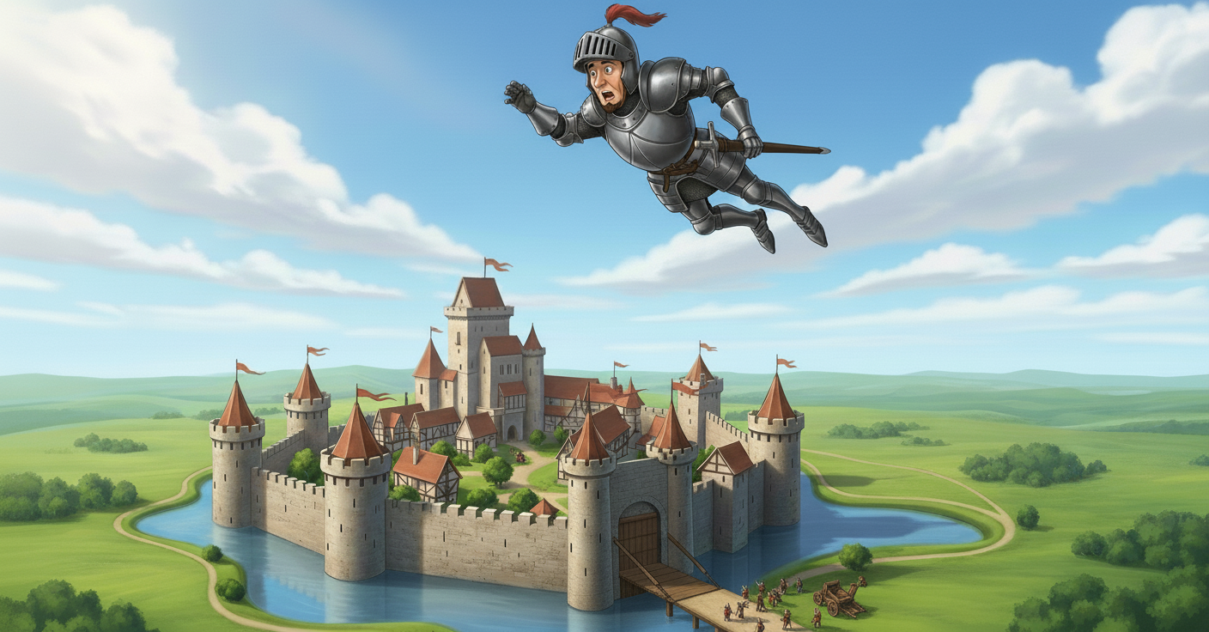
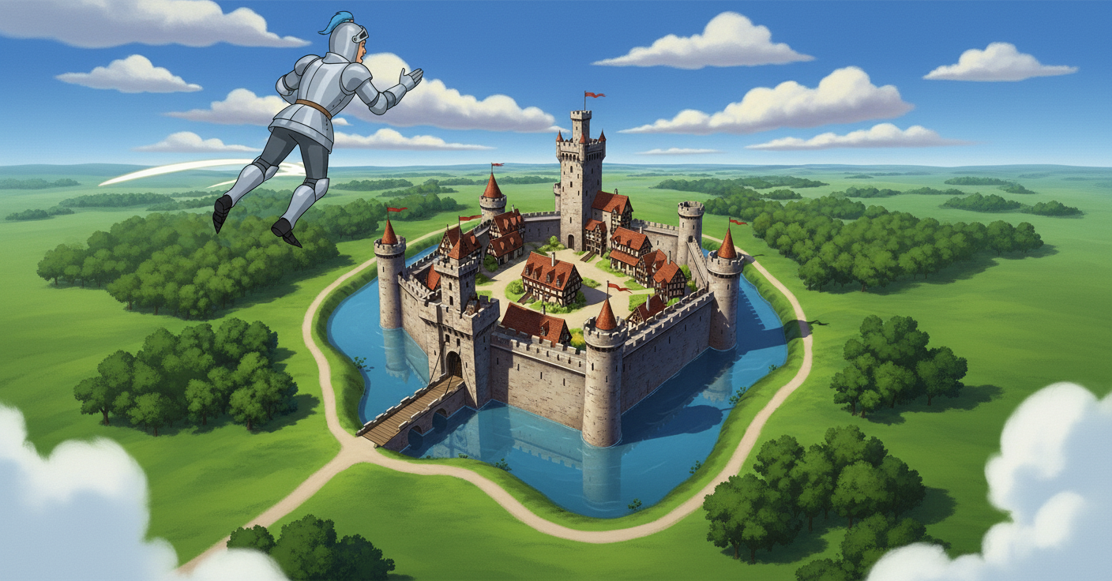
Notes:
so you catapult one of your knights high into the sky to get a birds-eye-view. He lands and starts describing the walls. You are going to draw your plans as he tells you what he saw.

Slide 4
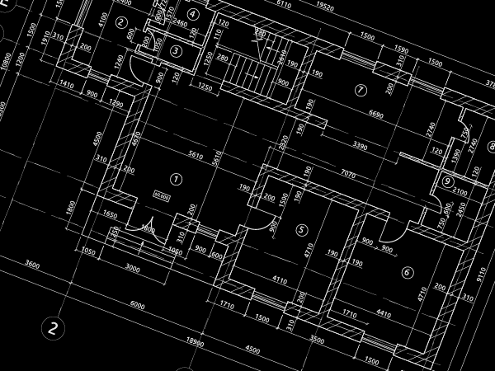

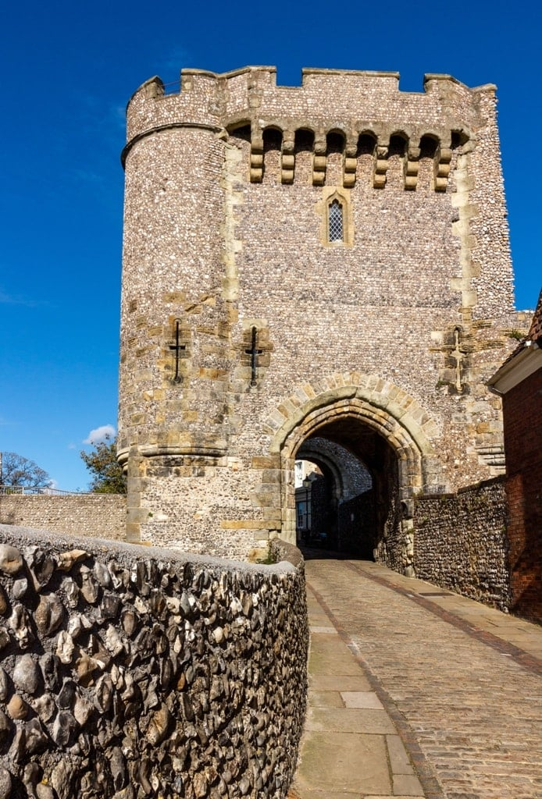
Step 1: The Barbican
This is the barbican – the first line of defense. It is like a mini-castle that guards your real castle.
Draw a rectangle about 3 inches wide and 1 inch tall about an inch from the top of your paper. Label it: Barbican.

Slide 5
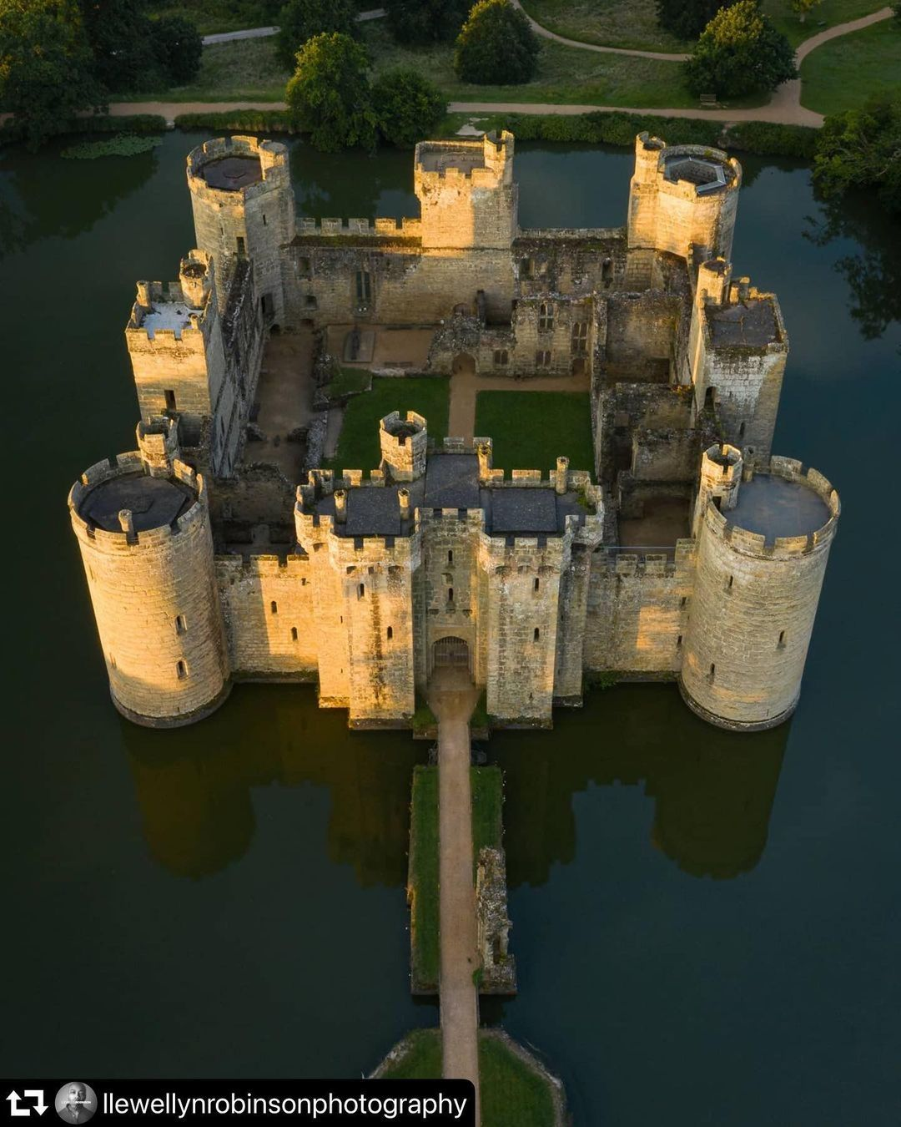
Step 2: The Moat
The moat made it harder for enemies to get to the wall; specifically, it kept siege towers from getting to the walls.
Underneath that rectangle, draw a large rectangle with somewhat wavy lines that is about 2 inches from the edge of your paper all around. Label it “Moat”.

Slide 6
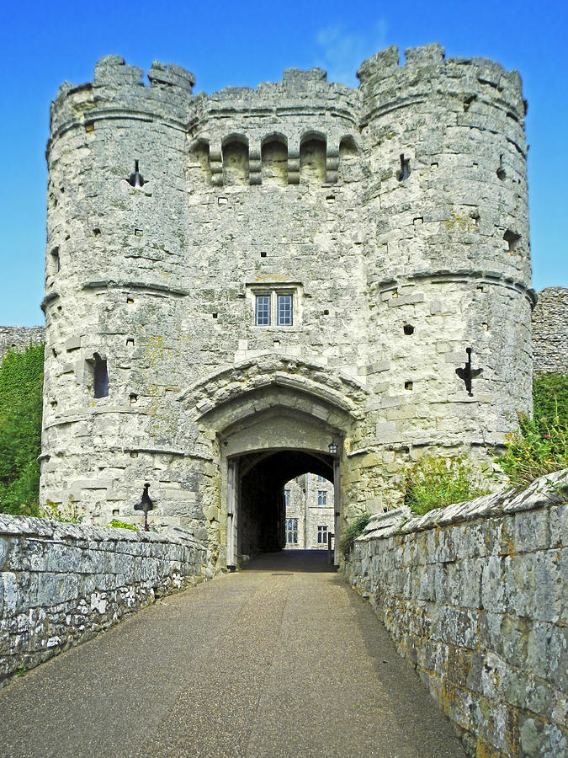
Step 3: The Gate House
The gate is the weakest part of any building since it is not solid brick. So, the gate house was often filled with defensive traps like “murder holes” which were small openings in the ceiling where defenders could drop rocks or burning oil on attackers.
Draw a small rectangle, slightly smaller than the one you drew for the barbican (about 2 inches by ½ inch) just under the moat at the top of your paper. Label it Gate House.

Slide 7
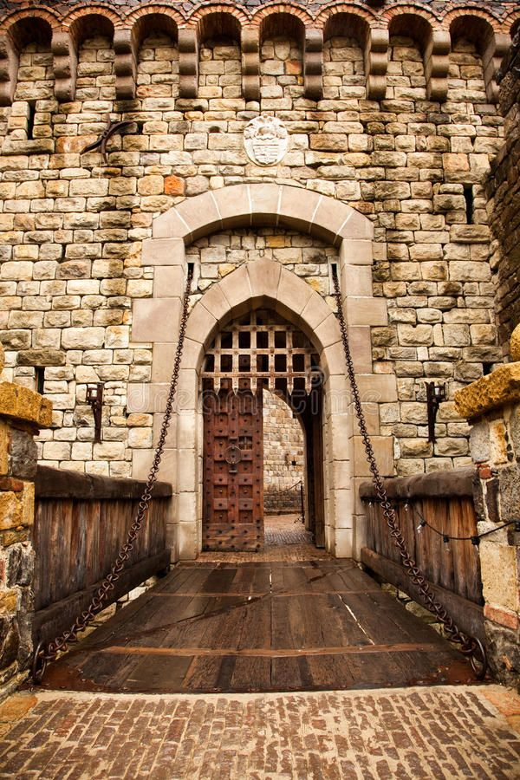
Step 4: The Draw Bridge
If your enemy can’t get to your gate, then its weakness doesn’t matter! The drawbridge could be raised stop enemy advancement.
Draw a thin, tall rectangle connecting the barbican to the gatehouse. It should cross the moat. Draw vertical lines on it to indicate it is made of wood. Label it “Draw Bridge.”

Slide 8
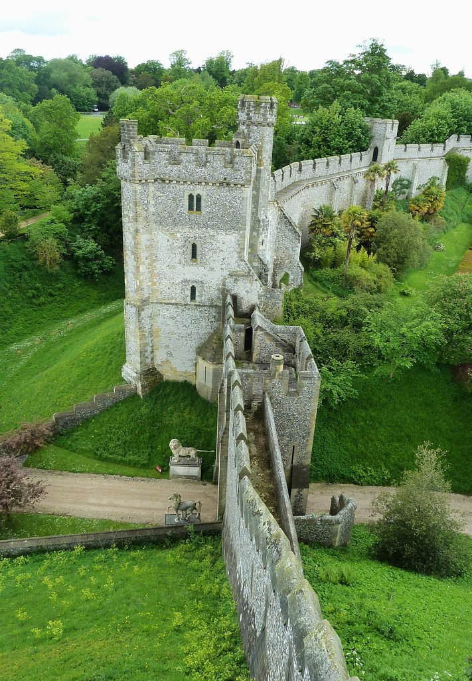
Step 5: Curtain Wall
The curtain wall is the main outer wall of the castle. It connects the gate house to the towers. The height is important as you want to prevent enemies from easily just climbing over them.
Draw a rectangle coming out of your Gate House that remains inside the moat all the way around. Draw a second rectangle right inside of it (to show the thickness of your wall.) Label it “Curtain Wall.”

Slide 9
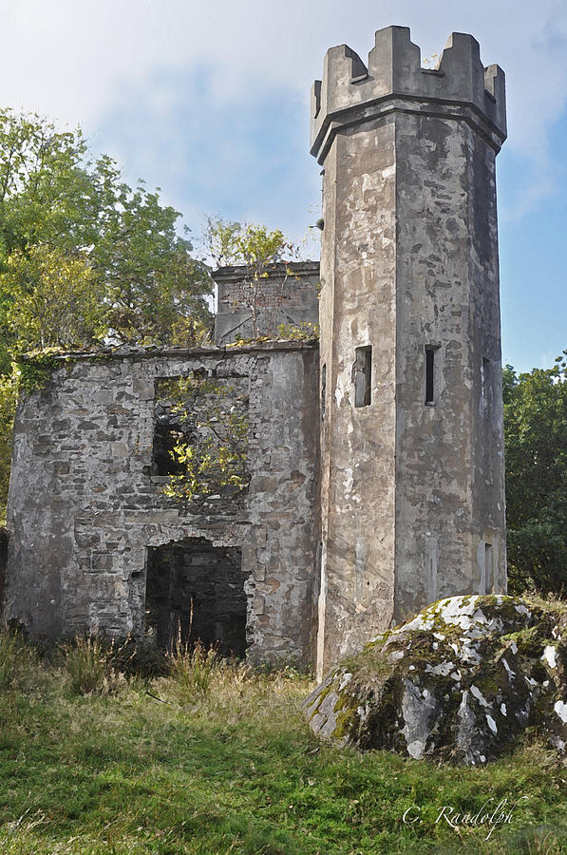
Step 6: Towers
Towers give vision over the surrounding area. They are angled or rounded so enemy weapons will bounce off of them more easily since their height makes them vulnerable.
At the four corners of your curtain wall, draw a circle to indicate a tower. You may draw two more circles anywhere on your castle plan to add two more towers.

Slide 10
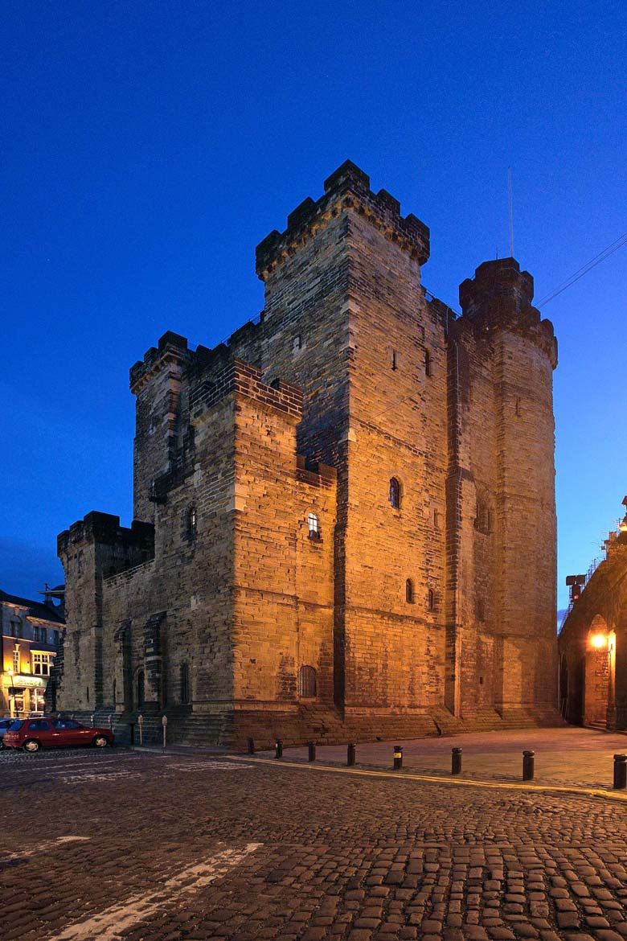
Step 7: The Inner Keep
The final line of defense is the keep – a castle within a castle. This heavily defended building is often where the king sleeps.
Just above the bottom of your curtain wall draw a square about 2 inches long on each side. Label it “Keep.”

Slide 11
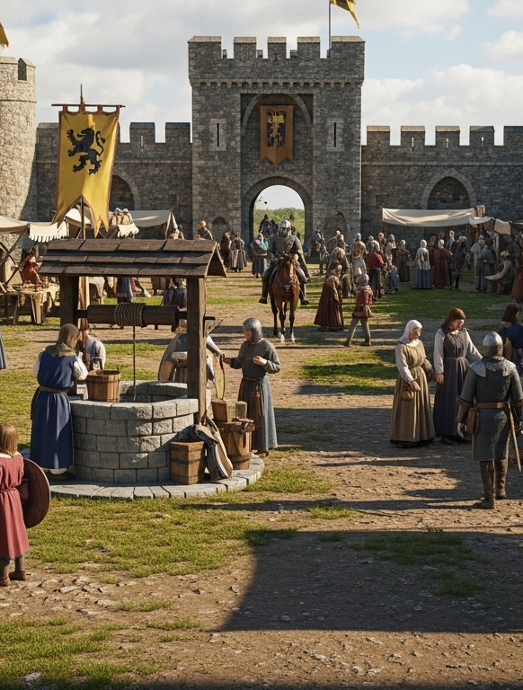
Step 8: The Bailey
The open space within the curtain wall is the bailey. The most important piece is the well. If you don’t have fresh water, your enemy can simply use a siege to cause you to surrender.
Between the gate house and the Keep, draw a few small boxes or triangles for little houses, stables, or trees. Draw a small circle labeled “The well” somewhere in this space. This inside space is called the Bailey. Label it ‘Bailey.’

Slide 12
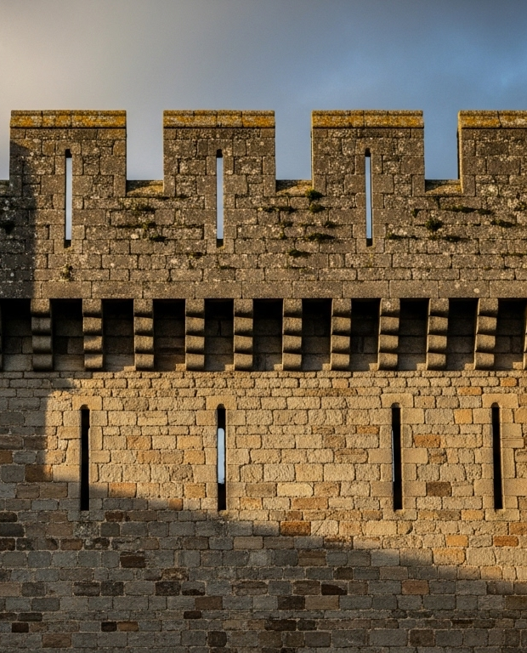
Step 9: Defenses
Castle walls get their distinct look from the battlements. The raised pieces offer protection while the lower ones allow soldiers to fire on the enemy.
Add arrow loops by drawing a straight line across any wall and battlements by drawing a jagged wall like teeth (think of the usual walls of a castle) over any currently placed walls.

Slide 13
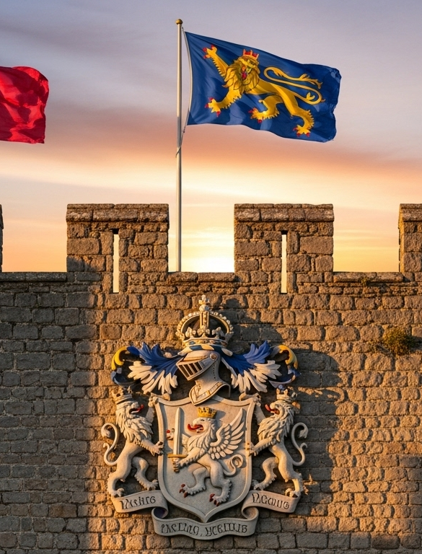
Step 10: Details
Castles are expensive so make it your own!
Now add details: flags on Towers, piranhas in the moat – you decide!

Slide 14
The Unseen
Turn your paper over. Draw a line across the middle of the page. On the top half of your paper write about any additional defenses your castle has that cannot be seen in your diagram.

Slide 15
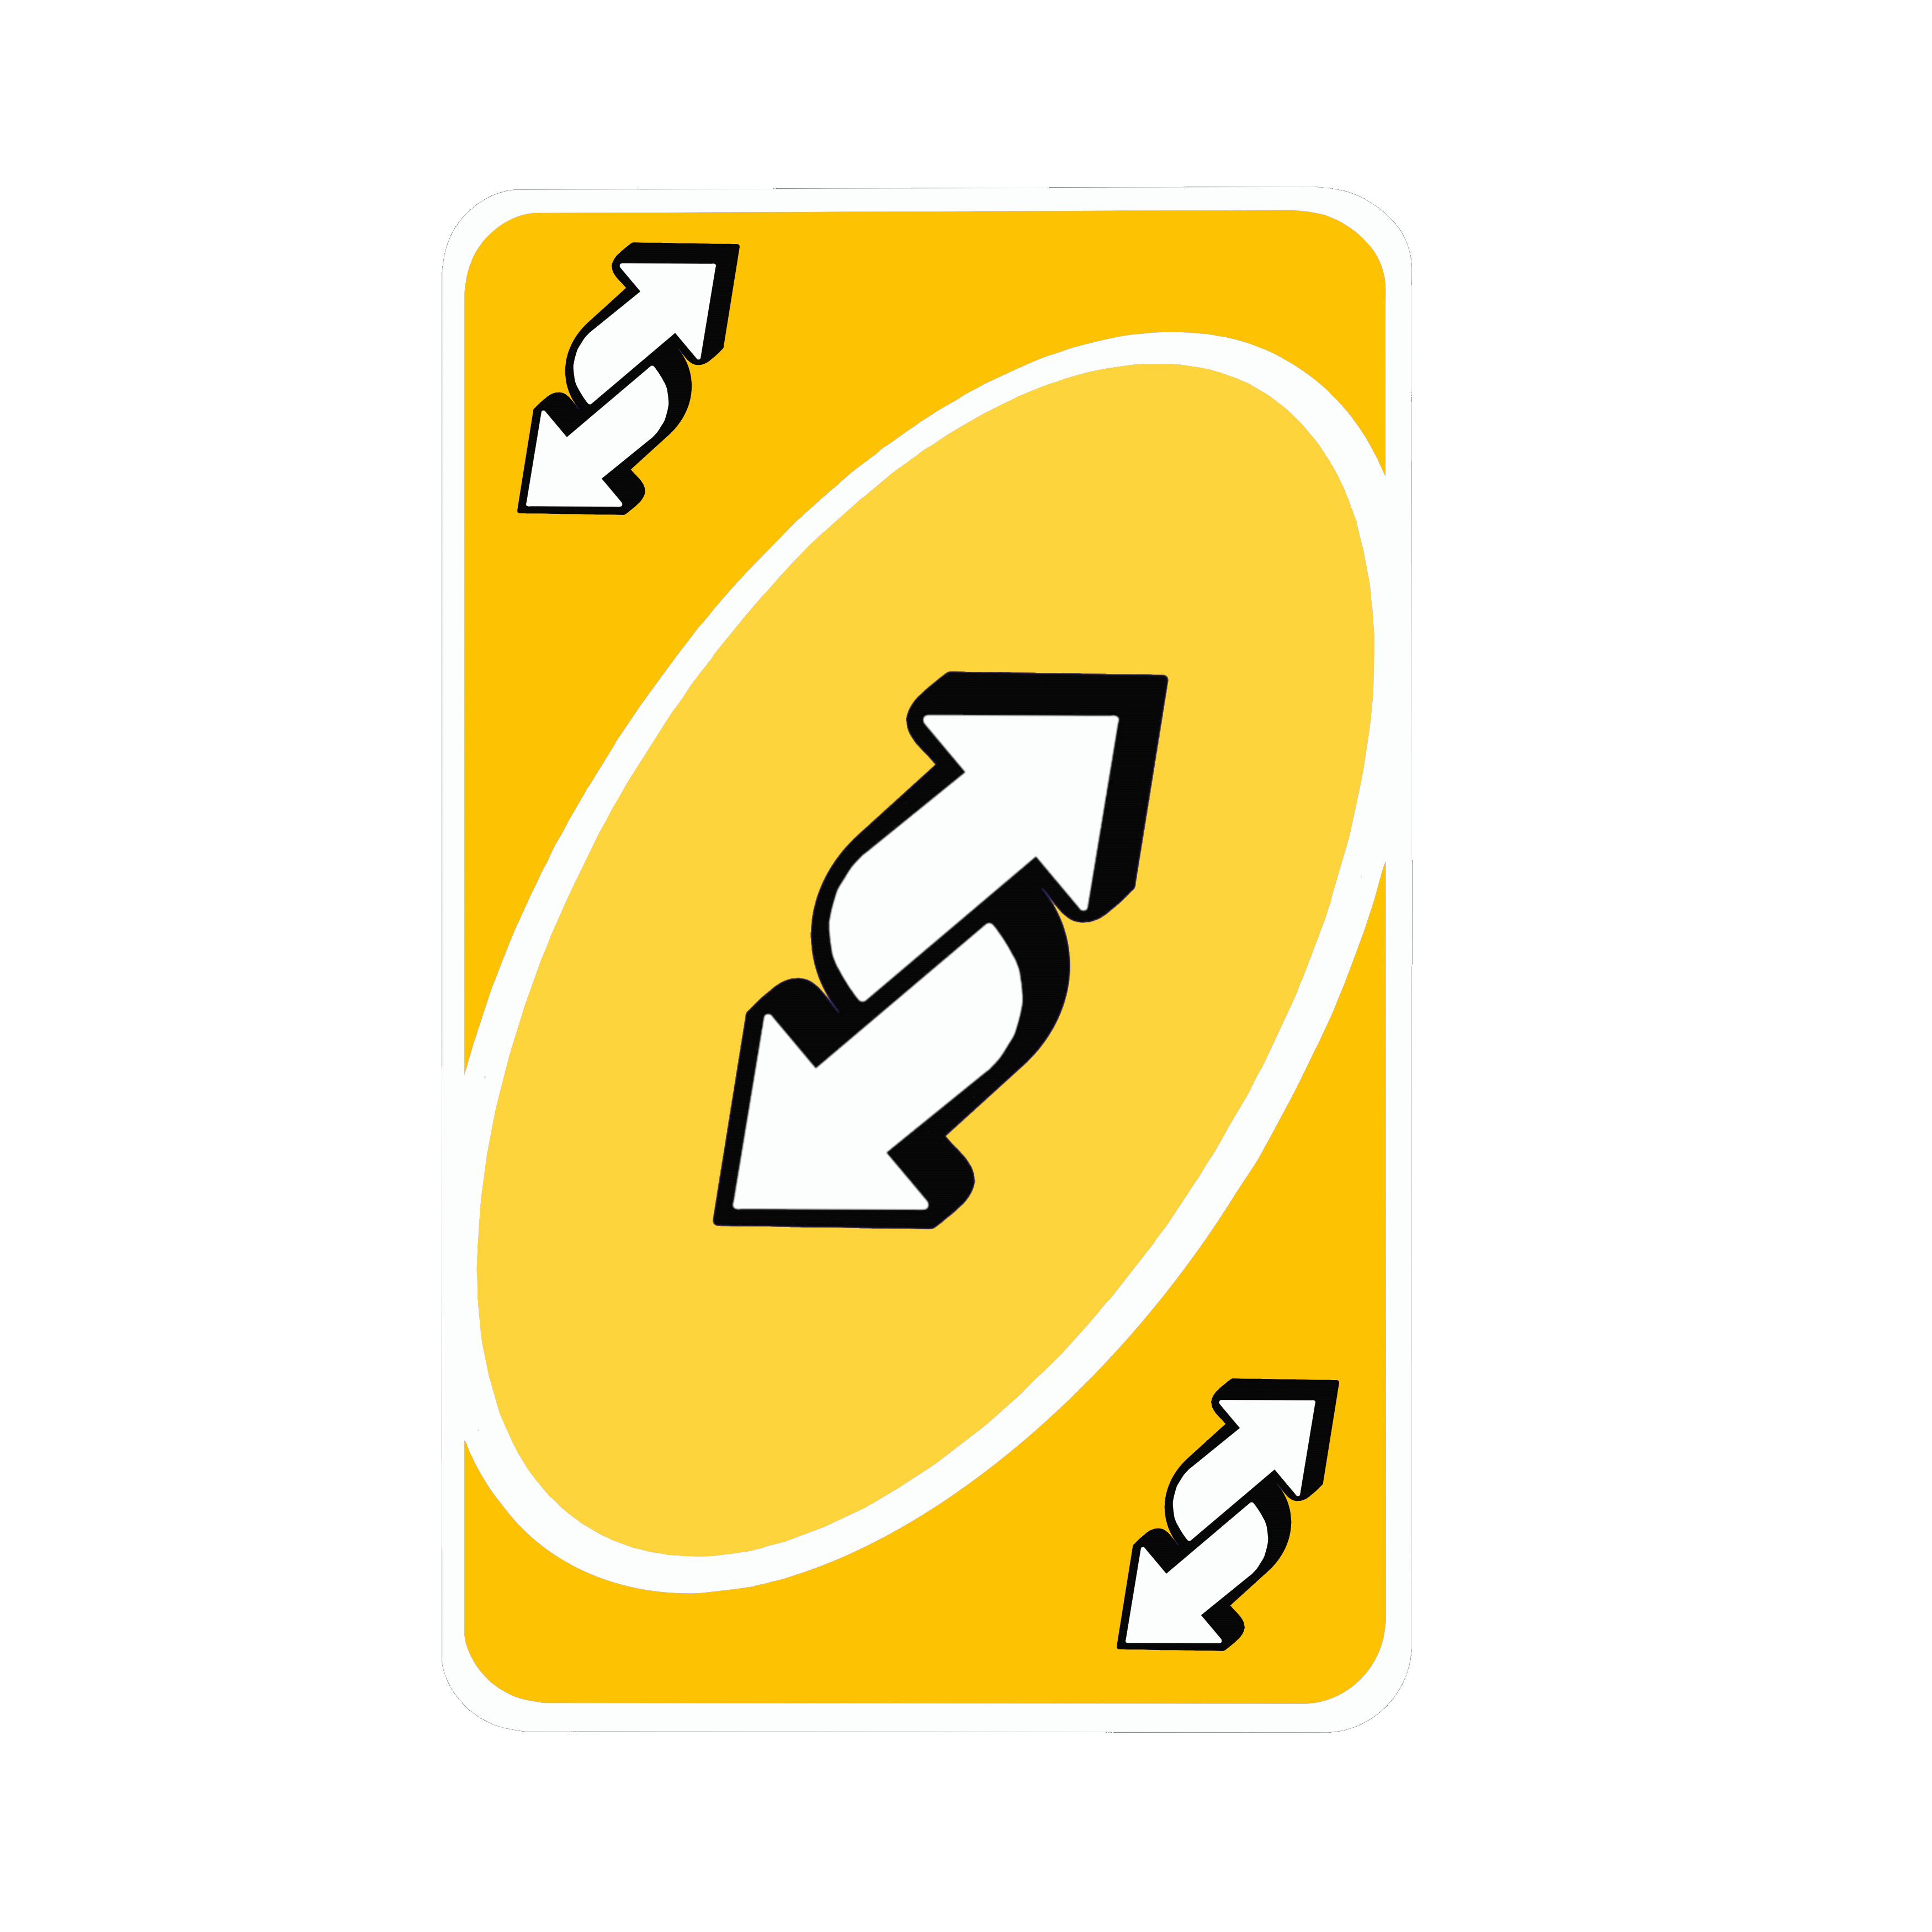


Slide 16
The Attack!
Trade papers with your partner. Take a couple minutes to evaluate their castle. Look for areas where they did not follow directions well. That is their weak point!
On the bottom of the back side, write a full paragraph attack plan explaining how you would attack their castle. Use specific strategies from your Christendom 3 notes!

Slide 17


The Attack!
Now, it’s time to attack! On their castle, draw your attack. Include any major siege weapons you intend to use.
Once you’ve drawn your force, add comic “sound” words like BOOM, BANG or KACHOW to bring your attack to life.
Battering Ram
Trebuchet
Siege Lines
Siege Tower

