Slide 1
COLORFUL
PARTY
Click on the button under the presentation preview that says "Download as PowerPoint template". You will get a .PPTX file that you can edit in PowerPoint.
Remember to download and install the fonts used in this presentation (you’ll find the links to the font files needed in the Presentation design slide)
GoogleSlides.org

Slide 2
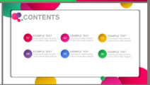
……
contents
GARDEN
02
HOUSE
01
ANNUAL WORK SUMMARY
SUCCESSFUL PROJECT
HOTEL
BEACH
03
04
COMPLETION OF WORK
NEXT YEAR WORK PLAN

Slide 3
GARDEN
colorful party
Is the color of milk and fresh snow, the color produced by the combination of all the colors of the visible spectrum.

Slide 4
GARDEN | colorful party
  Timeline
  Table
01
02
A complex idea can be conveyed with just a single still image, namely making it possible to absorb large amounts of data quickly.
A complex idea can be conveyed with just a single still image, namely making it possible to absorb large amounts of data quickly.
  Infographic
  Chart
03
04
A complex idea can be conveyed with just a single still image, namely making it possible to absorb large amounts of data quickly.
A complex idea can be conveyed with just a single still image, namely making it possible to absorb large amounts of data quickly.

Slide 5
GARDEN | colorful party
Get a modern PowerPoint Presentation that is beautifully designed. Easy to change colors, photos and text.
Bring the attention of your audience over a key concept using icons or illustrations
Is the color of milk and fresh snow, the color produced by the combination of all the colors of the visible spectrum.
Easy to change colors, photos and Text. Get a modern PowerPoint Presentation that is beautifully designed.

Slide 6

GARDEN | colorful party
01
02
03
04
Easy to change colors, photos and Text. Get a modern PowerPoint Presentation that is beautifully designed.
Easy to change colors, photos and Text. Get a modern PowerPoint Presentation that is beautifully designed.
Easy to change colors, photos and Text. Get a modern PowerPoint Presentation that is beautifully designed.
Easy to change colors, photos and Text. Get a modern PowerPoint Presentation that is beautifully designed.

Slide 7
GARDEN | colorful party
Easy to change colors, photos and Text. Get a modern PowerPoint Presentation that is beautifully designed.
Easy to change colors, photos and Text. Get a modern PowerPoint Presentation that is beautifully designed.
Easy to change colors, photos and Text. Get a modern PowerPoint Presentation that is beautifully designed.

Slide 8
HOUSE
colorful party
Is the color of milk and fresh snow, the color produced by the combination of all the colors of the visible spectrum.

Slide 9
HOUSE | colorful party
68%
You can simply impress your audience and add a unique zing and appeal to your Presentations.
CHART

Slide 10
HOUSE | colorful party
  PINK CHART
  RED CHART
  GREEN CHART
Easy to change colors, photos and Text. Get a modern PowerPoint Presentation that is beautifully designed.
Easy to change colors, photos and Text. Get a modern PowerPoint Presentation that is beautifully designed.
Easy to change colors, photos and Text. Get a modern PowerPoint Presentation that is beautifully designed.

Slide 11
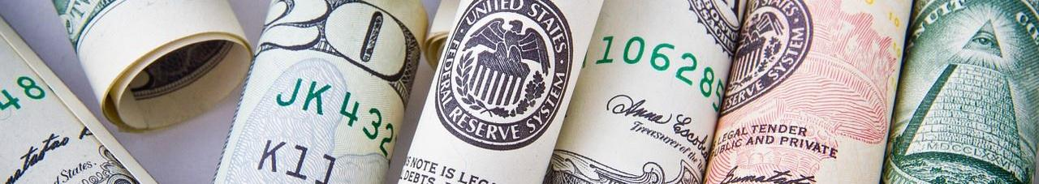
HOUSE | colorful party
1
2
3
4
  MONEY
  MONEY
  MONEY
  MONEY
Easy to change colors, photos and Text. Get a modern PowerPoint Presentation that is beautifully designed.
Easy to change colors, photos and Text. Get a modern PowerPoint Presentation that is beautifully designed.
Easy to change colors, photos and Text. Get a modern PowerPoint Presentation that is beautifully designed.
Easy to change colors, photos and Text. Get a modern PowerPoint Presentation that is beautifully designed.

Slide 12

HOUSE | colorful party
A picture is worth a thousand words
  Timeline
  Infographic
  Worldmap
Show and explain your web, app or software projects using these gadget templates.
Show and explain your web, app or software projects using these gadget templates.
Show and explain your web, app or software projects using these gadget templates.
  Table
  Chart
  Image
Show and explain your web, app or software projects using these gadget templates.
Show and explain your web, app or software projects using these gadget templates.
Show and explain your web, app or software projects using these gadget templates.

Slide 13
HOTEL
colorful party
Is the color of milk and fresh snow, the color produced by the combination of all the colors of the visible spectrum.

Slide 14
HOTEL | colorful party
PINK
  GOLDEN
01
Show and explain your web, app or software projects using these gadget templates.
GOLD
02
GREEN
03
  PINK
Show and explain your web, app or software projects using these gadget templates.
  GREEN
Show and explain your web, app or software projects using these gadget templates.

Slide 15
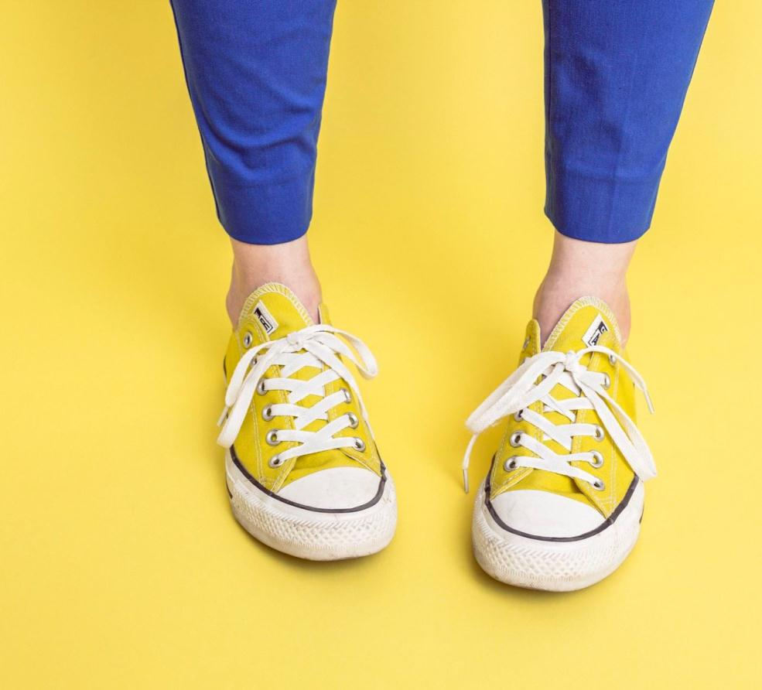
HOTEL | colorful party
  Big concept
Show and explain your web, app or software projects using these gadget templates.
  Big concept
Show and explain your web, app or software projects using these gadget templates.
  Big concept
Show and explain your web, app or software projects using these gadget templates.

Slide 16
HOTEL | colorful party
  Big concept
  Big concept
Show and explain your web, app or software projects using these gadget templates.
Show and explain your web, app or software projects using these gadget templates.
  Big concept
  Big concept
Show and explain your web, app or software projects using these gadget templates.
Show and explain your web, app or software projects using these gadget templates.

Slide 17
HOTEL | colorful party
Step
Step
Step
Step
Step
Step

Slide 18
BEACH
colorful party
Is the color of milk and fresh snow, the color produced by the combination of all the colors of the visible spectrum.

Slide 19
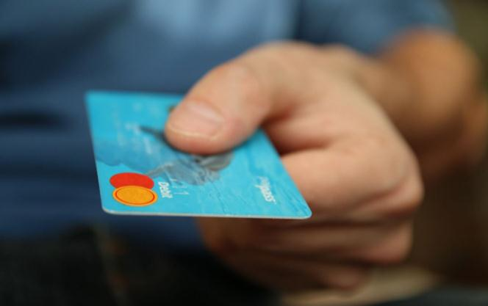
BEACH | colorful party
  IDEA
  MUSIC
A complex idea can be conveyed with just a single still image, namely making it possible to absorb large amounts of data quickly.
A complex idea can be conveyed with just a single still image, namely making it possible to absorb large amounts of data quickly.
  CONFIGURATION
  PROJECT
A complex idea can be conveyed with just a single still image, namely making it possible to absorb large amounts of data quickly.
A complex idea can be conveyed with just a single still image, namely making it possible to absorb large amounts of data quickly.

Slide 20

BEACH | colorful party
  WORLD
A complex idea can be conveyed with just a single still image, namely making it possible to absorb large amounts of data quickly.
  SHARE
A complex idea can be conveyed with just a single still image, namely making it possible to absorb large amounts of data quickly.
  NETWORK
A complex idea can be conveyed with just a single still image, namely making it possible to absorb large amounts of data quickly.
  SHOPPING
A complex idea can be conveyed with just a single still image, namely making it possible to absorb large amounts of data quickly.

Slide 21

BEACH | colorful party
“
A complex idea can be conveyed with just a single still image, namely making it possible to absorb large amounts of data quickly.
  USERS
  TIMELINE
Easy to change colors, photos and Text. Get a modern PowerPoint Presentation that is beautifully designed.
Easy to change colors, photos and Text. Get a modern PowerPoint Presentation that is beautifully designed.
  WORKSHOP
Easy to change colors, photos and Text. Get a modern PowerPoint Presentation that is beautifully designed.

Slide 22
BEACH | colorful party
  SWOT
Easy to change colors, photos and Text. Get a modern PowerPoint Presentation that is beautifully designed.
W
  SWOT
Easy to change colors, photos and Text. Get a modern PowerPoint Presentation that is beautifully designed.
O
  SWOT
S
Easy to change colors, photos and Text. Get a modern PowerPoint Presentation that is beautifully designed.
T
  SWOT
Easy to change colors, photos and Text. Get a modern PowerPoint Presentation that is beautifully designed.

Slide 23
THANK YOU
presentation
Special thanks to all the people who made and released these awesome resources for free:
Presentation template by GoogleSlides.org
GoogleSlides.org

Slide 24
GoogleSlides.org
Google Slides
Select slide and edit your presentation
You can download and share your presentation!
Powerpoint Templates
Free Powerpoint Presentation Template (.pptx)
You can upload Google Slides..
Free Powerpoint Templates: https://googleslides.org/free-templates
Abstract Google Slides: https://googleslides.org/free-templates/abstract-google-slides
Animal and Wildlife Presentation: https://googleslides.org/free-templates/animal-wildlife-presentation-template
Biology Powerpoint Templates: https://googleslides.org/free-templates/biology-presentation-slides
Business & Finance Google Slides: https://googleslides.org/free-templates/business-finance-templates
Chemistry Powerpoint Slides: https://googleslides.org/free-templates/chemistry-google-slides-template
Christmas Google Slides: https://googleslides.org/free-templates/christmas-new-year-templates
Education Google Slides: https://googleslides.org/free-templates/education-google-slides
Flowers Powerpoint Templates: https://googleslides.org/free-templates/flowers-powerpoint-templates
Food and Drinks Slides: https://googleslides.org/free-templates/food-drinks-powerpoint-templates
Games Powerpoint Templates: https://googleslides.org/free-templates/games-powerpoint-templates
Medical Google Slides: https://googleslides.org/free-templates/medical-powerpoint-templates
Nature Powerpoint Templates: https://googleslides.org/free-templates/nature-google-slide-templates
Religious Google Slides: https://googleslides.org/free-templates/religion-powerpoint-templates
Sports Powerpoint Slides: https://googleslides.org/free-templates/sports-presentation-slides
Technology Google Slides: https://googleslides.org/free-templates/technology-powerpoint-templates
Transportation Powerpoint Templates: https://googleslides.org/free-templates/transportation-google-slides

