Slide 1

2020
BLACK WHITE NEWSPAPER
Presentation Template
www.freepptbackgrounds.net

Slide 2
CONTENTS
02
04
Business
Base
01
03
Company
Models

Slide 3

01
COMPANY

Slide 4
TITLE HERE
TITLE HERE
A complex idea can be conveyed with just a single still image, namely making it possible to absorb large amounts of data quickly.
TITLE HERE
TITLE HERE
TITLE HERE
A complex idea can be conveyed with just a single still image, namely making it possible to absorb large amounts of data quickly.

Slide 5
TITLE HERE
TITLE
TITLE
TITLE
TITLE
We hope that this template will return to you as a time, money and reputation.
We hope that this template will return to you as a time, money and reputation.
We hope that this template will return to you as a time, money and reputation.
We hope that this template will return to you as a time, money and reputation.

Slide 6

TITLE HERE
OPTION HERE
We hope that this template will return to you as a time, money and reputation.
We hope that this template will return to you as a time, money and reputation.
OPTION HERE
We use well-known development methodologies to create a customized approach for each of the projects. This allows us to achieve high quality outcomes and full transparency towards.

Slide 7
TITLE HERE
STEP HERE
01
02
STEP HERE
We hope that this template will return to you as a time, money and reputation.
We hope that this template will return to you as a time, money and reputation.
STEP HERE
03
04
STEP HERE
We hope that this template will return to you as a time, money and reputation.
We hope that this template will return to you as a time, money and reputation.
01
02
03
04

Slide 8

02
BUSINESS

Slide 9

TITLE HERE
OPTION HERE
A complex idea can be conveyed with just a single still image, namely making it possible to absorb large amounts of data quickly.
OPTION HERE
A complex idea can be conveyed with just a single still image, namely making it possible to absorb large amounts of data quickly.
OPTION HERE
OPTION HERE
A complex idea can be conveyed with just a single still image, namely making it possible to absorb large amounts of data quickly.
OPTION HERE
A complex idea can be conveyed with just a single still image, namely making it possible to absorb large amounts of data quickly.

Slide 10
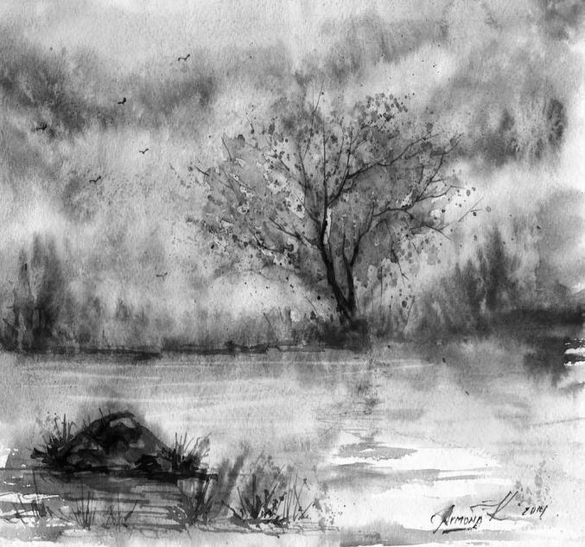
TITLE HERE
We use well-known development methodologies to create a customized approach for each of the projects. This allows us to achieve high quality outcomes and full transparency towards.
DESCRIPTION HERE
A complex idea can be conveyed with just a single still image, namely making it possible to absorb large amounts of data quickly.
DESCRIPTION HERE
A complex idea can be conveyed with just a single still image, namely making it possible to absorb large amounts of data quickly.

Slide 11
TITLE HERE
NOTE HERE
NOTE HERE
NOTE HERE
NOTE HERE
A complex idea can be conveyed with just a single still image, namely making it possible to absorb large amounts of data quickly.
A complex idea can be conveyed with just a single still image, namely making it possible to absorb large amounts of data quickly.
A complex idea can be conveyed with just a single still image, namely making it possible to absorb large amounts of data quickly.
A complex idea can be conveyed with just a single still image, namely making it possible to absorb large amounts of data quickly.

Slide 12

TITLE HERE
TITLE HERE
TITLE HERE
A complex idea can be conveyed with just a single still image, namely making it possible to absorb large amounts of data quickly.
A complex idea can be conveyed with just a single still image, namely making it possible to absorb large amounts of data quickly.
TITLE HERE
We hope that this template will return to you as a time, money and reputation.

Slide 13
TITLE HERE
TITLE
We hope that this template will return to you as a time, money and reputation.
TITLE
We hope that this template will return to you as a time, money and reputation.
TITLE
We hope that this template will return to you as a time, money and reputation.
TITLE
We hope that this template will return to you as a time, money and reputation.

Slide 14

03
MODELS

Slide 15
TITLE HERE
STEP HERE
STEP HERE
We hope that this template will return to you as a time, money and reputation.
We hope that this template will return to you as a time, money and reputation.
STEP HERE
STEP HERE
We hope that this template will return to you as a time, money and reputation.
We hope that this template will return to you as a time, money and reputation.

Slide 16



TITLE HERE
STAGE HERE
A complex idea can be conveyed with just a single still image, namely making it possible to absorb large amounts of data quickly.
STAGE HERE
STAGE HERE
A complex idea can be conveyed with just a single still image, namely making it possible to absorb large amounts of data quickly.
A complex idea can be conveyed with just a single still image, namely making it possible to absorb large amounts of data quickly.

Slide 17
TITLE HERE
OPTION HERE
We use well-known development methodologies to create a customized approach for each of the projects. This allows us to achieve high quality outcomes and full transparency towards.
OPTION HERE
We use well-known development methodologies to create a customized approach for each of the projects. This allows us to achieve high quality outcomes and full transparency towards.
OPTION HERE
We use well-known development methodologies to create a customized approach for each of the projects. This allows us to achieve high quality outcomes and full transparency towards.
OPTION HERE
We use well-known development methodologies to create a customized approach for each of the projects. This allows us to achieve high quality outcomes and full transparency towards.

Slide 18



TITLE HERE
DESCRIPTION HERE
DESCRIPTION HERE
DESCRIPTION HERE
We use well-known development methodologies to create a customized approach for each of the projects. This allows us to achieve high quality outcomes and full transparency towards.
We use well-known development methodologies to create a customized approach for each of the projects. This allows us to achieve high quality outcomes and full transparency towards.
We use well-known development methodologies to create a customized approach for each of the projects. This allows us to achieve high quality outcomes and full transparency towards.

Slide 19




TITLE HERE
80%
60%
50%
42%
NOTE HERE
NOTE HERE
NOTE HERE
NOTE HERE
A complex idea can be conveyed with just a single still image, namely making it possible to absorb large amounts of data quickly.
A complex idea can be conveyed with just a single still image, namely making it possible to absorb large amounts of data quickly.
A complex idea can be conveyed with just a single still image, namely making it possible to absorb large amounts of data quickly.
A complex idea can be conveyed with just a single still image, namely making it possible to absorb large amounts of data quickly.

Slide 20

04
BASE

Slide 21
TITLE HERE
A complex idea can be conveyed with just a single still image, namely making it possible to absorb large amounts of data quickly.
A complex idea can be conveyed with just a single still image, namely making it possible to absorb large amounts of data quickly.
A complex idea can be conveyed with just a single still image, namely making it possible to absorb large amounts of data quickly.
A complex idea can be conveyed with just a single still image, namely making it possible to absorb large amounts of data quickly.
A complex idea can be conveyed with just a single still image, namely making it possible to absorb large amounts of data quickly.
A complex idea can be conveyed with just a single still image, namely making it possible to absorb large amounts of data quickly.

Slide 22
TITLE HERE
A complex idea can be conveyed with just a single still image, namely making it possible to absorb large amounts of data quickly.
A complex idea can be conveyed with just a single still image, namely making it possible to absorb large amounts of data quickly.
TITLE HERE
TITLE HERE
TITLE HERE
TITLE HERE
A complex idea can be conveyed with just a single still image, namely making it possible to absorb large amounts of data quickly.
A complex idea can be conveyed with just a single still image, namely making it possible to absorb large amounts of data quickly.

Slide 23

TITLE HERE
TITLE
A complex idea can be conveyed with just a single still image, namely making it possible to absorb large amounts of data quickly.
A complex idea can be conveyed with just a single still image, namely making it possible to absorb large amounts of data quickly.
A complex idea can be conveyed with just a single still image, namely making it possible to absorb large amounts of data quickly.
TITLE
TITLE

Slide 24
TITLE HERE
We hope that this template will return to you as a time, money and reputation.
We hope that this template will return to you as a time, money and reputation.
We hope that this template will return to you as a time, money and reputation.
TITLE
TITLE
TITLE
TITLE
TITLE
We hope that this template will return to you as a time, money and reputation.
We hope that this template will return to you as a time, money and reputation.

Slide 25
2020
THANK YOU !
Black White Newspaper Template
www.freepptbackgrounds.net

