Slide 1



Phonics: i as in it
Colour the boxes that have the letter i and practise making the sound.
t
s
i
a
i
t
p
i
a
s
© State of New South Wales (Department of Education), 2023. Except for the Department of Education logo, other logos and trademark-protected material, this resource is licensed under the Creative Commons Attribution 4.0 International Licence

Slide 2

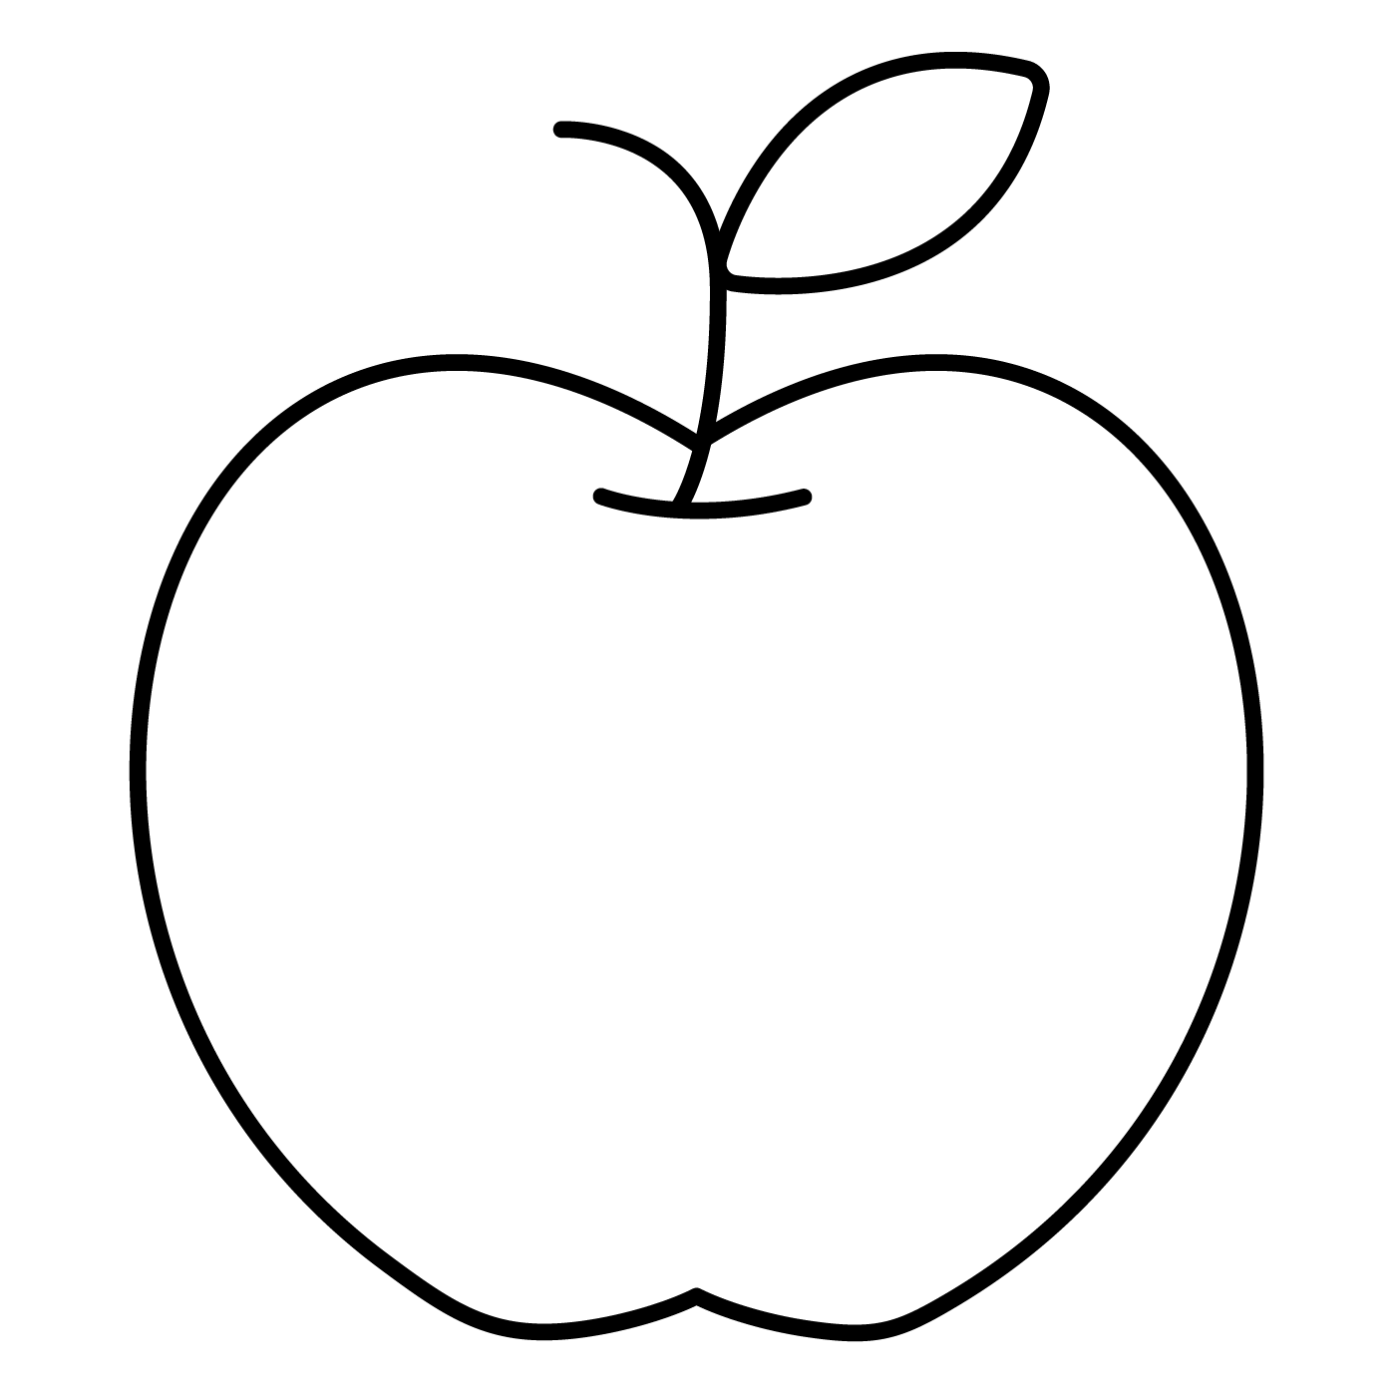


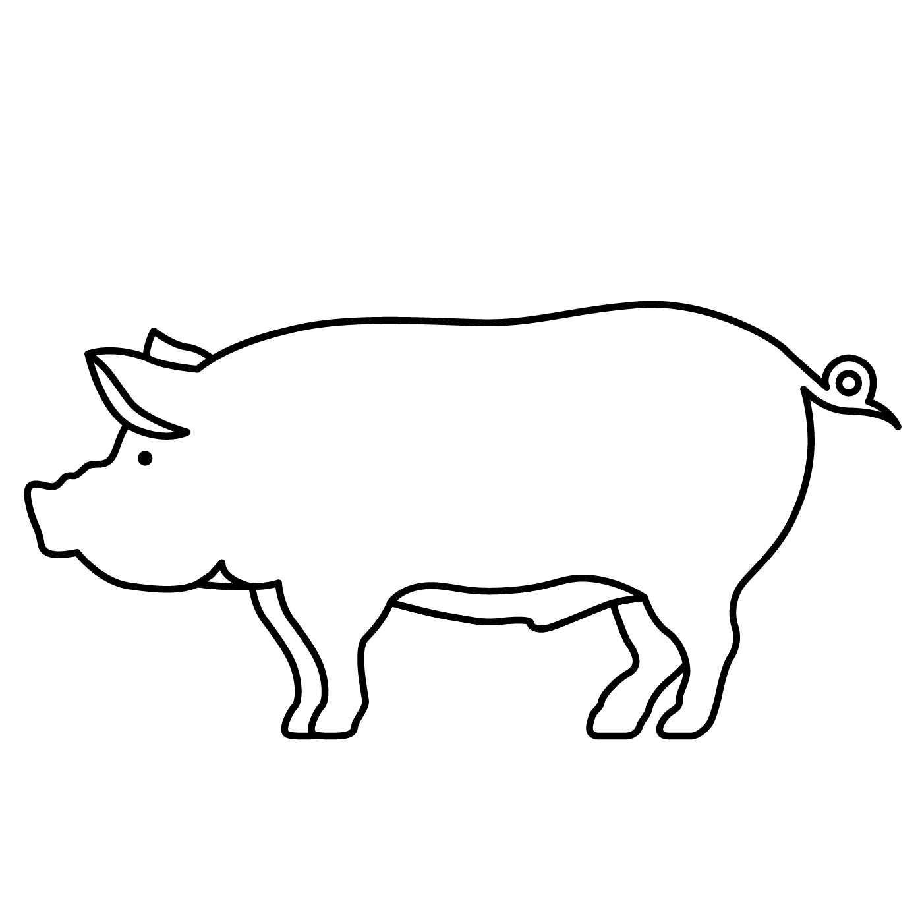

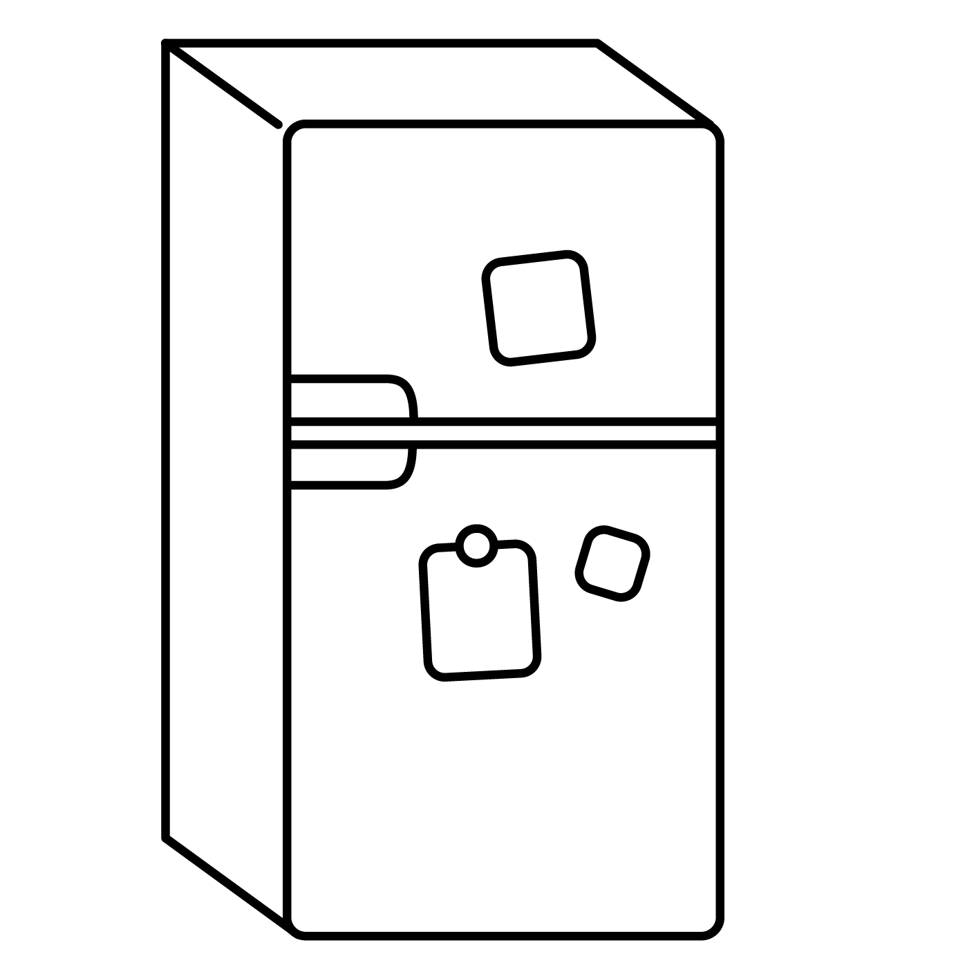
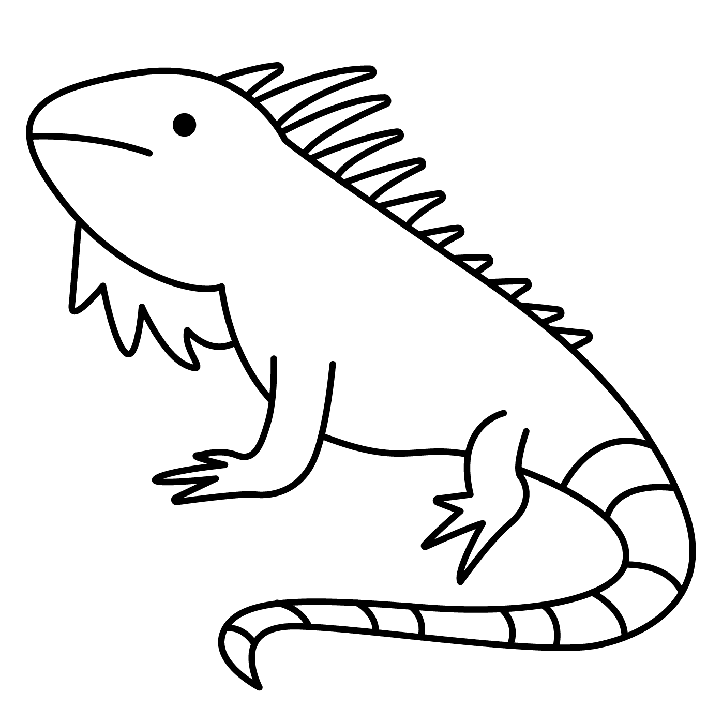
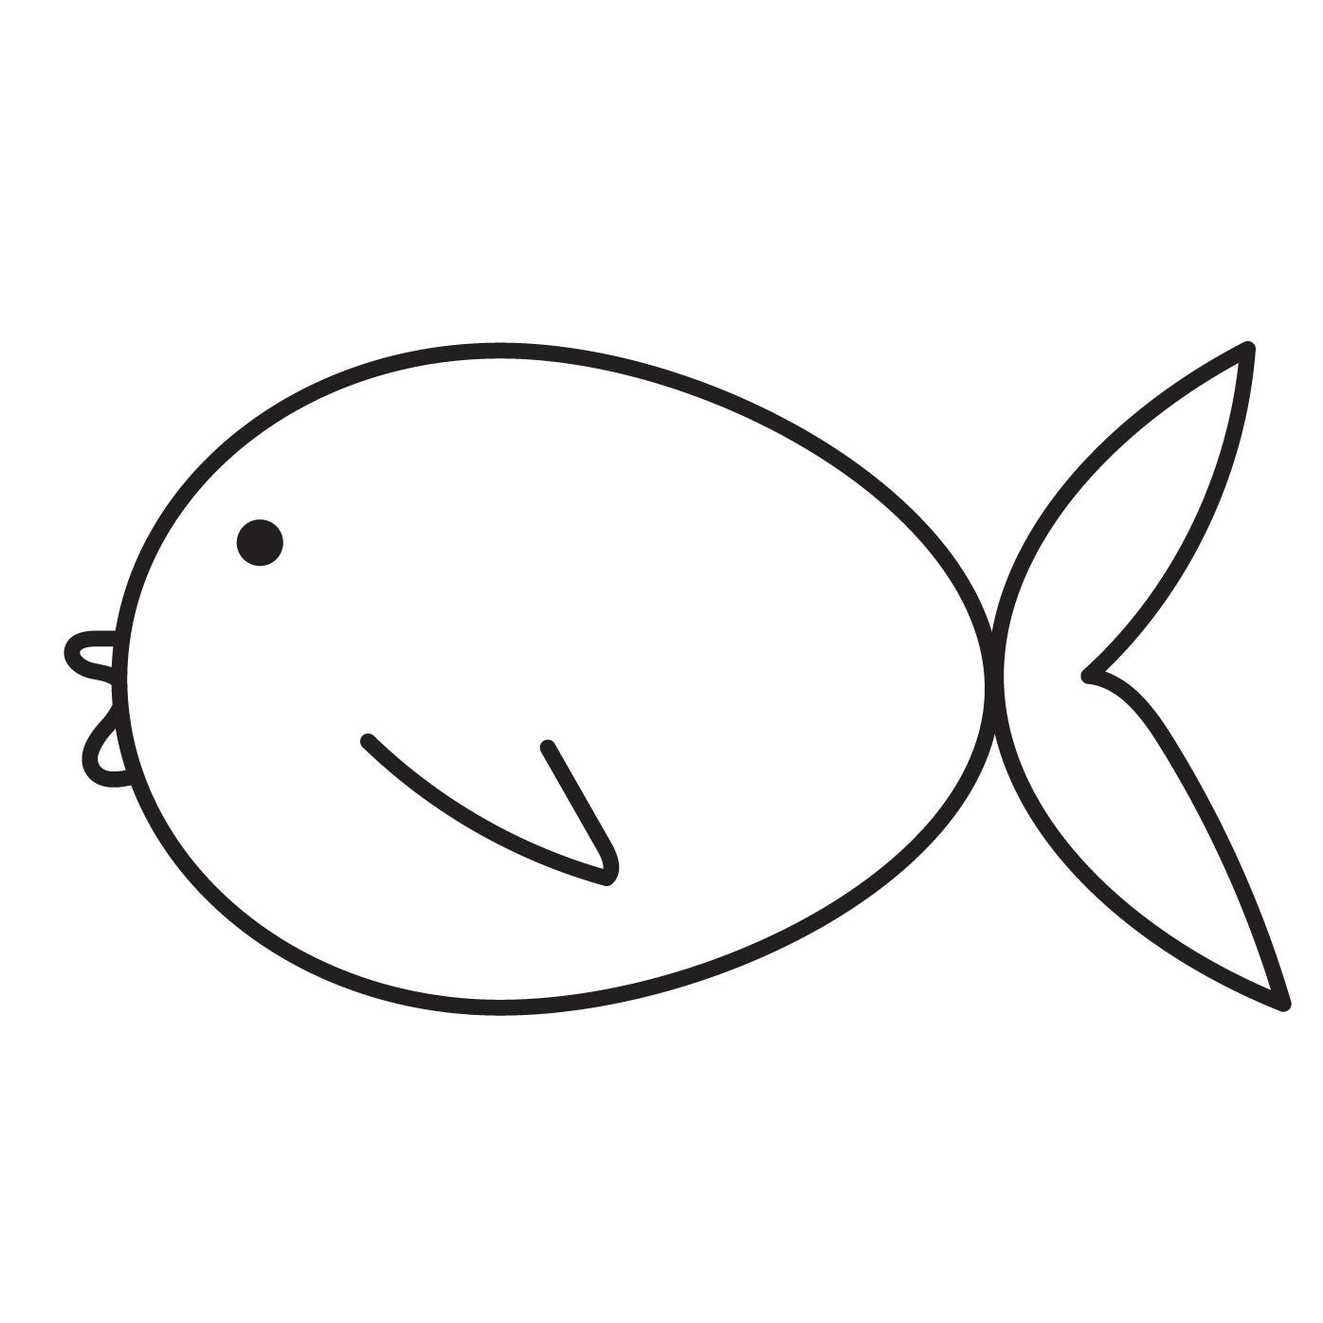

Phonics: i as in it
Colour the pictures that contain the i sound.
i
Draw your own pictures that start with the i sound.
© State of New South Wales (Department of Education), 2023. Except for the Department of Education logo, other logos and trademark-protected material, this resource is licensed under the Creative Commons Attribution 4.0 International Licence

Slide 3


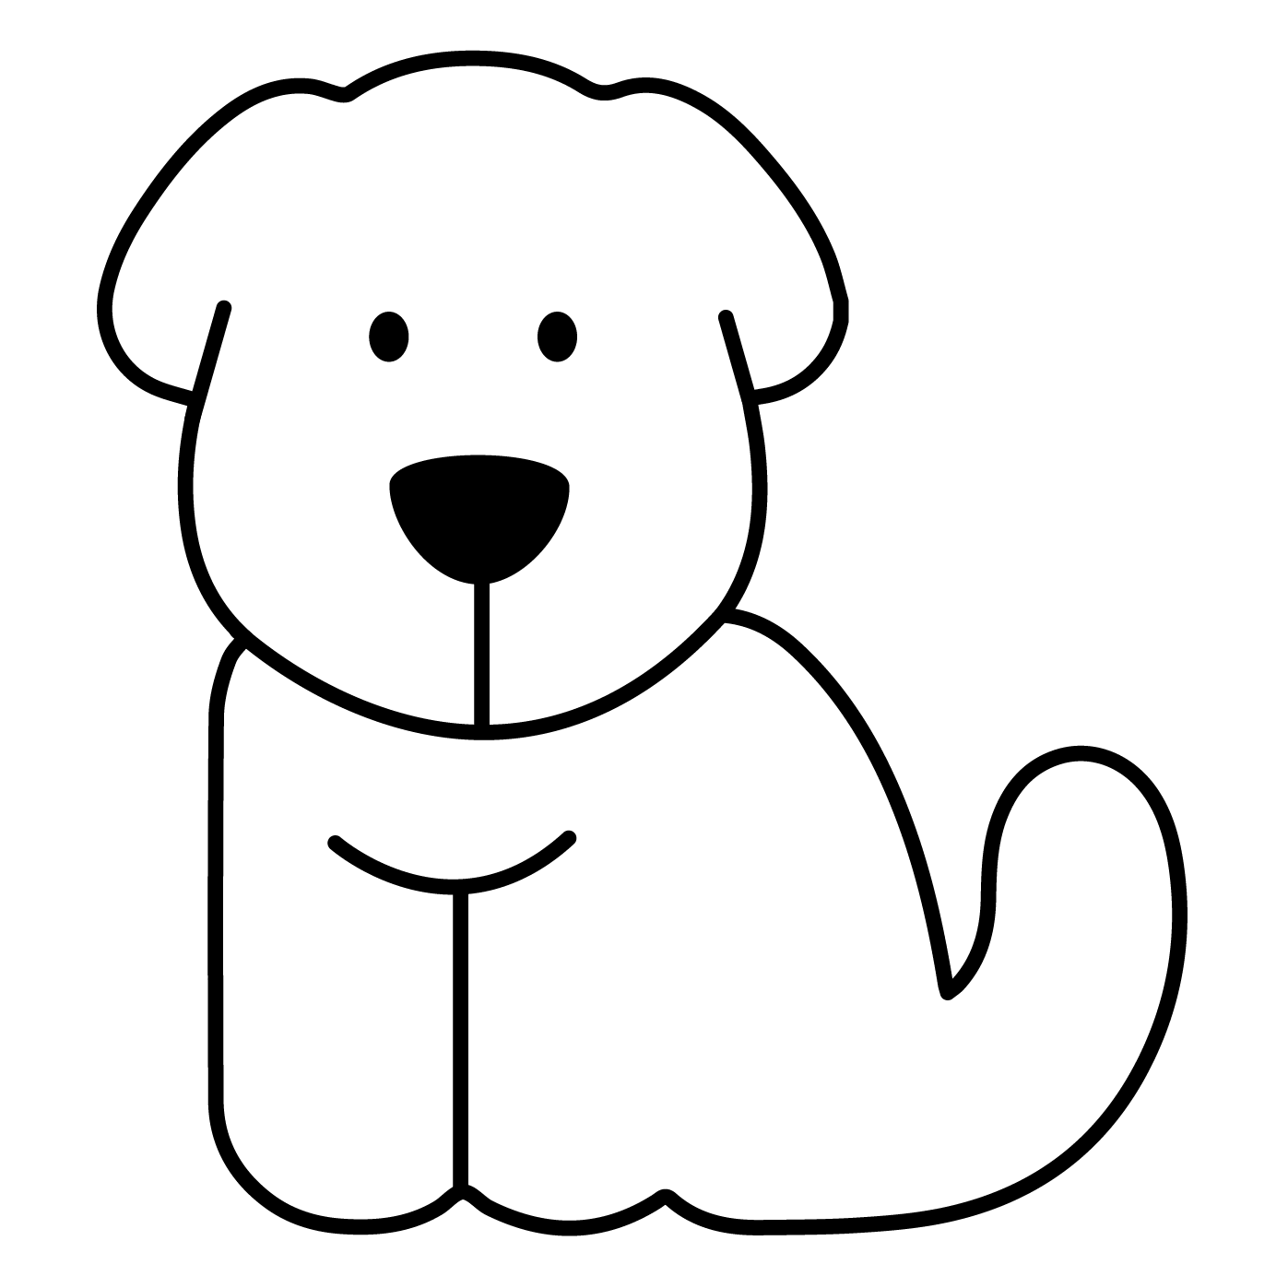
Phonics: i as in it
Colour in the i in each word.
p
i
g
p
i
n
s
i
t
Draw a picture of something that starts with ‘i’.
© State of New South Wales (Department of Education), 2023. Except for the Department of Education logo, other logos and trademark-protected material, this resource is licensed under the Creative Commons Attribution 4.0 International Licence

