Slide 1
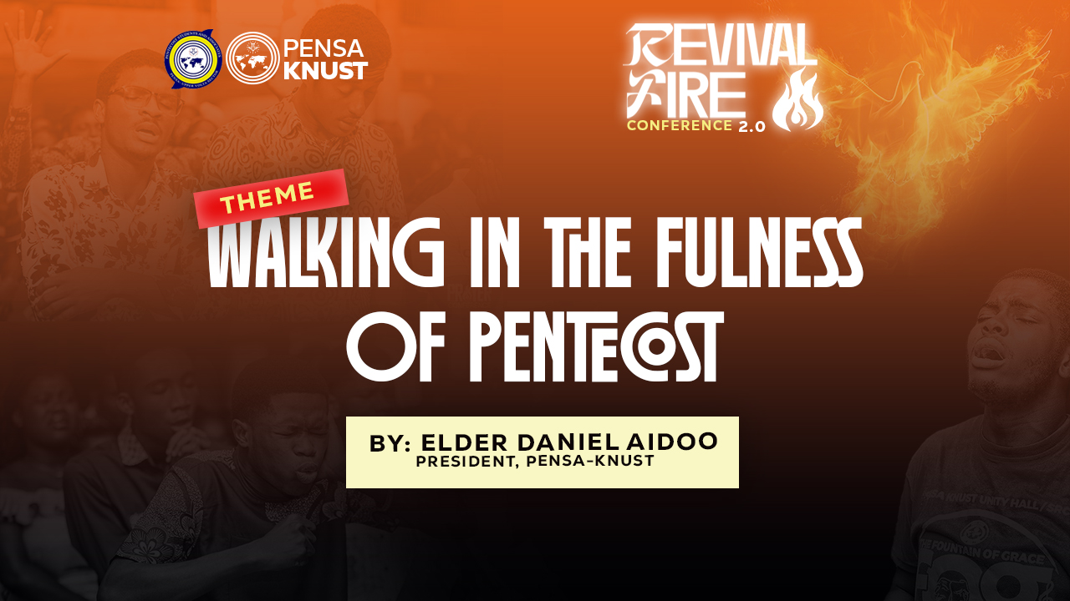

Slide 2

Seven feasts of the Old Testatment
1. Passover
2. Unleavened bread
3. First fruits
4. Pentecost
5. Trumpets
6. Day of Atonement
7. Tabernacles

Slide 3

Pentecost of the Old Covenant was an event but that of the New covenant is an experience.

Slide 4
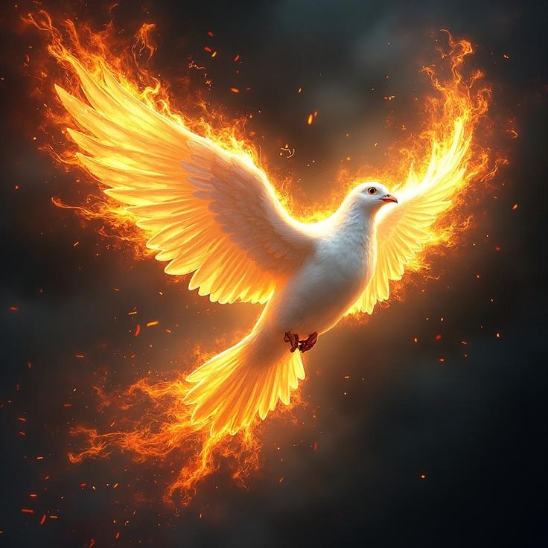
Joel 2:28-29
And it shall come to pass afterward, that I will pour out my spirit upon all flesh; and your sons and your daughters shall prophesy, your old men shall dream dreams, your young men shall see visions:
And also upon the servants and upon the handmaids in those days will I pour out my spirit.
1. Ruin of Isreal
2. Restoration of Israel
3. Revival of Israel

Slide 5
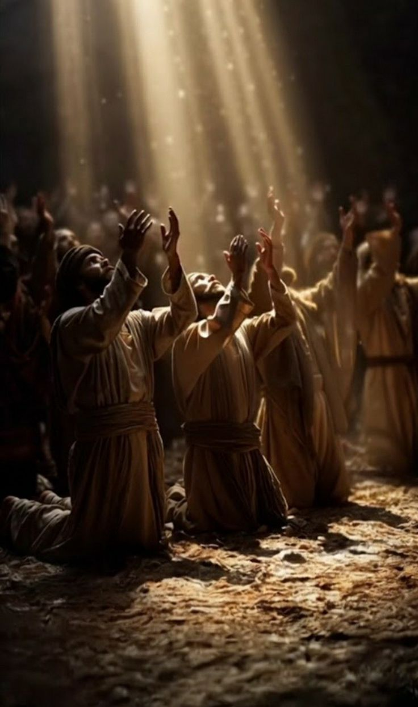
The Promised Holy Spirit
Pentecost is a progression from a promise to a release and from obedience to experience.
Acts 1:4-8, Luke 24 :49, Acts 2:1-4

Slide 6
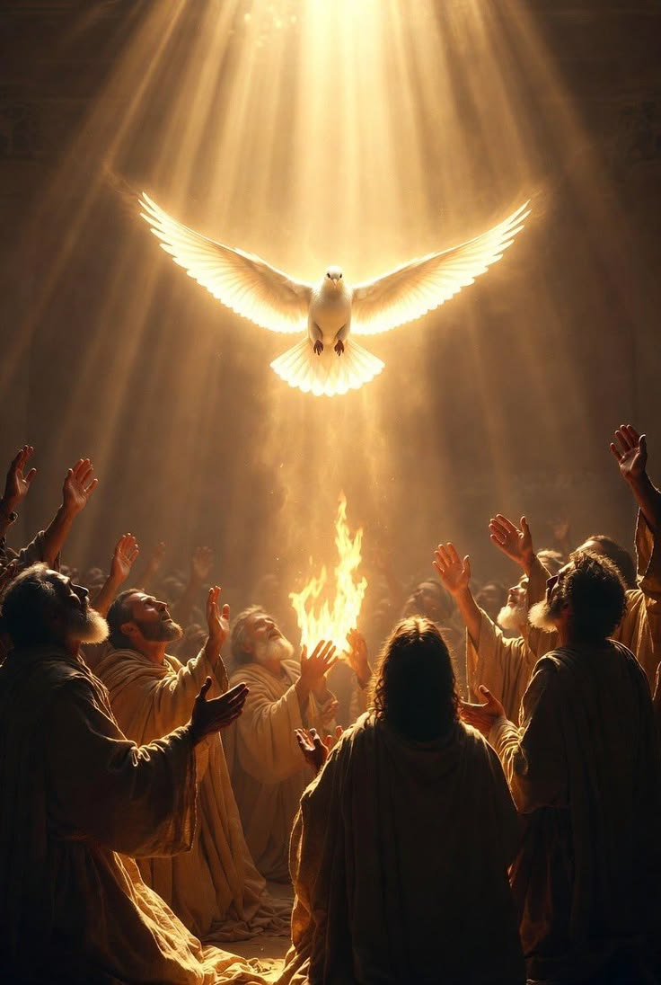
The purpose of God for Pentecost is to establish heaven on earth and to cause man to experience the powers of the age to come.

Slide 7
Realities of the Pentecost experience
1. Supernatural manifestation
3. Witnessing
The infilling of the Spirit is an initiation into the realm of power. Tongues speaking is not Pentecost in itself, it is the beginning of Pentecost.
Declaring boldly with evidence
2. Prayer and the word
Pentecost is birthed by prayer, fueled by prayer and propelled by prayer.
The word of God prevailed in Ephesus.
4. Fellowship
Consecration is not isolation

Slide 8
“
Whatever initiated a move of God must be maintained to sustain the move of God.
Sustaining the Pentecostal experience
1. WAITING
Prayer and fasting coupled with the word
2. FAITH AND BOLDNESS
Faith is the vehicle that drives supernatural manifestations.

