Slide 1


NEW EMPLOYEE
ORIENTATION
Free presentation template

Slide 2


WELCOME
Welcome to the world of fantasy! Join us on a journey to explore the mystical creatures, enchanted lands, and magical wonders that exist beyond our reality. Discover the wonders and secrets of this exciting realm and unlock the power of imagination.

Slide 3
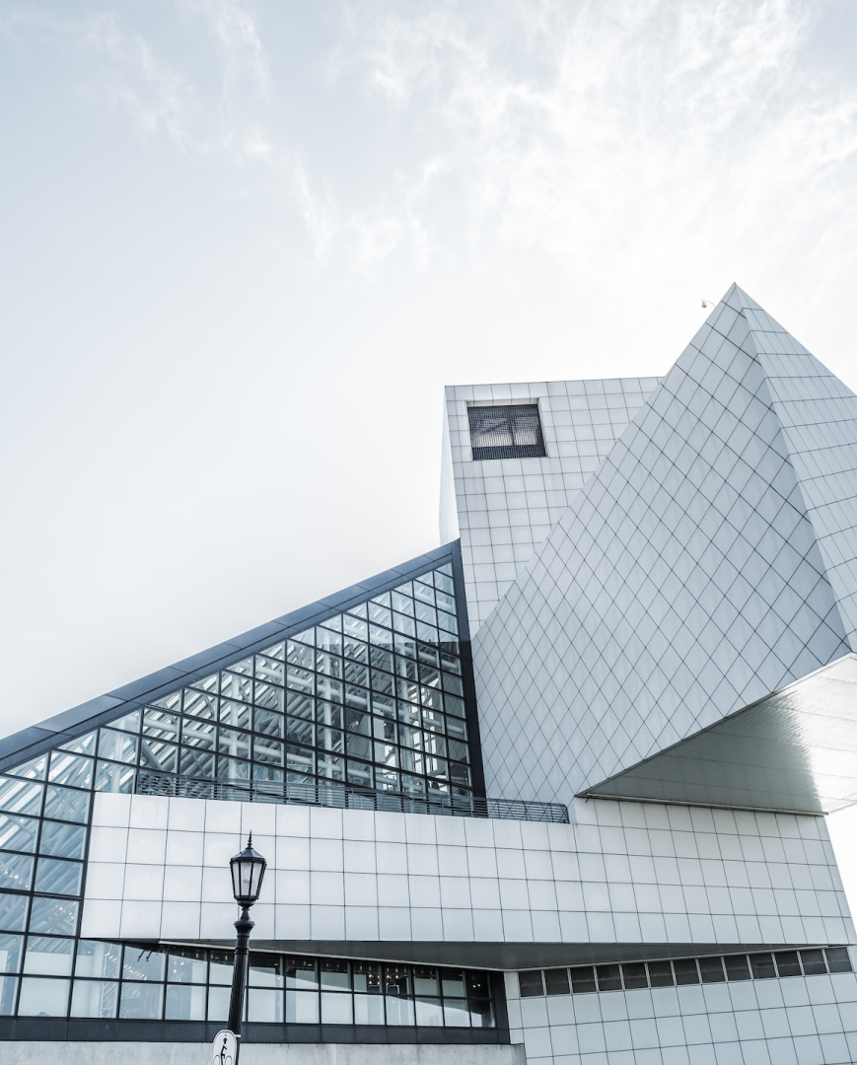
TABLE OF CONTENTS
1
INTRODUCTION
2
COMPANY PROFILE
3
JOB ROLE AND RESPONSIBILITIES
4
COMPENSATION AND BENEFITS
5
TEAM INTRODUCTION
6
FACILITIES AND WELFARE

Slide 4


INTRODUCTION
The Fantasy Realm: Uncovering the Secrets of the Imagination and the Magic that Lies Within

Slide 5



MESSAGE FROM CEO
Fantasy is the gateway to the impossible, the land where the ordinary becomes extraordinary, and the impossible becomes possible. It is the realm of the imagination, where anything can happen and everything is possible.
THE DREAM WEAVER

Slide 6
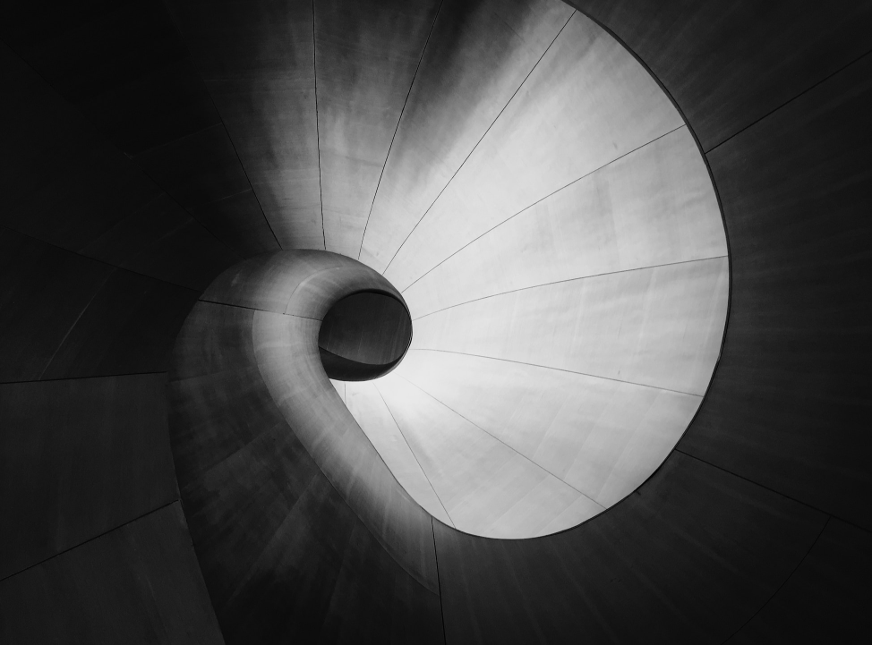
COMPANY PROFILE
The Fantasy Realm: Uncovering the Secrets of the Imagination and the Magic that Lies Within

Slide 7

COMPANY'S HISTORY
ECLIPSE
WAR
FOUNDATION
A rare eclipse occurs, causing strange and unpredictable magical effects.
A volcanic eruption devastates a nearby city, forcing its inhabitants.
An elf helps humans obtain the Crystal of the Unicorn from the Elven Forest.
2020
2022
2024
2021
2023
OBTAIN
INVASION
A group of adventurers sets out to recover an ancient artifact.
A powerful sorcerer and a cunning thief cross paths, leading to a partnership.

Slide 8

VALUE
234,567
Unicorn sightings
A tally of the number of unicorns spotted in the fantasy realm.

Slide 9

VALUE
233 COINS
85%
535 KM
456 HOURS
Treasure Found
Wished Granted
Journey Distance
Duration of Spell Casting

Slide 10






REVENUE
Item 1
Item 2
Item 3
12
10
8
6
4
2
0
2015
2016
2017
2018
2019
2020
2021

Slide 11

LOCATION
ENCHANTED FOREST
A magical forest filled with talking animals and enchanted creatures.
CRYSTAL CAVES
A network of underground caves filled with precious gems and crystals.
DRAGON'S LAIR
A dangerous and mysterious place where dragons reside.

Slide 12




ACHIEVEMENTS
SPELLCASTING COMPETITION
TREASURE
HUNT
A significant event in the history of the fantasy realm, in which the greatest spellcasters of the realm in tournament.
A significant event in the history of the fantasy realm, in which a massive and awesome treasure hunt was organized.

Slide 13



MISSION
UNICORN SIGHTINGS
A record of the number of unicorns spotted in the fantasy realm and the beauty and mystery that surrounds these enchanting creatures.
DRAGON TAMING
A closer look at the art of taming dragons and the brave adventurers who dare to take on these fearsome creatures.

Slide 14


ROLE AND RESPONSIBILITIES
The Fantasy Realm: Uncovering the Secrets of the Imagination and the Magic that Lies Within

Slide 15

ROLE
DRAGON TAMING TECHNIQUE
A guide to taming and caring for dragons in the realm of magic.
THE ART OF UNICORN SIGHTING
Tips and tricks for spotting the elusive unicorns in their natural habitat.

Slide 16

RESPONSIBILITIES
1
DISCOVER THE SECRETS
Explore the lush, vibrant forest and uncover the mysteries that lie within.
2
FIND YOUR OWN PATH
Choose your own path through the forest, and see where it takes you.
3
MEET THE CREATURES
Encounter the mythical creatures that call the forest home, from animals to fairies.

Slide 17

"The Evolution of the Unicorn" is a study exploring the historical, cultural, and mythical development of the iconic fantasy creature. From its ancient roots in Mediterranean mythology to its modern-day representation in popular culture, this research delves into the various interpretation.
COMPENSATION AND BENEFITS

Slide 18



COMPENSATION
SALARY
STOCK
INSURANCE
INCENTIVES

Slide 19







BENEFITS
"The Art of Archery": Discover the intricacies of the Art of Archery as practiced
"The Music of the Elves": Immerse yourself in the enchanting music of the elves
"The Life of an Elf": Learn about the customs and daily life of the elves, from their structure
Believed to have originated from ancient tales and legends in various cultures.

Slide 20

"The Evolution of the Unicorn" is a study exploring the historical, cultural, and mythical development of the iconic fantasy creature. From its ancient roots in Mediterranean mythology to its modern-day representation in popular culture, this research delves into the various interpretation.
TEAM INTRODUCTION

Slide 21



OUR TEAM

Slide 22



MEMBERS
ELEMENTALEN
The Guardians of the Four Elements
ELDRUIN
LUNARIA
The Fire Mage
The Moon Priestess

Slide 23
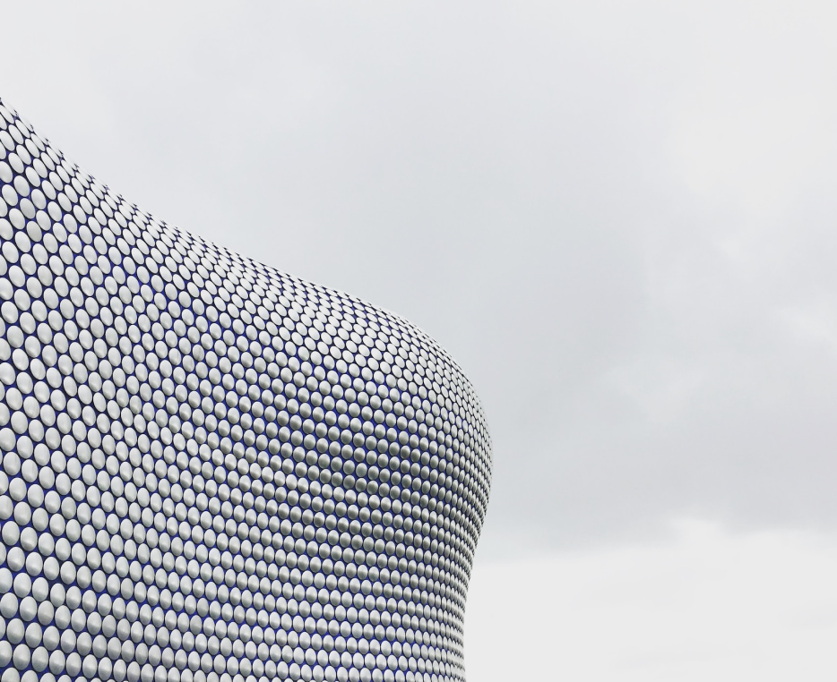
FACILITIES AND WELFARE
"The Evolution of the Unicorn" is a study exploring the historical, cultural, and mythical development of the iconic fantasy creature. From its ancient roots in Mediterranean mythology to its modern-day representation in popular culture, this research delves into the various interpretation.

Slide 24









FACILITIES AND WELFARE
Treasure
Dragon
Unicorn
Rainbow

Slide 25






THANK YOU FOR CHOOSING EATEMP
We offer free and high-quality slides templates for your presentations. We appreciate you choosing us and hope our templates have been helpful.
As a new website, we rely on your support to grow, so please help us by sharing our site with your friends and colleagues.
eatemp._
@eatemp
eatempofficial
@eatemp.official

