Slide 1
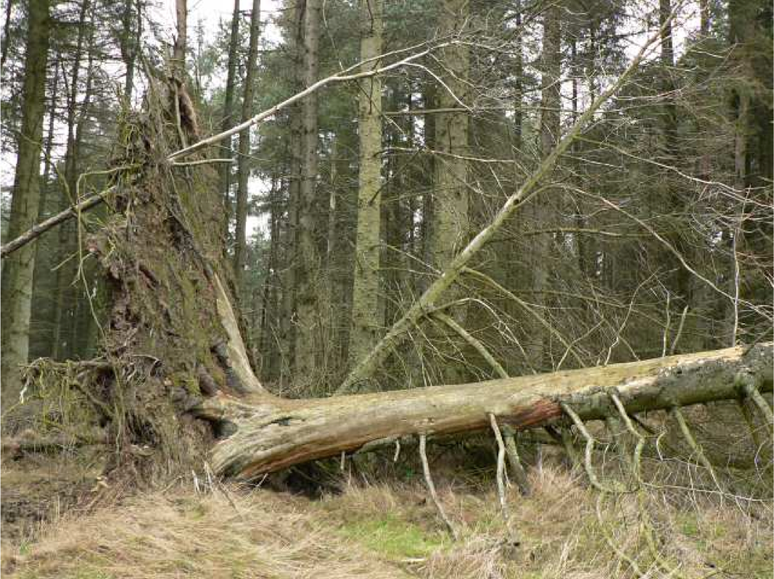

Name _____________________
When a Tree Falls
As long as a baby tree gets enough water and light, it will grow big and tall. But what if a baby tree starts growing in a dark forest of adult trees? Without sunlight, there’s no way a baby tree can grow quickly enough to reach adult size.
Remember that an adult tree has many branches and leaves. These are great for catching sunlight. But in a storm, all of those branches and leaves can be a bad thing. Sometimes, if the wind blows strongly enough, the branches and leaves catch the wind. This can knock the tree over.
Have you ever seen a tree knocked over after a storm?
Plant Adaptations

Slide 2
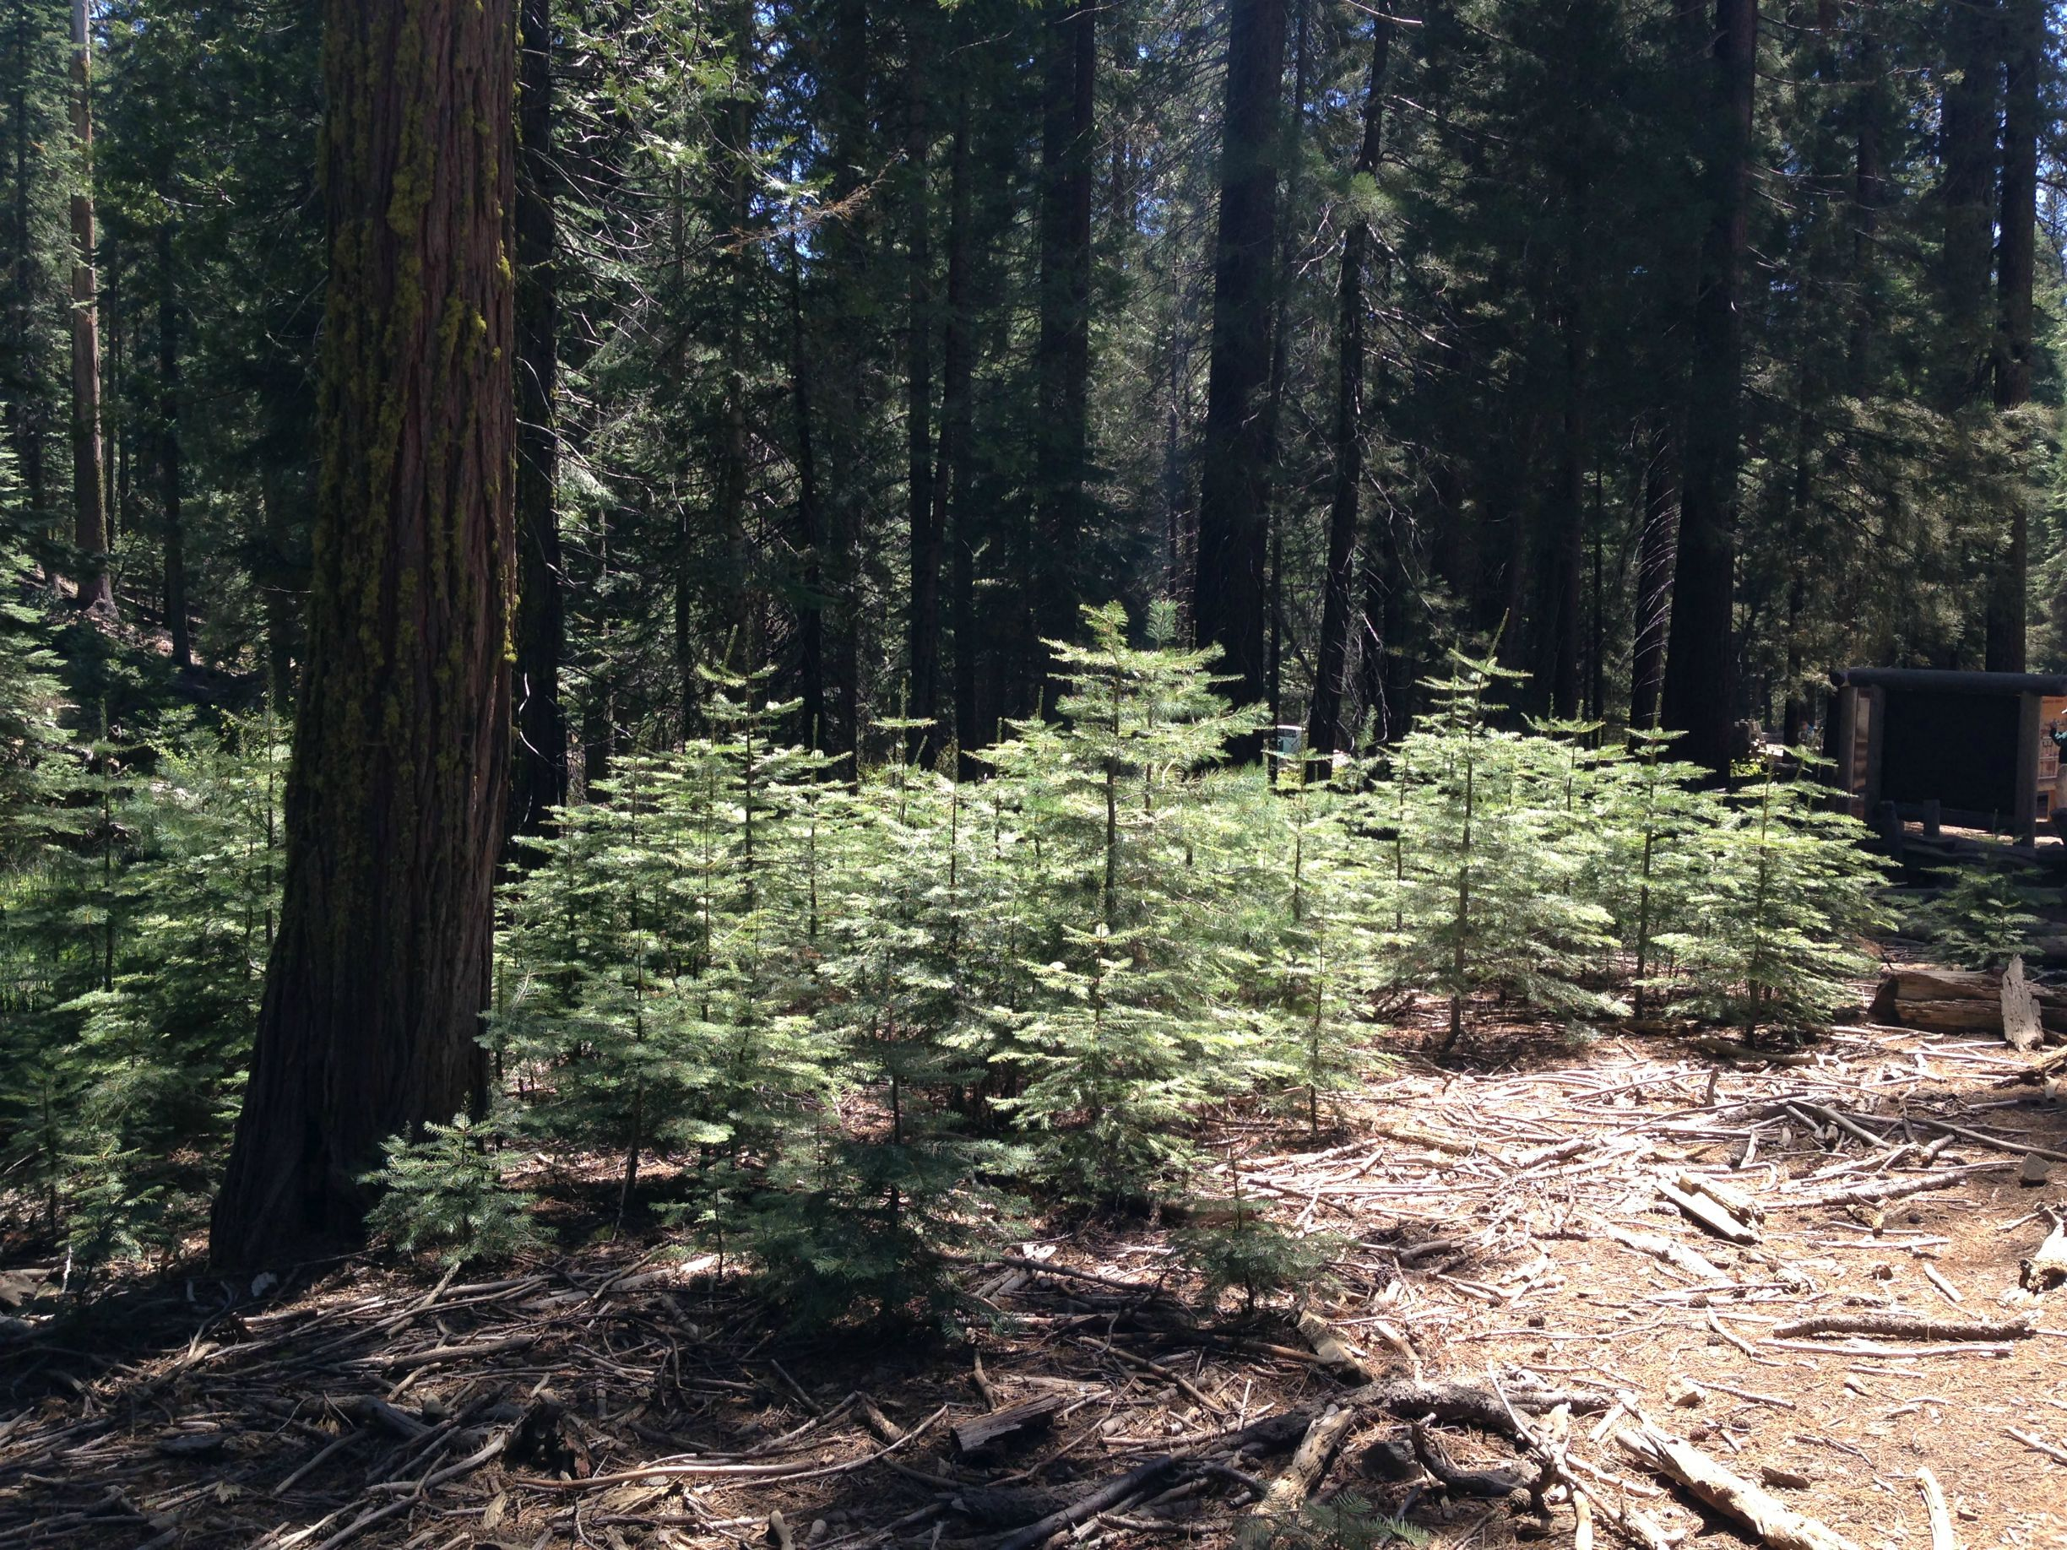
But that can help baby trees growing nearby. There are now patches of sunlight on the forest floor. Now the baby trees have a chance to grow tall. They will grow more quickly than ever, sometimes doubling or even tripling their height in one year. They are racing to grow tall in order to quickly fill in the space before their neighbors do. They are literally racing for the Sun!
How old do you think these baby trees are? Most of the baby trees you see in a forest might be older than you think. Baby trees can stay small for several years, growing very slowly if they have no light. It’s as if they’re waiting for an adult tree to get knocked over!
Plant Adaptations

