Slide 1

How to prepare for your financial future
This session is aimed at Key Stage Five (recommended for Year 13)

Slide 2
Having a respectful learning environment
We will listen to each other respectfully
We will avoid making judgements or assumptions about others
We will comment on what has been said, not the person who has said it
We won’t put anyone on the spot and we have the right to pass
We will not share personal stories or ask personal questions
If there is a question that you do not wish to ask aloud, you can write it on a Post-it Note which will be collected throughout the session and answered at the end
Notes:
Teacher delivery
Students should be invited to ask questions and they should be provided with an opportunity to ask questions anonymously. It is useful to have a question box or allocated space on the whiteboard for students to share questions.
It is suggested that students are provided with post-its or slips to write their questions on and as the teacher circulates throughout the lesson these questions can be collected and answered throughout the session or using an allocated ‘question time’ at the end of the session.
Students can be invited to respond to questions asked by their peers. If responses to questions are based on personal preference or opinion, the teacher should make this clear when answering.

Slide 3
Session 3:
Credit cards

Slide 4

Learning objectives and outcomes
Learning objective: To understand how credit cards work and to assess the benefits and risks of using one
By the end of the session, I will be able to:
1
2
3
Explain what a credit card is
Describe how a credit card works
Assess the benefits and risks of using a credit card

Slide 5
Unit outline
Session 1 | Session 2 | Session 3 | Session 4 | Session 5 | Session 6
The economy | Mortgages | Credit cards | Pensions | ISAs | Financial decisions

Slide 6

Starter | What is a credit card?
Lucy is looking to buy a new sofa. She decides to use a credit card.
Talk to the person next to you:
What is a credit card?
How much might a sofa cost?
Why might she choose to use a credit card here?
Notes:
Use as a baseline assessment.

Slide 7
What is a credit card?
Activity 1: Use the missing words below to fill in the gaps
A credit card is a card issued by a bank or (1)………………………… that allows a person to borrow money to pay for goods and services with (2)………………………… that accept credit cards for payment.
Credit cards are a type of (3)………………………… They are not attached to an account like debit cards, so the person is not (4)………………………… money they have but are borrowing money from the bank/financial institution.
This means that the bank allows them to borrow money based on the (5)………………………… that they pay the money back over a period of time, plus interest (the extra money paid regularly, usually monthly, as a percentage of the sum of money borrowed) and any other (6) ……..the bank may have stated when the person signed up for the credit card.
spending
condition
debt
charges
retailers
financial services company
Resource 1: What is a credit card?
Notes:
Teacher delivery
Student can work in pairs to fill in the right word- this task can be done verbally and teacher feedback is a quick verbal check

Slide 8
What is a credit card?
A credit card is a card issued by a bank or financial services company that allows a person to borrow money to pay for goods and services with retailers that accept credit cards for payment.
Credit cards are a type of debt. They are not attached to an account like debit cards, so the person is not spending money they have but is borrowing money from the bank/financial institution.
This means that the bank allows them to borrow money based on the condition that they pay the money back over a period of time, plus interest and any other charges the bank may have stated when the person signed up for the credit card.
spending
condition
debt
charges
retailers
financial services company
Notes:
Teacher explanation
Consolidate and go through explanation of what credit cards are.
Stretch: Teacher can also question students about a debit card and how this differs from a credit card.

Slide 9
Credit cards and credit scores
A credit score shows how financially reliable a person is; the higher the score, the better deals a person can get for financial products such as a loan or mortgage.
What behaviours do you think can increase or decrease credit scores when a person uses a credit card?
A credit score improves when a person stays within the credit limit and pays at least the minimum on time every month (though it’s even better to pay the full amount!)
A credit score decreases when a person misses or is late paying the monthly repayments, or goes above the credit limit

Slide 10
Your perspective
AGREE DISAGREE
Everyone uses credit cards
Using credit cards can help people build up a good credit rating
Credit cards provide free and unlimited money
Notes:
Teacher instructions
Students can discuss their answers in pairs, explaining the reasons for their responses
Teacher then invites students to share their responses and gauges prior knowledge of the class/students on the topic
Teacher delivery
Teacher addresses that all students will have different preconceptions, ideas and levels of understanding on credit cards and that this task is about sharing our prior knowledge to develop this further and to start clarifying any misconceptions.
1. Not everyone has to use credit cards, their use is dependent of many factors including their lifestyle, perhaps unexpected costs like a car breaking down.
2. Can show banks that a person is able to pay back money on a regular basis and manage their money.
3. They do not provide free money as at some point a person would have to pay interest even if for a limited amount of time at the beginning they may not have to. Also, not unlimited money because the amount you can borrow is normally capped to a maximum amount.

Slide 11
Your perspective
AGREE DISAGREE
1. Everyone uses credit cards
Not everyone does, it depends on personal preference. Some people may also not pass a ‘credit check’ (which is a way for banks to see how well somebody has managed their money or credit in the past to assess how financially risky they are) so may not be eligible.
Notes:
Teacher instructions
Students can discuss their answers in pairs, explaining the reasons for their responses
Teacher then invites students to share their responses and gauges prior knowledge of the class/students on the topic
Teacher delivery
Teacher addresses that all students will have different preconceptions, ideas and levels of understanding on credit cards and that this task is about sharing our prior knowledge to develop this further and to start clarifying any misconceptions.
1. Not everyone has to use credit cards, their use is dependent of many factors including their lifestyle, perhaps unexpected costs like a car breaking down.
2. Can show banks that a person is able to pay back money on a regular basis and manage their money.
3. They do not provide free money as at some point a person would have to pay interest even if for a limited amount of time at the beginning they may not have to. Also, not unlimited money because the amount you can borrow is normally capped to a maximum amount.

Slide 12
Your perspective
AGREE DISAGREE
2. Using credit cards can help people build up a good credit score
If a person pays back the money they owe regularly, using a credit card can be a good way to improve credit rating, but if repayments are not paid back in time, it can worsen or lead to a poor credit rating.
Notes:
Teacher instructions
Students can discuss their answers in pairs, explaining the reasons for their responses
Teacher then invites students to share their responses and gauges prior knowledge of the class/students on the topic
Teacher delivery
Teacher addresses that all students will have different preconceptions, ideas and levels of understanding on credit cards and that this task is about sharing our prior knowledge to develop this further and to start clarifying any misconceptions.
1. Not everyone has to use credit cards, their use is dependent of many factors including their lifestyle, perhaps unexpected costs like a car breaking down.
2. Can show banks that a person is able to pay back money on a regular basis and manage their money.
3. They do not provide free money as at some point a person would have to pay interest even if for a limited amount of time at the beginning they may not have to. Also, not unlimited money because the amount you can borrow is normally capped to a maximum amount.

Slide 13
Your perspective
AGREE DISAGREE
3. Credit cards provide free and unlimited money
No, eventually there is a cost in interest payments and a limited amount that can be spent, known as a credit limit.
Notes:
Teacher instructions
Students can discuss their answers in pairs, explaining the reasons for their responses
Teacher then invites students to share their responses and gauges prior knowledge of the class/students on the topic
Teacher delivery
Teacher addresses that all students will have different preconceptions, ideas and levels of understanding on credit cards and that this task is about sharing our prior knowledge to develop this further and to start clarifying any misconceptions.
1. Not everyone has to use credit cards, their use is dependent of many factors including their lifestyle, perhaps unexpected costs like a car breaking down.
2. Can show banks that a person is able to pay back money on a regular basis and manage their money.
3. They do not provide free money as at some point a person would have to pay interest even if for a limited amount of time at the beginning they may not have to. Also, not unlimited money because the amount you can borrow is normally capped to a maximum amount.

Slide 14
Learning objectives and outcomes
Learning objective: To understand how credit cards work and to assess the benefits and risks of using one
By the end of the session, I will be able to:
1
2
3
Explain what a credit card is
Describe how a credit card works
Assess the benefits and risks of using a credit card

Slide 15
How do credit cards work?
Activity: Place the statements in the correct order. Which comes first?
Pay back at least minimum repayments or more based on somebody’s monthly salary and how long they can pay back what they owe on the credit card (also known as the balance).
Apply for a credit card online by comparing the terms and conditions of using credit cards, such as the rate of interest charged (we will explore this later in more detail).
Use the credit card to buy goods & services.
If the balance is paid back in full, no interest is paid.
If the balance is paid off in instalments, interest will charged on what's owed, unless in an introductory interest free (known as 0% APR) period.
Resource 2: How do credit cards work? Card sort
Notes:
Delivery instruction: Students to place the 3 points in order considering the process of managing credit cards and the whole process. This task can be done verbally.
—
https://www.lloydsbank.com/credit-cards/help-and-guidance/how-credit-cards-work.html

Slide 16
Answers | How do credit cards work?
Apply for a credit card online by comparing the terms and conditions of using credit cards, such as the rate of interest charged (we will explore this later in more detail).
Use the credit card to buy goods & services.
Pay back at least the minimum repayments or more based on somebody’s monthly salary and how long they can pay back what they owe on the credit card (also known as the balance).
If the balance is paid back in full, no interest is paid.
If the balance is paid off in instalments, interest will charged on what's owed, unless in an introductory unless in an introductory interest free (known as 0% APR) period.
Notes:
Teacher explanation
Feedback on the correct order and introduction.

Slide 17
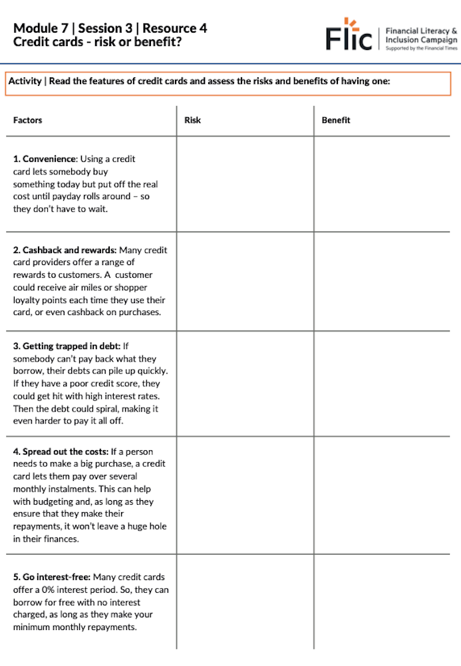
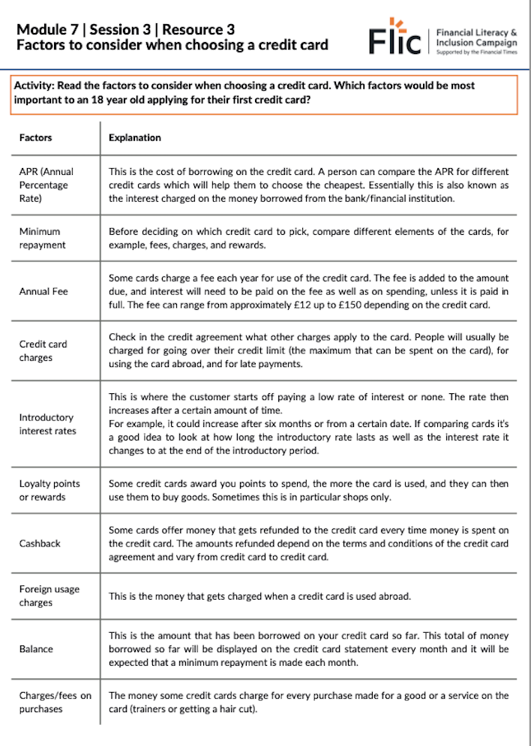
Factors to consider when selecting a credit card
Activity
Read about the key factors to consider when choosing a credit card.
Choose the most important factors for an 18-year-old getting their first credit card.
Rank these factors in order and explain why they matter.
Review the 10 credit card features.
Weigh the risks and benefits of having a credit card.
Electricity bills
Weekly food shop
Lunch out
Lunch out
Resource 3: Credit cards: Factors to consider
Notes:
Teacher delivery
Students can work in pairs to match the factors to the correct explanation.
Teacher explanation
Teacher introduces the idea that there are many factor that impact which credit card is best for an individual depending on their personal circumstances and that this activity will help them to identify and explain some of these factors- students will then use these factors in the following task in advising which credit card is best to use in different situations.
Stretch: Students rank the factors from most important to least when making your choice explaining why they think this.
Teacher feedback using the answers: Correct pairs of factors and definitions: 1E, 2H, 3A, 4J, 5F, 6B, 7D, 8I, 9C, 10G.

Slide 18
Annual Percentage Rate (APR)
APR is the cost of borrowing on a credit card for a year, which includes:
The cost of borrowing i.e. the interest rate charged
Other fees such as an application fee
The higher the % APR, the more expensive it is to borrow
The lower the % APR, the cheaper it is to borrow
Notes:
Teacher explanation
An APR is therefore meant to give you the overall equivalent cost of a debt, which you can then use to compare against other credit and loan products. It must be displayed by a lender before any agreement is signed. The fact it includes charges sometimes means the APR can be a bit confusing. For example, an interest rate could be 22.2% per annum but the APR is 27.3%, as the impact of a £25 annual fee adds the equivalent to another 5.1% interest. Yet this is useful as it allows a true comparison.

Slide 19

Annual Percentage Rate (APR)
The APR is the cost of a loan (how much was borrowed plus the interest and any fees) per year.
The higher the APR, the more expensive it is to borrow.
Example:
If Neeta borrows £1,000 from the bank
→ with 30% APR
→ and paid this back over one year
→ she’d have to pay back £1,300 in total.
This includes the £1,000 loan + £300 interest and fees

Slide 20


Credit card pay-back options | Case study
The longer it takes to pay back credit (borrowed money), the more interest a customer will pay
Lucy has £1,000 credit on her credit card. This means she owes the bank £1,000. She has an APR (annual percentage rate) of 30% and has to pay a minimum of £50 back per month. Here are 3 different ways she can pay off her credit.
What do you notice about these options? Which might be best for Lucy and why? Use the numbers in the tables to support your responses.
Option 1: Pay back in full
Pays the full amount | Pay £1,000
Interest charged | None
Time to pay back | 0
Option 2: Pay the minimum amount
Pays the minimum monthly amount | Pay £50 per month
Interest charged | £335
Time to pay back | 2 years, 3 months
Option 3: Pay more than minimum amount
Pays more than the minimum per month | £200 per month
Interest charged | £72
Time to pay back | 6 months
Credit card calculator used: https://www.moneysupermarket.com/credit-cards/calculator/
Notes:
Please find average credit card interest rates here: https://www.bankofengland.co.uk/statistics/money-and-credit/2023/january-2023

Slide 21
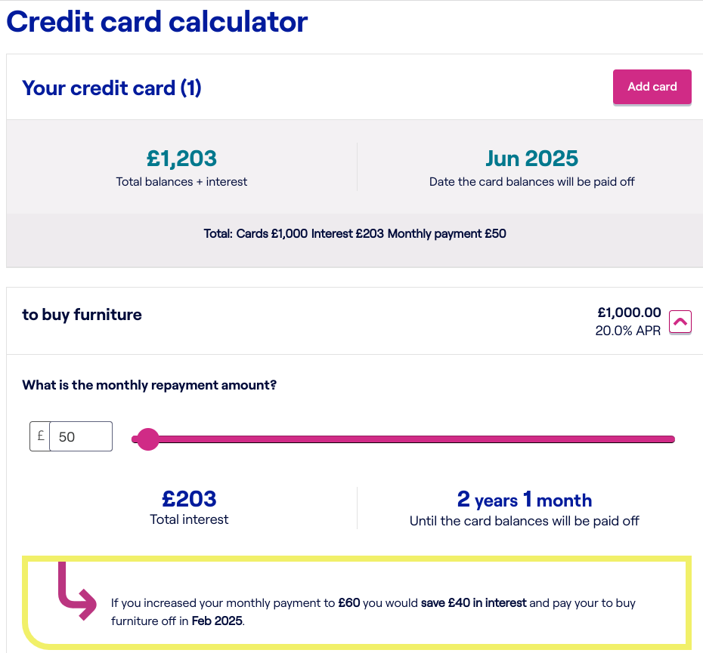
Credit card payback options
What have we learnt?
Play around with credit payback options here
If Lucy pays more each month, she pays less interest and clears her debt faster.
Paying it back immediately avoids interest—but isn’t always realistic.
She must at least make the minimum payment to avoid fees and protect her credit score.
Credit cards offer interest-free periods. This means that the user will typically get up to 3 or 4 weeks between spending on their credit card and having to pay back interest.

Slide 22

Using a credit card responsibly
Watch the video (2m4s)
List some of the benefits of using a credit card responsibly
Credit cards: The benefits and pitfalls

Slide 23

Credit cards vs. other borrowing options
Credit cards have their time and place.
For big purchases (e.g., kitchen refurb) or debt repayment, a personal loan is usually cheaper.
Loans typically have 5-10% interest, while credit cards can charge 25-30%.

Slide 24
Learning objectives and outcomes
Learning objective: To understand how credit cards work and to assess the benefits and risks of using one
By the end of the session, I will be able to:
1
2
3
Explain what a credit card is
Describe how a credit card works
Assess the benefits and risks of using a credit card

Slide 25
Multiple choice Q1
APR stands for:
A. Annual Profit Rate
B. Annual Percentage Rate
C. Accumulated Percentage Rate
D. Absolute Percentage Return
Weekly food shop
Lunch out
Lunch out
Notes:
Teacher delivery
Assessment for learning. Teacher reads out or students to read aloud and put their hands up to share answers

Slide 26
Multiple choice Q1
APR stands for:
A. Annual Profit Rate
B. Annual Percentage Rate
C. Accumulated Percentage Rate
D. Absolute Percentage Return
Weekly food shop
Lunch out
Lunch out

Slide 27
Multiple choice Q2
The credit card holder should repay the bank or financial institution that issued the credit card:
A. As little or as much as they like every month
B. A minimum flat rate of £5 per month
C. The minimum percentage or minimum amount required by the lender
D. 25% of the total amount they owe the lender
Weekly food shop
Lunch out
Lunch out
Notes:
Teacher delivery
Assessment for learning. Teacher reads out or students to read aloud and put their hands up to share answers

Slide 28
Multiple choice Q2
The credit card holder should repay the bank or financial institution that issued the credit card:
A. As little or as much as they like every month
B. A minimum flat rate of £5 per month
C. The minimum percentage or minimum amount required by the lender
D. 25% of the total amount they owe the lender
Weekly food shop
Lunch out
Lunch out

Slide 29
Multiple choice Q3
Using a credit card responsibly and managing repayments on time can:
A. Help to build a person’s credit score, which makes it easier to borrow further money for a loan or mortgage
B. Help a person afford to buy even more goods and services that they might not be able to fund from their salary
C. Damage a person’s credit score, as they should only be borrowing money they actually have in their bank account
Notes:
Teacher delivery
Assessment for learning. Teacher reads out or students to read aloud and put their hands up to share answers

Slide 30
Multiple choice Q3
Using a credit card responsibly and managing repayments on time can:
A. Help to build a person’s credit score, which makes it easier to borrow further money for a loan or mortgage
B. Help a person afford to buy even more goods and services that they might not be able to fund from their salary
C. Damage a person’s credit score, as they should only be borrowing money they actually have in their bank account
Lunch out

Slide 31
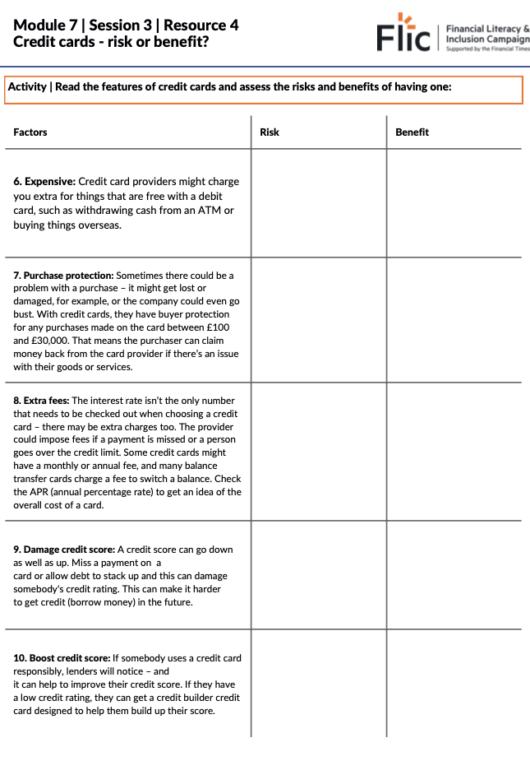
Discussion
“Overall, a credit card is a risk rather than a benefit and should not be used”
In pairs, discuss the statement above and make a judgment for or against, writing a paragraph to justify your response. Use the ‘Risk or benefit’ worksheet to help inform your response.
Be ready to share ideas with the class.
Lunch out
Resource 4: Credit cards: risk or benefit?
Notes:
Delivery instruction:Students work in groups of three to discuss and complete the Learning Resource 4 ‘Assessing Credit Cards Worksheet’ by ticking risk or benefit
Teacher explanation
Teacher develops the idea that risks and benefits have to be weighed up against the individual’s circumstances and ability to manage their finance and budget their monthly expenditure (money coming into their account) and outgoings (money leaving their accounts (bills and personal spending).

Slide 32
Stretch - Critical thinking
Do you think credit cards should be called ‘credit cards’?
Could the name be confusing?
What are the positives about the name?
Could the name be misleading?
What other names can you think of?
Notes:
Adaptive learning
Ask higher ability students to write up a short article explaining their reasoning.

Slide 33
Learning objectives and outcomes
Learning objective: To understand how credit cards work and to assess the benefits and risks of using one
By the end of the session, I will be able to:
1
2
3
Explain what a credit card is
Describe how a credit card works
Assess the benefits and risks of using a credit card

Slide 34
Any questions?
?

Slide 35



Services available for people who have concerns about their personal finances
Citizens Advice – Debt and Money – This resource contains links to advice on a number of topics, including financial difficulties, cost of living and communicating with creditors.
National Debtline – Debt and Money – a debt advice charity run by the Money Advice Trust, offering a free and confidential debt advice service.
Childline Helpline
0800 1111
At school, you can speak with an adult you trust.
This could be your form tutor, head of year or the school’s safeguarding officer.

Slide 36
Links to learn more!
Articles to extend learning
Please visit the FLIC learning hub - https://resources.ftflic.com/ for further resources
Money Helper
Credit Card Guide (Money)

