Slide 1
Building Sustainable Programs:
From Myth to Reality
Ronnie Detrich
Wing Institute

Slide 2
Goals for Today
Why sustainability is important.
What we know about sustainability in education.
How do we make sustainable programs a reality.
Evaluate PBS as a sustainable innovation.
Consider threats to sustainability of PBS.

Slide 3
Why Sustainability is Important
“The ultimate goal of the “evidence-based movement” is make better use of research findings in typical service settings, to benefit consumers and society….”
(Fixsen, 2008)

Slide 4
Why Sustainability is Important
“If the application of behavioral techniques does not produce large enough effects for practical value, then the application has failed…Its practical importance, specifically its power in altering behavior enough to be socially important, is the essential criterion.”
(Baer, Wolf, & Risley, 1968)

Slide 5
What is “social importance?”
Dimensions of Social Validity (Wolf, 1978):
  The social significance of the goals.
  The social appropriateness of the procedures.
  The social importance of the effects.

Slide 6
Social Importance and Sustainability
Sustainability is a key component of the “social importance of the effects.”
  Programs that do not sustain do not produce “socially important effects.”

Slide 7
Defining Features of Sustainable Programs
Maintain over time.
Maintain across generations of practitioners.
Operate within existing financial and staffing resources.
Practices become the way we do business.

Slide 8
What Do We Sustain with PBS?
It is important to be clear about what we are trying sustain.
With PBS the critical feature is data based decision making.
  Specific practices are not important.
  It is important that practices are effective.
    Can be and should be replaced when something more effective is developed.

Slide 9
Sustainability: What We Know
Average life span of an educational innovation is 18-48 months (Latham, 1988).
  Why?
    Innovation more difficult than expected.
    Causes too much change.
    Takes too much time.
    Supporters leave.
    Personnel lack training.
    External funds run out.
    Inadequate supervision.

Slide 10
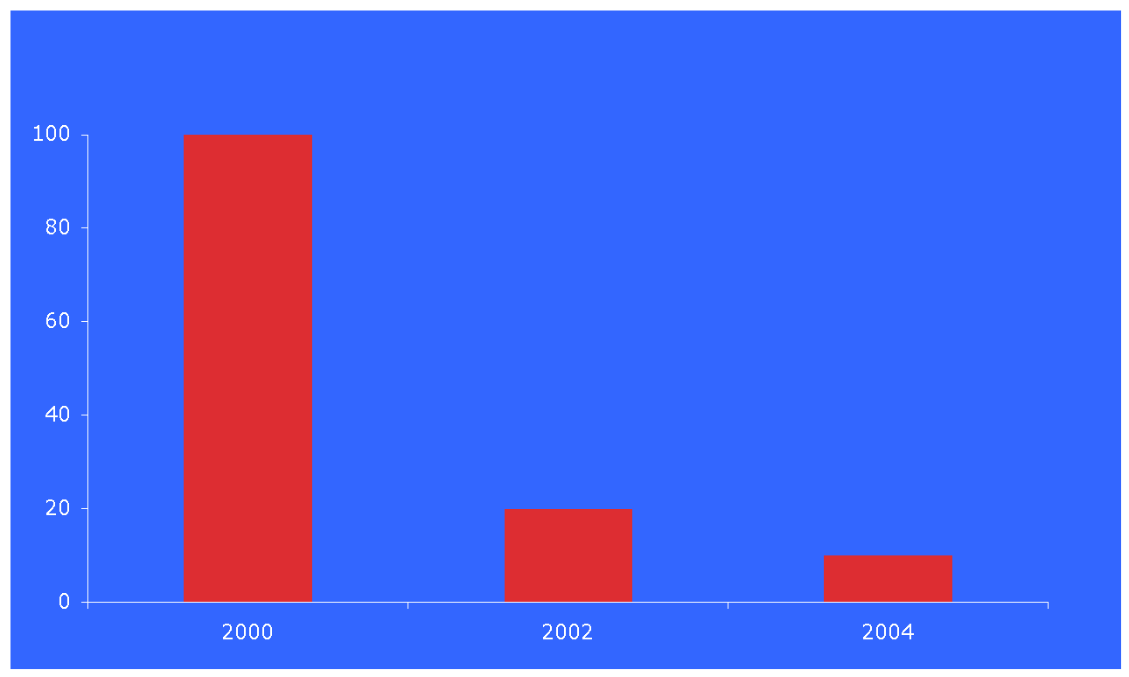
What Happens to School Reform Initiatives
80% of initiatives ended within 2 years
90% of initiatives ended within 4 years
Data from Center for Comprehensive School Reform

Slide 11
Sustainability: The Myth
“It is at least a fair presumption that behavioral
applications, when effective, can sometimes
lead to social approval and adoption.”
(Baer, Wolf, & Risley, 1968)

Slide 12
Even Well Tested Programs Often Fail to Sustain
Elliott & Mihalic (2004) review Blueprint Model Programs (violence prevention and drug prevention programs) replication in community settings.
  Programs reviewed across 5 dimensions
    Site selection
    Training
    Technical assistance
    Fidelity
    Sustainability

Slide 13
Keys to Sustainable Programs
Critical elements in site readiness
  Well connected local champion
  Strong administrative support
  Formal organizational commitments
  Formal organizational staffing stability
  Up front commitment of necessary resources
  Program credibility within the community
  Program sustained by the existing operational budget.

Slide 14
Keys to Sustainable Programs
Critical elements of training
  Adhere to requirements for training, skills, and education.
  Hire all staff before scheduling training.
  Encourage administrators to attend training.
  Plan and budget for staff turnover.
  Implement program immediately after training.

Slide 15
Keys to Sustainable Programs
Critical elements of Technical Assistance
  Proactive plan for technical assistance.
Critical elements of Fidelity
  Monitor fidelity.
Critical elements of Sustainability
  Function of how well other dimensions are implemented.

Slide 16
Building Sustainable Programs
Optimally, sustainability should be a focus from
the day a project is implemented. With most
projects, the pressure of just becoming
operational often postpones such a focus until
well into the 2nd year.
(Alderman & Taylor, 2003)

Slide 17
Building Sustainable Programs
Evidence-based and effective practices often fail due to ineffective implementation strategies.
  (Dean Fixsen, et al., 2005)

Slide 18
Building Sustainable Programs
Diffusion of innovation is a social process, even more than a technical matter.
The adoption rate of innovation is a function of its compatibility with the values, beliefs, and past experiences of the individuals in the social system.
      (Rogers, 2003)

Slide 19
A History Lesson
In 1601, James Lancaster of British Royal Navy first experimentally demonstrated that a daily dose of fruit prevented scurvy.
  Had no impact on practices of Navy.
1747, James Lind again demonstrated effects of fruit in preventing scurvy.
  Had no impact on practices of Navy.
1795 British Royal Navy provided fruit on all ships. Scurvy eliminated.
1865 British Board of Trade adopted policy and wiped out scurvy in the merchant marine.

Slide 20
Effective Implementation: The Path to Sustainability
Implementation and sustainability requires systems change.
  All elements of a system must be involved in the change.

Slide 21
Effective Implementation: The Path to Sustainability
Innovative practices do not fare well in old organizational structures and systems.
Organizational and system changes are essential to successful implementation.
  Expect it.
  Plan for it.

Slide 22
Effective Implementation: The Path to Sustainability
Effective support for a new way of work for teachers/ staff.
  Facilitative administration.
  Decision support data systems.
  Systems interventions/alignment.

Slide 23
Effective Implementation: The Path to Sustainability
Change the behavior of adult education professionals.
  “Systems don’t change, people do” (Jim Wotring).
  Change organizational structures, cultures, and climates.
  Change the thinking of system directors and policy makers.

Slide 24
Phases Of Implementation
Adoption & Exploration
Program Installation
Initial Implementation
Full Operation
Over Time
and Over
Generations
Long Term Operation
Desired Outcome
Sustainability

Slide 25
Levels within the system
Alignment Across Levels
Federal
State
District
School
Teacher
Student
Education Outcomes Achieved

Slide 26
Threats to Sustainable PBS
Success
  In several states PBS is now mandated if schools fail to meet specific standards such as disproportionate identification rates for special education for students of color.
    There may be no local champion and PBS may not be seen as credible by the community.
  Rapid growth may make it difficult to maintain quality systems.

Slide 27
Threats to Sustainable PBS
PBS is multi-tiered prevention approach.
  Much of the emphasis is placed on universal interventions at the local level.
  Must of also develop effective systems for selected and targeted interventions.
    More is known about intensive (red) than selected (yellow) interventions.
  Change in leadership at any level threatens stability and sustainability at all levels.

Slide 28
Building Sustainable Programs
“A culture is preserved one generation at a time.”
Dewey Balfa

Slide 29
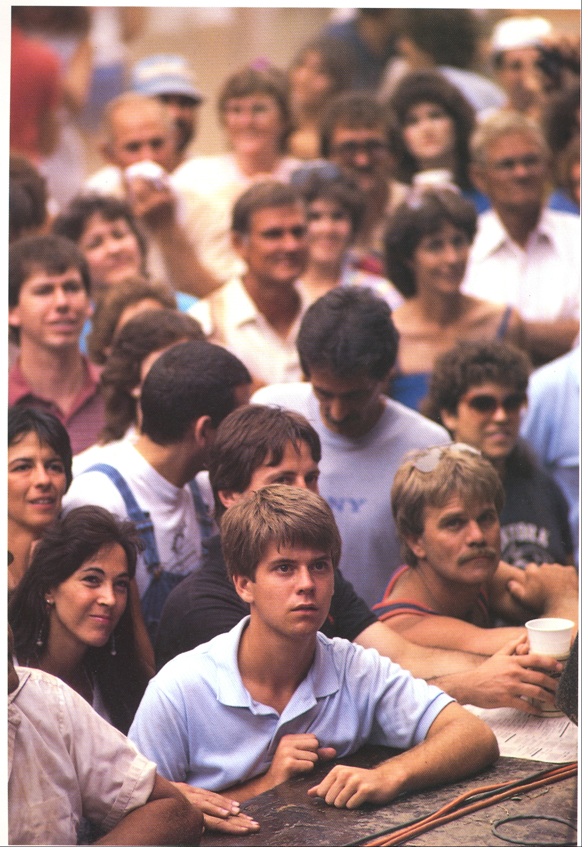

Slide 30
