Slide 1
CPaaS Omni-Channel Solution
Document Version - November 2023

Slide 2
Release Notes
November 2023
Item | Slide No. | Change Description
CPaaS Omni-Channel Product Deck | 3 | CPaaS Omni-Channel Product deck updated

Slide 3
Problem Statement & Solution
Overview
Key Features
Value Propositions
Snapshot
Success Stories

Slide 4

Problem Statements & Solutions
Technology Integration and Maintenance
Channels Integration
3
Complex integration processes and maintenance requirements for multiple communication channels result in increased operational complexities and costs.
Inconsistent customer experience due to the absence of integration between various communication channels.
1
Implement a CPaas Cloud Omni Channel Solution system that synchronizes customer data across all channels, enabling a seamless transition between different touchpoints.
Adopt a flexible and scalable CPaas Cloud Omni Channel Solution system that streamlines technology integration and maintenance, reducing operational complexities and costs associated with managing multiple communication channels.
Communication & Collaboration
Lack of effective communication and collaboration among teams handling different channels leads to delays and errors in customer support.
Agent Performance Monitoring
2
4
Difficulty in tracking and evaluating agent performance consistently across different communication channels, leading to inaccurate performance assessments.
Implement collaborative tools and platforms that enable real-time communication and knowledge sharing among teams, ensuring a consistent and coordinated approach to customer queries and issues.
Implement standardized performance metrics and evaluation criteria that apply uniformly across all channels, providing a comprehensive and fair assessment of agent performance.

Slide 5


Overview
CPaaS (Communications Platform as a Service) Omni Channel Solution refers to a cloud-based communication platform that enables businesses to integrate various communication channels into a single, unified interface.
This solution allows businesses to interact with their customers seamlessly across multiple channels; such as voice, messaging, and (soon) social media, from a centralized platform hosted in the cloud. Our Omni-Channel Solution maximizes work productivity enabling the agents to work from virtually anywhere in the world and thus providing 24/7 customer service.

Slide 6
Key Features - Overview
Dashboard
Custom dashboards turn a matrix of numbers into actionable insights that match customer unique needs. Organize data with custom dashboards and reports.
Communication Hub
Monitor your call center data when the agents are on the call to make quick decisions and improve your operating efficiency
Auto Attendant
Personalize customer journeys and offer self-service voice options with a graphic, flexible IVR solution.
Inbox Management
A plethora of features to optimize call and chat features in your omni channel. agent management, popup configuration, post-call actions, live-chat appearance, etc.

Slide 7
Key Features - Call Center System
Advance Call Routing
With this feature, you can make use of Ring All / Round Robin / Skill-based Routing / Sticky Agent.
Supervisor Tools
With special tools, supervisors have access to active calls monitoring (call barge, call spy, whisper), queue management, with detailed agent performance history.
Agent Tools
Agents are able to add notes for call on the portal pop-up box, view the call history for customer inquiries and expectation.
Announcement Message
Customize the message content by text and mp3 file, play when the customer waiting in the queue.

Slide 8
Key Features - Live Chat
Chat Widget Customization
Supervisors are able to set live chat appearance such as its primary color, text color, and also font, for working hours and non-working hours or public holidays.
List Customer's Transactions
Grouped all the transactions by a customer so agents are able to trace back all the transactions to and from a customer.
Pre-written or pre-formulated messages that agents can quickly access and use to respond to frequently asked questions or common customer inquiries during chat interactions.
Canned Response
Chat Transcript
Both agents and customers can keep a chat for future reference by receiving a transcript by email.

Slide 9






Value Propositions
Operational Efficiency
Flexible & Scalable
Improving operational efficiency by centralizing customer data and communication, enabling better coordination among various departments and ensuring a unified approach to customer service and support
The on-demand nature of cloud solutions allows true scalability for companies when needed. Easily customize the service anytime for unlimited scalability.
Workforce Optimization
Seamless Customer Experience
Enabling brands to staff agents to work from virtually anywhere in the world and thus provide 24/7 customer service.
Providing a seamless and consistent customer experience across all channels, allowing customers to interact with the brand in a unified manner, irrespective of the platform or device they choose to use.
Rich insights and Analytics
Quality Management & Compliance
Analyze your KPIs on real-time dashboards and react quickly to the hold time, resolution time, number of people in the queue and more.
Recorded call are for coaching and compliance purposes.

Slide 10
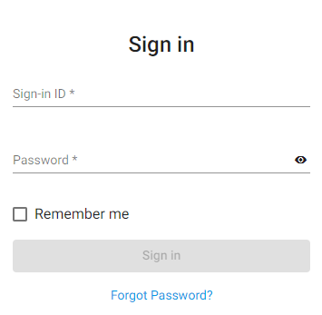
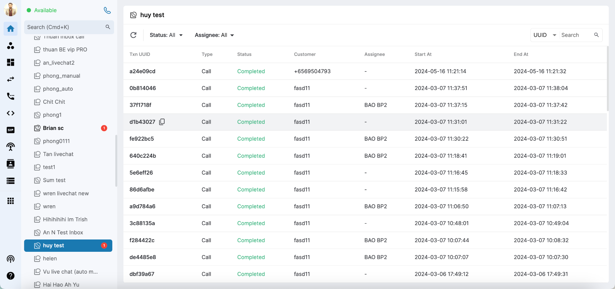
CPaaS Portal
With CPaaS Omni-Channel Solution, manage customer interactions through a unified platform that can be accessed from anywhere.

Slide 11
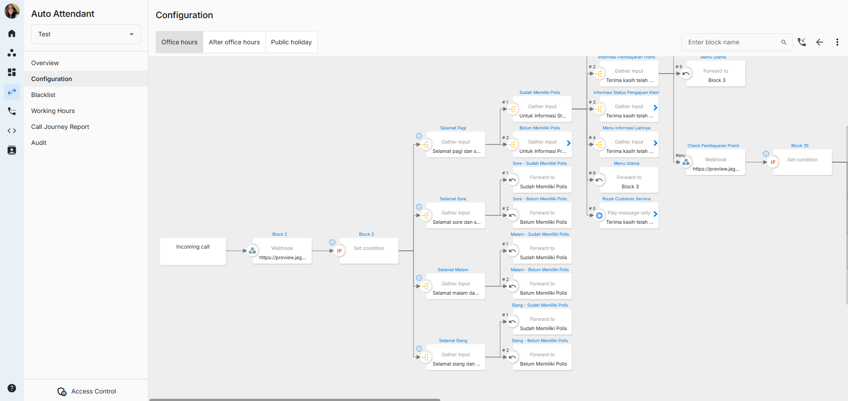
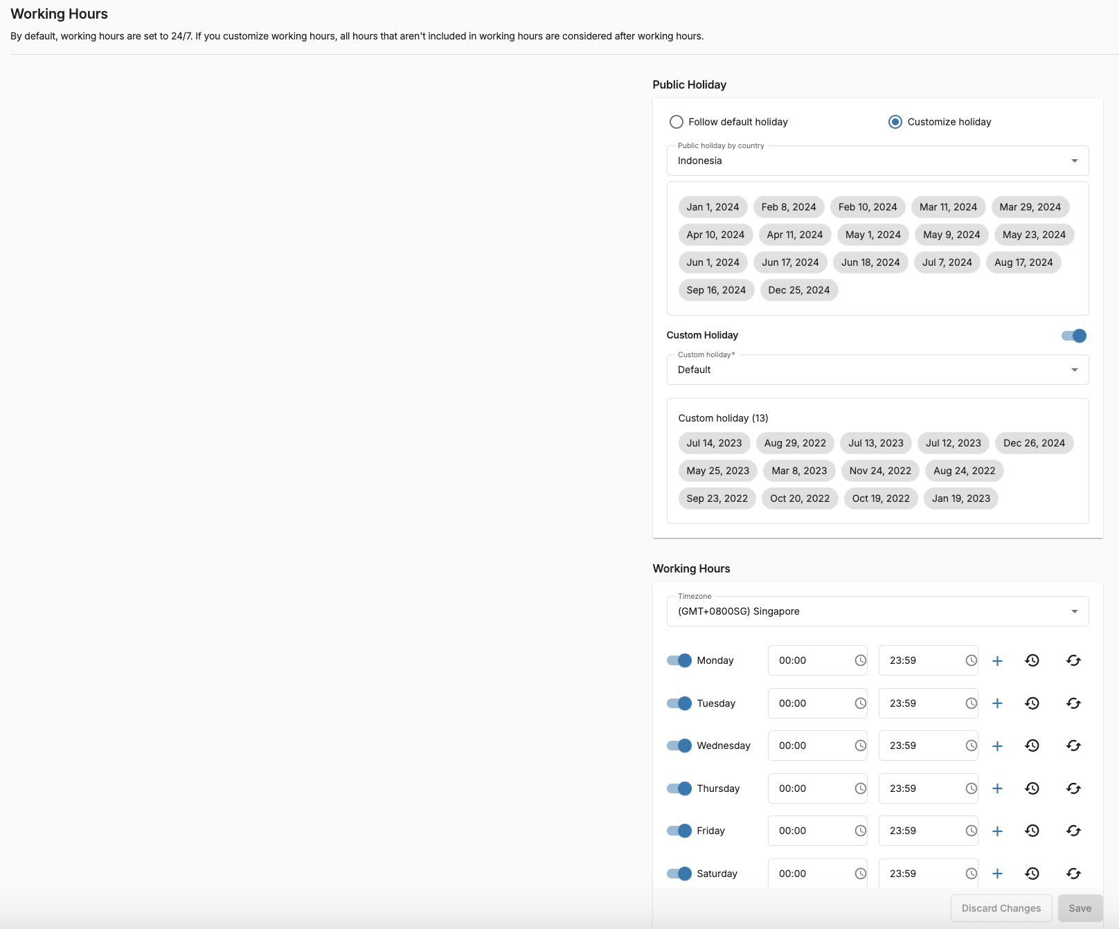
Auto Attendant
Personalize customer journeys and offer self-service voice options with a graphic, flexible IVR solution. No coding or IT skills needed!

Slide 12
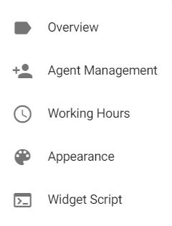
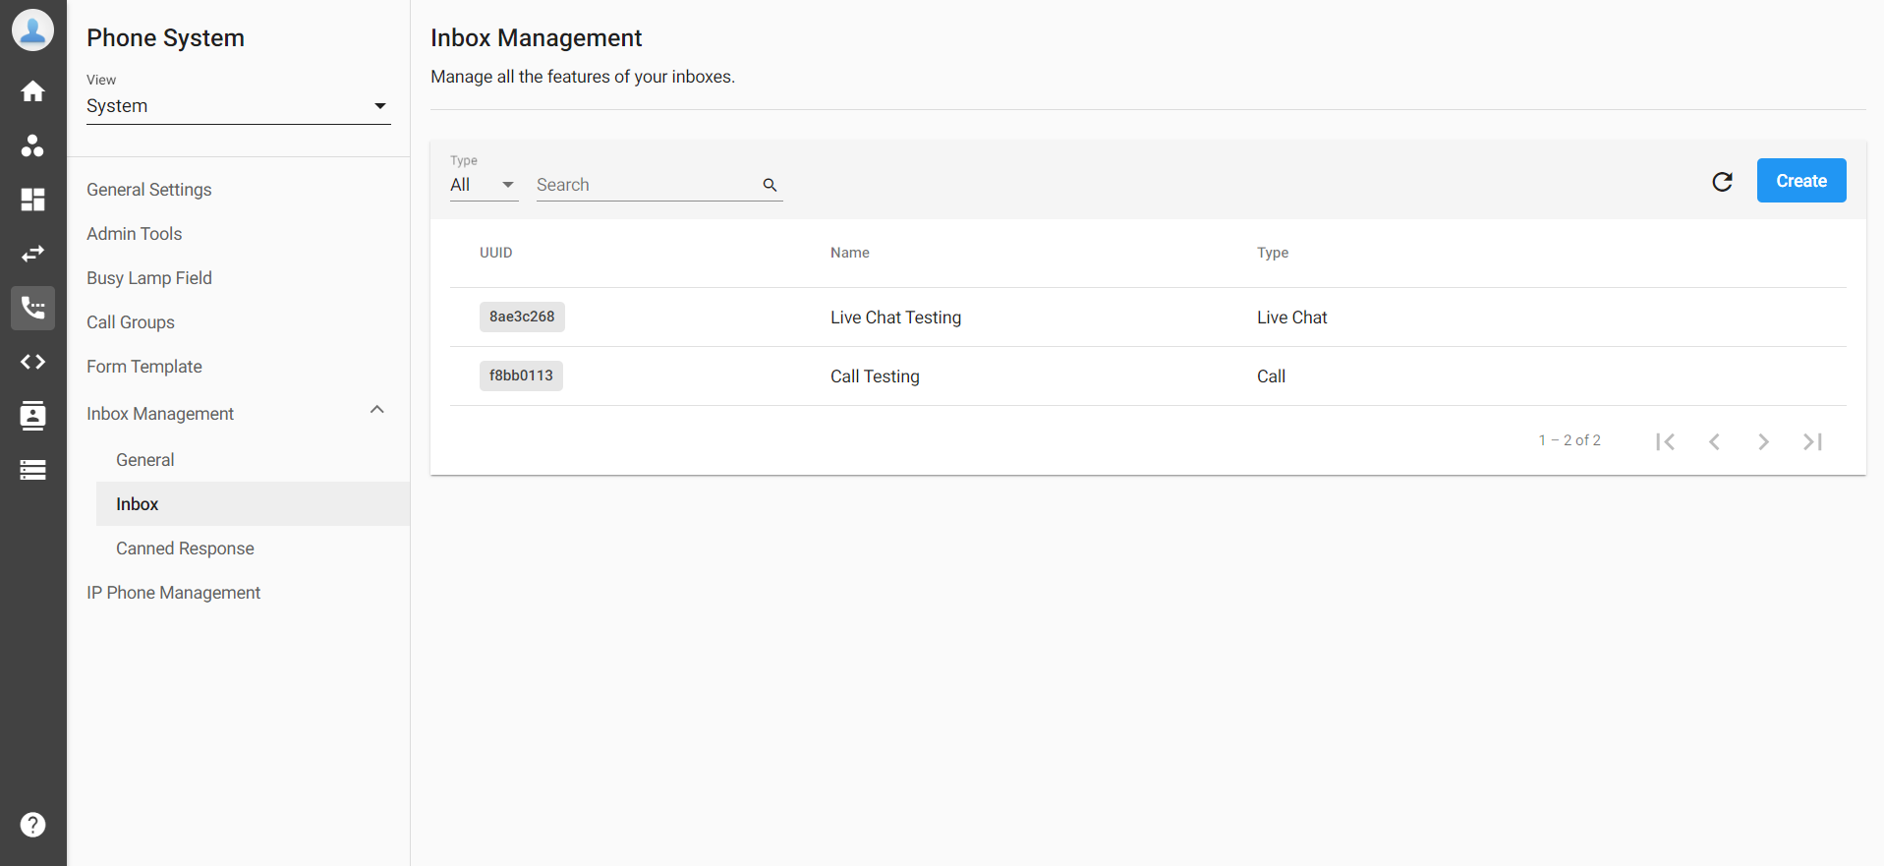
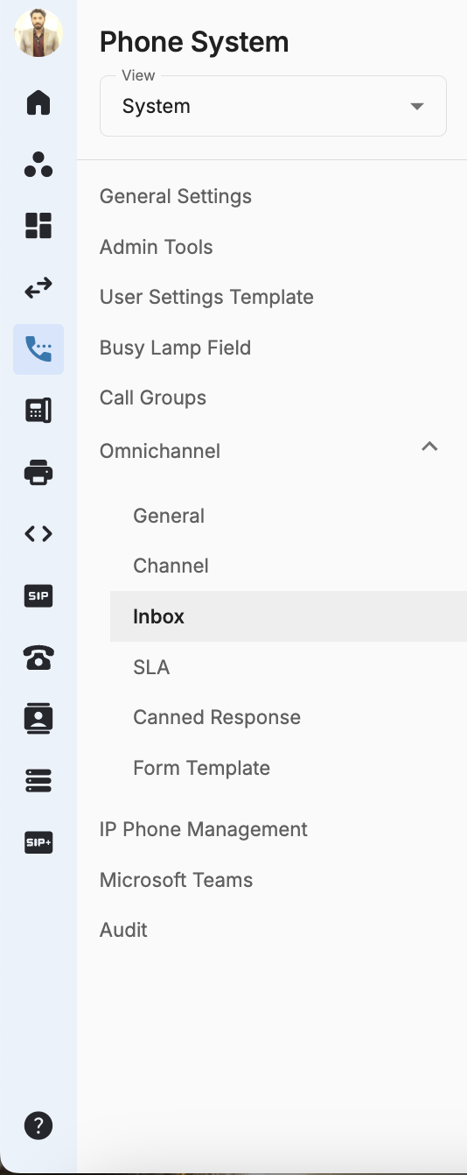
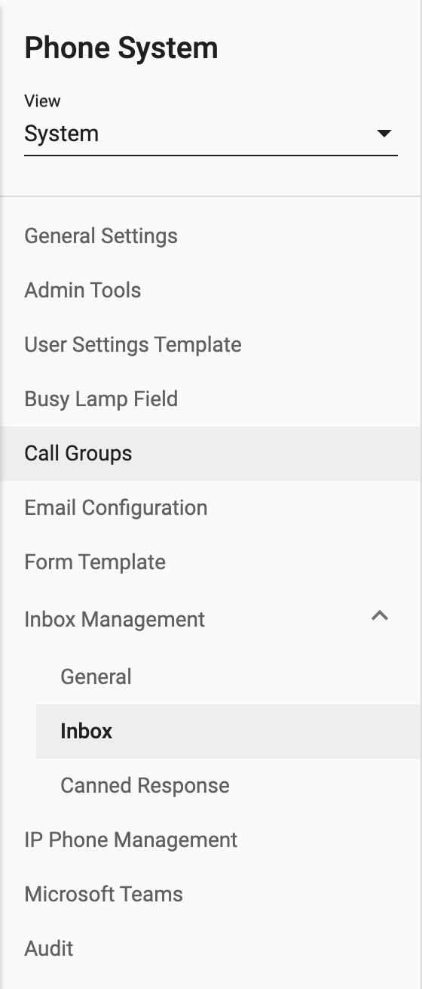

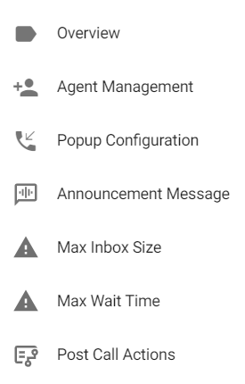
Inbox Management
Agent management, popup configuration, post-call actions, live-chat appearance, etc.
A wealth of features to optimize inbox management of your omni channel.

Slide 13
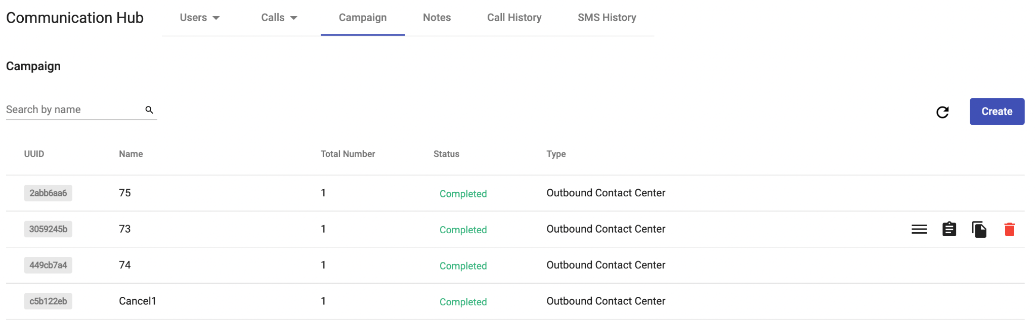

Outbound Campaign
Construct a number of different Outbound Contact Center campaigns, and keep tabs on their progress with ease using the comprehensive reporting provided. When a campaign's phone number list is uploaded to the Outbound Contact Center, it can be used as an automatic dialer.

Slide 14
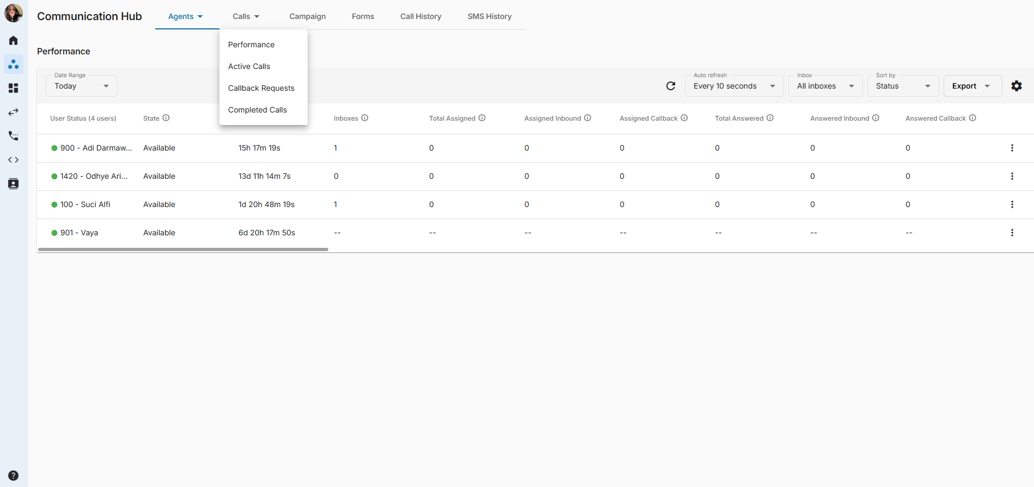
Communication Hub
Monitor your call center data in real time to make quick decisions and improve your operating efficiency.

Slide 15
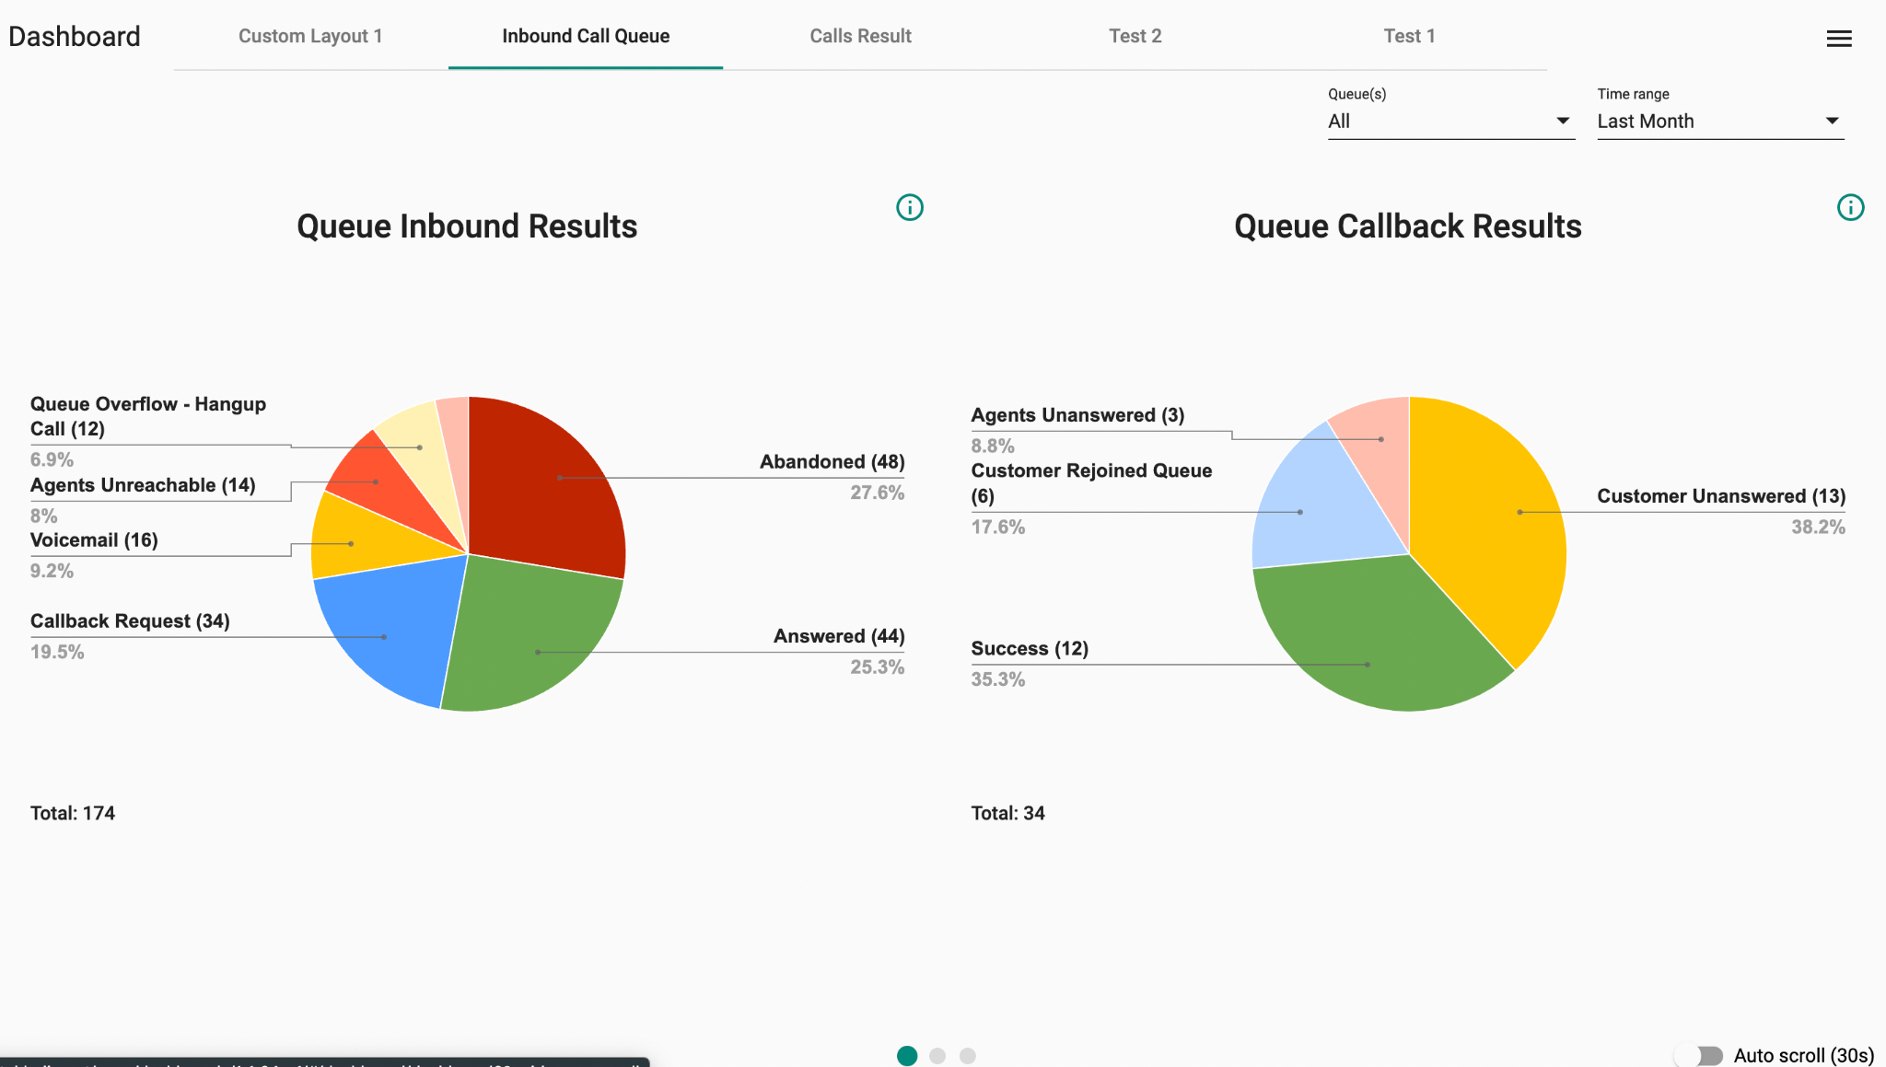
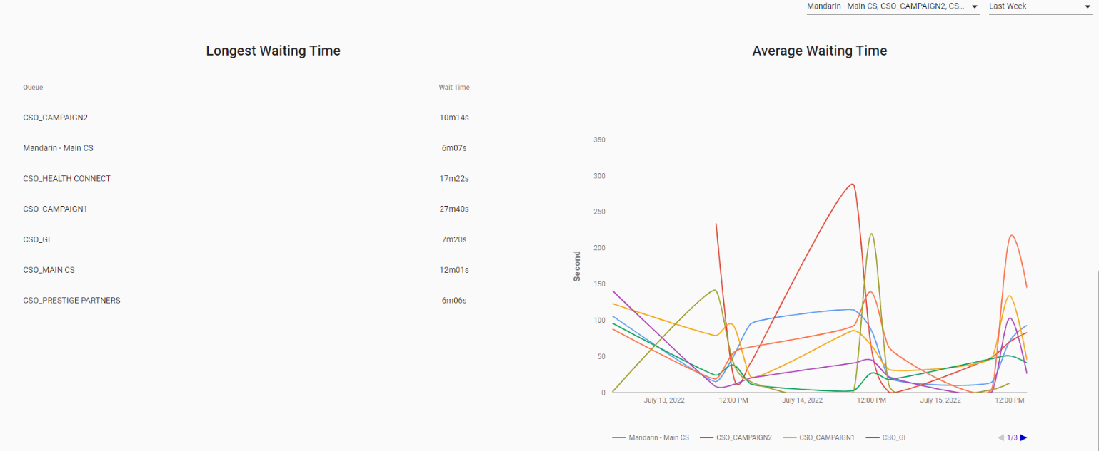
Dashboard
Gain actionable insights to make the right decisions with Dashboard - a visual reporting tool that use powerful analytics features to help you monitor your call data

Slide 16



Success Stories
Singapore Insurance Provider
A Singaporean multinational finance and insurance corporation is relying on our CPaaS Omni Channel Solution integrating with their company data to verify the identities of customers via NRIC (National Registration Identity Card) and one time password. With our Omni-Channel Solution, the customer service experience will be enhanced because customers will be directed to the correct department without having to waste time contacting different divisions.
Notes:
-

Slide 17






Multiple NRIC found
Popup on the Desktop app to view customer info
CSA Inbox B
“Welcome to ABC Assurance. If you are our existing policyholder and are calling about your policy matters, please enter your NRIC or passport number. Otherwise, press 0.”
NRIC not found
Popup on the Desktop app to view customer info
CSA Inbox C
Received input?
Yes
Valid NRIC?
No
3 times
Checking Database over Webhook
No
“We have not received a response from you. Please hold while we connect your call to our Customer Service Officer.”
NRIC is valid
“Please enter your One-Time Password.”
Received input?
Yes
Valid OTP?
No
Checking Database over Webhook
3 times
Yes
Taking note on the popup while handling call
Unexpected error
Popup on the Desktop app to view customer info
Popup on the Desktop app to view customer info
CSA Inbox A
CCSA Inbox D
CSA Inbox E

Slide 18


Success Stories
Communications Technology Provider
A leading information and communications technology provider headquartered in Singapore uses CPaaS Omni Channel Solution with our developer tools to monitor their multilingual contact center and notify them immediately if any of their Agents exhibit any of the following behaviors:
5 Consecutive Abandoned Calls Detection
Away Detection
Offline Detection

Slide 19






Singapore
Korea
China
Thailand
“Thank you for calling ABC helpdesk. Please hold on while we transfer you to our helpdesk agent.”
“ABC 헬프데스크에 전화해 주셔서 감사합니다. 헬프데스크 상담원에게 연결하는 동안 잠시만 기다려 주십시오.”
“感謝您致電 ABC 服務台。請稍等，我們將您轉接給我們的服務台代理。”
“ขอบคุณที่โทรหาแผนกช่วยเหลือของ ABC โปรดรอในขณะที่เราโอนคุณไปยังตัวแทนฝ่ายช่วยเหลือของเรา”
Agent’s status changes to AWAY
Agent’s status changes to OFFLINE
Singapore CSA Queue
Korea CSA Queue
China CSA Queue
Thailand CSA Queue
Caller hangs up before Agent picks up
Agent picks up?
Yes
SMS alert to Supervisor
& Agent
Finish
Abandoned call
No
SMS alert to Supervisor
& Agent
Each 5 consecutive abandoned calls

Slide 20



Success Stories
Outbound Campaign
Financial Adviser
Pause
No
Work time?
Yes
Run
Auto-dials customers’ numbers in the number list and assigns to Omni Channel Inbox
A Financial adviser in Singapore uses CPaaS Omni Channel Solution to act as an auto-dialer and carry out automated call campaigns by automatically assigning calls to the chosen Omni-Channel Inbox which are handled by agents.
Omni Channel Inbox
Popup on the Desktop app to view customer info
Agent 1
Agent 2
Agent 3
Customers

