Slide 1
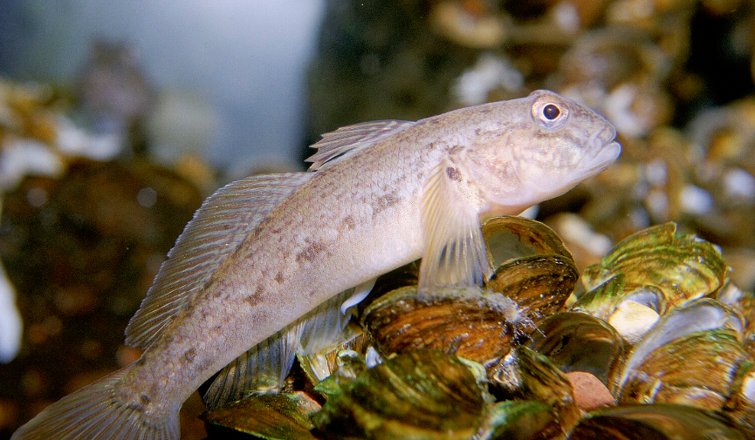
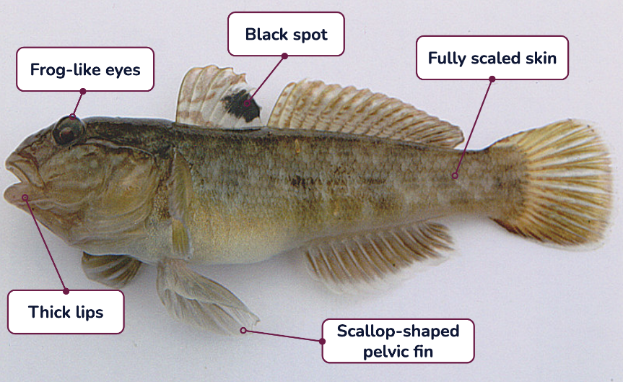
Round goby (Neogobius melanostomus)
The round goby is a small fish native to Central Eurasia that likes to hang out on the lake bottom. It is an invasive species in the St. Lawrence River, brought over in the ballast water of ships. Non-native species become invasive when they harm other species and the environment.
Characteristics:
Black spot on its dorsal fin and unique scallop-shaped pelvic fin.
The round goby can sometimes be mistaken for native sculpin which has a similar appearance. A quick check of the fins can confirm which species you're looking at - sculpin do not have a black dot on their dorsal fin, and they have two separate pelvic fins!
Torpedo-shaped body that can be 6 to 16 cm long
Large head with thick lips and bulging eyes, like a frog
Fully scaled brown to olive green or grey skin with dark brown spots
The round goby eats anything from aquatic insects to smaller fish and mussels
Seabirds and larger fish like the yellow perch and smallmouth bass eat the round goby
This Ocean School guide is licensed under CC BY-SA 4.0
The round goby problem
The round goby is an aggressive fish that grows very fast and reproduces often.They are a very strong competitor for some species who call the river home, like the tessellated darter fish and mottled sculpin. The populations of these native bottom dwelling species have declined since the arrival of the round goby.
Round gobies can eat the food and eggs of other fish, and take up the spaces they live, feed, and spawn. They also eat zebra mussels, this is a problem because mussels collect many toxins from the water which can then move up the food chain.
Notes:
Image source:
Round goby (cropped) by U.S. Fish and Wildlife Service (licensed under CC Public Domain) on USFWS National Digital Library
A large round goby (Neogobius melanostomus) caught in Netherlands (cropped) by Peter van der Sluijs (licensed under CC BY-SA 3.0 Deed) on Wikipedia

Slide 2
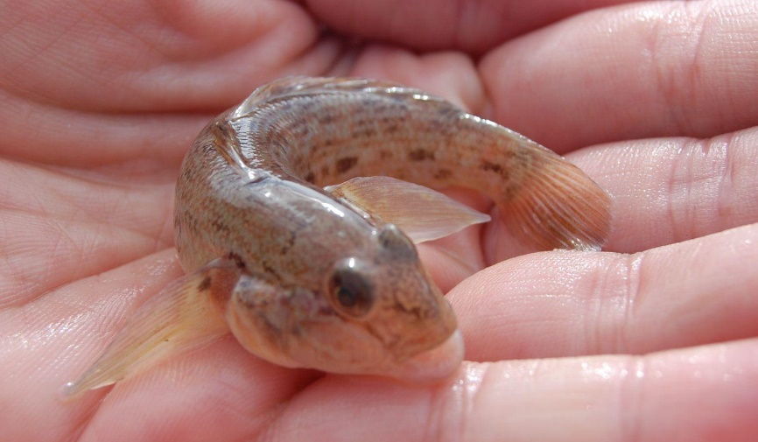
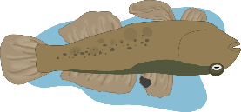
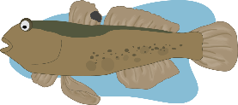
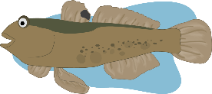
Climate change and the round goby
Cristina Charette is researching the impact of the round goby on the St. Lawrence River and how different habitats can influence the invasive species’ role in the food web. Her research has shown that abiotic factors like temperature and light, which are non-living parts of an ecosystem, can have a huge role in how the goby behaves.
The goby has been found to survive better in high levels of water conductivity and change how it feeds depending this abiotic factor. Conductivity describes the level of dissolved salts and minerals in water. Cristina’s work helps us understand how abiotic factors, which are influenced by climate change, can also impact the goby, and how its response to these changes can affect other organisms.
Read Cristina Charette’s research to learn more about how changes in conductivity can affect how the goby behaves!
Abiotic factor | What it means | Habitat suitability | Goby’s feeding behaviour
Very low conductivity | ↓↓↓ Very low concentration of ions in the water | Unsuitable The goby cannot settle. | ✖
Low conductivity | ↓↓ Moderate concentration of ions in the water | Somewhat suitable The goby will be stressed. | Selective feeding The goby will feed on invertebrates that live on the river bottom.
High conductivity | ↑ High concentration of ions in the water | Very suitable The goby will be relaxed. | Generalist feeding The goby will feed on both invertebrates that live on the river bottom, including zebra mussels, and invertebrates that live in the water column.
Notes:
Image source:
Round Goby (Cropped) by Ohio Sea Grant (Licensed under CC BY-NC 2.0 Deed) on Flickr

Slide 3
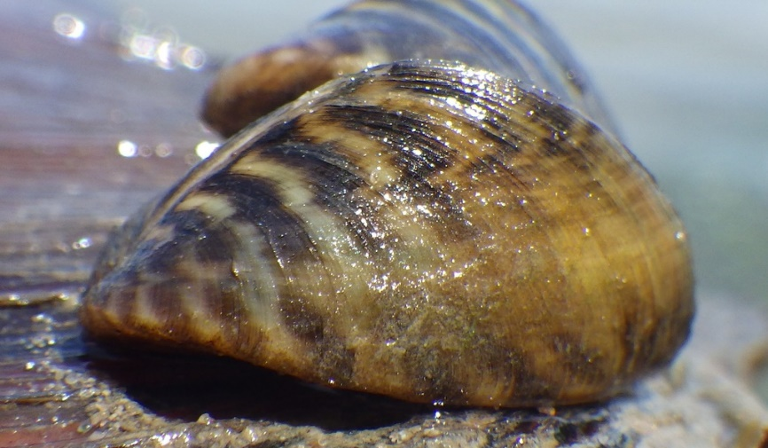
The domino effect
Climate change can make it easier for invasive species to adapt and spread to new areas. Both climate change and invasive species can cause the loss of native biodiversity. Losing these native species and having more invasive species can make the environment more vulnerable to changes, which in turn makes it more vulnerable to invasive species.
Overall, the cycle that climate change and invasive species can create makes it harder to take care of our environment and protect the plants and animals that live in it.
Invasive species modify and make ecosystems vulnerable
Climate change can modify abiotic factors
Ecosystems can become even more vulnerable from these effects
THE CLIMATE CHANGE EFFECT
Abiotic changes can can create suitable habitat conditions that attract more invasive species
Abiotic changes can influence how invasive species behave
The impacts of changed feeding behaviours
When the goby settles and invades habitats with high conductivity they will eat more zebra mussels. This is a problem as zebra mussels are also invasive species that accumulate many harmful toxins in their tissues. When the goby preys on zebra mussels, these toxins are passed on to the goby. Animals that eat goby will also consume these toxins. The concentration of toxins therefore increases up the food chain, causing health issues and mortality. This is called biomagnification.
Notes:
Image source:
Zebra Mussel (Dreissena polymorpha) (Cropped) by Mark C. Hove (Licensed under CC BY-NC 4.0 Deed) on iNaturalist

