Slide 1


Communication
Principal Professional Learning
September 2024
Notes:
Time frame: under 1 minute
Talking points:
Welcome and introductions

Slide 2
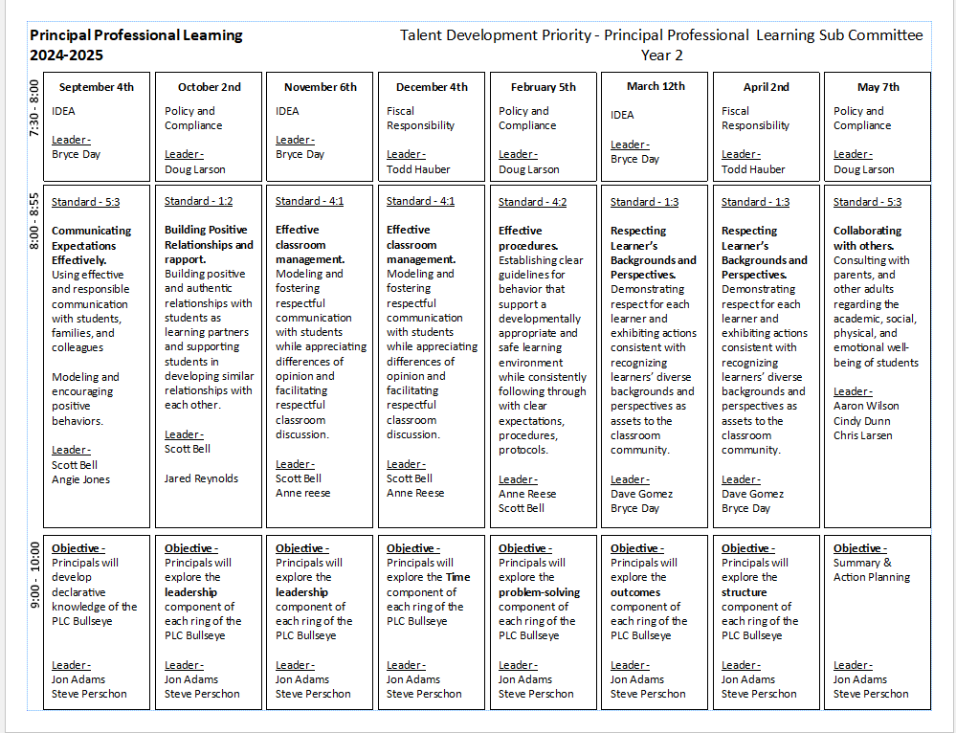
Notes:
Time frame: under 1 minute
Talking points:
Share the scope and sequence for the year

Slide 3

Standards
Teacher Standard 5.3
Using effective and responsible communication with students, families, and colleagues
Administrator Standard Domain 4 Standard B
Uses effective, timely and professional communication in all situations with staff, students, parents, and community members
Utilizes effective communication in face to face conversations, facilitation of meetings, consensus-building, difficult conversations, email, text, etc.
Notes:
Time frame: under 1 minute
Talking points:
Introduce the teacher and administrator standards
Share that we will be helping them to understand their role in supporting teachers as well as understanding their own personal skills they use to communicate

Slide 4
24-25 Behavioral Support
We kicked off the behavior training with:
MTSS Bootcamp
Teacher Professional Learning in August
Administrator trainings throughout this year
Notes:
Time frame:under 1 minute
Talking points:
Remind administrators about MTSS Bootcamp
Per the Granite District Board and district negotiations behavior will be a topic covered this year
Teachers were trained in August about topics regarding behavior of their choice
Administrators can continue to train staff through the year as well in their faculty meetings and teacher professional learning days

Slide 5








CCR
PBIS/MTSS Coaches
General Education Behavior Specialists
Chad Coon
Granger & Olympus
Liz Green
Hunter & Cottonwood
Shanna Bingham
Kearns & Skyline
April Foyston
Cyprus & Taylorsville
genedbehaviorteam@graniteschools.com
Notes:
Time frame:under 1 minute
Talking points:

Slide 6
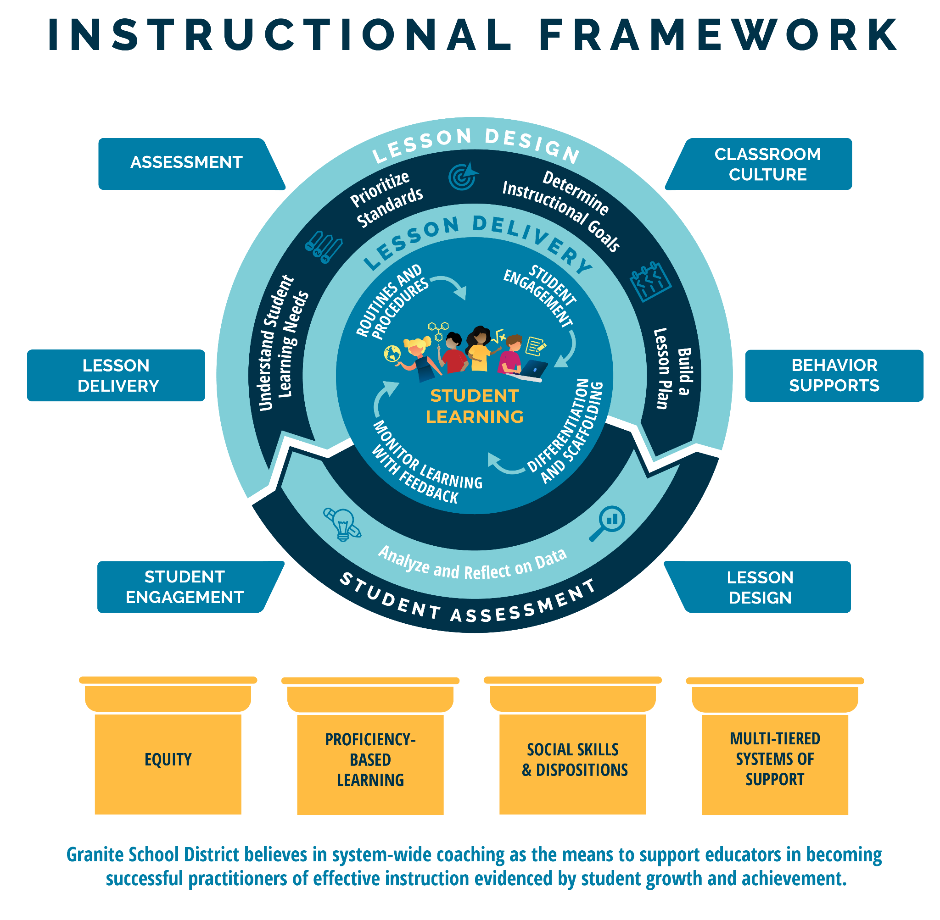
Notes:
Time frame: 1 minute
Talking points:
This is the Granite School District Instructional Framework. This framework is based on the evidence-based instructional practices embedded in the GSD Strategic Plan and represents all of Granite School District priorities. You will notice student learning is at the heart of the framework as it represents our commitment to student learning around which everything else is built. The framework features the basic elements of a high quality instructional cycle including Lesson Design, Lesson Delivery, and Student Assessment. You will notice the evidence-based practices at the lesson delivery level that we expect to see in what the teacher and the student are doing during the lesson. The high quality instructional cycle components are reinforced through ongoing, job-embedded coaching in: lesson design, student engagement, lesson delivery, assessment classroom culture and behavior supports, all of which contribute to meaningful learning and career and college readiness. The framework rests on the foundational pillars of Granite School District’s commitment to Equity, Proficiency-Based Learning, Social Skills and Dispositions and Multi-Tiered Systems of Support.

Slide 7
Objectives
Administrators will be able to identify personal skills they use to communicate with students, families and colleagues
Notes:
Time frame: under 1 minute
Talking points:
Highlight that we will address communication from the perspective of how an administrator can communicate and how an administrator can support other educators in communication

Slide 8
Essential Questions
What is “responsible communication”?
What do we want to communicate to our students/ families/ colleagues?
How are we communicating with our students/ families/ colleagues?
How do we know?
Notes:
Time frame: under 1 minute
Talking points:

Slide 9

Communication
Teacher Standard 5.3
Using effective and responsible communication with students, families, and colleagues
Notes:
Time frame: 2 minutes
Talking points:
Share the teacher standard that we are working from today
Share the video as a fun way to promote the need for positive communication

Slide 10
Why Do We Care About Communication?
How is communication tied to behavior?
When has poor communication caused you problems?
Examples of times that effective communication made a difference?
Notes:
Time frame:10 minutes (3 minutes on each question, 1 minute wrap-up)
Talking points:
Large Group Discussion
Spend 3 minutes on each question
How is communication tied to behavior?
When has poor communication caused you problems?
Examples of times that effective communication made a difference?

Slide 11
Communication
Teacher Standard 5.3
Using effective and responsible communication with students, families, and colleagues
What does “Responsible Communication” mean?
Notes:
Time frame: 5 minutes
Talking points:
Share the open ended question to the group to have a brief whole group share out
Ask “What are other synonyms you might use instead of responsible?” and have a brief whole group share out
Things such as deliberate, purposeful

Slide 12
Table Activity and School Spotlights
Students
Schoolwide | Classroom
Families/Communities
Faculty/Staff
Notes:
Time frame: 2 minutes (1 minute explanation, 1 minute to create poster)
Talking points:
Share with them how to create their posters, letting them know that they will be hung on the wall for a Gallery Walk at the end of the session
Give them 1 minutes to create their poster and determine who will be the scribe

Slide 13
Communication
How are these ideas communicated to students?
Schoolwide?
Teacher/Classroom?
How are these ideas communicated to families?
How do you communicate with faculty and staff?
How do you promote strong communication amongst your faculty and staff?
Notes:
Time frame: 4 minute
Talking points:
Have a table discussion for 4 minutes about ideas they have in each area
Possible examples:
Schoolwide: Graduate of Granite, PBIS, Safety, Belonging, etc.
Classroom: Same as above, procedures, class rules aligning with school expectations
Families:
Faculty/Staff:

Slide 14

Communication at West Kearns - Schoolwide
How are these ideas communicated to students?
Schoolwide?
Notes:
Time frame: 5 minutes
Talking points:
An administrator will share out about effective ways they have found to communicate with families
HERE is a link to additional ML supports for communication from the Ed. Equity Department

Slide 15

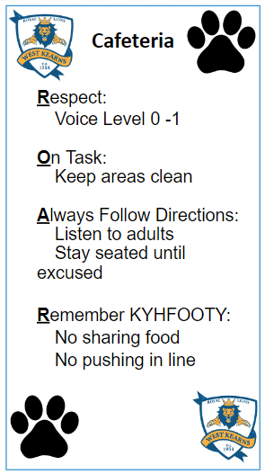
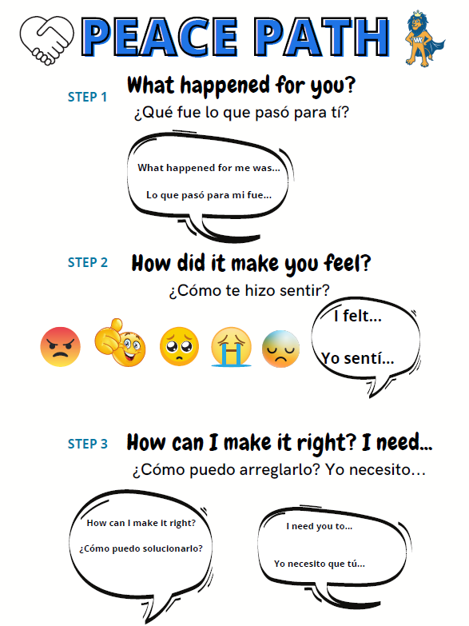

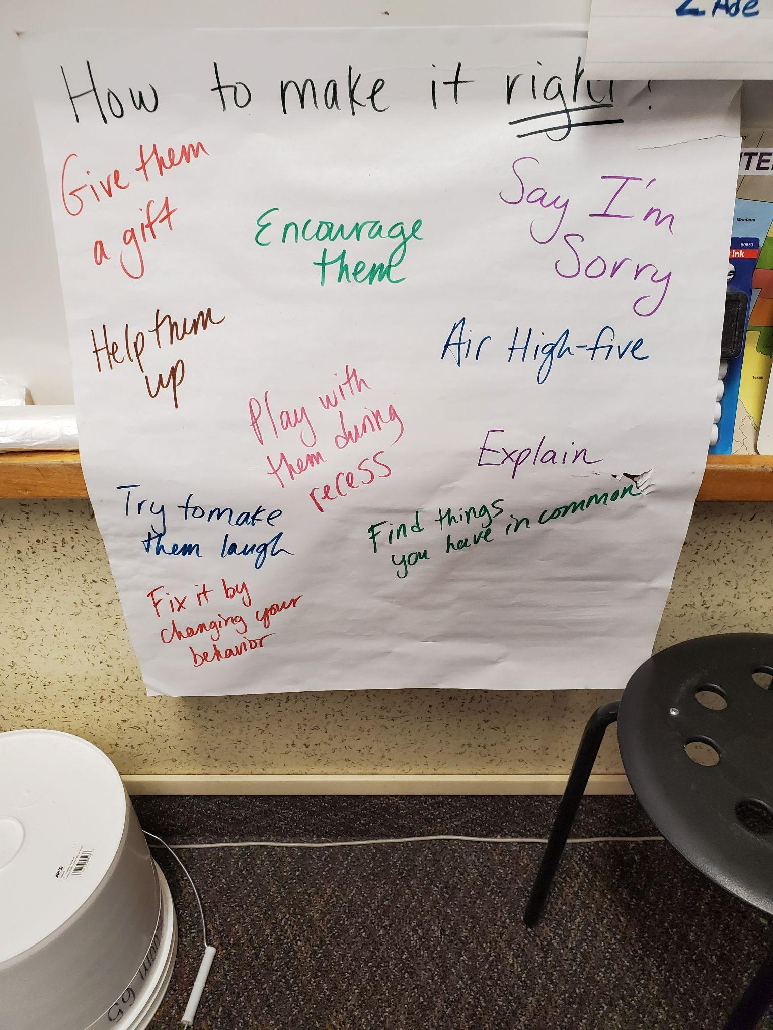
Communication at West Kearns - Schoolwide
How are these ideas communicated to students?
Clear, consistent expectations school-wide
Restorative Tools easily accessible
Signage
Strong PBIS foundation
Notes:
Time frame: 5 minutes
Talking points:
An administrator will share out about effective ways they have found to communicate with families
HERE is a link to additional ML supports for communication from the Ed. Equity Department

Slide 16
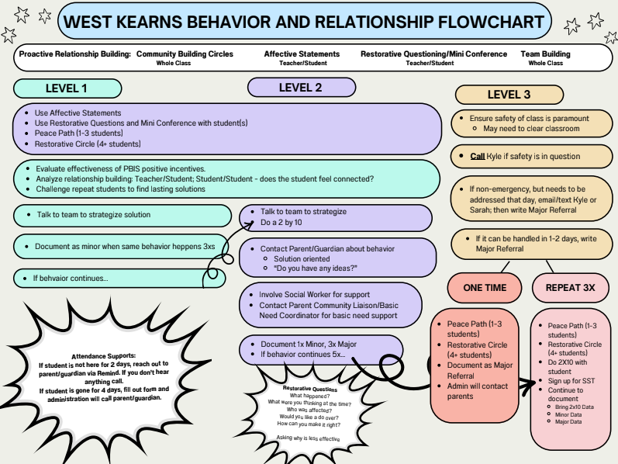
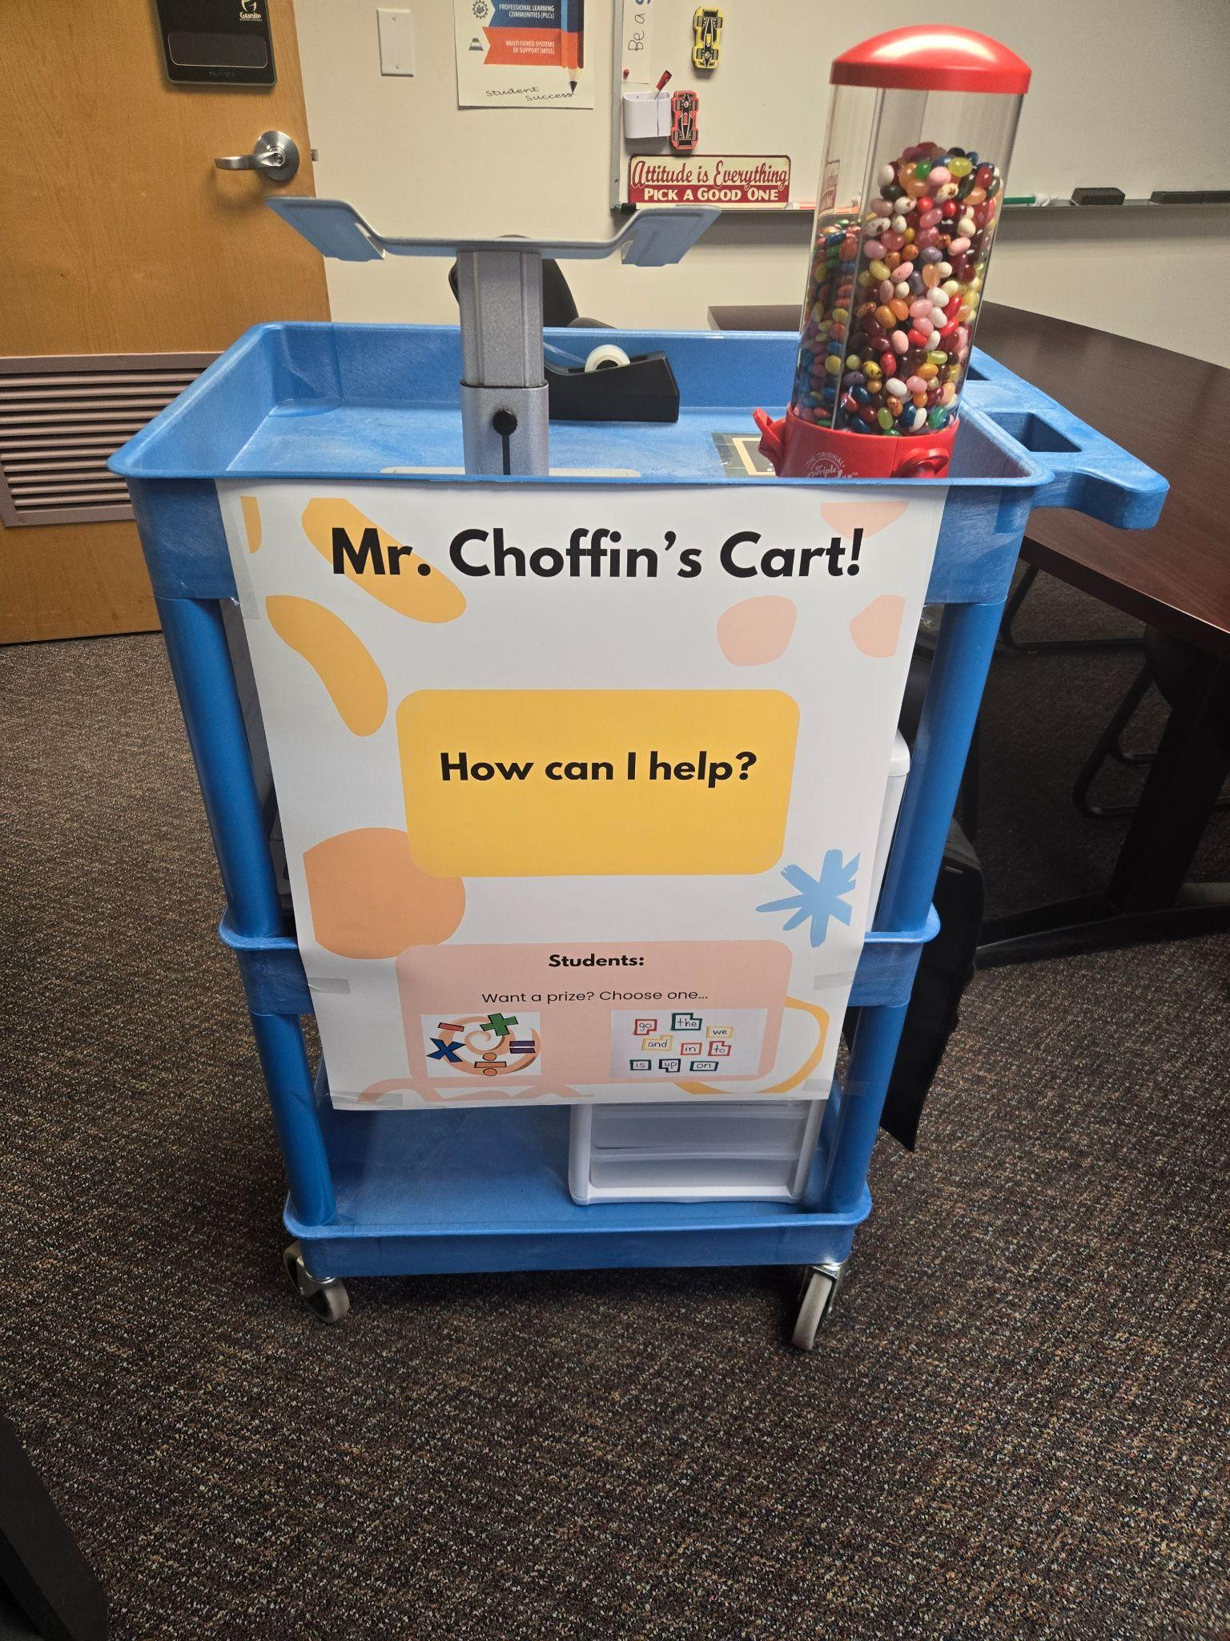
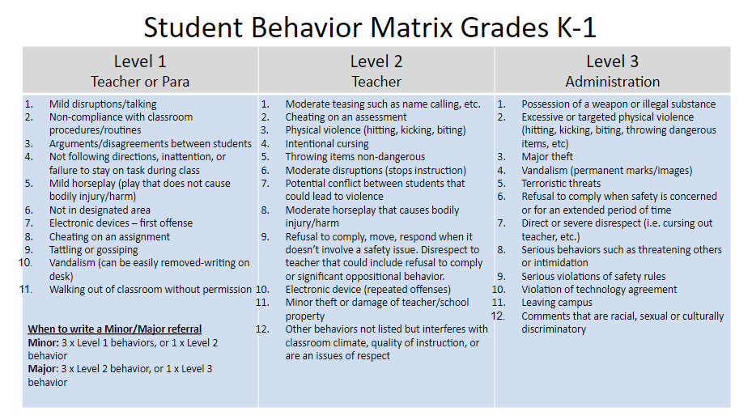
Communication at West Kearns - Faculty/Staff
How are these ideas communicated to teachers?
Clear, consistent expectations school-wide
Training in RJ, and clear flowchart of support.
Support is close by!
Notes:
Time frame: 5 minutes
Talking points:
An administrator will share out about effective ways they have found to communicate with families
HERE is a link to additional ML supports for communication from the Ed. Equity Department

Slide 17
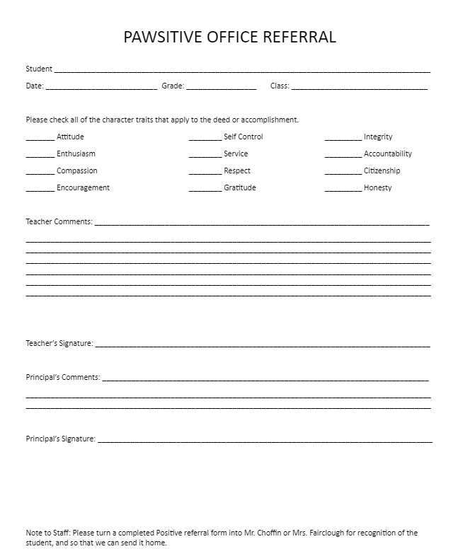
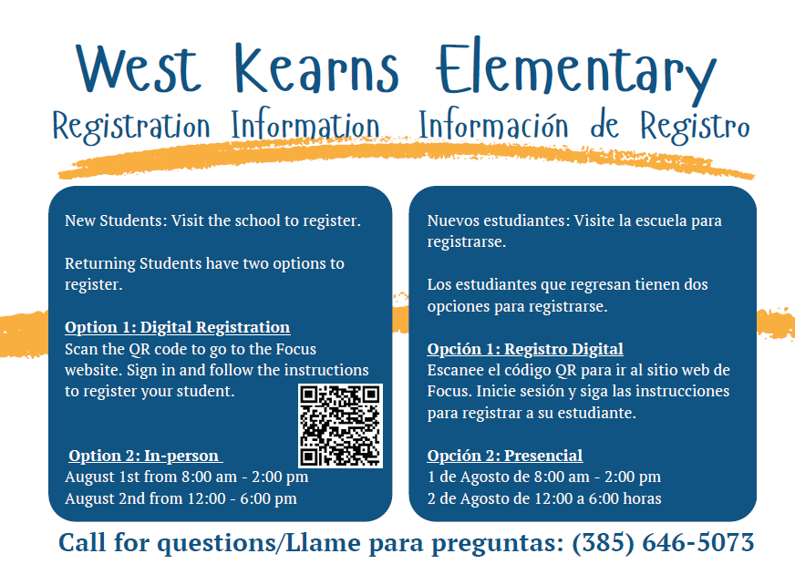
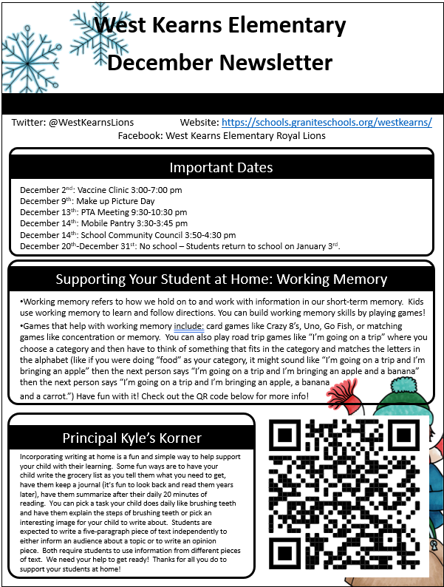


Communication at West Kearns - Families
How are these ideas communicated to families?
PAWSitive referrals
Great things are visible!
Clear communication
Notes:
Time frame: 5 minutes
Talking points:
An administrator will share out about effective ways they have found to communicate with families
HERE is a link to additional ML supports for communication from the Ed. Equity Department

Slide 18
Communication at West Kearns
How are these ideas communicated to all stakeholders?
Train… Teachers, Paras, Front Office, Students, Parents
How:
-One parent at a time. One student at a time.
-All staff speaking the same language, such as Affective Statements, Restorative Questions, Restorative Circles, Community Building Circles.
-Build tool kits for and buy-in for teachers/students/parents as successes are experienced.
Notes:
Time frame: 5 minutes
Talking points:
An administrator will share out about effective ways they have found to communicate with families
HERE is a link to additional ML supports for communication from the Ed. Equity Department

Slide 19
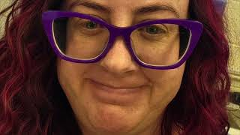

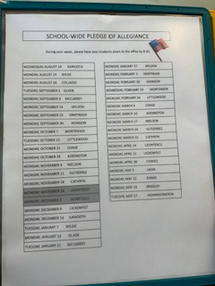
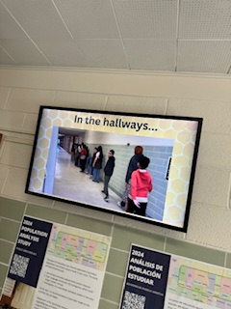
Communication at Redwood - Schoolwide
How are these ideas communicated to students?
Schoolwide?
Morning Announcements and Pledge
Weekly Ram Reel
Hallway Signage & Videos
Notes:
Time frame: 5 minutes
Talking points:
An administrator will share out about their PBIS system, how they have incorporated Graduate of Granite into their PBIS system, how they ensure students know the schoolwide expectations (tours or the school, videos, etc.)

Slide 20
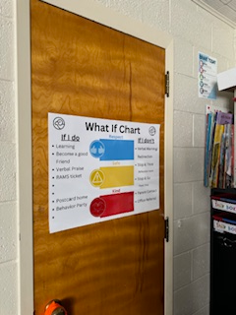
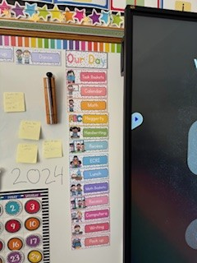


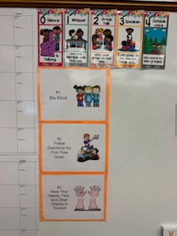

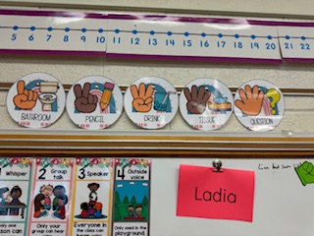
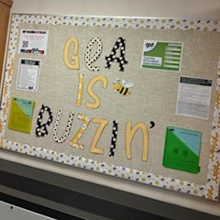
Communication at Redwood - Classroom
How are these ideas communicated to students?
Teacher/Classroom?
Classroom Signage
Modeling & Verbal Instructions
Additional Adult Learning
Notes:
Time frame: 5 minutes
Talking points:
An administrator will share out about some of their teachers and how they incorporate their school wide expectations into their classroom rules, how they set up classroom procedures, as well as how they design strong lessons with objectives and success criteria that support the positive classroom environment and behaviors

Slide 21

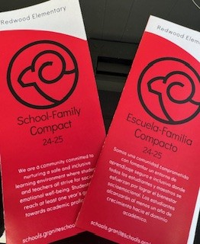
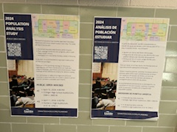




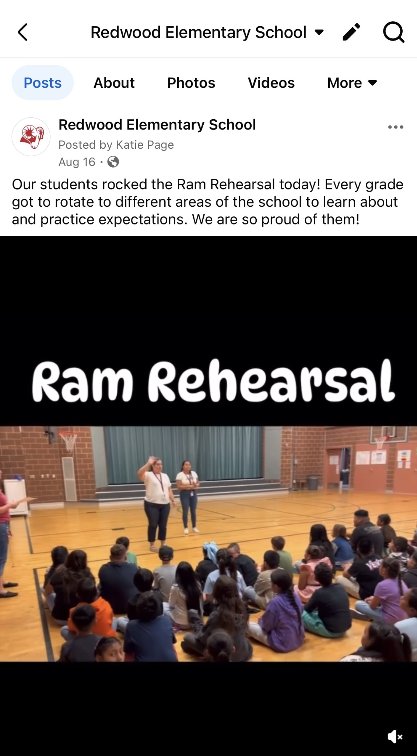
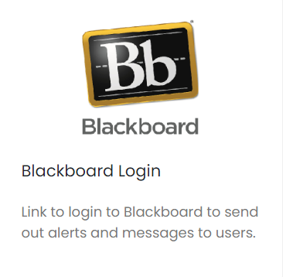

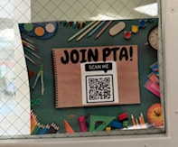
Communication at Redwood - Families
How are these ideas communicated to families?
Notes:
Time frame: 5 minutes
Talking points:
An administrator will share out about effective ways they have found to communicate with families
HERE is a link to additional ML supports for communication from the Ed. Equity Department

Slide 22
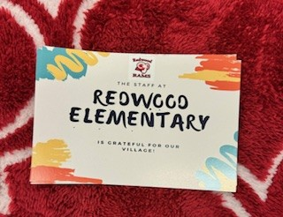
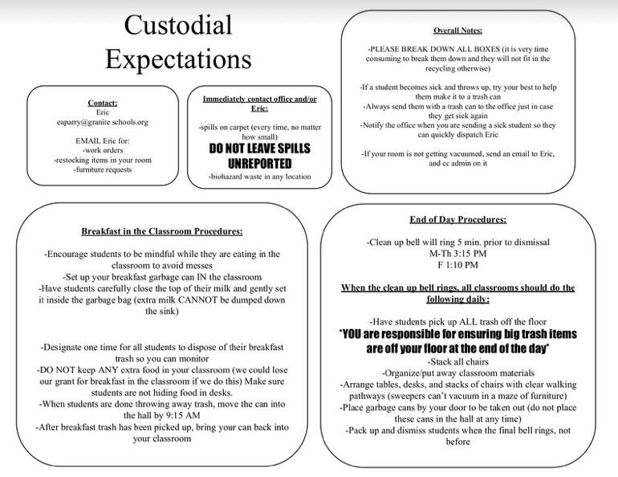
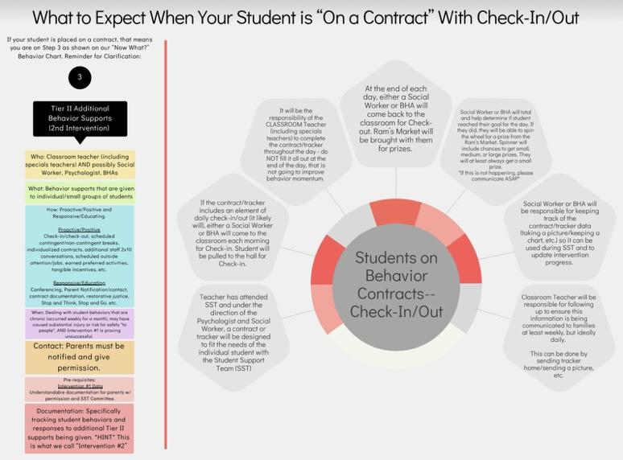
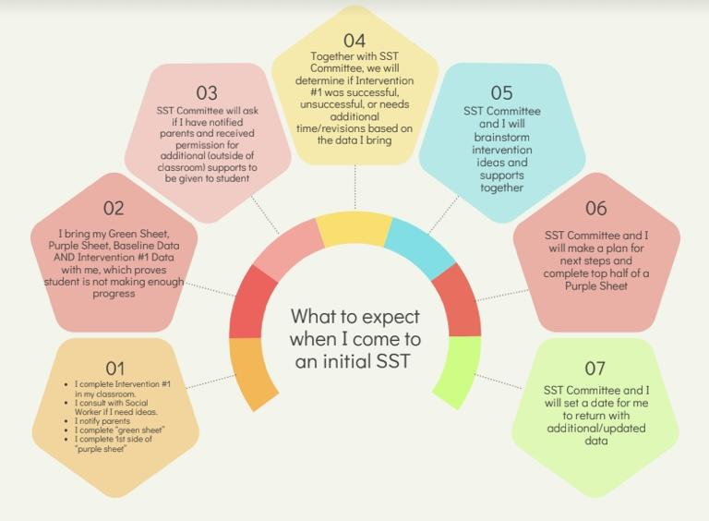

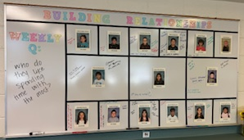
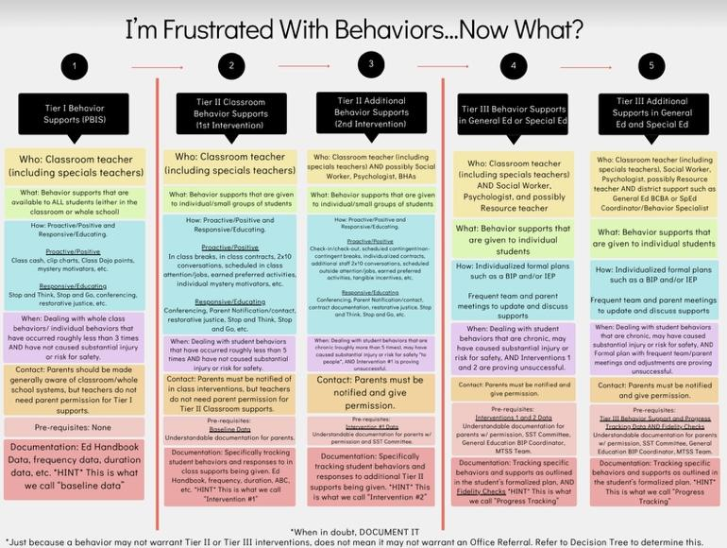
Communication at Redwood - Faculty/Staff
How do you communicate with faculty and staff?
How do you promote strong communication amongst your faculty and staff?
Notes:
Time frame: 5 minutes
Talking points:

Slide 23

Communication at Wilson - Classroom
How are these ideas communicated to students?
Teacher/Classroom?
Notes:
Time frame: 5 minutes
Talking points:
An administrator will share out about effective ways they have found to communicate with families
HERE is a link to additional ML supports for communication from the Ed. Equity Department

Slide 24

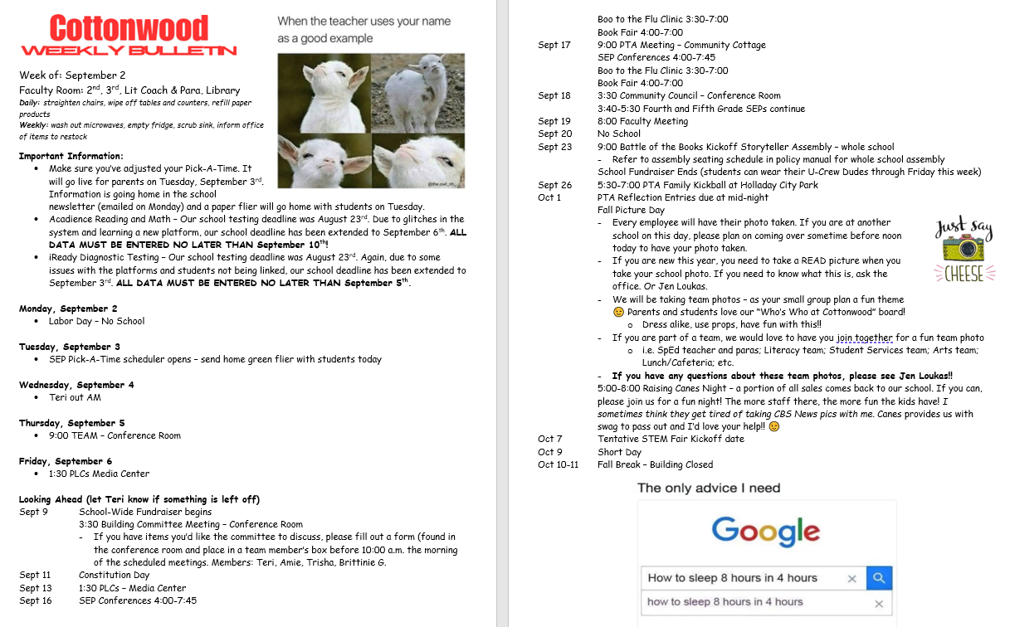
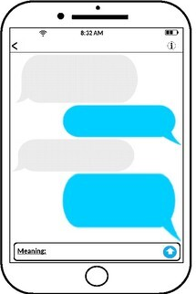


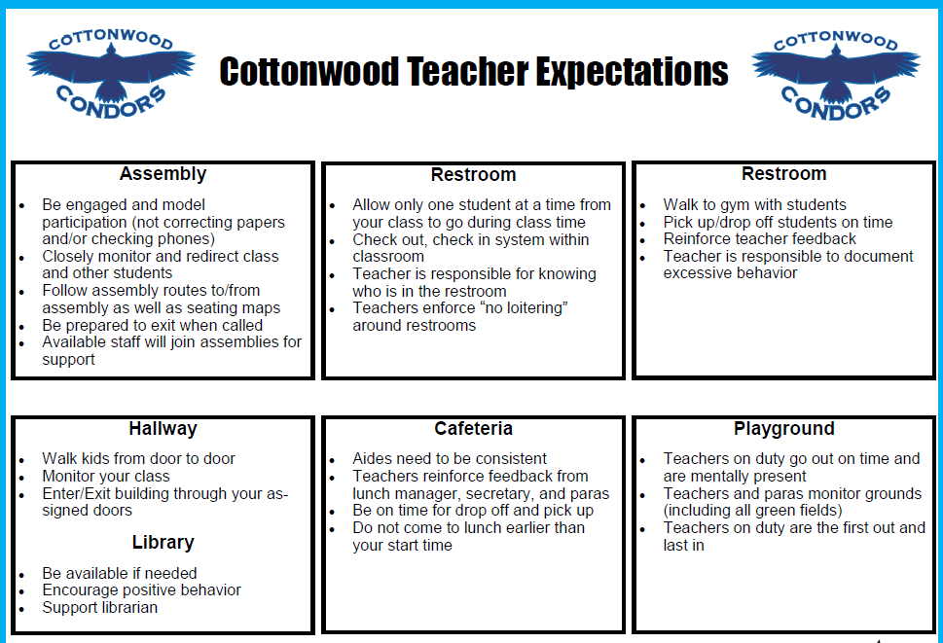

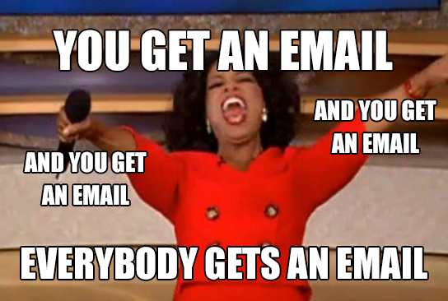
Communication at Cottonwood El. - Faculty
How are these ideas communicated to faculty?
Notes:
Time frame: 5 minutes
Talking points:
An administrator will share out about effective ways they have found to communicate with families
HERE is a link to additional ML supports for communication from the Ed. Equity Department

Slide 25



How do you know?
Surveys:
Stakeholder Input
Community/Family
Anecdotal
Continual Improvement Plan
Notes:
Time frame: 4 minutes
Talking points:
Share ways that they can know they are having effective communication as well as supporting faculty/staff with having effective communication
PG&E goals, surveys, CIP goals, TFI data, Panorama surveys

Slide 26
Gallery Walk
Please hang your posters around the room and spend the next 5 minutes walking around and looking at other ideas from your colleagues
Notes:
Time frame: 5 minutes
Talking points:
Share Gallery Walk expectations

Slide 27
Feedback
Survey Link

