Slide 1

Welcome to My Classes
Enter Presenter’s Name
Replace with your school logo
Notes:
NOTE TO SPEAKER: Anything that is red on the slides or in the speaker notes is meant for you to personalize/remove based on your school’s needs. Additionally, you can hide any slides that do not pertain to your school’s My Classes setup.
Audience: Teachers
Speaker Notes:
Welcome, everyone! Today, we’re going to take a look at how My Classes can make everyday classroom routines easier for both you and your students. You’ll see how this tool helps students quickly find the right resources, view class announcements, and participate in discussions. We’ll also walk through how you can troubleshoot common student login issues, so you feel ready to use My Classes with confidence from day one.

Slide 2
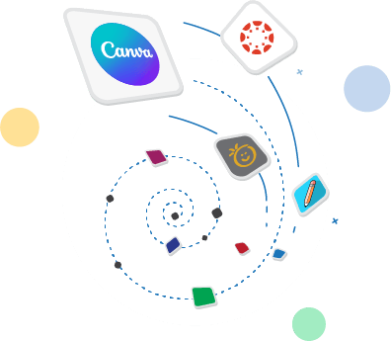
Agenda
1
My Classes Overview
2
Teacher View
3
Student View
Notes:
Speaker Notes:
My Classes gives you one easy place to organize resources, share class updates, and support students throughout the day. We’ll start with a quick overview of what My Classes can do, then take a closer look at both the teacher and student views.
Resources
Explore My Classes – This article highlights the key features of My Classes.
Quick Guide for Instructors – A handy reference guide designed for teachers navigating their new dashboard.

Slide 3
My Classes Overview
Notes:
Speaker Notes:
First, let’s set the stage. My Classes gives you a dedicated space inside LaunchPad for each class you teach.
Resources
Explore My Classes – This article highlights the key features of My Classes.
Explore My Classes (Explora Mis Clases) - Help Article - Spanish version.

Slide 4
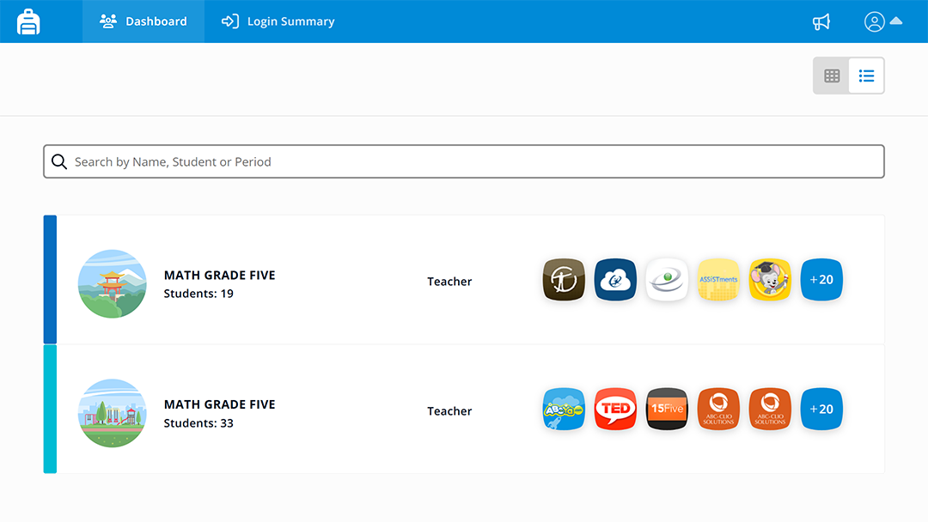
What Is My Classes?
Your hub for class apps, announcements, and discussions.
Notes:
Speaker Notes (Edit any text in RED to meet your school needs)
Think of My Classes as a central hub for each class. Students can quickly find the apps they need, and you can keep them informed with announcements and discussions. You can also help students with QuickCards and password tools right from the same place when enabled.
Resources
3.1 My Classes Tour - Learn what My Classes is and how it helps teachers organize class resources, communication, and student access data.
Quick Guide for Instructors – A handy reference guide designed for teachers navigating their new dashboard.

Slide 5
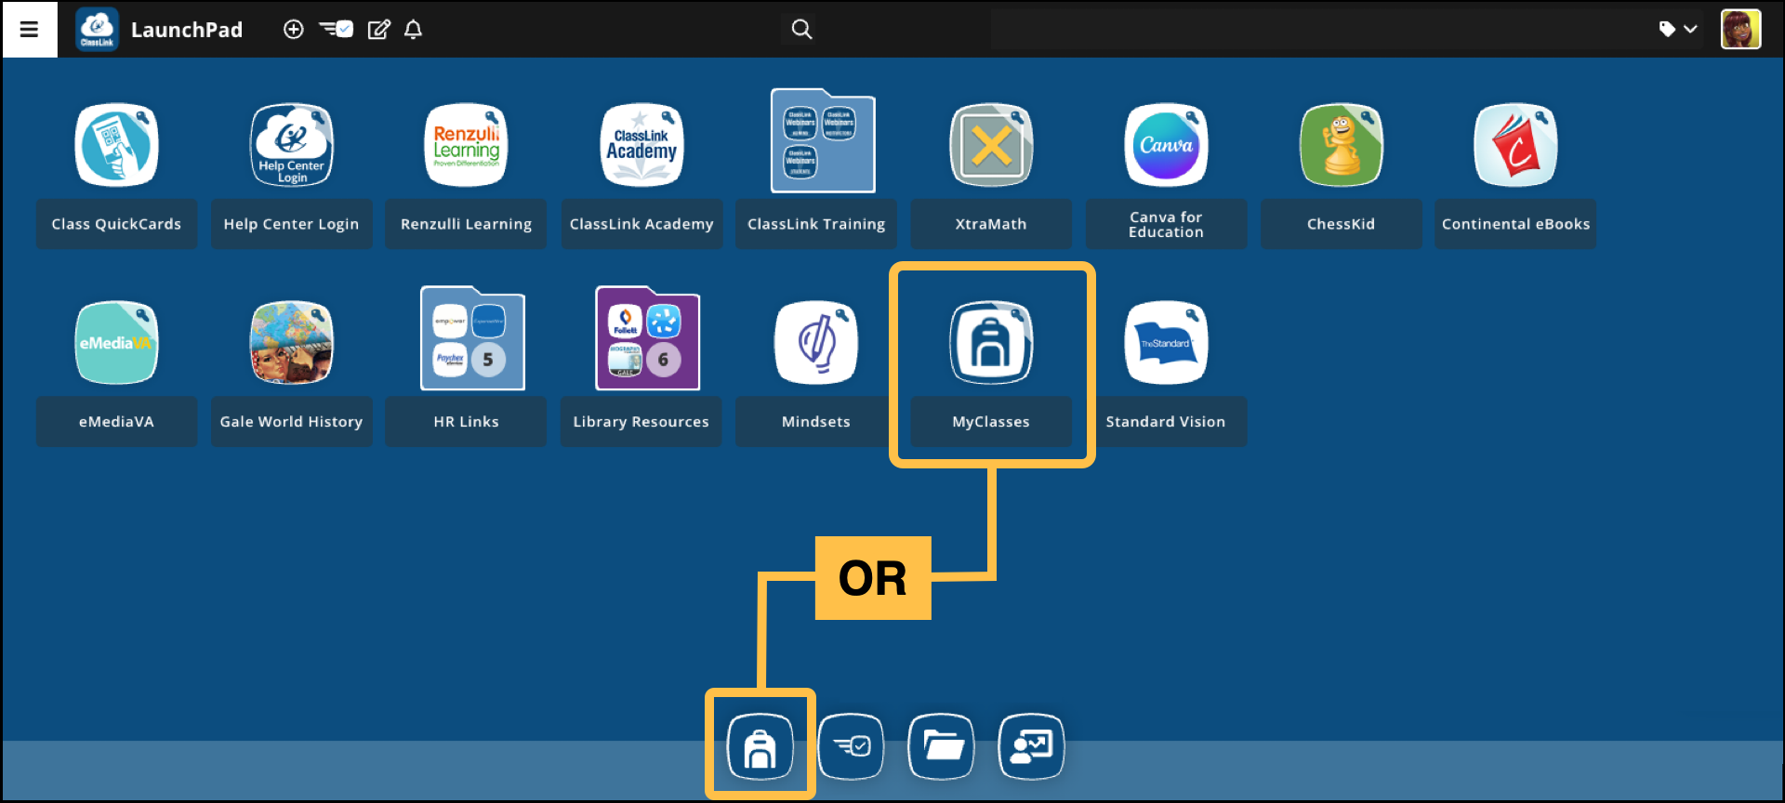
Launch My Classes
Notes:
Speaker Notes:
After you open your LaunchPad, look for the Backpack icon in your ClassLink Favorites Bar or the Backpack in your list of apps.
Resources
My Classes Overview Video - Quick overview of how to access My Classes and what it contains.

Slide 6
My Classes:
Teacher View
Notes:
Speaker Notes:
Let's take a look at the teacher view first, and then we'll switch over to the student experience.
Resources
3.1 My Classes Tour - Learn what My Classes is and how it helps teachers organize class resources, communication, and student access data. You’ll get a quick look at the main tools and how they support your class.

Slide 7
My Classes Dashboard
Notes:
Speaker Notes:
Let’s start with the My Classes Dashboard, where you will see your classes, the number of students in each class, and your class apps.
Resources
Explore My Classes – This article highlights the key features of My Classes.
Quick Guide for Instructors – A handy reference guide designed for teachers navigating their new dashboard.

Slide 8
Navigation Bar
Notes:
Speaker Notes:
At the top of My Classes, the navigation bar helps you move around quickly. You can use it to get back to your Dashboard, check the Login Summary, view Announcements, or open your Profile menu.
Resources
My Classes Overview - A short video on how to access My Classes and what it contains.

Slide 9
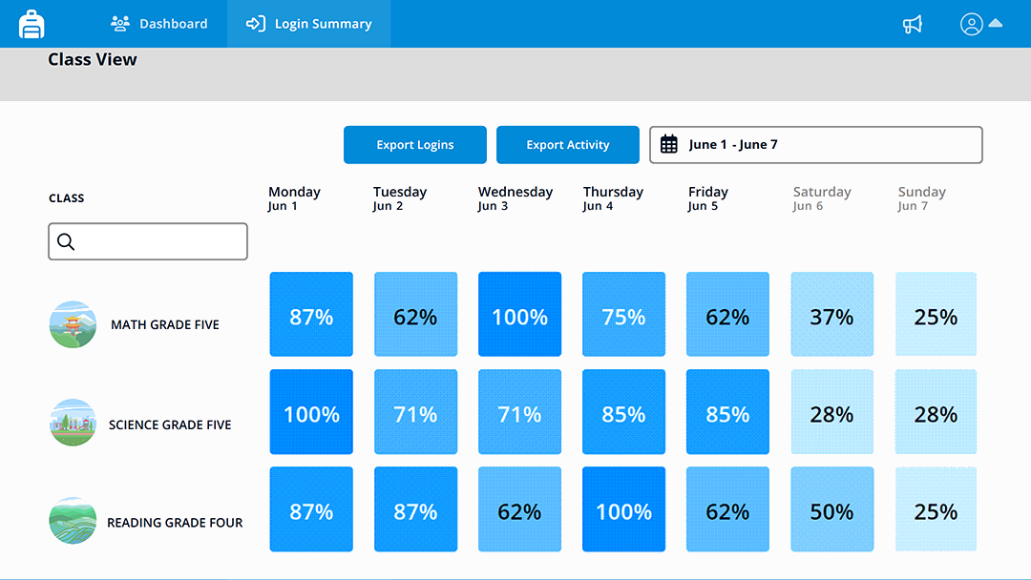
Login Summary
Notes:
Speaker Notes:
Next, let’s look at Login Summary which gives you a quick view of student activity across your classes. You can see daily login data, which makes it easier to spot patterns. For example, you might notice a class that needs a reminder to log in, or see that access has been steady throughout the week.
It’s a simple way to check, “Are my students getting where they need to go?”
Resources
Explore My Classes – This article highlights the key features of My Classes.

Slide 10
Announcements
Notes:
Speaker Notes:
The Announcements tool, represented by the bullhorn icon, lets you create a new announcement or review announcements you have already posted. We’ll explore creating announcements later.
Resources
3.4 Announcements in My Classes - Learn how to use Announcements in My Classes to share clear updates, reminders, and class information with students. You’ll see how announcements help keep students informed and focused.

Slide 11
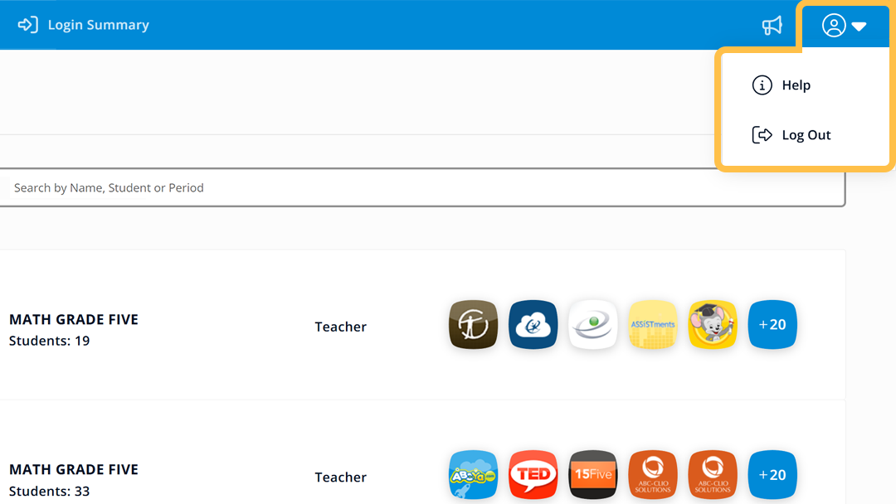
Profile
Notes:
Speaker Notes:
The Profile icon is where you’ll find your personal account options. From here, you can access ClassLink help resources or securely sign out at the end of your session.
Resources
My Classes Overview - A short video on how to access My Classes and what it contains.
Explore My Classes - This article highlights the key features of My Classes.

Slide 12
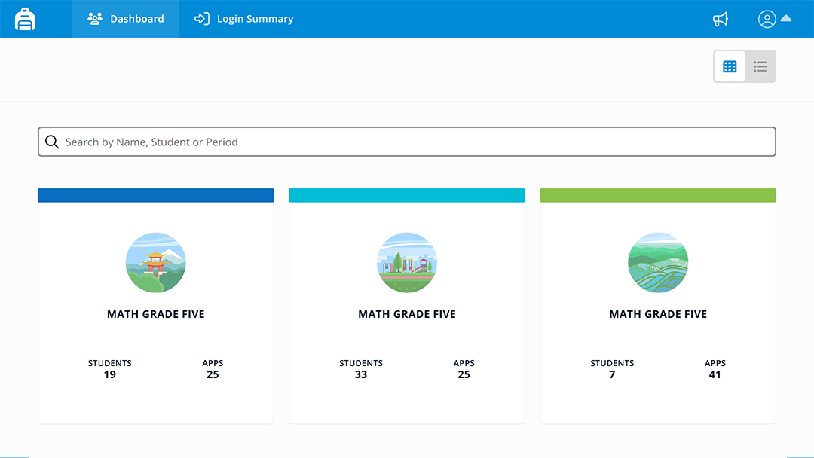
Dashboard View
Tile
List
Notes:
Speaker Notes:
You can switch your dashboard layout based on whatever style works best for you. Tile view offers a more visual layout, while List view gives you a detailed, line-by-line view of your information.
This change only affects your personal display, so choose the view you prefer. It won’t change what students see.
Resources
3.1 My Classes Tour - Learn what My Classes is and how it helps teachers organize class resources, communication, and student access data. You’ll get a quick look at the main tools and how they support your class.
Explore My Classes - This article highlights the key features of My Classes.

Slide 13
Search Bar
Notes:
Speaker Notes:
The search bar helps you quickly find what you need. Type a class name, student name, or keyword, and results start to appear right away.
Resources
My Classes Overview - A short video on how to access My Classes and what it contains.

Slide 14
Access a Class
Notes:
Speaker Notes:
Next, let’s take a closer look at what’s available for individual classes. From the My Classes Dashboard, select any class to open its page.
Resources
My Classes Overview - A short video on how to access My Classes and what it contains.
Explore My Classes – This article highlights the key features of My Classes.

Slide 15
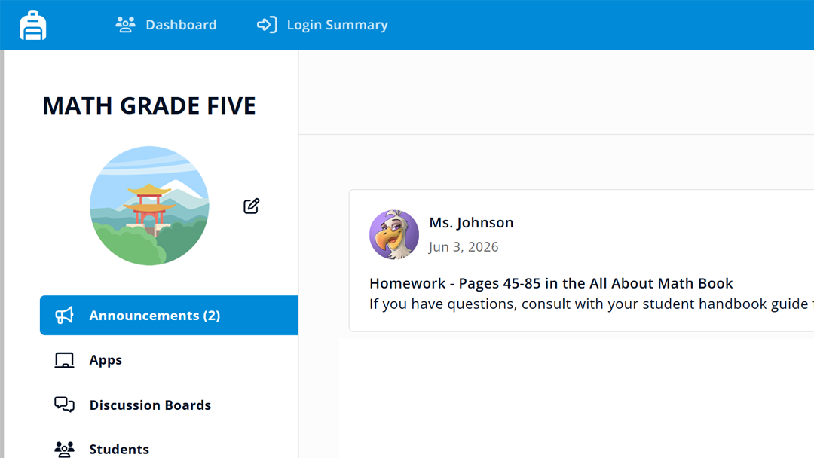
Customize Name and Icon
Notes:
Speaker Notes:
If you don’t allow an option, remove it from the paragraph below.
Each class page displays the tools and details for that class. At the top, you’ll see the class name and edit icon. This is where you can personalize the class by updating the name, choosing an icon, and selecting an accent color. It’s a quick way to make each class stand out.
Resources
3.1 My Classes Tour - Learn what My Classes is and how it helps teachers organize class resources, communication, and student access data.

Slide 16
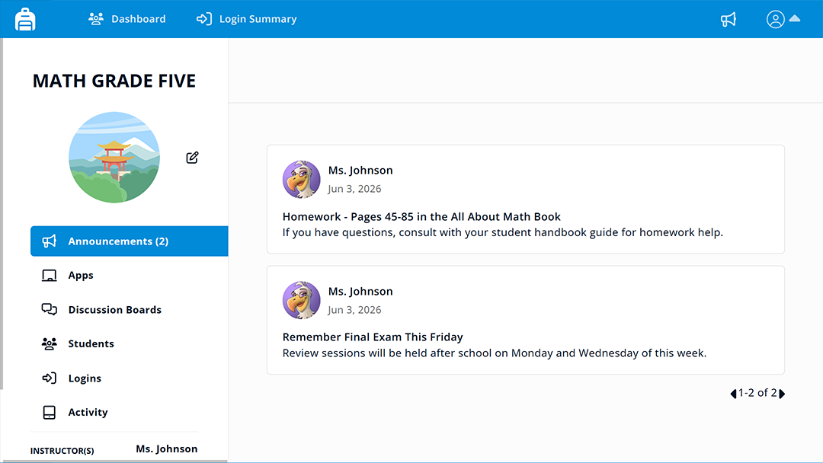
Announcements
Hide this slide if you don’t allow this action. If using this action, remove this text box.
Notes:
Speaker Notes:
Hide this slide if announcements are not enabled for your school.
When students open your class, the first thing they’ll see is your announcements. This makes it the perfect space for daily reminders, project due dates, or weekly tasks.
Resources
3.4 Announcements in My Classes - Learn how to use Announcements in My Classes to share clear updates, reminders, and class information with students. You’ll see how announcements help keep students informed and focused.

Slide 17
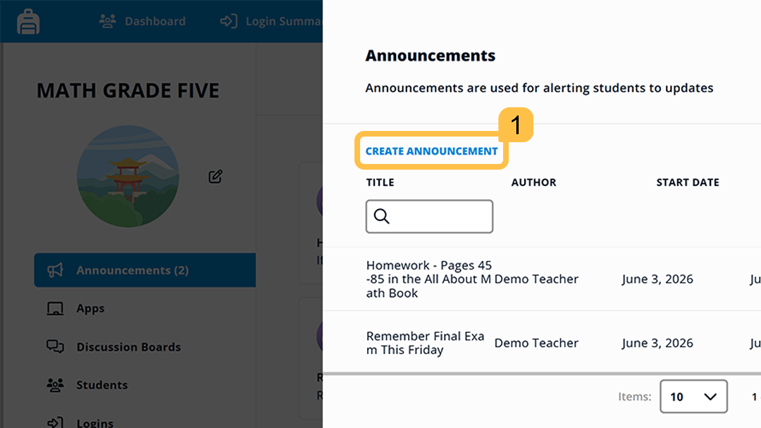
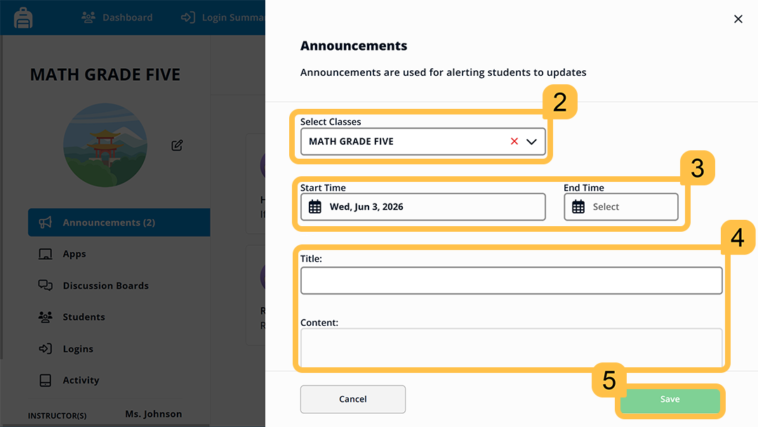
Create an Announcement
Hide this slide if you don’t allow this action. If using this action, remove this text box.
Notes:
Speaker Notes:
Hide this slide if announcements are not enabled for your school.
When you’re ready to share an update, select Create Announcement. From there, enter a title and message, choose which class or classes should see it, and set the dates for when it should start and end. After a quick final check, select Save, and your announcement is ready to go.
Resources
3.4 Announcements in My Classes - Learn how to use Announcements in My Classes to share clear updates, reminders, and class information with students. You’ll see how announcements help keep students informed and focused.

Slide 18
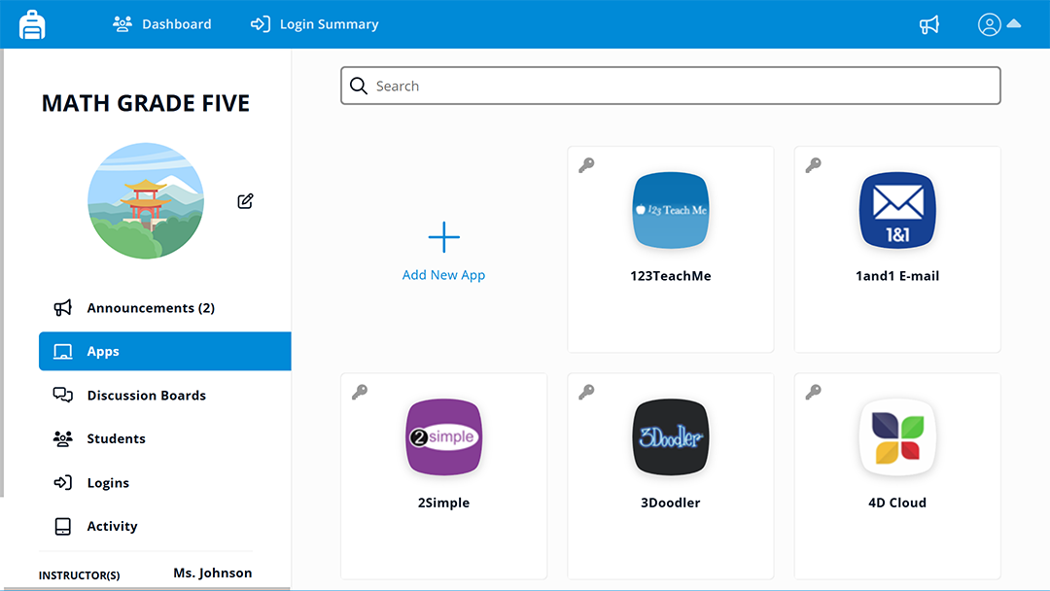
Apps
Notes:
Speaker Notes:
Next, select Apps from the class page to see the resources connected to that class. If you see a padlock on an app, that means it was added by the school or district, and you can’t remove the app.
💡 One quick note: apps in My Classes may look like LaunchPad apps, but they don’t have any of the right click menu options.
Resources:
3.3 Applications in My Classes - Learn how to manage class apps in My Classes so students can find the right resources faster. You’ll see how to add apps, use custom links, and keep each class space focused on the tools students need.

Slide 19
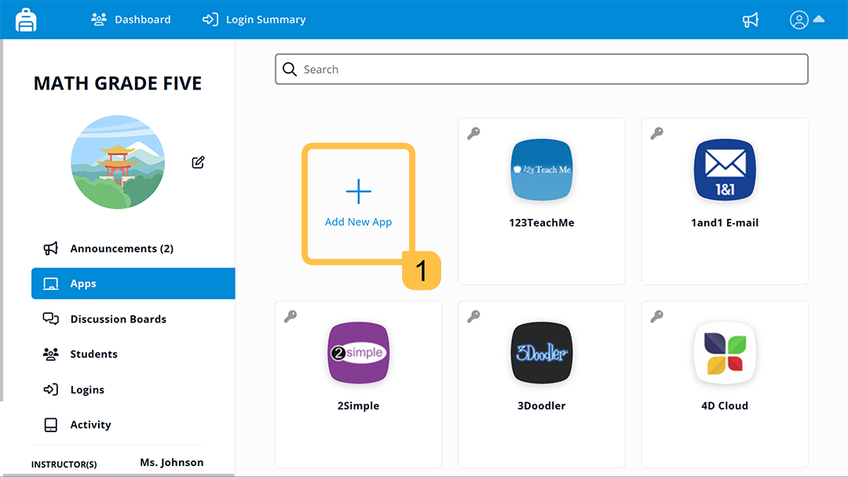
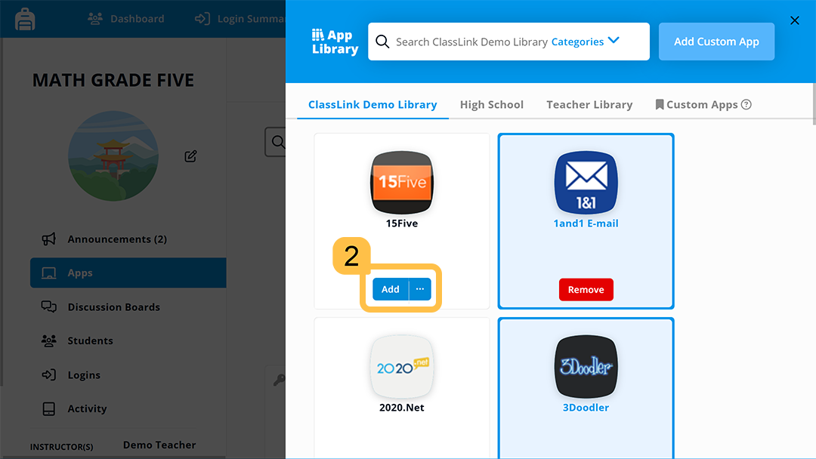
Add Apps
Notes:
Speaker Notes:
You can add your own apps to your classes. Select + Add New App, find the app you want, and select Add. The great thing is that you can add the app to one or more classes at the same time.
Resources
3.3 Applications in My Classes - Learn how to add and manage apps in My Classes so students can find the right resources faster.

Slide 20
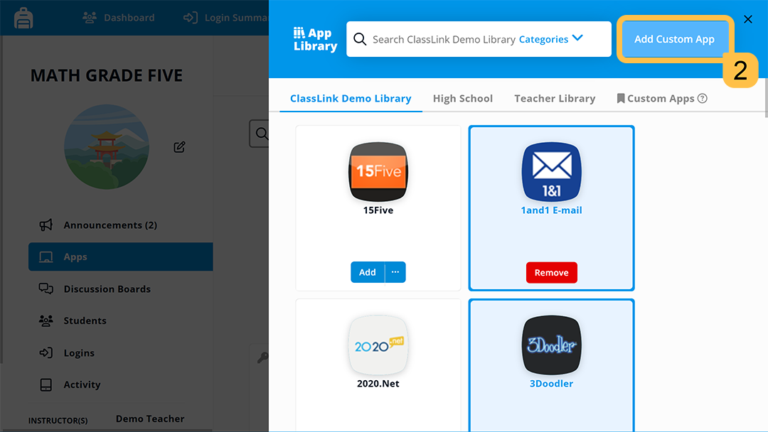
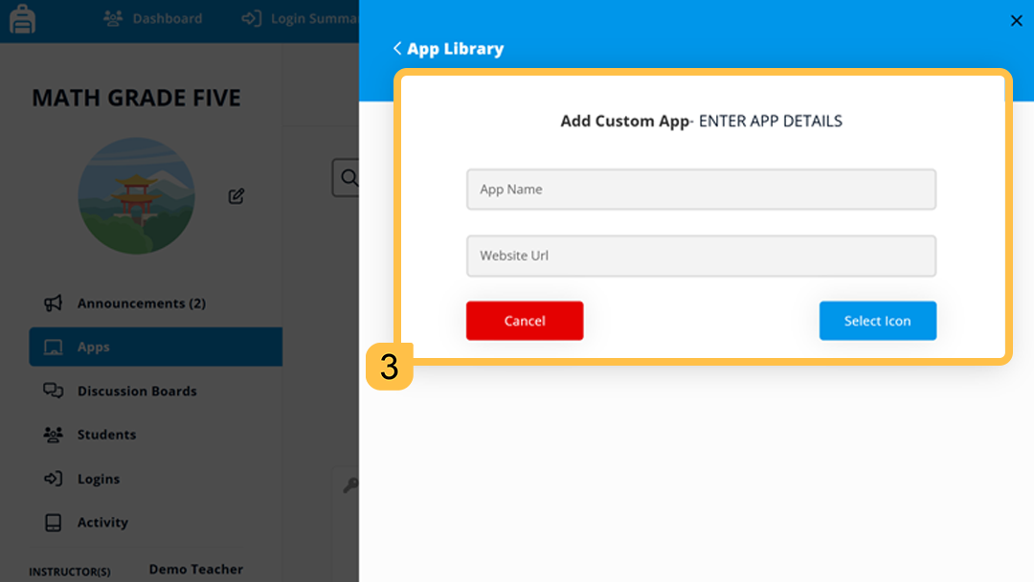
Add Custom Apps
Notes:
Speaker Notes:
You can also add a resource that is not already in the App Library by creating a custom app. Select + Add New App, choose the option to add a custom app, and paste in the website link. This is a great option for class websites, online articles, videos, forms, or other links students need. After you add it, students can find it right alongside their other class apps.
Resources
3.3 Applications in My Classes - Learn how to add and manage apps in My Classes so students can find the right resources faster.

Slide 21
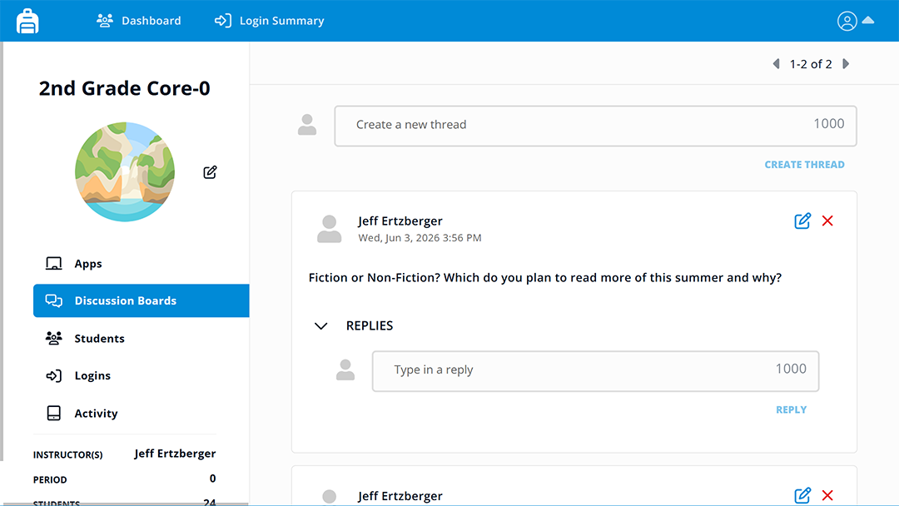
Discussion Boards
Hide this slide if you don’t allow this action. If using this action, remove this text box.
Notes:
Speaker Notes:
Hide this slide if discussions are not enabled for your school.
Next, you’ll find Discussion Boards. You can use these to post questions, reflection prompts, quick check-ins, or a place for students to ask for class support. These prompts are plain text, so you won’t be able to add images, links, or videos directly in the prompt.
Resources
Use My Classes Discussion Boards - Help Article
3.5 Discussion Boards in My Classes - Learn how to use Discussion Boards in My Classes to build class community and support student conversations. You’ll see how to create discussion threads, guide student replies, and keep conversations focused.

Slide 22
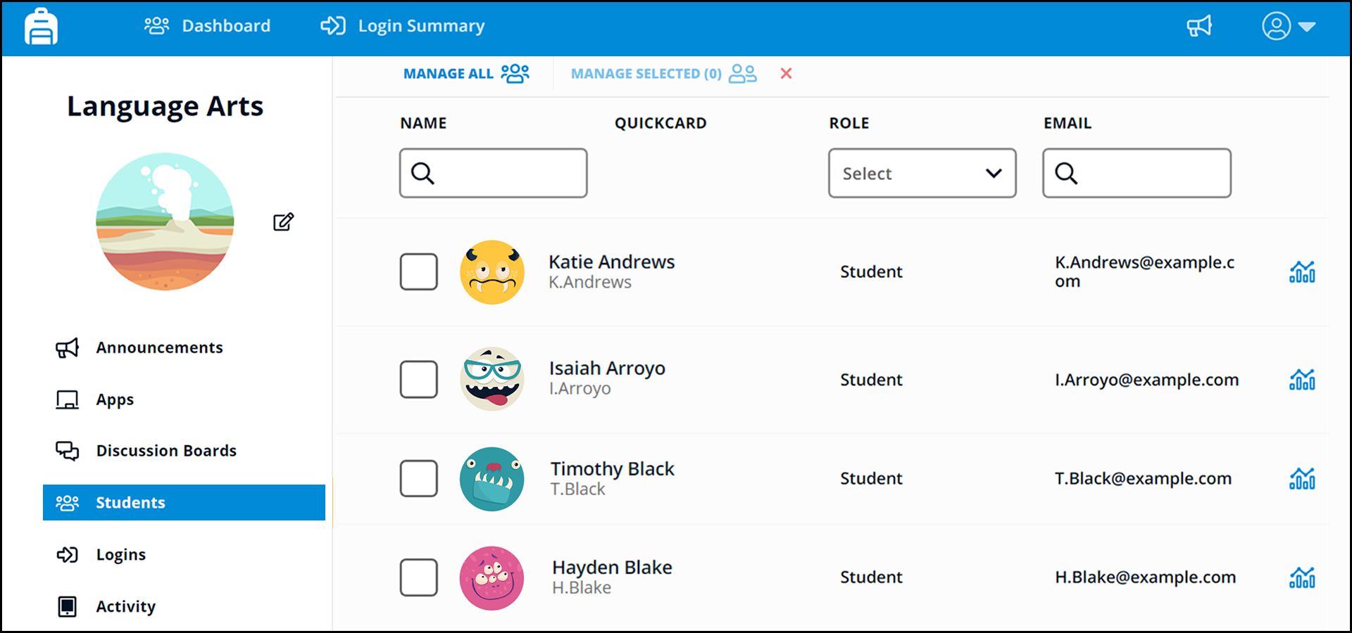
Students
Notes:
Speaker Notes:
The Students section shows you the roster for the class. From here, you can see who is enrolled, check student email addresses, and access student analytics.
Resources:
3.6 My Classes Student-Usage Resources - Learn how to use My Classes student usage data to review logins, app activity, and access patterns. You’ll see how these tools can help support students and guide follow-up.

Slide 23
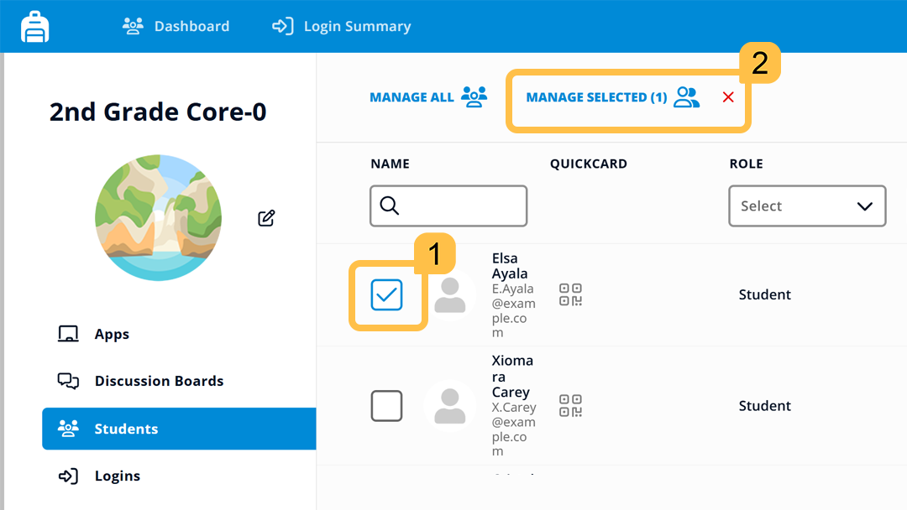
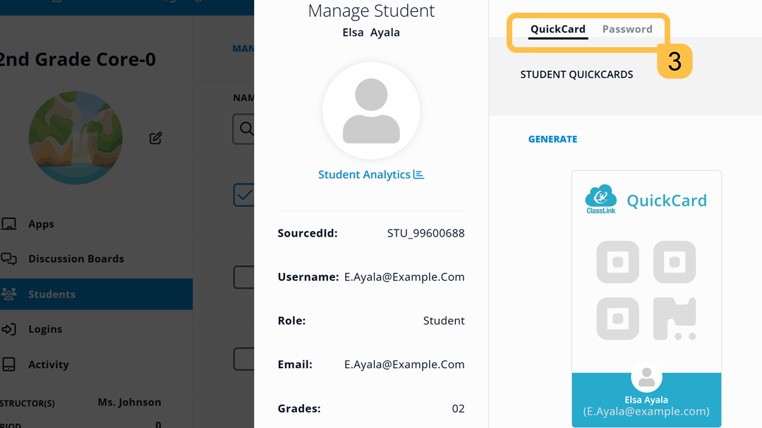
QuickCards and Passwords
Hide slide if you don’t allow this action. If using this action, remove this text box.
Notes:
Speaker Notes:
Access to QuickCards and Passwords may not be enabled by your administrator. If you do not have these tools, you can hide this slide.
One extremely convenient tool in the Students section of My Classes is the ability to print a new QuickCard or reset a student’s password. This can be a big help when a student is stuck at the start of class and needs quick access.
From the student roster, select one or more student(s). Then use the Manage Selected link to open the available support options. From there, you can print a QuickCard or reset a password for a student.
Resources:
Print QuickCards From My Classes - Watch to learn how to print QuickCards from My Classes.
Reset student passwords in My Classes - This video goes through the process of resetting student passwords inside of My Classes.
Generate and Manage QuickCards From My Classes - Help Article.

Slide 24
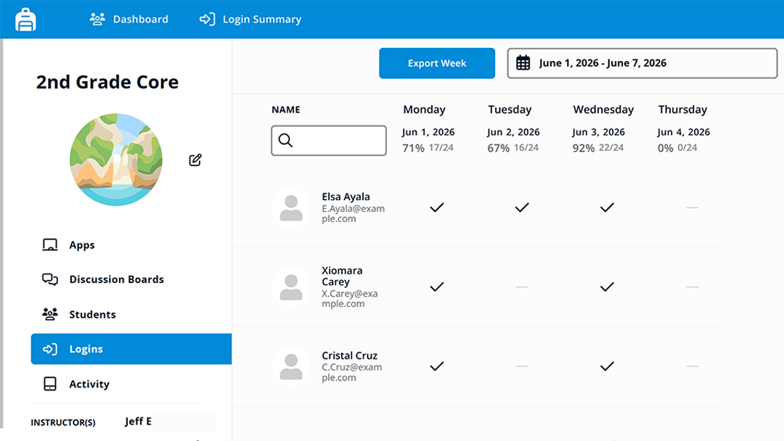
Logins
Notes:
Speaker Notes:
Logins gives you a quick daily view of who logged in to ClassLink. You’ll see checkmarks for students who logged in and dashes for students who did not. This can help when you want to spot access issues or follow up with a student who may need help.
Resources
3.6 My Classes Student-Usage Resources - Learn how to use My Classes student usage data to review logins, app activity, and access patterns. You’ll see how these tools can help support students and guide follow-up.

Slide 25
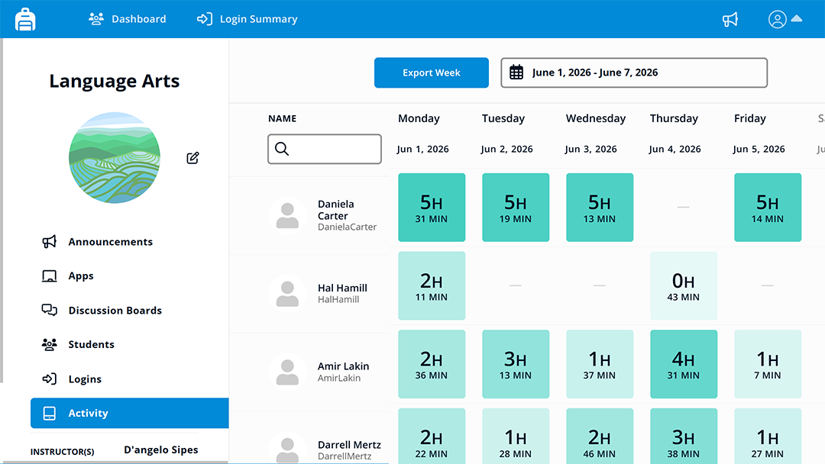
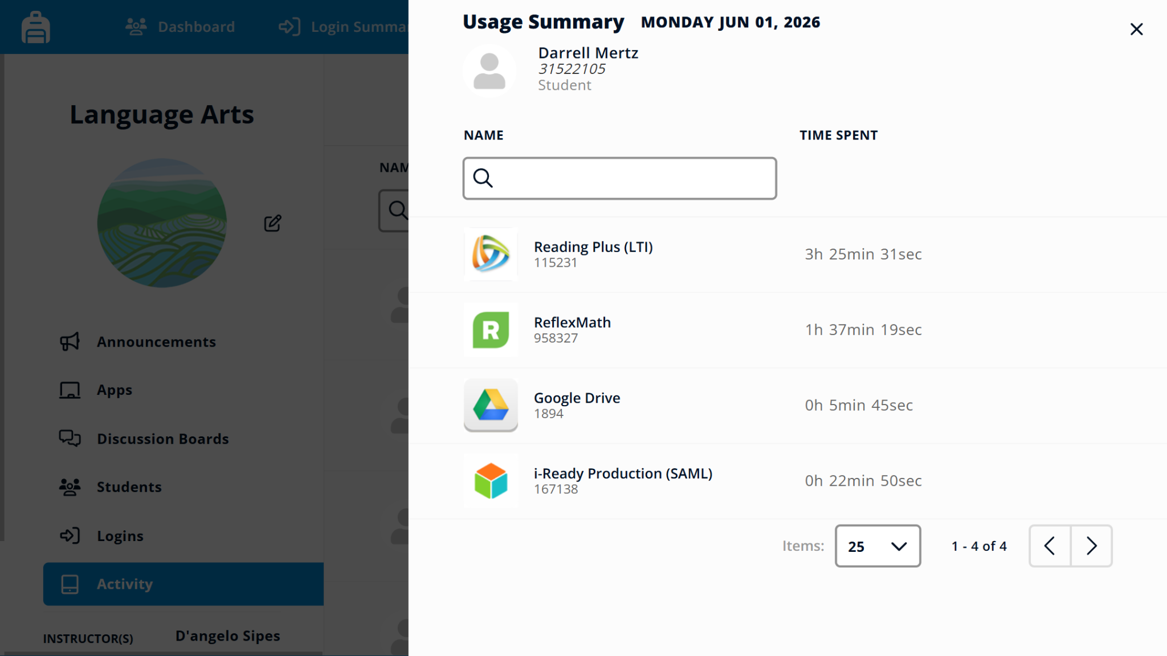
Activity
Notes:
Speaker Notes:
Activity gives you a closer look at student app use. You can see how much time students spent in apps and click into a day for more detail. This is not meant to replace what you already know as the teacher, but it can give you another helpful clue when a student says, “I couldn’t get in,” or when you want to better understand how students are using their digital resources.
Resources
3.6 My Classes Student-Usage Resources - Learn how to use My Classes student usage data to review logins, app activity, and access patterns. You’ll see how these tools can help support students and guide follow-up.

Slide 26
My Classes:
Student View
Notes:
Speaker Notes:
Now that you've taken a closer look at the teacher view, let's check out what students see.

Slide 27
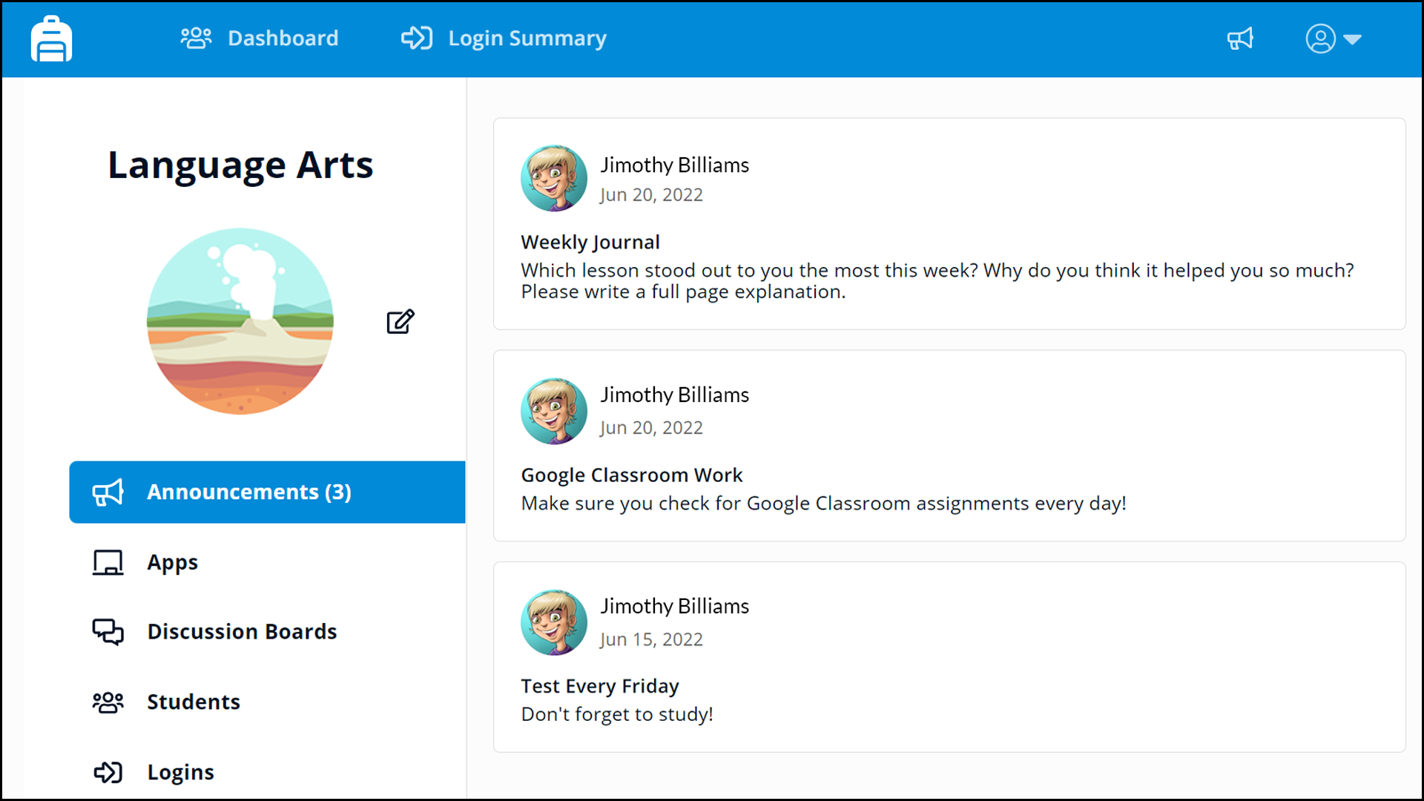
Announcements
Notes:
Speaker Notes:
Announcements are the first thing students see when they open your class in My Classes, so they are a great place for updates, reminders, and due dates.
Resources
3.4 Announcements in My Classes - Learn how to use Announcements in My Classes to share clear updates, reminders, and class information with students. You’ll see how announcements help keep students informed and focused.

Slide 28
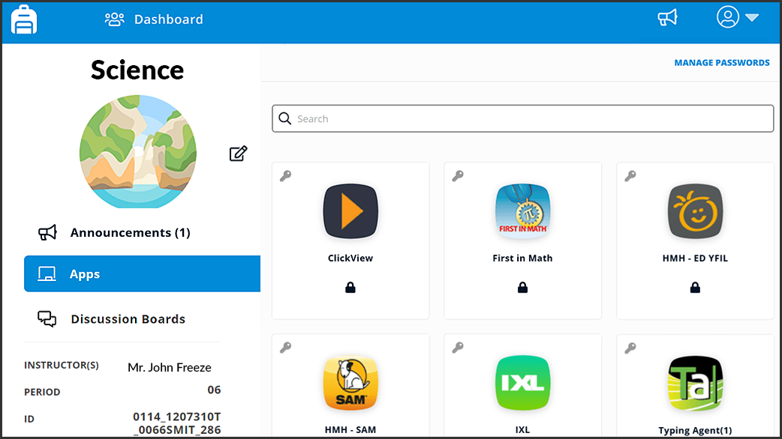
Apps
Notes:
Speaker Notes:
In the Apps tab, students see resources assigned to that class, including apps you add and any locked apps assigned by your school. Students can open assigned apps, but they can’t add or remove apps from the class.
Resources
3.3 Applications in My Classes - Learn how to add and manage apps in My Classes so students can find the right resources faster.

Slide 29
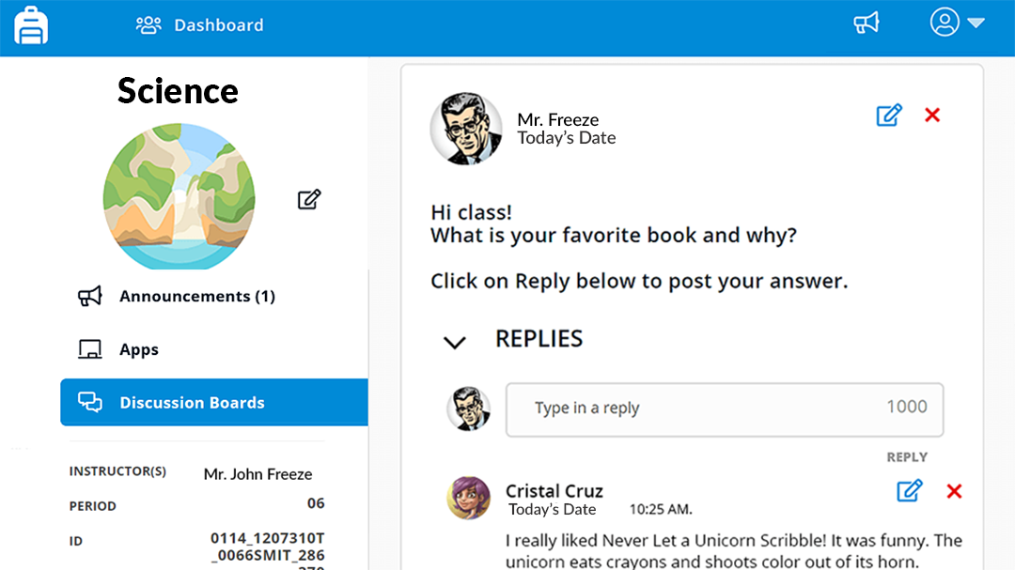
Discussions
Hide this slide if you don’t allow this action. If using this action, remove this text box.
Notes:
Speaker Notes:
Hide this slide if discussions are not enabled for your school.
In Discussions, students can join class conversations, ask questions, and reply to threads you create for that class. This gives students one place for class support and discussion, while you keep the space focused and can remove student posts when needed.
Resources
3.5 Discussion Boards in My Classes - Learn how to use Discussion Boards in My Classes to support class conversations. You’ll see how to create threads, guide replies, and keep student discussions focused.

Slide 30
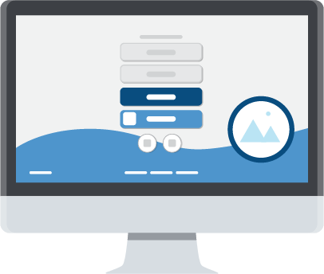
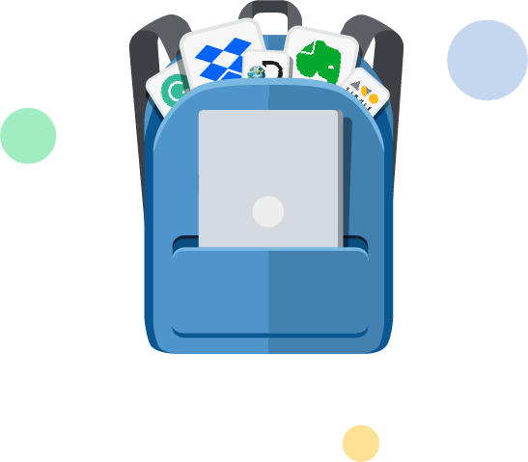
Recap
Organize
Communicate
Support
Keep all your apps for each class together.
Share announcements and guide discussions.
Print QuickCards and reset student passwords, when enabled.
Notes:
Speaker Notes:
As we wrap up, remember that My Classes is meant to make daily class routines easier. You can use it to give students one place for class apps, post updates they can find quickly, and provide quick support when a student may need help.
You do not need to use every feature all at once. Start small. Pick one class, add the resources students use most, and try one announcement this week. Once that feels comfortable, the rest of My Classes becomes much easier to build into your normal routine.
Resources
3.1 My Classes Tour - Learn what My Classes is and how it helps teachers organize class resources, communication, and student access data.

Slide 31
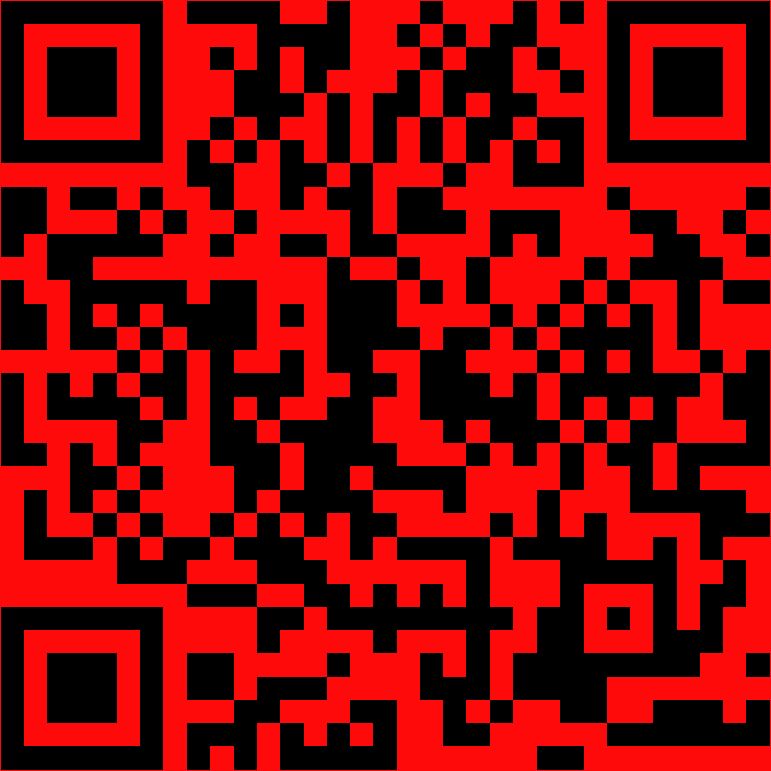
Thank You
Notes:
Replace the QR with one of your own that takes learners to a survey to gain feedback on this presentation.

