Slide 1

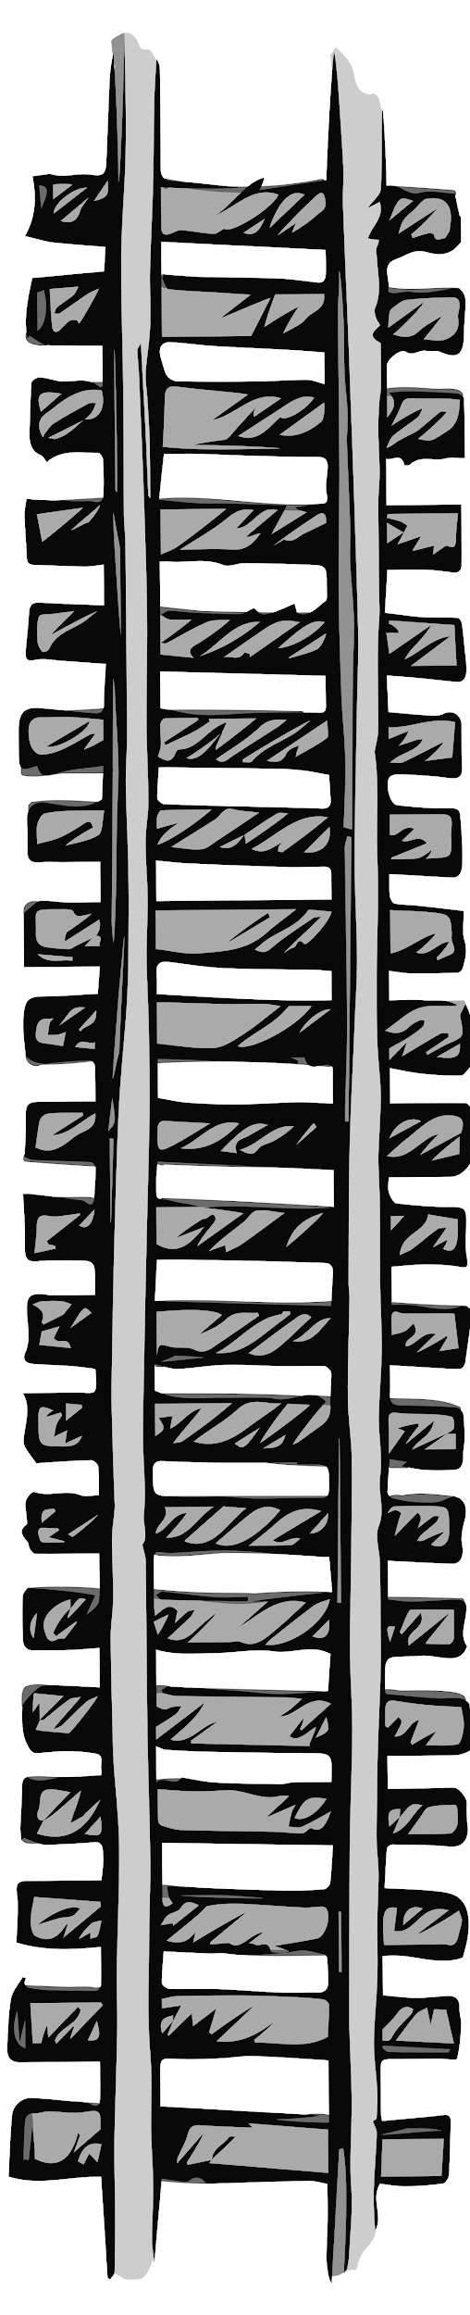


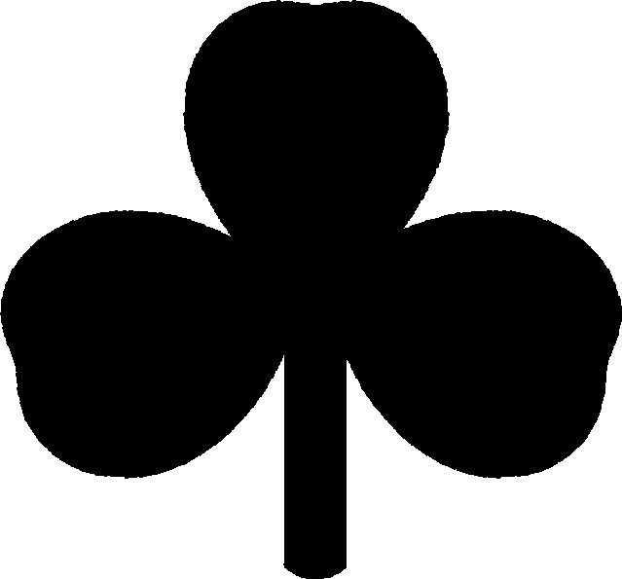
Valley
Valley
Why is the first hill of a roller coaster
always the highest?
Track A
Name: _______________
(Klunk)
Klunk’s Track
Notes:
Paperclip credit: https://www.shutterstock.com/image-vector/paperclip-office-vector-1041653890

Slide 2
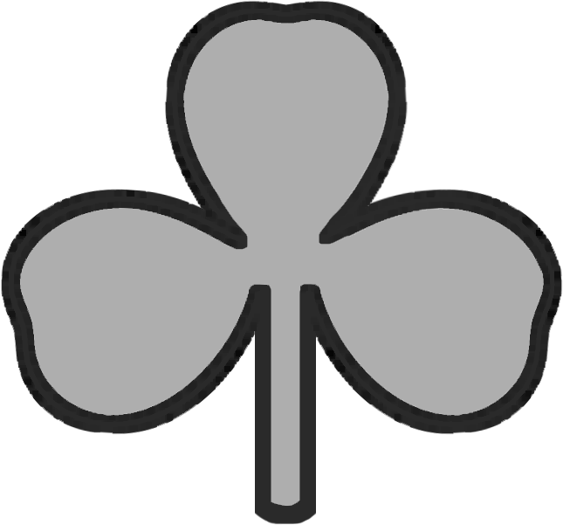

Hill
Hill
Boom’s Track
Track B
(Boom)
Name: ________________
Why is the first hill of a roller coaster
always the highest?
Notes:
Paperclip credit: https://www.shutterstock.com/image-vector/paperclip-office-vector-1041653890

Slide 3
Valley
Valley
Why is the first hill of a roller coaster
always the highest?
Track C
Name: _______________
(Crash)
Crash’s Track
Notes:
Paperclip credit: https://www.shutterstock.com/image-vector/paperclip-office-vector-1041653890

Slide 4
Hill
Hill
Pow’s Track
Track D
(Pow)
Name: __________________
Why is the first hill of a roller coaster
always the highest?
GOAL! GOAL! GOAL!
Notes:
Paperclip credit: https://www.shutterstock.com/image-vector/paperclip-office-vector-1041653890

