Slide 1


GRAPE WINE
Presentation Template
www.freepptbackgrounds.net

Slide 2
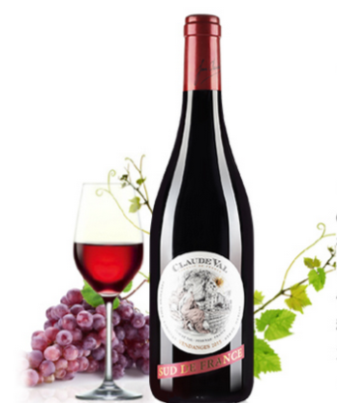
Base
Business
A complex idea can be conveyed with just a single still image, namely making it possible to absorb large amounts of data quickly.

Slide 3




Enterprise
Customer
Defined Focused user Acquisition Strategy

Slide 4
Organic
Social Media
Conferences and Events

Slide 5



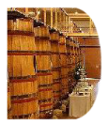
Our Service
Powerpoint
Easy to change colors, photos and Text.
Web Design
Keynote
Development
Infographic

Slide 6
Circle Infographic
Meet our Team
1
2
3
4
Solutions
Web
Design
Devices
Click on the button
under the
presentation
Get a modern
PowerPoint
Presentation
Click on the button
under the
presentation
Get a modern
PowerPoint
Presentation

Slide 7
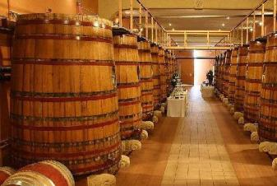

Infographics
You have to be signed in to your Google account.
Click on the button under the presentation preview that says "Use as Google Slides Theme.
Opening Cerenomy
Speakers Introduction
Opening
Break
Free

Slide 8


Speakers
Speakers Introduction
Is the color of gold, butter and ripe lemons. In the spectrum of visible light, yellow is found between green and orange.

Slide 9
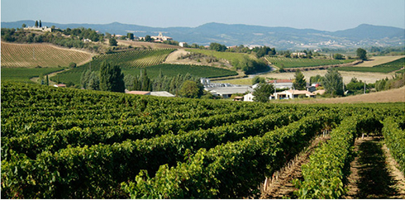
Mission & Vision
Our Values
We use well-known development methodologies to create a customized approach for each of the projects.

Slide 10

About us
Annual Meeting
We use well-known development methodologies to create a customized approach for each of the projects.
Conferences

Slide 11
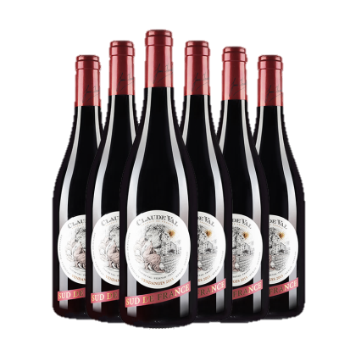
Transport
Suggest
Qality
%100
Pure
Delicious

Slide 12
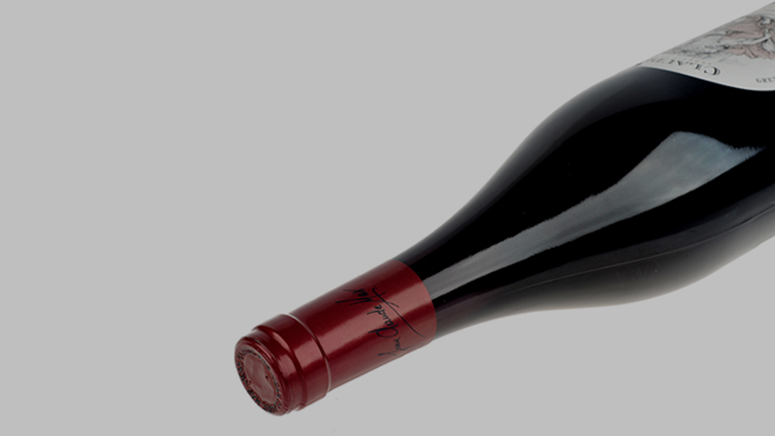
Split
Skills
This allows us to achieve high quality
outcomes and full transparency towards.

Slide 13
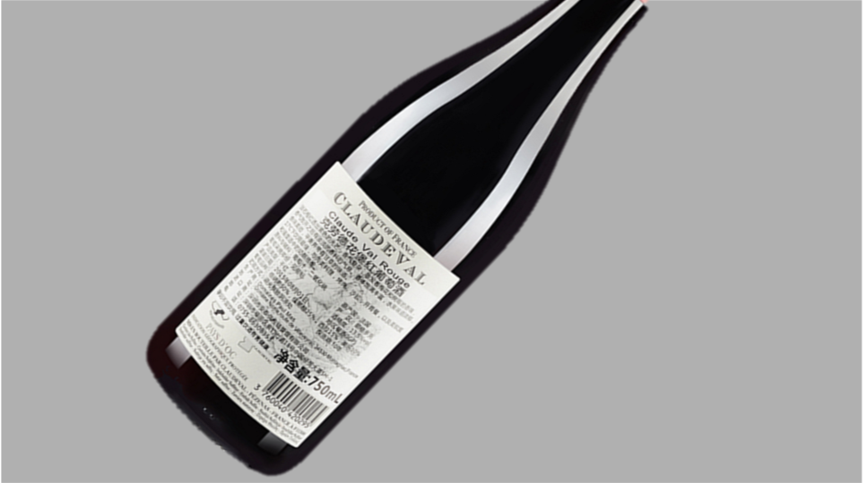
Share
Signature
We press play on your digital story. Using conceptual,
digital design, we work with you to build experiences
that feel 'right' for your users.

Slide 14
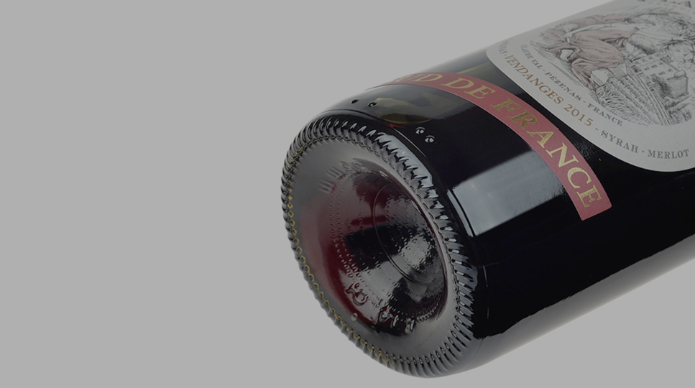
Send
Schedule
We press play on your digital story. Using conceptual,
digital design, we work with you to build experiences
that feel 'right' for your users.

Slide 15

Lanage
Lower
Moving from creative ideas to solid strategy and
execution, we help your target market resonate
fully with your brand. When you get them, they
will get you, quicker.

Slide 16
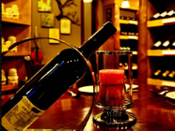

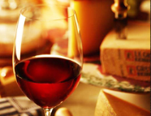
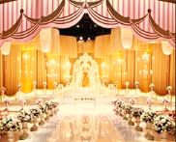
Occupation
Accept
2
4
Simple & Smooth, exactly how purchasing experiences
We leverage digital tools, design and words, to
1
3
Simple & Smooth, exactly how purchasing experiences
We leverage digital tools, design and

Slide 17
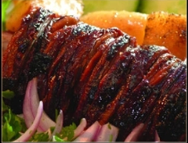
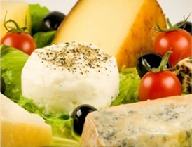
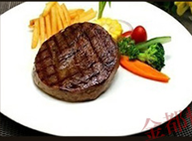
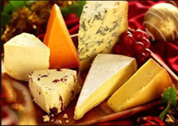
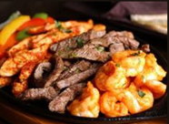
Add

Slide 18
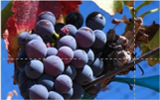
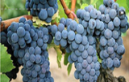
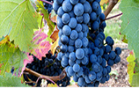
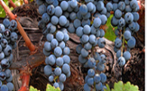
Advertisement
Advise
Sometimes it's easier to go old school, our copywriters prefer a good ball.
Agenda
Your audience relate and absorb information on different sensory levels. We know visual stories are amplified with the right words
Apply
Your audience relate and absorb information on different sensory levels. We know visual stories are amplified with the right words
Approve
The user can demonstrate on a projector or computer, or print the presentation and make it into a film to be used in a wider field. Using PowerPoint

Slide 19

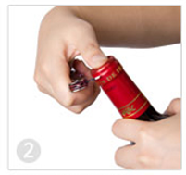
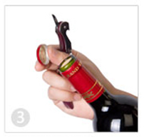
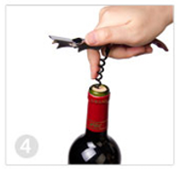
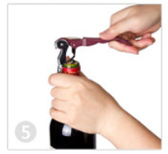
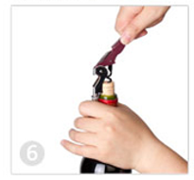
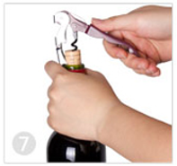
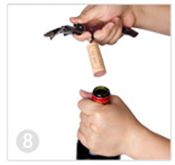
Authorize
The user can make
a presentation
It is a very sad thing that
We certainly do not forget
I believe that people
Your audience relate
The user can demonstrate
The user can make
Enter the comprehensive

Slide 20



Complain
I believe that people would be alive today if there were
The time is now, the place is here.
I believe that people would be alive today if there were
Color
Bouquet
Wine tasting
The time is now, the place is here. Stay in the present. You can do nothing to change the past, and the future will never come exactly as you
Genius hath electric power which earth can never tame. Lydia M. Child
The time is now, the place is here. Stay in the present. You can do nothing to change the past, and the future will never come exactly as you

Slide 21





Competition
Cancel 10-18℃
Genius hath electric power which earth can never tame. Lydia M. Child
Calculate
I feel very strongly that change is good because it stirs up the system. Ann Richards
Certification 60-80%
A large income is the best recipe for happiness I ever heard of. Mansfield Park
Comparison
Genius hath electric power which earth can never tame. Lydia M. Child
Choose
I feel very strongly that change is good because it stirs up the system. Ann Richards
Commission
A large income is the best recipe for happiness I ever heard of. Mansfield Park

Slide 22
THANK YOU !
Grape Wine Presentation
www.freepptbackgrounds.net

