Slide 1

Towards an integrated sensor system control for direct laser melting
Michele LANZETTA, Francesco MORANTE
University of Pisa Italy Department of Civil and Industrial Engineering
This presentation: www.lanzetta.unipi.it/research/am

Slide 2

Towards an integrated sensor system control for direct laser melting
DEFECTS ANALYSIS AND MONITORING STRATEGIES

Slide 3
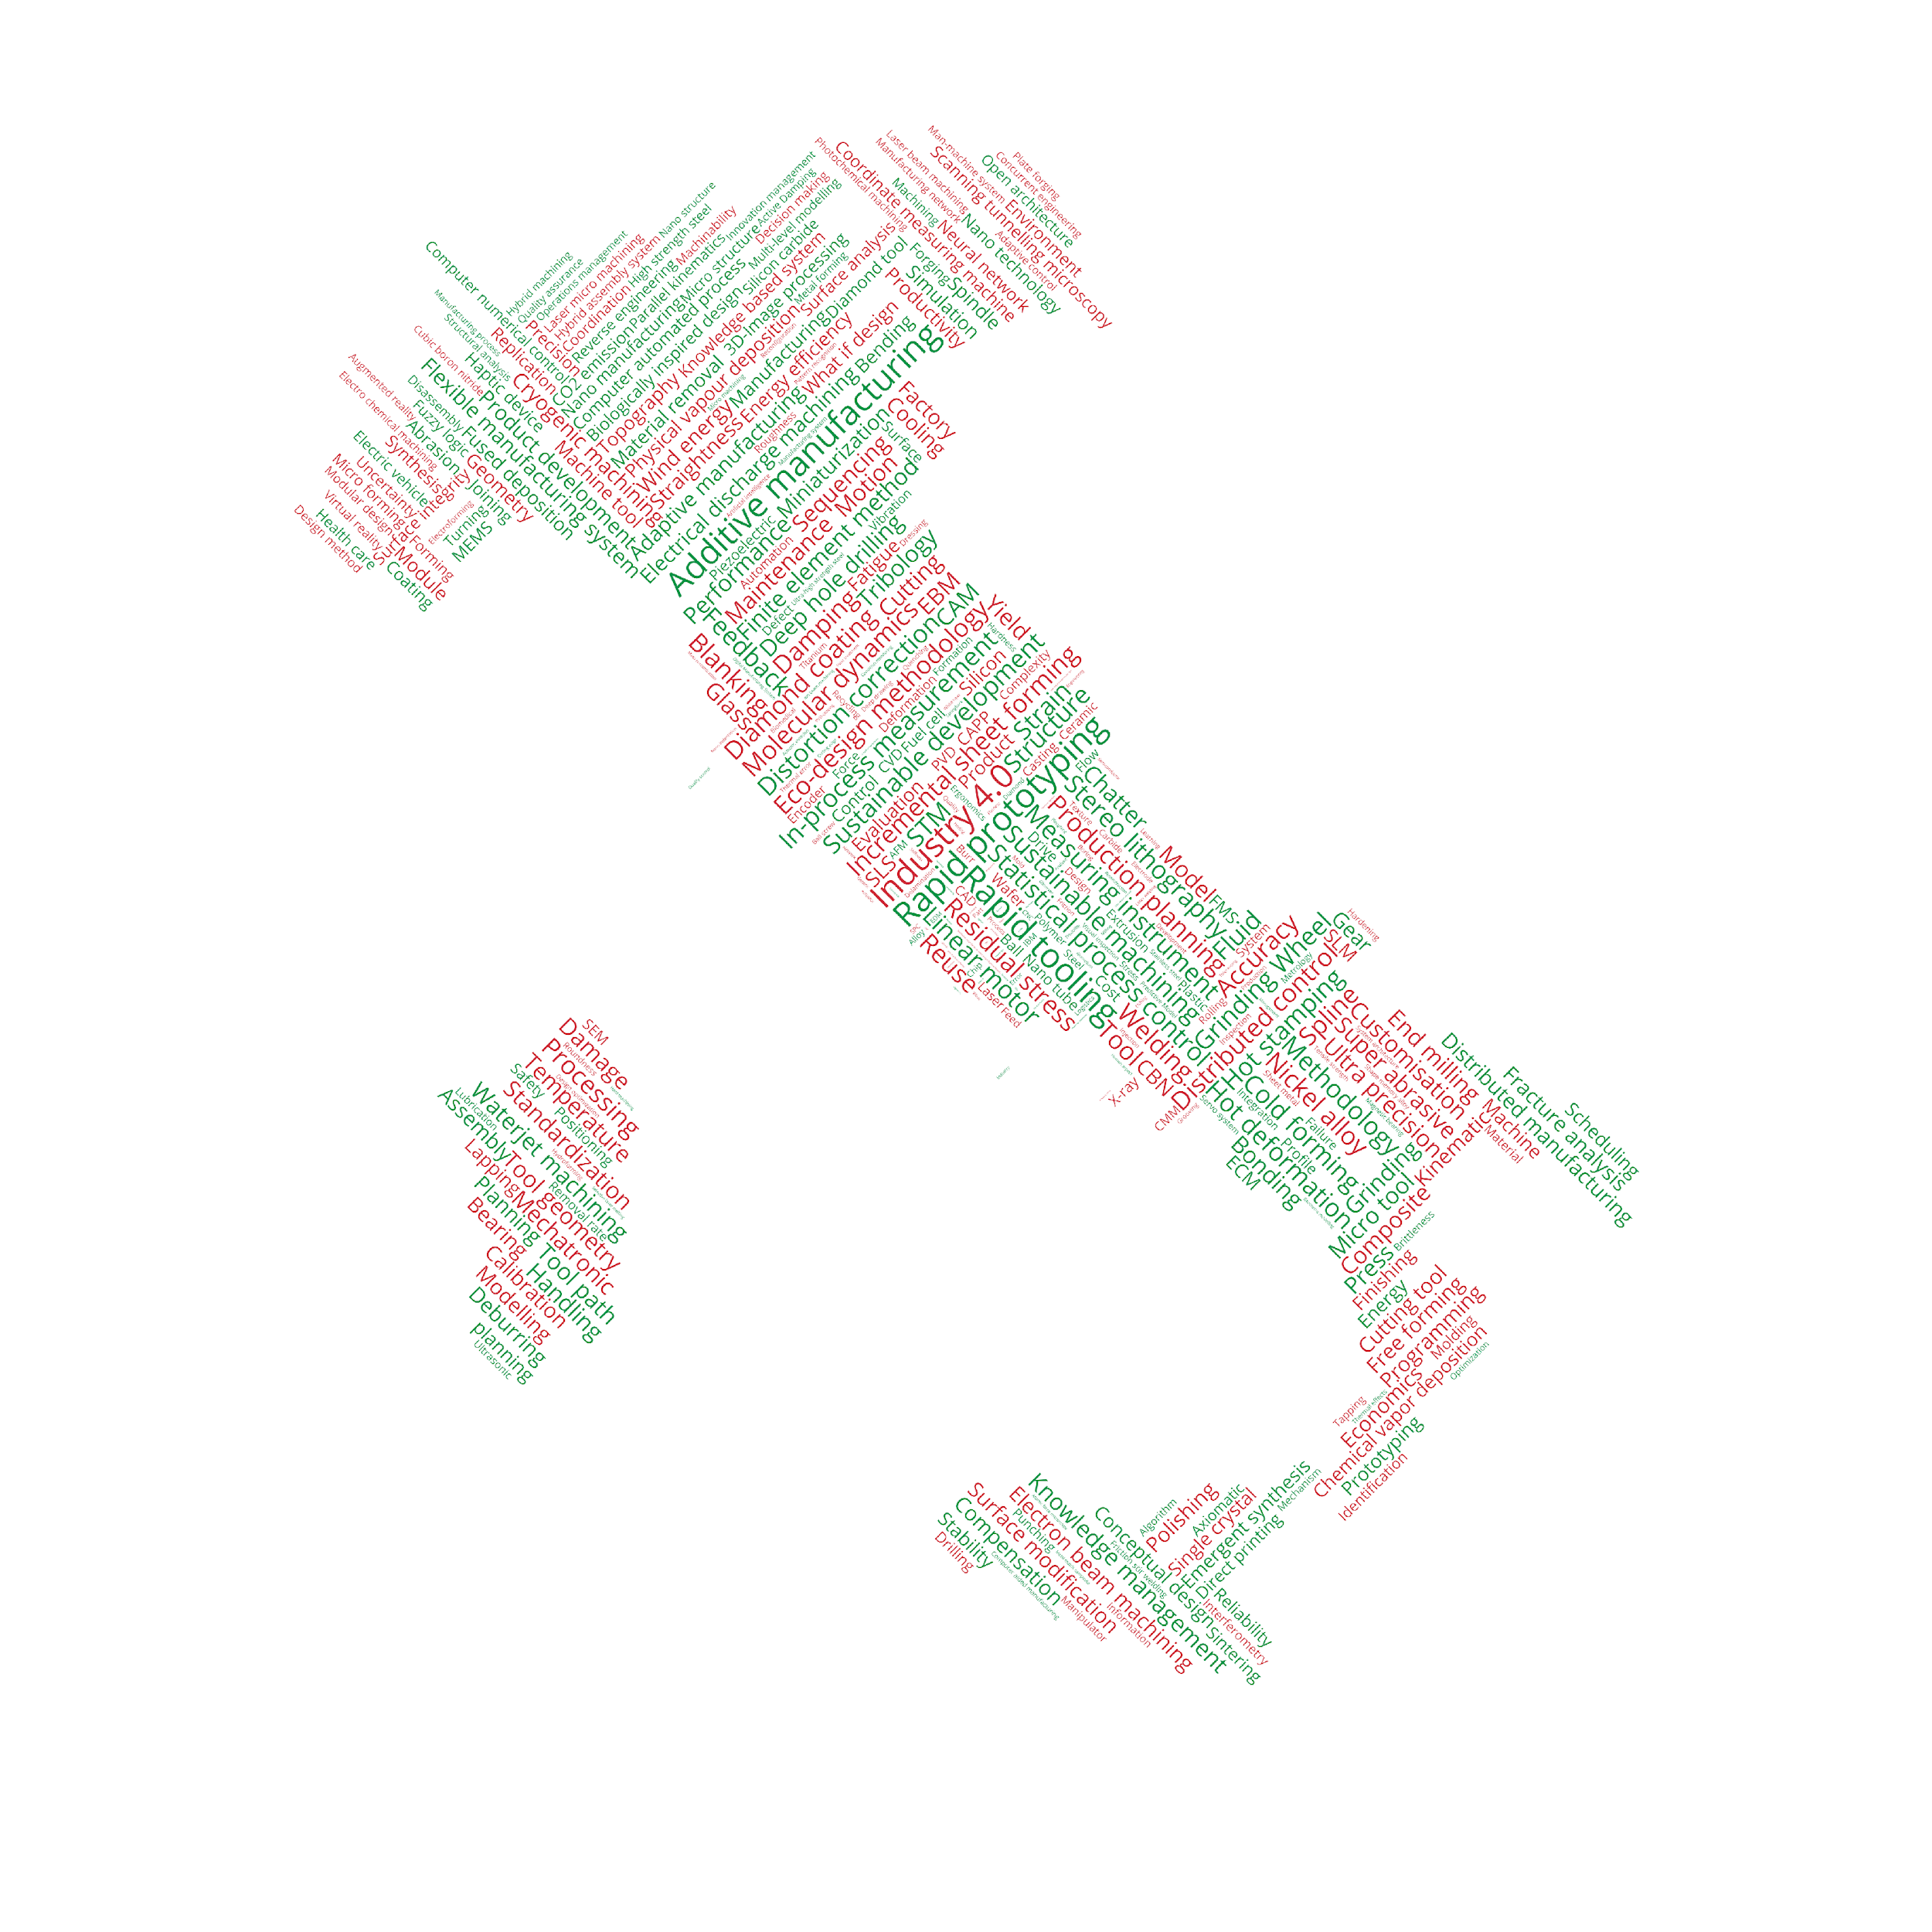




Michele LANZETTA
University of Pisa
Department of Civil and Industrial Engineering

Slide 4

National Academy for
Additive Manufacturing
additive.dici.unipi.it
Funder: prof. Michele LANZETTA
University of Pisa
Department of Civil and Industrial Engineering

Slide 5
Interuniversity Research Center for
Additive Manufacturing
www.ciram.net
Co-Funder: prof. Michele LANZETTA
University of Pisa
Department of Civil and Industrial Engineering

Slide 6

Additive Manufacturing
Focus Group
AITeM.org
Italian Academy of Production Engineering
www.additivemanufacturing.work
Coordinator: prof. Michele LANZETTA
University of Pisa
Department of Civil and Industrial Engineering

Slide 7
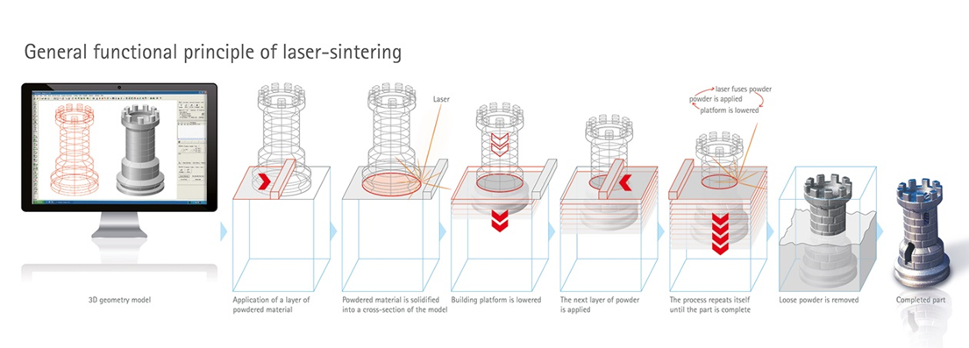
Direct Metal Laser Sintering (DMLS) Process

Slide 8
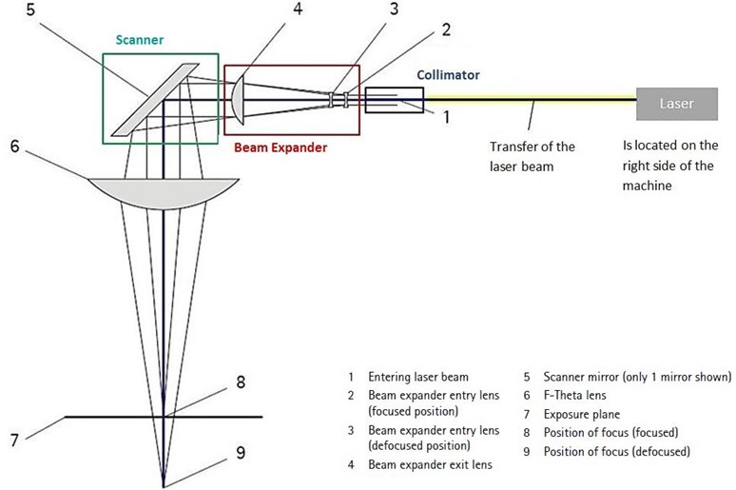
Direct Metal Laser Sintering (DMLS) Process
Optical system
Laser: Ytterbium 1064 nm
Optical fiber: bring the radiation from the laser
Collimator: collimate the laser radiation
Beam expander: increase the beam diameter
Scanner: with high dynamic mirrors to direct the beam
F-Theta lens: focus the beam

Slide 9
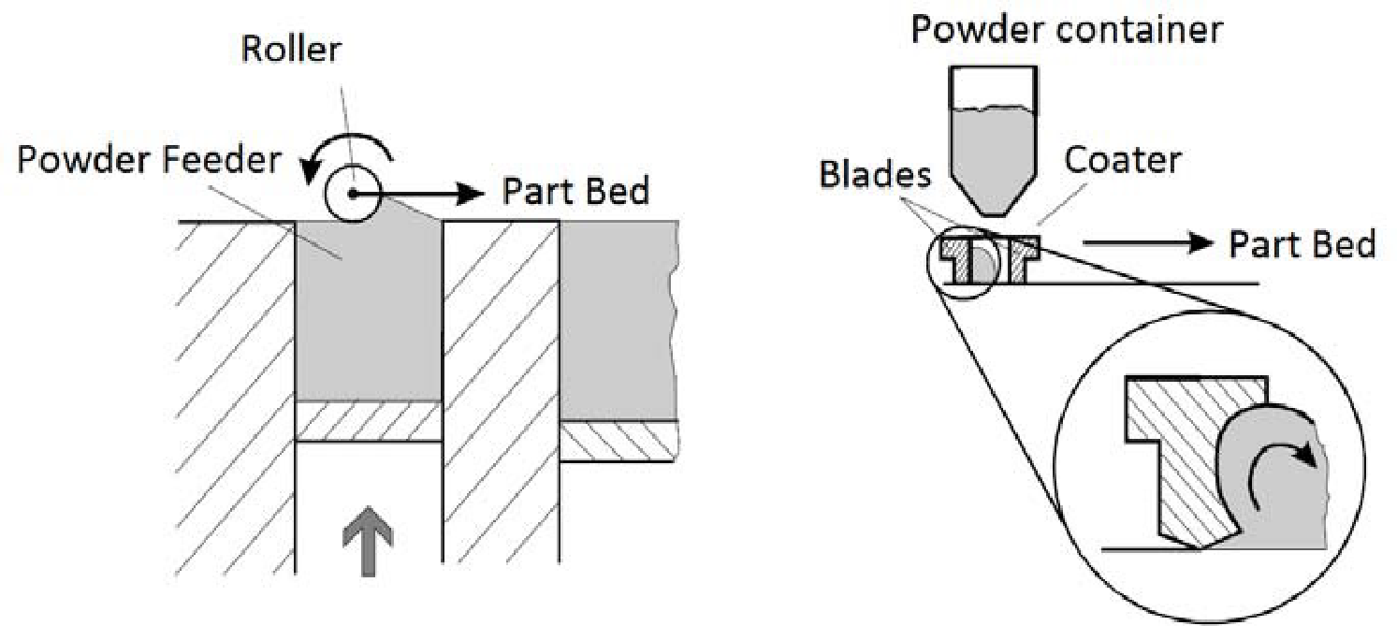
Direct Metal Laser Sintering (DMLS) Process
Recoating system
Today two different spreading system are present on the market
A roller or a blade spread the powder on the bed
A. Amado et al. 2011

Slide 10
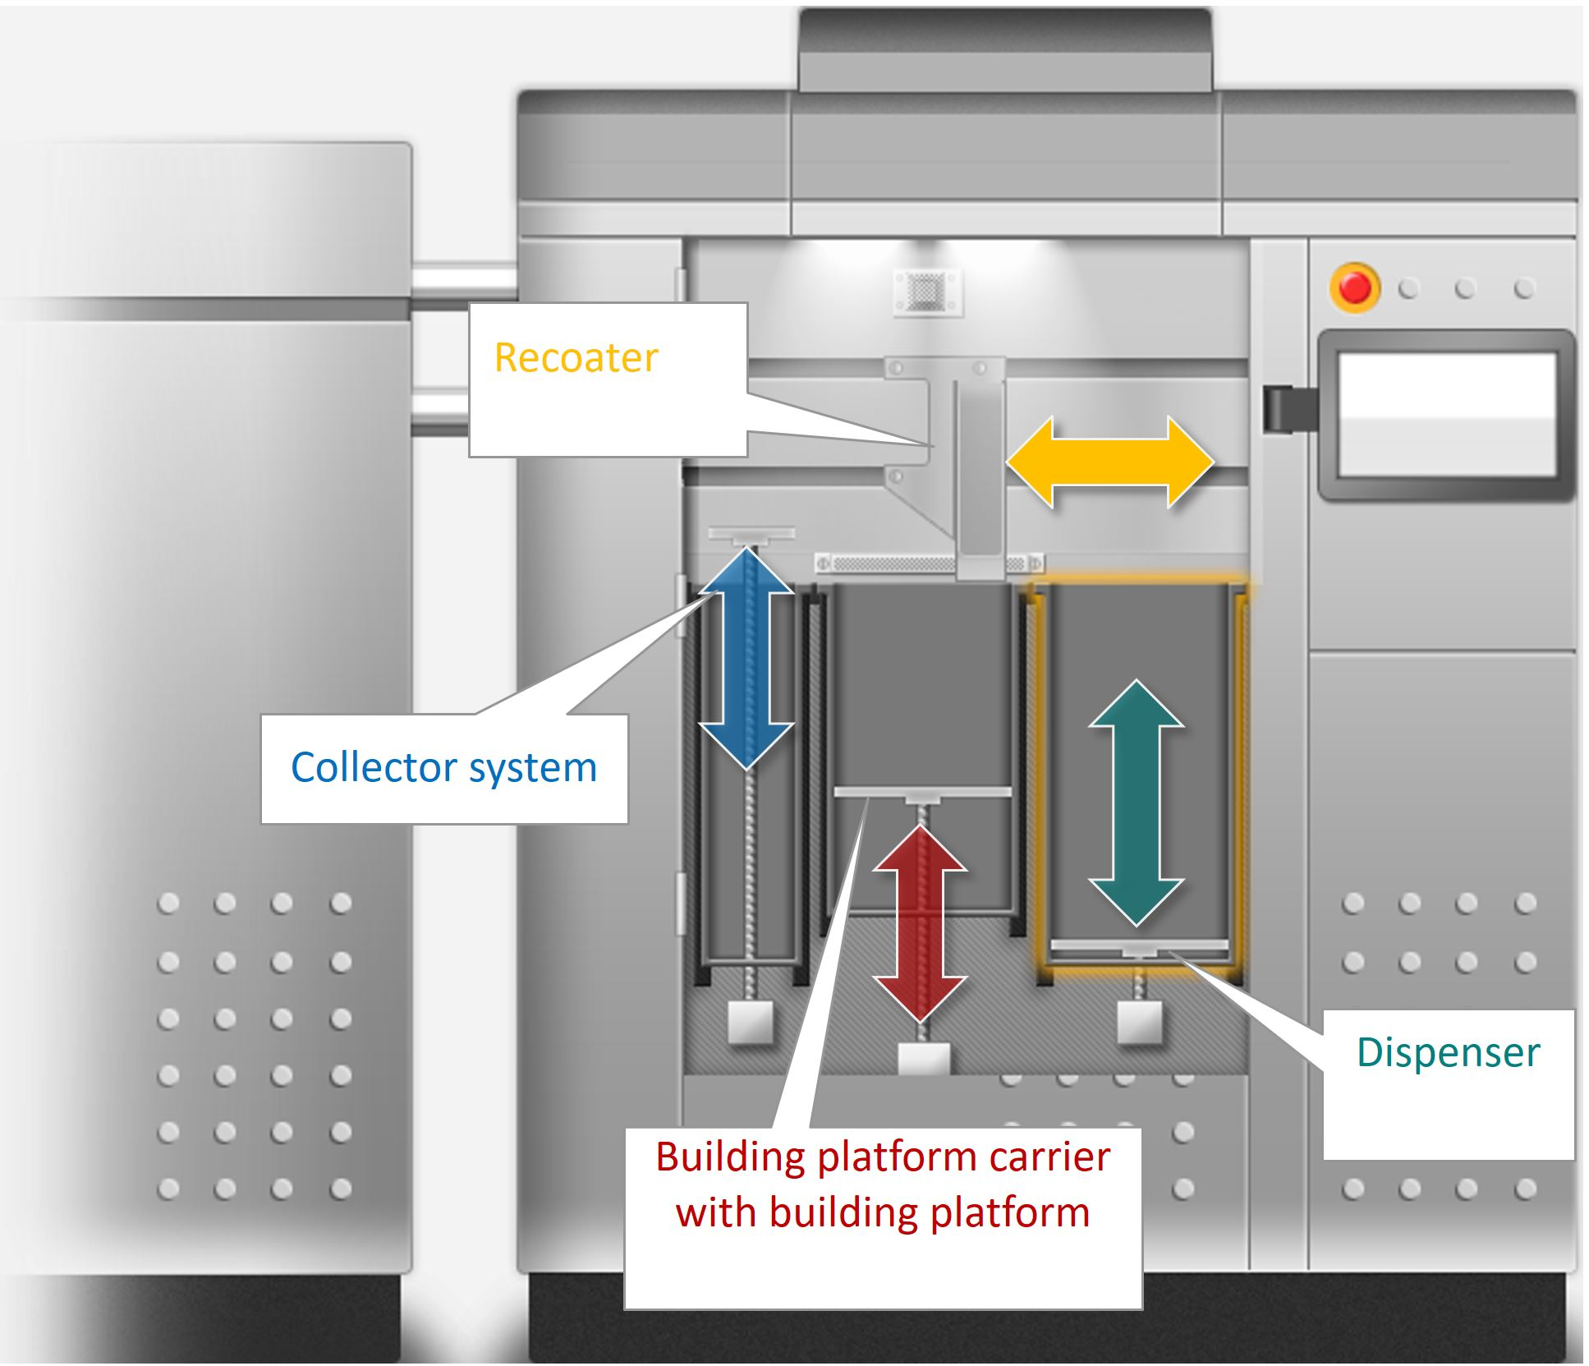
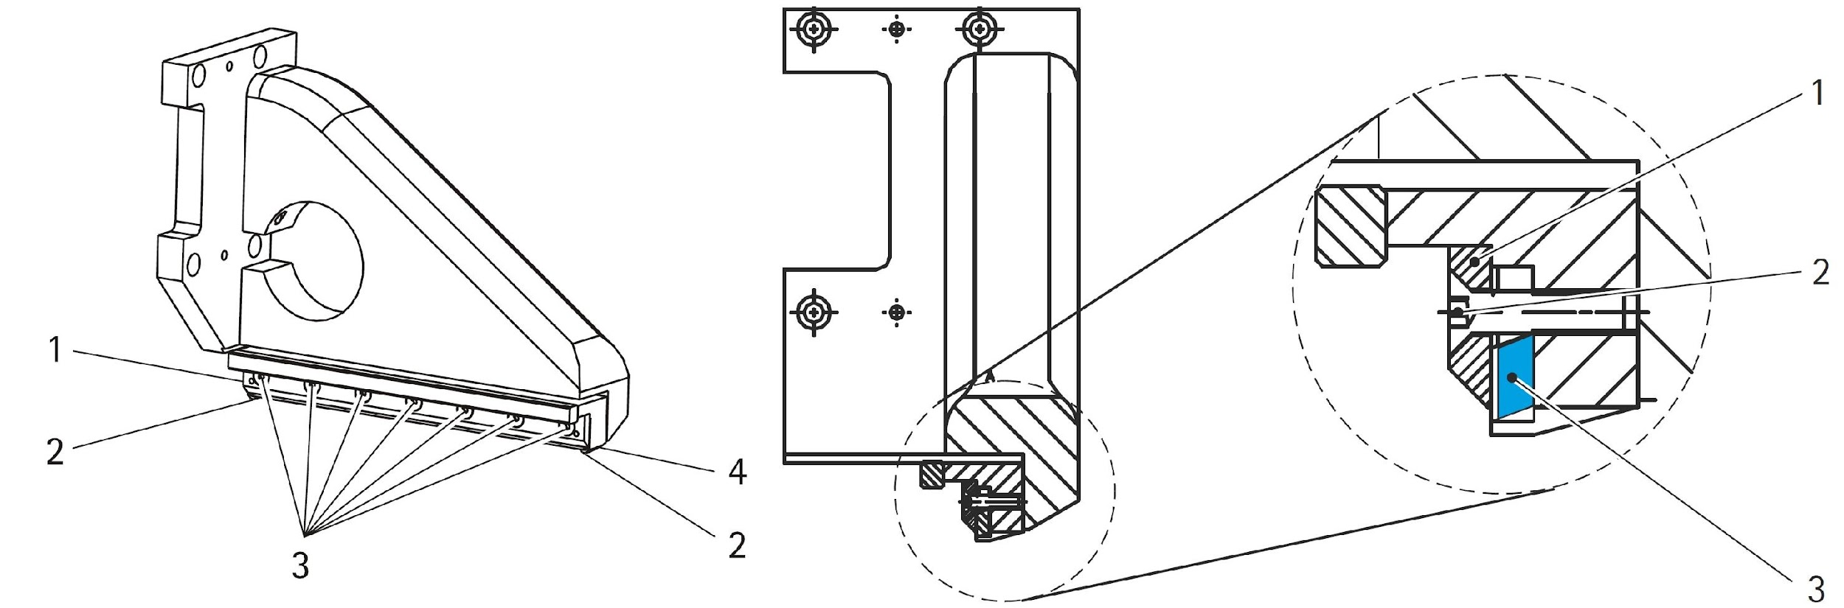
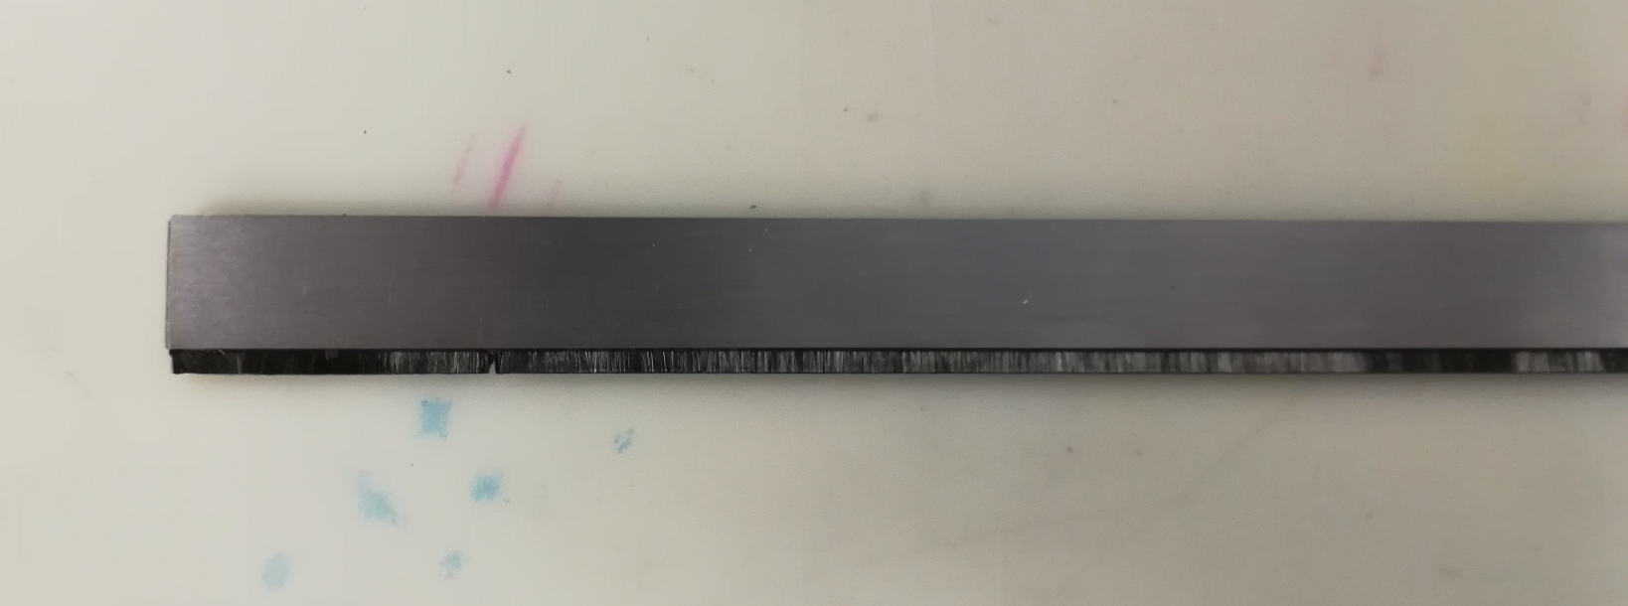
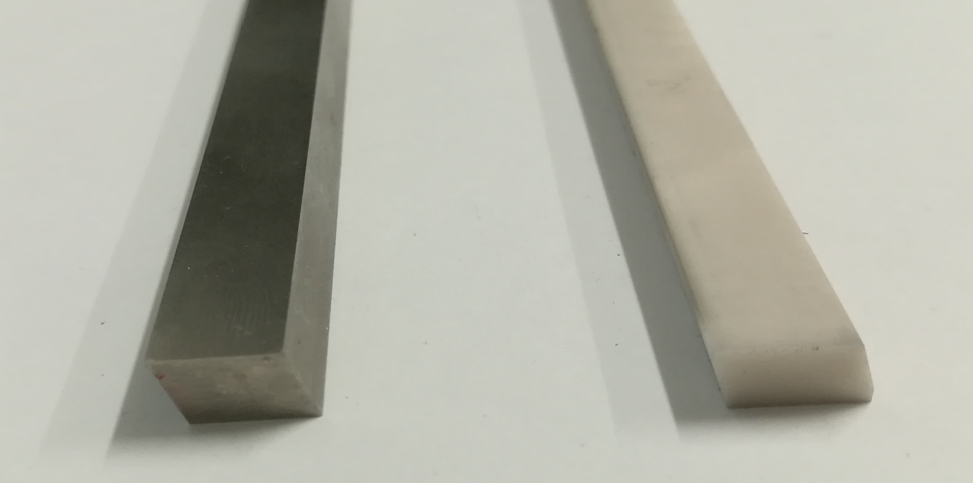
Direct Metal Laser Sintering (DMLS) Process
Recoating system
3 platform on EOS® M280 e M290
Recoater with changeable blade

Slide 11
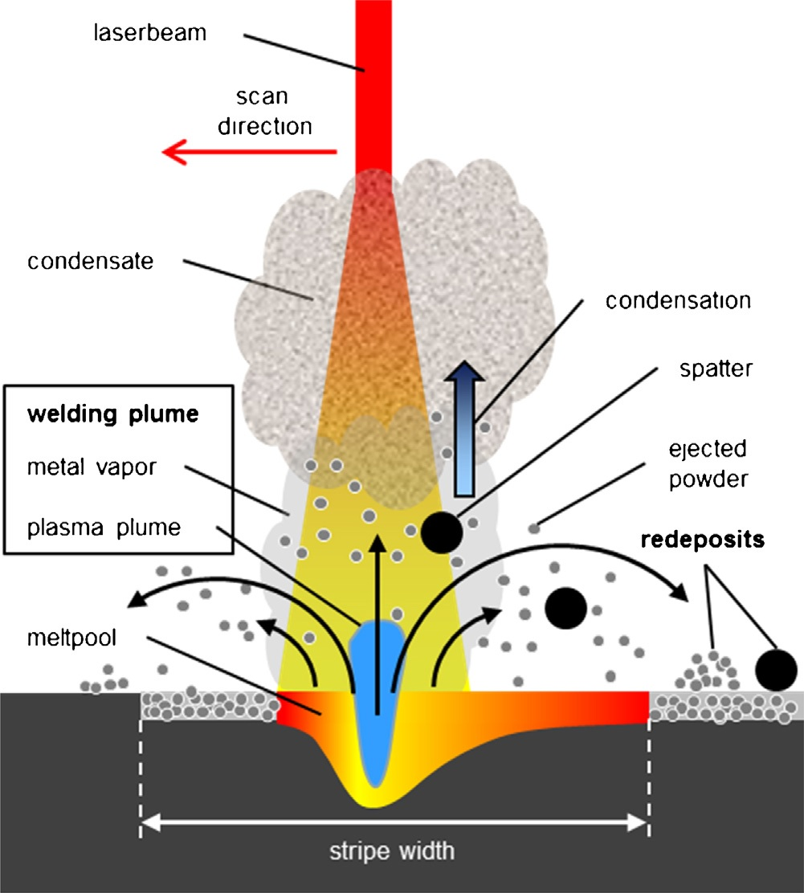
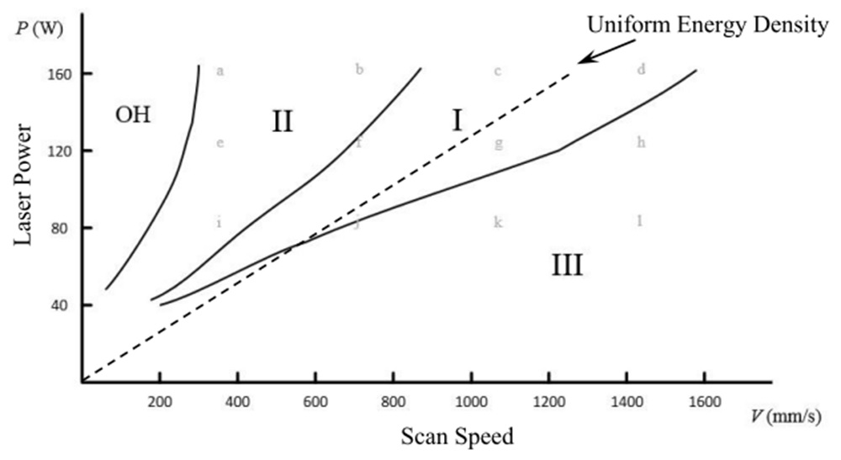
Direct Metal Laser Sintering (DMLS) Process
Key hole process
Main process parameters: speed, laser power, hatch distance
Emission of different types of products
H. Gong, 2013
A. Ladewiga et al. 2016

Slide 12
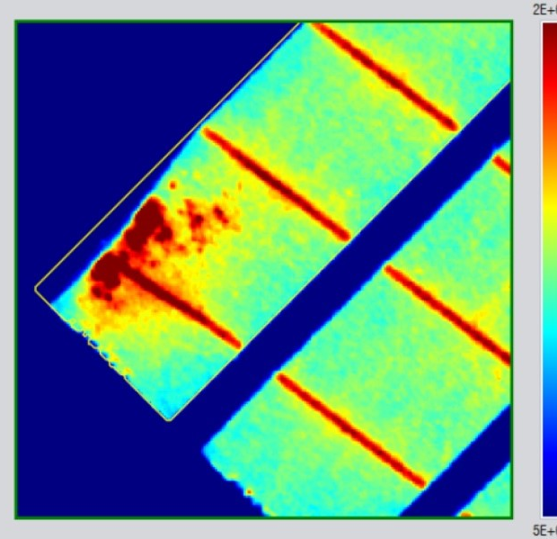
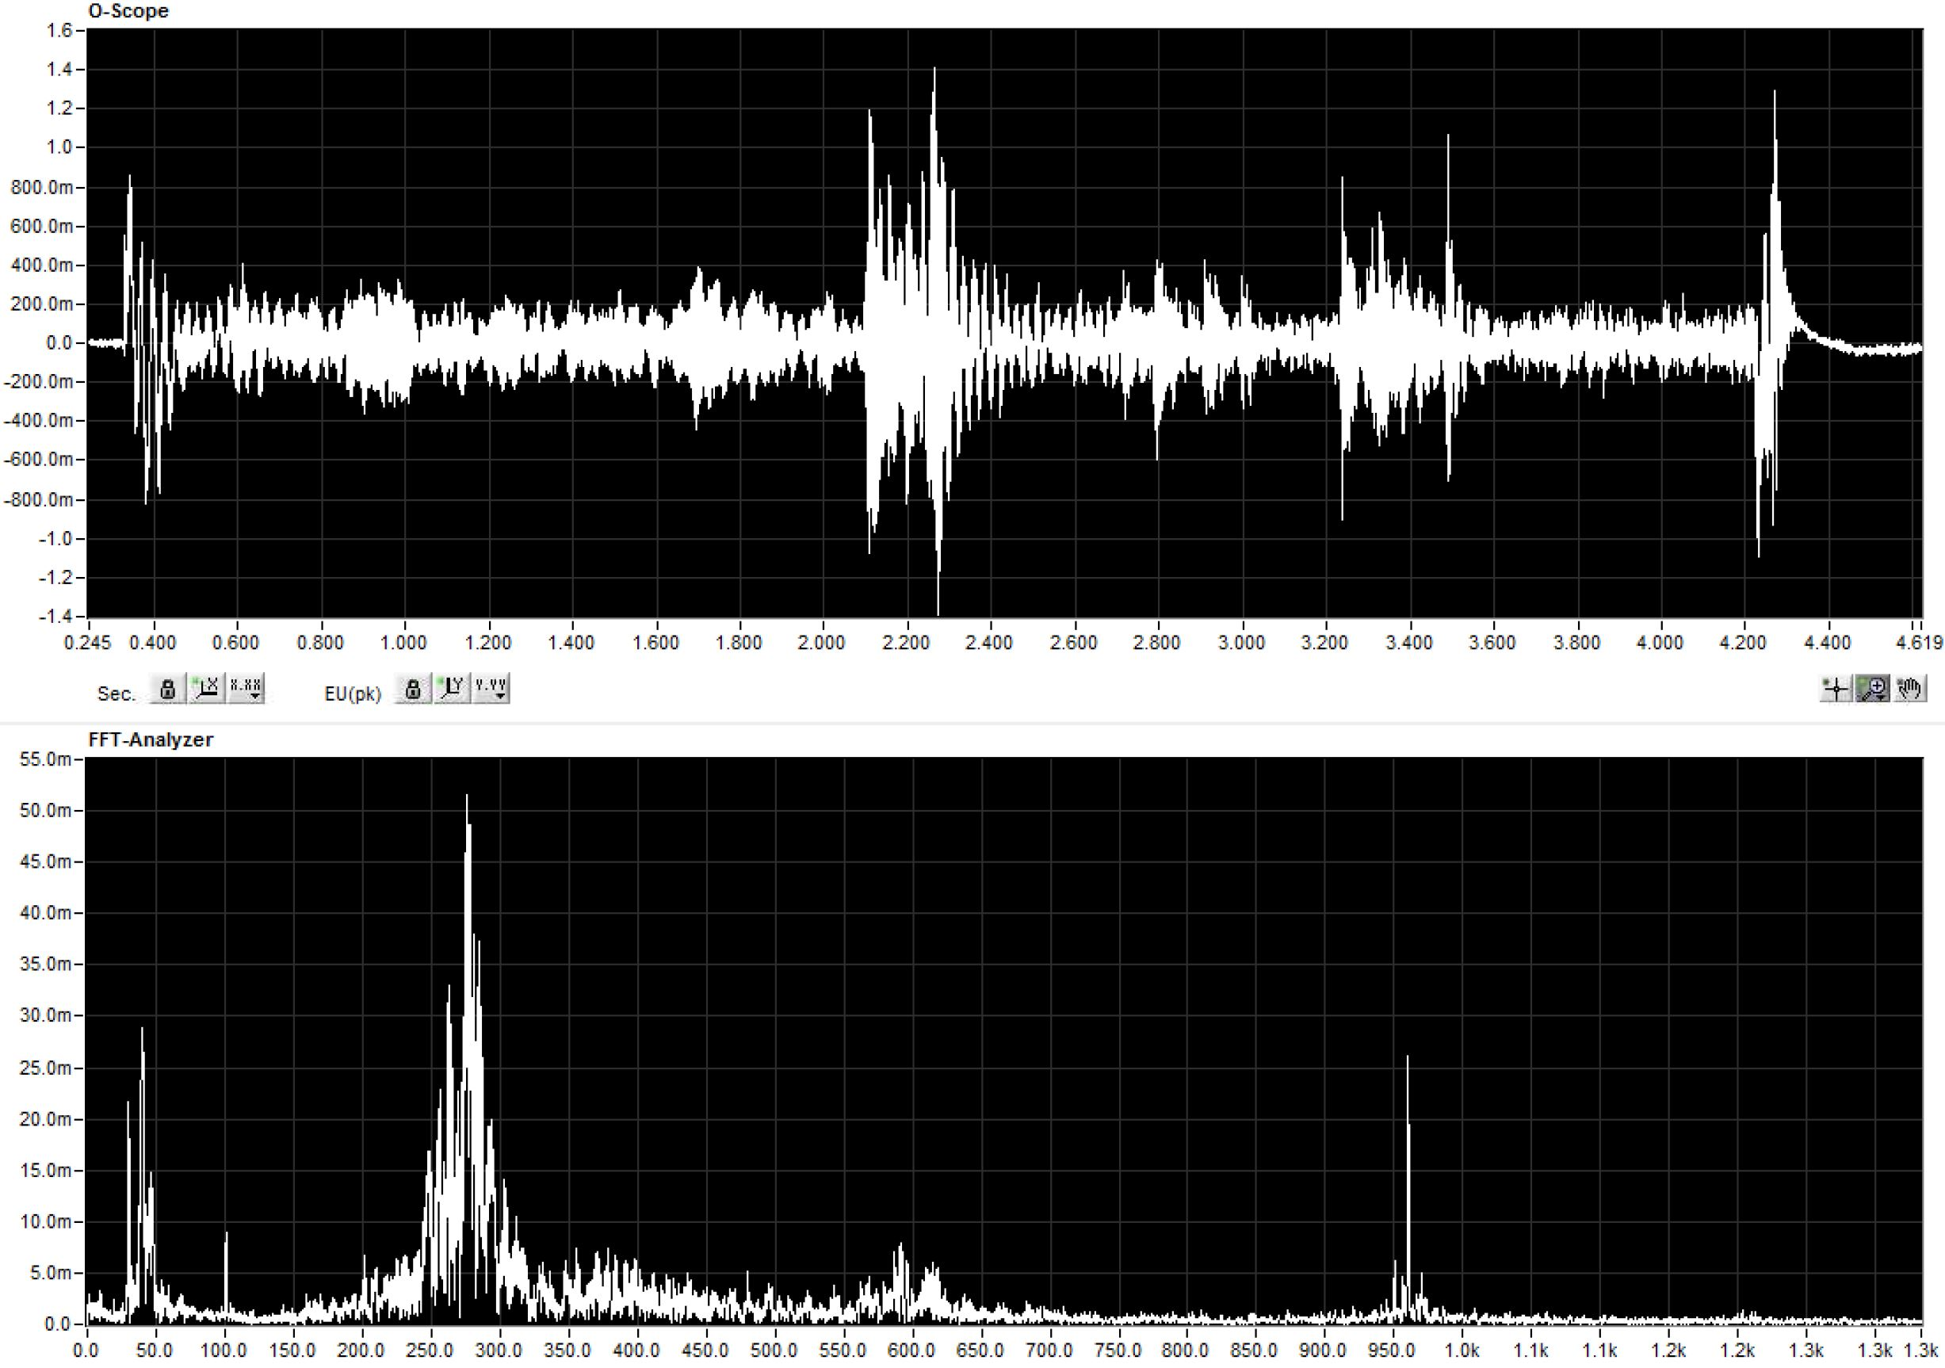
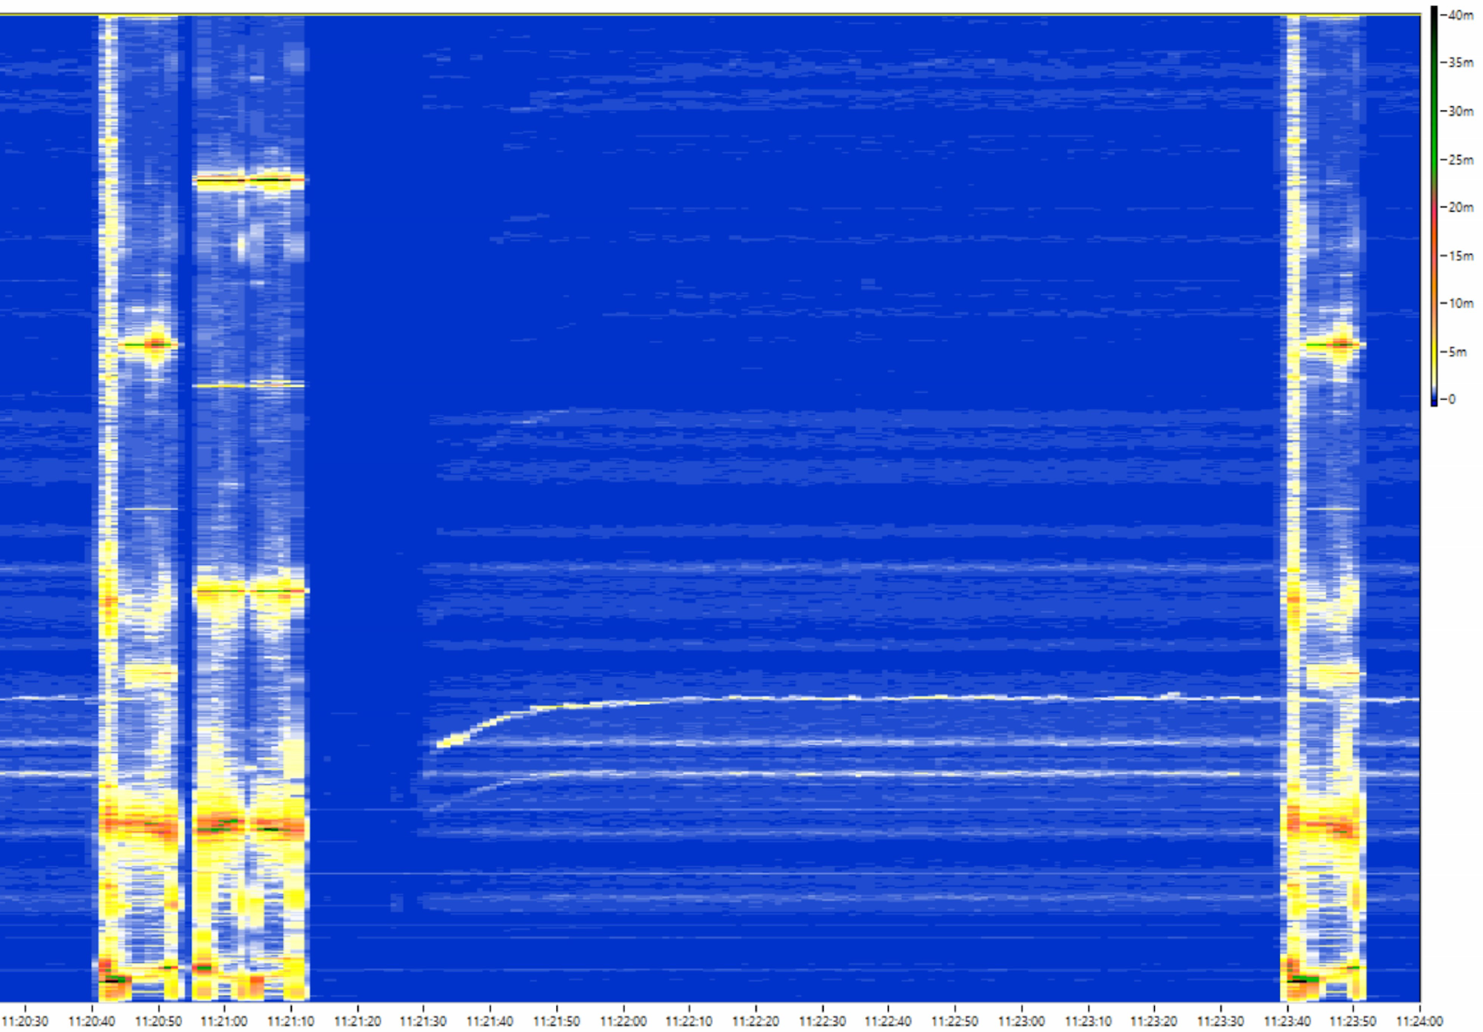
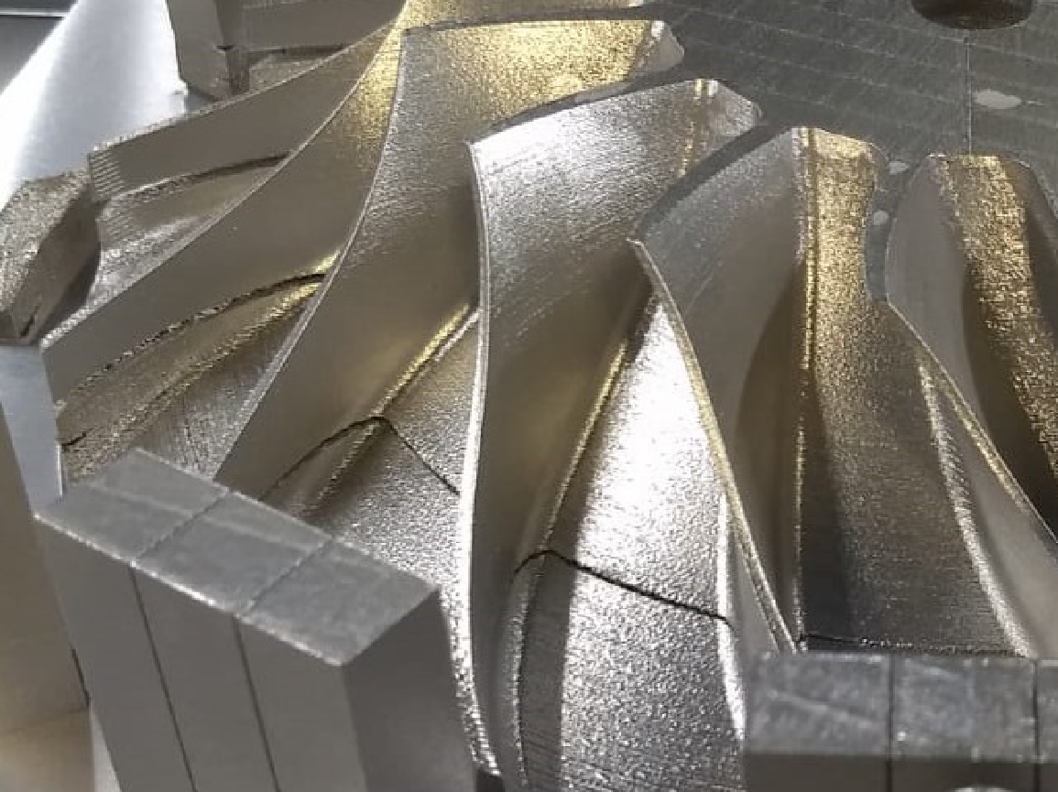
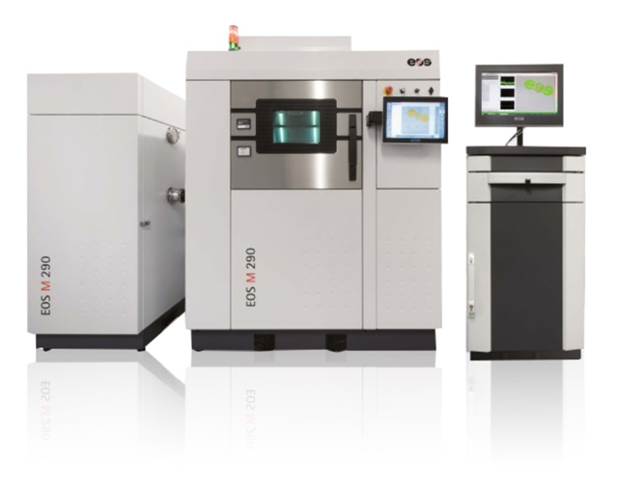

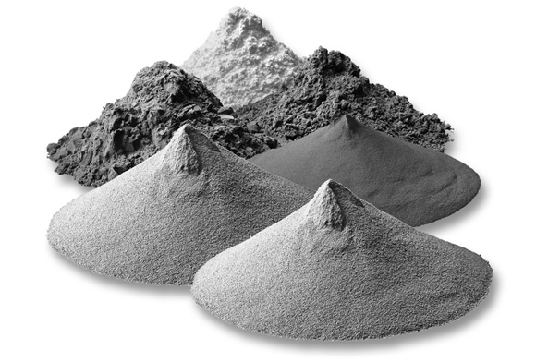
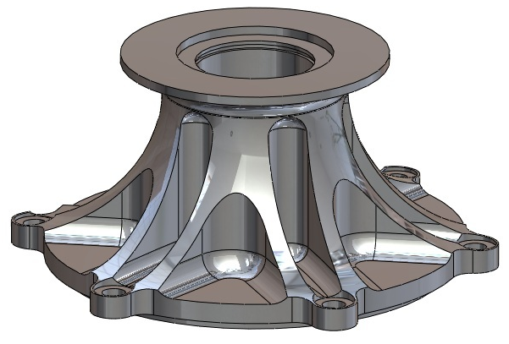
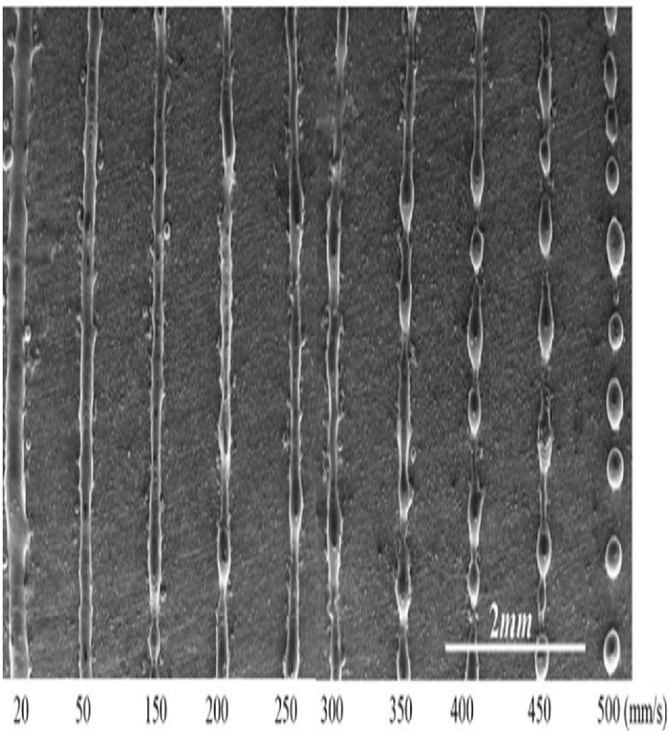
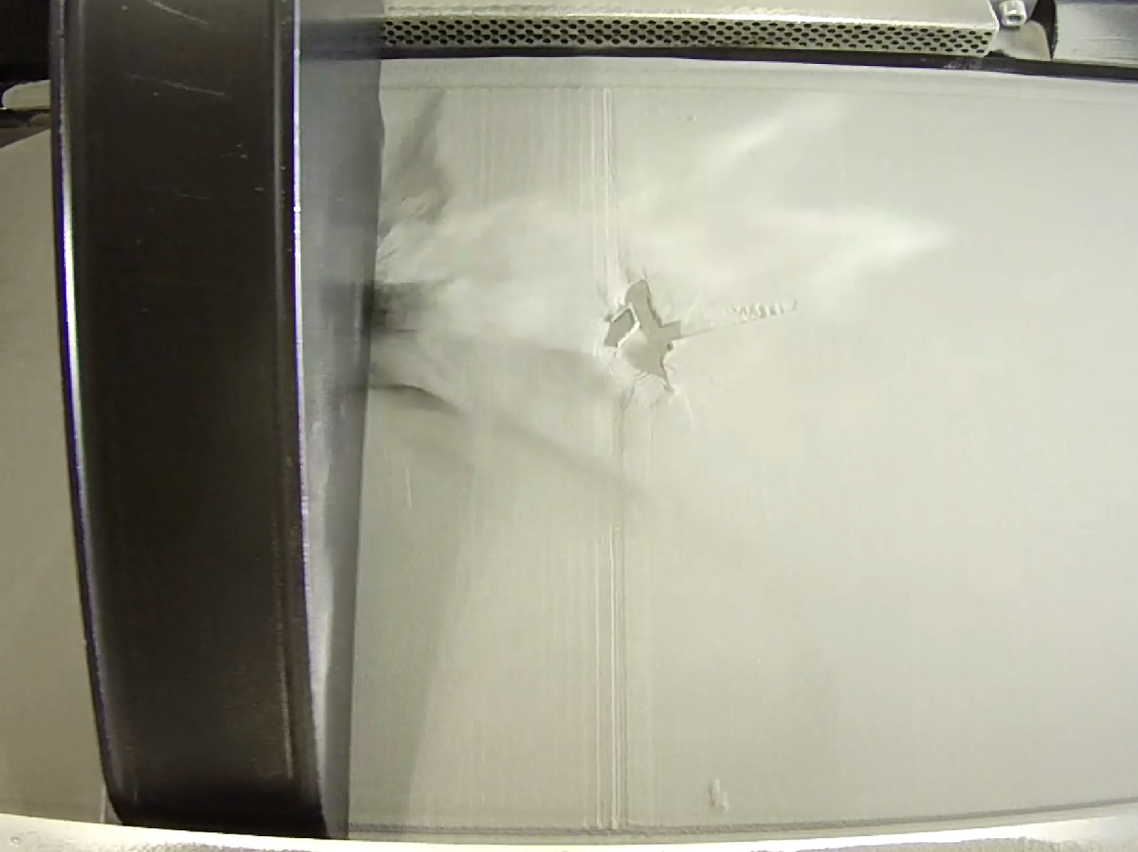
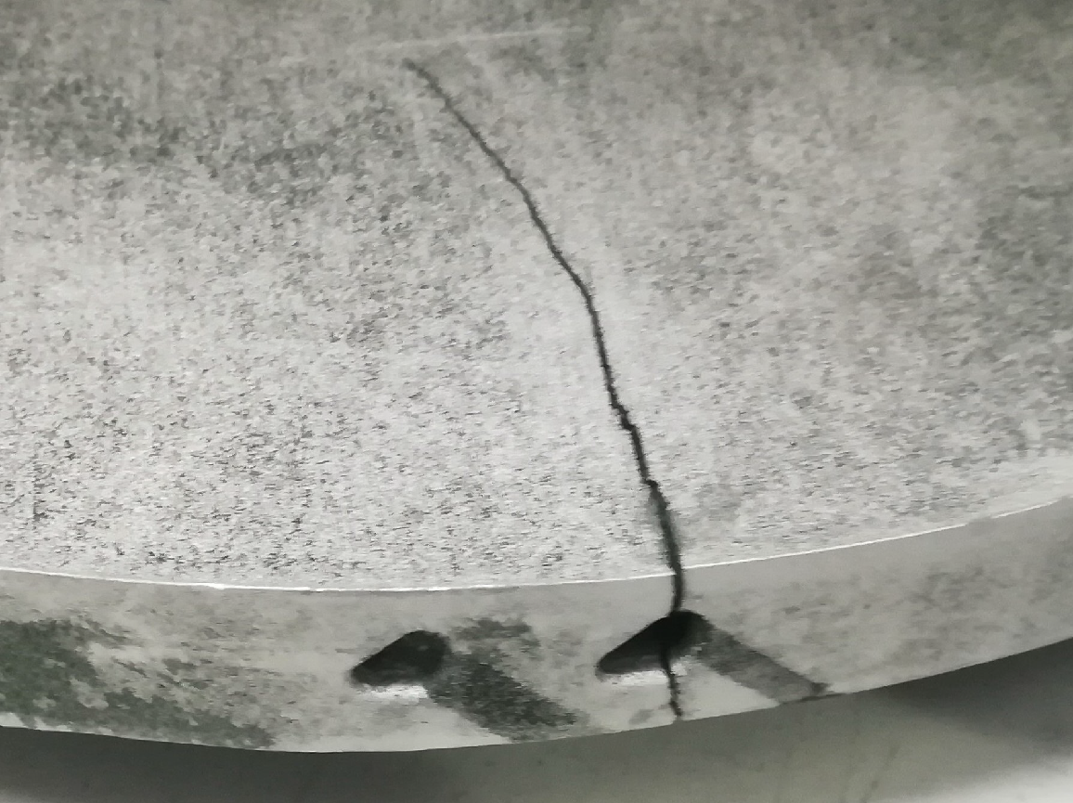
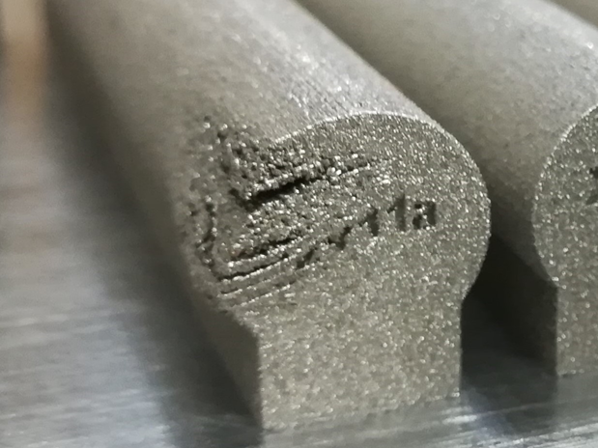
Defects classification

Slide 13
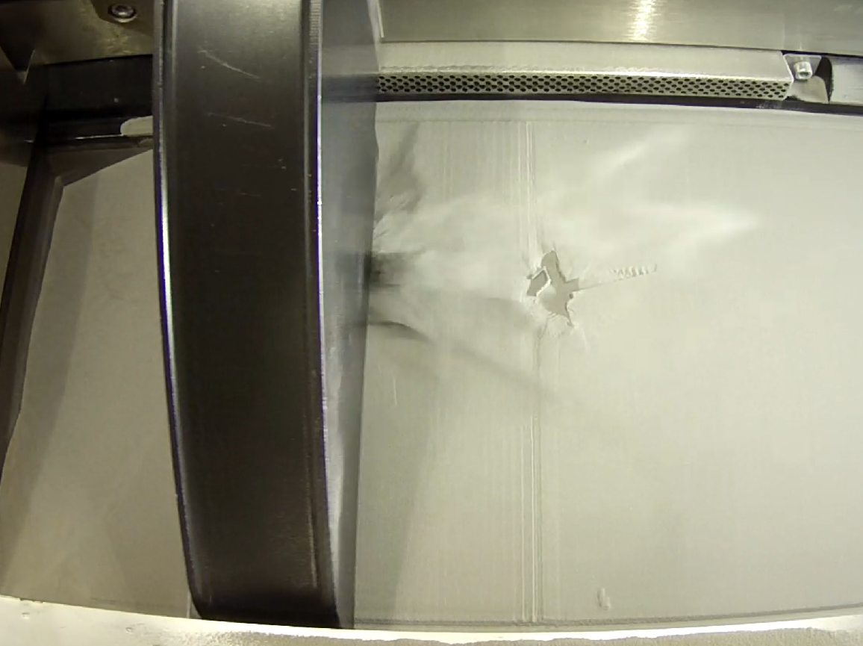
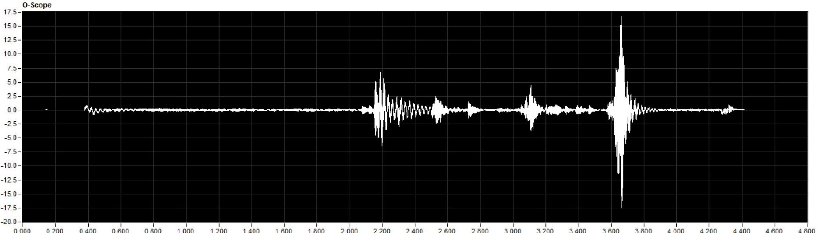
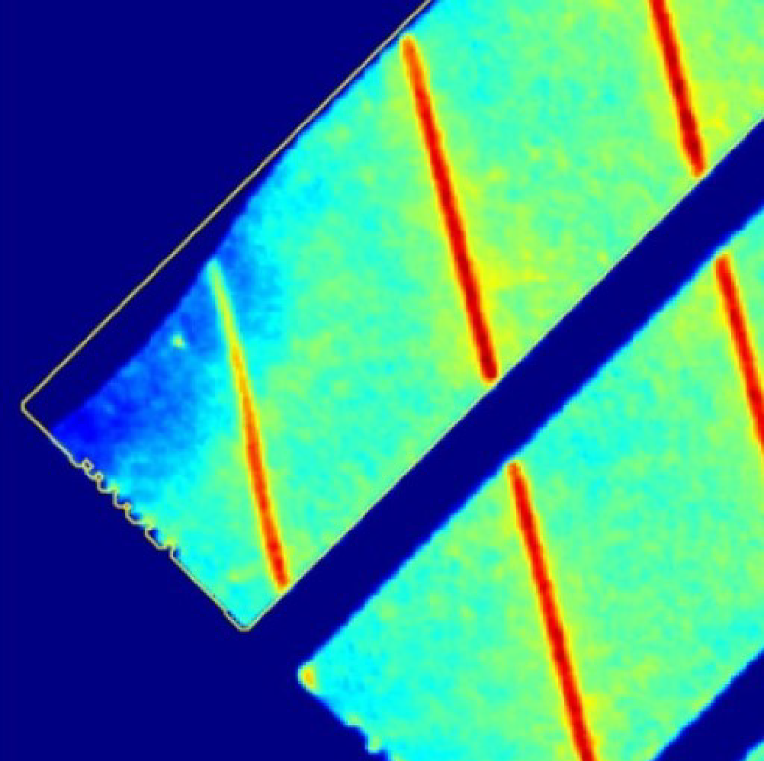
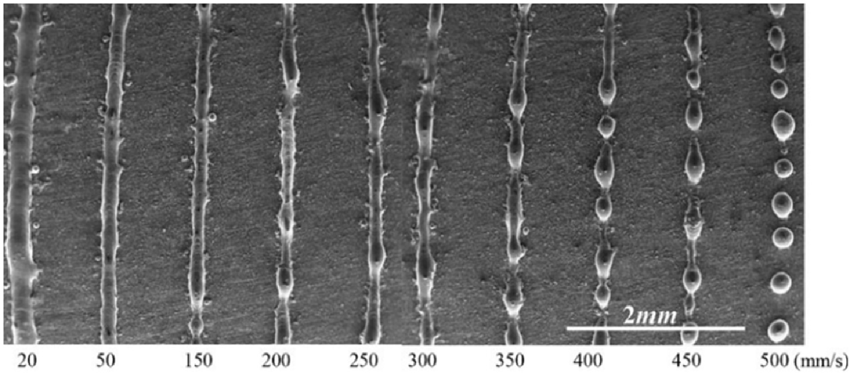
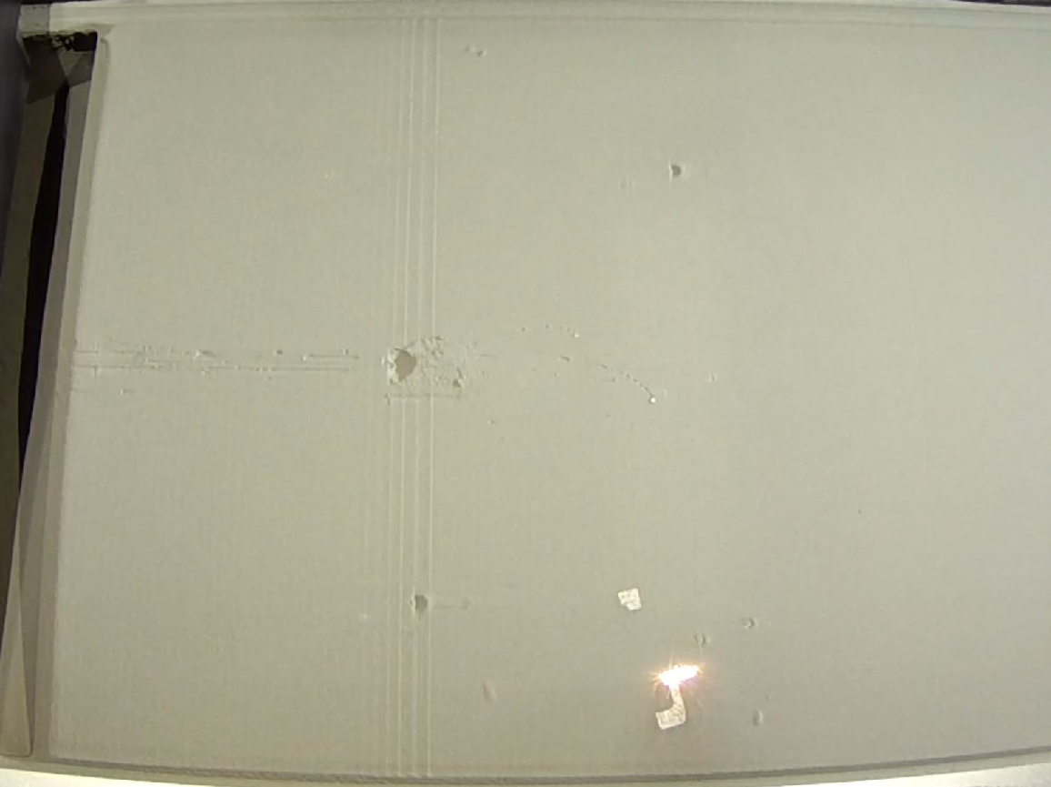
Defects classification
Process defects
R. LI et al. 2012

Slide 14
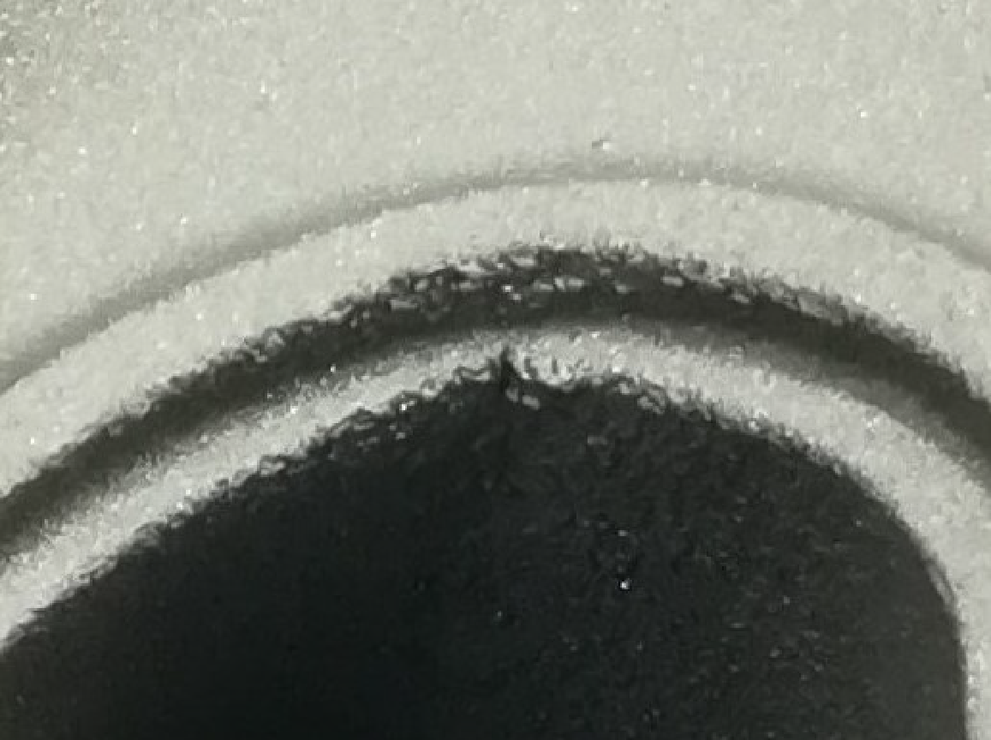
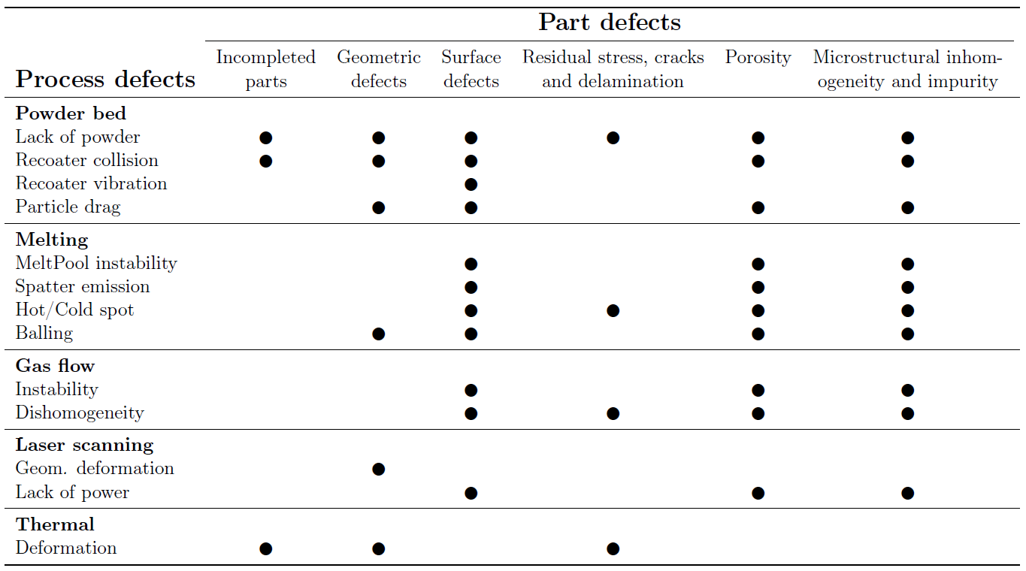
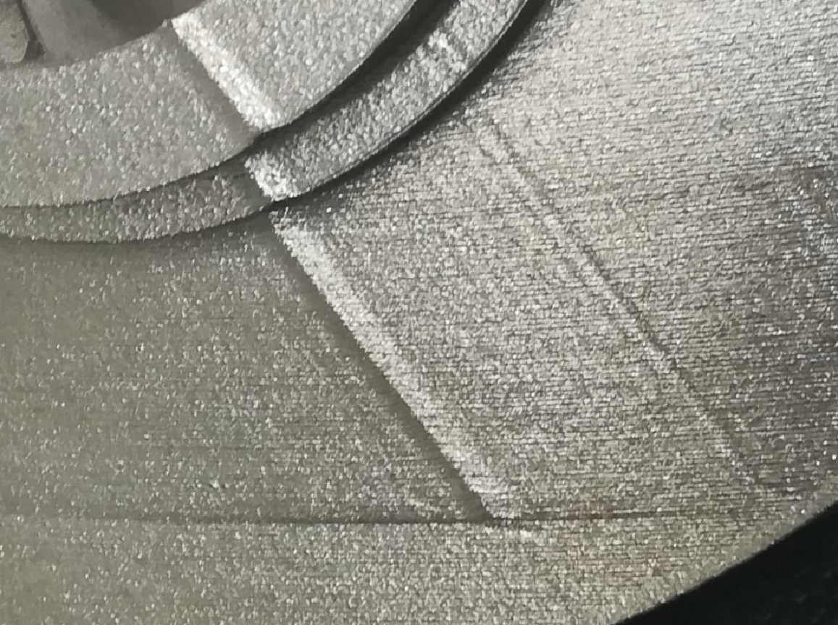
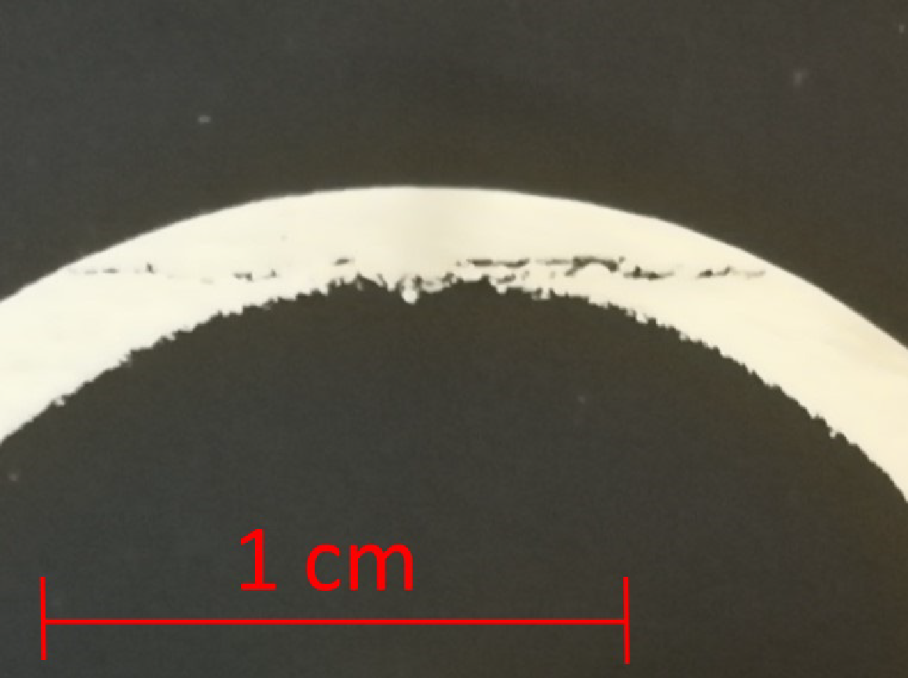
Defects classification
Part defects

Slide 15
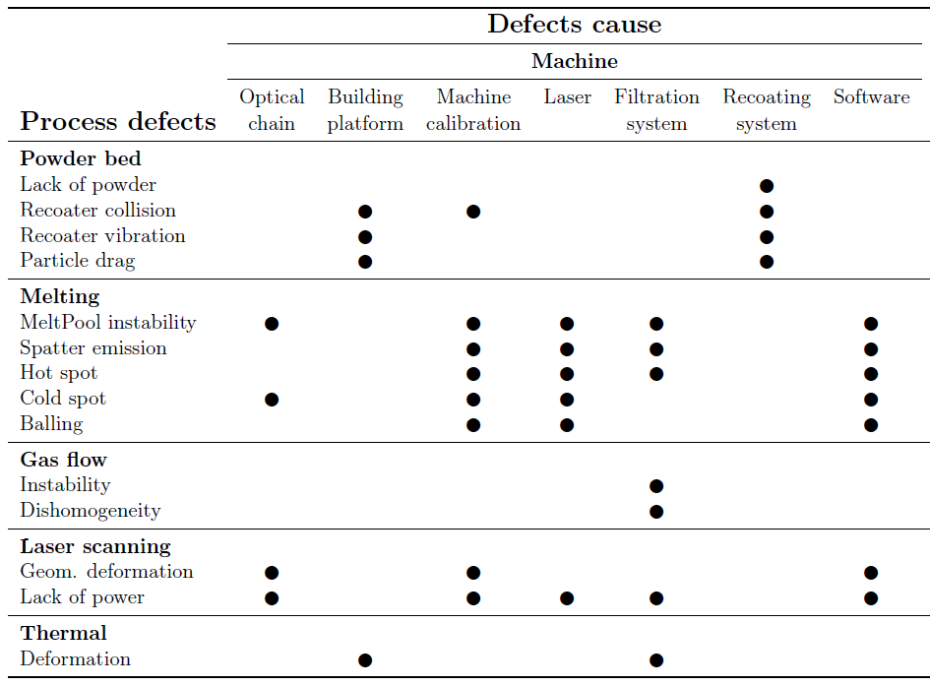
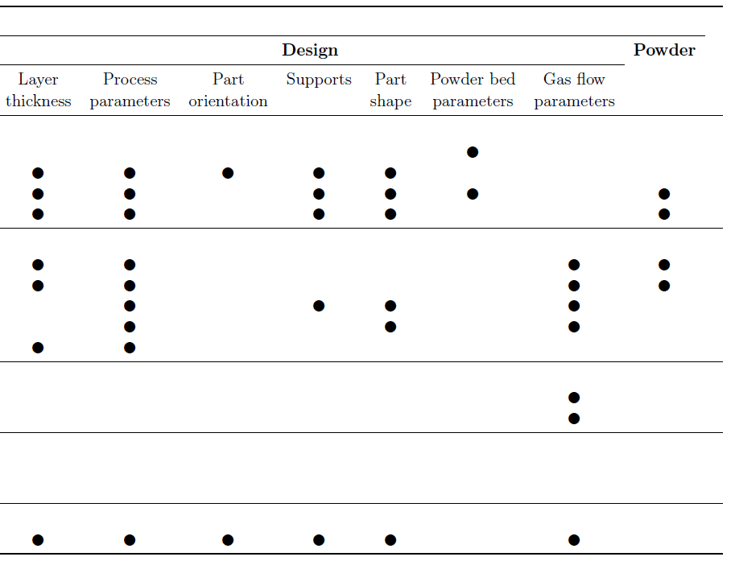
Defects classification
Defect sources

Slide 16
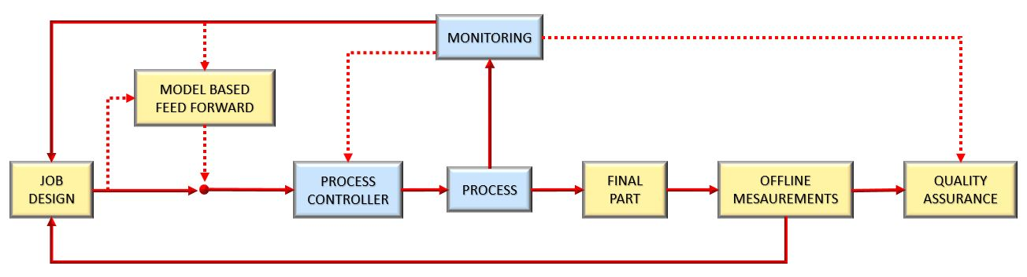
DMLS in situ Monitoring

Slide 17
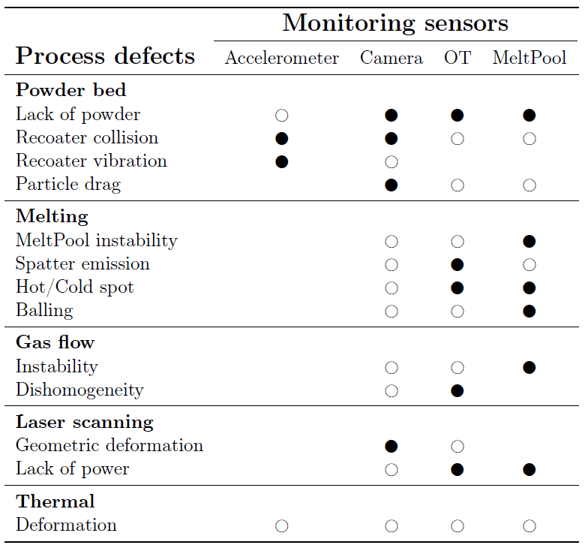
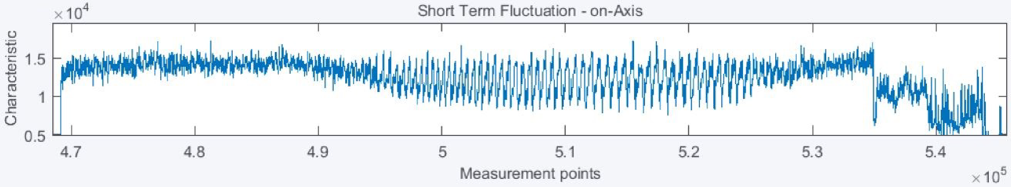
DMLS in situ Monitoring
Monitoring sensors

Slide 18
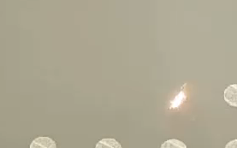
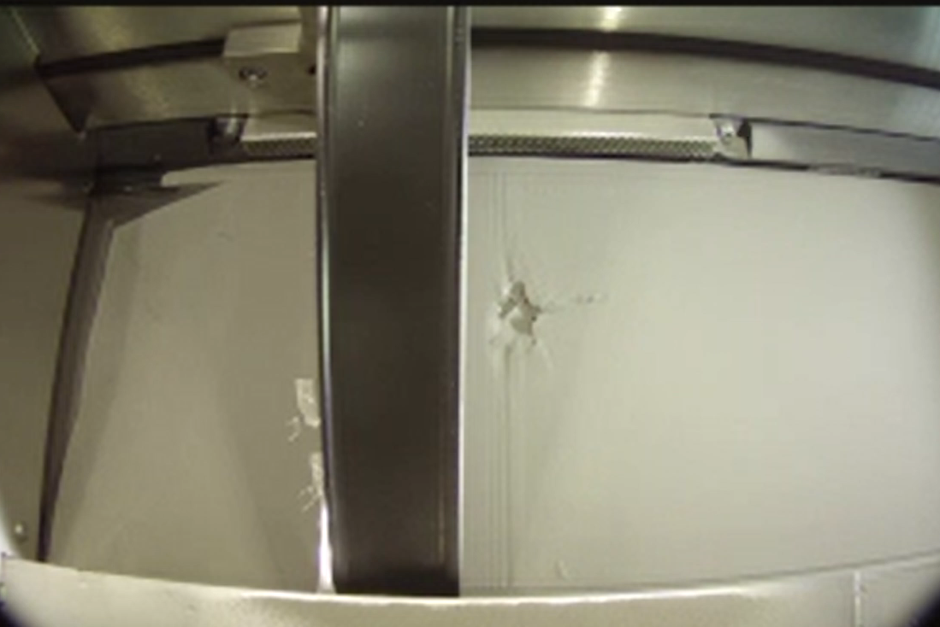
Camera Monitoring
Remote online visualization
Recording system

Slide 19
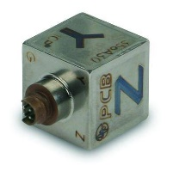
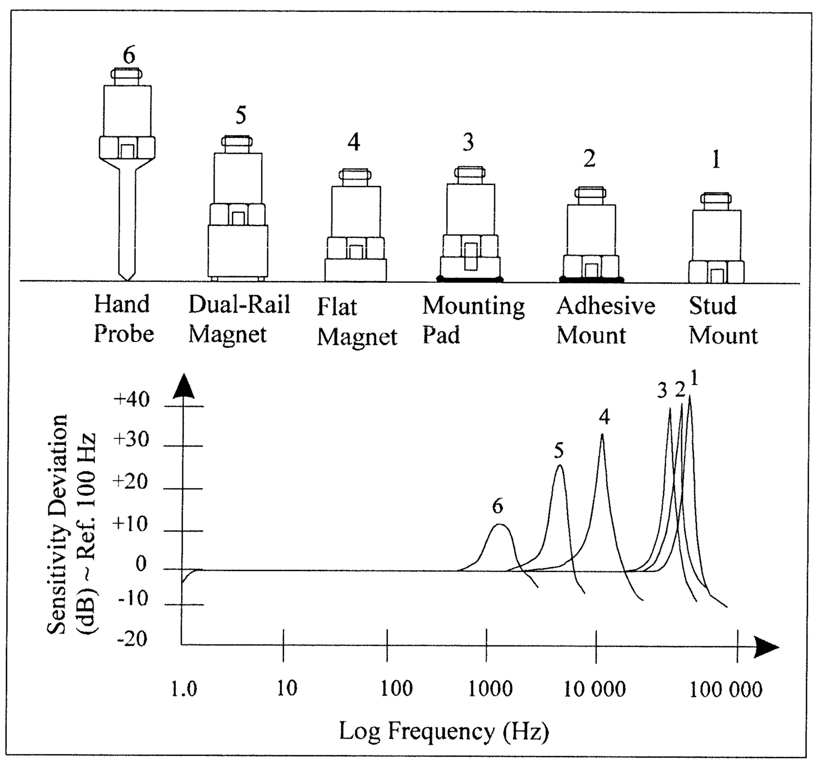
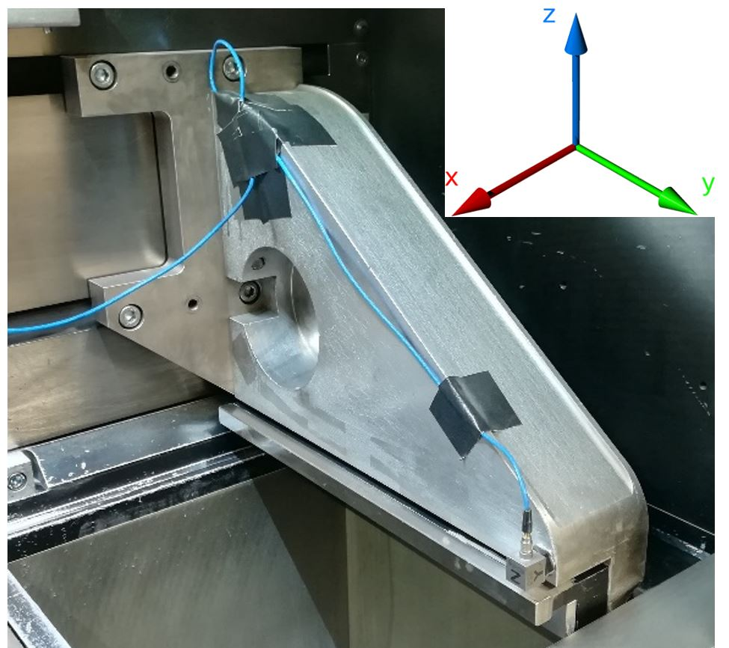
Accelerometer monitoring
Recoating system vibration
Powder bed quality analysis
Threshold alarm setting

Slide 20
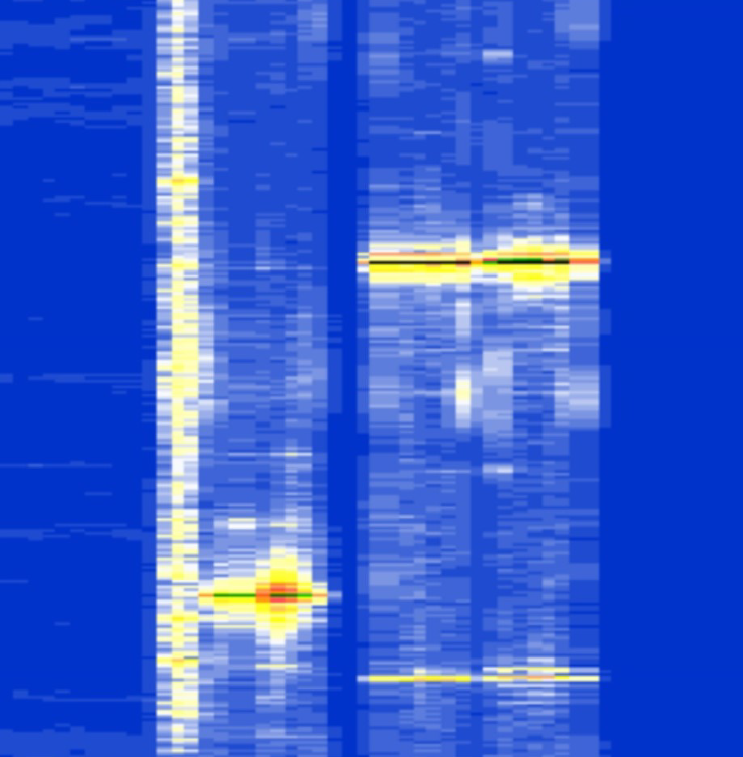
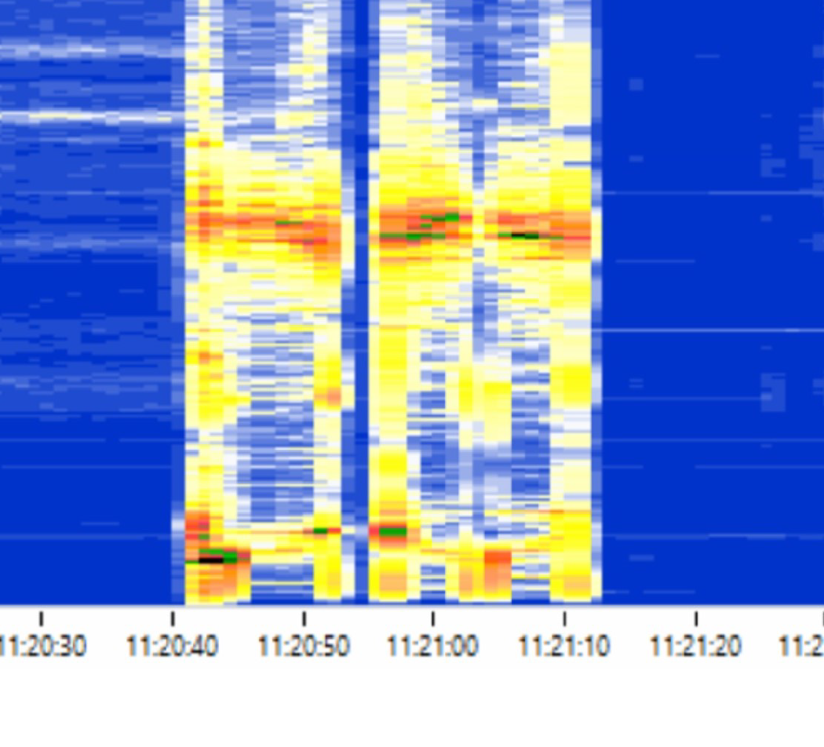


Accelerometer monitoring
Signal analysis
Frequencies of recirculation fan identification
Natural frequencies identification
Engine frequencies identification

Slide 21
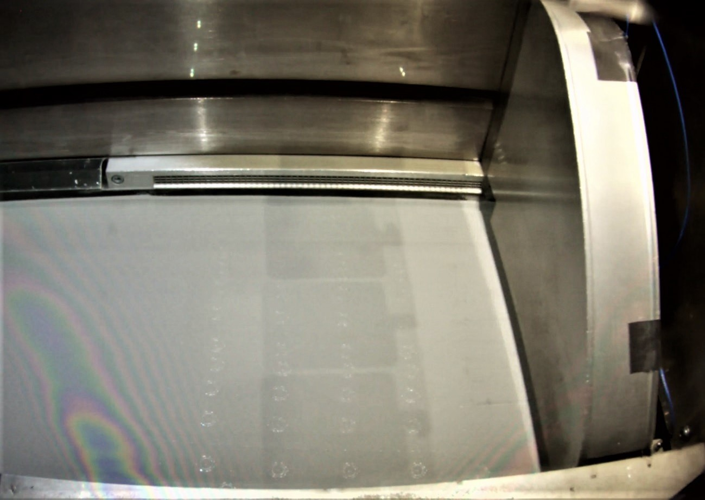
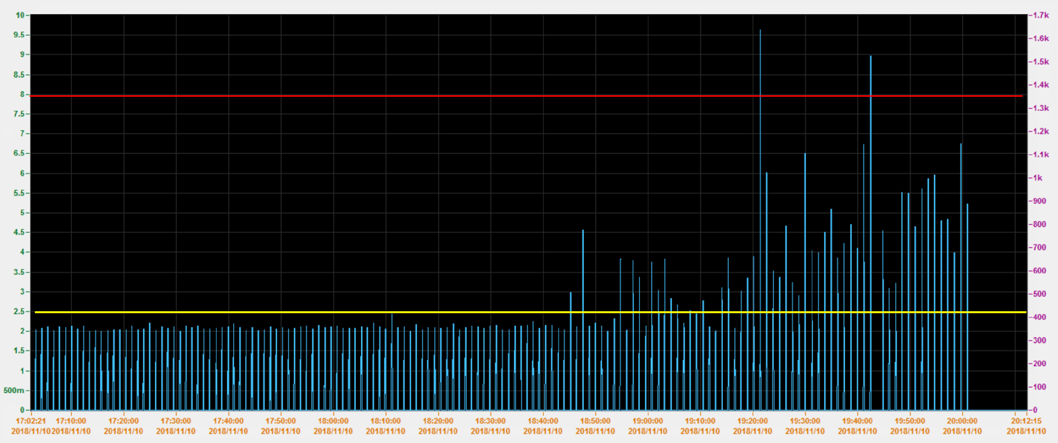
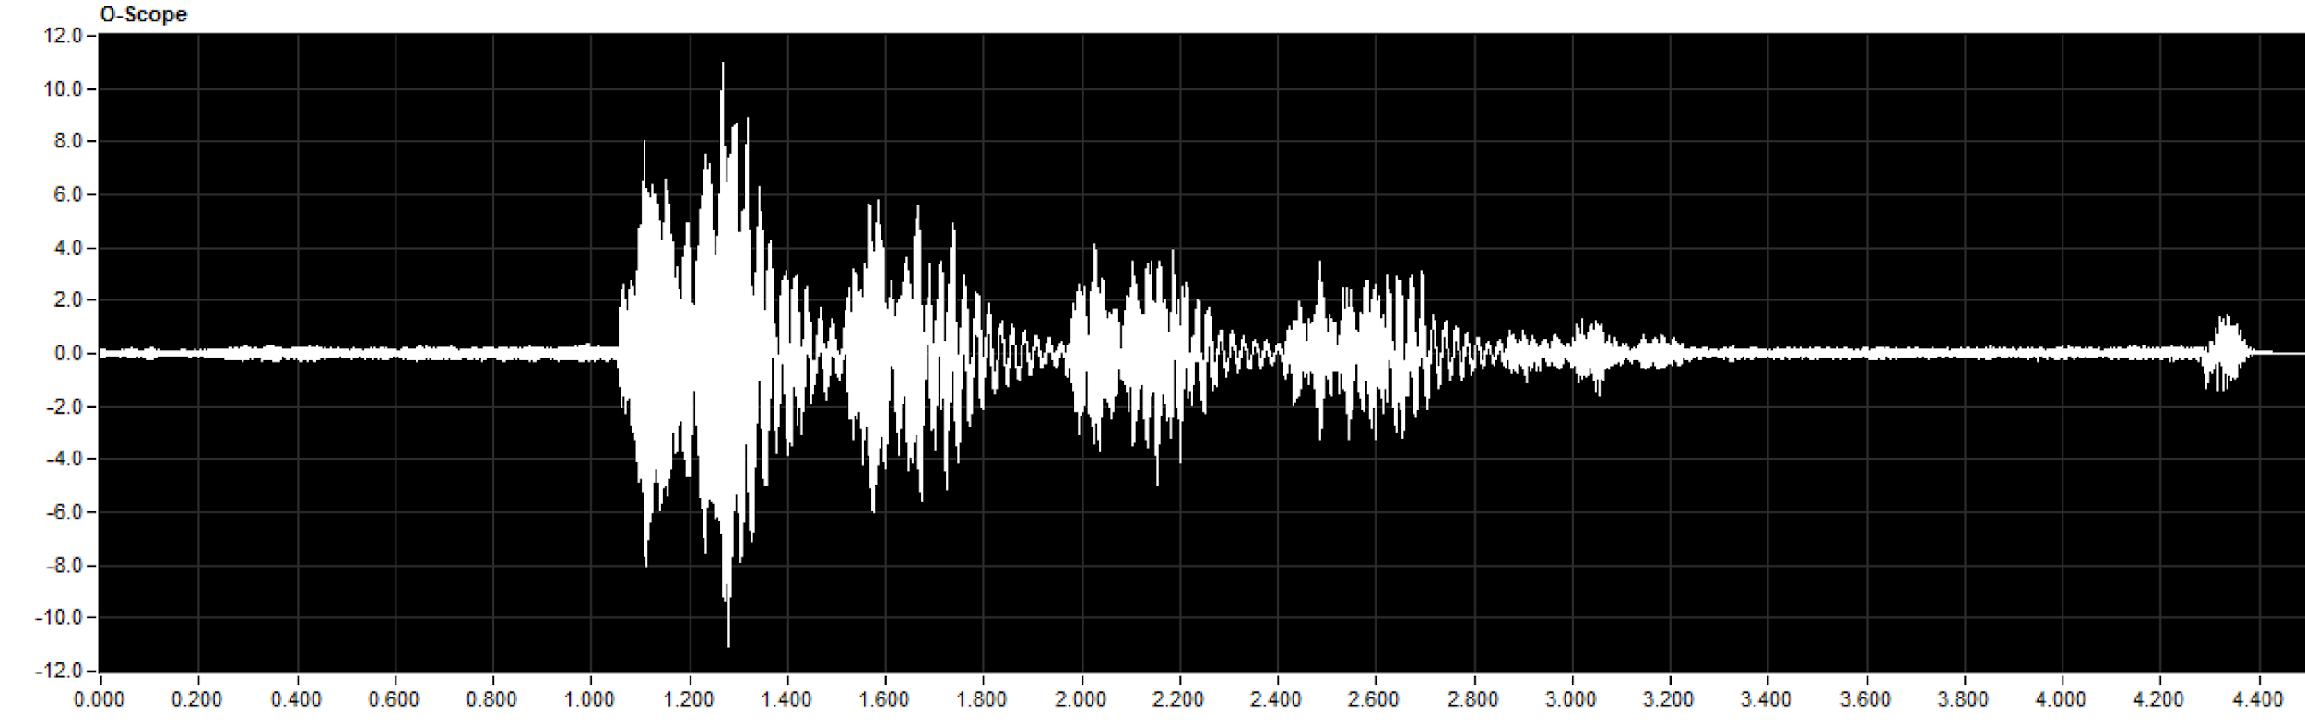
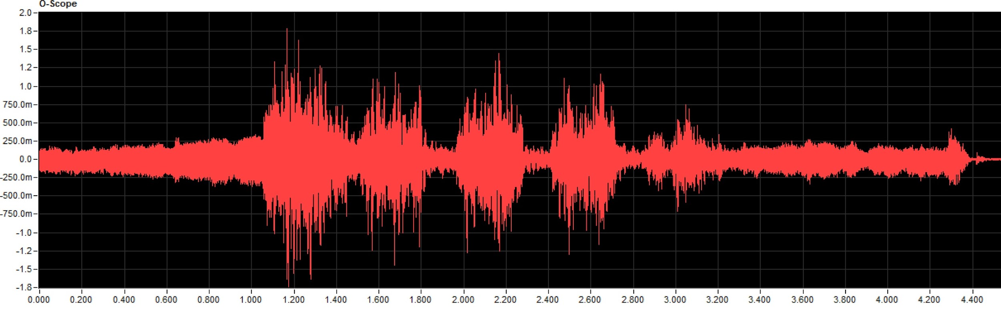
Accelerometer monitoring
Recoater system collision with parts
Parts collision detection
Acceleration max detection
Threshold alarm setting to prevent recoater stop

Slide 22
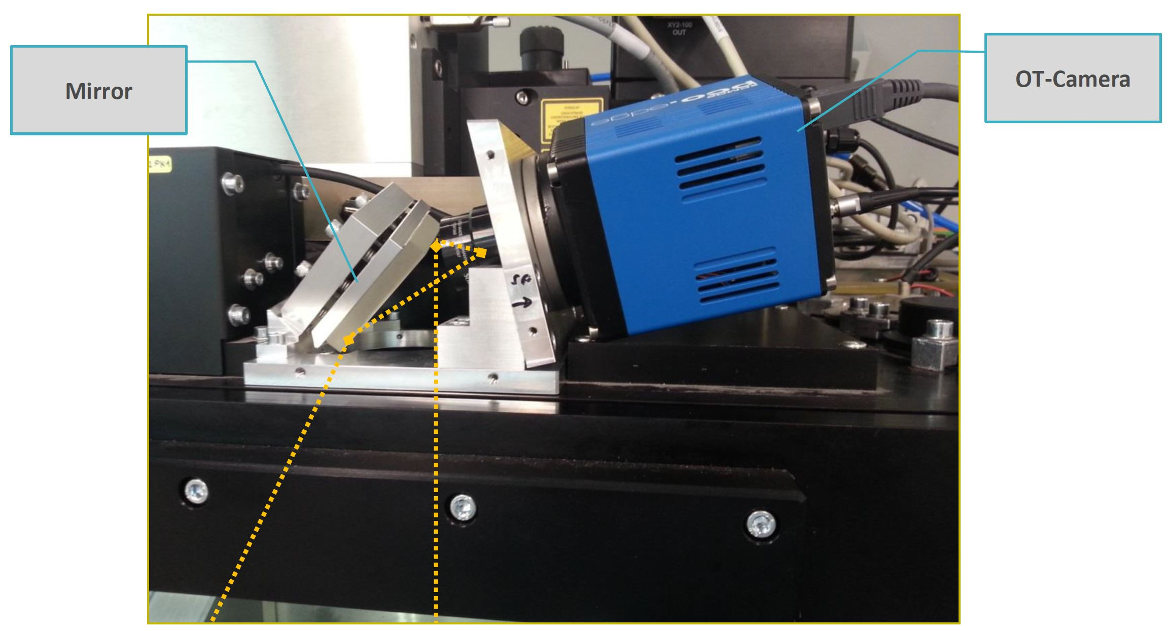
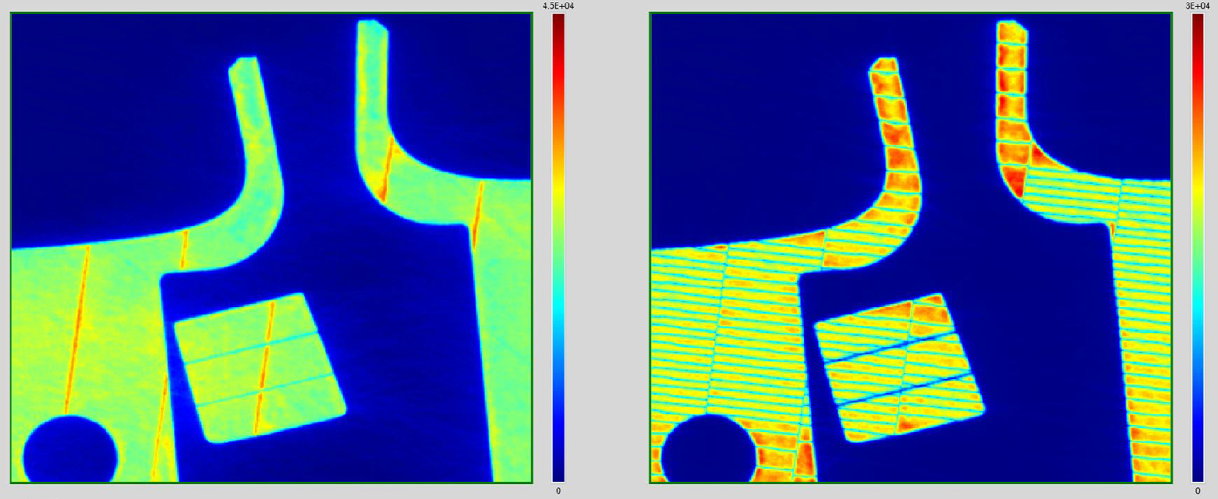
Optical Tomography Monitoring
CMOS Full HD Camera 10 fps
Filter @960 nm
Elaboration software with three different algorithms

Slide 23
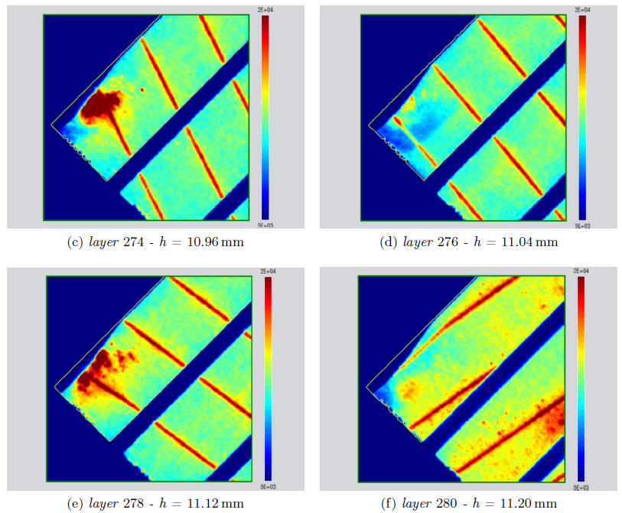
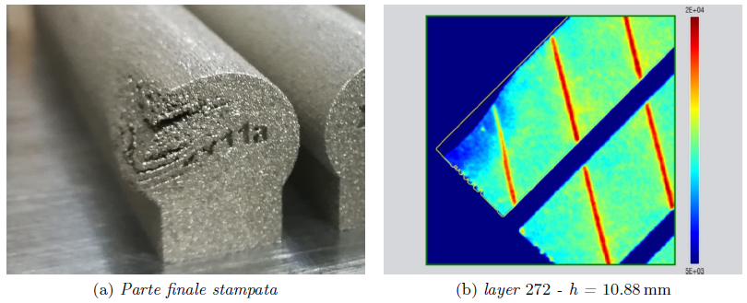
Optical Tomography monitoring
Lack of powder
Cold area during lack of powder
Hot area during thicker layer melting

Slide 24




Optical Tomography monitoring
Gas flow analysis
Parts thermal profile with different nozzles

Slide 25



Optical Tomography monitoring
Defects identification examples
Hotspots in downskin area
High roughness on the part

Slide 26

Optical Tomography monitoring
Defects identification examples
Spatter emission visualization with different GV (Grey value)

Slide 27

Optical Tomography monitoring
Key hole collapse
Key hole collapse zone are visible like colder stripes

Slide 28


MeltPool Monitoring
2 photodiodes with different filters
On-axis and off-axis signal
Online and offline analysis software

Slide 29

MeltPool monitoring
Lack of powder
60 kHz signal visualization
Differences between on- and off-axis images

Slide 30








Sensors integration
Accelerometer
Photodiodes
IR camera
Camera

Slide 31






Sensor integration
Lack of powder
Accelerometer signal
OT image
MeltPool signal and Exposure map

Slide 32





Sensor integration
Recoater collision
Rugosità
Porosità

Slide 33





Available
sensors
Accelerometer
Camera
IR camera
Photodiodes
Sensors
integration
Online feed-back
Powder spreading
Powder bed defects
Exposure
Melting defects
NO
YES
YES
NO –––> Next layer

Slide 34
Towards an integrated sensor system control for direct laser melting
Michele LANZETTA, Francesco MORANTE
University of Pisa Italy Department of Civil and Industrial Engineering
This presentation: www.lanzetta.unipi.it/research/am

