Slide 1
General Portal Settings
- Admin Guide -
October 2024

Slide 2
Release Notes
Item | Slide No. | Change Description
Inbound call filter | 42 | Remove some actions in Inbound Call Filter at Organization Level
UI Enhancement | 98 | Notification to set up custom Public holiday for upcoming year
Security Policy | 111-112 | Add “Always Remember Me” to the Security Policy setting

Slide 3

Agenda
Introduction
Manage Account
Manage Organization
File Explorer
DNC

Slide 4
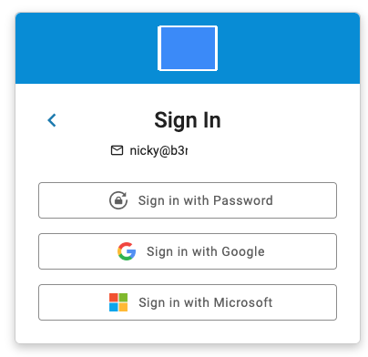
General Portal Settings <Login Portal>
Members who have been granted Portal Access can login by:
Sign In with Password
Sign In with Google
Sign In with Microsoft

Slide 5
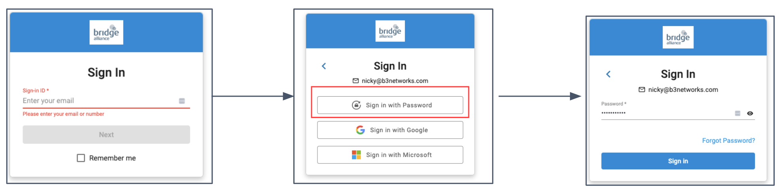
General Portal Settings <Login Portal>
Sign In with Password:
Login to the Domain
Enter a valid Email address
Select the Option Sign In with Password
Enter the Password
Click Sign In

Slide 6
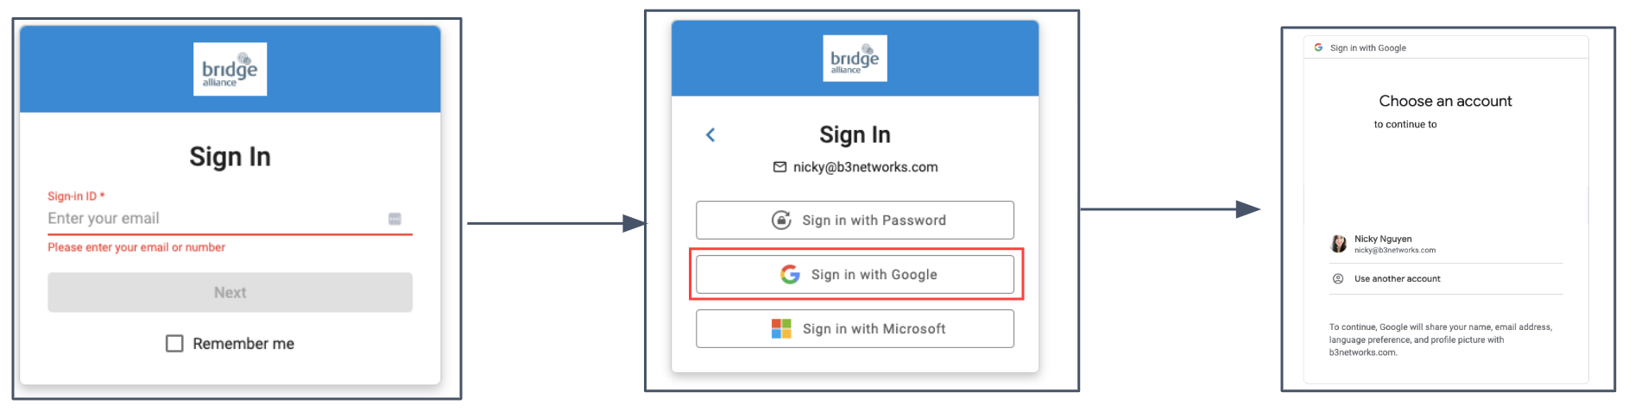
General Portal Settings <Login Portal>
Sign In with Google:
Login to the Domain
Enter a valid Email address
Select the Option Sign In with Google
Choose a Google Account to Proceed

Slide 7
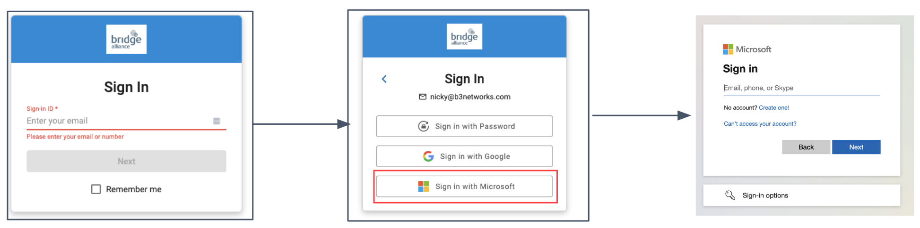
General Portal Settings <Login Portal>
Sign In with Microsoft:
Login to the Domain
Enter a valid Email address
Select the Option Sign In with Microsoft
Enter your Microsoft Email and Password
Click Sign In

Slide 8
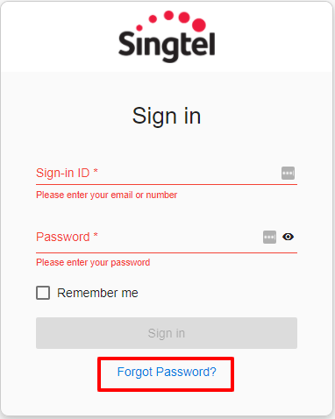

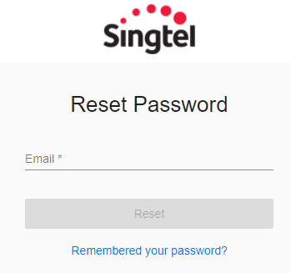
General Portal Settings <Password Reset>
In the case wherein members forget their Password and unable to log in to their account, they can trigger a Password Reset.
They will receive a link via their Registered Email to set a new Password for their respective account.

Slide 9
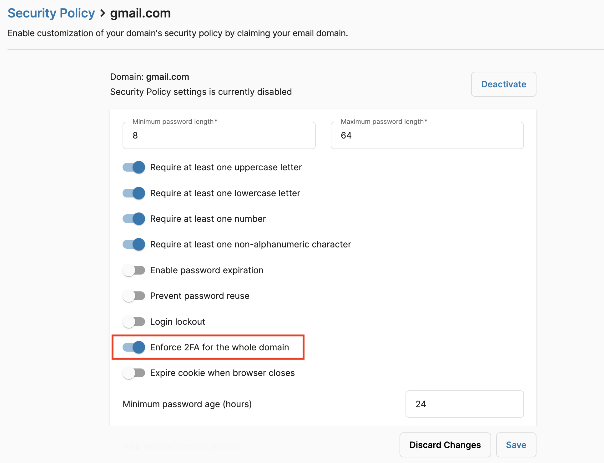
Authenticator App
Authenticator apps offer a secure, convenient, and cost-effective method for implementing two-factor authentication, providing robust protection against unauthorized access.
Prerequisites:
User must enable 2FA feature in Security Policy from Portal Settings.
User must download Authenticator App on their Mobile device (Google Authenticator or Microsoft Authenticator)

Slide 10
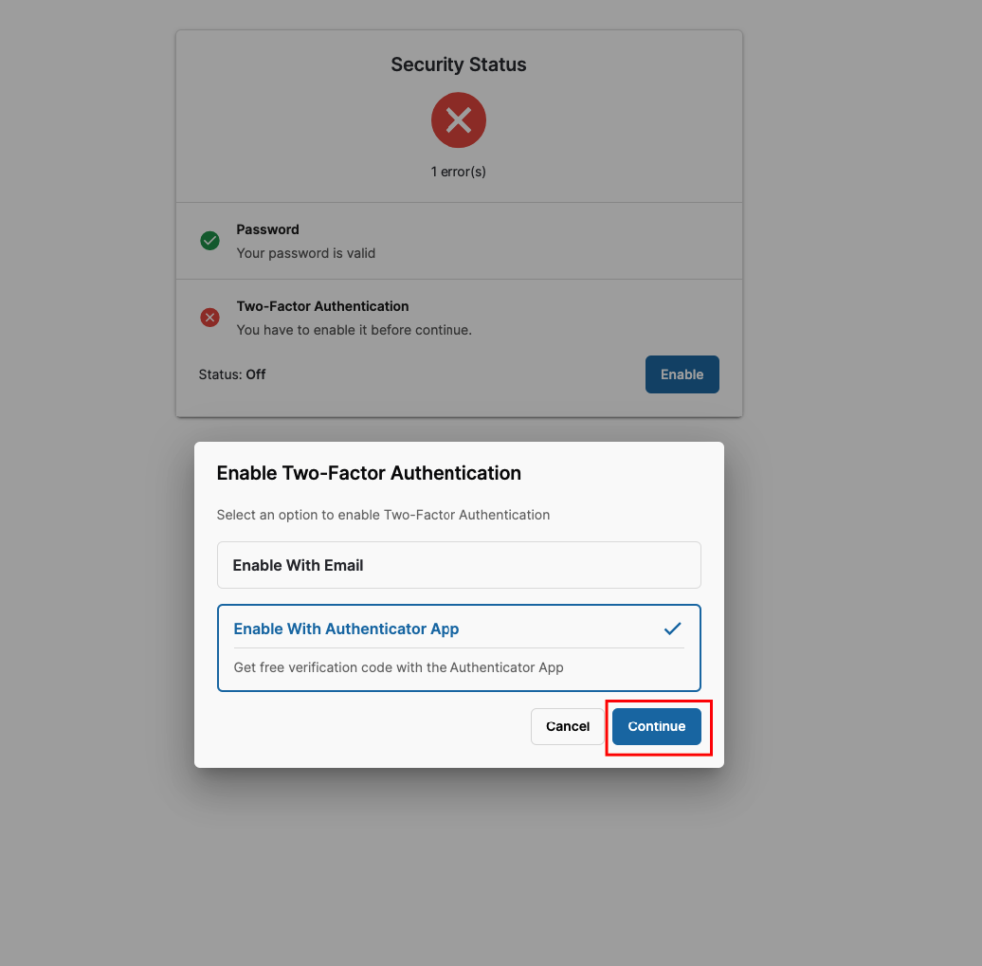
Authenticator App
Step 1: Login to the Portal
Login to the portal by using password or SSO method.
After initial login, a screen will appear to promptly set up 2FA.
Choose Enable With Authenticator App, then click Continue

Slide 11
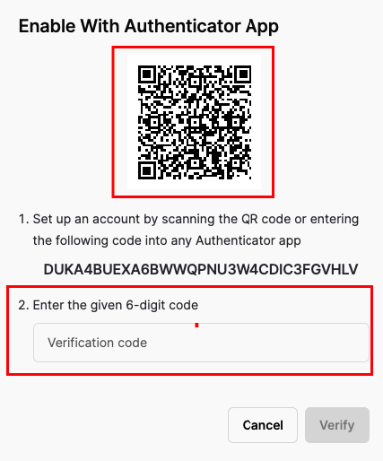
Authenticator App
Step 2: Set up 2FA with an Authenticator App
A pop up will appear. Open preferred authenticator app on mobile device.
Scan the QR code displayed on the pop-up using app's camera.
Authenticator app will generate a unique 6-digit code

Slide 12
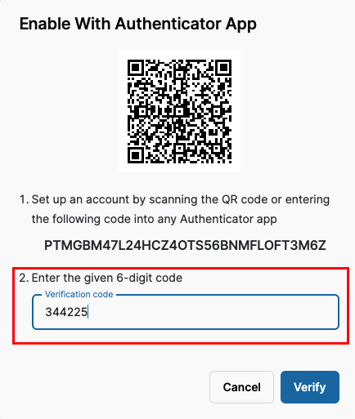
Authenticator App
Step 3: Verification Code
Enter the 6-digit code from app into the blank Verification code and click Verify to complete 2FA setup.
Note:
If can not scan QR code due to camera issues or preference, using a secret code displayed alongside the QR code. Enter this code into authenticator app to generate the 6-digit code.

Slide 13
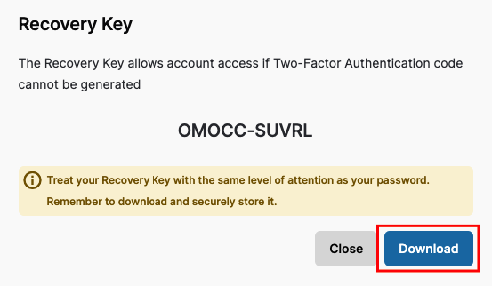
Authenticator App
Step 4: Save Recovery Key
A pop-up will show to request user to download or save the Recovery Key.
User should save this Key in case they need to recovery account.

Slide 14
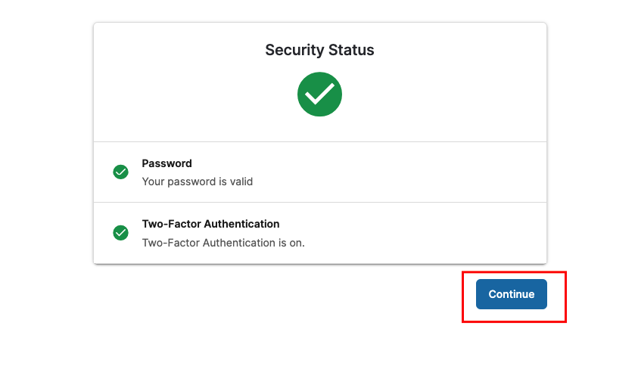
Authenticator App
Step 5: Confirmation
Once completing all the steps, a confirmation message will pop up. Click Continue to finalize the setup.
User can use authenticator app for the next login.

Slide 15
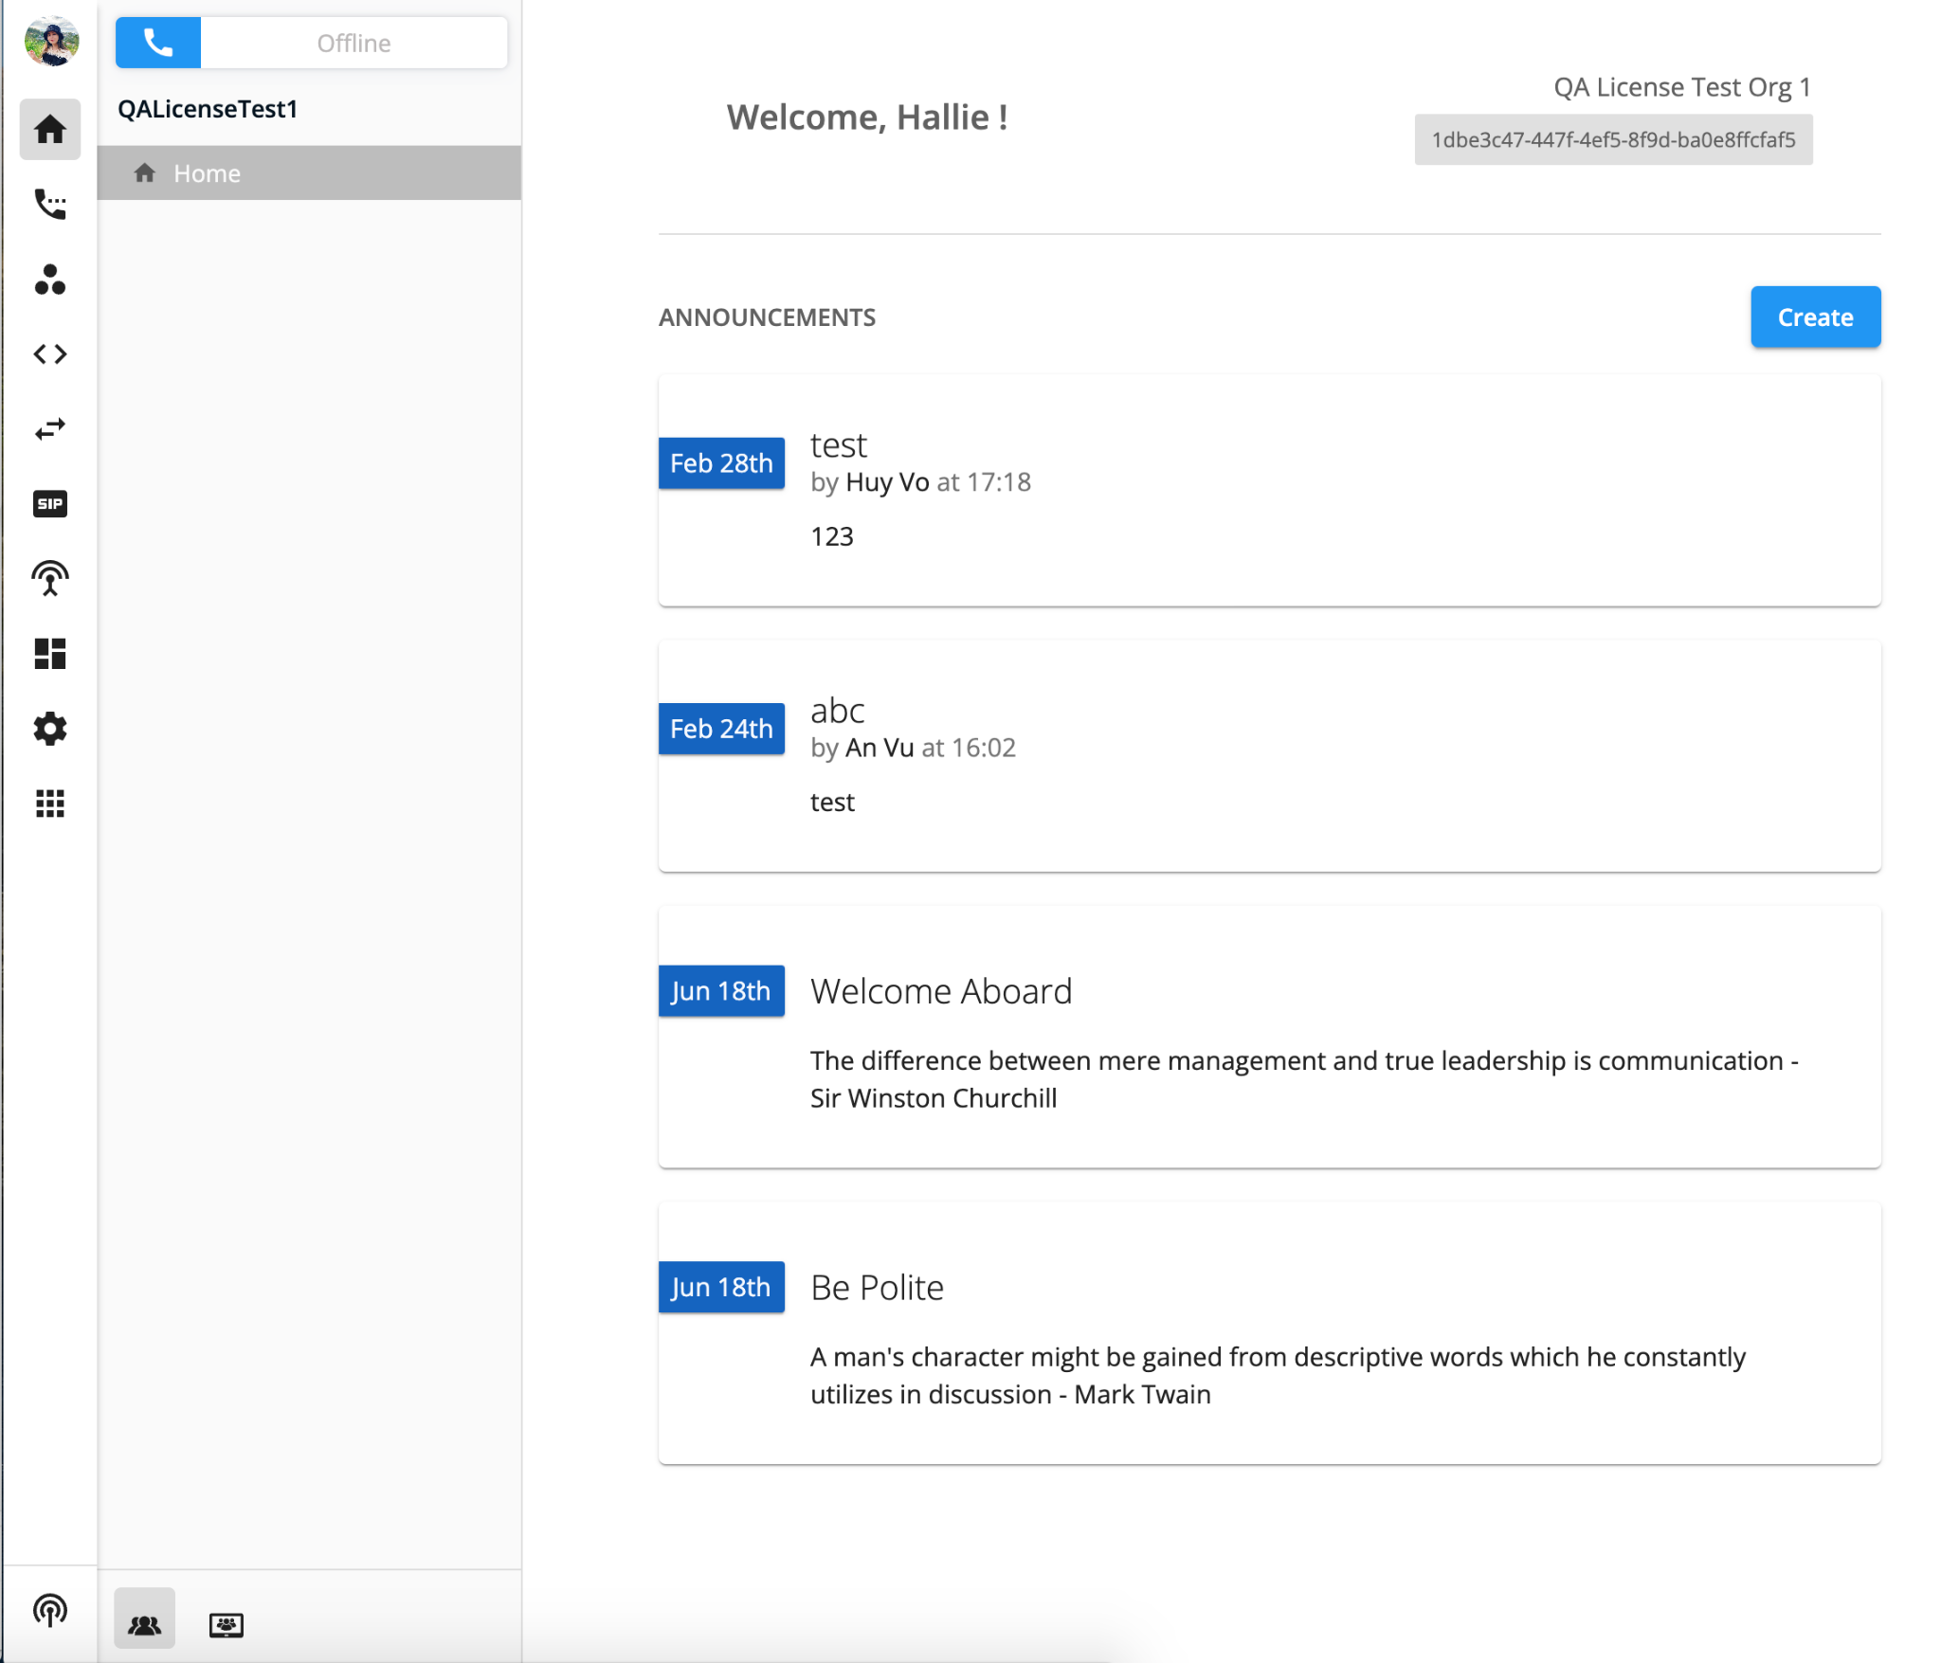
General Portal Settings <Homepage>
Design for
Digital Customer Experience
Enterprise Teams and Access Management Workflow
Dark Mode Supported
Once logged in, Owner/Admins will be directed to the Homepage wherein they can view/create announcements for their organization, and access the Web Phone/Team Chat on the side bar.

Slide 16
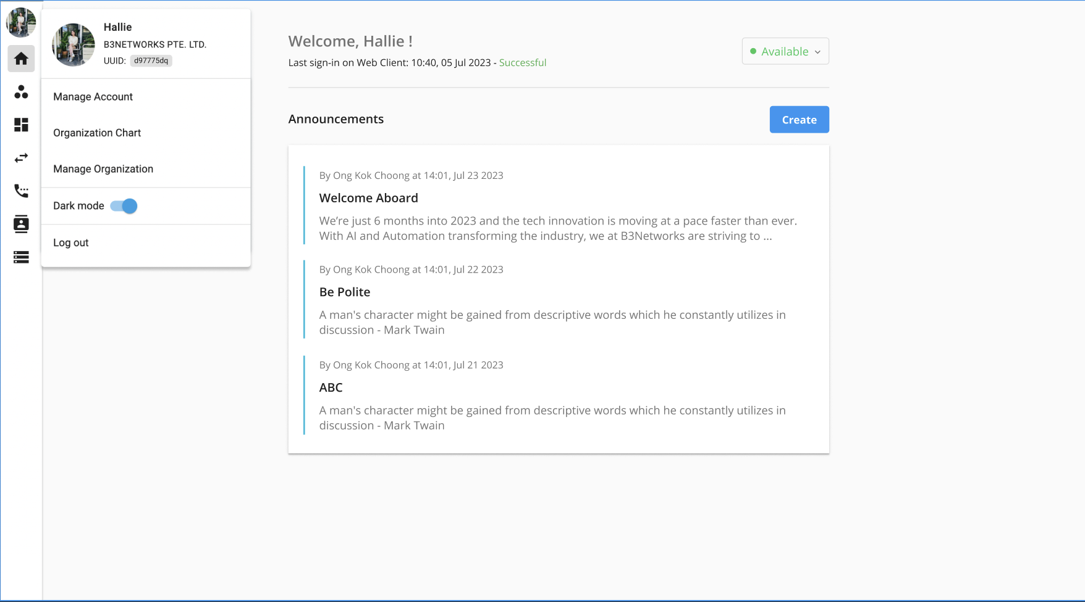
General Portal Settings <Homepage>
UI supports to display each item in Home tab according to assigned licenses of users.
Item in Home Page | Assigned Licenses
Status Bar | Base: Phone System Addon: None

Slide 17
General Portal Settings <Homepage>
Portal offers both light mode and dark mode, allowing users to select their preferred visual settings:
Login to the portal
Go to profile
Turn on/off for light/dark mode

Slide 18
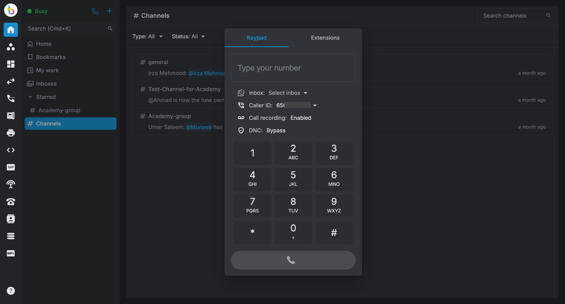
General Portal Settings <Homepage>
Item in Home Page | Assigned Licenses
Status Bar Web Phone Call icon | Base: Phone system Addon: Web Phone

Slide 19
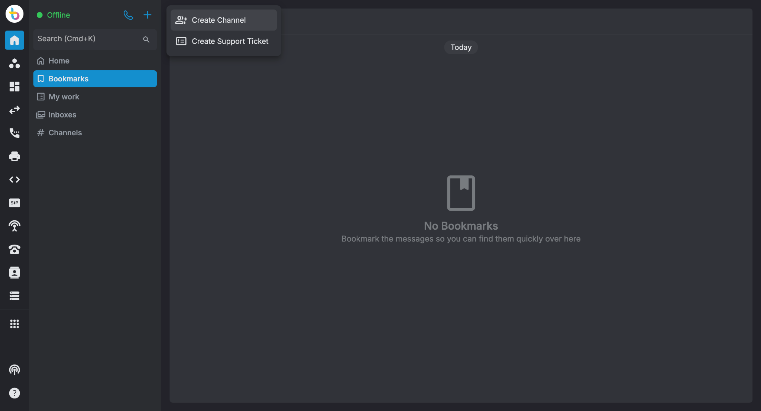
General Portal Settings <Homepage>
Items in Home Page | Assigned Licenses
Status bar Team Chat section on web | Base: Phone system Addon: Team Chat & Web Phone

Slide 20
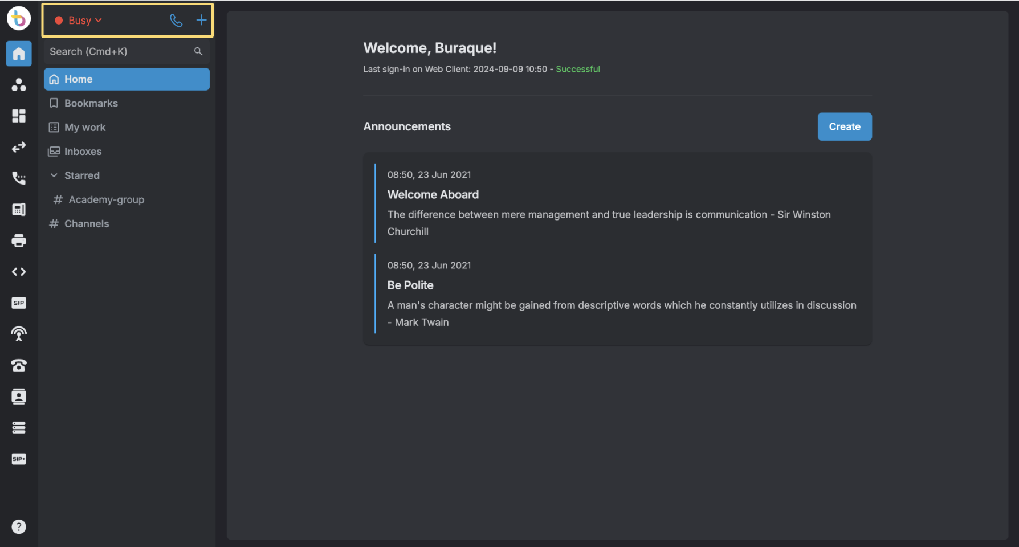
General Portal Settings <Homepage>
Items in Home Page | Assigned Licenses
Status Bar Inbox Section: Me + inboxes | Base: Phone System Addon: Contact Center (compulsory) Channel License (live chat or support center or email etc) opptional based on what channel the agents belong to
Note:
The agents' state on Unified Workspace keeps users aware of their current status, helping them manage workflow, task load, and availability effectively
Status bar is Available by default and is not allowed to change if the extension is assigned to Microsoft Teams and Zoom licenses.

Slide 21
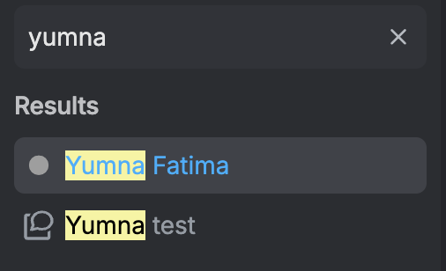
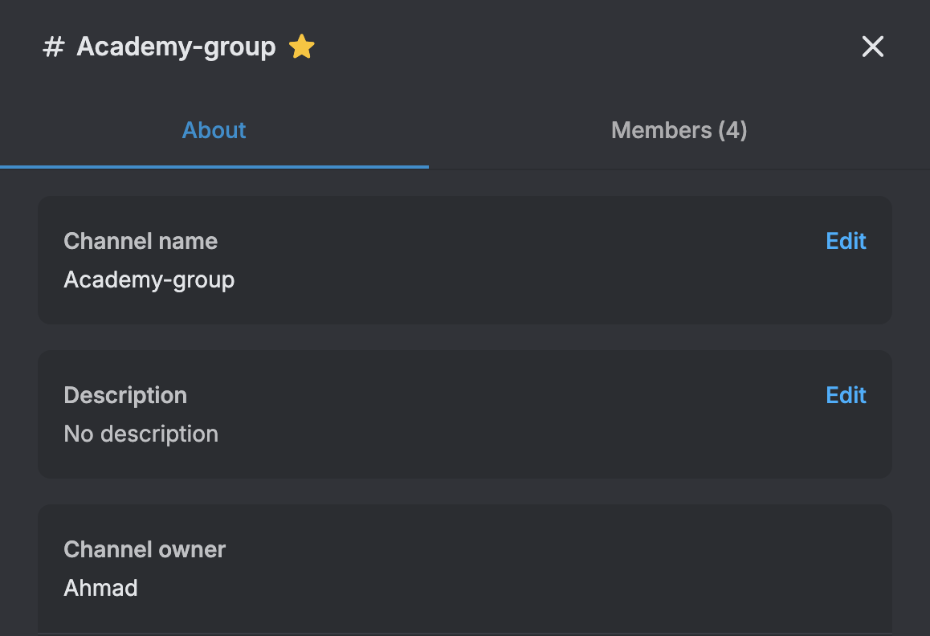
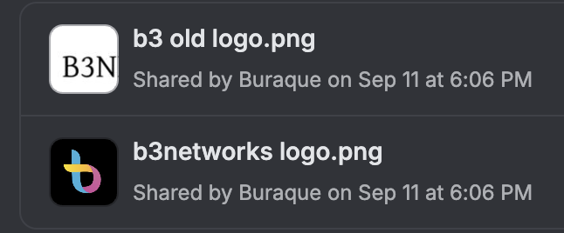
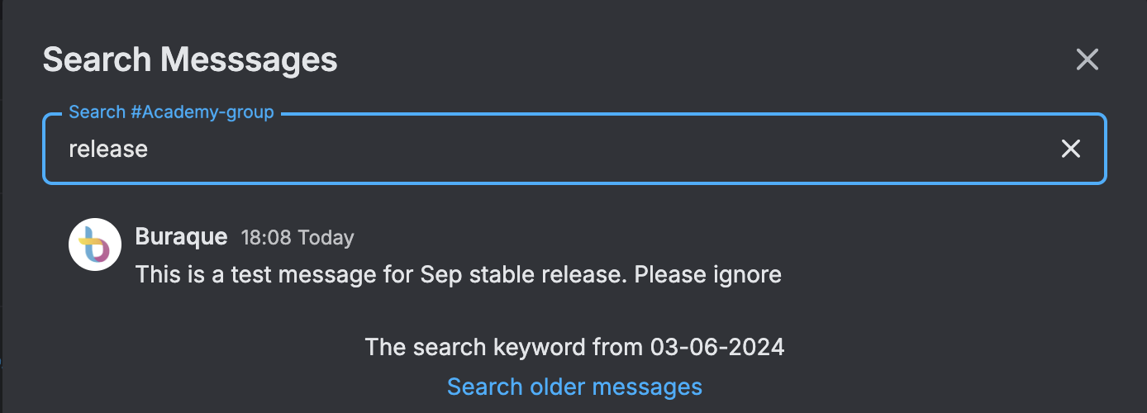
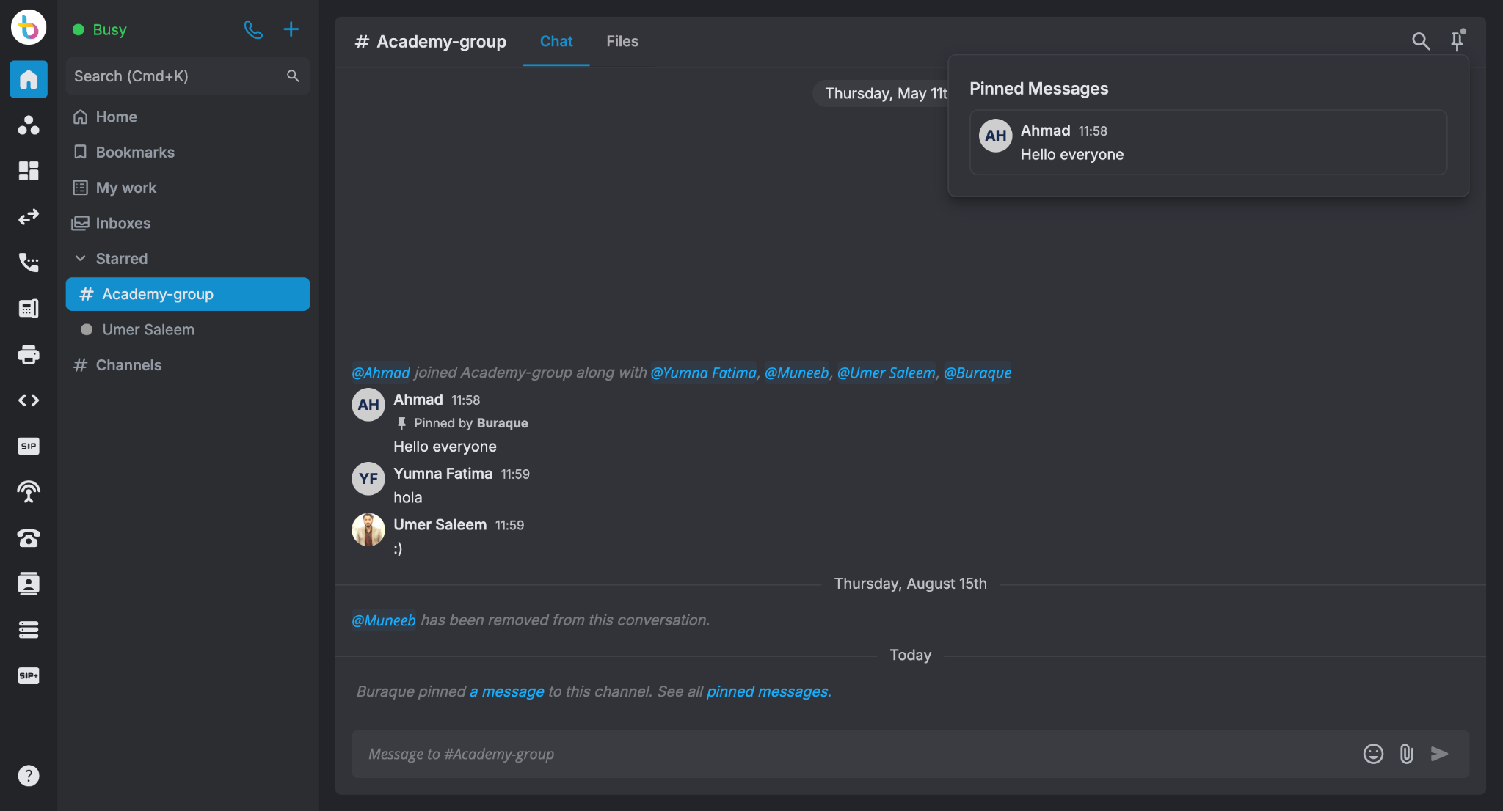

General Portal Settings <Homepage> Explanation
Click on the channel name to check channel information
Search users and channels
Check uploaded files
Search messages
Check Bookmarked messages
Agents can manage their tickets
Check pinned messages
All Inboxes merged inside one tab
Display starred users and channels
Display available channels

Slide 22
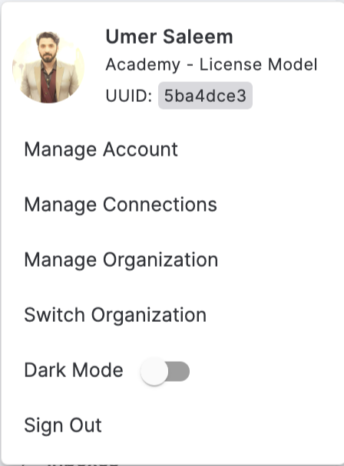
General Portal Settings Profile Menu Explanation
Identity Avatar
Identity Name
Org Name
Org UUID
Manage Organization
(If access to Org settings)
Switch Organization
(If access to multiple Orgs)
Enable Light/Dark Mode
Sign Out

Slide 23
Manage Accounts

Slide 24

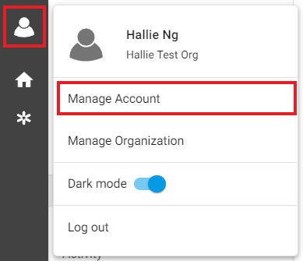


General Portal Settings <Account Navigation Options>
By clicking on the User Icon, the following options can be selected:
Manage Account: Lets Owner/Admins edit certain settings for their accounts.
Manage Organization: Directs Owner/Admins to the Org Management tab wherein they can navigate and manage Organization related Settings.
Dark Mode: Allows Owner/Admins to switch colors on the sidebar (Dark/Light).
Log Out: Allows Owner/Admins to sign out of the accounts.

Slide 25
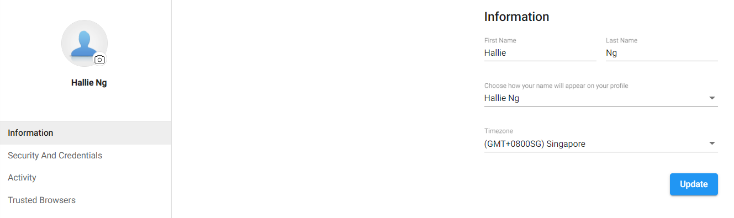

Manage Account <Information>
Owner/Admins can customize their:
Account Image
Account Name
Timezone

Slide 26
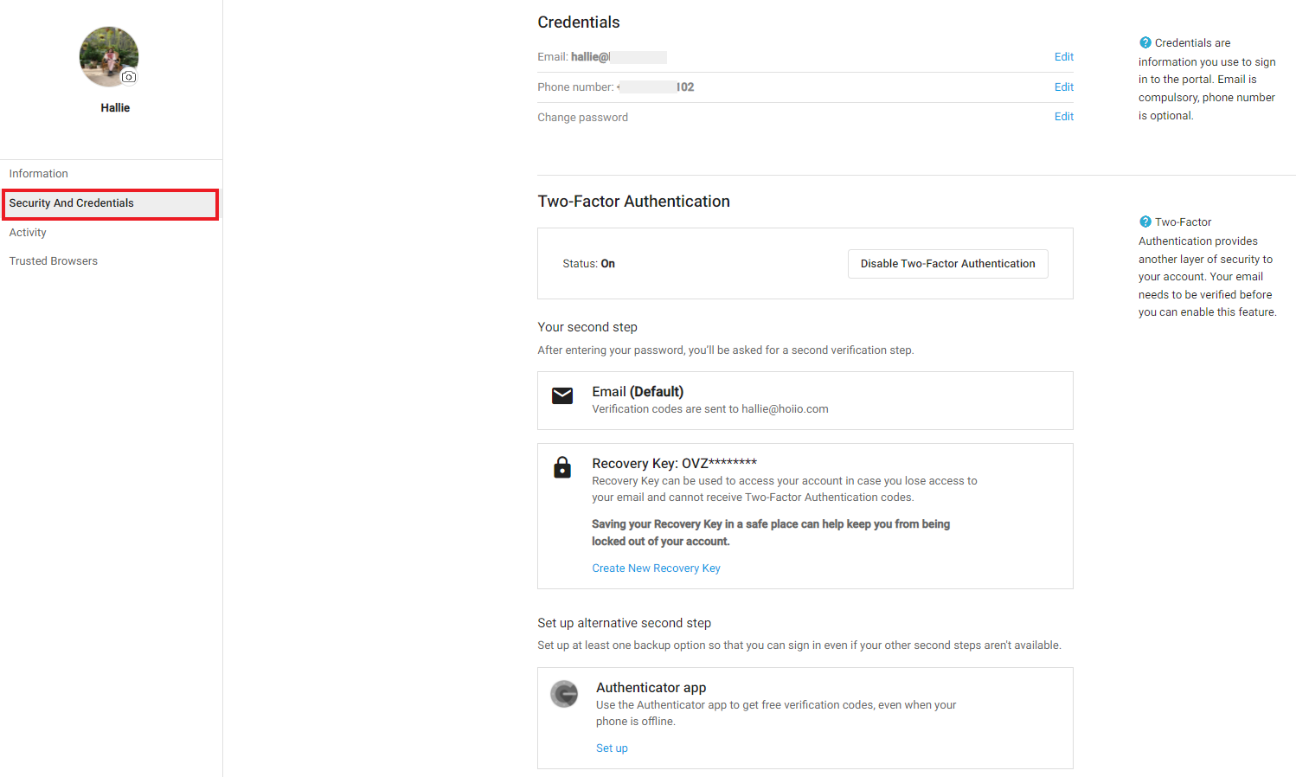
Manage Account <Security and Credentials>
Allows Owner/Admins to manage their:
Account Credentials
  Email Address
  Phone Number
  Password
Two-Factor Authentication
  Recovery Key
  Alternative Second Step

Slide 27
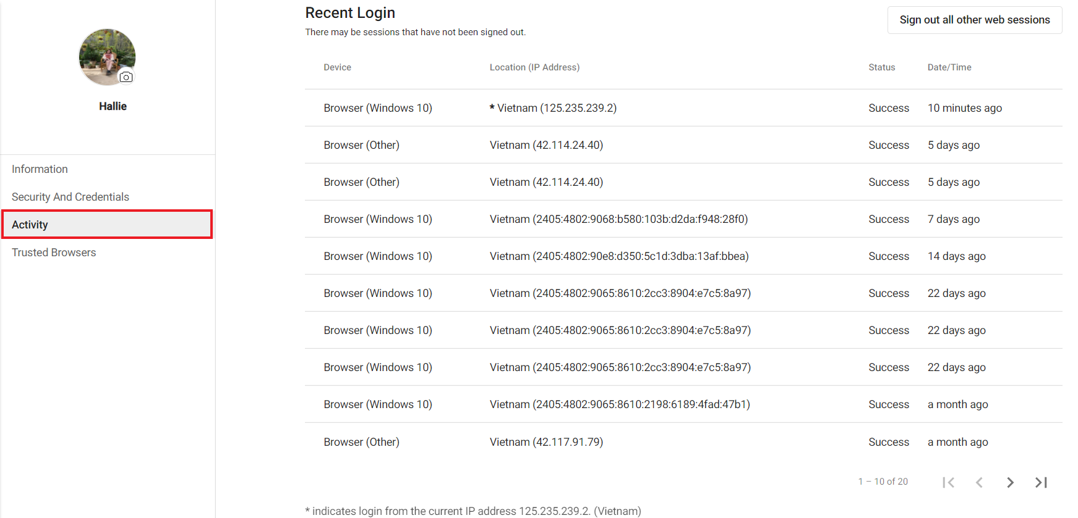
Manage Account <Activity>
Gives Owner/Admins visibility on login activity for their account.
The portal shows the twenty (20) most recent account activities.

Slide 28
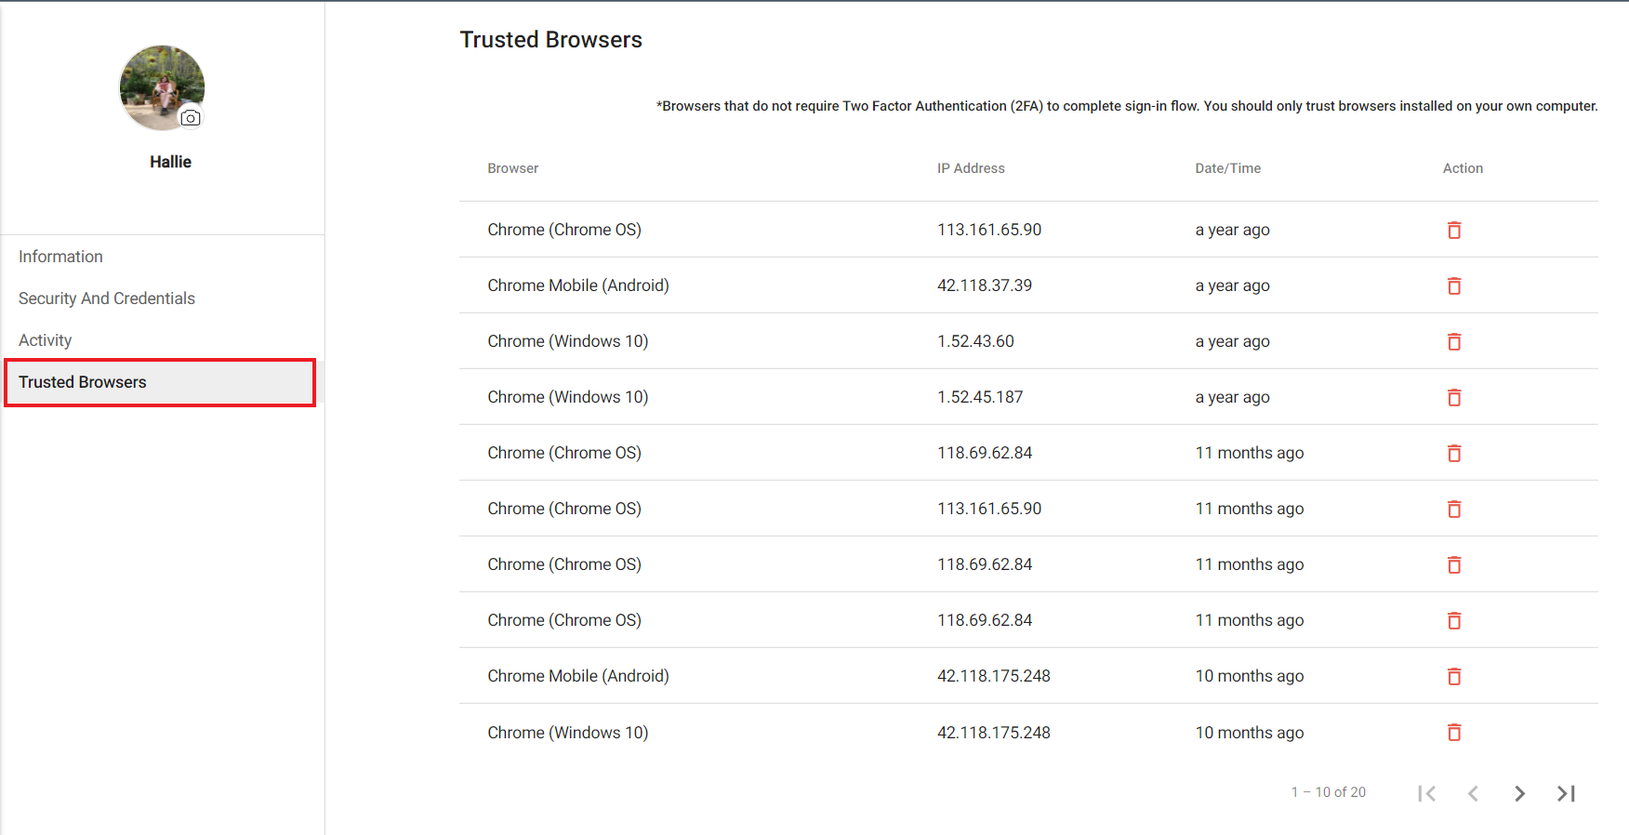
Manage Account <Trusted Browsers>
Shows the list of trusted browsers the Owner/Admins have accessed their accounts from.
*Trusted Browsers do not require Two Factor Authentication (2FA) to complete sign-in flow. You should only trust the browsers installed on your own computer.

Slide 29
Manage Organization

Slide 30
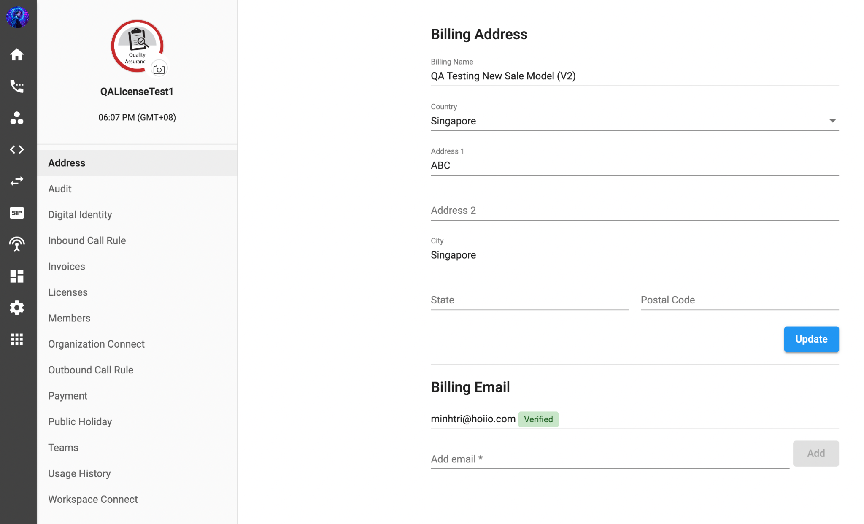
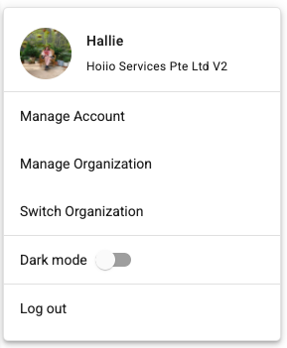
Manage Organization <Overview>
Manage Organization is a page for admins to easily manage and navigate to general organization information.

Slide 31
Permission Management for Manage Organization
Permission | Behaviors
Admin does not have any of the following Permissions: People Organization Settings | Cannot access Manage Organization page See Error Message upon access: “Insufficient permissions. Please contact your Organization’s Owner.”
Admin has Permission: People > The whole organization | Can access Manage Organization page with following tabs: Members (Everyone) Licenses (Everyone) Teams (Every team)
Admin has Permission: People > Specific teams | Can access Manage Organization page with following tabs: Members (Assigned team) Licenses (Assigned team) Teams (Assigned team)
Admin has Permission: Organization Settings | Can access Manage Organization page with following tabs:
 | Address Audit Digital Identity Inbound Call Rule Invoices | Organization Connect Outbound Call Rule Payment Public Holiday Usage History

Slide 32
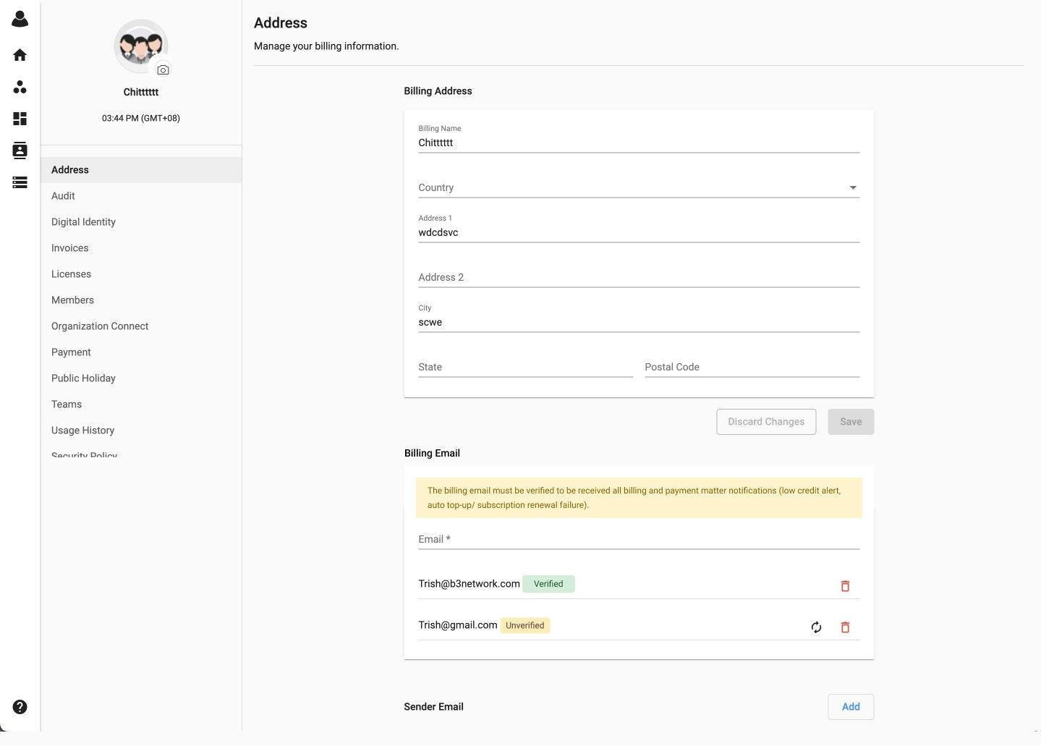
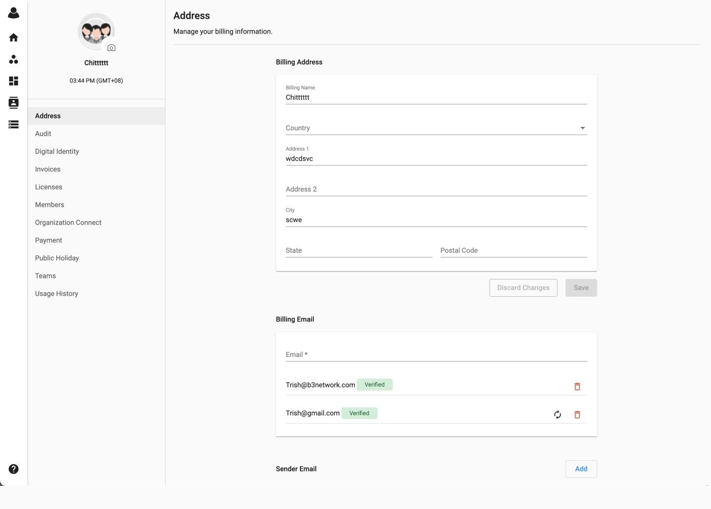
Manage Organization <Address>
Allows admins to update:
Billing Address:
Choose [Address]
Change Billing Details
Update
Billing Email:
Fill in Email address
Add
Note:
If the billing email is unverified, users will see a highlighted warning message stating that the billing email must be verified in order to receive all billing and payment matter notifications
If every billing email is verified, then the warning message will not be visible

Slide 33
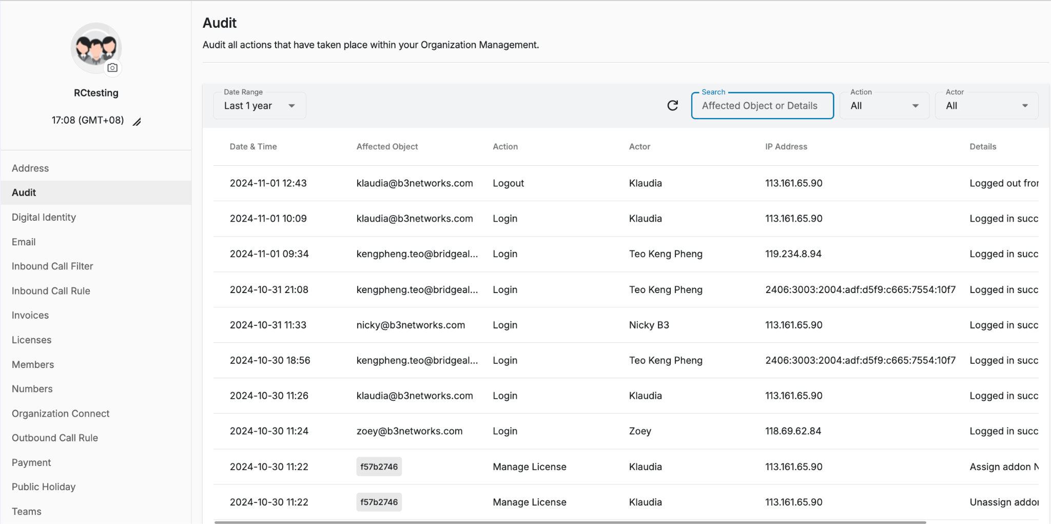
Manage Organization <Audit>
The tab allows admins to audit all actions taken place within the portal.
Only Owners and Admins (who are granted access from Organization Settings Permission Group) can access Audit tab in Manage Organization.
Retention Period:
The retention period in which users can see the audit logs is 1 year.
If you request logs that are older than 1 year, we will handle it as a one-time request, and B3 will charge a fee for retrieving them.

Slide 34
Manage Organization <Audit>
Audit Tab Column Details
Date & Time | Display timestamp of the action
Affected Object | Display the target object of the action
Action | Display the actions of actors within the organization
 | All Create Email Create Member Create Team Login Logout Create inbound Call Rule Update Inbound Call Rule Create Outbound Call Rule Update Outbound Call Rule Manage User Assignment Manage VIP Member Manage Myinfo Manage Billing information Manage Organization Connect Manage Permission Group | Send Activation Email Topup Update Member Update Team Update Public Holiday Edit Directory Name Provision Extension Remove Store Credit Card Delete Extension Delete Pending User Disable Auto Topup Edit Custom Holiday Edit Extension Key Enable Auto Topup Manage License
Actor | Done via Identity Done via System Done via Remote Support
IP Address | Display the IP address that triggered the action
Details | Show detailed actions of the actors within the organization

Slide 35
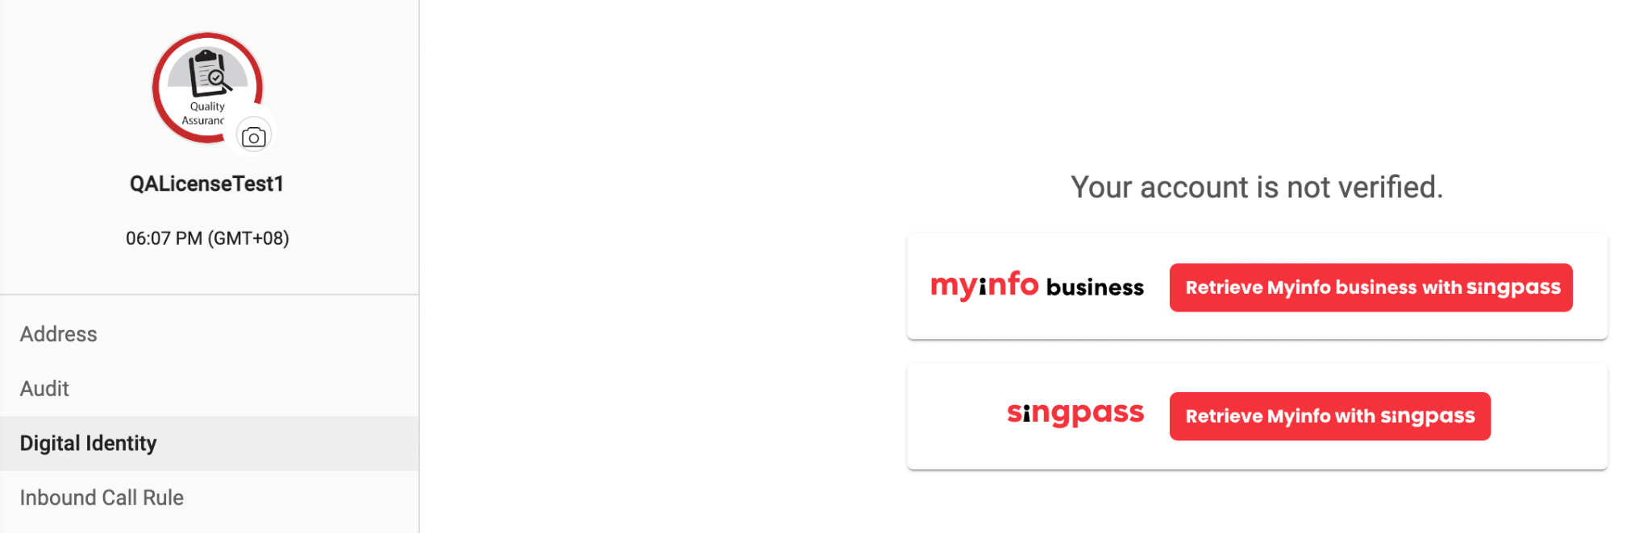
Manage Organization <Digital Identify>
Overview
MyInfo is a service that allows individual/corporate users to manage their personal data and pre-fill forms in digital services transactions.
This verification step is obligatory if users would like to purchase number from the system.

Slide 36


Manage Organization <Digital Identify>
2. Verify your account with MyInfo
For personal account, choose [SingPass] > a link will open, please insert SingPass ID, and Password before login
For company account, choose [MyInfo Business] > a link will open, please insert UEN ID, CORPPASS ID and Password to log in

Slide 37
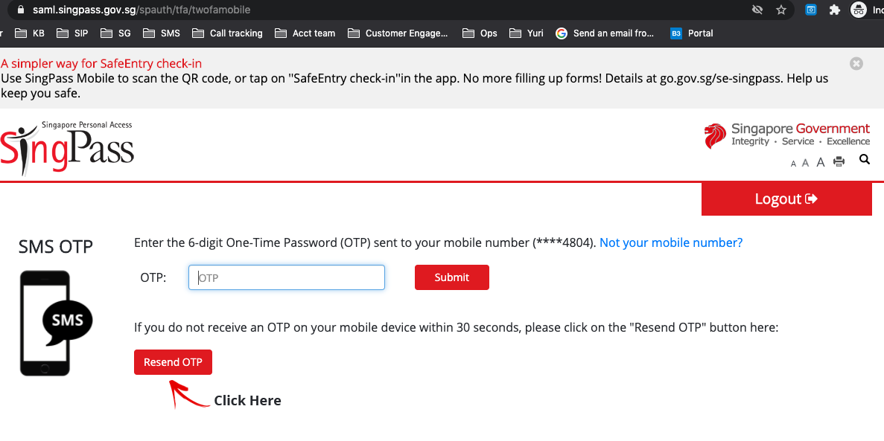
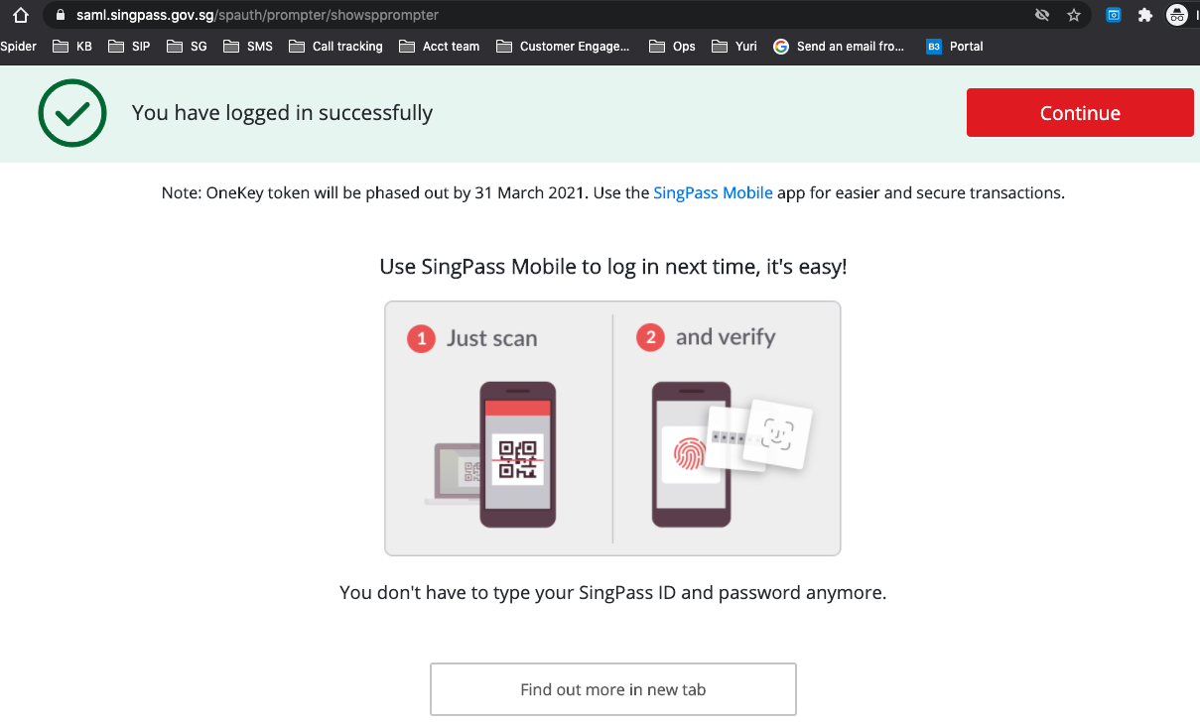
Manage Organization <Digital Identify>
2. Verify your account with MyInfo (cont’d)
Key in your OTP
2. Then press [Continue]

Slide 38
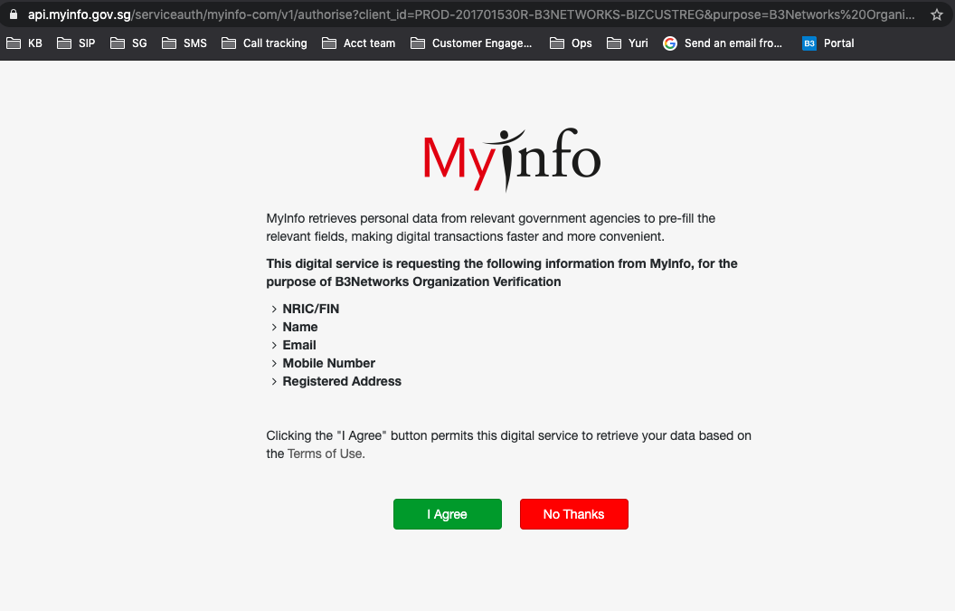
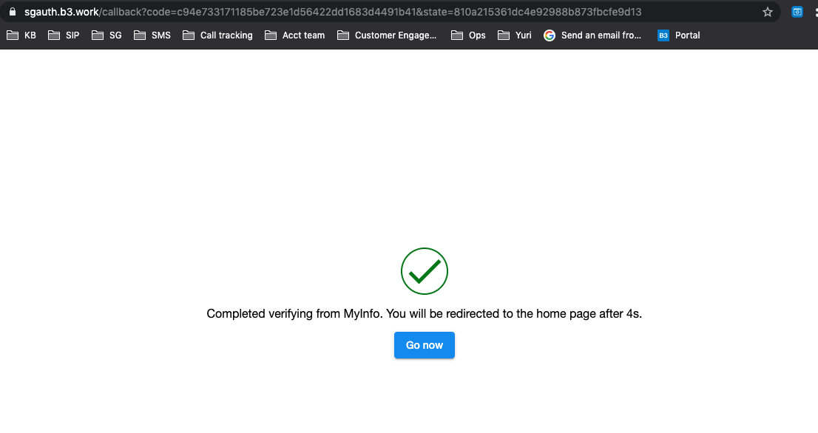
Manage Organization <Digital Identify>
2. Verify your account with MyInfo (cont’d)
3. Click [I Agree]
4. Complete the process

Slide 39
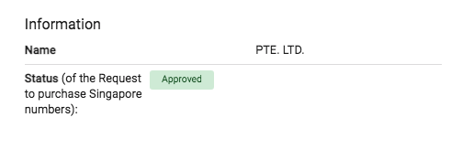
Manage Organization <Digital Identify>
2. Verify your account with MyInfo (cont’d)
5. Go back to the portal to check verified information

Slide 40
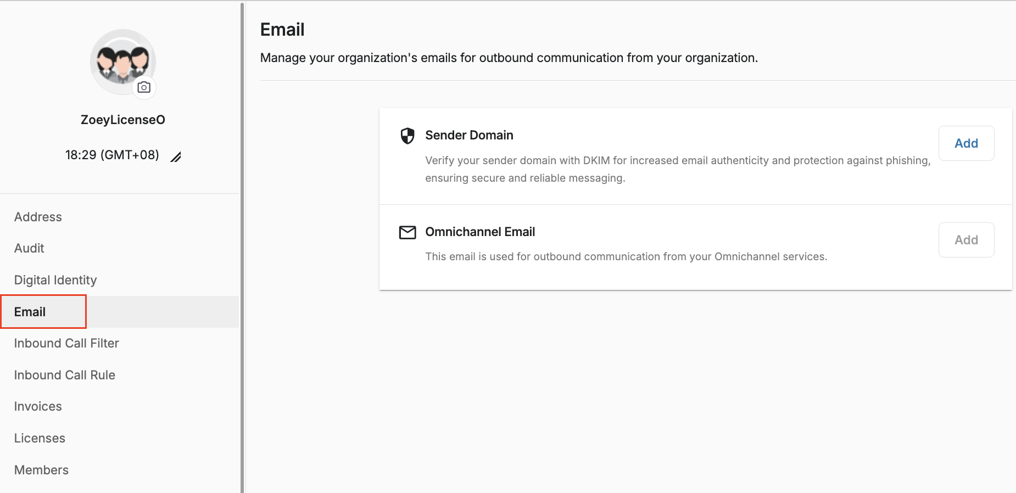
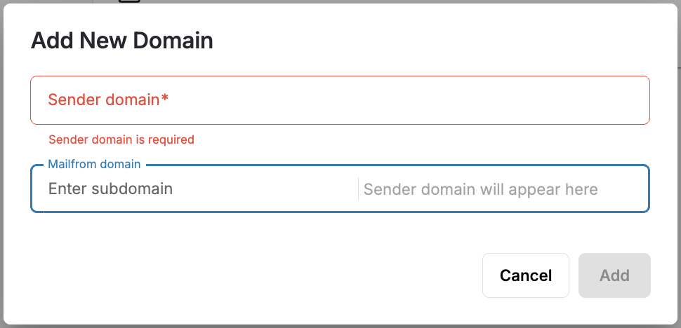
Manage Configuration <Email>
Sender Domain
Allow verifying sender domains for secure outbound communication.
Sender Domain
Allow adding and managing sender emails for the outbound communication of the Omnichannel services.
Note:
To There's a maximum limit of 10 Sender domains and 10 Omnichannel emails.
When adding a sender domain, users can optionally specify a Mailfrom domain. If not specified initially, it can't be added later.
Mailfrom domain: users only need to input Subdomain. Sender domain will automatically appear.
Mailfrom domain = Subdomain (enter) + Sender domain (autofilled).

Slide 41
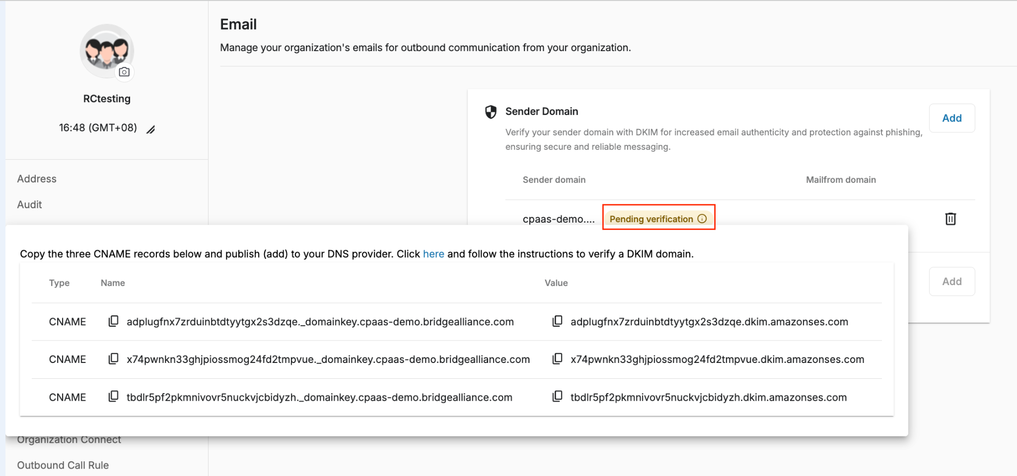
Manage Configuration <Email>
Configuration:
Sender Domain:
Click Add Sender Domain
Input Sender domain
Input subdomain for Mailfrom domain (optional)
Click Add
Click on the info icon of Pending verification
Follow the instructions to verify domains

Slide 42
Manage Configuration <Email>
Configuration:
Omnichannel Email:
Note: After verifying a Sender Domain, users can add Omnichannel emails.
Click Add Omnichannel Email
Input Email
Select one verified domain
Click Add

Slide 43
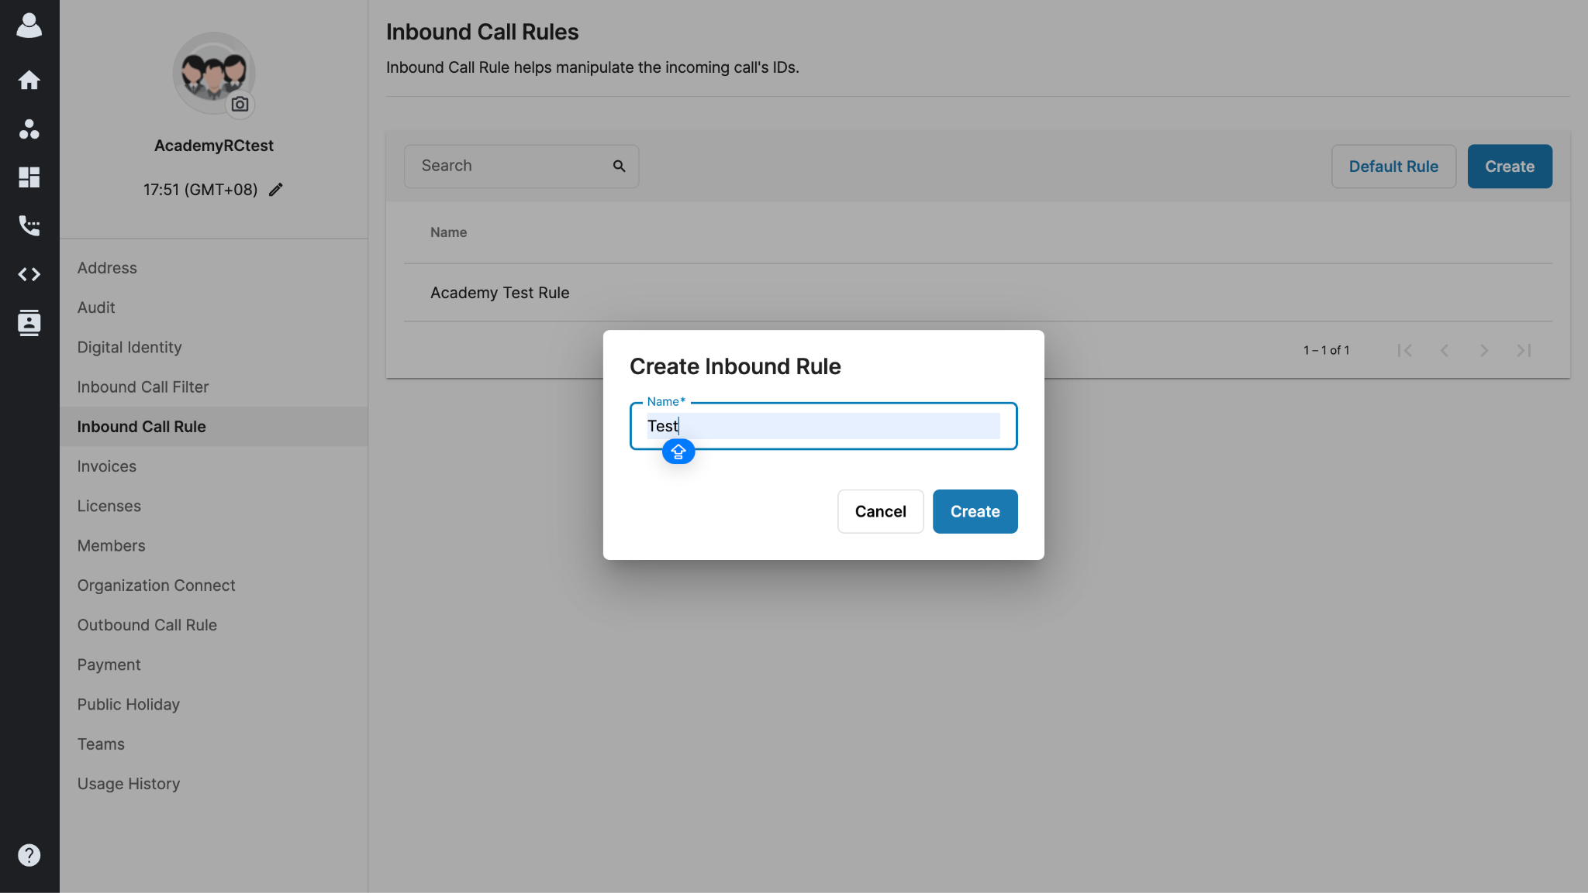
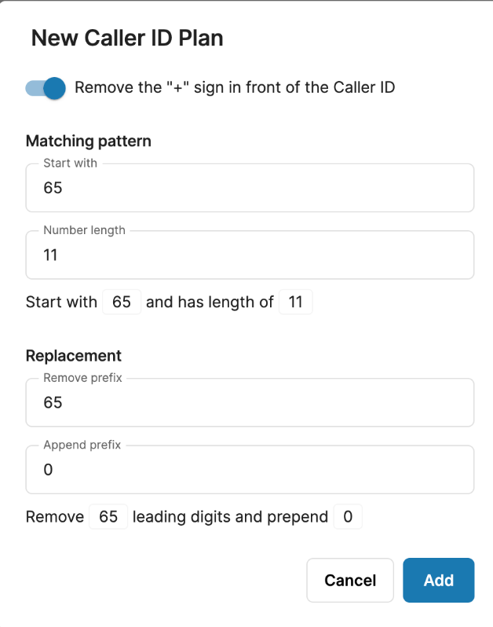
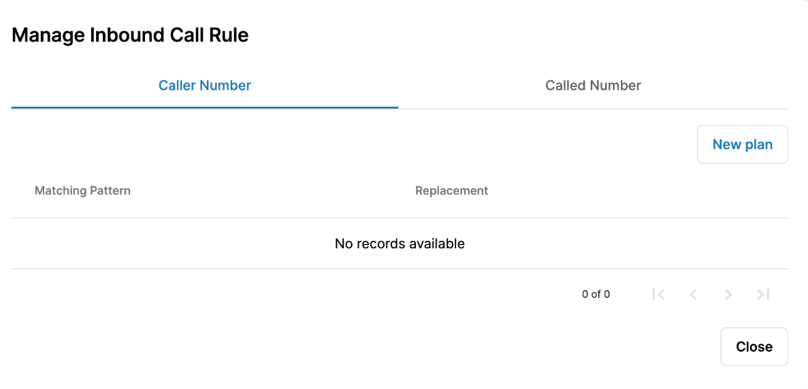
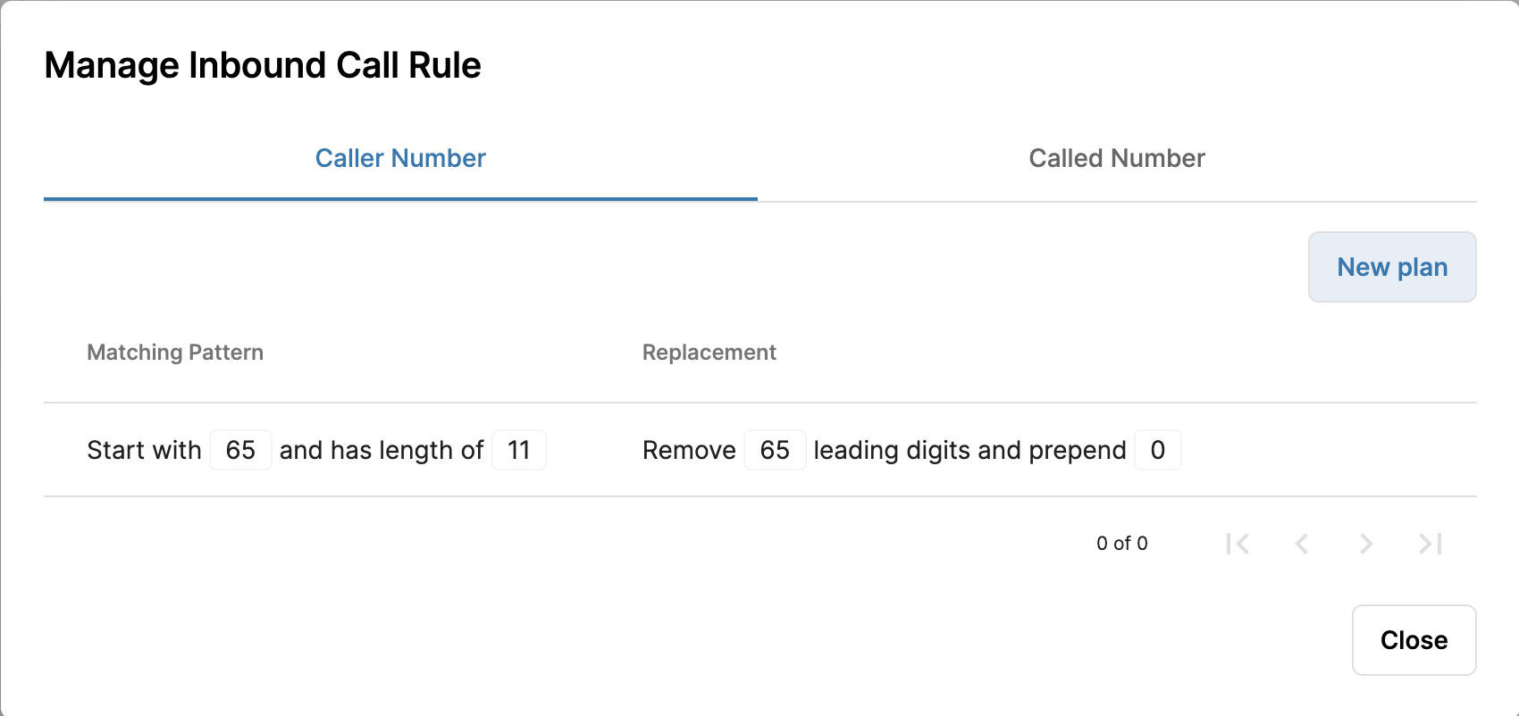
Manage Configuration <Inbound Call Rule>
Custom Inbound Call Rule
As a default, the system will display this standard Caller ID on the recipient's side when users make outgoing calls:
<country code> + <area code> + <destination>
It is possible for Owner/Admins to create an Inbound Call Rule that will override the way the recipients see the Caller ID.
To create an Inbound Call Rule, follow the steps below:
Go to Manage Organization
Go to Inbound Call Rule
Click Create
Give the rule a name > Create
Click on the New plan button to configure the rule
Provide the Caller ID plan > Add

Slide 44
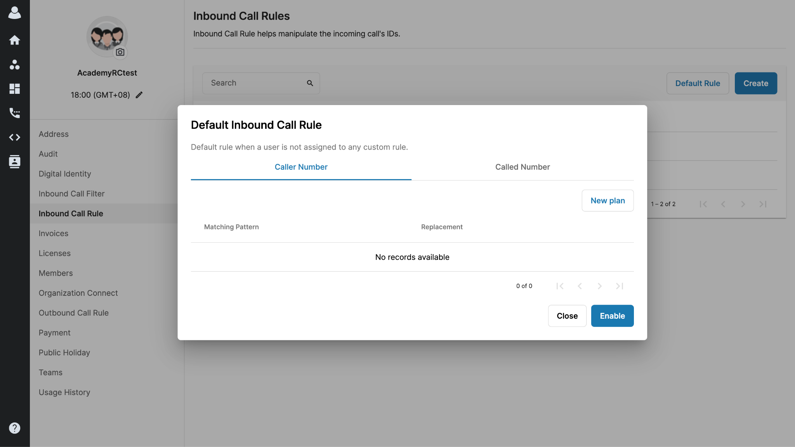
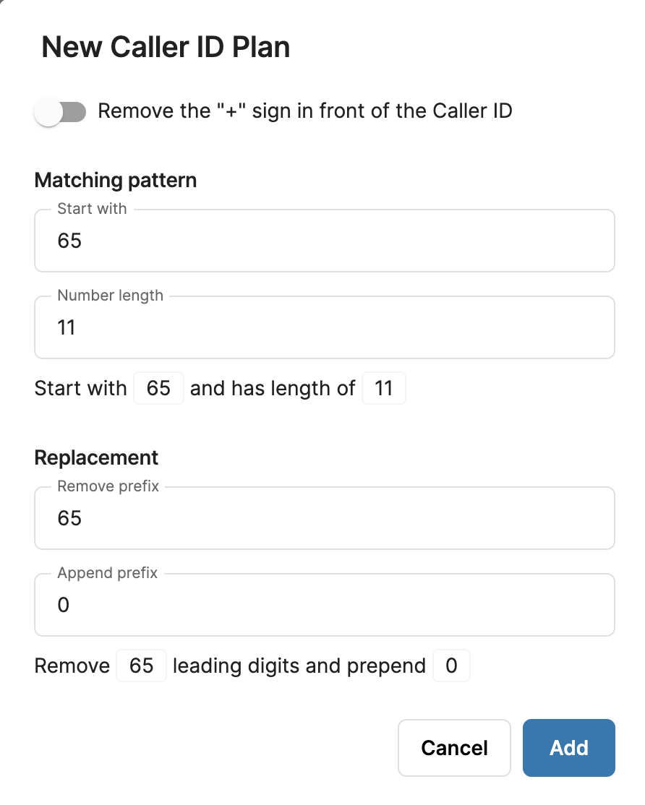
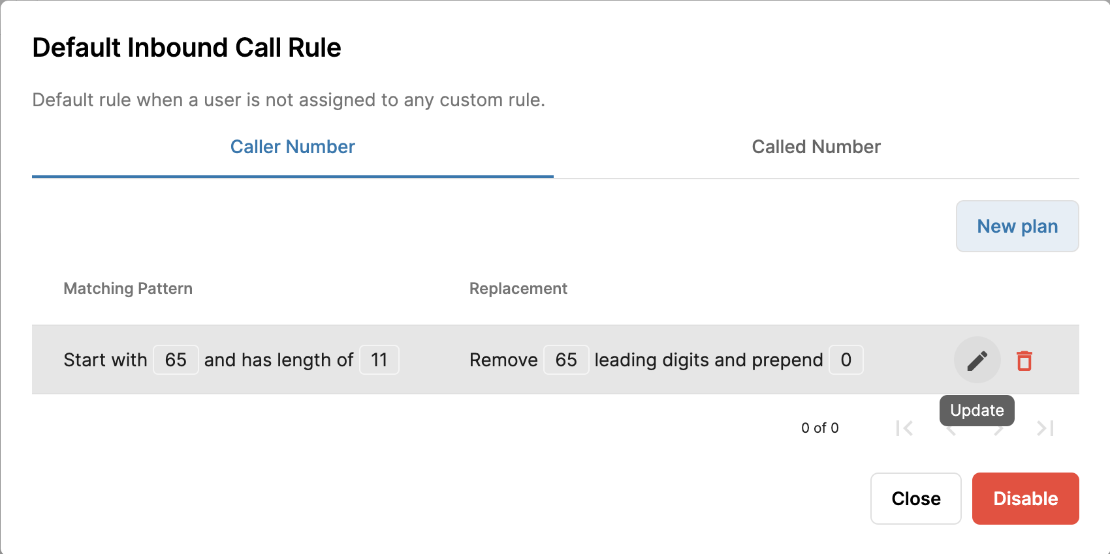
Manage Configuration <Inbound Call Rule>
Default Inbound Call Rule
Apart from the custom Inbound Call Rules, Owner/Admins can also create a default Inbound Call Rule for the whole organization. This rule will only apply to those users who have not been assigned to any custom Inbound Call Rule.
To create a Default Inbound Call Rule, follow the steps below:
Go to Manage Organization
Go to Inbound Call Rule
Click Default Rule
Click Enable
Click New plan
Provide the Caller ID plan > Add
Note: You can disable the default plan if it’s unnecessary.

Slide 45
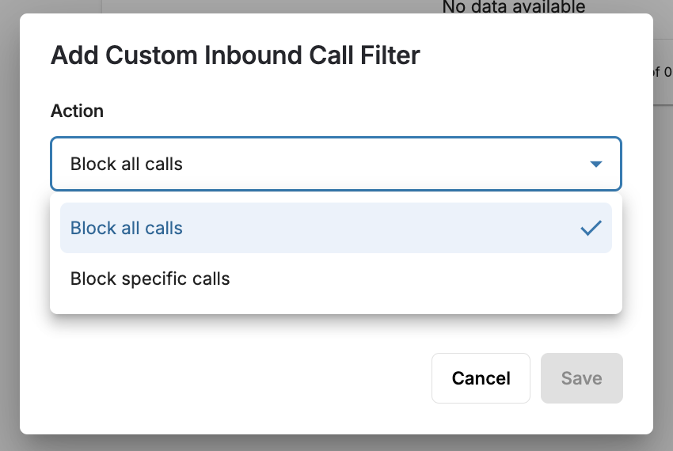
Manage Configuration <Inbound Call Filter>
Inbound Call Filter
Inbound Call Filter is supported in our system at organizational level and actions will be updated at user level.
To setup Inbound Call Filter at organizational level, follow the steps below:
Go to Manage Organization
Select Inbound Call Filter
Click on Add and select the Action
  Block all calls (To block all incoming calls except the ones on the list)
  Block specific calls (To block specific numbers on the list)
Note:
For more details on Rule Hierarchy and Validation, please visit: https://b3networks.helpjuice.com/en_US/call-rules-holidays/inbound-call-filter

Slide 46

Manage Organization <Invoices>
Individual Tax Invoices will be sent right after all purchases, including topup, subscription, hardware.
Monthly Tax Invoices only include microtransactions items such as call, sms, DNC check, will be sent in the first week of the next month.

Slide 47


Manage Organization <Licenses>
Overview
Owner/Admins can check and manage all of the provisioned Licenses in this section.

Slide 48


Manage Organization <Licenses>
Overview
Owner/Admins can check and manage all of the purchased Add-on Licenses in this section.

Slide 49





Manage Organization <Licenses>
Directory Name will also affect the listing name inside the directory within mobile app.
Overview
Owner/Admins can check and assign licenses to users in this section.

Slide 50



Manage Organization <Licenses>
Export Extension Details
Users can export Extension details and available Number license in Phone system license tab
Go to Manage Organization
Select License tab
Choose Phone System
Click the Download button
Export the Data
Data can be exported in a CSV format.

Slide 51

Manage Organization <Licenses>
Unassigned License Availability
When a User is deleted from the Organization, the system will unassign the Base License associated with that User.
Change its status to AVAILABLE, so the User in charge of managing the Licenses will know that there is an Available License that could be assigned to someone else.
For Example:
Initial situation:
Total Phone System Base Licenses = 10
Available Licenses = 3
Assigned License - Ext 100 = User Test 1
After Owner/Admin deletes User Test 1 from the Org:
Total Phone System Base Licenses = 10
Available Licenses = 4
License - Ext 100 = Available
Not retained with Blank User
Available to assign to other Users

Slide 52





Manage Organization <Members>
Overview
Allows Owner/Admins to see the list of all their members and the roles they have been assigned to.
All the unverified users will be listed under Pending List regardless of they are invited by Manual Creation or Bulk Creation.
Bulk Creation
Manual Creation

Slide 53
Manage Organization <Members>
2. Account Types & Privileges
Role | Description | Actions
Owner | Each Organization can only have 1 Owner. Cannot be deleted. Can be transferred. Has all privileges within the Organization. | Create Admins Create Members Set Admin Permission Group
Admin | Each Organization can have more than 1 Admin (max: 100 admins). Can be deleted. Has the rights that Owner granted on Permission Group. | Create Members Assign Members to Teams
Member | Each Organization can have multiple users (max: 10,000 members), invited by Admins or the Owner. Can use the Apps for which access privileges have been granted. Cannot be assigned with Permission Group.
10,000 members limitation counts for both Active and Disabled members in the Organization.

Slide 54


Manage Organization <Members>
3. Manual Creation
Go to Member tab
Select Create
Fill in the info
Select Role for user(s)
Assign user(s) to created team
Filter by Status: Pending > Send Activation Emails to imported members
The members will receive an email with the title "Your account has been created!" with a link to set the password.
**There will be a notification of pending list in the Active/Disabled page.
Owner can add Admins/Members
Admin can add Members

Slide 55

Manage Organization <Members>
3. Manual Creation
Go to Member tab
Select Create
Fill in the info
Select Role for user(s)
Assign user(s) to created team
Filter by Status: Pending > Send Activation Emails to imported members
The members will receive an email with the title "Your account has been created!" with a link to set the password.
**There will be a notification of pending list in the Active/Disabled page.

Slide 56


Manage Organization <Members>
4. Bulk Creation
Go to Member tab
Select Import
Select options:
  Portal Access
  No Portal Access
Download the Template
Fill in the info
Upload the File
Filter by Status: Pending > Send Activation Emails to imported members
The members will receive an email with the title "Your account has been created!" with a link to set the password.
**By default, the account’s role of Bulk creation is Member.
**There will be a notification of pending list in the Active/Disabled page.
Portal Access
No Portal Access

Slide 57
Manage Organization <Members>
4. Bulk Creation
Go to Member tab
Select Import
Select options:
  Portal Access
  No Portal Access
Download the Template
Fill in the info
Upload the File
Filter by Status: Pending > Send Activation Emails to imported members
The members will receive an email with the title "Your account has been created!" with a link to set the password.
*By default, the account’s role of Bulk creation is Member.
**There will be a notification of pending list in the Active/Disabled page.

Slide 58


Manage Organization <Members>
5. Account Info - Disable/Enable an Account
Only Owner can disable and enable the accounts in the organization.
Disable:
  At the Status section, choose Disable and confirm to proceed
Enable:
  Filter in the Disabled status tab, choose the Member that you want to enable. At the Status section, choose Enable and confirm to proceed

Slide 59

Manage Organization <Members>
5. Account Info - Delete an Account
Only the Owner can delete accounts in the organization.
Filter Status by Disabled > Select the account that you want to delete.
Click the Trash icon
Confirm to proceed

Slide 60


Manage Organization <Members>
5. Account Info - Change Account Name
The Owner/Admins can change the member name for the user
Select the account that you want to change role.
Click on the Member Name
Update the name for the user
Update
Notes:
This feature is only available for members who belong to only one organization.

Slide 61



Manage Organization <Members>
5. Account Info - Change Account’s Role
Only the Owner can change the Account’s Role from Admin to Member and vice versa.
Select the account that you want to change role.
At the Role section, click Change.
Choose Role
Update

Slide 62



Manage Organization <Members>
5. Account Info - Email
Both Owner and Admins can add new registered email for other users within the Organization.
Select the account that you want to change registered email address.
At the Email section, click Create.
Fill in the email
Create
* A verification email containing password setup instructions will be sent to the above email address.

Slide 63
Manage Organization <Members>
5. Account Info - VIP Members
Members which are added to the VIP list will not be visible in any of the search/list. This includes but is not limited to:
The member page
The member list under the license page
The extension list that is assigned to VIP members
The unified workspace page
By default, no one has access to VIP members' information except for the OWNER of the organization.
ADMIN roles will need permission to access. Click here for more details.
For Directory sharing with the other organizations, ALL VIP members are not shareable. There is no configuration to allow this sharing.

Slide 64

Manage Organization <Members>
5. Account Info - VIP Member
Add a Member to the VIP List
Select the account that you want to be VIP member.
At the VIP member section, toggle ON the button.
Confirm
B. Remove a Member from the VIP List
Select the account that you want to remove from the VIP list.
At the VIP member section, toggle OFF the button.
Confirm

Slide 65


Manage Organization <Members>
5. Account Info - VIP Member
Add a Member to the VIP List
Select the account that you want to be VIP member.
At the VIP member section, toggle ON the button.
Confirm
B. Remove a Member from the VIP List
Select the account that you want to remove from the VIP list.
At the VIP member section, toggle OFF the button.
Confirm

Slide 66
Manage Organization <Members>
6. Manage - The Owner gives privileges to Admins
The Owner of the organization can decide which access to give to which Admins using different Permission Groups.
People
This permission is to decide whether an Admin can access and do the configuration for other members of the organization.
For Organization Management:
Menu | Action | Owner | Admin (With permission to manage PEOPLE in the WHOLE ORGANIZATION) | Admin (With permission to manage PEOPLE in the specific Teams) | Member
Licenses | Provision Licenses | ✅ | ✅ | ✅ | ❌
 | Assign Users | ✅ | ✅ | ✅ | ❌
 | Assign Addon Licenses to Users | ✅ | ✅ | ✅ | ❌
Members | Create Admins | ✅ | ❌ | ❌ | ❌
 | Create Members | ✅ | ✅ | ✅ | ❌
 | Import/Export Members | ✅ | ✅ | ✅ | ❌
 | Change Role (Admin ⇄ Member) | ✅ | ❌ | ❌ | ❌

Slide 67
Manage Organization <Members>
6. Manage - The Owner gives privileges to Admins
The Owner of the organization can decide which access to give to which Admins using different Permission Groups.
People
This permission is to decide whether an Admin can access and do the configuration for other members of the organization.
For Organization Management:
Menu | Action | Owner | Admin (With permission to manage PEOPLE in the WHOLE ORGANIZATION) | Admin (With permission to manage PEOPLE in the specific Teams) | Member
Members | Disable/Enable Members' Accounts | ✅ | ✅ | ✅ | ❌
 | Enable VIP Member | ✅ | ❌ | ❌ | ❌
 | Give permission to manage Organization Settings | ✅ | ❌ | ❌ | ❌
 | Send Activation Emails to Pending Users | ✅ | ✅ | ✅ | ❌
 | Delete Pending Members' Accounts | ✅ | ✅ | ✅ | ❌
 | Export Pending Users List | ✅ | ✅ | ✅ | ❌
 | Delete Disable Members' Accounts | ✅ | ❌ | ❌ | ❌

Slide 68
Manage Organization <Members>
6. Manage - The Owner gives privileges to Admins
The Owner of the organization can decide which access to give to which Admins using different Permission Groups.
People
This permission is to decide whether an Admin can access and do the configuration for other members of the organization.
For Organization Management:
Menu | Action | Owner | Admin (With permission to manage PEOPLE in the WHOLE ORGANIZATION) | Admin (With permission to manage PEOPLE in the specific Teams) | Member
Teams | Create Teams | ✅ | ✅ | ❌ | ❌
 | Edit Team's Name | ✅ | ✅ | ✅ | ❌
 | Disable/Enable Teams | ✅ | ✅ | ✅ | ❌
 | Assign Admins to manage Teams | ✅ | ✅ | ❌ | ❌
 | Add Members to Teams | ✅ | ✅ | ✅ | ❌
 | Manage Teams | ✅ | ✅ | ✅ | ❌

Slide 69
Manage Organization <Members>
6. Manage - The Owner gives privileges to Admins
The Owner of the organization can decide which access to give to which Admins using different Permission Groups.
People
This permission is to decide whether an Admin can access and do the configuration for other members of the organization.
For Phone System: This permission will also relate to the Phone System permission.
People | Phone System | Permission
❌ | ❌ | Configure personal Phone System settings for themselves only.
❌ | ✅ | Can configure personal Phone System settings for themselves. Can configure Phone System's system settings.
✅ | ❌ | Can configure personal Phone System settings for: Themselves Everyone in the organization Members in all teams

Slide 70
Manage Organization <Members>
6. Manage - The Owner gives privileges to Admins
The Owner of the organization can decide which access to give to which Admins using different Permission Groups.
People
This permission is to decide whether an Admin can access and do the configuration for other members of the organization.
For Phone System: This permission will also relate to the Phone System permission.
People | Phone System | Permission
✅ | ✅ | Can configure personal Phone System settings for: Themselves Everyone in the organization Members in all teams
✅ | ❌ | Can configure personal Phone System settings for: Themselves Members of assigned teams
✅ | ✅ | Can configure personal Phone System settings for: Themselves Members of assigned teams Can configure Phone System's system settings.

Slide 71


Manage Organization <Members>
6. Manage - The Owner gives privileges to Admins
People
Owner can assign created Teams to Admins so they can manage settings for their Teams.
Admins can check which Teams they have been assigned to.
Admins can assign members to Teams.
Owner view
Admin view

Slide 72


Manage Organization <Members>
6. Manage - The Owner gives privileges to Admins
Manage Organization Settings:
Owner can assign allow Admins to manage the settings such as: Address, Organization Connection,...
Owner view
Admin view

Slide 73
Manage Organization <Members>
6. Manage - The Owner gives privileges to Admins
Manage Phone System:
This permission is to decide whether an Admin can access the Phone System's system settings.
This permission will relate to the People permission.
Owner view
Admin view

Slide 74
Manage Organization <Members>
6. Manage - The Owner gives privileges to Admins
Manage Developer:
This permission is to decide whether an Admin can access the Developer settings page.
Owner view
Admin view

Slide 75
Manage Organization <Members>
6. Manage - The Owner gives privileges to Admins
Manage Auto Attendant:
This permission is to decide whether an Admin can access the Auto Attendant settings page.
Auto Attendant
Auto Attendant
Owner view
Admin view

Slide 76
Manage Organization <Members>
6. Manage - The Owner gives privileges to Admins
Manage SIP:
This permission is to decide whether an Admin can access the SIP settings page.
SIP Trunk
SIP Trunk
Owner view
Admin view

Slide 77

Manage Organization <Members>
7. Manage - The Owner gives privileges to Admins
Manage Dashboard:
This permission allows an Owner to grant access to the Dashboard settings to certain Admins. Only the Admins that have been given access to Dashboard can see the Dashboard icon and access it.

Slide 78


Manage Organization <Members>
8. Manage - The Owner gives privileges to Admins
Manage File Explorer:
This permission allows an Owner to grant access to the File Explorer to certain Users - Admin Roles. User that are given permission to File Explorer can access to it and download Call Recording files.
Owners’ View
Admin’s View

Slide 79
Manage Organization <Members>
7. Manage - The Owner gives privileges to Admins
Manage Contacts:
This permission allows an Owner to grant access to the Contact Application to certain Admins.
Owner has full access to the Contact > Company Blacklist/Whitelist
Admin must be granted permission by Owner to access Contact > Company Blacklist/Whitelist
Member cannot access Contact > Company Blacklist/Whitelist

Slide 80


Manage Organization <Members>
9. Licenses
Owner/Admins can check and assign licenses to their members in this tab.

Slide 81



Manage Organization <Members>
10. Export Active Member Report
Owner/Admins can export active member report by clicking the Export button.

Slide 82

Manage Organization <Numbers Management>
Numbers tab under Manage Organization helps manage all organization's numbers in one place.
Permission Management
Organization owner and admin with Organization Setting & People permission group can overview and edit Number tab.
Login to the organization's portal
Go to Manage Organization
Select Numbers tab
User can filter by:
  Provider (Vendor name)
  Service (Assigned Base license)
Search for a specific number in search bar

Slide 83

Manage Organization <Numbers Management>
Unassign and Reassign a number
To unassign or reassign a number, follow the steps below:
Go to Manage Organization
Select Numbers tab
Click on the Edit icon
Select Service
Select the assignee
Click Unassign / Reassign
Done

Slide 84


Manage Organization <Numbers Management>
2. Notification from Power SIP Trunk
A notification for pending PowerSIP invitation will be displayed above, user can click on it to be navigated to the Pending Invitation page which allow user to accept / reject the invitation.

Slide 85

Manage Organization <Organization Connect>
This Organization Connect tab allows an organization to link with other organizations. With the link, it can do the following things:
Share the Directory with other organizations.
  For directory sharing with the other organizations, ALL VIP members are not sharable. There is no configuration to allow this sharing.
Make an Inter-organization Call to other organizations by using their Extension Keys.

Slide 86
Manage Organization <Organization Connect>
Directory
Directory gathers the data from the organization and combines them. It includes but is not limited to the following:
  Member’s information
  Extension’s information
  Organization’s information
These data will show on the Contacts of the Mobile and Desktop Applications.
The user can configure which extensions to share with the connected organizations.
  VIP contacts are not shareable by default. Click here for more details on VIP Members.
  This sharing is per group. Once it is shared, all organizations inside the group can view the information.
In the organization accepting the share:
  The user needs to create an Outbound Call Rule that allows the extensions to be able to dial to the connected organization.
  Only extensions that are assigned to this Outbound Call Rule can view the shared Directory.

Slide 87


Manage Organization <Organization Connect>
B. Configuration
There are 2 types of accounts in Organization Connect:
Owner Organization
  Source Organization = The account that sent out the invitation to link Org.
Member Organization
  Destination Organization = The account that received the invitation to link Org.
*** Maximum bidirectional linked organizations is 10 accounts.

Slide 88



Manage Organization <Organization Connect>
B. Configuration
Owner/Source Organization - Send invitation
Go to the Manage Organization, choose Organization Link
Click Create Connection button
Input the UUID of the Organization that you would like to link
Invite
Once you finished:
  An invitation will be sent to the destination account.
  You will see a Pending Accept status

Slide 89




Manage Organization <Organization Connect>
B. Configuration
Member/Destination Organization - Receive invitation
Go to the Manage Organization, choose Organization Connect
View the invitation with the Pending status
Select one of the options:
  Accept
  Deny
Once you finished, the invitation will:
  Change Status to Active
  Be removed

Slide 90

Manage Organization <Organization Connect>
Re-Invite the Declined Invitation
If the Recipient Org accidentally or willingly rejects the Invitation, and wants the initiator to re-invite, the Initiator Organization can trigger the Invitation again.
Choose Organization Connect
Select status Declined
Select the account and click on Resend

Slide 91




System Configuration <Outbound Call Rule>
Users need to be assigned to an Outbound Call Rule in order to make outbound calls.
To create an Outbound Call Rule, follow the steps below:
Go to Manage Organization
Go to Outbound Call Rule
Click Create
Give the rule a name > Create
Click on the pencil icon next to the created rule
At the plan as you wish > Update

Slide 92




System Configuration <Outbound Call Rule>
Outbound Call Rule is composed of the rules for:
Dial plan: By default, if users want to make an outbound call from our system, they will need to follow this standard:
  <country code> + <area code> + <destination>
However, to reduce the steps, owner/admins can set up a dial plan for users’ calls. By setting this up, users will not have to key in the country code every time they call out.
Country whitelist: the list of countries users can call to.

Slide 93




System Configuration <Outbound Call Rule>
Outbound Rules are composed of the rules for:
Dial plan: By default, if users want to make an outbound call from our system, they will need to follow this standard:
  <country code> + <area code> + <destination>
However, to reduce the steps, owner/admins can set up a dial plan for users’ calls. By setting this up, users will not have to key in the country code every time they call out.
Country whitelist: the list of countries users can call to.
  Passcode required: users need to key in their passcode in order to call to these countries.

Slide 94



System Configuration <Outbound Call Rule>
Outbound Rules are composed of the rules for:
Country whitelist: the list of countries users can call to.
  Passcode required: users need to key in their passcode in order to call to these countries.
Organization Link: After the 2 organizations are connected, they need to define a Prefix to call the other side.
  The code is per direction per connection
  Limit 3 digits
*Note: Make sure the Matching Rules do not conflict with the Dial Plan
  Inter-organization Call:
  Prefix + Ext Number

Slide 95



System Configuration <Domain Default Outbound Call Rule>
Outbound call rule can also be defined at the domain level to be automatically inherited by all customer organizations under that domain.
The Owner or Admins with privileges will set up the Domain Default Outbound Call Rules, including the Dial Plan and Country Whitelist for the organization.
Steps:
Go to Admin Organization
Select Portal Settings
Select Portal Config
Scroll down to the option “CpaaS default outbound/ inbound rule”
Select Outbound Call Rule
Click Update
Set up the Dial Plan and Country Whitelist for this new rule
Admin Org
Note:
The Outbound Rule that is created here will be applied to all the customer organizations under the same Domain, only if these organizations do not have their own Outbound Call Rule. If an organization has its own rule, that specific rule will be followed instead of the Domain Outbound rule.
If the Domain updates the Domain Outbound Call Rule, the new version will apply to the newly created organizations. For existing organizations that follow or use the old version, the initial settings that were set up for them will continue to apply.

Slide 96


System Configuration <Domain Default Outbound Call Rule>
Customer Organization under the same domain which inherit the Rule Template from Domain
Steps:
Go to the "Customer Organization"
Select Manage Organization
Select Outbound Call Rule
Click Default Rule
Click Import Domain Rule
After clicking the Import button, the Domain Rule will appear (allowing for customization based on specific requirements, if needed)
Note:
Users can import Domain Rule to their Organization Default Rule as well as Custom Rules.
The imported Dial Plan and Country Whitelist rules are customizable according user requirements.
Any changes in the Customer Organization won’t affect the Original Domain Outbound Rule.

Slide 97

Manage Organization <Payment>
Overview
This tab allows users to manage their payment information

Slide 98

Manage Organization <Payment>
A. Prepaid account
Usable credit: the amount that account can spend on, i.e. credit transfer/ issue, usage and subscription renewal.
  Usable credit = Balance - Reserved credit - Liability + Credit limit
Balance: the amount stored in this wallet.
Reserved credit is caused by an ongoing transaction. If the transaction is successful, Reserved credit is deducted; otherwise, it is returned to the Usable credit.
Credit limit: the maximum amount of money the service provider lets the account borrow.

Slide 99



Manage Organization <Payment>
A. Prepaid account
View and adjust auto top-up settings
View and adjust auto subscription renewal settings using stored card
View and remove stored credit card (if any)

Slide 100

Manage Organization <Payment>
B. Postpaid account
Amount due: the sum of all costs that the account has been invoiced for, minus any payments that have been applied to those costs.
  If it’s DR:
The amount that user needs to settle
Maximum Expecting invoice = Credit Limit
If it’s CR:
The amount that user has overpaid
Maximum Expecting invoice = Amount Due + Credit Limit
Current Balance: all the amount the customer needs to settle, including the billed and unbilled amounts.
Current Balance = Expecting invoice + Amount Due

Slide 101
Manage Organization <Payment>
B. Postpaid account
Reserved credits: caused by an ongoing transaction
Credit limit: the maximum amount of money that you let the user borrow.
Applied on the expecting invoice.
Reset every month.
Expecting invoice: the usage amount for the current bill period = the amount has not yet billed / invoiced.
Usable credits: the total credits that customer can use for this month

Slide 102


Manage Configuration <Public Holiday>
Default Holiday
Besides setting the Public Holidays for each user, the Owner/Admins can set a default Public Holiday for the whole organization.
To configure organization default holiday, please follow the steps below:
Click on the profile icon > Go to Manage Organization
Go to the Public Holiday tab
Select Default Holiday
Select country from Public holiday by country drop down list
Toggle On Custom Holiday
Click (+) icon to add new custom holiday
Click Save to proceed.

Slide 103


Manage Configuration <Public Holiday>
Custom Holiday Rule
A custom holiday rule is a configurable setting within Public Holiday tab under Manage organization that allows organizations to define specific holidays according to their unique requirements.
Create a Custom Holiday Rule
Click on the profile icon > Go to Manage Organization
Go to the Public Holiday tab
Click Create button
Input Rule name
Click the (+) icon to add a holiday > Add your custom holidays
Create

Slide 104



Manage Configuration <Public Holiday>
Custom Holiday Rule
Edit a Custom Holiday Rule
Hove the mouse over the Rule already created
Click on Edit icon
You can change:
  Rule name
  Add or remove a custom holiday
Once completed, Click Save.
Note:
Custom Holidays are only applicable for the selected year, Owner/Admin need to review and update their settings accordingly
Please note that these settings for custom holidays are not recurring. You will receive a reminder on December 24th of each year to review and update your custom public holiday configurations for the upcoming year, provided that at least one custom holiday is configured.

Slide 105


Manage Configuration <Public Holiday>
Custom Holiday Rule
Delete a Custom Holiday Rule
Hover the mouse over the rule you wish to delete
Click on the Trash bin icon on the right
A new popup will will appear asking for confirmation
Click Delete to confirm.

Slide 106




Manage Organization <Teams>
The Owner can follow the steps below to:
Create Team:
Go to Teams tab
Select Create
Give the new Team a name
Create
Add Team’s Members:
Select the Team
Choose Add member
Add

Slide 107





Manage Organization <Teams>
Once Admins are assigned to Teams by Owner, they can see the information in the Members tab.
Moreover, they are allowed to change, update the Application Settings for themselves as well as the members within their teams.
Application Settings - Admin view
Members tab - Admin view

Slide 108

Manage Organization <Usage History>
Allows Owner/Admins to check the Usage reports of the respective month.

Slide 109

Manage Organization <Security Policy>
This page supports to configure Security Policy at Organization level.
Only owner of the organization can claim email domains and set security policy for the organization level
The request will be received by B3 and either be rejected or approved
If the request is accepted, user can set up the security policy and it will only be applicable to all users ending with the same email domain
Log in to the Portal
Go to Manage Organization
Click on Security Policy

Slide 110


Manage Organization <Security Policy>
Click on [Claim email domain]
Pre-fill email domain according to the Owner’s email and do not allow to edit
After the Owner submits the request, show the below UI while waiting for B3 team to manually approve the request

Slide 111

Manage Organization <Security Policy>
Once the email domain has been approved and claimed, show the default policy. By default, security policy settings will be disabled.
Activate and Disable buttons at the top of the screen are used to activate/disable the security policy settings.

Slide 112

Manage Organization <Security Policy>
Discard Changes and Save buttons are only available if the Owner edits anything.
Save and Activate button will only appear if the security policy is disabled. Clicking this button = Save the changes and activate the policy.

Slide 113

Manage Organization <Security Policy>
Owner of the organization can claim multiple Email Domains to support more use cases.
Owner is able to enable and manage security policy setting for each claimed email domains.

Slide 114

Manage Organization <Security Policy>
Once approved, the screen will be shown as below, owner can activate/deactivate the Security Policy setting by clicking the button below the Security Policy Status (1).
To access the Security Policy setting, click to the pencil icon (2).

Slide 115

Manage Organization <Security Policy>
Owners can claim additional email domains by clicking Claim Email Domain and then entering the desired domain name.
Note:
The maximum number of claimed email is 5 (including all statuses).

Slide 116

Manage Organization <Security Policy>
To check the status of claimed email domains, owners can filter at Request Stat to view claimed email domains based on their current status.
There are 3 statuses:
Approved
Pending
Rejected
Note:
For Pending, Rejected - contact B3's team for assistance in resolving any issues or expediting the process.
For Rejected, a reason and submitted time will be shown along with the email domain.

Slide 117

Manage Organization <Security Policy>
In each approved email domains, owner can access to Security Policy setting and edit them.
By default, Security Policy settings will be Deactivate.
Owner can activate Security Policy setting by clicking on Activate button.
If Security Policy is deactivating, Save & Activate button will appear, edit the setting and click this button = save the changes and activate the policy.
Discard Changes and Save buttons are only available if the Owner edits anything.

Slide 118
Manage Organization <Security Policy>
Owner can deactivate the setting by clicking on Deactivate button.
In case, owner wants to go back email domain list, click on Security Policy.

Slide 119

Manage Organization <Security Policy>
Once the request is rejected, the users will be notified as per the below UI:

Slide 120

Manage Organization <Security Groups>
Security Groups: Manage security groups to restrict device logins to trusted IP addresses only
Note: Support users with below sip domains
  Singapore: sipsg01.b3networks.com, sipsg02.b3networks.com
  Indonesia: sipid01.b3networks.com
  Thailand: sipth01.b3networks.com
1. Security Groups
Note: Owner and Admin with Organization Settings permission have full access to all actions.
How to configure
Go to [Manage Organization]
Select [Security Groups]
Click on [Create] button
Input Name
Input IP range and/or IP address
Click [Add] or Enter
Click on [Create]

Slide 121


Manage Organization <Security Groups>
Note:
Input Limit: Maximum 50 entries can be added per group. Exceeding this limit will disable the input field.
Input Validation: The system will notify users of incorrect format entries and prevent invalid entries from being added.
  Error: Please remove the invalid IP ranges first
After a group is created, when users delete it, have to type “CONFIRM” to proceed.

Slide 122

Manage Organization <Security Events>
Owner and Admin with Organization Settings permission have full access to all actions.
Display: Event Name, Time, Actor, IP Address, and Details.
Filter
Time | Today/This week/This month/Specific date time
Event Name | - SIP credentials requests from an unauthorized IP Address - SIP registers from an unauthorized IP Address - Outgoing call attempt from an unauthorized IP Address
Actor | Allow searching by the exact actor name
Details | Search by typing keywords within event details

Slide 123
File Explorer

Slide 124


File Explorer
File Explorer is a file management application that centralizes all call recording files.
License Requirement:
Base License: File Explorer
After buying the license, owner of the organization can see File Explorer icon on the sidebar.
Permission:
The Permission page is for Owner/granted Admins to grant permissions to Members. Possible actions include:
View (Members that are assigned View access can only browse the File Explorer and download files)
View and Manage (Members that are assigned View and Manage access can browse, download, delete, restore, and shred files on the File Explorer)

Slide 125



File Explorer <Assign Permissions to a Member>
To Assign Permissions to a Member:
Go to File Explorer > Permission > Assign
Select a Member from the drop down or search a member
Click Assign Permissions and select either View or Manage
Click the Assign button

Slide 126


File Explorer <To Edit Permissions for a Member>
Go to File Explorer > Permission
Search the member in the search bar using their Name or find them in the list
Click the pencil icon to edit permissions for that member
Check or uncheck the View and Manage permissions and click Update

Slide 127

File Explorer <Access Rule>
The following table explains the actions possible depending on the privileges granted to each role:

Slide 128



File Explorer <Download a Call Recording File>
Go to File Explorer > Select time range
Select All or Chose a Folder or Go to Folder > Select Recording File
Click the Download Icon

Slide 129

File Explorer <Delete a Call Recording File>
Go to File Explorer > Select time range
Select All or Chose a Folder or Go to Folder > Select Recording File
Click the Delete Icon
To confirm your action, click the Delete button
To cancel your action, click the Cancel Button

Slide 130



File Explorer <Restore a Call Recording File>
Go to File Explorer > More Action (click on the ellipsis icon) > Trash
Chose a Folder or Go to Folder > Select Recording File
Click on the Restore Icon

Slide 131

File Explorer <Shred a Call Recording File>
Go to File Explorer > More Action (click on the ellipsis icon) > Trash
Chose a Folder or Go to Folder > Select Recording File
Click on the Shred Icon
To confirm your action, type CONFIRM in the textbox and click on the Shred button

Slide 132


File Explorer <Check Pending Actions>
Go to File Explorer > More Action (click on the ellipsis icon) > Job List
Check the Pending Jobs. These will have the following details:
- Job ID
- Type (Download/Delete/Restore/Shred)
- Status (Pending/Done)
Once completed, the Job will disappear from the Pending Jobs list.

Slide 133
Compliance

Slide 134

Compliance
Compliance page under Communication Hub main objective is:
DNC lookup: Check the DNC status of numbers
Activity Logs: Check the activity status of numbers
Access Control
This page is only accessible by the user who has the DPO add-on license.
Users also need a DNC add-on license to check DNC status of numbers.
Go to [Communication Hub]
Select [Compliance]
Fill in number
Search

Slide 135
Compliance
Result | Cause | Color | Main text | Description on hovering
permitted | consent | green | Allowed | Number is whitelisted.
permitted | coverage | green | Allowed | Non-Singapore number.
permitted | bypass | green | Allowed | User configures to bypass or override DNC.
permitted | license | green | Allowed | DNC subscription/license is missing or terminated.
permitted | credit | green | Allowed | Credit is insufficient.
permitted | dnc | green | Allowed | Number is not registered to DNC registry.
blocked | consent | red | Blocked | Number is blacklisted.
blocked | coverage | red | Blocked | Not available.
blocked | bypass | red | Blocked | Not available.
blocked | license | red | Blocked | DNC subscription/license is missing or terminated but the account is COMPLIANT.
blocked | credit | red | Blocked | Credit is insufficient but the account is COMPLIANT.
blocked | dnc | red | Blocked | Number is registered to DNC registry.
Compliance Results

Slide 136
Bulk Filtering

Slide 137

Bulk Filtering
Bulk filtering functionality allows users to upload a number list and check for the DNC status. The system will check the csv file and send the results via email or download from the portal once it has been uploaded.
Access
This page is only accessible by the user who has the DNC Bulk Filtering add-on license.
Go to [Communication Hub]
Select [Bulk Filtering]
Click [Upload CSV]
Select a file
Fill in email address
Click [Scan]

Slide 138


Bulk Filtering
=> Users can download the report directly from the web portal or check the report sent via email
Note:
All numbers will be charged regardless of how many times they have previously been uploaded and checked.
Duplicated phone numbers in the same file will still be charged twice.

