Slide 1







Court of Justice, the General Court (created in 1988) and the Civil Service Tribunal

Slide 2










Introduction
The European Union (EU), comprised of 28 Member States, functions under treaties establishing legal frameworks for its operation.
The EU's judicial institution, including:
The Civil Service Tribunal
The Court of Justice
The General Court (established in 1988)
plays a crucial role in upholding legality and ensuring uniform interpretation and application of EU law.

Slide 3
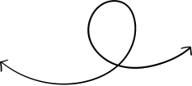


Evolution of the EU's Judicial Structure
Initially established as the European Communities, the EU gained legal personality with the Lisbon Treaty in 2009, replacing the European Community.
The Court of Justice, General Court, and Civil Service Tribunal form the core of the EU's judiciary, responsible for evaluating the legality of acts and ensuring consistent legal application.

Slide 4





Role and Function of the General Court
The General Court, established in 1988, operates autonomously from the Court of Justice, aiming to alleviate its workload and enhance judicial protection through a two-tier court system.
The Civil Service Tribunal, attached to the General Court in 2004, addresses disputes between the EU and its officials/staff.

Slide 5

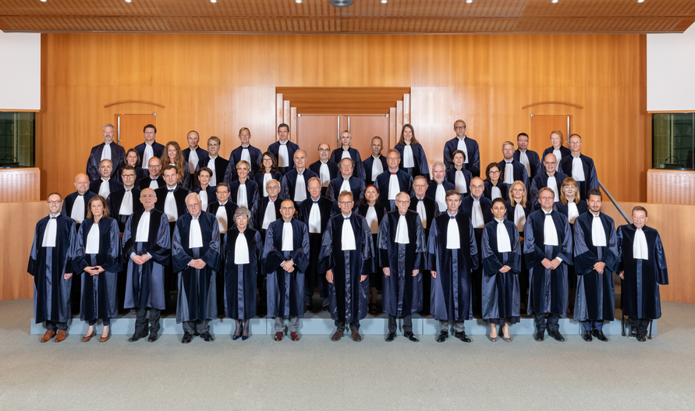



Composition and Structure
The General Court consists of at least one judge from each Member State, serving renewable six-year terms, appointed by consensus of Member State governments.
Judges operate impartially and independently, with no permanent Advocates General, although judges may fulfill this role in exceptional cases.
The court convenes in various formations, including Chambers, Grand Chambers, and plenary sessions, depending on case complexity.

Slide 6
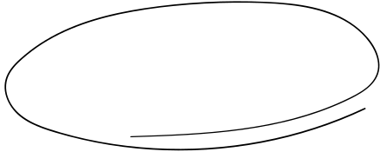

Jurisdiction and Cases
The General Court adjudicates on a wide range of matters, including annulment of EU institution acts, actions between Member States and EU bodies, compensation claims, intellectual property disputes, and appeals from the Civil Service Tribunal.

Slide 7

Procedure
The General Court follows a structured procedure, including written and oral phases, involving applications, defenses, replies, rejoinders, and interventions.
Public hearings facilitate engagement between judges and parties, with judges deliberating and delivering judgments openly.

Slide 8



Summary
The General Court, along with the Court of Justice and Civil Service Tribunal, plays a vital role in upholding EU law and ensuring judicial accountability within the Union.
Its evolution, jurisdiction, structure, and procedures are pivotal in maintaining legal coherence and safeguarding the rights of EU citizens and institutions.

Slide 9
Thank you for joining me today!

