Slide 1
The Granite Way
Professional Learning
Ability to use assessments and to track progress so that students are learning at or above grade/content expectations
January 10, 2020 Instructional/Student Learning Process
Expanded Instruction and Support
Notes:
This presentation is a continuation of the training you received in September 2019.

Slide 2
Connect to Past/Follow-up:
SY 2018
Instructional Process
SY 2019
Learning Environment
SY 2020
Instructional/Student Learning Process
Expanded Instruction and Support
Notes:
This is a quick summary of what the Scope and Sequence of GWPL has been for the past three years.

Slide 3
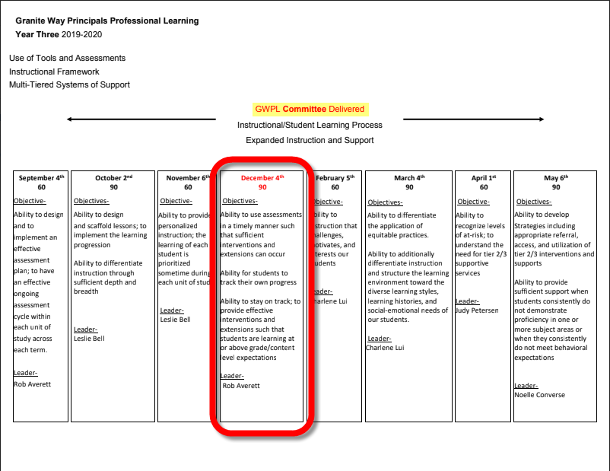
Notes:
Principals are receiving the training on December 4, 2019.

Slide 4
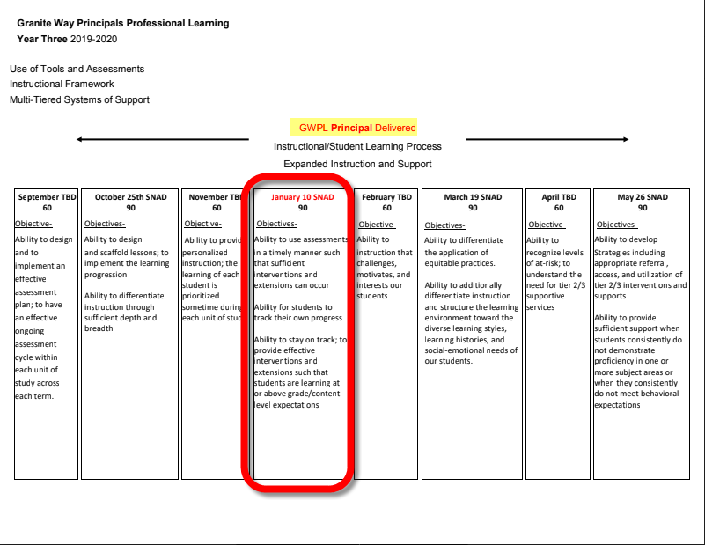

Slide 5
Admin Plan Self-Reflection
1. What went well in the GWPL on differentiation? What was impactful and valuable?
2. What problems did we experience? Why?
3. How can I better plan my next GWPL?
Notes:
Administrators on December 4, 2020:
Please take a few minutes to contemplate last month’s Granite Way Professional Learning. How did the “upgrade” a lesson with differentiation go? First have individual reflection 1 minutes, then 2 minutes to discuss at their tables and 1 minute for a whole group share out of “ah ha”

Slide 6
Teacher Lesson Plan Self Reflection
1. What went well in this lesson? Why?
2. What problems did I experience? Why?
3. Preparation and research – What differentiation strategy did I incorporate?
4. Final thoughts? How did the class do? What should I change for next time? What did I learn from this experience that will help me in the future?
Notes:
For Teachers on January 10, 2020:
Please take a few minutes to contemplate last month’s Granite Way Professional Learning. Connecting to last month’s GWPL, how did the “upgrade” a lesson with differentiation go? First have individual reflection 2 minutes, then 5 minutes to discuss at their tables and 3 minutes for a whole group share out of “ah ha”

Slide 7
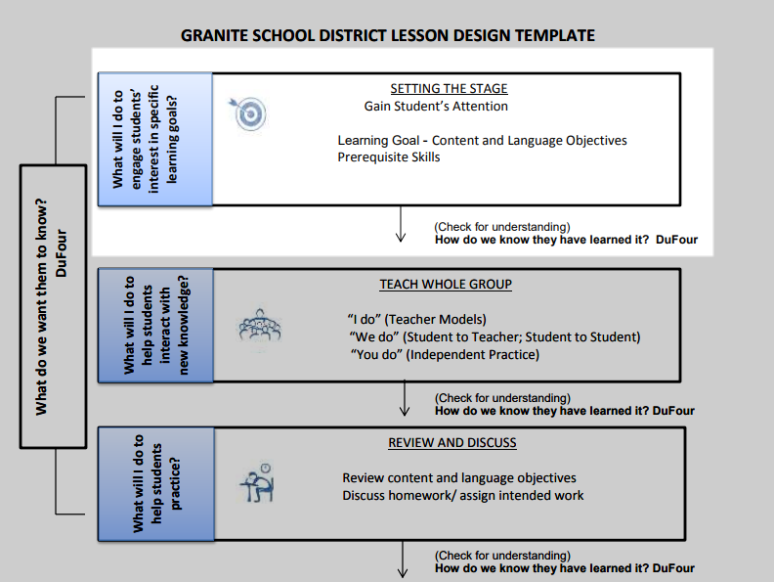
Today’s Content Objectives
Use student assessment results to:
identify core standards with the greatest needs and those with strengths,
identify students who progressed in core knowledge, also those who stayed the same and those who improved.
Provide tools for students to track their progress.
Suggest tools to provide interventions and extensions.
Notes:
Content and Language Objectives are unifying elements of the GSD Lesson Design Template.
The content objective is to teach a technique using district assessments and tools to use assessment results to target core standards that need improvement, students who have progressed over time and to help students to track their progress and receive additional support if appropriate.

Slide 8
Today’s Language Objective
Learners will review and discuss the terminology of the assessment cycle:
· Plan
· Implement
· Analyze
· Apply
· Evaluate
Learners will also identify next steps and complete their action plan.
Notes:
The key terms for today’s language objective are:
Plan
Implement
Analyze
Apply
Evaluate

Slide 9
Notes:
Action: Review the assessment cycle and share insights:
Key Points:
September’s training focuses on steps 1 & 2 (Plan and Implement)
(December) January’s training focuses on steps 3, 4, & 5 (Analyze, Apply, Evaluate)
Granite School District focuses on student achievement and learning through use of our assessments and tools aligned to core standards.

Slide 10
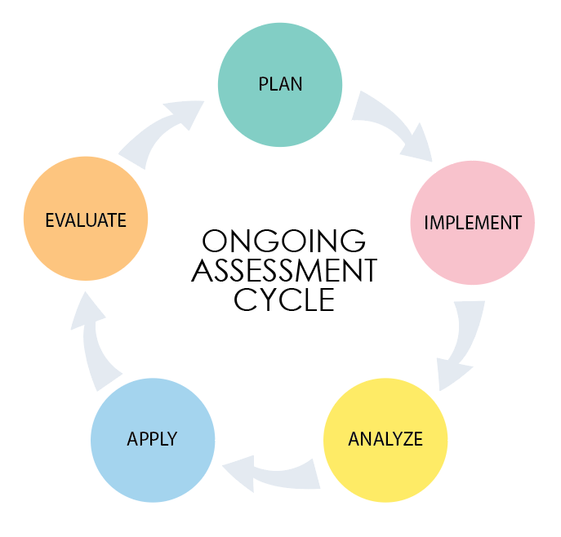
Multiple Modalities of Assessment
Today’s training will emphasize SchoolCity tools
that provide analytics aligned to the core
measure progress by student in multiple subjects
In a Proficiency Based Grading environment
anticipates students will receive other modalities of assessment
discussed in GWPL September 2019
Students need the opportunity to demonstrate that they are highly proficient demonstrated in SchoolCity and other modalities
Notes:
This session continues training started in September but takes advantage of your access to district assessment results:
Standard Analysis tells you and your teachers as soon as an assessment is completed which standards students demonstrate skill and those which students need additional attention.
The Pivot Tables developed for you by the Department of Student Assessment compare performance by class or school on how students proficiency changed between the pre-test and post-test on district assessments. They are available now and will be fully accurate when the 1st semester post-test window closes on January 30, 2020.

Slide 11
Assessments guide instruction to improve student learning
Granite Benchmarks provide current, on-going indications of what students know:
Standard Analysis report tells how well a class mastered core content
General information
Early in the semester or year
Pivot Table reports tell which students progressed, who stayed the same, and who went backwards
Compares pre-post test results
Available shortly after the post-test window closes
Principals and Teachers receive information specific to their school or class
Notes:
You will have time to work in the Standard Analysis report to see which standards your class has not mastered.
You will use the Pivot Table function to compare pre-test results to post-test results and to identify the students who need the most support. Teachers should complete the Semester 1 Post Tests before the end of the semester both to have reliable results and to guide instruction.
Your work today will be live as it pertains to your class. The exception is that Kindergarten teachers will need to review DIBELS results which do not have alignment to Utah core standards to analyze using those features. A handout for Kindergarten Teachers will be prepared for the January training.

Slide 12
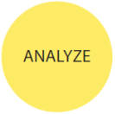
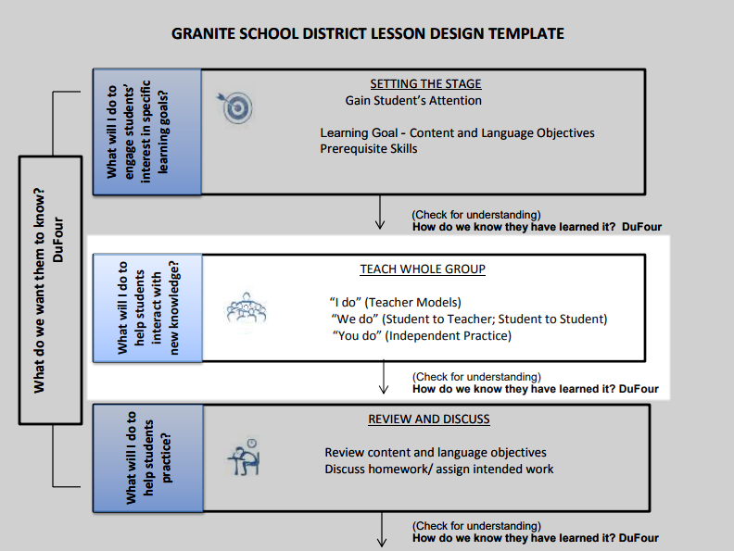
Guided Practice
Notes:
Today’s professional learning will be “hands-on.”
I will show you how to do an activity related to the outcomes expected of this lesson and then you will have time to try this as an activity. The activity will tie to your classroom-based, district assessments and will point you at work you and your PLC should be focusing on.
Proficiency Scales have been prepared by the district to provide coherence between schools and networks.
Rubrics are to be student-friendly and can be used by PLCs to calibrate their work.

Slide 13
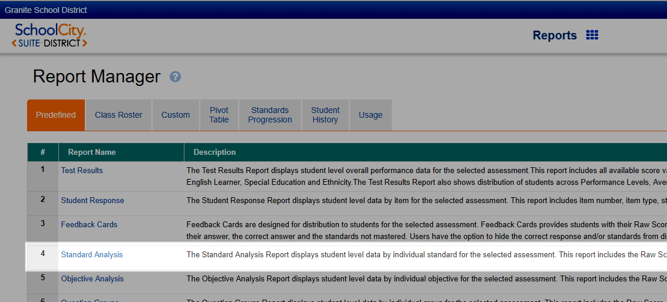
How to access the Standard Analysis
Click or go to granite.schoolcity.com using the Chrome browser
Enter your GSD username and password
Select
Select
A guide “How to find Standard Analysis reports in SchoolCity” is available at the GSD Intranet
Notes:
The Standard Analysis report assesses student mastery of Utah Core standards. Each teacher in Granite School District is expected to teach at least one class that is measured by a Granite Benchmark with the exception of Kindergarten.
You should be familiar with logging into SchoolCity but this guide will help if you need reminders.
The link in paragraph 5 provides additional information on accessing the Standards Analysis report.

Slide 14
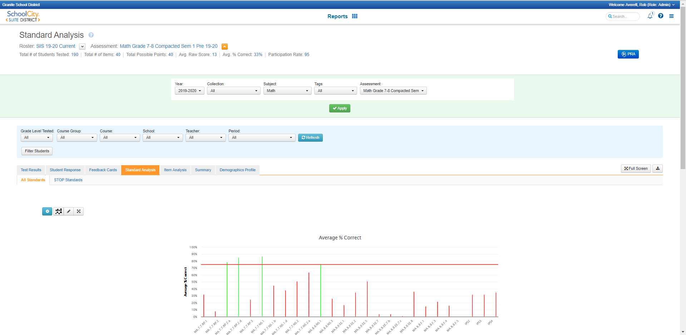
Notes:
(Note to Speaker: These are intended to provide an animation effect; move quickly through slides 14 to 19).
This slide shows the portion of the Standard Analysis report which summarizes student proficiency by standard.

Slide 15
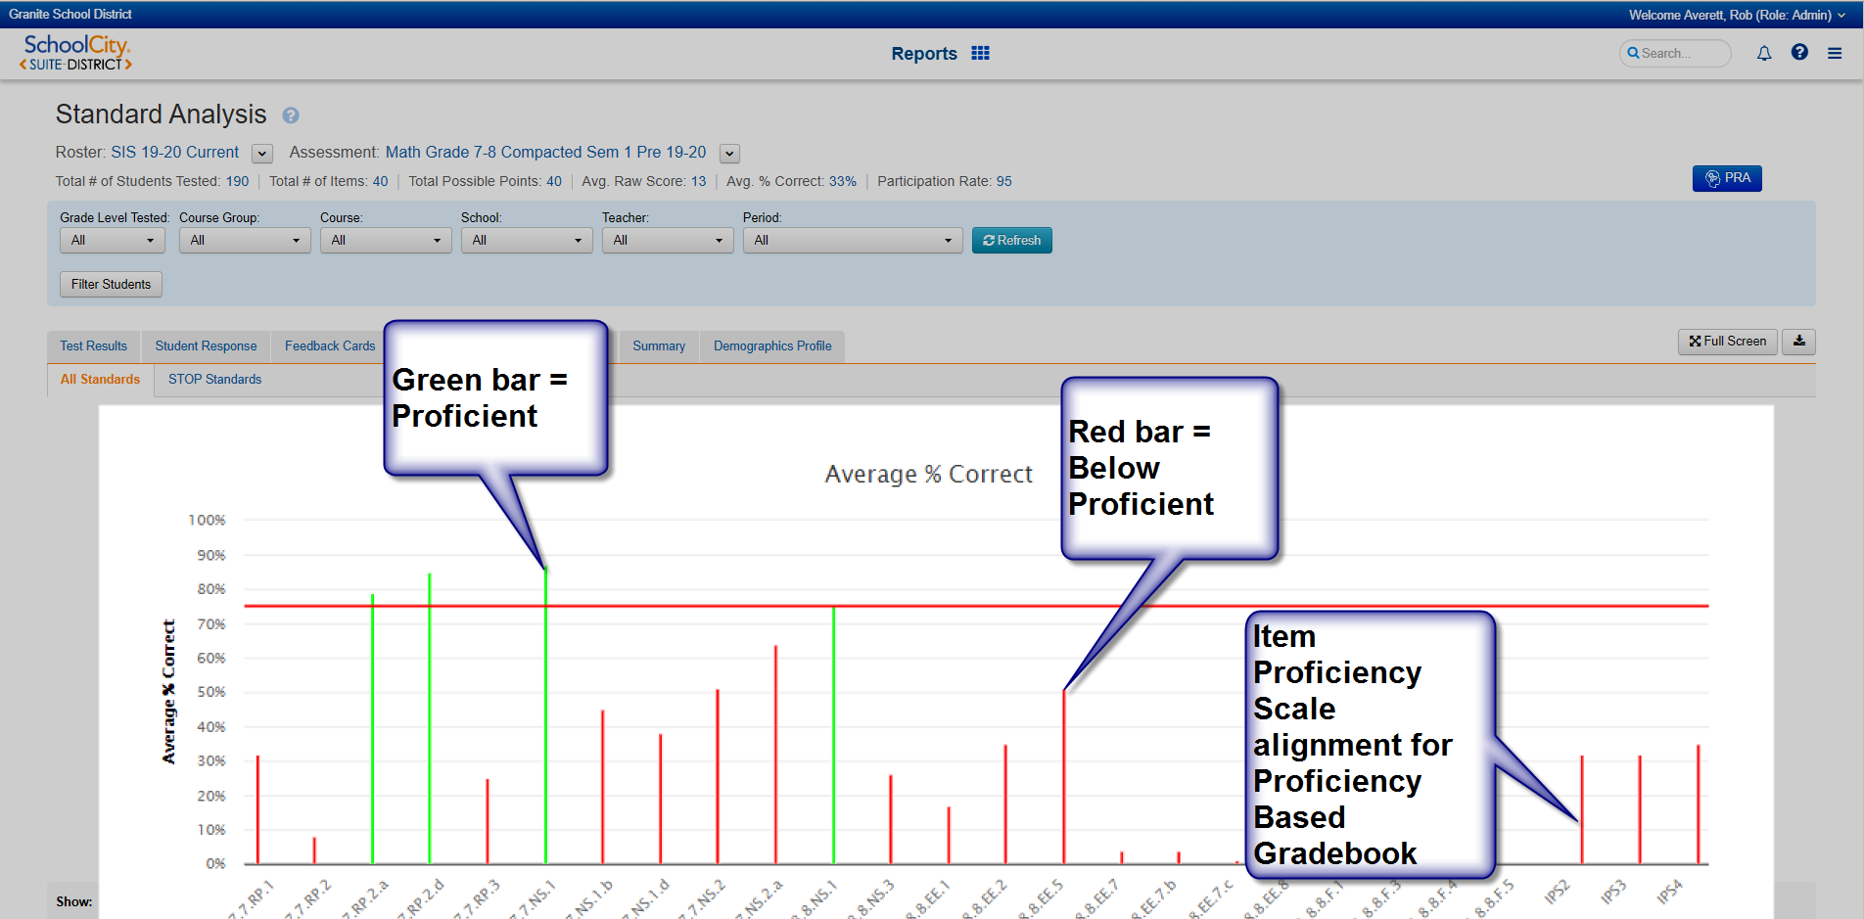
Notes:
Green bars indicate the group reached proficiency on the standard.
Red indicates the group was not proficient; the lower the bar the lower overall proficiency.
The last three columns pertain to the Item Proficiency Scales which link to the Proficiency Based Grading (PBG) Gradebook.

Slide 16
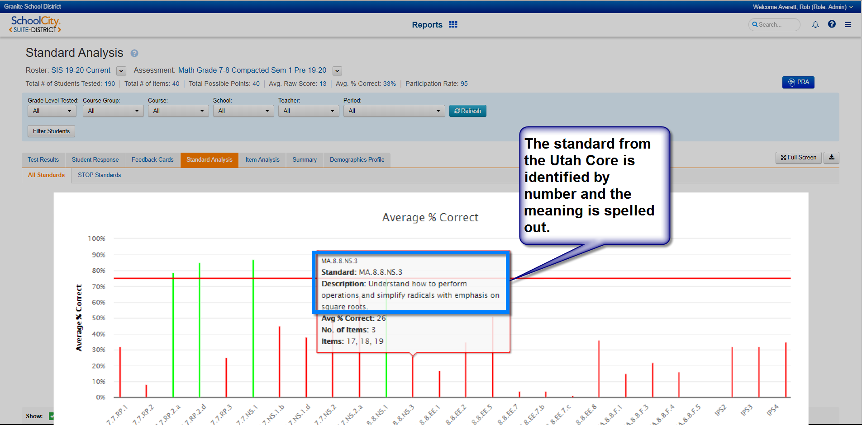
Notes:
The Utah Core Standard that is being assessed is identified by number and the description can be viewed by hovering over the proficiency bar.

Slide 17
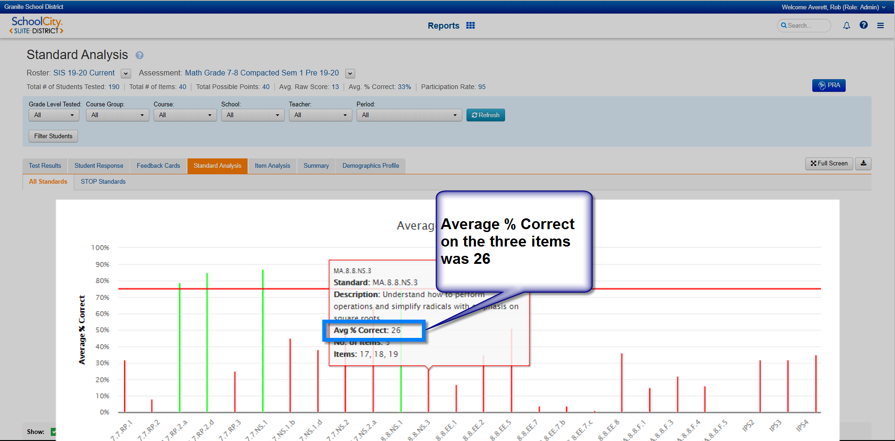
Notes:
This is an indication of the % correct.

Slide 18
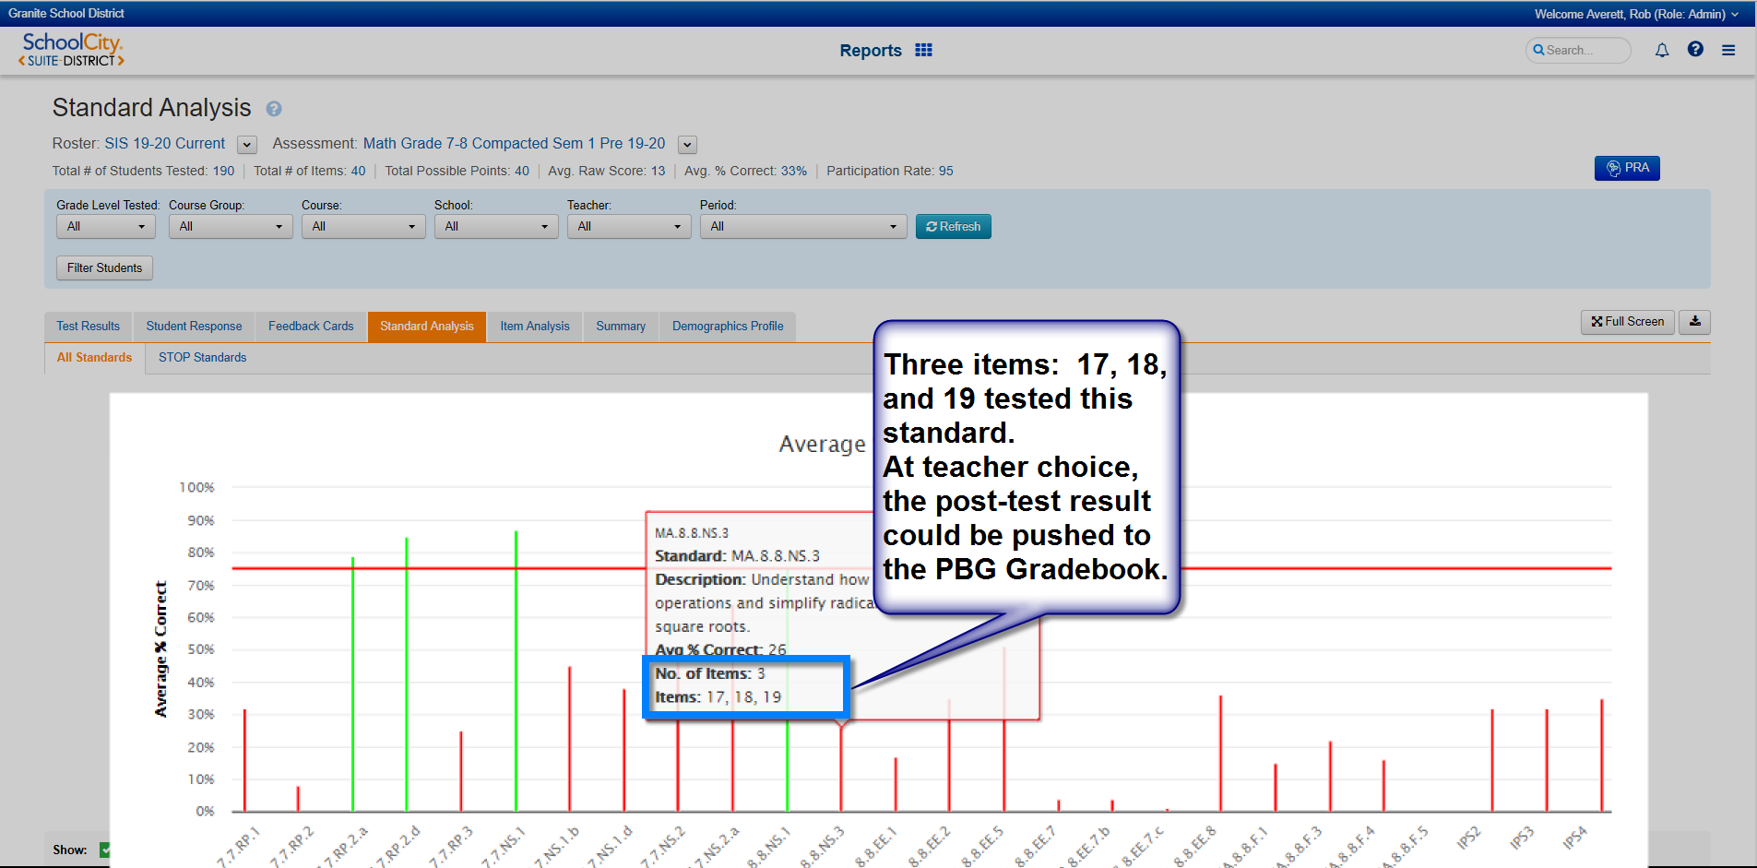
Notes:
Three items were tested for this standard. The highest proficiency level attained would be pushed to the PBG Gradebook if the teachers chooses.

Slide 19
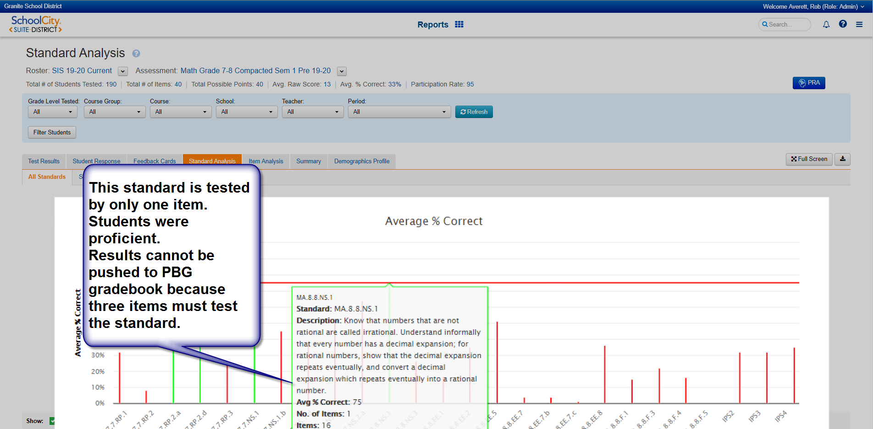
Notes:
Only one item was used to test this standard. The result would not push to the PBG Gradebook.

Slide 20
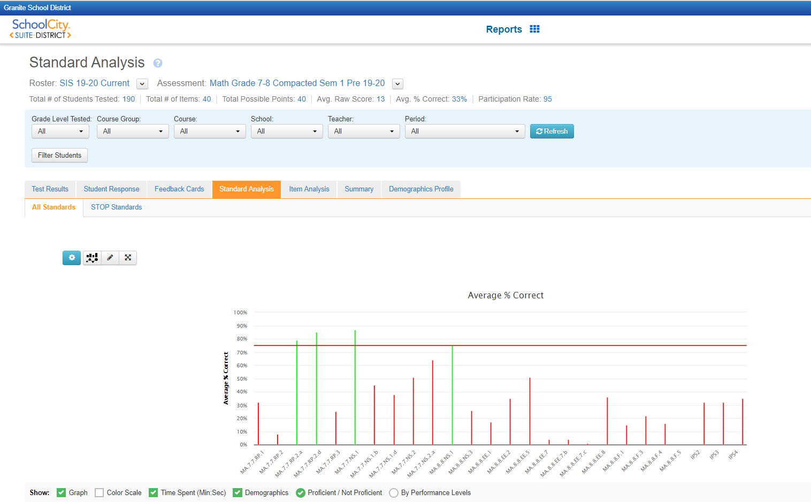
Activity #1
Using the materials provided and a Standard Analysis report pertaining to your role, analyze the results by each core standard.
What do the patterns say about the areas needing improvement?
What do the patterns say about strengths?
Notes:
Activity 1: Using the materials provided and a Standard Analysis report pertaining to your role, analyze the areas of strength and needs improvement.
Contact Chelsey Rollins for additional training
Kindergarten should select “Acadience (DIBELS) - Kindergarten” for their students for this and the following activity using “Test Results” not “Standard Analysis.” The “Standard Analysis” feature is under development for Kindergarten assessments to support Kindergarten PLCs. Kindergarten teachers can student achievement and needs using “Test Results”.

Slide 21
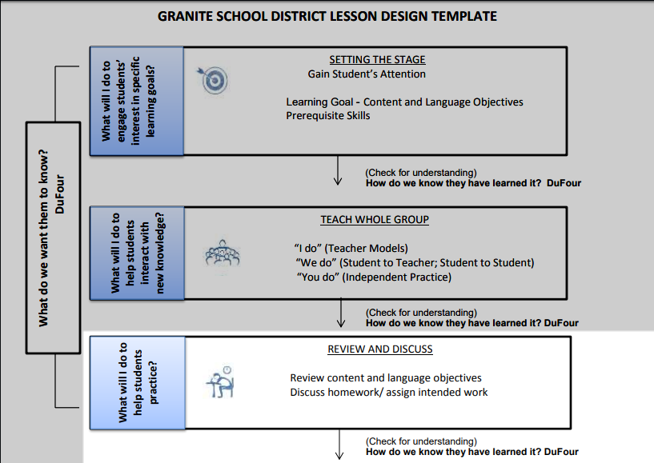
Review and Discuss
In small groups discuss:
What did you learn from student results for the assessment you reviewed?
Have you already been giving additional attention to the standards with low mastery?
What do you need to do now?
Notes:
Discuss:
What did you learn from student results for the assessment you reviewed?
Have you already been giving additional attention to the standards with low mastery:
What do you need to do now?

Slide 22
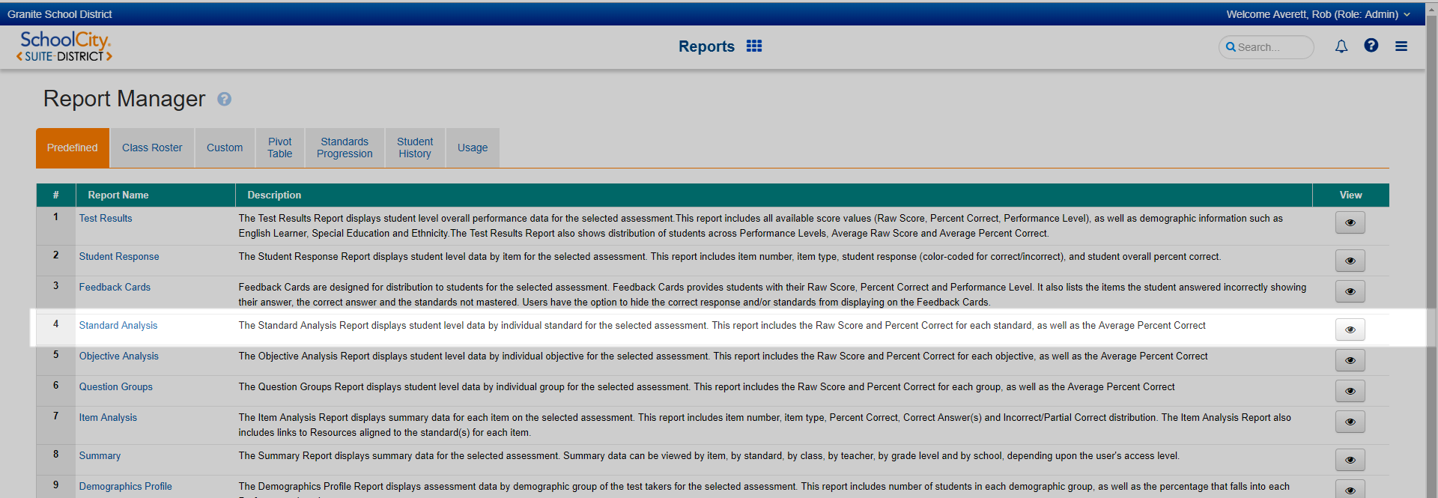
Click here for more information on the Standard Analysis Report.
Notes:
Additional detail regarding the information in the Standard Analysis Report is accessible by clicking the link at the top of this slide.

Slide 23
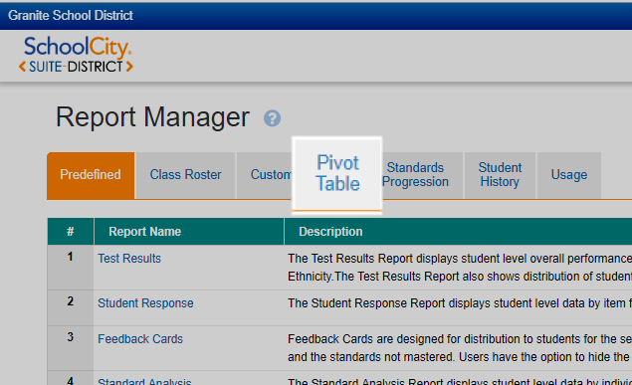
How to access Pivot Tables
Click or go to granite.schoolcity.com using the Chrome browser
Enter your GSD username and password
Select
A guide “How to find pivot table reports in SchoolCity” is available at the GSD Intranet
Notes:
Pivot Tables are created for most tests by the Formative Assessment Specialist. They provide a method to see how students have improved between the Pre-Test and Post-Test and to identify the students who are struggling. This is particularly useful to monitor growth by students in the bottom 25% who count twice in school accountability.

Slide 24
Identifying needs at student level
Notes:
Cells highlighted in Green indicate growth.
Pre-test results are recorded vertically (the y-axis).
Post-test results are recorded horizontally (the x-axis).
The intersection of “Proficient” on the post-test (horizontal) with the “Below Proficient” from the pre-test (vertical) indicates 536 students moved up two levels during the semester.

Slide 25
Notes:
Yellow cells indicate students who did not improve.

Slide 26
Notes:
Red cells indicate students whose performance got worse.

Slide 27
Notes:
Click on the underlined number to create a list of the students in the cell, in this case, the 16 students who lost proficiency.

Slide 28
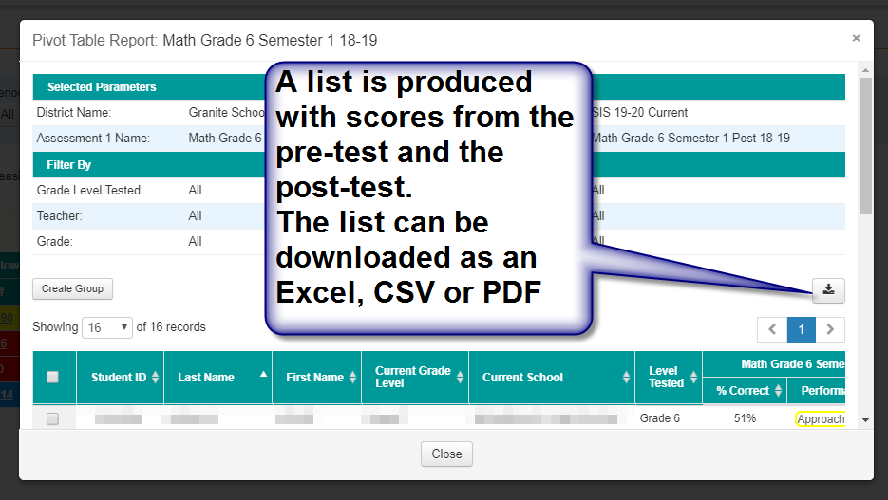
Notes:
A list can be downloaded to work with the students who need additional help.

Slide 29
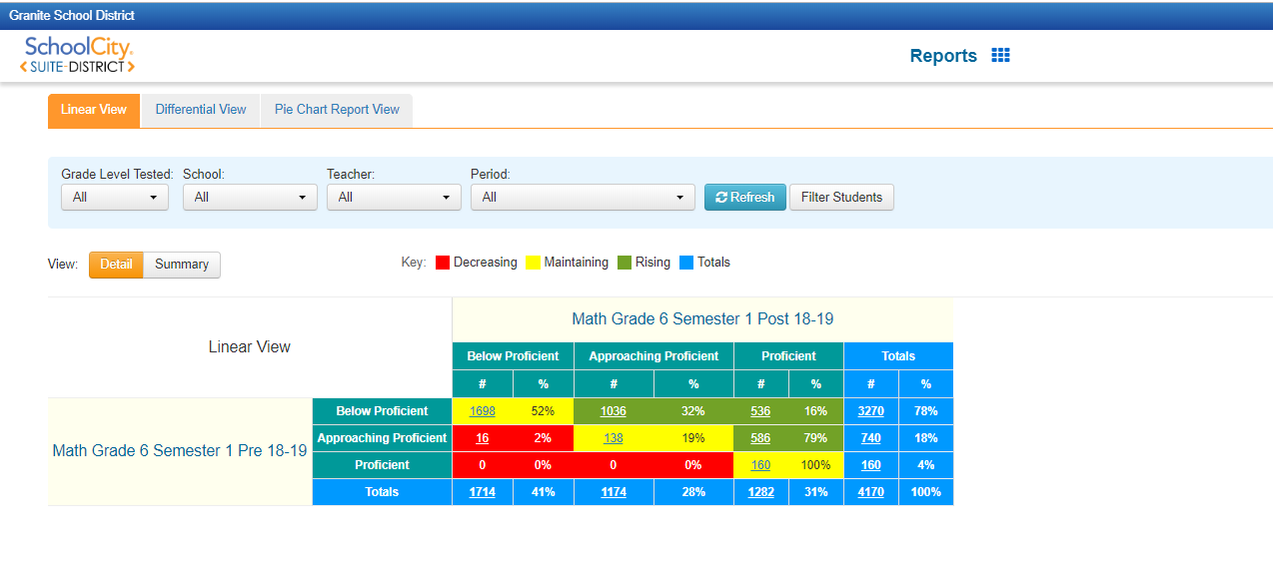
Activity #2
Using the materials provided and a Pivot Table report pertaining to your role, analyze the areas of strength and needs improvement.
Notes:
Activity #2. Select a pivot table pertaining to your assessments. Explore the results. What do they tell you about student achievement during the semester?

Slide 30
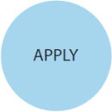
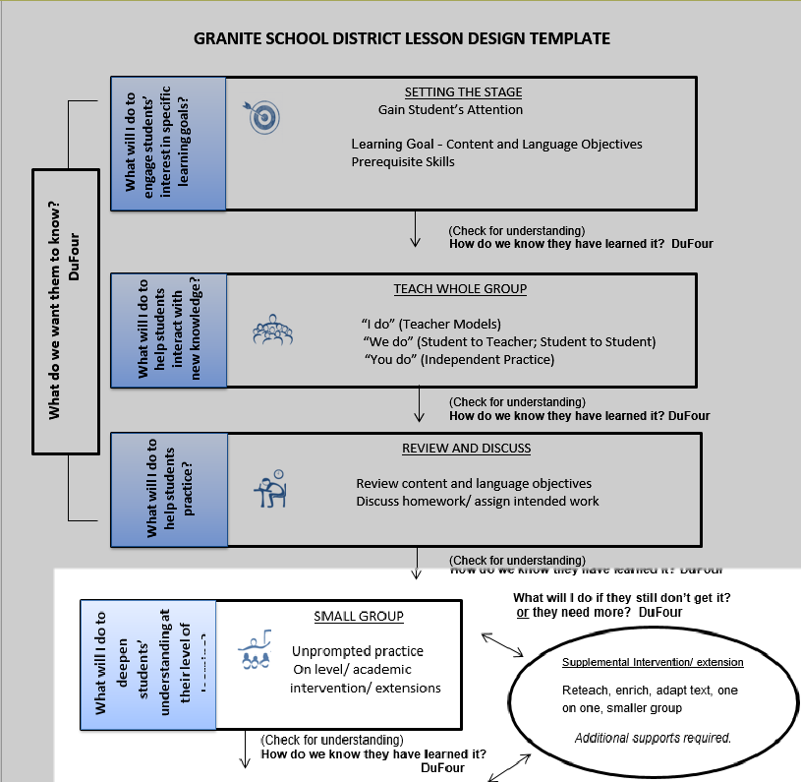
Tracking Progress
Tracking Progress
Notes:
You have had the opportunity to analyze student growth in your school.
Teachers need to bring a device that will allow them to access SchoolCity during the GWPL training so they can explore the results pertaining to their classroom. Some Pivot Tables will have been updated for the 1st Semester of SY 2020 for the 10 January training. Elementary schools do not all complete their post-tests until three weeks after the semester change but most secondary tests are probably complete and will show real-time results.
Proficiency Scales have been prepared by the district to provide coherence between schools and networks.
Rubrics are to be student-friendly and can be used by PLCs to calibrate their work.

Slide 31
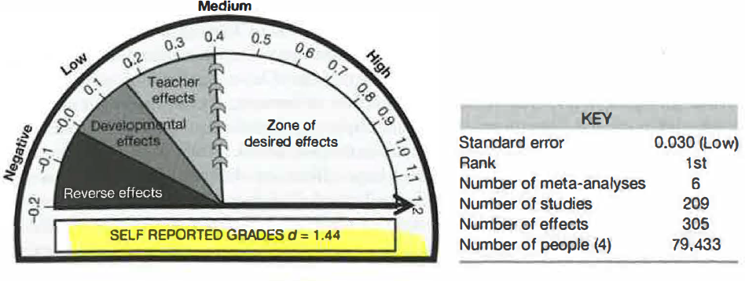
Students Self-Reporting Grades / Tracking Progress
In Visible Learning, John Hattie identifies “Students Self Reporting Grades” as the activity with the highest effect-size for student achievement.
Notes:
Students can track their growth. This has the highest effect-size on student growth according to John Hattie. Remember, typical teacher effect is between .25 and .40. Self-reported grades, which means tracking and anticipating results, has a 1.44 effect-size which is the highest of all he studied.

Slide 32
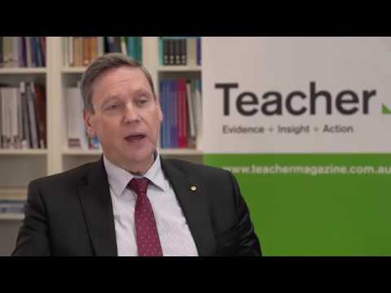
Notes:
Professor Geoff Masters AO has served as Chief Executive Officer and board member of the Australian Council for Educational Research (ACER) since 1998. He has a PhD in educational measurement, and has published widely in the fields of educational assessment and research. His contributions to education have been recognised through the award of the Australian College of Educators’ Medal in 2009 and his appointment as an Officer of the Order of Australia in 2014.

Slide 33
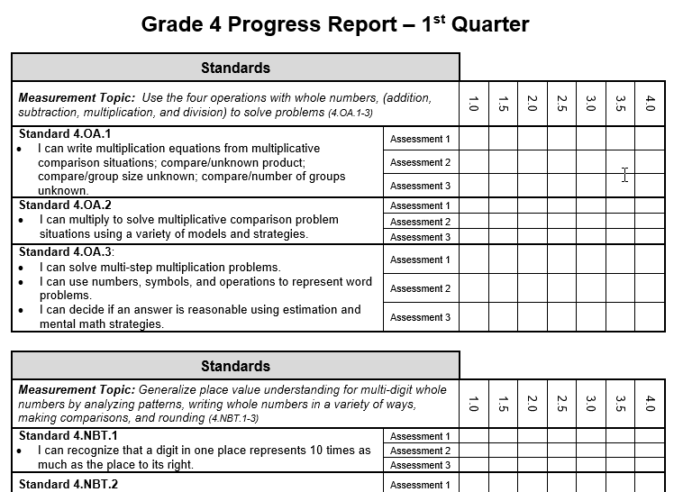
Tools for Students to Monitor Progress - Elementary
Elementary school example:
student can color-in the proficiency level
or record the date they increase proficiency
Notes:
This is an example of a tracker appropriate for an elementary student. Note how well it works in a Proficiency Based Grading environment.

Slide 34
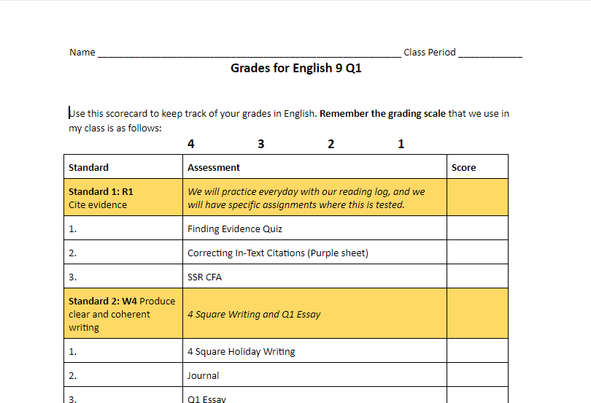
Tools for Students to Monitor Progress - Secondary
Secondary school example:
student records proficiency level
Notes:
This is an example of a tool for secondary students to track progress. Madison Brown at Granger HS developed this tool.

Slide 35
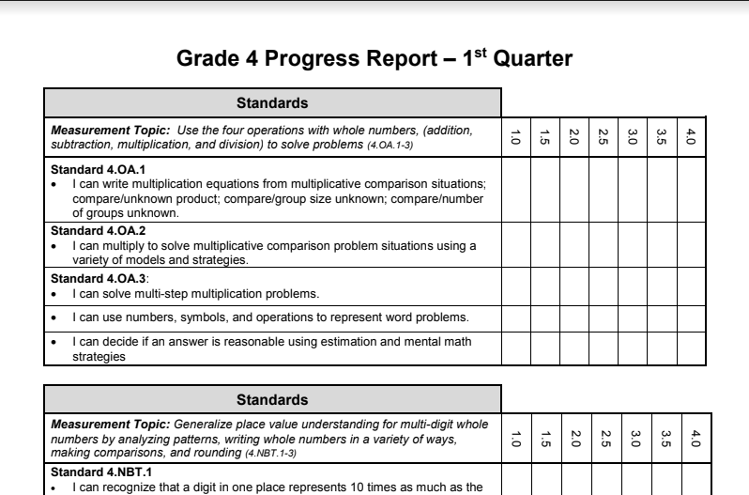
Activity #3
Review materials in the Shared Google Drive.
Are there materials that would work well for you?
Do you have tools that you would like to share - send to sasorensen@granitesd.org.
Notes:
Activity 3: Click on the tab at the January 2020 GWPL for Activity 3. It will provide you access to examples of student progress tracking tools that are in use in various schools across Granite School District. Consider their strengths and possible use for your school.
Take a few minutes to discuss at your table.

Slide 36
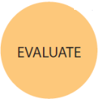
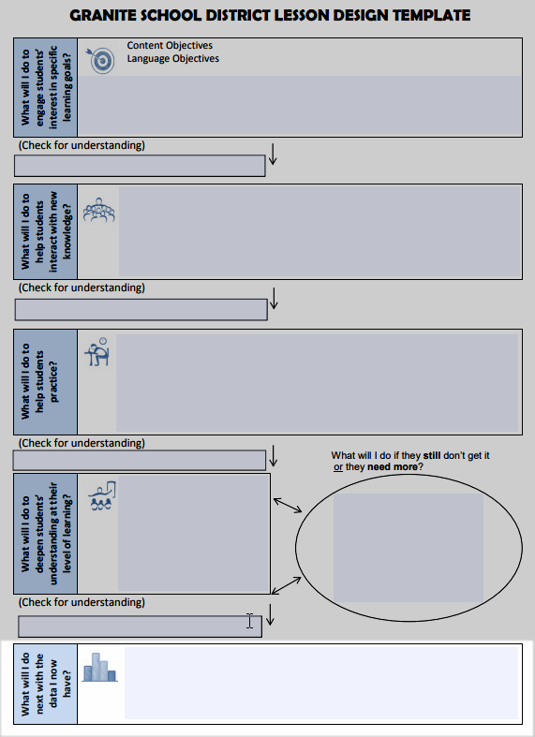
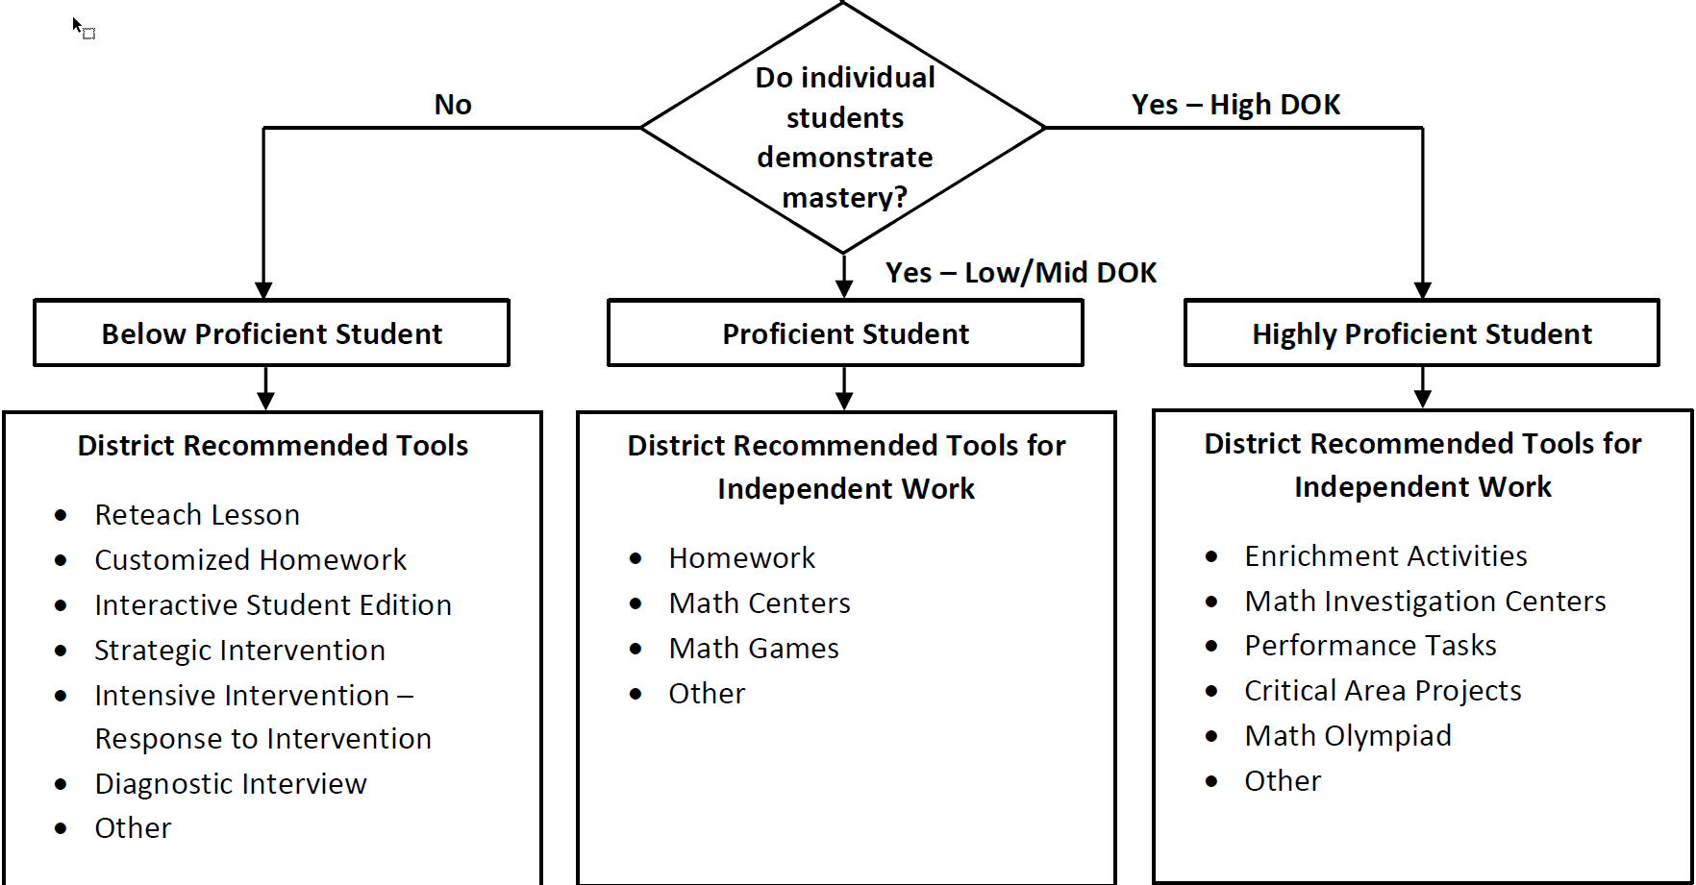
Intervention and Extension
Elem ELA Decision Tree
Secondary ELA Decision Tree
Elem Math Decision Tree
Secondary Math Decision Tree
(Copies in Additional Resources at the end of this presentation)
Notes:
Granite School District Decision trees identify tools to provide intervention to increase student learning and to extend learning for students achieving master.

Slide 37
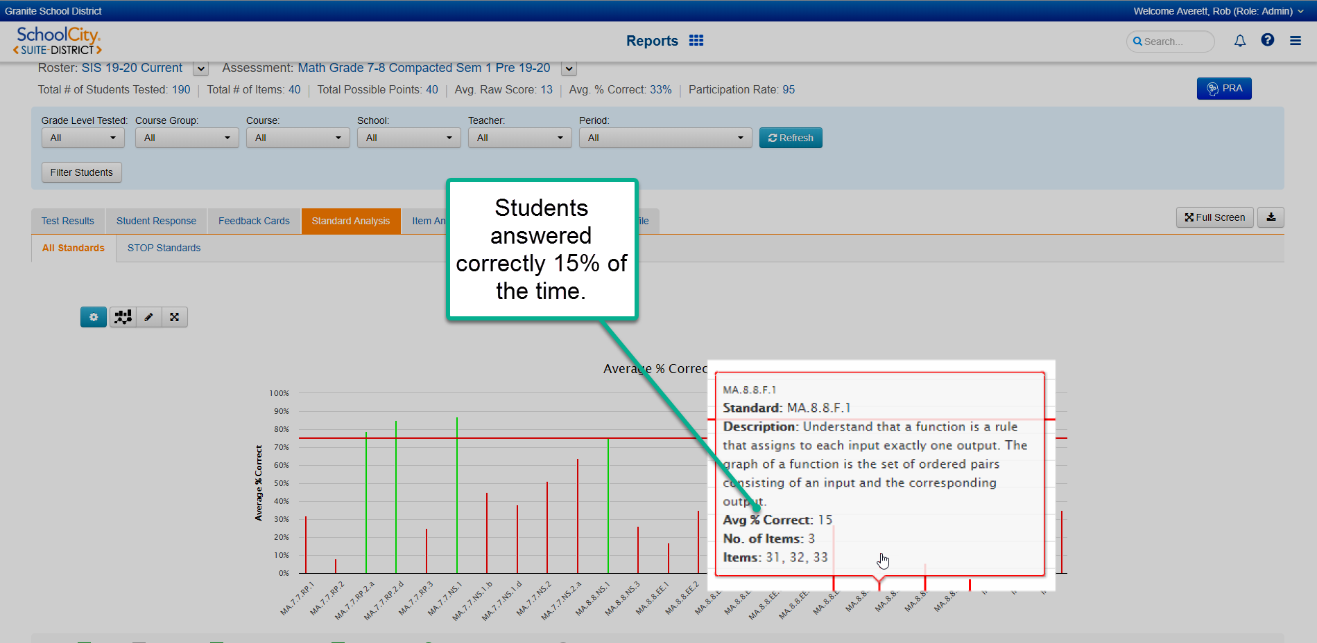
Notes:
This is an example of a standard with learning gaps. Only 15% of the students got a correct answer to any one of the three items associated with this standard. Granite School District assessments and tools provide a direct way to assign interventions to resolve the learning gaps.

Slide 38
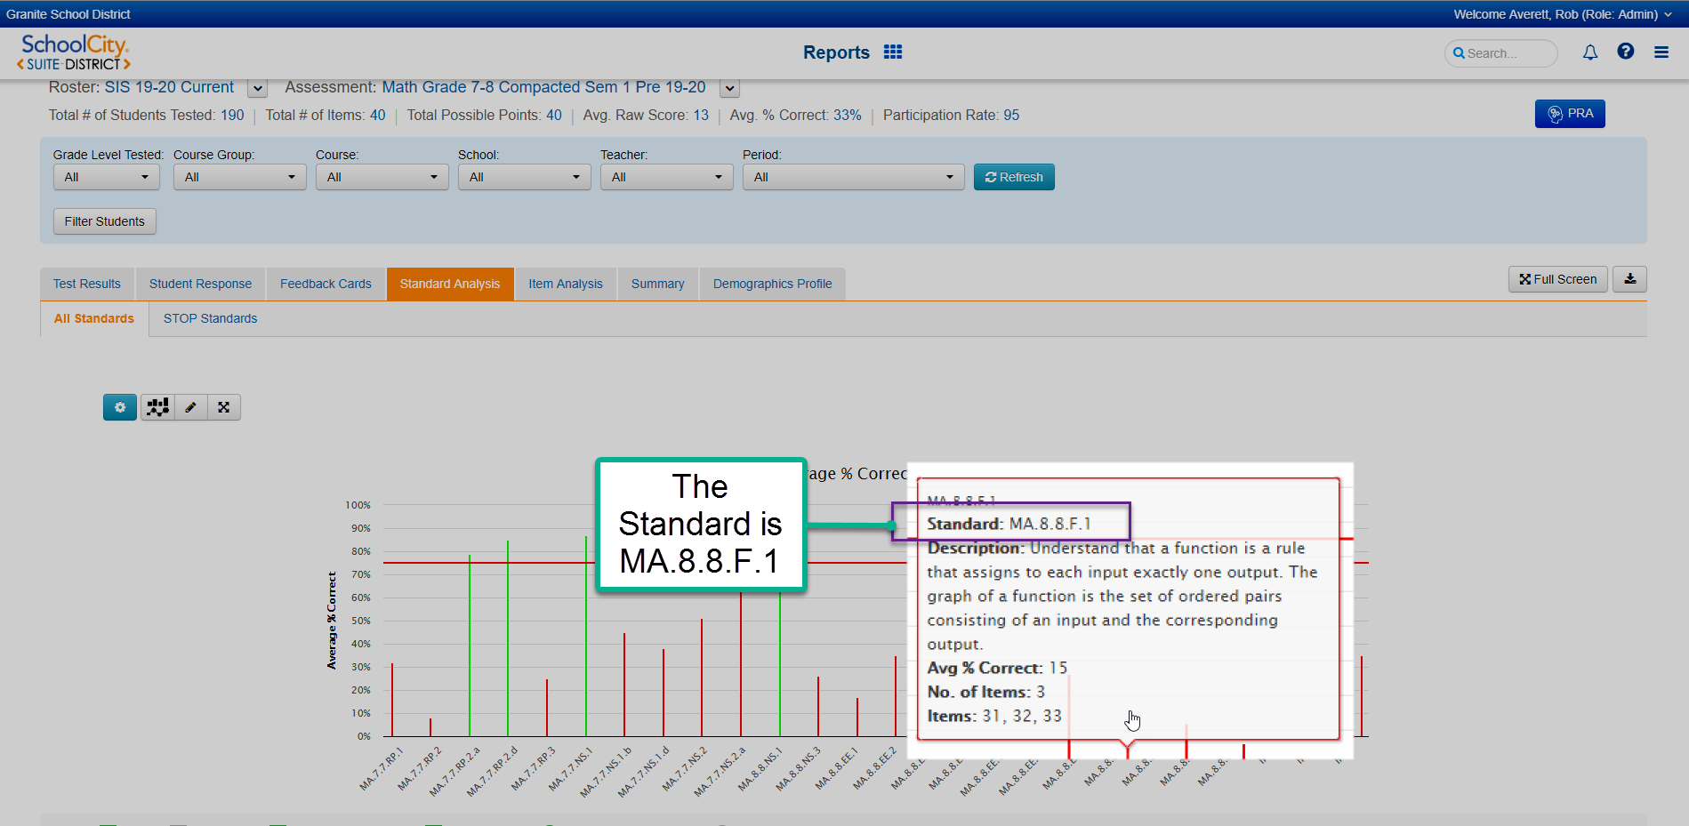
Notes:
The standard identified with learning gaps is MA.8.8.F.1, the role of a function in mathematics.

Slide 39
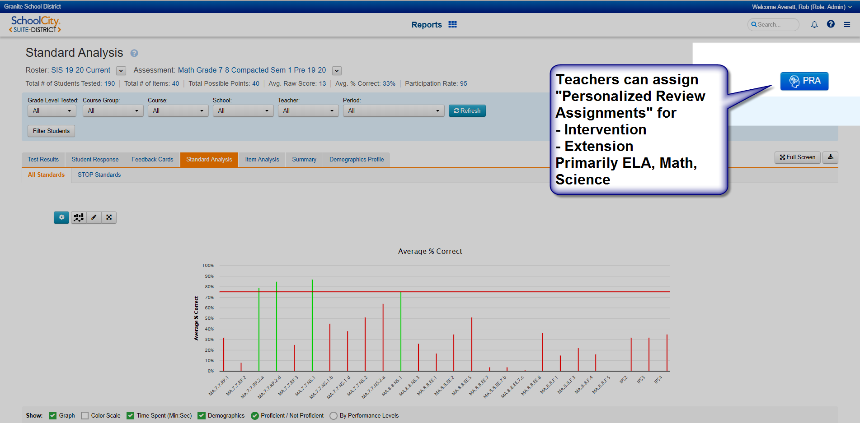
Notes:
From the Standard Analysis page the teacher can assign a Personalized Review Assignment to students.
The button is in the upper right hand corner.
These activities are mostly available for ELA, Math and Science because they are an area of concentration by states and the federal government.

Slide 40
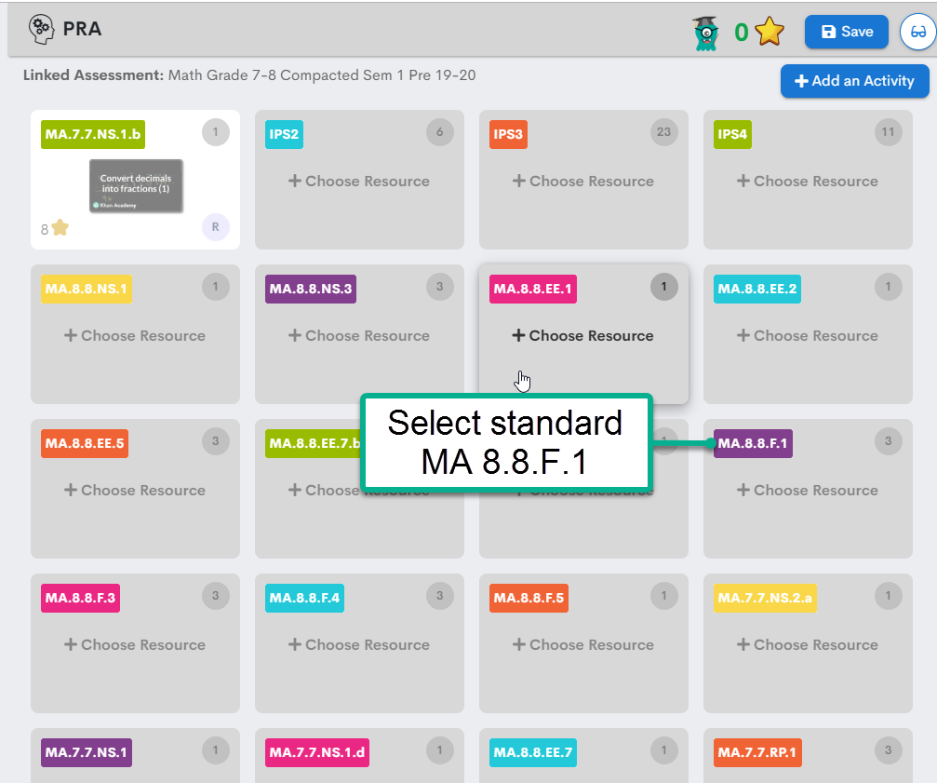
Notes:
After pressing the PRA button the teacher can review supplemental materials relating to the standard.

Slide 41
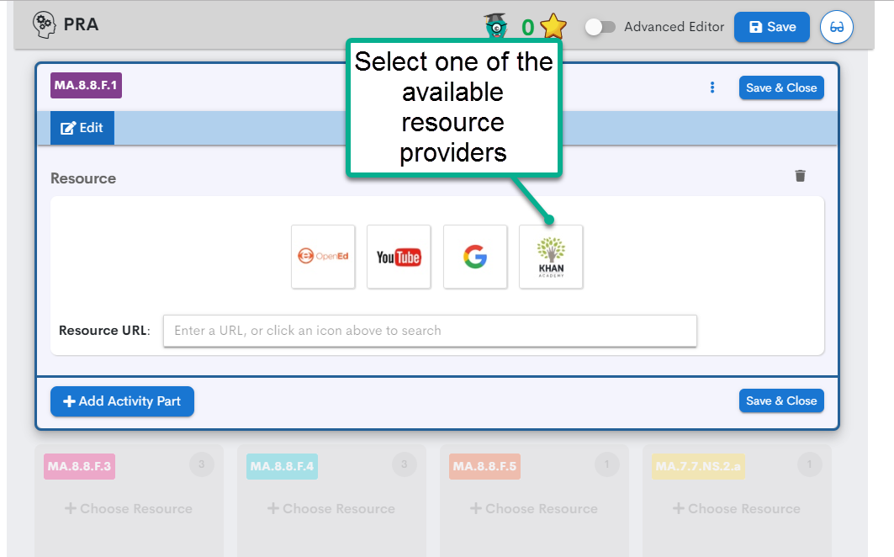
Notes:
There are several sources of supplemental materials.
Khan Academy is selected here because it includes only closely aligned materials
Teachers who are Google educators can assign content of their choice through this feature.
Any student not achieving proficiency will receive the Personalized Review Assignment when the teacher makes the selection.

Slide 42
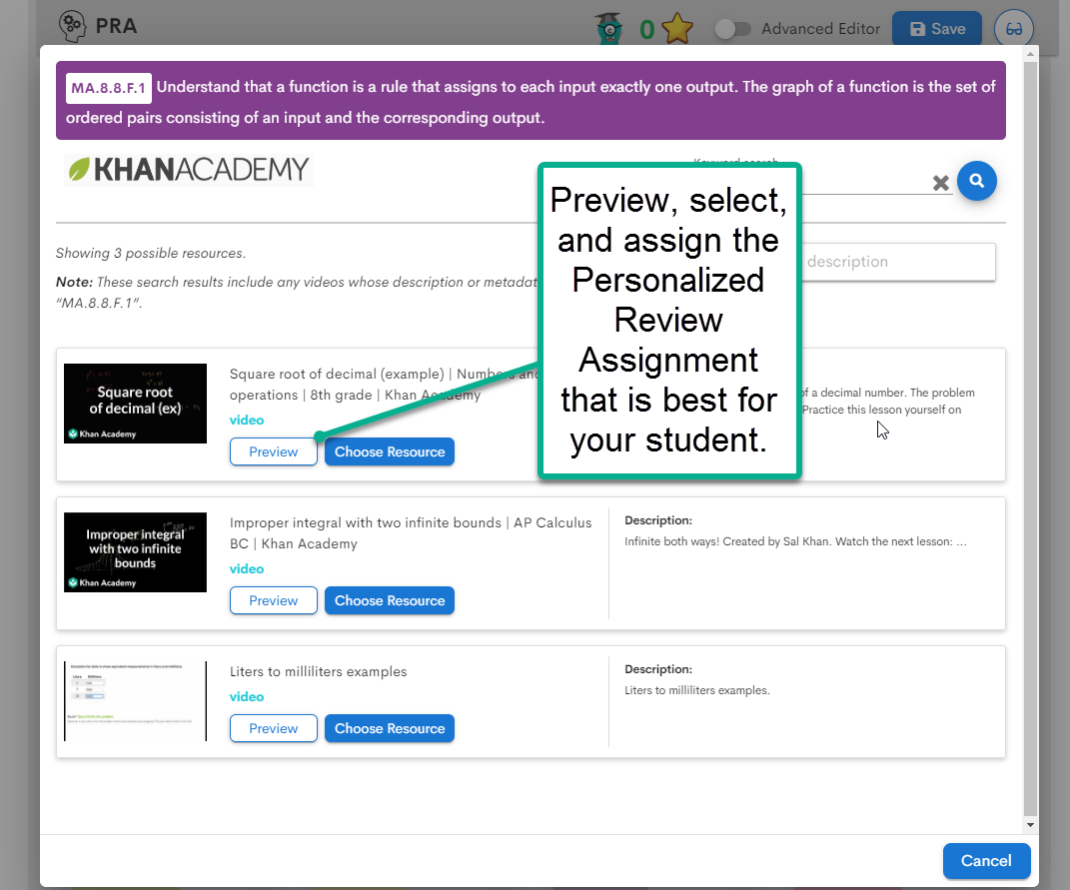
Notes:
For Standard MA.8.8.F.1 there are two resource offered. The teacher can preview the assignment to make sure it addresses the learning task and then assign it to students.

Slide 43
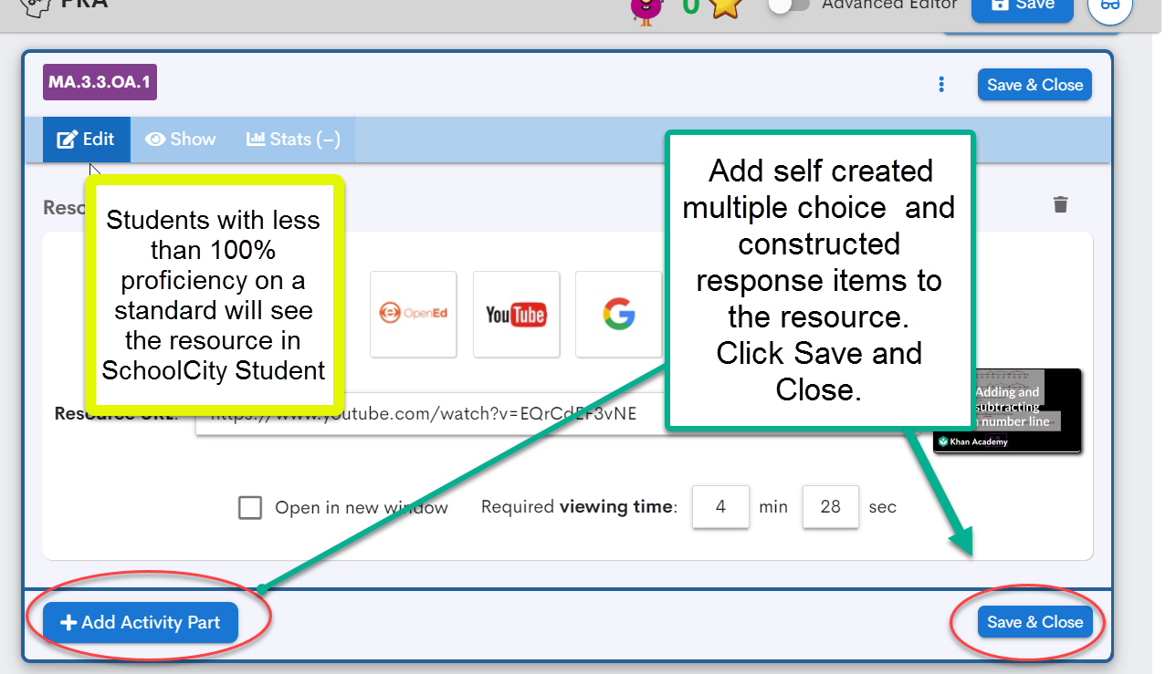
Notes:
The teacher can assign a supplemental assessment activity related to this Personalized Review Assignment in order to verify it has met the intended purpose
All students not achieving 100% proficiency will receive the supplemental activity.

Slide 44
Extension
Extensions should be planned using level 4 sample tasks from proficiency scales for each content . They lead to in-depth understanding of the standard so students can demonstrate proficiency on the standard in complex ways.
In small groups discuss:
How can my school extend the curriculum for advanced learners?
Notes:
Granite School District Curriculum Maps identify Level 4 sample tasks that allow students to extend their learning.

Slide 45
Today’s Objectives
Content Objective:
Use student assessment results to:
identify core standards with the greatest needs and those with strengths,
identify students who progressed in core knowledge also those who stayed the same and those who improved.
Provide tools for students to track their progress.
Apply tools to keep the course on track and for teachers to provide interventions and extensions.
Language Objective:
Learners will use the terminology of the assessment cycle:
Plan, Implement, Analyze, Apply, Evaluate.
Notes:
(Model the use of Language and Content Objectives)
Read individually or have a person in the group read it.

Slide 46
Administrators, Please take a minute to complete our survey
Go to graniteway.org and click “Meeting Feedback”

Slide 47
Additional Resources

Slide 48
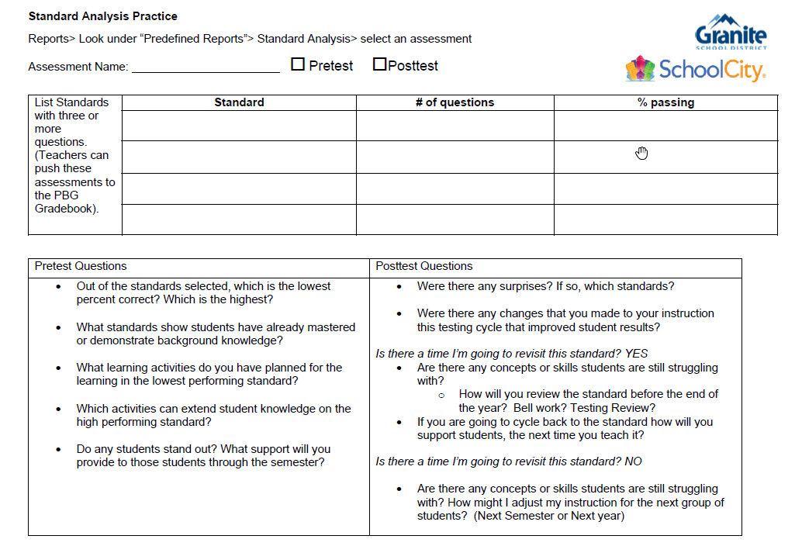
Activity
1

Slide 49
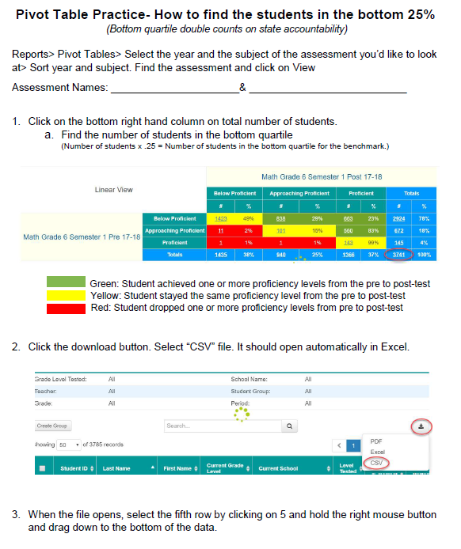
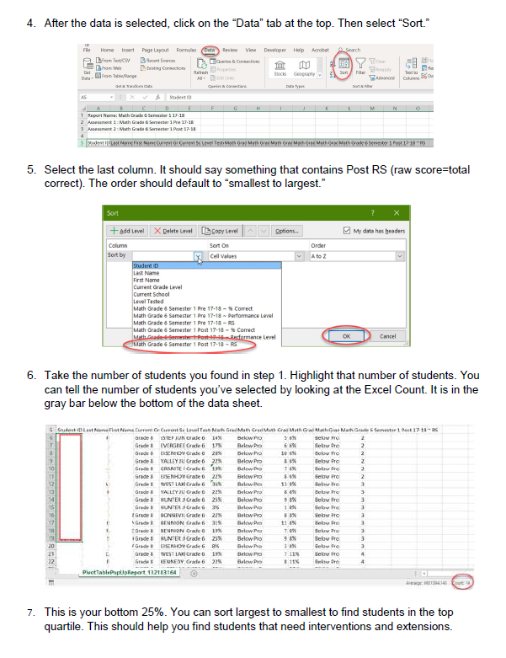
Activity
2

Slide 50
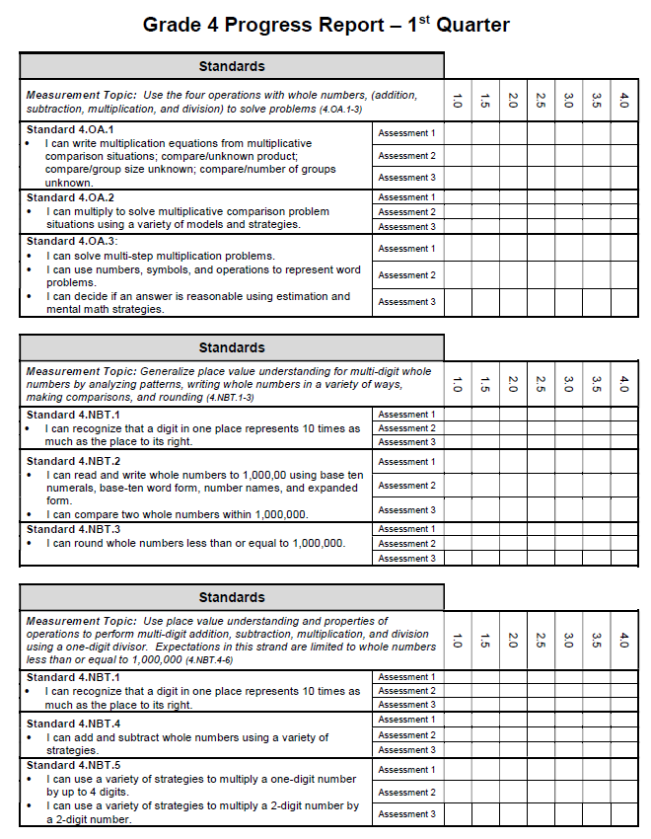
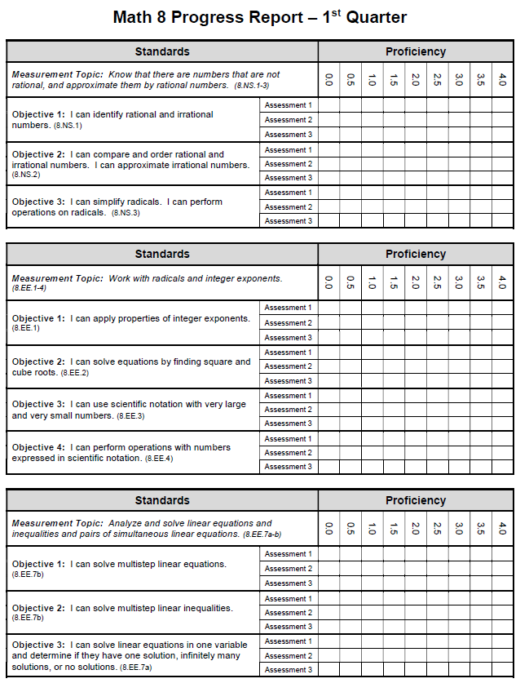
Activity
3

Slide 51
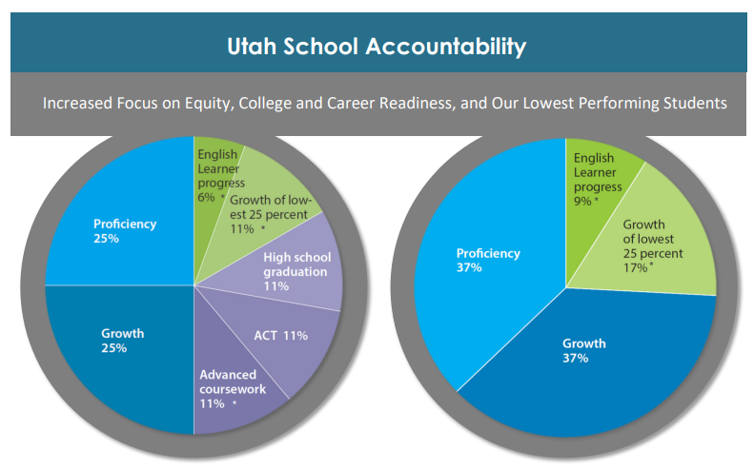
Utah School Accountability Handout

Slide 52
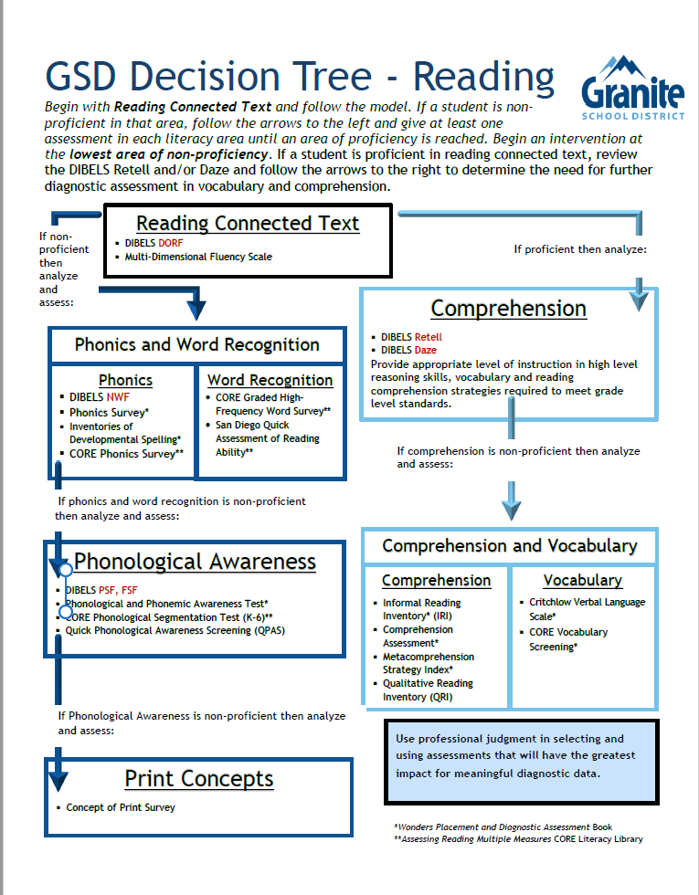
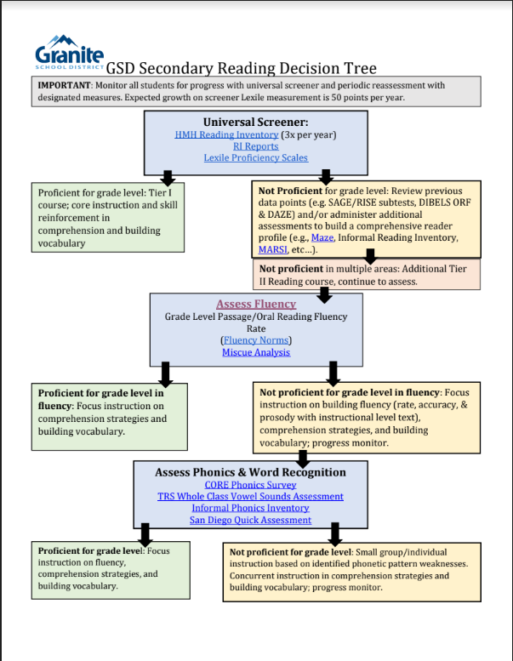

Slide 53
