Slide 1
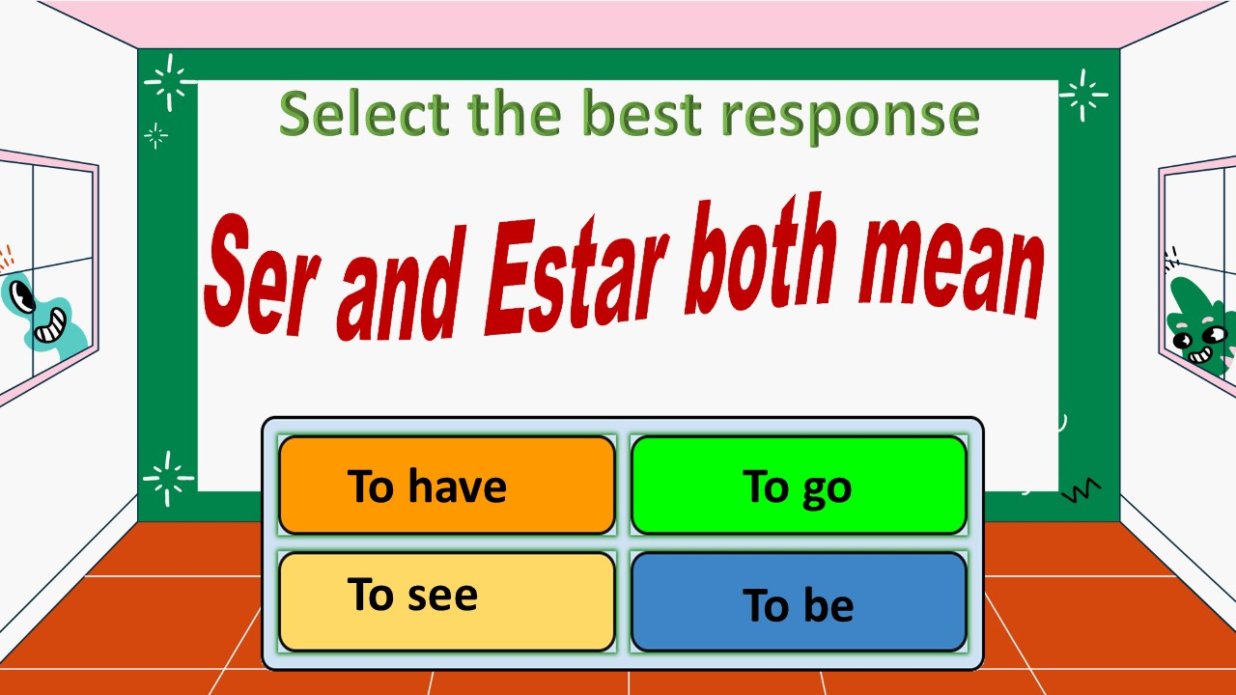
Notes:
🍐 This is a Pear Deck Draggable™ Slide.
🍐 To edit the type of question, go back to the "Ask Students a Question" in the Pear Deck sidebar.

Slide 2
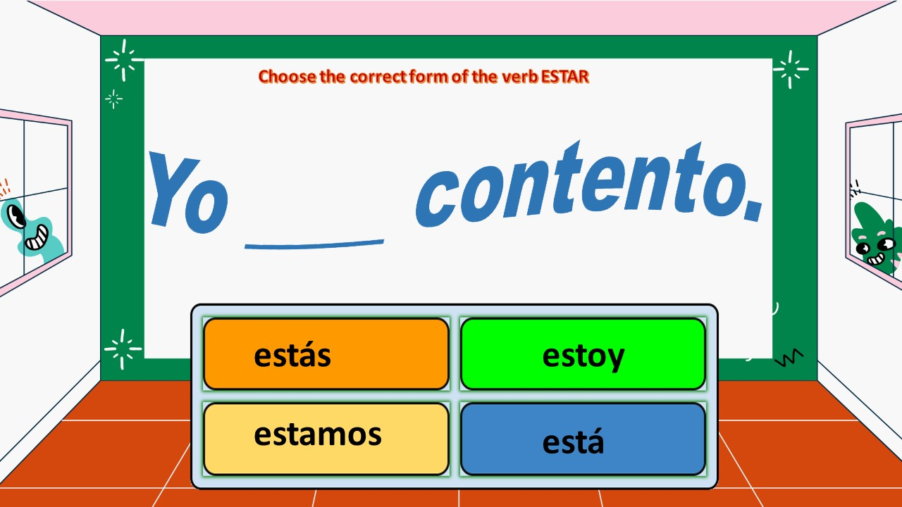
Notes:
🍐 This is a Pear Deck Draggable™ Slide.
🍐 To edit the type of question, go back to the "Ask Students a Question" in the Pear Deck sidebar.

Slide 3
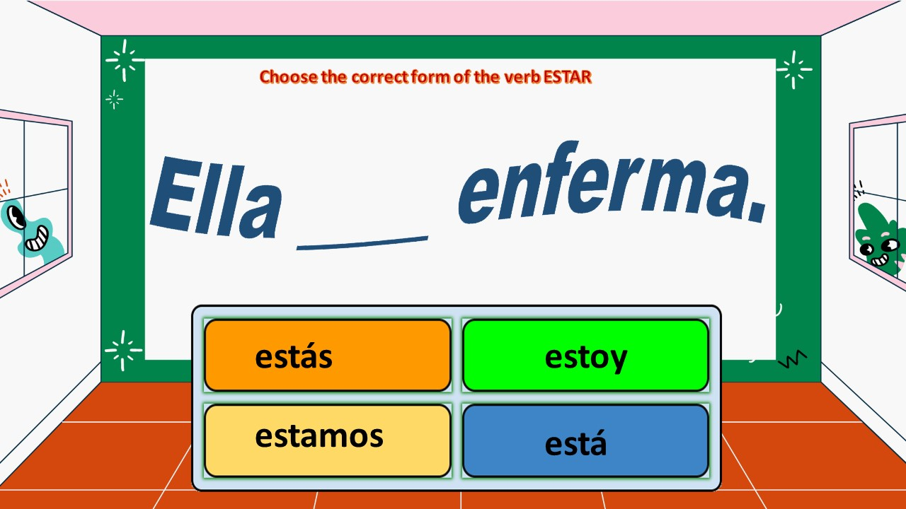
Notes:
🍐 This is a Pear Deck Draggable™ Slide.
🍐 To edit the type of question, go back to the "Ask Students a Question" in the Pear Deck sidebar.

Slide 4
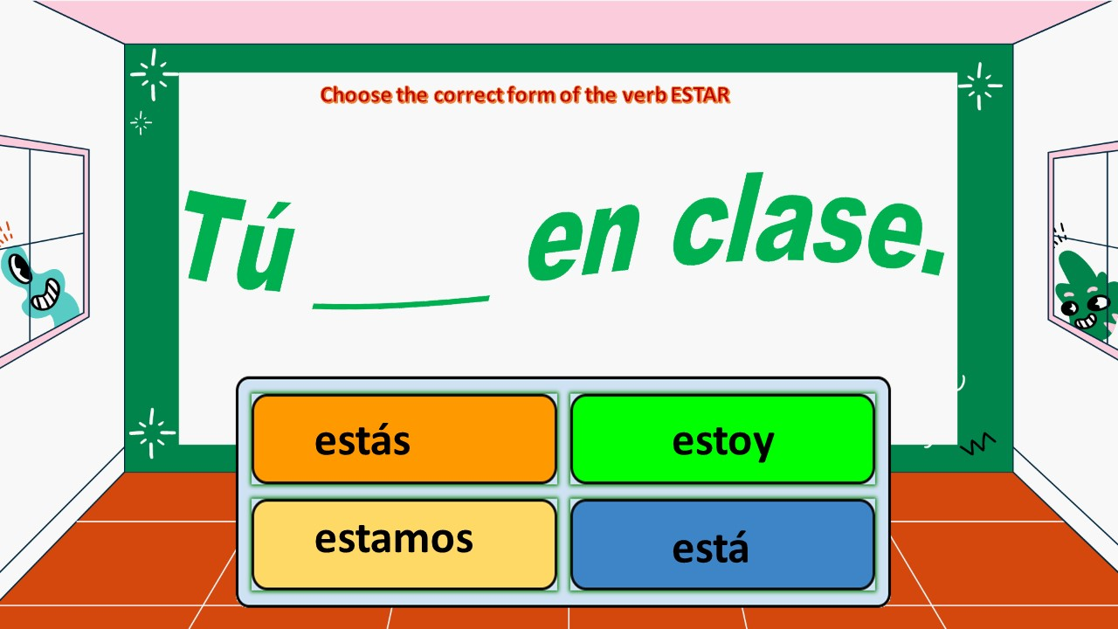
Notes:
🍐 This is a Pear Deck Draggable™ Slide.
🍐 To edit the type of question, go back to the "Ask Students a Question" in the Pear Deck sidebar.

Slide 5
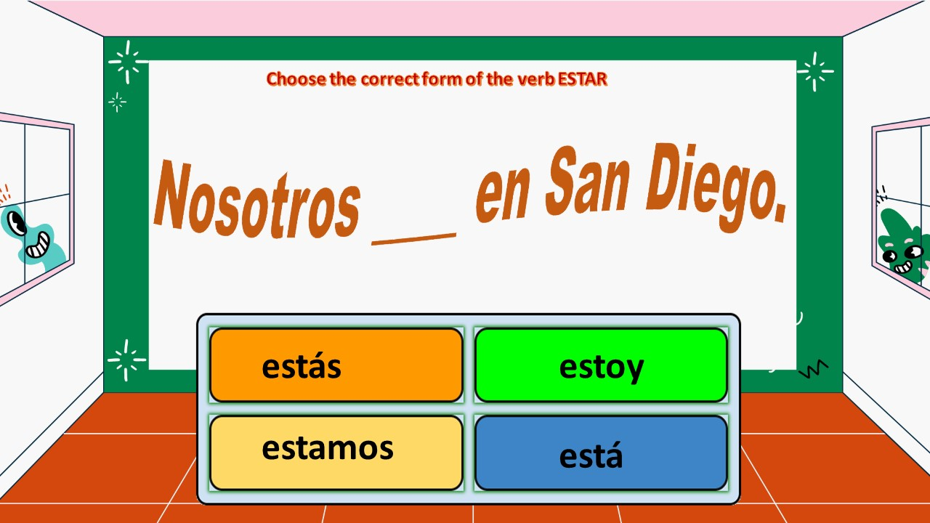

Slide 6
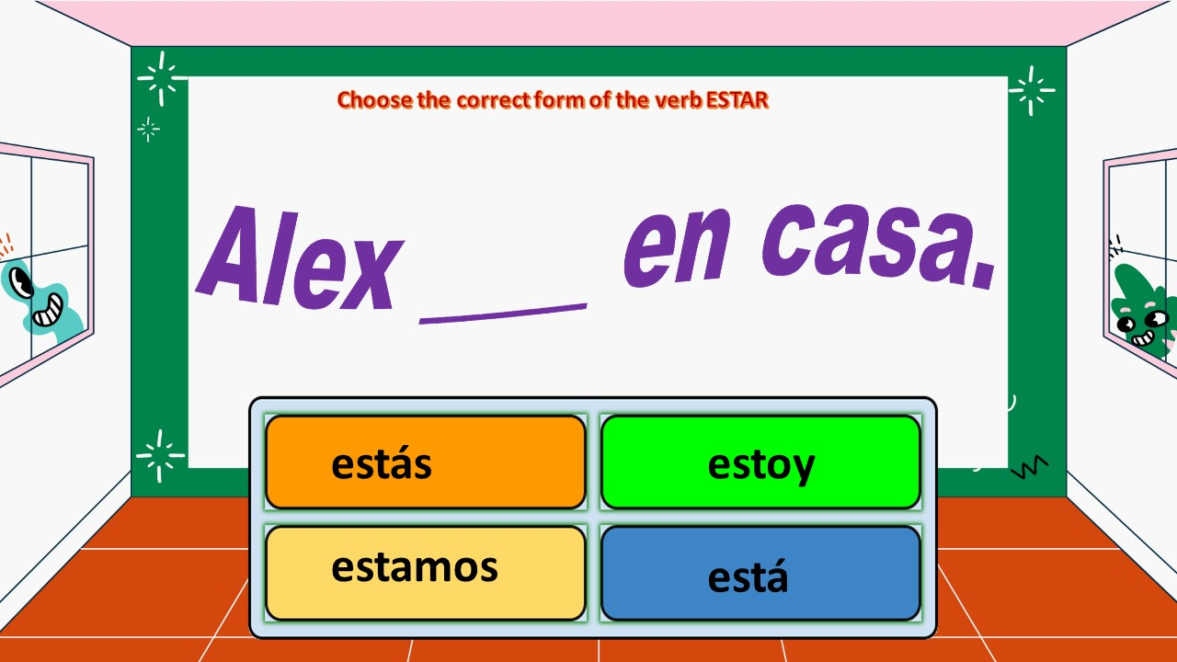
Notes:
🍐 This is a Pear Deck Draggable™ Slide.
🍐 To edit the type of question, go back to the "Ask Students a Question" in the Pear Deck sidebar.

Slide 7
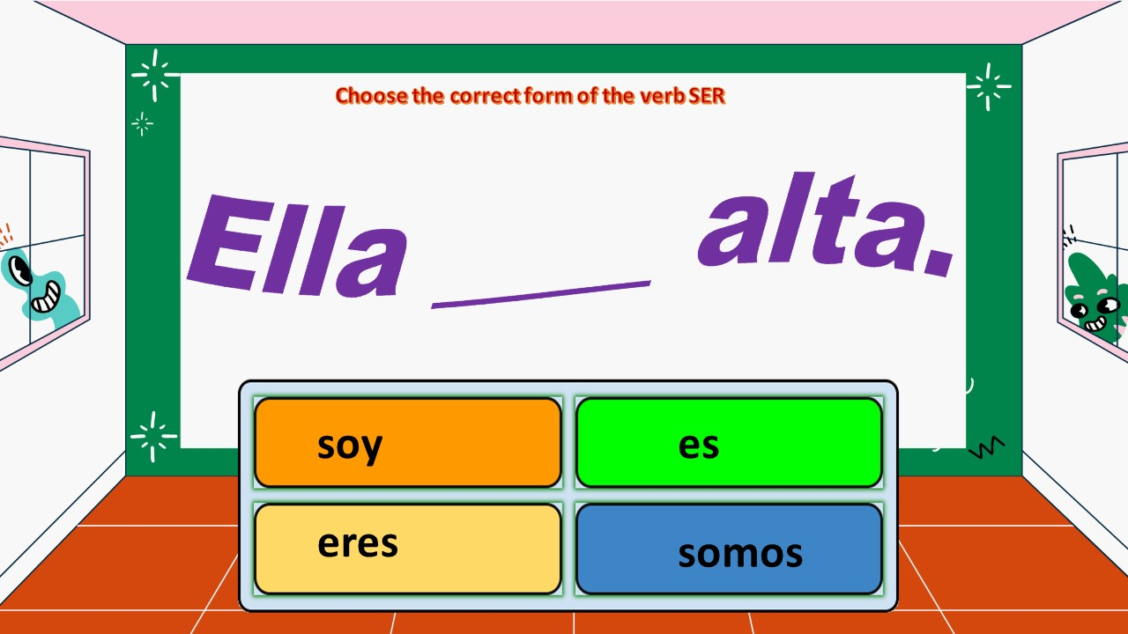
Notes:
🍐 This is a Pear Deck Draggable™ Slide.
🍐 To edit the type of question, go back to the "Ask Students a Question" in the Pear Deck sidebar.

Slide 8
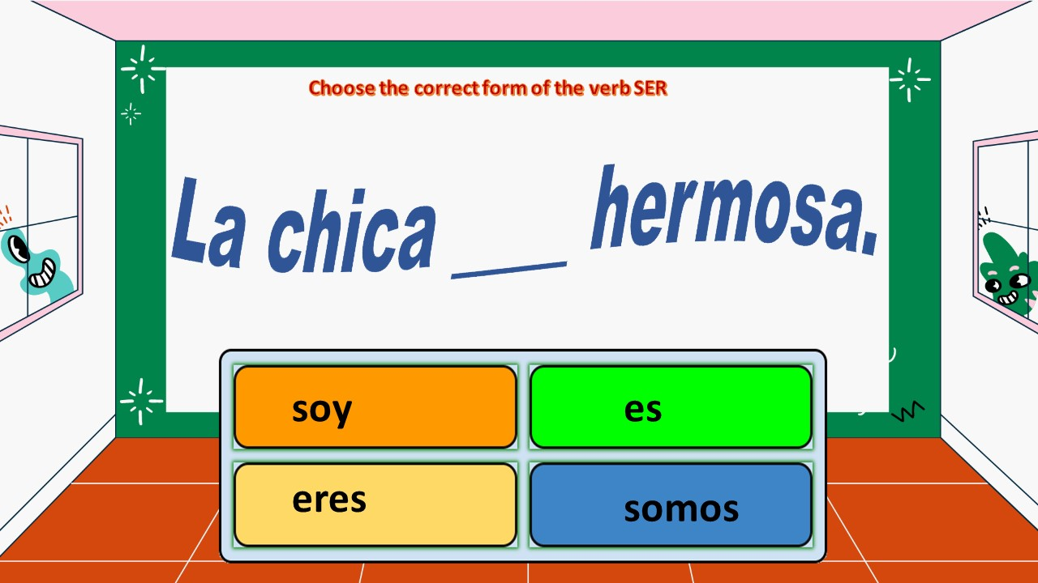
Notes:
🍐 This is a Pear Deck Draggable™ Slide.
🍐 To edit the type of question, go back to the "Ask Students a Question" in the Pear Deck sidebar.

Slide 9
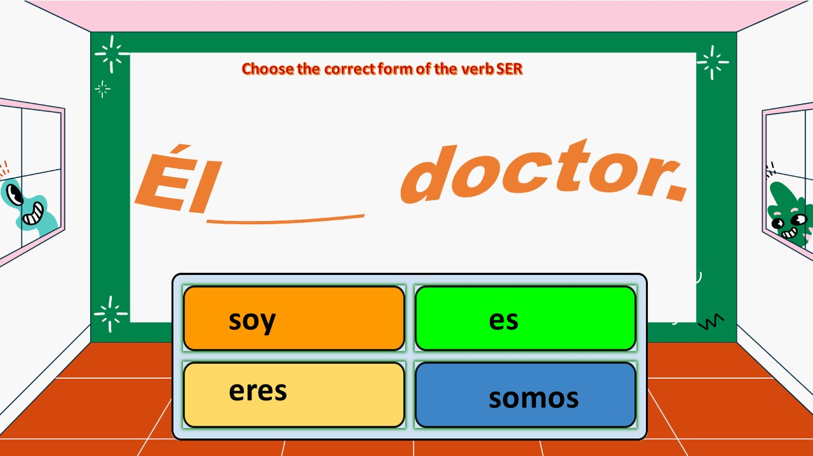
Notes:
🍐 This is a Pear Deck Draggable™ Slide.
🍐 To edit the type of question, go back to the "Ask Students a Question" in the Pear Deck sidebar.

Slide 10
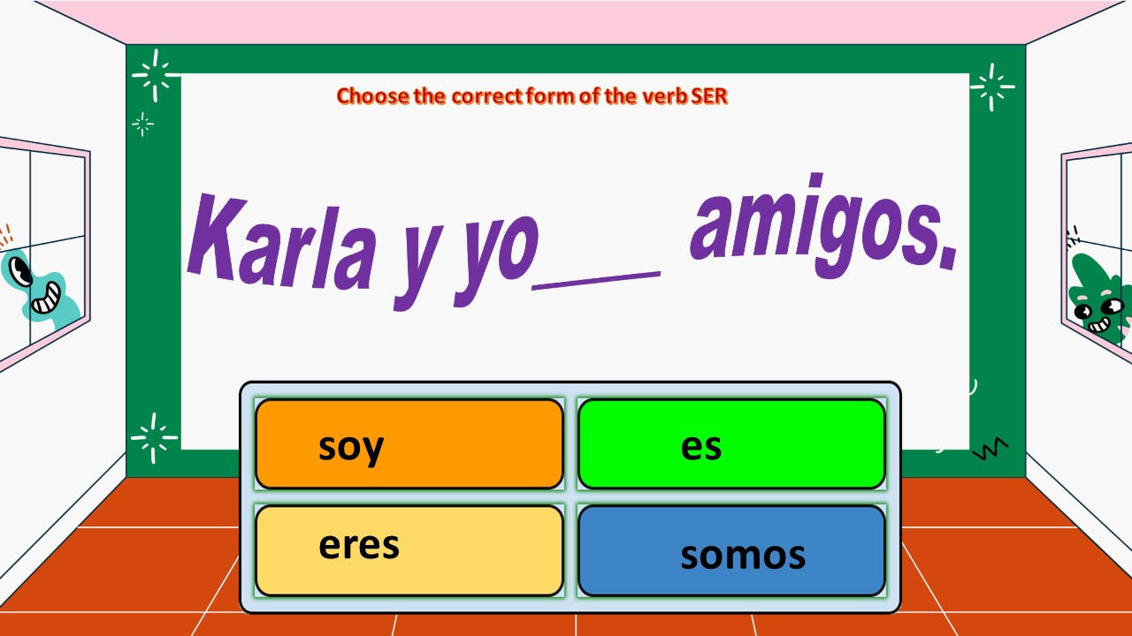
Notes:
🍐 This is a Pear Deck Draggable™ Slide.
🍐 To edit the type of question, go back to the "Ask Students a Question" in the Pear Deck sidebar.

Slide 11
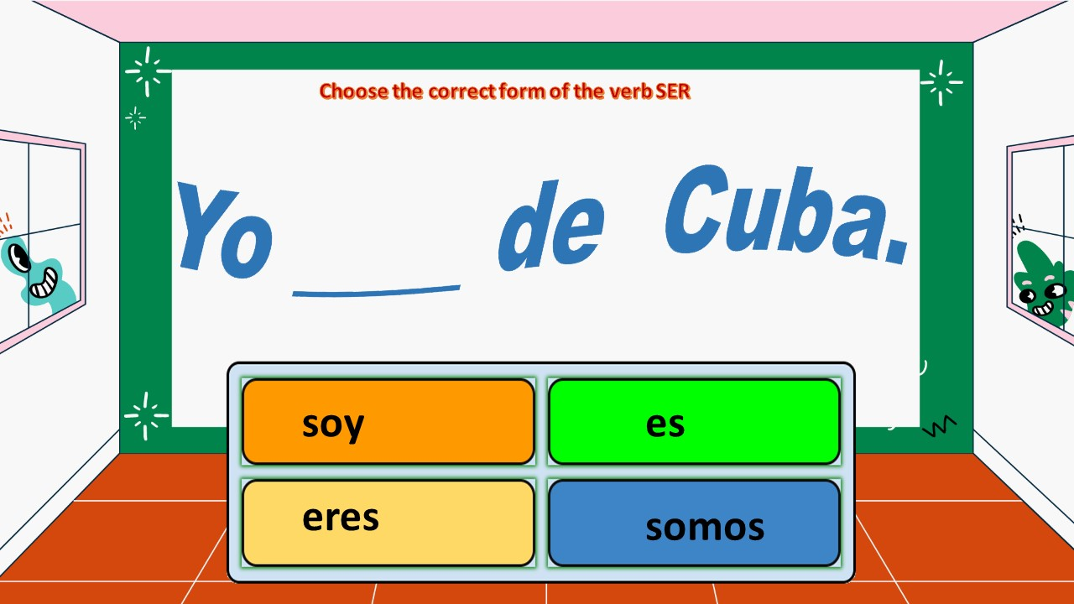
Notes:
🍐 This is a Pear Deck Draggable™ Slide.
🍐 To edit the type of question, go back to the "Ask Students a Question" in the Pear Deck sidebar.

Slide 12
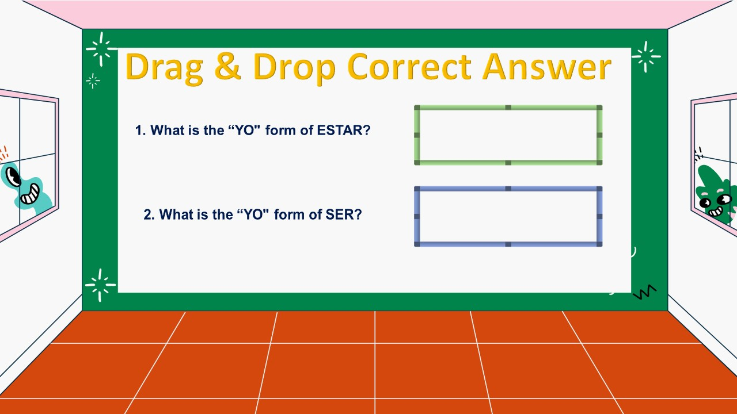




Notes:
🍐 This is a Pear Deck Drawing Slide
🍐 To edit the type of question, go back to the "Ask Students a Question" in the Pear Deck sidebar.

Slide 13
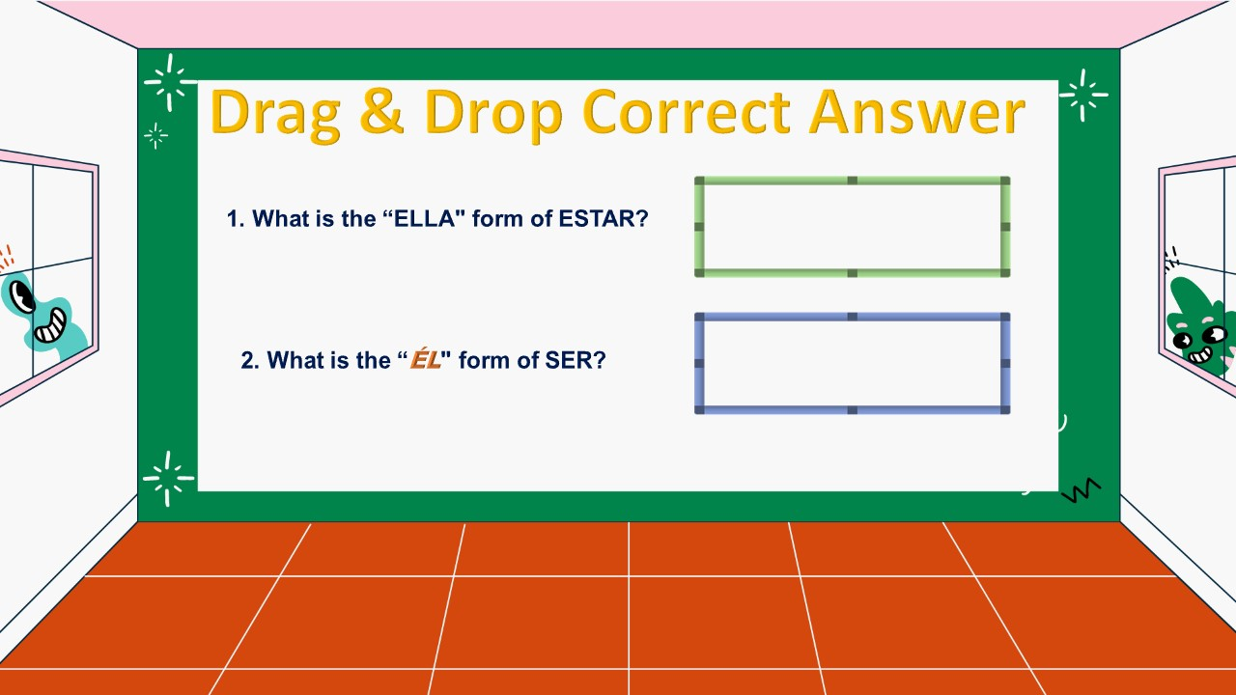

Notes:
🍐 This is a Pear Deck Drawing Slide
🍐 To edit the type of question, go back to the "Ask Students a Question" in the Pear Deck sidebar.

Slide 14
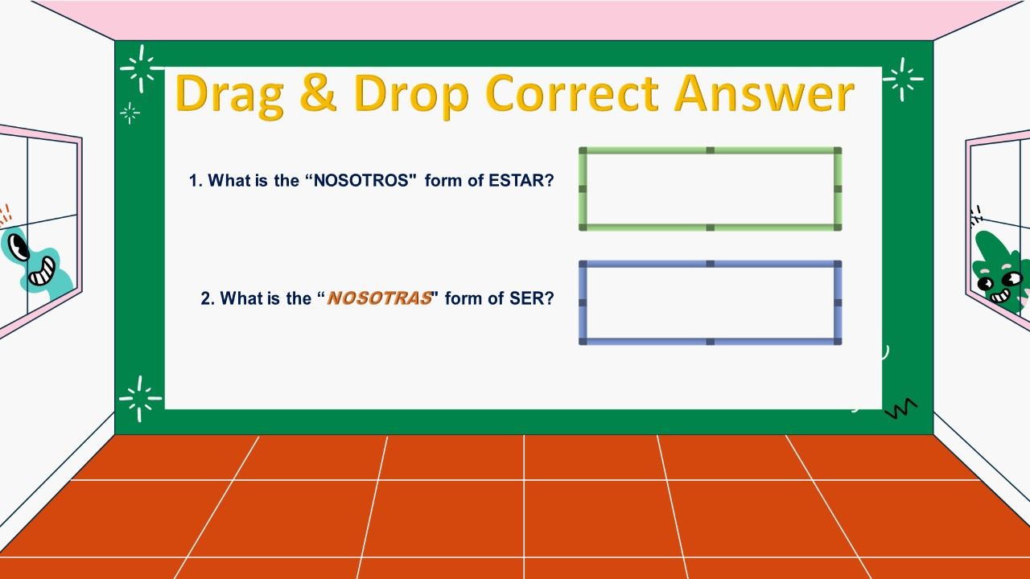




Notes:
🍐 This is a Pear Deck Drawing Slide
🍐 To edit the type of question, go back to the "Ask Students a Question" in the Pear Deck sidebar.

Slide 15


Notes:
🍐 This is a Pear Deck Drawing Slide
🍐 To edit the type of question, go back to the "Ask Students a Question" in the Pear Deck sidebar.

Slide 16

Notes:
🍐 This is a Pear Deck Drawing Slide
🍐 To edit the type of question, go back to the "Ask Students a Question" in the Pear Deck sidebar.

Slide 17
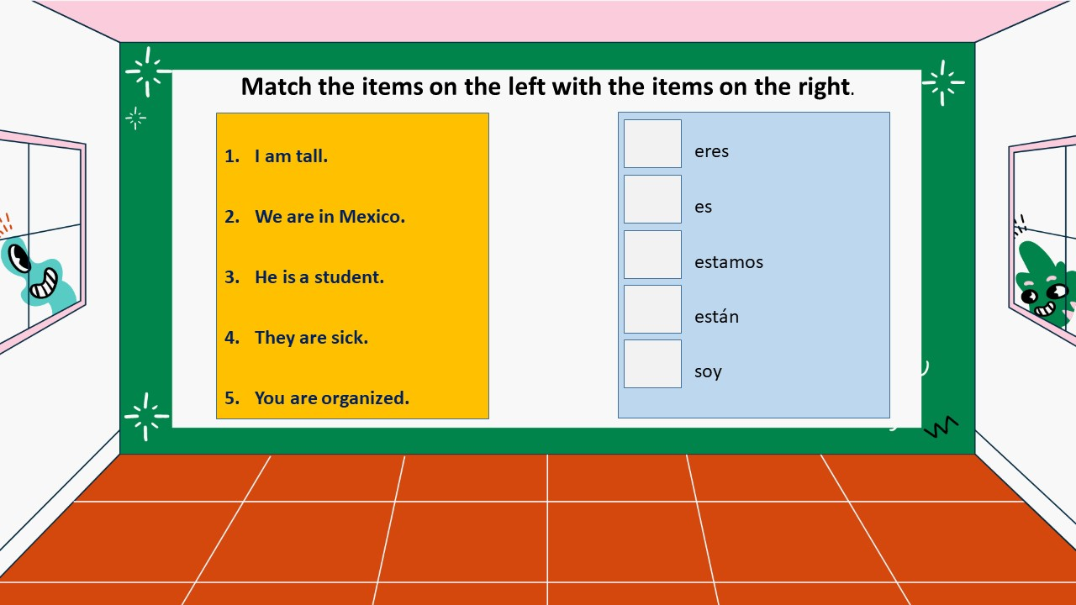

Notes:
🍐 This is a Pear Deck Text Slide
🍐 To edit the type of question, go back to the "Ask Students a Question" in the Pear Deck sidebar.

Slide 18
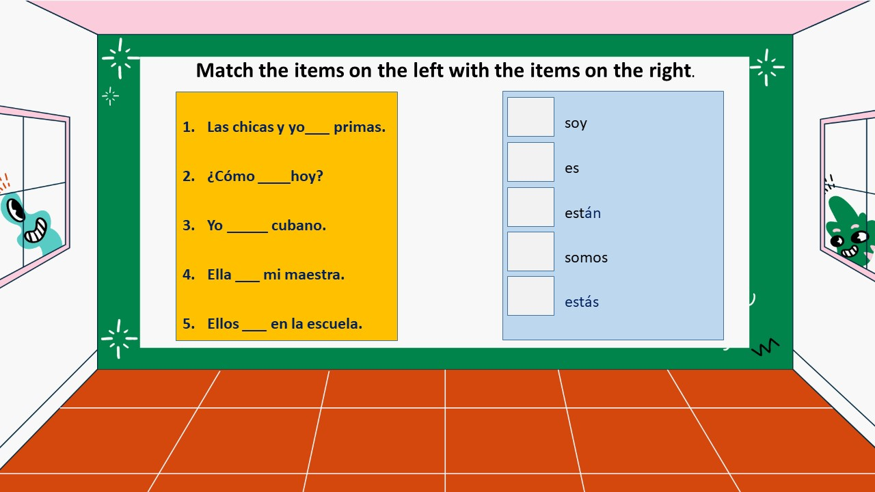

Notes:
🍐 This is a Pear Deck Text Slide
🍐 To edit the type of question, go back to the "Ask Students a Question" in the Pear Deck sidebar.

Slide 19
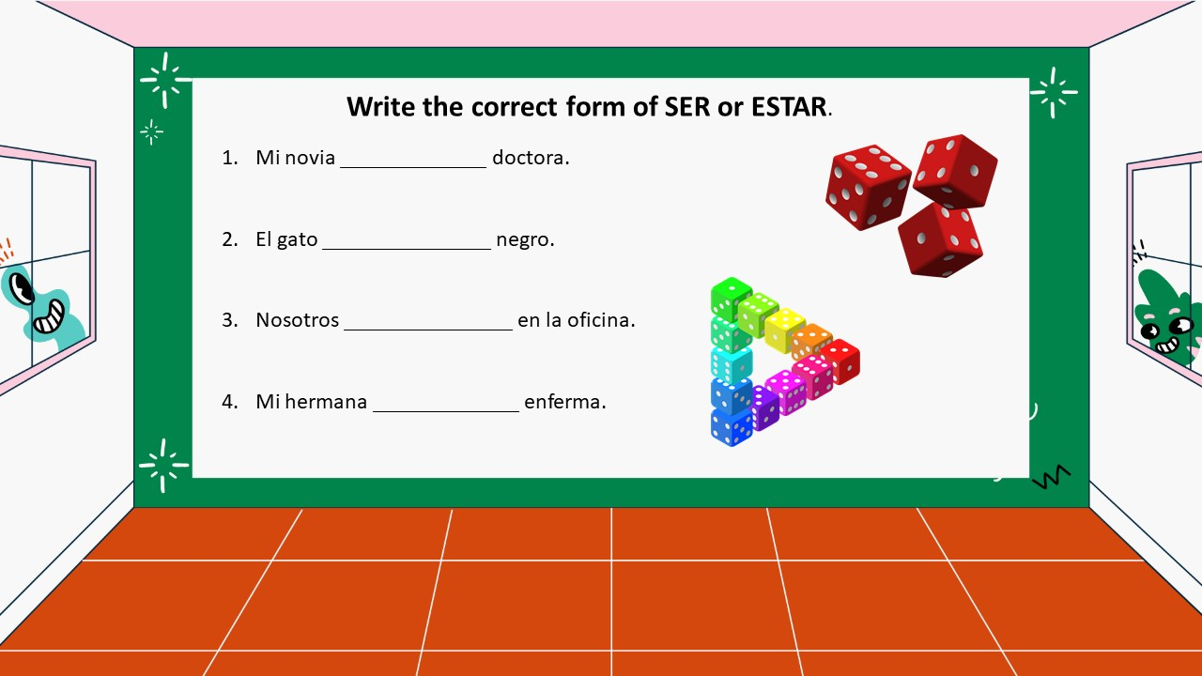

Notes:
🍐 This is a Pear Deck Text Slide
🍐 To edit the type of question, go back to the "Ask Students a Question" in the Pear Deck sidebar.

Slide 20


Notes:
🍐 This is a Pear Deck Text Slide
🍐 To edit the type of question, go back to the "Ask Students a Question" in the Pear Deck sidebar.

Slide 21
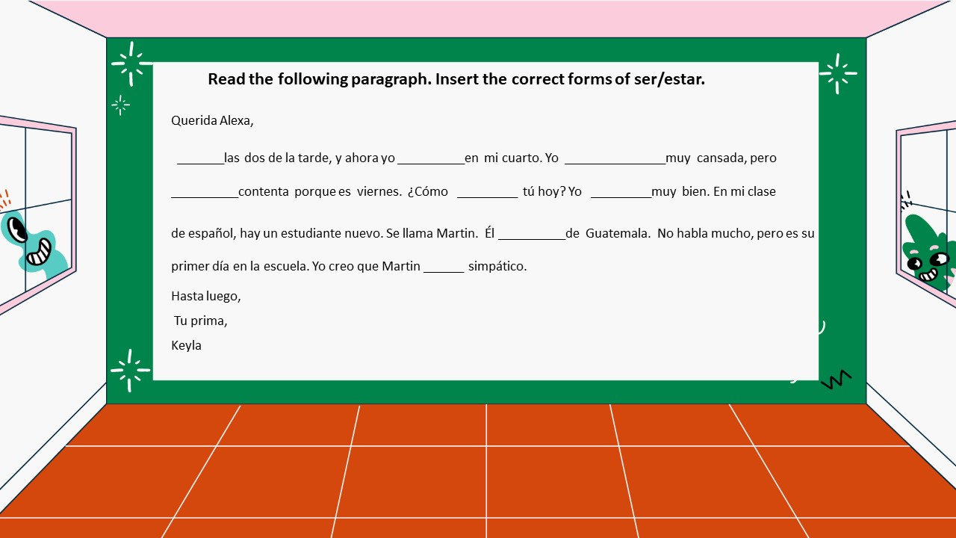

Notes:
🍐 This is a Pear Deck Text Slide
🍐 To edit the type of question, go back to the "Ask Students a Question" in the Pear Deck sidebar.

Slide 22
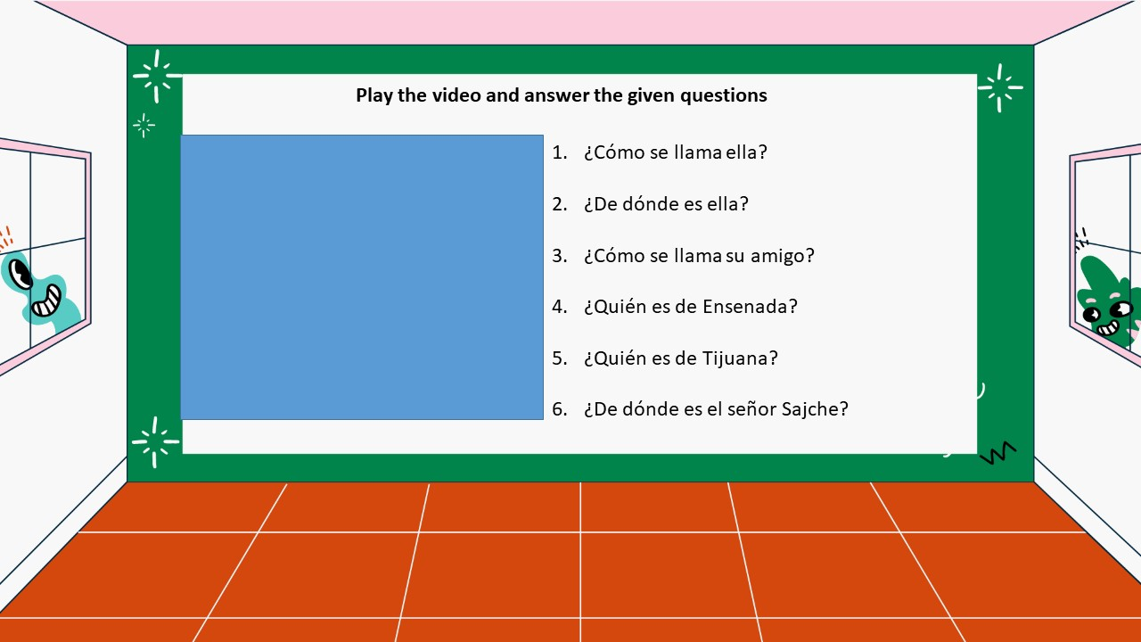

Notes:
🍐 This is a Pear Deck Text Slide
🍐 To edit the type of question, go back to the "Ask Students a Question" in the Pear Deck sidebar.

