Slide 1

What the Data Tell Us
CAPSES
October 2010
Jack States
Randy Keyworth
The Wing Institute

Slide 2
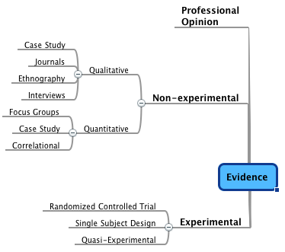
What Evidence Should We Trust?
Notes:
All forms of research a place
Hammer to take a screw out

Slide 3
The Fallibility of Professional Judgment: a false sense of accuracy
CRITERIA FOR TREATMENT CHOICES
CLIENT
PHYSICIAN
Your intuition (gut feeling) about what will be effective
77%
22%
Your demonstrated track record of success based on data you have gathered systematically and regularly
39%
92%
Results of controlled experimental Studies
37%
92%
Gambrill and Gibbs, 2002
Notes:
Goosey gander
Criteria for making decisions about clients
Criteria for your doctor making decisions about you

Slide 4
The Fallibility of Professional Judgment: errors in reasoning
Common errors in reasoning that can effect perceptions and decisions.
Circular Reasoning
Non-Sequitur
Post Hoc
Red Herring
Equivocation
False Dichotomy
Lying
Authority
Shifting the Burden of Proof
Self-Referential Fallacy
Ad Hominem
Sidestepping/Avoiding the Question
Suppressed (Stacking the Deck)
Statistics
Jumping to Conclusions
Traditional Wisdom
Analogy
Humor
Extrapolation
Circumstantial
Guilt by Association
Best-in-Field Fallacy
Notes:
Diet/Sugar: Does not affect behavior or cognitive performance
Learning Styles:

Slide 5
Non-Experimental
Qualitative Research
QUALITATIVE CASE STUDY RESEARCH COMPONENTS AND STRUCTURE OF A CURRICULUM-BASED MENTORING PROGRAM AT THE MIDDLE SCHOOL LEVEL, GOLIGHTLY, M (1996)
Outcomes of the Study
This study has been conducted to discover the components and structure of a curriculum-based mentoring program at the middle school level. A second purpose of the study was to discover common traits and characteristics eighth grade mentoring students exhibit. A major outcome of this study is that it may lead to developments in curriculum, which include mentoring programs to build strong leadership qualities in young people. A curriculum including mentoring could successfully employ older students to serve as positive role models for younger children. Middle school mentors would have valuable opportunities to serve as leaders, while further building character in themselves. Younger students in a peer mentoring program would benefit by spending time with a caring guide who shows concern for their well being. Younger students could benefit as well, academically, as older mentors would be available to offer them assistance and support. These mentors can fill the role of the missing role model and caregiver for younger students who need positive examples and guidance.
From the findings in this research study, several important ideas have evolved which could help educators interested in school based mentoring programs. Findings in this study have revealed traits the mentoring students feel are important in service as positive role models. These traits include responsibility, helpfulness, caring, respect for self and others, and a sense of ethics. The mentoring program in this study was shown effective in continuing the development of these qualities in participating students. Through findings in this study, educators will have the design and structure needed to implement such a program within an existing curriculum. Through student participation in this type of mentoring program, students will find opportunities to serve in their school and community while continuing to develop effective traits such as responsibility, helpfulness, and respect.
Notes:
Initial examination of phenomenon
Predominant form of ed research past 40 yrs
Hard to get a handle on results

Slide 6
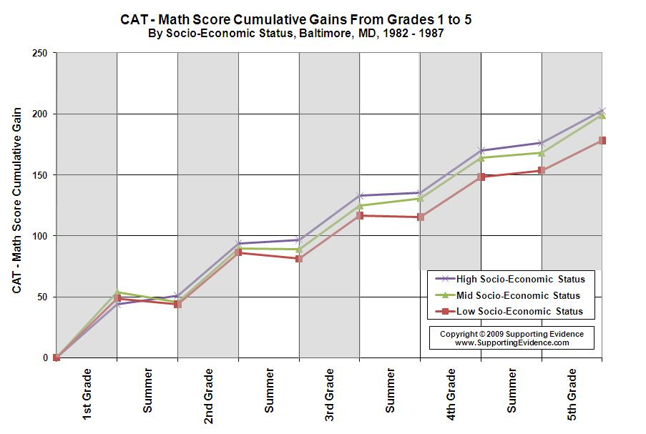
Correlational Design
Notes:
Cannot tell us cause and effect
Tell where to begin to conduct rigorous studies

Slide 7
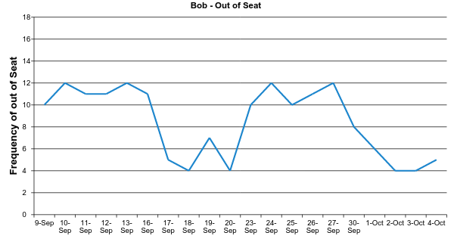
Single Subject Design
A
B
A
B
Baseline
Intervention
Baseline
Intervention
Notes:
Cause and effect
Good for solving problems w/ one student
Problems w/ external validity
What works published standards

Slide 8
Randomized Control Trial (RCT)
An experimental design used to establish a cause and effect relationship.
In an RCT the investigators randomly assign eligible subjects into groups to receive or not receive one or more interventions that are being compared.
Notes:
Cause and effect
Statistical method
Strength in providing external validity
Gold Standard

Slide 9
How to Interpret Results:
Effect Size
Cohen’s d | Effect Size
Small | d = .2
Medium | d = .5
Large | d = .8
Meta-analysis
A literature review that establishes a single effect
Offers a quantitative alternative of the magnitude of the effect – Effect Size
Notes:
Magnitiude of impact
Can be negative
Can be more than one
Seen practices over 20 - suspect

Slide 10
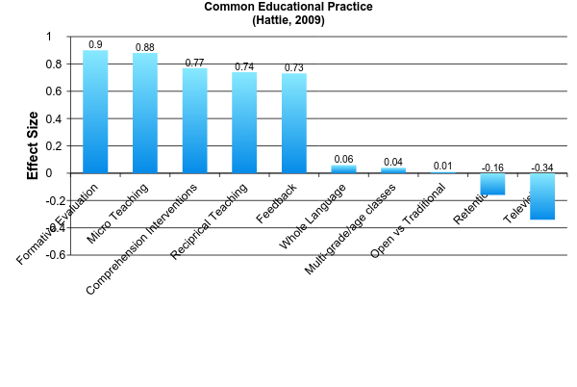
Examples of Meta-analyses
Large .8
Medium .5
Small .2
Notes:
Visible Learning: A Synthesis of over 800 meta-anyses and student achievement

Slide 11
Continua of Evidence
Quantity of the Evidence
Quality of the Evidence
Meta-analysis (systematic review)
Current “Gold Standard”
High Quality
Randomized Controlled Trial
Repeated Systematic Measures
Single Case Designs
Semi-Randomized Trials
Single Case Replication (Direct and Parametric)
Well-conducted
Clinical Studies
Threshold of Evidence
Convergent Evidence
Uncontrolled Studies
Expert Opinion
Various Investigations
General Consensus
Single Study
Personal Observation
Janet Twyman, 2007
Notes:
Science relies on the use of rigorous methods and replication

Slide 12
What is the Current State of Education Research?
Insufficient number of rigorous studies
What Works Clearinghouse
Campbell Collaborative
American Educational Research Association

Slide 13
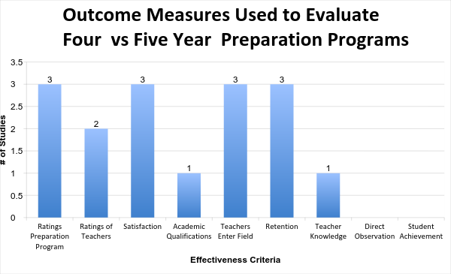
What is the Current State of Education Research?
No studies examined teaching outcomes

Slide 14
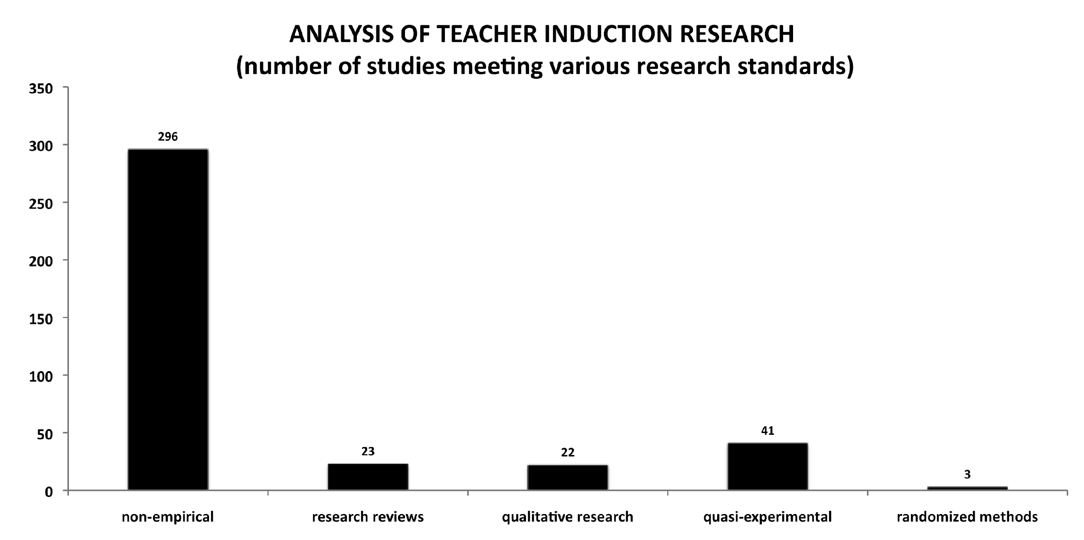
Less than 1% offer qualify as rigorous
SOURCE: SRI (2004)
Notes:
90% of schools provide

Slide 15
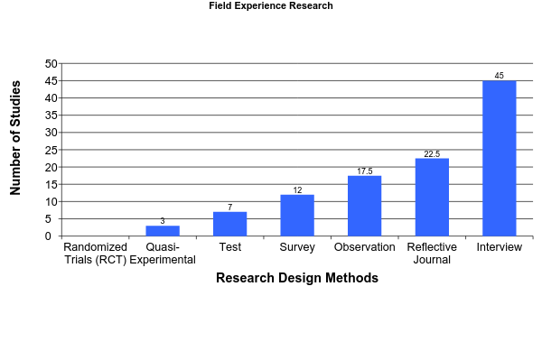
Research Designs
Assessment Methods
AERA Report : Studying Teacher Education, 2005
Notes:
Teacher Preparation and Student Achievement, Boyd, 2009:
Results: Teachers who came from programs that provided more oversight to student teachers and that was classroom skills and curriculum linked directly to entering classroom performed significantly better

Slide 16
What is the Focus of Most
Reform Effects?
Home
Staff
Student
Systems
Structural
Reforms
Notes:
Structural

Slide 17
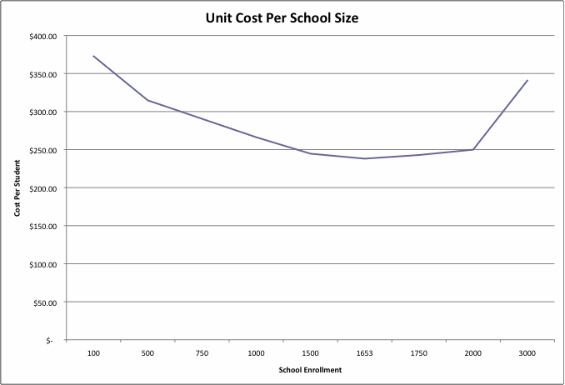
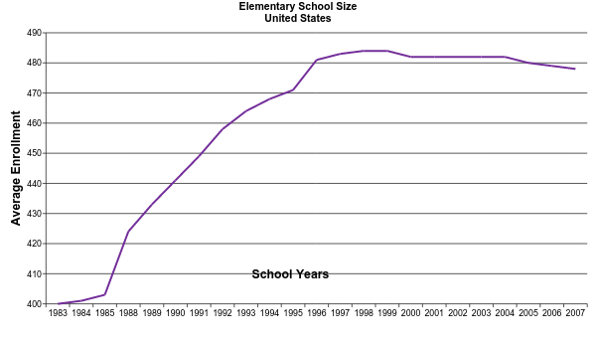
School Size

Slide 18
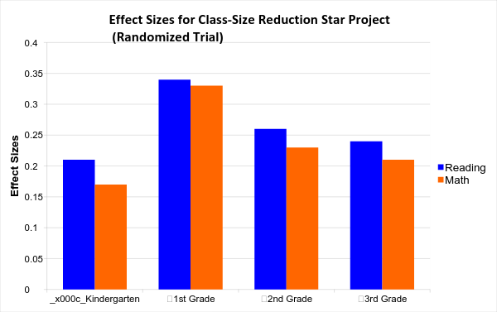
Class Size

Slide 19
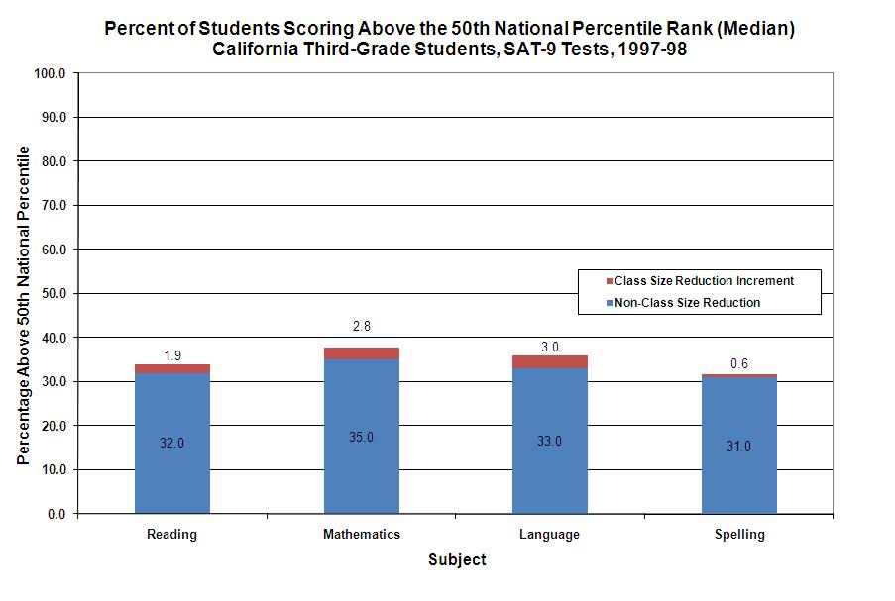
Little Gain at an Annual Cost of More Than $1.5 Billion
Notes:
1.5 Billion per year

Slide 20
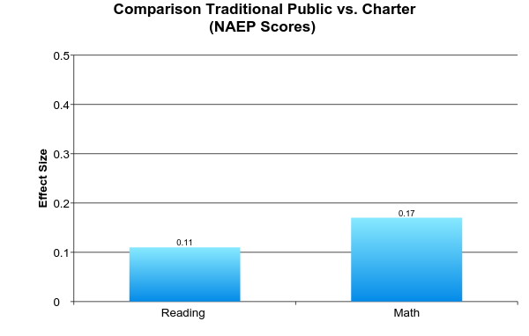
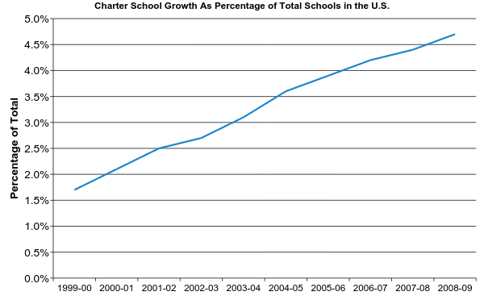
How Effective are Charter Schools
Public Schools minimally out-perform Charter Schools
There are more than 5,000 Charter schools in the United States
.2 = small effect size

Slide 21
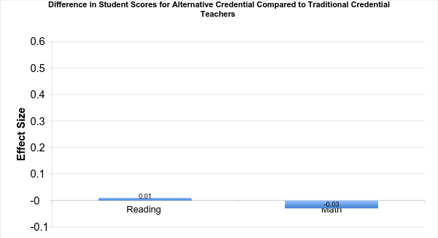
What We Know
- No Child Left Behind mandates full state certification
- In 2004-05 approximately 1 in 7 teachers did not meet standard
This study found no benefit to student achievement
Constantine, J., Player D., Silva, T., Hallgren, K., Grider, M., and Deke, J. (2009). An Evaluation of Teachers Trained Through Different Routes to Certification, Final Report (NCEE 2009- 4043). Washington, DC: National Center for Education Evaluation and Regional Assistance, Institute of Education Sciences, U.S. Department of Education.

Slide 22
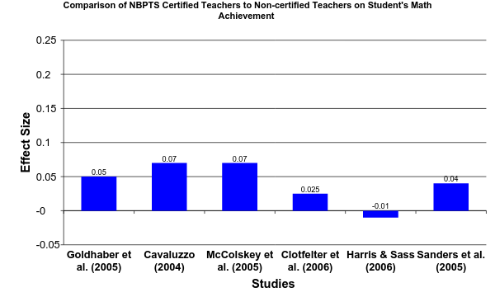
What We Know
82,000 teachers are NBPTS certified nationwide
National Certification Has Minimal Impact on Improving Student Achievement
National Board Certification and Teacher Effectiveness: Evidence from A Randomized Assigned Experiment, December 2008

Slide 23
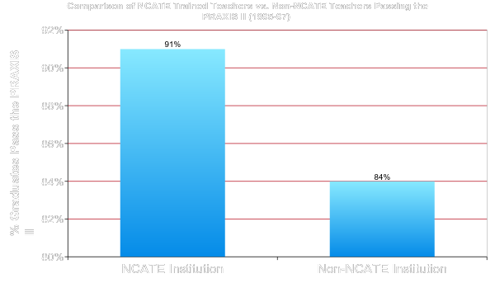
  What We Know
  No rigorous research is available regarding achievement and National Council for the Accreditation of Teacher Education (NCATE)
Rigorous Research on Student Achievement Absent
Notes:
Teacher Education Accreditation Council (TEAC)
Accredits over 650 programs
Establishes standards for preparation programs
‘Praxis II measure knowledge of specific subjects that K–12 educators will teach and teaching skills and knowledge.

Slide 24
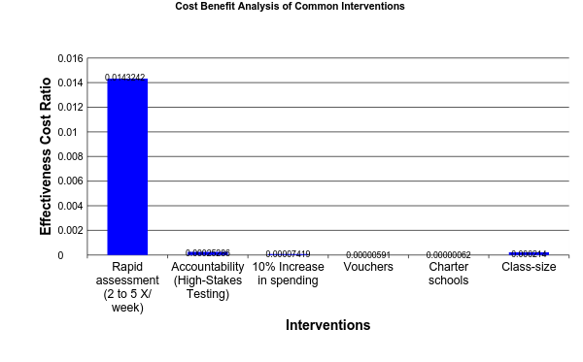
What We Know
The impact of structural interventions has been disappointing
Yeh Calculations
Wing Institute Calculation
(Effectiveness Cost Ratio = Effect Size/Cost Per Student)
Yeh, S. S. (2007). The cost-effectiveness of five policies for improving student achievement. American Journal of Evaluation, 28(4), 416-436.

Slide 25
What Works?
Effective Classroom Instruction

Slide 26
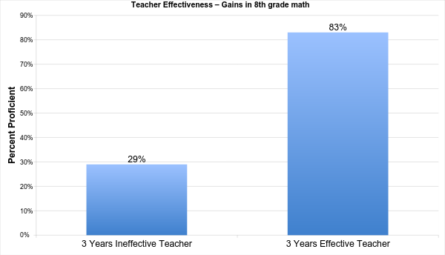
What We Know
Teachers are very important: Effect Size .20 - .40
7% - 21% of student gains can be attributed to teacher effectiveness
(Nye et al., 2004)
Source: Sanders and Rivers 1996

Slide 27
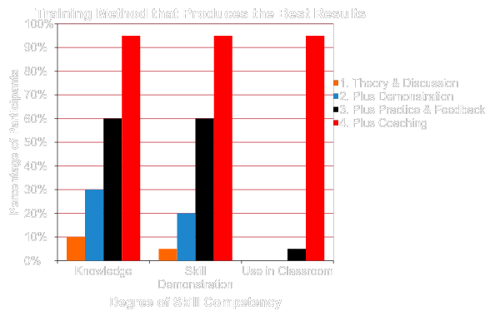
What We Know About Teaching
Student Achievement Through Staff Development, Joyce & Showers, 2002

Slide 28
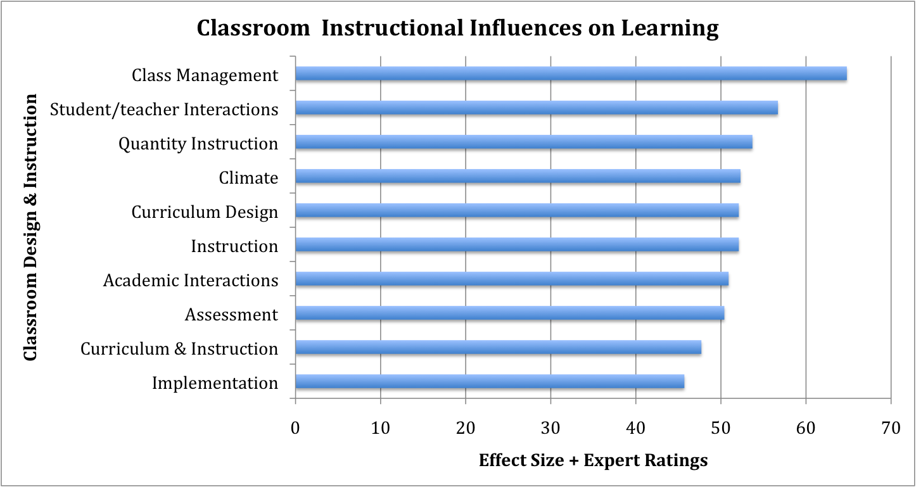
What Makes a Difference
M. C. Wang, G. D. Haertel, and H. J. Walberg, 1994

Slide 29
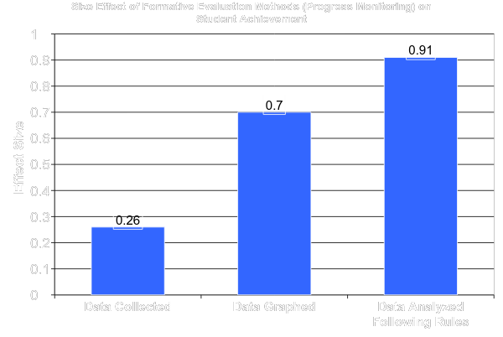
What We Know - About Assessment
Large
Effects of Systematic Formative Evaluation: A Meta-Analysis, Fuchs & Fuchs, 1986

Slide 30
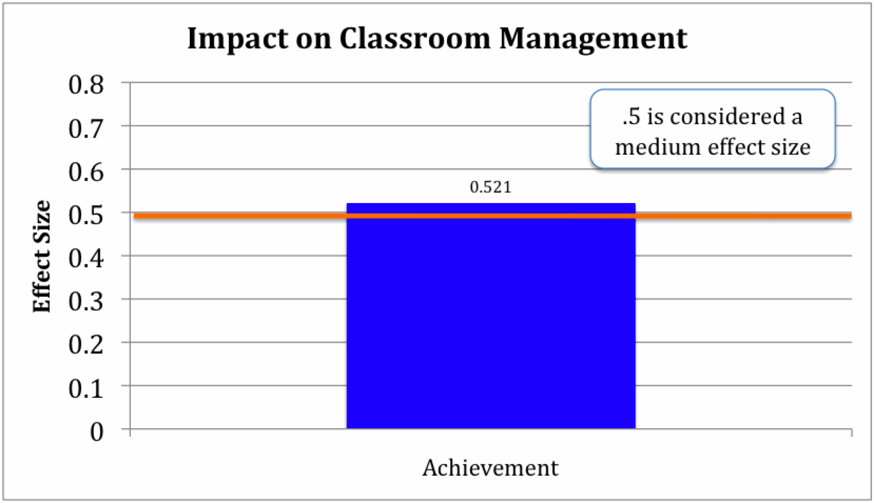
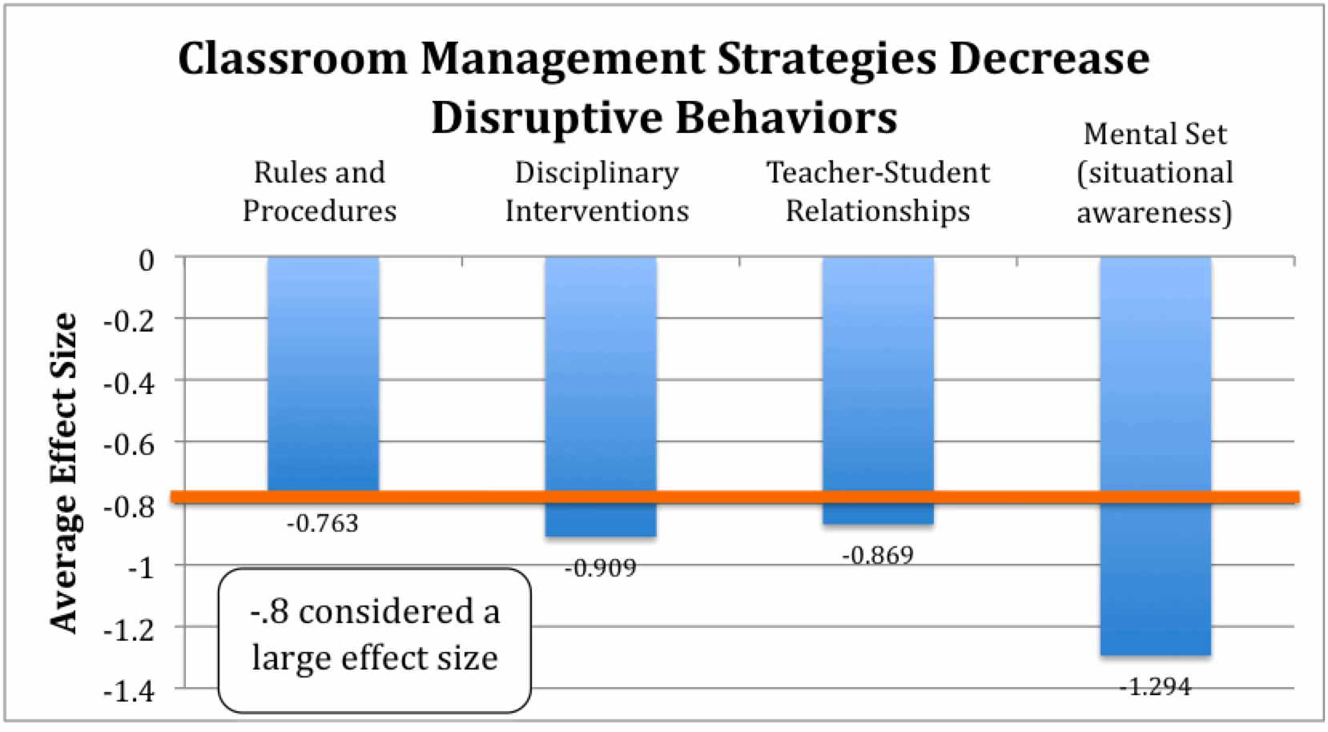
The Impact of What Happens in the Classroom

Slide 31
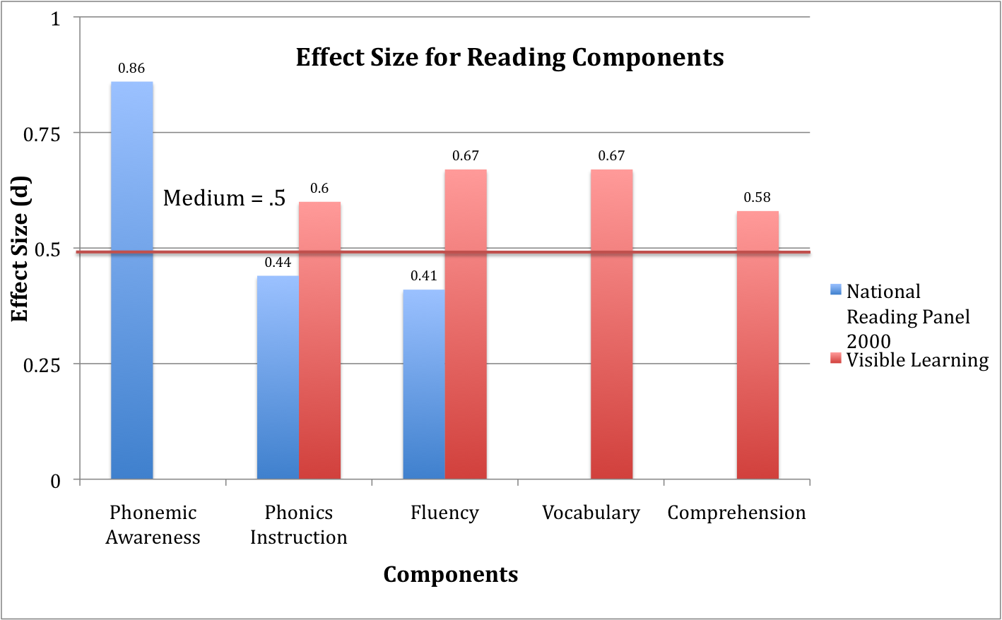
What Do We Know About Reading

Slide 32
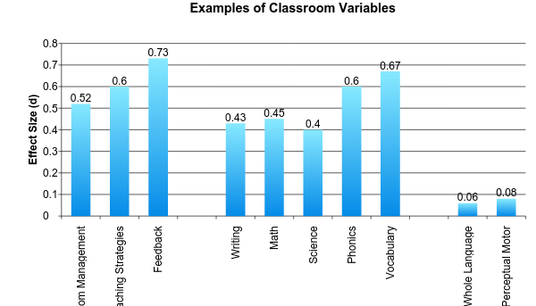
The Impact of What Happens in the Classroom
Curricula
Medium
Visible Learning, Hattie, J (2009)

Slide 33
What Do We
Know About
Teacher Preparation?

Slide 34
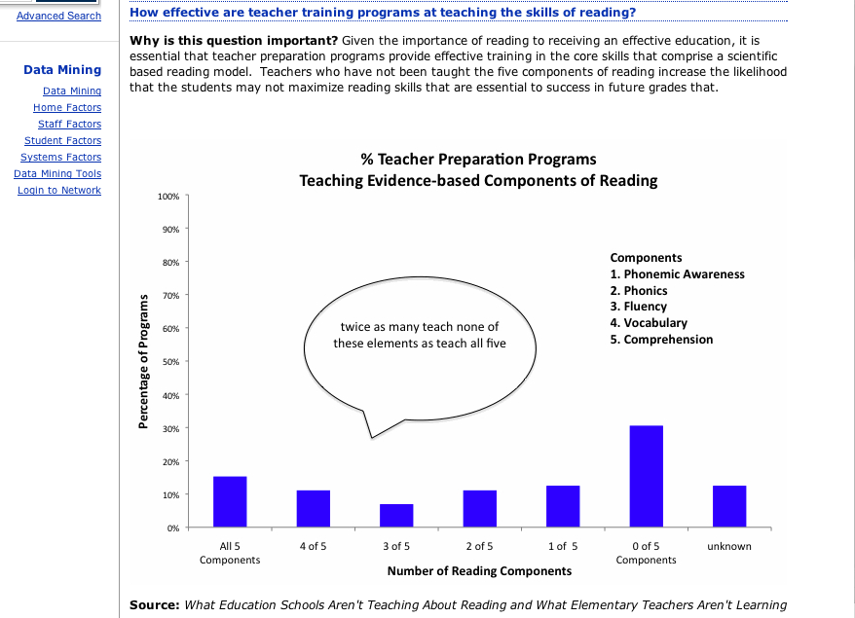

Slide 35
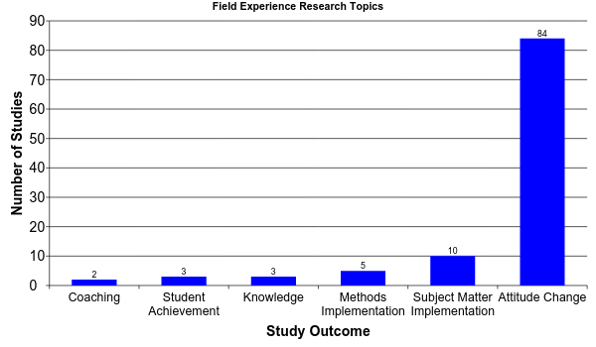
What We Know
There are no data to know how widely coaching is employed
The principal measure was
“Attitude Change” and only 3 out of 107 were experimental
AERA Report : Studying Teacher Education, 2005

Slide 36
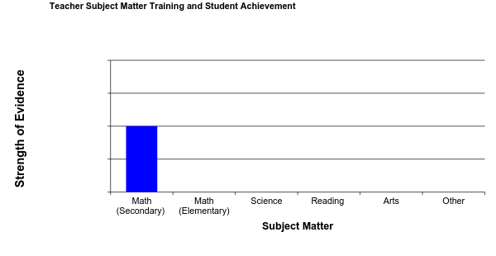
What We Know
- No Child Left Behind mandates subject matter competency
- Subject matter effect size: .06 - .12
Strong
Subject matter impact negligible
Minimal
Insignificant
Literature Review
Studying Teacher Education: The Report of the AERA Panel on Research and Teacher Education (2005)
Creating Effective Teachers: Concise Answers for Hard Questions (2003)
Notes:
American Educational Research Association
Two types of subject matter courses:
Undergraduate courses
Education courses
Research limited to reading, math, and science
However, there is little definitive research on the kinds or amount of subject matter preparation
Until the development of NAEP, NELS, and LSAY data sets could teachers subject matter training be linked to achievement
Research limited to reading, math, and science
However, there is little definitive research on the kinds or amount of subject matter preparation

Slide 37
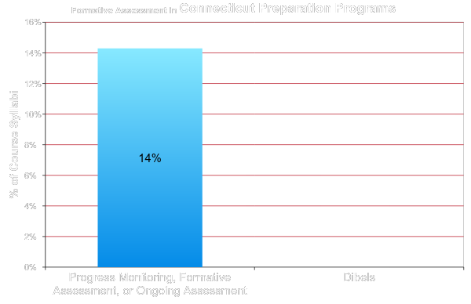
What Schools Are Teaching
Sample of 13
Elementary Teacher Programs
Response to Intervention and Teacher Preparation, Spear-Swerling, 2008

Slide 38
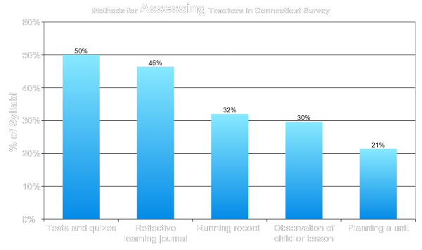
How Are Teaching Candidates Assessed?
no examples based on achievement
Response to Intervention and Teacher Preparation, Spear-Swerling, 2008
Notes:
George Noel – What Preparation Programs provide the best raining
Assess students in the use of methods that work

Slide 39
In Conclusion
Research is a guide to what works
Review research with a critical eye
Select interventions that work with your population
Avoid the quick fix
Select interventions that are cost effective
Implement interventions as designed

