Slide 1
Gym Workout
FREE PRESENTATION TEMPLATE

Slide 2
Welcome
Welcome to the world of fantasy! Join us on a journey to explore the mystical creatures, enchanted lands, and magical wonders that exist beyond our reality. Discover the wonders and secrets of this exciting realm and unlock the power of imagination.

Slide 3
Introduction
01
02
Encounters
The Extraordinary Realm
Unicorn Sightings
Table of Contents
Wonders
03
04
Magic
Wishes Granted
Spellcasting
Adventure
05
06
Conclusion
Happily Ever After
Embrace the Fantasy

Slide 4
Introduction
The Fantasy Realm: Uncovering the Secrets of the Imagination and the Magic that Lies Within

Slide 5
The Realm of the Extraordinary
Welcome to the Fantasy World, a realm of wonder and enchantment where anything is possible. Here, dragons breathe fire, unicorns prance through meadows, and rainbows shine brightly. This world is a place where wishes come true, where potions can be cursed and spells are cast. It's a place of treasure and adventure, where the impossible becomes possible. But the greatest treasure of all is the one that lies within.
The world of fantasy is a reflection of our deepest desires, our fondest dreams, and our wildest imaginations. It's a place where we can let go of the constraints of reality and explore the boundless possibilities of the human mind. In this introduction, we will delve into the mysteries of this realm, uncovering the magic and wonder that lies within. So come with us and let's embark on a journey through the Fantasy World.

Slide 6
Unicorn Sightings
Dragon Taming
A record of the number of unicorns spotted in the fantasy realm and the beauty and mystery.
A closer look at the art of taming dragons and the brave adventurers who dare to take on these fearsome creatures.

Slide 7
Dragon Taming
A closer look at the art of taming dragons and the brave adventurers who take on these creatures.
Unicorn Sightings
Unicorn Sightings
A record of the number of unicorns spotted in the fantasy realm and the beauty and mystery.
A record of the number of unicorns spotted in the fantasy realm and the beauty and mystery.

Slide 8
Fantasy is the gateway to the impossible, the land where the ordinary becomes extraordinary, and the impossible becomes possible. It is the realm of the imagination, where anything can happen and everything is possible.
The Dream Weaver

Slide 9
Dragon Taming Technique
A guide to taming and caring for dragons in the realm of magic.
The Art of Unicorn Sighting
Tips and tricks for spotting the elusive unicorns in their natural habitat.

Slide 10
The Magic of Dragons: A Research
Dragon Taming
Archery
Music
"The Art of Archery": Discover the intricacies of the Art of Archery .
"The Music of the Elves": Immerse yourself in the enchanting music.
Life
Unicorn
Unicorn
"The Life of an Elf": Learn about the customs and daily life of the elves.
"The Art of Archery": Discover the intricacies of the Art of Archery .

Slide 11
S
W
O
T
Eclipse
Eclipse
Eclipse
Eclipse
Rare event causes unpredictable magic.
Rare event causes unpredictable magic.
Rare event causes unpredictable magic.
Rare event causes unpredictable magic.
Quest
Quest
Quest
Quest
Adventurers seek immortal artifact.
Adventurers seek immortal artifact.
Adventurers seek immortal artifact.
Adventurers seek immortal artifact.

Slide 12
Some Data
75%
Enchanted Creatures
60%
Magic-Wielding Individuals

Slide 13
234,567
UNICORN SIGHTINGS
A tally of the number of unicorns spotted in the fantasy realm.

Slide 14
Portal to Adventure
A web application
A web application designed for discovering the world of fantasy

Slide 15
The Future of Fantasy
An mobile app
An app designed for exploring and experiencing the enchanting realm of fantasy
Explore a magical world
Experience fantasy firsthand
Immerse in a realm of magic
Discover untold wonders
Live your fantasy dreams

Slide 16
A Magic Picture

Slide 17
Fantasy Realm at a Glance

Slide 18
The Timeline
Transformation
Kingdoms clash in conflict.
Peasant discovers magical powers.
Plot to assassinate leader uncovered.
War
Eclipse
Quest for artifact
Volcano disaster
2021
2022
2020
Rise
2022
Invasion
Humans acquire Crystal
Shimmering City established
City expands, conquers neighbors.
Kingdom invaded
Betrayal
Hero's festival

Slide 19
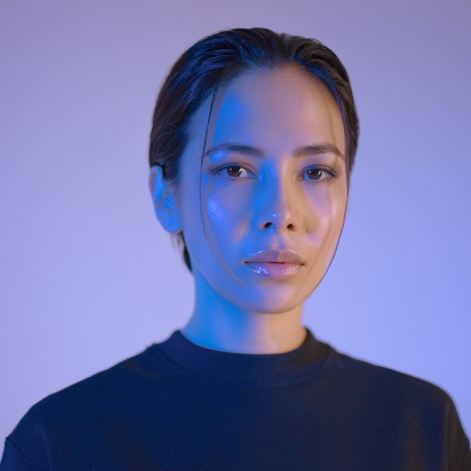
Our Team
Lunaria
The Moon Priestess
Elementalen
The Guardian
Eldruin
The Fire Mage

Slide 20
The List
Dragons
Fire-breathing creatures that are often powerful and dangerous
Medieval-like Settings
Worlds with castles, knights, and feudal systems
Chosen One Trope
A hero chosen by destiny to save the world
Magic
An integral part of fantasy stories, can take many forms
The Best Curse
A curse that is unique, creative, and fits within the story
Unique Creatures
A variety of fantastical beings that inhabit the world

Slide 21
Thank you for choosing EaTemp
We offer free and high-quality slides templates for your presentations. We appreciate you choosing us and hope our templates have been helpful.
As a new website, we rely on your support to grow, so please help us by sharing our site with your friends and colleagues.
Credit | Image: Unsplash

