Slide 1



Phonics: o as in on
Colour the boxes that have the letter o and practise making the sound.
o
o
d
o
a
p
o
t
i
o
© State of New South Wales (Department of Education), 2023. Except for the Department of Education logo, other logos and trademark-protected material, this resource is licensed under the Creative Commons Attribution 4.0 International Licence

Slide 2




Phonics: o as in on
Colour the words that have the letter o and and practice making the sound.
not
cat
pop
sat
got
on
Colour in the pictures that use the o sound
© State of New South Wales (Department of Education), 2023. Except for the Department of Education logo, other logos and trademark-protected material, this resource is licensed under the Creative Commons Attribution 4.0 International Licence

Slide 3
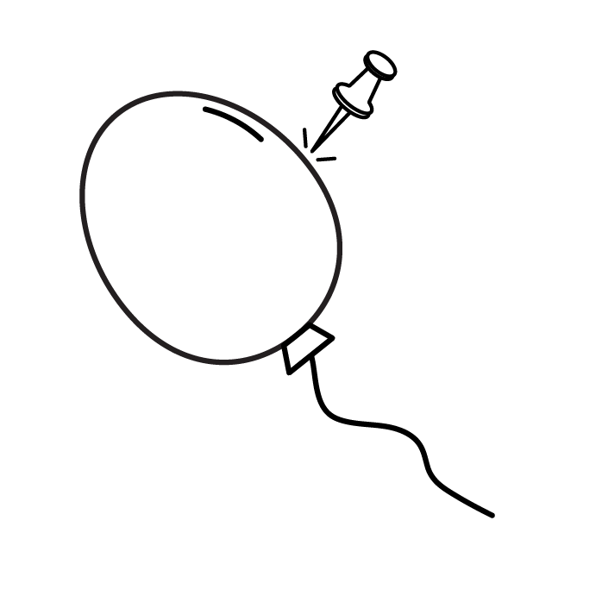
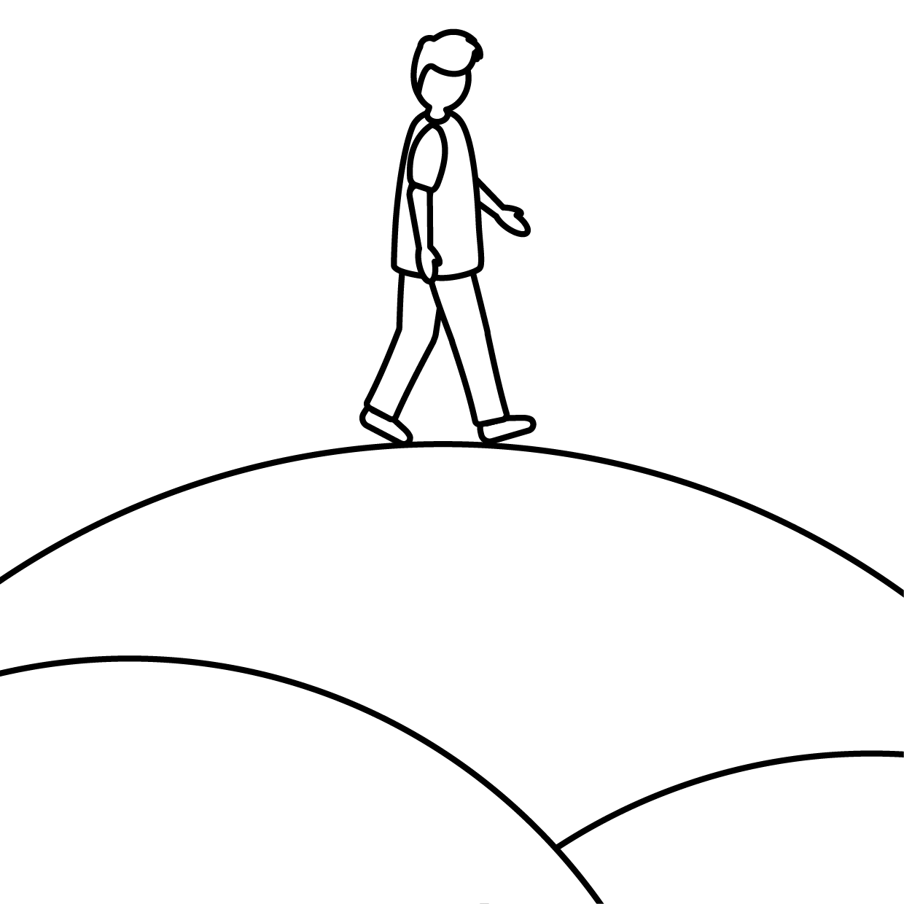

Phonics: o as in on
Colour in the o sound in each word.
p
o
p
d
o
g
t
o
p
p
o
t
Draw your own pictures that start with the o sound.
© State of New South Wales (Department of Education), 2023. Except for the Department of Education logo, other logos and trademark-protected material, this resource is licensed under the Creative Commons Attribution 4.0 International Licence

