Slide 1







Funeral
FREE PRESENTATION TEMPLATE

Slide 2
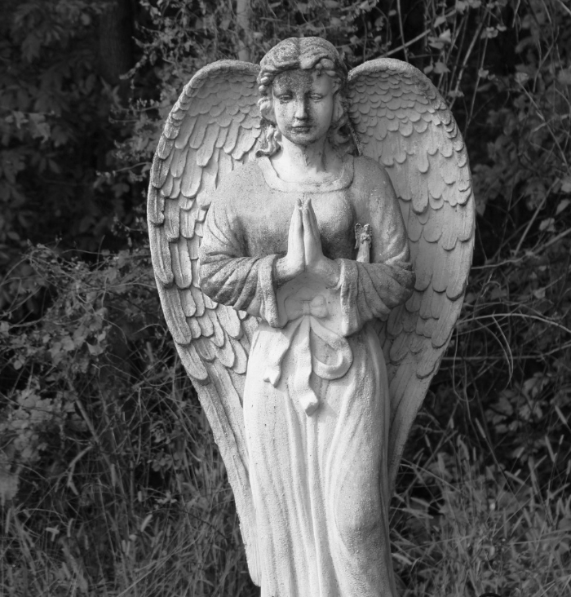
R.I.P
Welcome to the world of fantasy! Join us on a journey to explore the mystical creatures, enchanted lands, and magical wonders that exist beyond our reality. Discover the wonders and secrets of this exciting realm and unlock the power of imagination.

Slide 3

Table of Contents
01
03
About Him
Achievements
The Extraordinary Realm
Wishes Granted
02
04
Memories
The family
Unicorn Sightings
Spellcasting

Slide 4
01
About Him
The Fantasy Realm: Uncovering the Secrets of the Imagination and the Magic that Lies Within

Slide 5
The Realm of the Extraordinary
Welcome to the Fantasy World, a realm of wonder and enchantment where anything is possible. Here, dragons breathe fire, unicorns prance through meadows, and rainbows shine brightly. This world is a place where wishes come true, where potions can be cursed and spells are cast. It's a place of treasure and adventure, where the impossible becomes possible. But the greatest treasure of all is the one that lies within.
The world of fantasy is a reflection of our deepest desires, our fondest dreams, and our wildest imaginations. It's a place where we can let go of the constraints of reality and explore the boundless possibilities of the human mind. In this introduction, we will delve into the mysteries of this realm, uncovering the magic and wonder that lies within. So come with us and let's embark on a journey through the Fantasy World.

Slide 6




The most important things
Unicorn Sightings
Dragon Taming
A record of the number of unicorns spotted in the fantasy realm and the beauty and mystery that surrounds these enchanting creatures.
A closer look at the art of taming dragons and the brave adventurers who dare to take on these fearsome creatures.

Slide 7


Unicorn Sightings
Dragon Taming
A record of the number of unicorns spotted in the fantasy realm and the beauty and mystery.
A closer look at the art of taming dragons and the adventurers who take on these creatures.

Slide 8

Fantasy is the gateway to the impossible, the land where the ordinary becomes extraordinary, and the impossible becomes possible. It is the realm of the imagination, where anything can happen and everything is possible.
The Dream Weaver

Slide 9
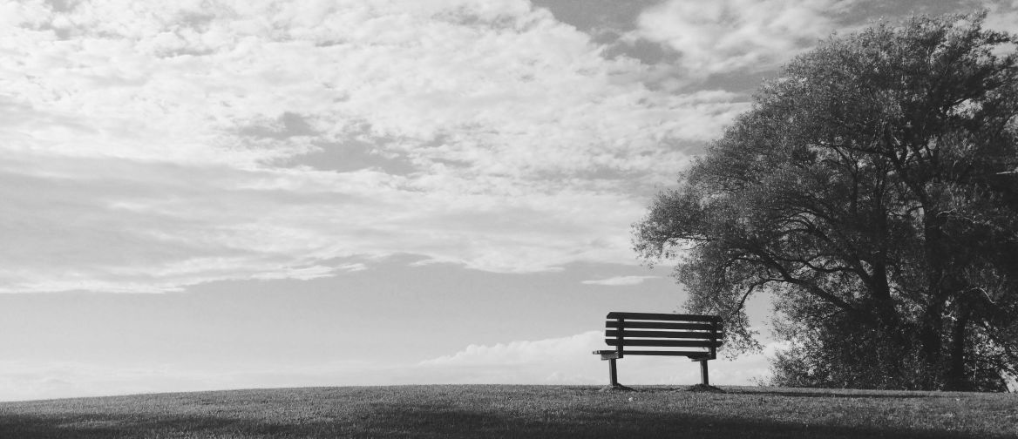

Dragon Taming
The Art of Unicorn
Dragon Taming
A guide to taming and caring for dragons in the realm of magic.
Tips and tricks for spotting the elusive unicorns in their natural habitat.
A guide to taming and caring for dragons in the realm of magic.

Slide 10




His interest
"The Art of Archery": Discover the intricacies of the Art of Archery .
6.7M
4.4M
"The Music of the Elves": Immerse yourself in the enchanting music of the elves.
2.3M
"The Life of an Elf": Learn about the customs and daily life of the elves.

Slide 11




Beautiful Memories
Basic
Elite
Legendary
  Access to the entry-level dungeons.
  A limited number of quests and battles per month.
  Ability to form a small party with fellow adventurers.
  Access to the intermediate and advanced dungeons.
  A greater number of quests and battles
  Ability to form larger parties with adventurers.
  Access to the most challenging dungeons.
  Unlimited quests and battles per month.
  The ability to form the largest parties.

Slide 12





Beautiful Memories
Eclipse
Eclipse
Eclipse
Eclipse
Rare event causes unpredictable magic.
Rare event causes unpredictable magic.
Rare event causes unpredictable magic.
Rare event causes unpredictable magic.
Quest
Quest
Quest
Quest
Adventurers seek immortal artifact.
Adventurers seek immortal artifact.
Adventurers seek immortal artifact.
Adventurers seek immortal artifact.

Slide 13


Big Moments
70%
Enchanted Creatures
possess the ability to cast spells.
Magic-Wielding Individuals
60%
practice the art of illusions.
90%
Spells Cast
are dark magic, foretelling danger.

Slide 14
1940-2024
UNICORN SIGHTINGS
A tally of the number of unicorns spotted in the fantasy realm.

Slide 15
1940
1960
Treasure Found
Wished Granted
2000
2007
Duration of Spell Casting
Journey Distance

Slide 16
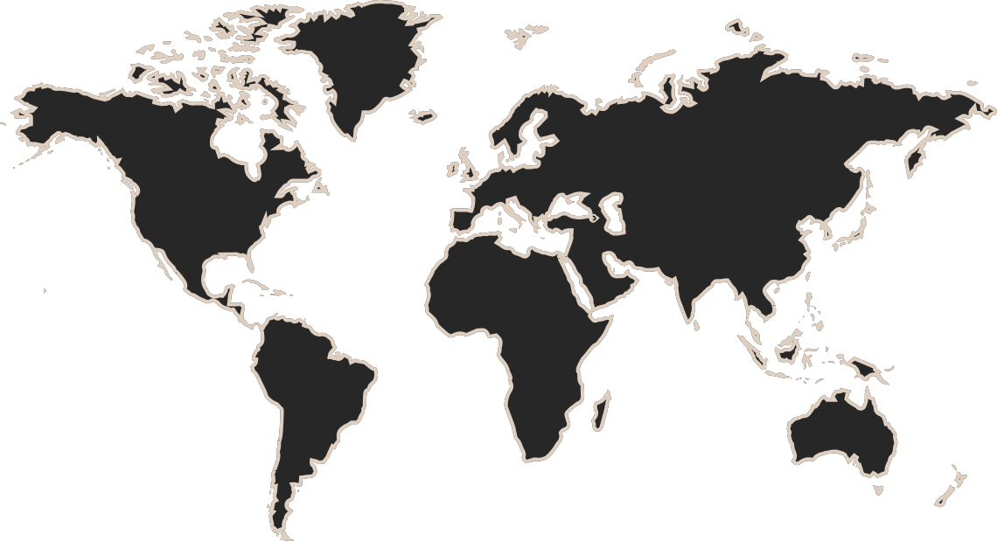
Travel Around The World
The Enchanted Forest
A magical forest filled with talking animals and enchanted creatures.
The Crystal Caves
A network of underground caves filled with precious gems and crystals.
The Dragon's Lair
A dangerous and mysterious place where dragons reside.

Slide 17


His Life Timeline
Dragon Taming
Unicorn Migration
First dragon was successfully tamed
Large herd of unicorns migrated to the realm
2022
2023
2024
2025
Enchanted Pool
Rainbow Sightings
A magical pool with power to grant wishes
Unusually large number of rainbows were sighted

Slide 18



His Family
Eldruin
Elementalen
Lunaria
The Fire Mage
The Guardian
The Moon Priestess

Slide 19





Family Memories
The Forbidden Forest: A place of mystery and wonder, where mystical creatures roam and flora flourishes.
The Crystal Caves: A network of glittering caves filled with precious gems and minerals, guarded by fierce beasts.
The Enchanted Garden: A place of pure beauty and tranquility, where the colors of the flowers are vibrant.

Slide 20

Thank you for
choosing EaTemp
We offer free and high-quality slides templates for your presentations. We appreciate you choosing us and hope our templates have been helpful.
As a new website, we rely on your support to grow, so please help us by sharing our site with your friends and colleagues.
Credit | Image: Unsplash

