Slide 1


Initiation to Scratch
Advanced
Translated and adapted by the RÉCIT from a document created by Nancy Brouillette, RÉCIT, CSS de l’Énergie, made available, with exception, according to the Creative Commons Licence 4.0 international.

Slide 2
<Going Further With Scratch>

Slide 3
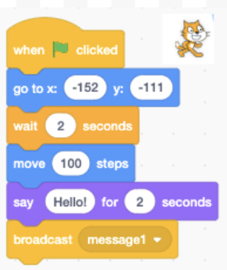
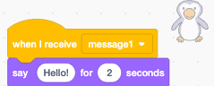
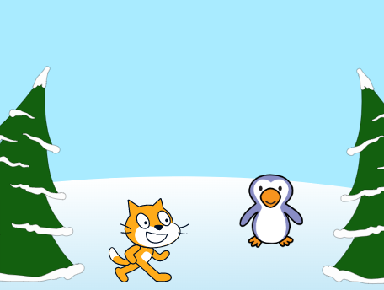

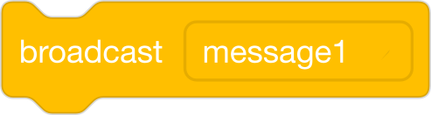

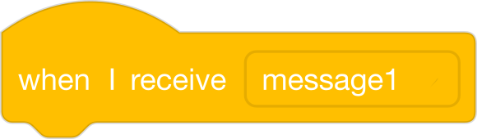
Coding a dialogue between 2 sprites
Example of program
Events
To direct and coordinate actions between the sprites : using broadcast and receive is an efficient way to program.

Slide 4
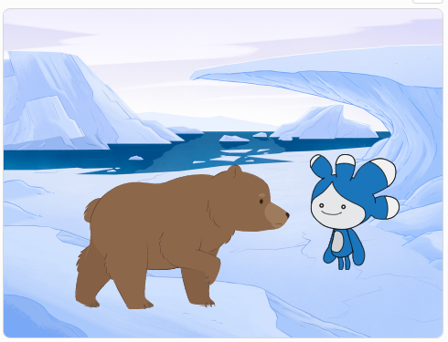
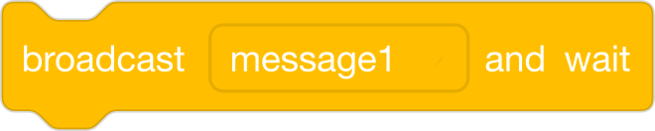
Example:
Broadcast and Wait
The “broadcast and wait” block sends a message to all scripts and waits until all the triggered scripts are done running before continuing.

Slide 5
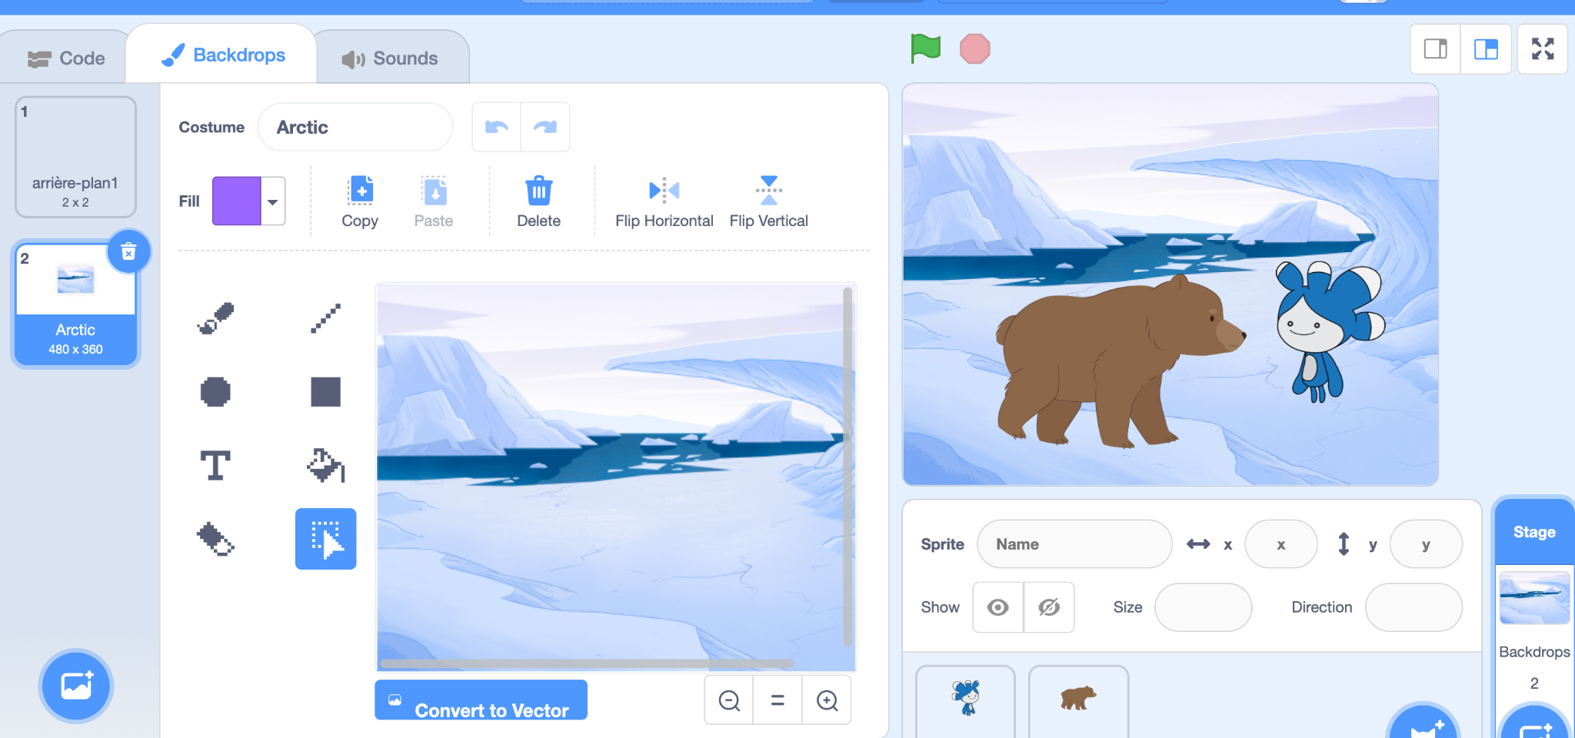
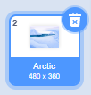
2. Switch to a 2nd backdrop
Information
By clicking on Backdrops or Stage, we can view the Backdrops tab.
You can delete a backdrop by clicking on the trash icon in the top right corner when it is selected.
Backdrop name
Notes:
J

Slide 6
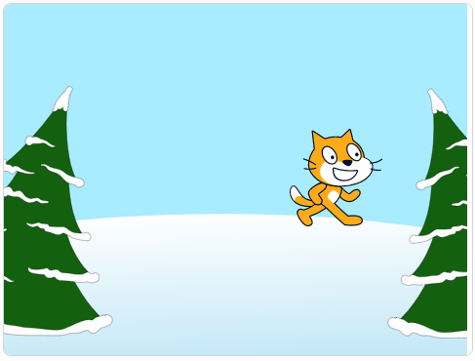
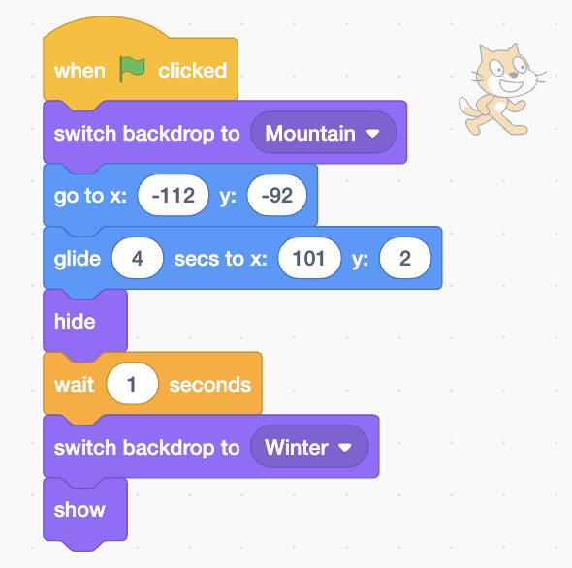
2. Switch to a 2nd backdrop
Effective practice
Code the chosen backdrop at the start of the program.
Example of program
2nd backdrop
Notes:
J

Slide 7


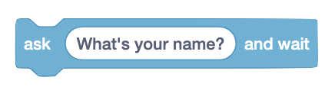

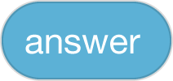
3. Ask the user a question and capture the answer
To do this, you will need blocks in categories that have not yet been explored.
Sensing
Operators
Notes:
N

Slide 8
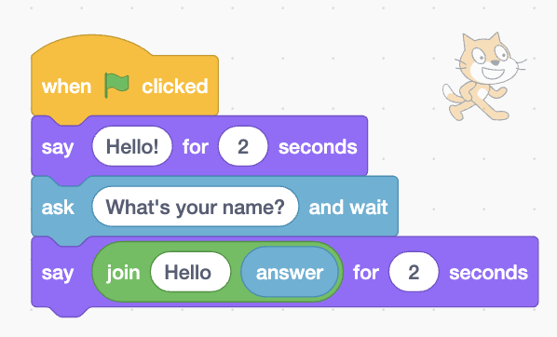
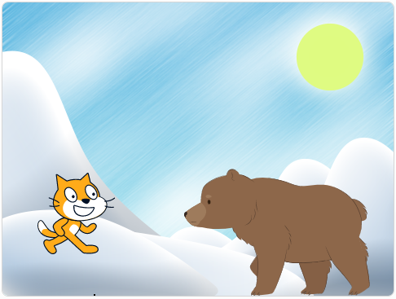
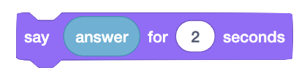
Sensing
Example of program
You could make the sprite repeat the answer.
What if we wanted to say Hello + answer?
Sensing
Notes:
N

Slide 9
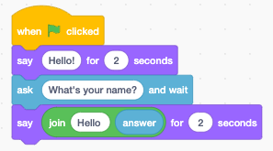

Operators
Example of program
Notes:
N

Slide 10
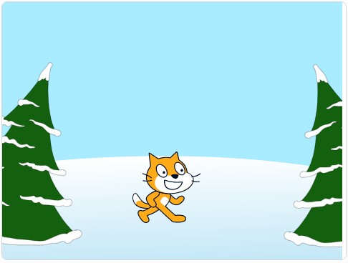

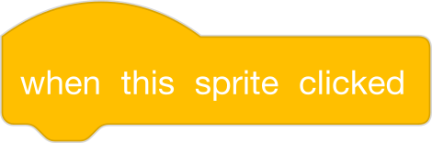
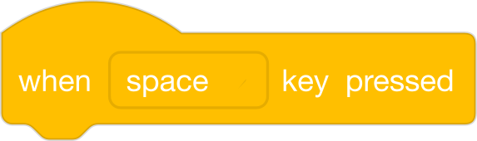
4. Use different Start Blocks
Have fun exploring different Start Blocks to create a variety of sequences!
When you share your project, don’t forget to add this information in the Instructions section.
Example of program
Notes:
J

Slide 11
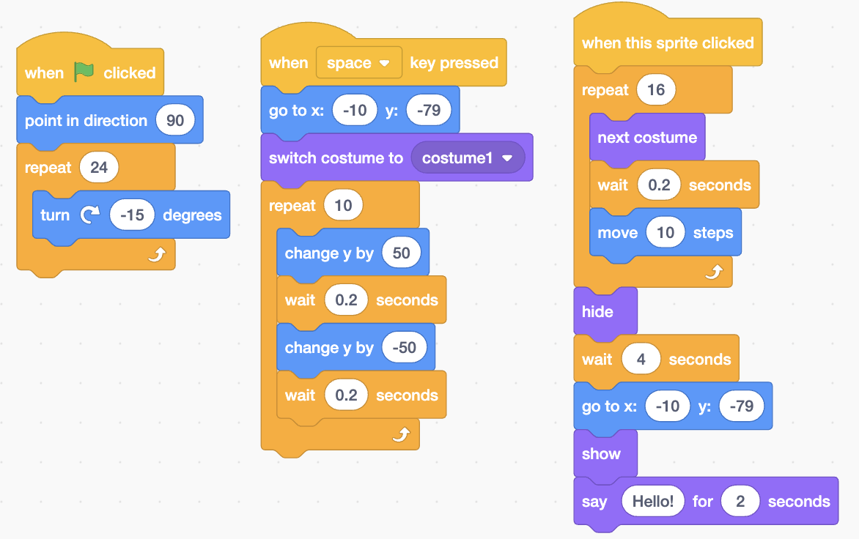
Example of program
Notes:
J

Slide 12
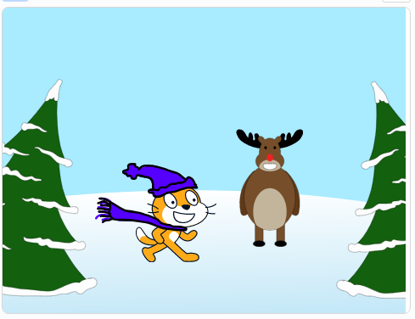
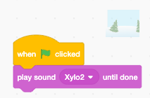
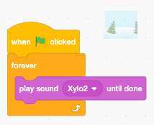
5. Add music to the Backdrop
Here, we are programming a backdrop.
Example
Notes:
J

Slide 13
kreocode.ca

