Slide 1


Slide 2




Sustainability: The first thing. The only thing?
Wing Institute Conference 2008
Dean L. Fixsen, Karen A. Blase,
Michelle A. Duda, Sandra F. Naoom,
Melissa Van Dyke
National Implementation Research Network Louis de la Parte Florida Mental Health Institute

Slide 3
Evidence-Based Movement
The “evidence-based movement” is an international experiment to make better use of research findings in typical service settings.
The purpose is to produce greater benefits to consumers and society.

Slide 4
Implementation
The “to” in Science to Service
Notes:
Greenhalgh, T., Robert, G., MacFarlane, F., Bate, P., & Kyriakidou, O. (2004). Diffusion of innovations in service organizations: Systematic review and recommendations. The Milbank Quarterly, 82(4), 581-629.

Slide 5
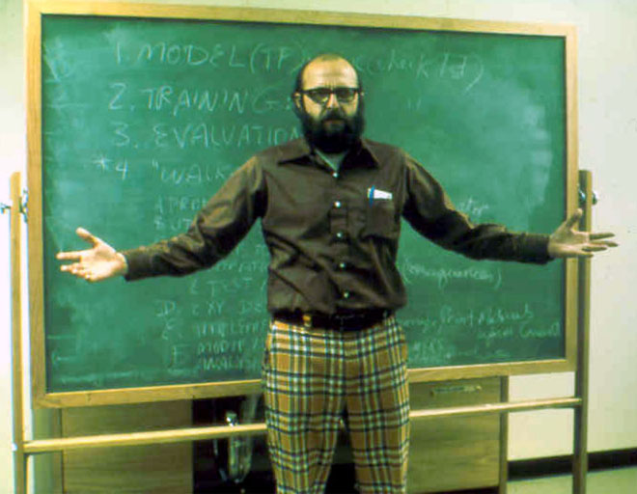
Circa 1975
Notes:
(c) Dean Fixsen and Karen Blase, 2004
‹#›

Slide 6

Karen Blase

Slide 7
Teaching–Family Model
Phillips, Phillips, Fixsen, & Wolf - 1967
Fixsen, Blase, Timbers, & Wolf (2001)
900
300
800
700
250
600
200
500
150
Cumulative Homes
400
300
100
Cumulative Couples
200
50
100
0
0
≤1972
1974
1976
1978
1980
1982

Slide 8
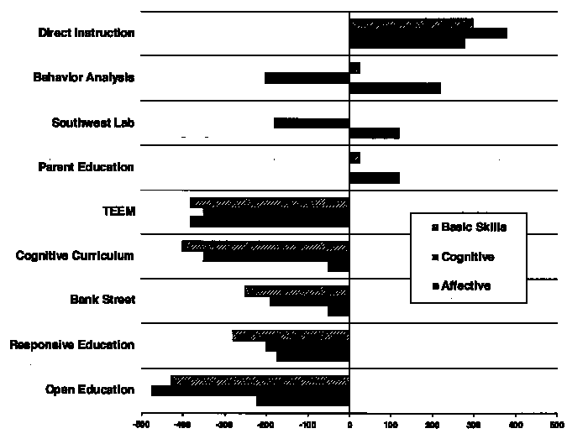
Follow Through Programs
Figure 1: This figure shows the average effects of nine Follow Through models on measures of basic skills (word knowledge, spelling, language, and math computation), cognitive-conceptual skills (reading comprehension, math concepts, and math problem solving) and self-concept. This figure is adapted from Engelmann, S. and Carnine, D. (1982), Theory of Instruction: Principles and applications. New York: Irvington Press.
Notes:
The purpose of the Follow Through planned variation experiment was to identify effective educational methods. However, there is little utility in identifying effective methods if they are not then made accessible to school districts. The Joint Dissemination Review Panel and the National Diffusion Network were created to validate and disseminate effective educational programs. In 1977, Follow Through sponsors submitted programs to the JDRP. "Effectiveness" was, however, broadly interpreted. For example, according the JDRP, the positive impact of a program need not be directly related to academic achievement. In addition, a program could be judged effective if it had a positive impact on individuals other than students. As a result, programs that had failed to improve academic achievement in Follow Through were rated as "exemplary and effective." And, once a program was validated, it was packaged and disseminated to schools through the National Diffusion Network. The JDRP's validation practices did not go unchallenged. According to former Commissioner of Education, Ernest Boyer, "Since only one of the sponsors (Direct Instruction) was found to produce positive results more consistently than any of the others, it would be inappropriate and irresponsible to disseminate information on all the models..." (quoted in Carnine, 1984, p. 87). However, commissioner Boyer's concerns could not prevent the widespread dissemination of ineffective instructional approaches. The JDRP apparently felt that to be "fair" it had to represent the multiplicity of methods in education. Not only did this practice make it virtually impossible for school districts to distinguish between effective and ineffective programs, it defeated the very purpose for which the JDRP and NDN were established.
Quoted from: Cathy L. Watkins (1995). Follow Through: Why Didn't We? Effective School Practices, 15 (1),

Slide 9
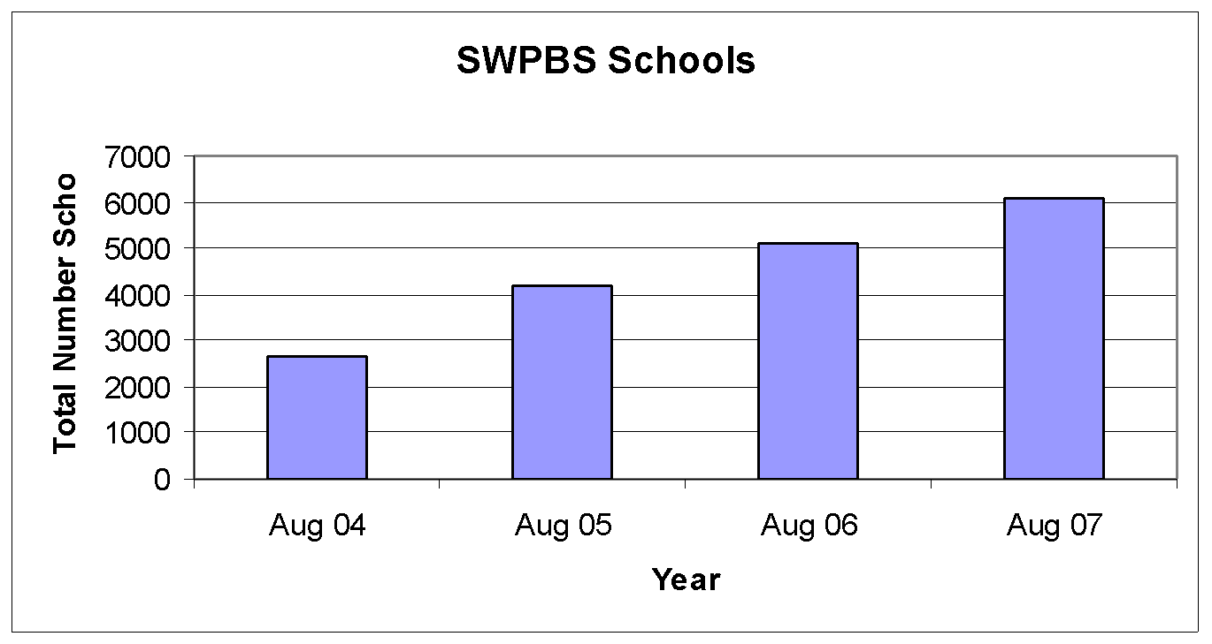
School Wide PBS

Slide 10
Implementation Reviews
Human service prevention and treatment programs (e.g. substance abuse, adult / children’s MH, justice, health, education)
Advanced manufacturing technologies
AMA clinical guidelines
Engineering: bridge maintenance
Hotel service management
National franchise operations
Cancer prevention & treatment

Slide 11
Implementation
Letting it happen
Recipients are accountable
Helping it happen
Recipients are accountable
Making it happen
Purposeful use of implementation practices and science
Implementation teams are accountable
Based on Greenhalgh, Robert, MacFarlane, Bate, & Kyriakidou, 2004
Notes:
Greenhalgh, T., Robert, G., MacFarlane, F., Bate, P., & Kyriakidou, O. (2004). Diffusion of innovations in service organizations: Systematic review and recommendations. The Milbank Quarterly, 82(4), 581-629.

Slide 12
Ineffective Methods
Excellent experimental evidence for what does not work
Diffusion/dissemination of information by itself does not lead to successful implementation (research literature, mailings, promulgation of practice guidelines)
Training alone, no matter how well done, does not lead to successful implementation

Slide 13
Ineffective Methods
Excellent evidence for what does not work
Implementation by edict/ accountability by itself does not work
Implementation by “following the money” by itself does not work
Implementation without changing supporting roles and functions does not work
Paul Nutt (2002). Why Decisions Fail
Notes:
Nutt, P. C. (1986). Tactics of Implementation. Academy of Management Journal, 29(2), 230-261.

Slide 14
What Works
Effective intervention practices
+
Effective implementation practices
=
Good outcomes for consumers

Slide 15
Implement Innovations
IMPLEMENTATION
Effective
NOT Effective
Student Benefits
Effective
INTERVENTION
NOT Effective

Slide 16
Implementation
An effective intervention is one thing
Implementation of an effective intervention is a very different thing

Slide 17
EBPs & Implementation
From an implementation perspective, what do we need to know about innovations such as evidence-based programs?

Slide 18
EBPs & Implementation
The usability of a program has little to do with the quality or weight of the evidence regarding that program
Evidence on intervention effectiveness for specific populations helps us choose what to implement
Evidence on the effectiveness of the intervention does not help implement the program or practice successfully

Slide 19
EBPs & Implementation
Core intervention components
Clearly described (who/what)
Practical measure of fidelity**
Fully operationalized (do/say)
Field tested (recursive revision)
Contextualized (org./systems fit)
Effective (worth the effort)

Slide 20
Implementation
What do we need to know about successful implementation methods?

Slide 21
Stages of Implementation
Implementation occurs in stages:
Exploration
Installation
Initial Implementation
Full Implementation
Innovation
Sustainability
2 – 4 Years
Fixsen, Naoom, Blase, Friedman, & Wallace, 2005

Slide 22
Stages of Implementation
Implementation occurs in stages:
Exploration
Installation
Initial Implementation
Full Implementation
Innovation
Sustainability
Implementation Outcomes
2 – 4 Years
Intervention Outcomes
0% 100%
Fixsen, Naoom, Blase, Friedman, & Wallace, 2005

Slide 23
Implementation Drivers
STAFF PERFORMANCE
EVALUATION
CONSULTATION & COACHING
DECISION SUPPORT DATA SYSTEMS
INTEGRATED & COMPENSATORY
FACILITATIVE ADMINISTRATIVE SUPPORTS
PRESERVICE TRAINING
RECRUITMENT AND SELECTION
SYSTEMS
INTERVENTIONS
Notes:
Practitioner selection. Who is qualified to carry out the evidence-based practices and programs? What are the methods for recruiting and selecting those practitioners? Beyond academic qualifications or experience factors, certain practitioner characteristics are difficult to teach in training sessions so must be part of the selection (S) criteria (e.g., knowledge of the field, common sense, social justice, ethics, willingness to learn, willingness to intervene, good judgment). Staff selection also represents the intersection with a variety of larger system variables. General workforce development issues, the overall economy, organizational financing, the demands of the evidence-based program in terms of time and skill, and so on impact the availability of staff for human service programs. Innovations such as evidence-based practices and programs represent new ways of providing treatment and support. Practitioners (and others) at an implementation site need to learn when, where, how, and with whom to use new approaches and new skills. Preservice and inservice training (T) are efficient ways to provide knowledge of background information, theory, philosophy, and values; introduce the components and rationales of key practices; and provide opportunities to practice new skills and receive feedback in a safe training environment. Most skills needed by successful practitioners can be introduced in training but really are learned on the job (C) with the help of a consultant/coach (e.g., craft information, engagement, treatment planning, teaching to concepts, clinical judgment). Implementation of evidence-based practices requires behavior change at the practitioner, supervisory, and administrative support levels. Training and coaching are the principle ways in which behavior change is brought about for carefully selected staff in the beginning stages of implementation and throughout the life of evidence-based practices and programs.
Staff performance evaluation (E) is designed to assess the use and outcomes of the skills that are reflected in the selection criteria, are taught in training, and reinforced and expanded in consultation and coaching processes. Assessments of practitioner performance and measures of fidelity also provide useful feedback to managers and purveyors regarding the progress of implementation efforts and the usefulness of training and coaching. Decision support data systems (e.g., quality improvement information, organizational fidelity measures) assesses key aspects of the overall performance of the organization to help assure continuing implementation of the core intervention components over time. Facilitative administration (A) provides leadership and makes use of a range of data inputs to inform decision making, support the overall processes, and keep staff organized and focused on the desired clinical outcomes. Finally, systems interventions (SI) are strategies to work with external systems to ensure the availability of the financial, organizational, and human resources required to support the work of the practitioners.

Slide 24
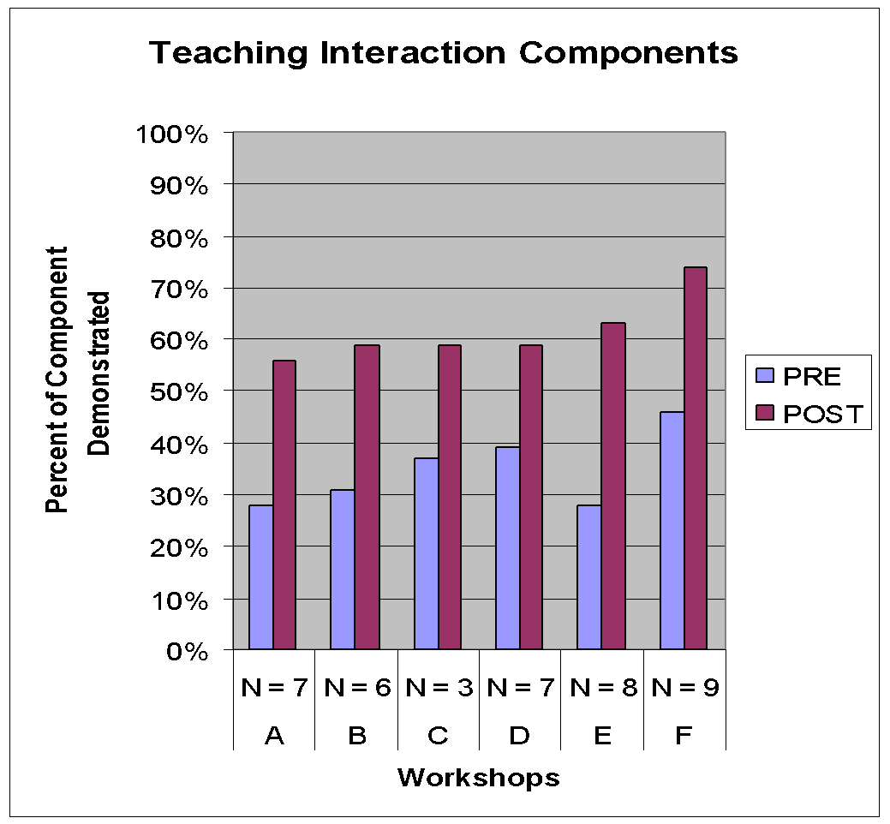
Notes:
Fixsen, D. L., Collins, L.B., Phillips, E.L., & Thomas, D.L. (1982). Institutional indicators in evaluation: An example from Boys Town. In A. J. McSweeney, W. J. Fremouw & R. P. Hawkins (Eds.), Practical Program Evaluation in Youth Treatment. Springfield, IL: Charles C. Thomas.

Slide 25
Integrated & Compensatory
OUTCOMES
(% of Participants who Demonstrate Knowledge, Demonstrate new Skills in a Training Setting,
and Use new Skills in the Classroom)
TRAINING
COMPONENTS
Knowledge
Skill
Demonstration
Use in the Classroom
Theory and Discussion
10%
5%
0%
..+Demonstration in Training
30%
20%
0%
…+ Practice & Feedback in Training
60%
60%
5%
…+ Coaching in Classroom
95%
95%
95%
Joyce and Showers, 2002
Notes:
The 2002 meta-analysis of training and coaching data by Joyce and Showers makes a compelling case for the need for skillful coaching. Only when training was accompanied by coaching in the service setting – in this case a classroom, was there substantial implementation in the practice setting.
These findings move supervision from systems that monitor units of service, react to crises and advise around case specifics to active coaching systems that monitor adherence to evidence-based practices, are purposeful in developing practitioner skills and offer support in trying out new approaches during that “awkward stage” just after training.

Slide 26
Implement Innovations
IMPLEMENTATION
Effective
NOT Effective
Perf. Assess. Fidelity
Effective
INTERVENTION
NOT Effective
Implementation without fidelity does not work

Slide 27
Functional Fidelity Assessment
Bedlington, et al., 1988
50%
2.0
r_{s} = – .94
1.9
40%
1.8
Delinquency (Outcome)
1.7
30%
1.6
Mean Self Reported Delinquency Ratings
Percent Parental-Teaching With Youths
1.5
20%
1.4
Teaching (Fidelity)
1.3
10%
1.2
1.1
0%
1.0
1
2
3
4
5
6
Homes

Slide 28
Implementation
Who does the work?
Notes:
(c) Dean Fixsen and Karen Blase, 2004
‹#›

Slide 29
Implementation Team
A group that knows the innovation very well (formal and practice knowledge)
A group that knows how to implement that innovation with fidelity and good effect
A group that accumulates data & experiential knowledge -- more effective and efficient over time (information economics, K. Arrow)
Notes:
(c) Dean Fixsen and Karen Blase, 2004
‹#›
An advantage of having a well organized and persistent approach to implementation of evidence-based practices and programs may be that the purveyor can accumulate knowledge over time (Fixsen & Blase, 1993; Fixsen, Phillips, & Wolf, 1978; Winter & Szulanski, 2001). Each attempted implementation of the program reveals barriers that need to be overcome and their (eventual) solutions. Problems encountered later on may be preventable with different actions earlier in the implementation process. The Toyota Supplier and Support Center (TSSC) is a purveyor of the Toyota Production Systems for manufacturing automobiles. MST Services, Inc. is the purveyor of the Multisystemic Therapy (MST) program for serious and chronic juvenile offenders. These are clear-cut examples of purveyors and each has a set of activities designed to help new organizations ("implementation sites") implement their respective programs. In other cases, the "purveyor" is not so readily identified nor are the activities well described. For example, the Assertive Community Treatment program and the Wraparound approach seem to have several individuals who act as consultants to communities and agencies interested in adopting those programs. The Wraparound group has recognized the problem of multiple definitions of their approach being used by different purveyors and have formed a national association to develop a common definition of the approach and a common set of processes for assessing the fidelity of new implementation sites (Bruns, Suter, Leverentz-Brady, & Burchard, 2004). The literature is not always clear about the activities of a purveyor. For example, the Quantum Opportunity Program (Maxfield, Schirm, & Rodriguez-Planas, 2003) was implemented in several sites in a major, multi-state test of the program. The report of the findings simply noted that the originators of the program had received funding to provide technical assistance to the implementation sites. Given the uneven results, it is unfortunate that there was no link back to purveyor activities.

Slide 30
Implementation Team
Prepare Communities
Prepare schools faculty, staff
Prepare Districts
Implementation Team
Assure Student Benefits
Work with Researchers
Assure Implementation
© Dean Fixsen, Karen Blase, Robert Horner, George Sugai, 2008
Notes:
(c) Dean Fixsen, Karen Blase, Robert Horner, George Sugai, 2008
‹#›
(c) Dean Fixsen and Karen Blase, 2004
‹#›

Slide 31
Implementation Team
Simultaneous, Multi-Level Interventions
Teacher
School
Management (leadership, policy)
Administration (HR, structure)
Supervision (nature, content)
Implementation Team
District
State and Community Context
Notes:
Purveyors also quickly learn that the sphere of influence is critical to the success of the implementation effort and over time take on a very active, simultaneous and multi-level intervention role to help increase the likelihood that such meta-contingencies as funding, licensing, referral mechanisms, regulations, and reporting requirements are aligned to support the new way of work

Slide 32
Implementation Team
Change the behavior of adult human service professionals
“Systems don’t change, people do” (J.W.)
Change organizational structures, cultures, and climates
Change the thinking of system directors and policy makers
Successful and sustainable implementation of evidence-based programs always requires organization and systems change.
Notes:
(c) Dean Fixsen and Karen Blase, 2004
‹#›

Slide 33
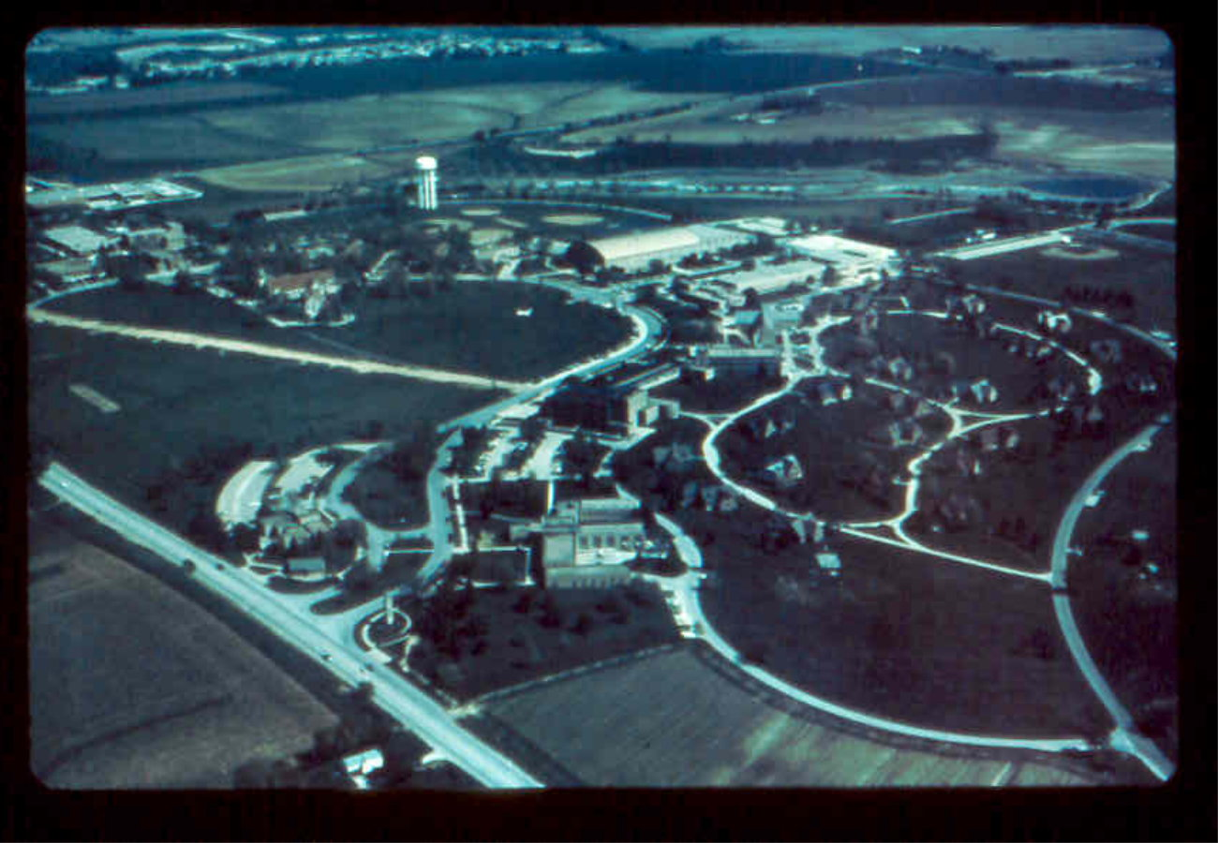
Organizational Change
Phillips, Baron, Blase, Fixsen, and Maloney (1975)

Slide 34
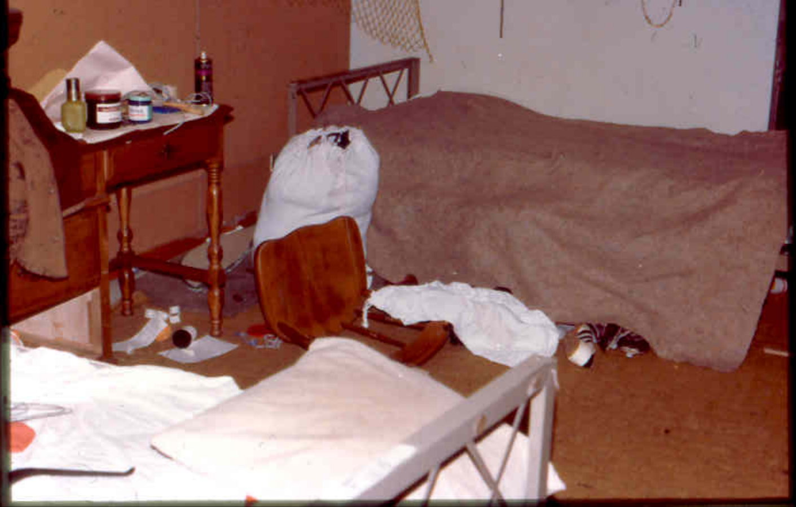

Slide 35
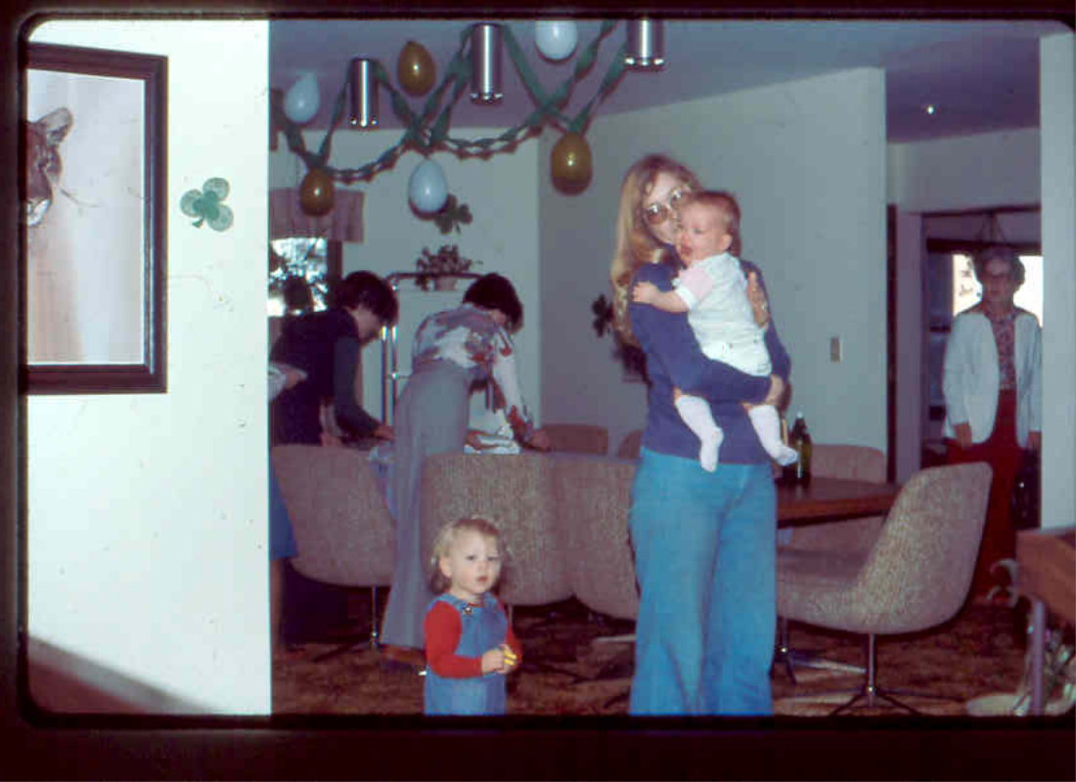

Slide 36
Implementation & Outcome
Fixsen, Phillips, et al. (1985)
4.0
7.0
r = .95
6.0
3.0
5.0
4.0
Training Level
Effectiveness
2.0
3.0
Training
Outcome
2.0
1.0
1.0
0.0
0.0
7/77
7/78
7/79
7/80
7/81
7/82
7/83
7/84
N = 41 Group Homes (152 Couples)

Slide 37
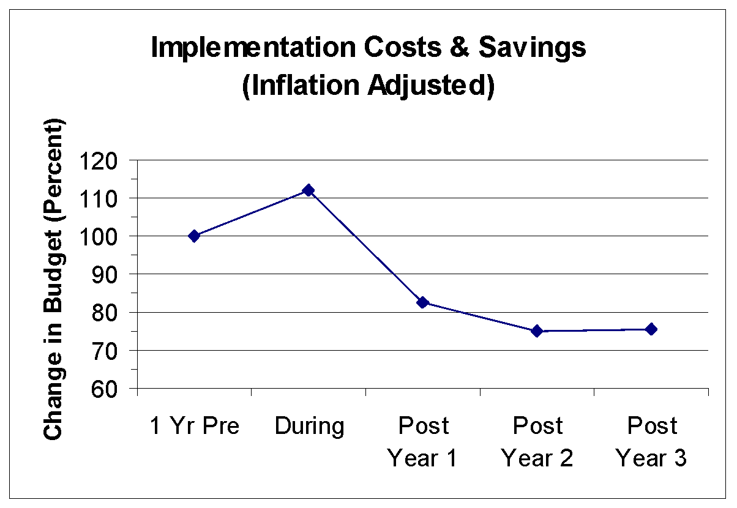
Costs and Savings

Slide 38
Budget Changes (4 years)
 | Pre | Post
Administration | 39% | 19%
Treatment Units | 59% | 75%
Training & Eval. | 2% | 6%
Reduction in administrative staff, reduction in maintenance staff and repairs, reduction in food/staff costs, nearly 100% staff redeployment/rehiring into newly defined positions

Slide 39
Sustainability
Notes:
Greenhalgh, T., Robert, G., MacFarlane, F., Bate, P., & Kyriakidou, O. (2004). Diffusion of innovations in service organizations: Systematic review and recommendations. The Milbank Quarterly, 82(4), 581-629.

Slide 40
Program Sustainability
Teaching-Family Model
Blase, Fixsen, & Phillips (1984)
100
90
80
70
% Homes Open 6+ Yrs.
60
50
40
30
20
10
N = 25
N = 219
0
Tx Unit Strategy
Org. Development Strategy
Notes:
Blase, K. A., Fixsen, D. L., & Phillips, E. L. (1984). Residential treatment for troubled children: Developing service delivery systems. In S. C. Paine, G. T. Bellamy & B. Wilcox (Eds.), Human services that work: From innovation to standard practice (pp. 149-165). Baltimore, MD: Paul H. Brookes Publishing.
Fixsen, D. L., & Blase, K. A. (1993). Creating new realities: Program development and dissemination. Journal of Applied Behavior Analysis, 26, 597-615.
Fixsen, D. L., Blase, K. A., Timbers, G. D., & Wolf, M. M. (2001). In search of program implementation: 792 replications of the Teaching-Family Model. In G. A. Bernfeld, D. P. Farrington & A. W. Leschied (Eds.), Offender rehabilitation in practice: Implementing and evaluating effective programs (pp. 149-166). London: Wiley.

Slide 41
Proximity Analysis
4 years to generate 60 attempted replications
5 years follow-up data
10 year time frame to “discover” proximity
100
90
80
70
60
% Sustained 5+ Years
50
40
Near
(3 hrs)
Near
30
20
10
Far
0
Kansas
N = 60
North Carolina
Notes:
Fixsen, D. L., Blase, K. A., Timbers, G. D., & Wolf, M. M. (2001). In search of program implementation: 792 replications of the Teaching-Family Model. In G. A. Bernfeld, D. P. Farrington & A. W. Leschied (Eds.), Offender rehabilitation in practice: Implementing and evaluating effective programs (pp. 149-166). London: Wiley.
By 1975 our organization in Kansas had attempted 60 replications of the Teaching-Family Model group home treatment program in Kansas and in 17 other states. As we did training and evaluations for new homes we also began losing group homes as couples left and were not replaced by Teaching-Parents or the Boards decided to close their homes. Figure shows an analysis of the first 60 replication group homes for the Kansas organization. As we analyzed the results for these homes, we found that 52% of the in-state homes continued to operate for 5 years or more while only 17% of the out-of-state homes operated that long.
We began looking at our own behavior and found that we knew a lot more about the Kansas homes. We were there more often to give advice and support, the Teaching-Parents came to see us more often, we called them more often, and so on. Proximity seemed to be very important to these communication and support functions.
At about this same time we began to see the spectacular results coming from our colleagues in North Carolina as well. In 1973 three of our graduate students from the University of Kansas (Gary Timbers, Karen Blase, Dennis Maloney) had moved to Morganton to start a new organization of group homes to serve children in the western half of North Carolina. All three had participated in the Kansas training and research efforts in support of Teaching-Family homes.
When we analyzed the data from the Teaching-Family group homes in North Carolina we found an even more positive result. As shown in Figure 2, over 70% of their homes (all in-state) operated for 5 years or more.
Proximity allowed more frequent contact, more support, and more immediate assistance with program implementation problems, all of which seemed to be related in important ways to the survival rates of the Teaching-Family group homes.

Slide 42
Regional Organization
Teaching-Family Homes
Site Services
Staff Selection
Staff Training
Staff Coaching
Staff Evaluation
Dec. Support Data Sys.
Facilitative Administration
System Interventions
Client Services
Client Services
Client Services
Notes:
Blase, K. A., Fixsen, D. L., & Phillips, E. L. (1984). Residential treatment for troubled children: Developing service delivery systems. In S. C. Paine, G. T. Bellamy & B. Wilcox (Eds.), Human services that work: From innovation to standard practice (pp. 149-165). Baltimore, MD: Paul H. Brookes Publishing.
Fixsen, D. L., & Blase, K. A. (1993). Creating new realities: Program development and dissemination. Journal of Applied Behavior Analysis, 26, 597-615.
Fixsen, D. L., Naoom, S. F., Blase, K. A., Friedman, R. M., & Wallace, F. (2005). Implementation Research: A synthesis of the literature. Tampa, FL: University of South Florida, Louis de la Parte Florida Mental Health Institute, The National Implementation Research Network (FMHI Publication #231).
Fixsen, D. L., Blase, K. A., Timbers, G. D., & Wolf, M. M. (2001). In search of program implementation: 792 replications of the Teaching-Family Model. In G. A. Bernfeld, D. P. Farrington & A. W. Leschied (Eds.), Offender rehabilitation in practice: Implementing and evaluating effective programs (pp. 149-166). London: Wiley.

Slide 43
Attempted Org. Replications
Fixsen, Blase, Timbers, & Wolf (2001)
100
90
80
70
% Achieve Certification
KU Ph.D.
60
50
40
30
N=9
N=10
20
10
Others
0
Pre (N=19) 6.4 Yrs
Org. Development Services
Notes:
Fixsen, D. L., Blase, K. A., Timbers, G. D., & Wolf, M. M. (2001). In search of program implementation: 792 replications of the Teaching-Family Model. In G. A. Bernfeld, D. P. Farrington & A. W. Leschied (Eds.), Offender rehabilitation in practice: Implementing and evaluating effective programs (pp. 149-166). London: Wiley.

Slide 44
Attempted Org. Replications
Fixsen, Blase, Timbers, & Wolf (2001)
1975 – 1990 59 attempted organizational implementations
4 years to a certification decision
20 year time frame for data collection
100
90
80
70
% Achieve Certification
KU Ph.D.
KU Ph.D.
60
Others
50
40
30
N=9
N=10
N=3
N=37
20
10
Others
0
Pre (N=19) 6.4 Yrs
Post (N=40) 3.7 Yrs
Org. Development Services
Notes:
Blase, K. A., Fixsen, D. L., & Phillips, E. L. (1984). Residential treatment for troubled children: Developing service delivery systems. In S. C. Paine, G. T. Bellamy & B. Wilcox (Eds.), Human services that work: From innovation to standard practice (pp. 149-165). Baltimore, MD: Paul H. Brookes Publishing.
Fixsen, D. L., & Blase, K. A. (1993). Creating new realities: Program development and dissemination. Journal of Applied Behavior Analysis, 26, 597-615.
Fixsen, D. L., Blase, K. A., Timbers, G. D., & Wolf, M. M. (2001). In search of program implementation: 792 replications of the Teaching-Family Model. In G. A. Bernfeld, D. P. Farrington & A. W. Leschied (Eds.), Offender rehabilitation in practice: Implementing and evaluating effective programs (pp. 149-166). London: Wiley.

Slide 45
Program Sustainability
Teaching-Family Model
Fixsen, Blase, Timbers, & Wolf (2001)
100
90
80
70
% Homes Open 6+ Yrs.
60
50
40
30
20
10
N = 84
N = 219
0
Tx Unit Strategy
Org. Development Strategy
Notes:
Blase, K. A., Fixsen, D. L., & Phillips, E. L. (1984). Residential treatment for troubled children: Developing service delivery systems. In S. C. Paine, G. T. Bellamy & B. Wilcox (Eds.), Human services that work: From innovation to standard practice (pp. 149-165). Baltimore, MD: Paul H. Brookes Publishing.
Fixsen, D. L., & Blase, K. A. (1993). Creating new realities: Program development and dissemination. Journal of Applied Behavior Analysis, 26, 597-615.
Fixsen, D. L., Blase, K. A., Timbers, G. D., & Wolf, M. M. (2001). In search of program implementation: 792 replications of the Teaching-Family Model. In G. A. Bernfeld, D. P. Farrington & A. W. Leschied (Eds.), Offender rehabilitation in practice: Implementing and evaluating effective programs (pp. 149-166). London: Wiley.

Slide 46
Most Purveyor Groups
Purveyor - IT
PE
IT - Purveyor
C
IT
DSDS
ORG
Purveyor
T
FA
IT
SI
S
IT
IT
IT = Implementation Team

Slide 47
Some Purveyor Groups
IT
PE
Purveyor
C
DSDS
Purveyor
ORG
Purveyor
T
FA
IT
SI
S
IT
IT

Slide 48
Sustainability Stage
PE
C
DSDS
ORG
IT
T
FA
SI
S

Slide 49
Scale Up
Notes:
Greenhalgh, T., Robert, G., MacFarlane, F., Bate, P., & Kyriakidou, O. (2004). Diffusion of innovations in service organizations: Systematic review and recommendations. The Milbank Quarterly, 82(4), 581-629.

Slide 50
A Sobering Observation
"All organizations [and systems] are designed, intentionally or unwittingly, to achieve precisely the results they get."
R. Spencer Darling
Business Expert

Slide 51
System Change
Innovative practices do not fare well in old organizational structures and systems
Organizational and system changes are essential to successful implementation
Expect it
Plan for it

Slide 52
Scale Up
EBPs now are boutique operations
Now have convincing demonstrations that EBPs can work in the real world
Pretty neat but not used on a scale sufficient to solve social problems
What will it take to have 100,000 replications that produce increasingly effective outcomes for 100 years?
Start with the end in mind

Slide 53
School Wide PBS

Slide 54
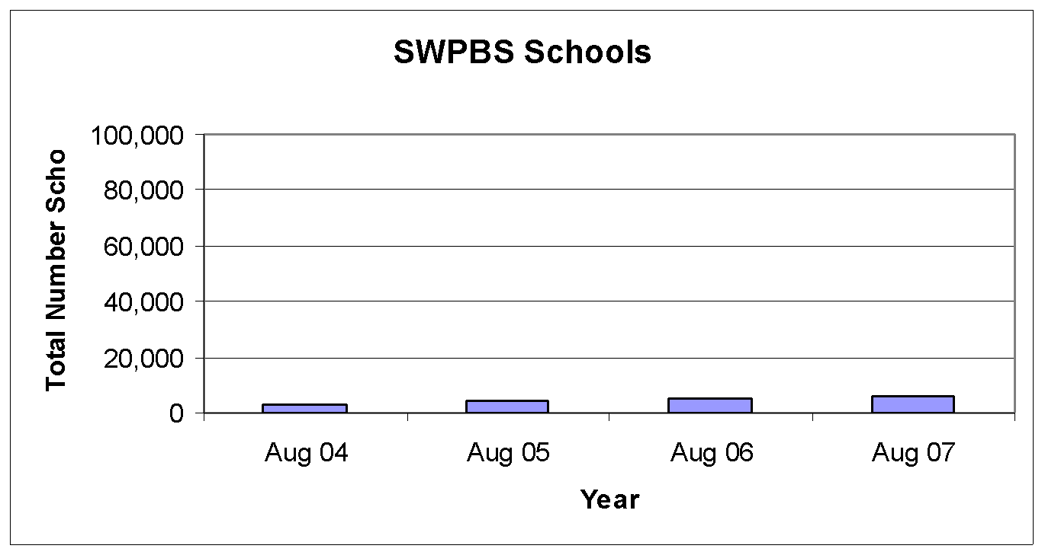
School Wide PBS
5% of all schools

Slide 55
Scale Up
To scale up interventions we must first scale up implementation capacity
Building implementation capacity is essential to maximizing the use of EBPs and other innovations

Slide 56
Scale Up
Interventions that are and remain effective through several generations of teachers, principals, superintendents, and state and national leaders
Implementation supports that are and remain effective through several generations of trainers, coaches, and state leaders

Slide 57
Creating Implementation Capacity
State Implementation and Scaling up of Evidence-based Practices (SISEP) Center
Karen Blase, Dean Fixsen, Rob Horner, George Sugai
www.scalingup.org
Notes:
(c) Dean Fixsen and Karen Blase, 2004
‹#›

Slide 58
IMPLEMENTATION CAPACITY FOR SCALING UP EBPs
State
Management Group
State
Transformation
Team
SISEP Support
First Regional Implementation Team
N = 50 – 200 Schools
Regional Implementation Team
N = 50 – 200 Schools
Regional Implementation Team
N = 50 – 200 Schools
Regional Implementation Team
N = 50 – 200 Schools
Notes:
(c) Dean Fixsen, Karen Blase, Robert Horner, George Sugai, 2008
‹#›
(c) Dean Fixsen and Karen Blase, 2004
‹#›

Slide 59
Systems Change
Federal Departments
State Department
Implementation Teams
Districts
ALIGNMENT
Schools
Teachers/ Staff
Effective Practices
FORM FOLLOWS FUNCTION

Slide 60
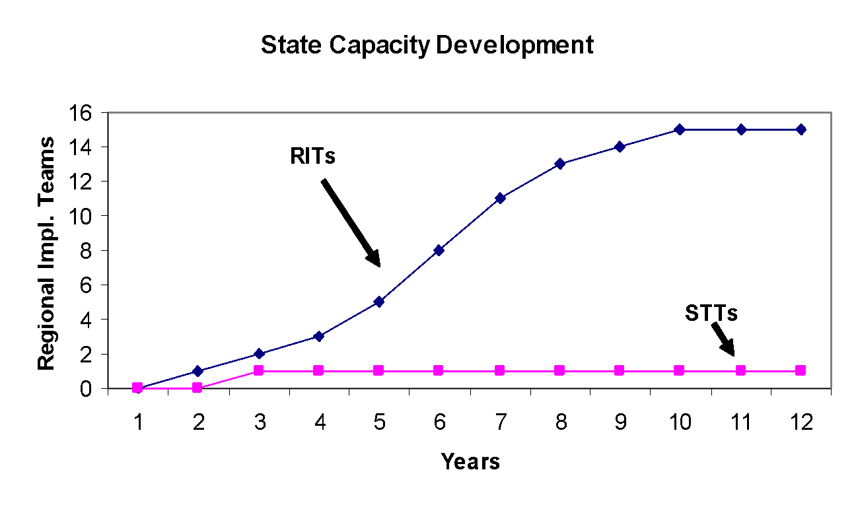
Saturation
44/51
Saturation
Intensive Development
Intensive Development

Slide 61

Functional Education
Policies
Bureaucracy
Schools
Teachers
© Dean Fixsen, Karen Blase, Robert Horner, George Sugai, 2008
Notes:
(c) Dean Fixsen, Karen Blase, Robert Horner, George Sugai, 2008
‹#›
(c) Dean Fixsen and Karen Blase, 2004
‹#›

Slide 62
Thank You
We thank the following for their support
Annie E. Casey Foundation (EBPs and cultural competence)
William T. Grant Foundation (implementation literature review)
Substance Abuse and Mental Health Services Administration (implementation strategies grants; NREPP reviews; SOC analyses of implementation; national implementation awards)
Centers for Disease Control & Prevention (implementation research contract)
National Institute of Mental Health (research and training grants)
Juvenile Justice and Delinquency Prevention (program development and evaluation grants
Office of Special Education Programs (Capacity Development Center contract)
Agency for Children and Families (Child Welfare Leadership Development contract)
Notes:
(c) Dean Fixsen and Karen Blase, 2004
‹#›

Slide 63
For More Information
Karen A. Blase
813-974-4463
kblase@fmhi.usf.edu
Dean L. Fixsen
813-974-4446
dfixsen@fmhi.usf.edu
National Implementation Research Network
At the Louis de la Parte Florida Mental Health Institute
University of South Florida
http://nirn.fmhi.usf.edu

Slide 64

For More Information
Implementation Research:
A Synthesis of the Literature
Fixsen, D. L., Naoom, S. F., Blase, K. A., Friedman, R. M. & Wallace, F. (2005). Implementation Research: A Synthesis of the Literature. Tampa, FL: University of South Florida, Louis de la Parte Florida Mental Health Institute, The National Implementation Research Network (FMHI Publication #231).
Download all or part of the monograph at:
http://nirn.fmhi.usf.edu/resources/publications/Monograph/index.cfm
Notes:
(c) Dean Fixsen and Karen Blase, 2004
‹#›

