Slide 1


Professional Growth and Evaluation Process - Elementary
Professional Growth and Evaluation Series
Notes:
Katy

Slide 2
Presenters
Secondary
Rick Anthony, Assistant Superintendent Educator Support and Development
Rob McDaniel, Director New Administrator Support
Elementary
Katy Timothy, Associate Director, Human Resources
Jon Adams, Director Leadership and Improvement
Notes:
Presenter - Katy
Time - 1 Min

Slide 3
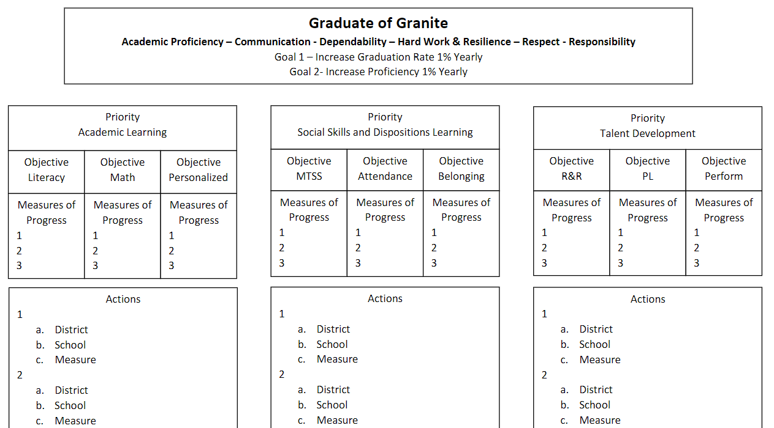
Notes:
Presenter -
Time - 1 Min Katy
Connect to the Strategic Plan

Slide 4


Objectives
Participants will gain an understanding of the process used for Professional Growth and Evaluation (PG&E) in Granite School District.
Notes:
Presenter - Katy
Time - 1 Min

Slide 5

Why the presentation on PG&E Logistics?
Increase clarity and congruence
Incorporate projected adjustments from Utah State Board of Education Rules
Reflect a capacity building approach
Review adjustments to multiple measures used in providing feedback
Notes:
Presenter - Katy
Time - 5 Min

Slide 6
Fall
NOTIFICATION AND ORIENTATION
Provide an orientation on evaluation in a faculty meeting no later than 20 days after school begins.
Inform the teacher(s) about the evaluation process at least 15 days prior to the first evaluation by -
Giving the teacher a copy of the standards
Reviewing the standards and allowing for questions/concerns
Explaining the multiple measures used by the evaluator
Securing the teacher’s verification of the notification requirement
Notes:
Presenter - Katy
Time - 5 min
Once this presentation is over, you’ll want to look at your Frontline list and make sure to send me the names of any people that need to be added and those that need to be removed. Don’t forget contract para positions. I can get your list cleaned up for you. I know from being an administrator that there’s nothing worse than having it PG&E day, where our teachers have time to complete their self-assessment, goals, and meet with you but can’t get on to do anything.
When you do this training, please make sure that you tell your staff to check their evaluation type when they get logged in to Frontline. Please contact me before filling out self-assessments, goals, and doing the BOY PG&E if there’s an error, otherwise I can’t fix it, and you’ll have to have them print everything out and then have me change it and then they’ll have to put everything else back in.
I would highly recommend setting up a time on Thursday, August 10th to do this PD with your staff. You’ll use and modify this slide deck to fit your school’s needs. Feel free to make a copy and take notes in your copy to save yourself time later and make notes that will be helpful to you. We want to help you best utilize your time and not send you from this training with more to do.

Slide 7
Activity - Notification and Orientation
Discuss how you have seen this done or how you have done it at your school. Include what you need to change.
5 Minutes to discuss.
5 Minute share out ideas.
Notes:
Presenter - Katy
Time - 10 min

Slide 8
Fall
SELF ASSESSMENT - Frontline Platform Entry
GOAL SETTING - Frontline Platform Entry
SUPERVISOR REVIEW AND COMMENT - Frontline Platform Entry
Due by September 30th
Notes:
Presenter - Katy
Time - 2 min
In the beginning of the year PG&E process, nothing is changing. Teachers will still do their self-assessment, they’ll set two or more goals.
These are due by 9/30, after that they’ll have the little red exclamation mark.
No change from past practice

Slide 9
Fall
SUPERVISOR CONSIDERATION OF MULTIPLE MEASURES
CLASSROOM OBSERVATION - Frontline Platform Entry (Fall and Spring)
  Date
  Notes
  Standard(s) identified as strengths
  Standard(s) identified as areas for growth
LESSON DESIGN REVIEW - Frontline Platform Entry (Fall)
  Date
  Notes
OTHER FRONTLINE OBSERVATIONS- Additional Frontline Classroom Observation and Lesson Design Forms can be requested from Katy as you have been able to do in the past
OTHER OBSERVATIONS - Can be made in the following locations and documented elsewhere:
  PLC, General Interactions, Etc.
Notes:
Presenter - Katy
Time - 2 min
This is what fall Multiple Measures are going to look like. You’ll still do a classroom observation, but the time frame of a minimum of 20 minutes has been removed. There is no rubric in the observation anymore. You’ll also do a Lesson Design Review with your teachers as part of the same form. This can be done when you do the debrief from the classroom observation. I would recommend trying to couple them together since you’ve got lots to do, but they can be done separately and saved in between, if needed.
Emphasize giving teachers the opportunity to respond. Use reflective feedback when questioning. Refer to resources you’ve been given.

Slide 10
Multiple Measures
The answer to all of the questions wanting specifics -
Like the answer “it depends”
Ours is -
Supervisor must feel comfortable they have the information needed for the feedback generated.
Notes:
Presenter - Katy
Time - 3 min
This is really a decision you get to make. How much data do you need to support your decisions? You won’t be using a rubric here anymore, you’ll take notes and support your decisions with documentation from your observation. You’ll do the same for Lesson Design Review. This is going to be a big adjustment for you and for your teachers.

Slide 11
What is Feedback?
Feedback is an interactive, dialogic process. It uses shared evidence and questioning to transform a learner’s current level of practice to a higher level of excellence by developing and advancing individual knowledge about pedagogy.
Notes:
Presenter - Jon
Time - 2 min
Coaching Techniques and Feedback PL Slide Deck

Slide 12
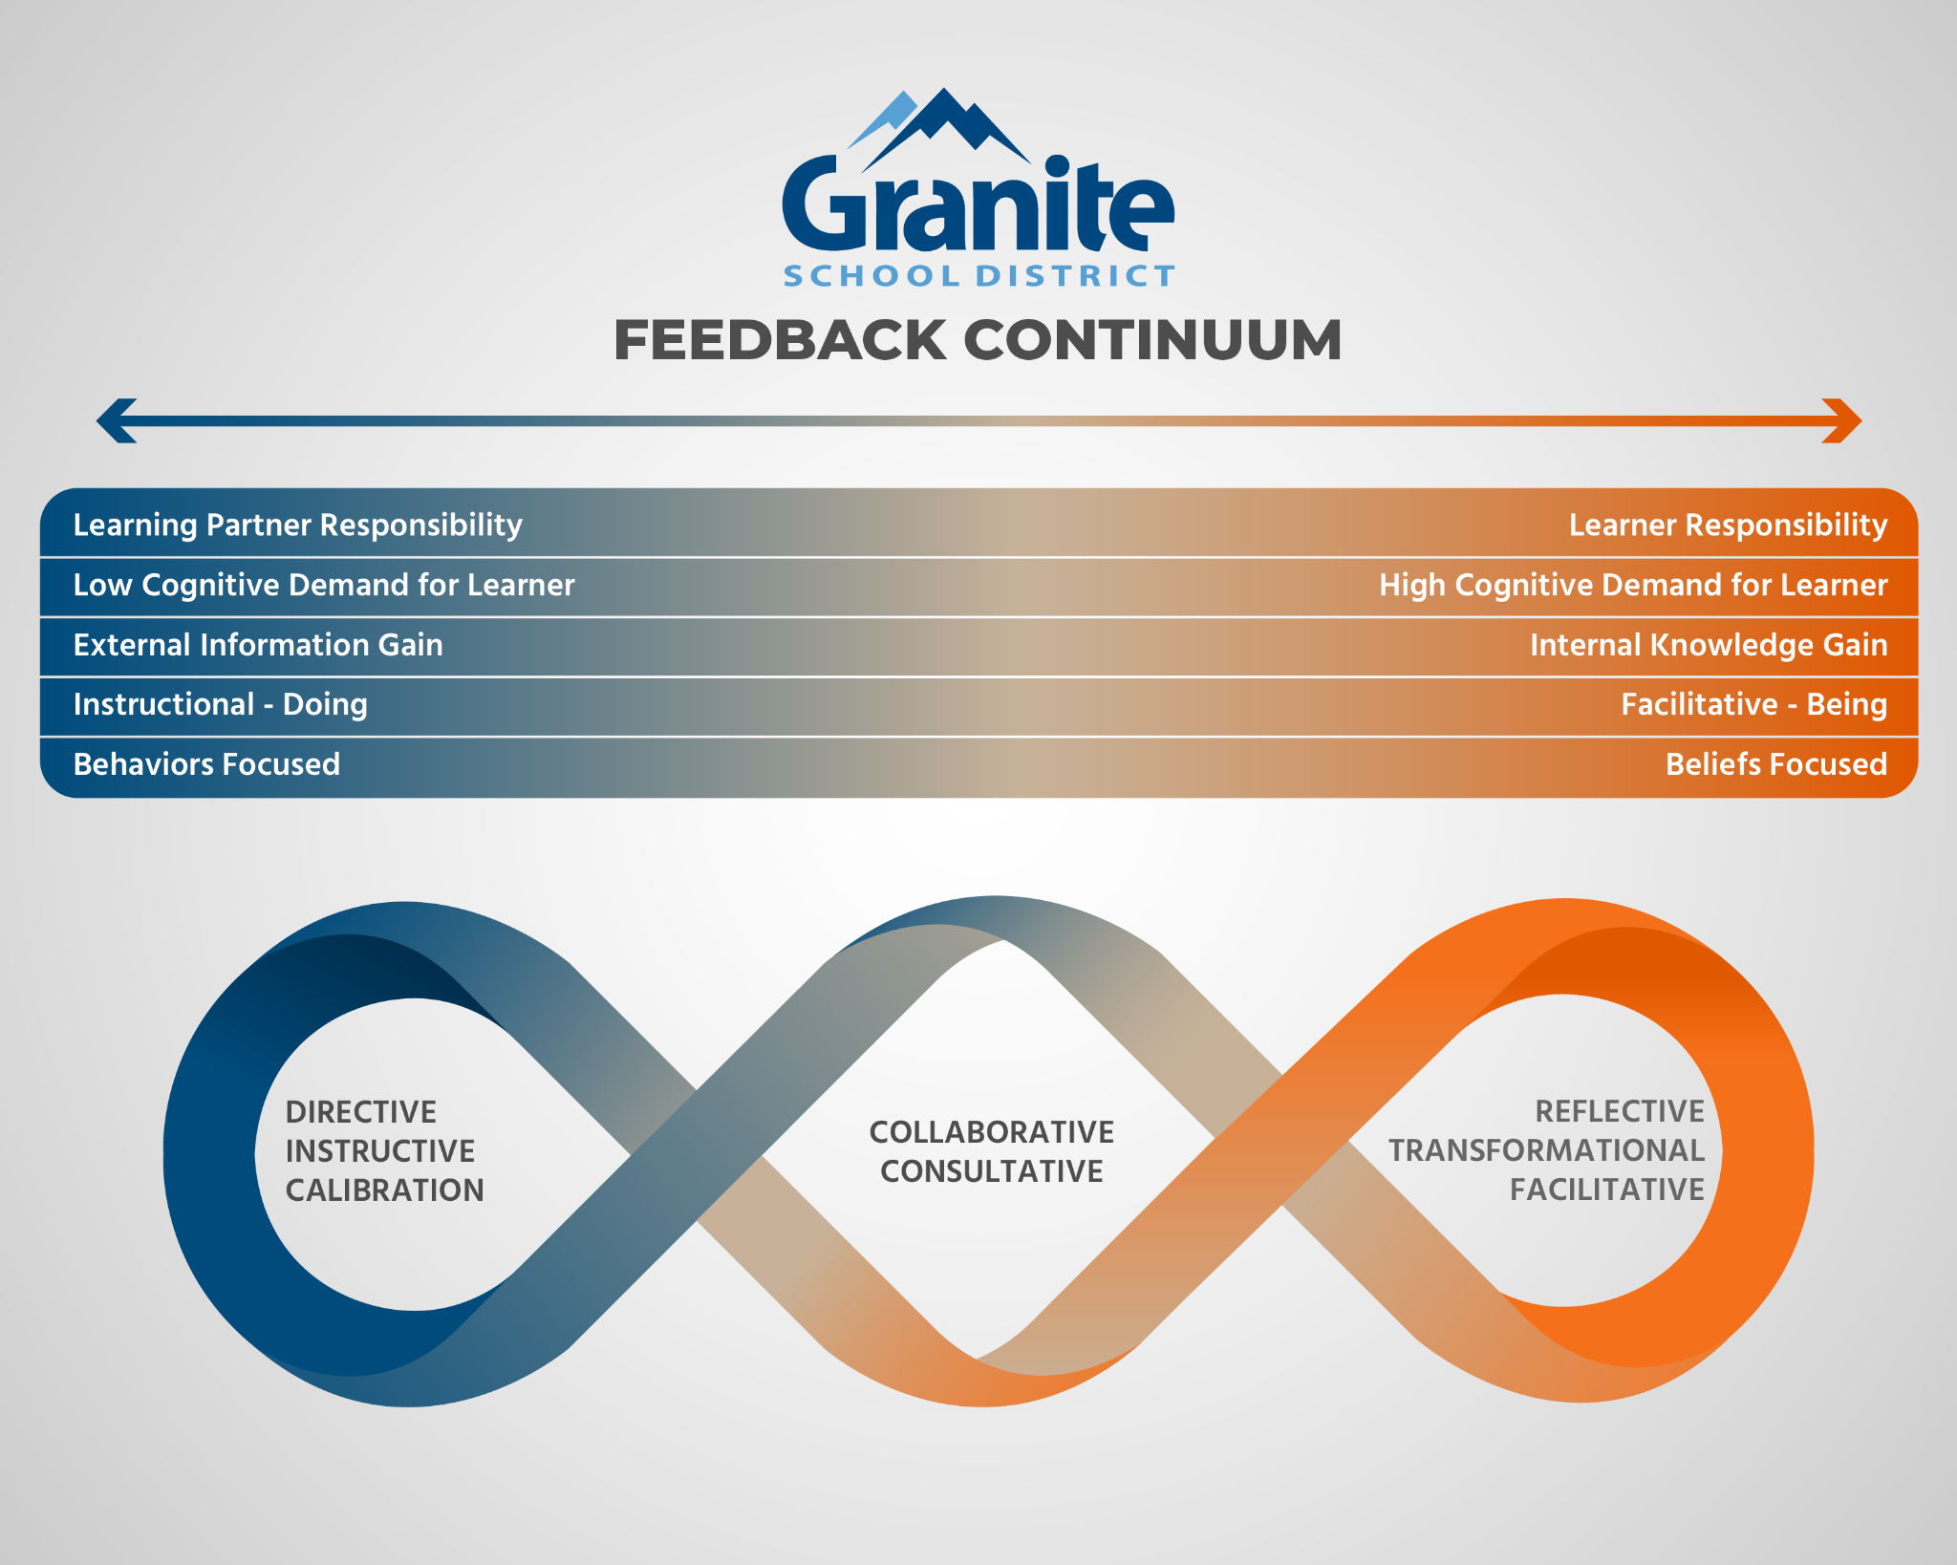
Notes:
Presenter - Jon
Time - 2 min
When we talk about feedback, we use the word “generated” rather than “given” because the reflective side of feedback is not “given” it is ideally generated by the learner.

Slide 13
Activity - Feedback
Supervisor must feel comfortable they have the information needed for the feedback generated.
5 Minutes to discuss how you are understanding what this means.
5 Minute share out.
Notes:
Presenter - Jon to give hand out of Multiple Measures
Time - 10 min

Slide 14
Classroom Observation
REQUIRED FOR BOTH PROVISIONAL AND CAREER
New form - more open - slide upcoming
Supervisor must feel comfortable they have the information needed for the feedback generated
Debrief with the individual
Provisional Deadline-Due November 15th
Career Educators-Due December 22nd (End of Fall Semester)
Notes:
Presenter - Jon
Time - 2 min
Big question is how long must you be in the classroom? The answer is “the supervisor must feel comfortable they have the information needed for the feedback generated”
If you feel you need more than one fall Classroom Observation, Katy Timothy in HR can open one for you.
Observation PL Slide Deck

Slide 15
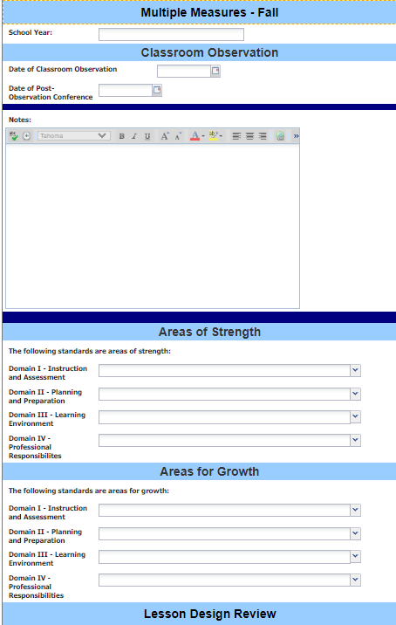
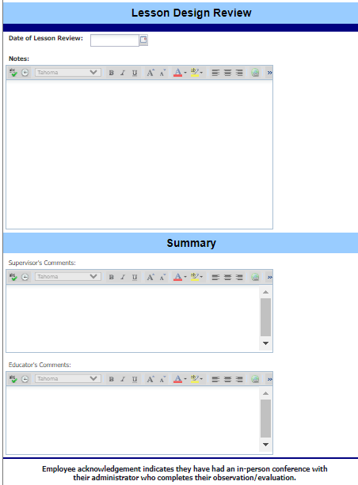
Fall Multiple Measures Form
Notes:
Presenter - Jon
Time - 2 min
This is the Fall Multiple Measures Form that will be used to conduct the Classroom Observation and the Lesson Design Review.

Slide 16
Lesson Design Review
REQUIRED FOR PROVISIONAL AND CAREER
Flexibility in modality of submission -
  Written
  Verbally Shared/Demonstrated
  PLC Collaboration
  Link to Canvas, Google Classroom
Supervisor must feel comfortable they have the information needed to support the feedback generated
Debrief with individual
Notes:
Presenter - Jon
Time - 2 min
Lesson Design PL Slide Deck

Slide 17
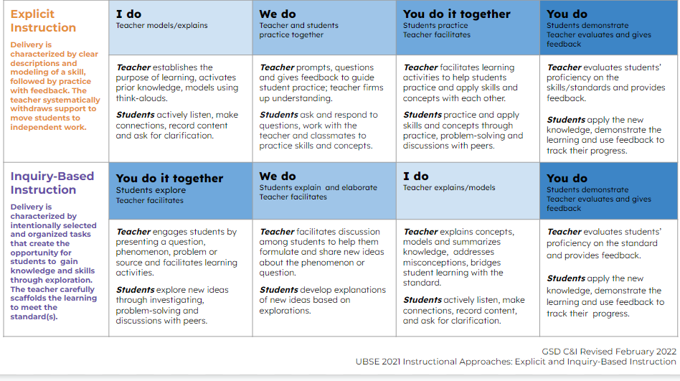
Notes:
Lesson Design PL Slide Deck
Jon

Slide 18
Activity - Lesson Design Review
Flexibility in modality of submission
Supervisor must feel comfortable they have the information needed for the feedback generated.
5 Minutes to discuss how you are understanding what these mean.
5 Minute share out.
Notes:
Presenter - Jon
Time - 10 min

Slide 19
Fall Multiple Measures Form
Notes:
Presenter - Jon (consider removing since the same slide is up above…leave if needed)
Time - 2 min
This is the Fall Multiple Measures Form that will be used to conduct the Classroom Observation and the Lesson Design Review.

Slide 20
Other General Observations
BOTH PROVISIONAL AND CAREER
Flexibility in -
  Length of time
  Place
  Number of times
Supervisor must feel comfortable they have the information needed for the feedback generated in the evaluation
No entry into Frontline other than incorporated into the evaluation of individuals on standards
Debrief on each of these is not required
Notes:
Presenter - Jon There is an extra fall observation opportunity. Ask Katy if you need this added to someone’s Frontline, and she can add it for you.
Time - 3 min

Slide 21
Fall
PROVISIONAL ONLY - EVALUATION
Supervisor rating on educator standards - Frontline platform entry
Has performance been satisfactory yes/no - Frontline platform entry
Debrief
Due by November 15th
CAREER
Reminder - debrief on Classroom Observation and Lesson Design
Due by December 22nd
Notes:
Presenter - Jon
Go through rubric, if you put a ‘no’ make sure you’re letting your SLID know as soon as you’re worried. For fall for provisional employees, make sure to do the classroom observation and lesson design reflection. For career employees for the fall you need to complete the classroom observation and the lesson design reflection with notes.
Time - 2 min

Slide 22
Winter
FRONTLINE PLATFORM ENTRY
MID YEAR REVIEW OF PROGRESS ON GOALS
SUPERVISOR REVIEW AND COMMENTS
Due by January 31st
Notes:
Presenter - Jon
Time - 1 min
No change from what is currently expected at the middle of the year.

Slide 23
Spring
SUPERVISOR CONSIDERATION OF MULTIPLE MEASURES
Classroom Observation - Frontline Platform Entry
  Date
  Notes
  Standard(s) identified as strengths
  Standard(s) identified as areas for growth
OTHER FRONTLINE OBSERVATIONS- Additional Frontline Classroom Observation and Lesson Design Forms can be requested from Katy as you have been able to do in the past
OTHER OBSERVATIONS - Can be made in the following locations and documented elsewhere:
  PLC, General Interactions, Etc.
Notes:
Presenter - Katy
Time - 1 min
The classroom observation portion of the spring Multiple Measures form will be the same as what you were just introduced to in the fall slides. There won’t be a rubric, just a place for notes and a place for you to choose areas of strengths and areas for growth.

Slide 24
Spring Continued
SUPERVISOR CONSIDERATION OF MULTIPLE MEASURES
Stakeholder Feedback Reflection - Frontline Platform Entry
  Date
  Notes
Student Growth Reflection - Frontline Platform Entry
  Date
  Notes
Supervisor must feel comfortable they have the information needed for the feedback generated.
Notes:
Presenter - Katy
Time - 2 min
Student Growth and Stakeholder Feedback PL Slide Deck
This part of the form is different and replaces the Lesson Design Review portion of the form that you were introduced to in the fall.
Emphasize that the teacher really has a lot of flexibility with the design of these new forms. We want to give them the opportunity to have some choice in what they select to share with you for growth data and stakeholder feedback.

Slide 25
Classroom Observation
REQUIRED IN SPRING FOR BOTH PROVISIONAL AND CAREER
Supervisor must feel comfortable they have the information needed for the feedback generated.
Debrief with the individual.
Provisional Deadline-Due March 15th
Career Educators-Due May 15th
Notes:
Presenter - Katy
Time - 1 min
All portions of the form need to be completed. If you do request additional observations, you can choose to either focus on the classroom observation portion and the lesson design review or just select the one that is most pertinent and put N/As in the boxes not filled. This is going to take more time. The goal is to give you more opportunities to provide you teachers with reflective feedback (and directive when needed) on how things are going in the areas of classroom observation, lesson design, stakeholder feedback, and student growth. We want to give teachers the opportunity to respond and to help build their skill sets and continue to help them grow.

Slide 26
Other Observations
REQUIRED IN SPRING FOR BOTH PROVISIONAL AND CAREER
Flexibility in -
  Length of time
  Place
  Number of times
Supervisor must feel comfortable they have the information needed for the feedback generated.
Notes:
Presenter - Katy
Time - 1 min

Slide 27
Stakeholder Feedback Reflection
REQUIRED IN SPRING FOR BOTH PROVISIONAL AND CAREER
Flexibility in modality -
  Written
  Verbally Shared
  Entered into Frontline End of Year Summary Field(s) Reflection
Supervisor must feel comfortable they have the information needed for the feedback generated.
Notes:
Presenter - Katy
Time - 2 min

Slide 28
Student Growth Reflection
REQUIRED IN SPRING FOR BOTH PROVISIONAL AND CAREER
Flexibility in modality -
  Written
  Verbally Shared
  Entered into Frontline End of Year Summary Field(s) Reflection
Flexibility in growth data used -
  Classroom assessment
  Common formative assessment
  Interim (Acadience, Reading Growth Measure, Benchmarks)
  Summative (WIDA, AP, RISE) from a prior year
Supervisor must feel comfortable they have the information needed for the feedback generated.
Notes:
Presenter - Katy
Time - 3 min

Slide 29
Activity - Stakeholder/Student Growth Reflection
Flexibility in modality of submission
Supervisor must feel comfortable they have the information needed for the feedback generated.
5 Minutes to discuss how you are understanding what these mean.
5 Minute share out.
Notes:
Presenter - Katy
Time - 10 min

Slide 30
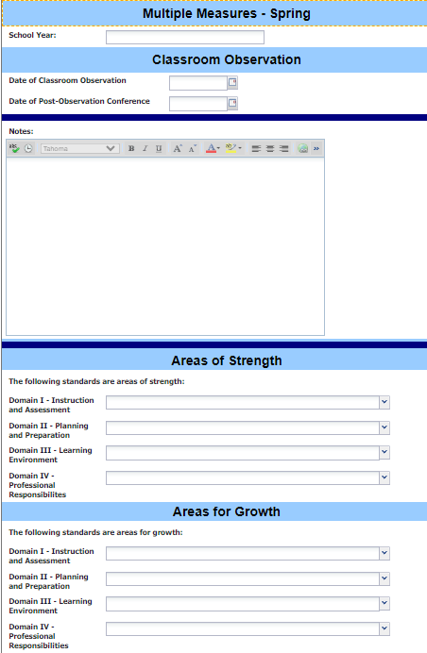
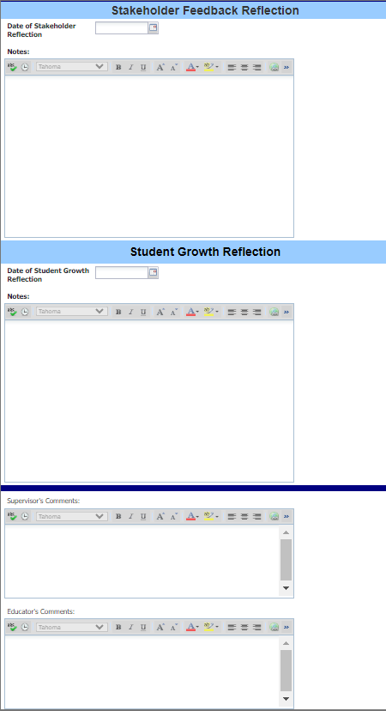
Spring Multiple Measures Form
Notes:
Presenter - Katy
Time - 2 min
This is the Multiple Measure Spring Form that will be used to conduct the Spring Classroom Observation, Stakeholder Feedback Reflection, and the Student Growth Reflection.

Slide 31
Spring
Supervisor rating
EVALUATION
Provisional - has performance been satisfactory yes/no - Frontline platform entry
Question is asked in both the Fall and Spring
Provisional - continued employment yes/no - Frontline platform entry
Question is asked in the Spring only
Supervisor rating on educator standards - Frontline platform entry
Career - has performance been satisfactory yes/no - Frontline platform entry
The question regarding continued employment has been removed
Supervisor rating on educator standards - Frontline platform entry
Debrief
Provisional Deadline-Due March 15th
Career Educators-Due May 15th
ALL TEACHERS WILL HAVE AN ANNUAL EVALUATION
Notes:
Presenter - Katy
Time - 3 min
There is no longer formative and summative.
No longer do we have Year End Formative Assessment. Provisional teachers receive an evaluation in fall and spring. Career teachers receive an evaluation in spring.
If No is marked, it shouldn’t come as a surprise

Slide 32
Spring
FRONTLINE PLATFORM ENTRY
END OF YEAR REFLECTION ON GOALS
SUPERVISOR REVIEW AND COMMENTS
Due May 15th
Notes:
Presenter - Katy
Time - 2 min
This has stayed the same.

Slide 33
Group Discussion
As a group, discuss the changes to observation and evaluation.
Are there any questions from your group or anything you need clarification on?
You’ll be using the slide deck to present to your own staff on Thursday, August 10th. Please use the remaining time to reflect on how this will be taught at your individual school.
Notes:
Presenter - Jon Time - 2 min We have time for one question per group. If you have additional questions or need more clarification, write it down on a post it and we’ll get it answered for you right away.
We won’t be able to push the May 15th deadline back this year because school is out for summer on May 24th.

