Slide 1










ARTIFICIAL INTELLIGENCE (AI)
FREE PRESENTATION TEMPLATE

Slide 2







TABLE OF CONTENTS
INTRODUCTION
AI APPLICATIONS
01
02
This section sets the foundation for the rest of the presentation by providing an overview of what AI is.
This section provides examples of how AI is being used in various industries.
SOCIAL IMPLICATIONS
AI AND SOCIETY
03
04
This section explores the social and ethical implications of AI. AI is transforming industries.
This section explores how AI is impacting society as a whole. AI is about applications in industries.

Slide 3






INTRODUCTION
AI, or Artificial Intelligence, refers to the simulation of human intelligence in machines that are programmed to think and act like humans. AI is designed to solve complex problems and improve efficiency and accuracy in decision-making.
01

Slide 4









TYPES OF AI
NARROW AI
GENERAL AI
SUPER AI
Narrow AI is designed to perform a specific task
General AI can perform any intellectual task that a human can
Super AI is hypothetical and would surpass human intelligence

Slide 5





HISTORY OF AI
The Dartmouth Conference, where the term "artificial intelligence" was first coined and AI was established as a field of research.
1956
The first AI system that could understand and respond to natural language was created by Terry Winograd, which marked a major step forward in natural language processing.
1974
IBM's Deep Blue defeated the world chess champion Garry Kasparov, demonstrating that machines could surpass human intelligence in specific domains.
1997
The emergence of deep learning led to breakthroughs in computer vision, speech recognition, and natural language processing.
2012

Slide 6


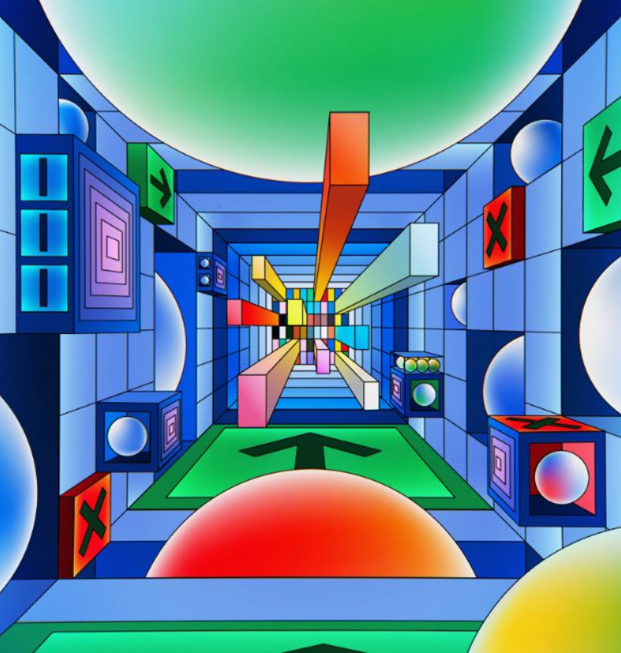
AI APPLICATIONS IN INDUSTRIES
AI has the potential to revolutionize numerous industries by providing new and innovative solutions to complex problems. From healthcare to finance, AI is already being used to improve efficiency, increase accuracy, and drive innovation. This section will explore some of the practical applications of AI in various industries, demonstrating the real-world impact of this technology.
02

Slide 7





IN HEALTHCARE
IDENTIFY CANCEROUS GROWTHS
01
In a study of 33,000 patient chest x-rays, an AI algorithm was able to identify potentially cancerous growths with 94% accuracy.
HEALTHCARE TOOLS
02
By 2026, the global market for AI-powered healthcare tools is projected to reach $28 billion.
MANAGEMENT
03
AI-powered virtual assistants can help doctors and nurses manage their schedules, order tests, and prioritize patient care.

Slide 8



IN FINANCE
75%
12,000
50%
people said that AI has improved their decision-making process.
Morgan Chase used AI to analyze 12,000 commercial loan agreements in seconds
The use of AI in fraud detection has led to a 50% reduction in false positives

Slide 9








IN MANUFACTURING
Item 2
Item 3
12
10
8
6
4
2
0
2015
2016
2017
2018
2019
2020
2021

Slide 10




IN TRANSPORTATION
REDUCE 20% FUEL CONSUMPTION
REDUCE 30% MAINTENANCE COSTS
Self-driving trucks powered by AI have been shown to reduce fuel consumption by up to 20%, saving companies thousands of dollars per year.
AI-powered predictive maintenance can reduce maintenance costs by up to 30%, and increase vehicle reliability and uptime.

Slide 11


03
SOCIAL IMPLICATIONS
Explores the broader impact of AI beyond specific industries or applications. Considers ethical and societal implications such as job displacement, bias, privacy concerns, and potential impacts on democracy and human rights. Encourages a critical and thoughtful approach to AI development and deployment, taking into account the potential risks and benefits to individuals and society as a whole.

Slide 12




AI AND JOBS
JOBS AT HIGH RISK
JOBS AT SIGNIFICANT RISK
14%
32%

Slide 13



AI ETHICS
81%
People believe that companies should prioritize ethical considerations
63%
Were concerned about the ethical implications of the AI system

Slide 14
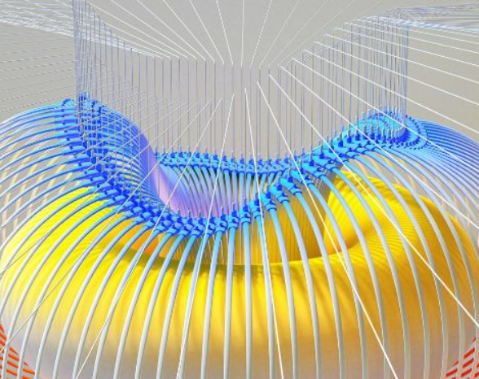

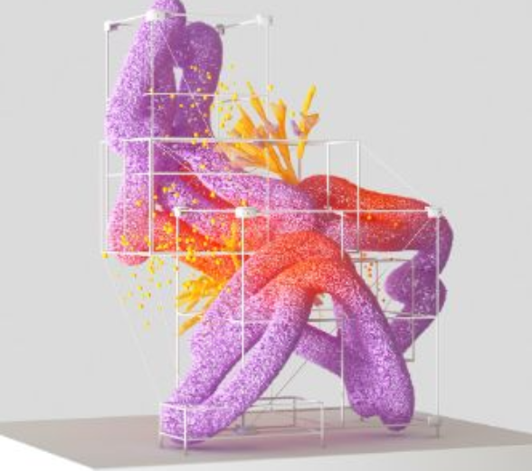

AI AND PRIVACY
A survey by Pew Research Center found that 64% of Americans are concerned about the way that companies are using their data, and 81% feel that they have little or no control over the data that companies collect about them.
20%
55%
The EU's GDPR includes provisions for ensuring that individuals have the right to access and control their personal data, including data that is processed using AI systems.

Slide 15

AI AND SOCIETY
Discusses the broader societal implications of AI, including its impact on job displacement, inequality, and social norms. This section aims to provide a comprehensive understanding of the ways in which AI is shaping our society and the challenges that need to be addressed.
04

Slide 16


THE RISE OF POWERFUL AI WILL BE EITHER THE BEST OR THE WORST THING EVER TO HAPPEN TO HUMANITY. WE DO NOT YET KNOW WHICH.
STEPHEN HAWKING

Slide 17








THANK YOU FOR
CHOOSING EATEMP
We offer free and high-quality slides templates for your presentations. We appreciate you choosing us and hope our templates have been helpful.
As a new website, we rely on your support to grow, so please help us by sharing our site with your friends and colleagues.
eatemp._
@eatemp
eatempofficial
@eatemp.official

