Slide 1
LACRIMAL APPARATUS
The lacrimal apparatus consist of:
Secretory Portion
Lacrimal glands
Accessory lacrimal glands
Krause and wolfring
2. Drainage portion:
Canalicali (puncta)
Lacrimal sac
Lacrimal duct (with opening in the inferior nasal meatus.)

Slide 2
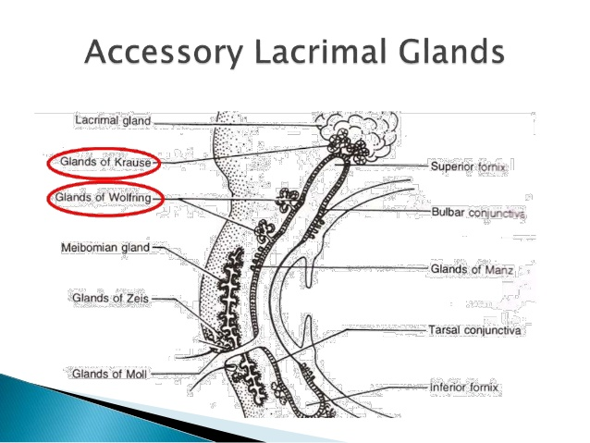

Slide 3
SECRETARY PORTION
1º made up of lacrimal gland located in the anterior lateral portion of the roof of the orbit in the lacrimal fossa.
It is divided:
A large orbital portion
A small palpebral portion by the lateral part of the aponeurosis of the LPSM.
The lacrimal gland is of the tubulo alveolar type has numerous acini composed of a double layer of cell surrounding a central canal which open into the secretory.

Slide 4
3 – 5 ducts drain the orbital portion while 5 – 7 ducts drain the palpebral portion.
The ducts of the orbital portion pass through the palpebral tube and each of the ducts opens separately into the superior temporal fornix.

Slide 5
Secretory innervation begin in the lacrimal (salivatory nucleus of the facial nerve (CNVII)). In the floor of the 4th ventricle and run through the facial nerve to the geniculate ganglion.
The lacrimal gland is drained by:
Lymphatic vessels ending in the pre–auricular lymph nodes

Slide 6
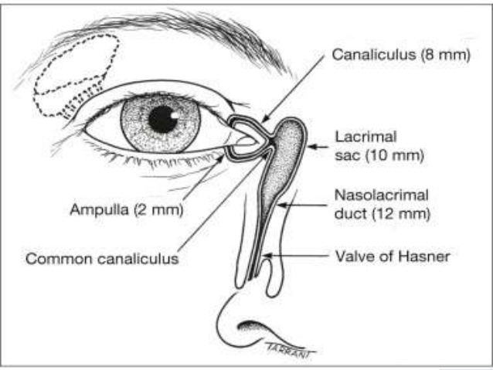

Slide 7
COMPOSITION OF THE LACRIMAL GLAND
Puncta
Ampullae/Vertical Canaliculi
Horizontal canaliculi
Lacrimal sac
Nasolacrimal duct
PUNCTA
Location:
Near the medical end of each eyelid
Normally the face in the slightly posterior direction and can be inspected by everting the medical aspect of the eyelids
NB: Treatment of excessive watering caused by punctual stenosis or malposition is relatively straight forward

Slide 8
AMPULLAE/VERTICAL CANALICULI
Length: 2mm long and
Forms the most proximal part of the lacrimal drainage system
In a one snip procedure the ampullae is slit vertically.
HORINZOTAL CANALICULI
Length: 8mm long
Upper and lower canaliculi form the common canaliculus which opens into the lateral wall of the of the lacrimal sac in about 90% of individual
In the remainder each canaliculi open separately.

Slide 9
A small flap of mucosa (valve of Rosen Muller) over hangs the entrance of the common canaliculi and:
Prevents reflux of tears from the sac into the canaliculus
Treatment of canaliculi Obstruction is frequently complicated.
LACRIMAL SAC
Length: 10mm long
Location: lie in the lacrimal fossa between
Anterior and
Posterior lacrimal crest
NB: the lacrimal bone and frontal process of the maxillary separates the lacrimal sac from the middle meatus of nasal cavity.

Slide 10
NASOLACRIMAL DUCT
Length: 12mm long
Location: Passes downward and angles slightly
Medial
Posterior to open into the inferior nasal meatus, lateral and below the inferior turbinate
The opening of the duct is particularly covered by a mucosal fold (valve of Hasner).
BLOOD SUPPLY
Obstruction of the duct may cause a 2º distension of the sac.
NB: The eye and the orbital content receive their main blood supply from the ophthalmic artery.

