Slide 1
How to manage
financial risk
This session is aimed at Year 9 and is also appropriate for KS4 and KS5

Slide 2
Unit outline
Session 1 | Session 2 | Session 3 | Session 4 | Session 5 | Session 6
Mobile phone products | Cryptocurrency | Financial exploitation | Online gaming | Online safety | Pocket money debate

Slide 3
Having a respectful learning environment
We will listen to each other respectfully
We will avoid making judgements or assumptions about others
We will comment on what has been said, not the person who has said it
We won’t put anyone on the spot and we have the right to pass
We will not share personal stories or ask personal questions
If there is a question that you do not wish to ask aloud, you can write it on a post-it note which will be collected throughout the session and answered at the end
Notes:
Teacher delivery
Students should be invited to ask questions and they should be provided with an opportunity to ask questions anonymously. It is useful to have a question box or allocated space on the whiteboard for students to share questions.
It is suggested that students are provided with post-its or slips to write their questions on and as the teacher circulates throughout the lesson these questions can be collected and answers throughout the session or using an allocated ‘question time’ at the end of the session.
Students can be invited to respond to questions asked by their peers. If responses to questions are based on personal preference or opinion, the teacher should be clear to preface any answers with this.

Slide 4
Session 2:
Cryptocurrency

Slide 5
By the end of the session, I will be able to:
Explain what cryptocurrency is and how it compares with traditional money
Assess the factors that influence financial decisions
Suggest ways to engage with crypto assets while managing risk

Slide 6








What is cryptocurrency?
Write what you know already, using some of these terms in a sentence:
money coins digital investment risk bank speculative
Currencies = A medium of exchange for goods and services.
A currency usually comes in the form of coins and notes, but now there are also digital currencies, such as cryptocurrency.
Notes:
Suggested timing: 4 minutes on task | 4 minutes feedback
From Left to right:
Bitcoin (BTC) - The most widely used cryptocurrency
Tether (USDT) – a stablecoin pegged to the US dollar.
Binance Coin (BNB) – the native token of the Binance exchange and the Binance Smart Chain.
Uniswap (UNI) – the governance token of the Uniswap decentralized exchange (DEX).
Decentraland (MANA) – the token for a virtual reality platform built on Ethereum.
TRON (TRX) – the native cryptocurrency of the TRON blockchain.
XRP (Ripple) – a digital payment protocol and cryptocurrency focused on fast, low-cost cross-border transactions.
Ethereum (ETH) – the native token of the Ethereum blockchain, used for decentralized applications and smart contracts.

Slide 7
What is cryptocurrency?
Write what you know already, using some of these terms in a sentence:
money coins digital investment risk bank speculative
A possible answer:
Cryptocurrency is a type of digital coin or currency. It's an investment, because people hope the value of the coin increases. However, it's speculative (a bet on a future change in cost) and not backed or protected by any bank. That's why it's a high risk option.
Notes:
Suggested timing: 4 minutes on task | 4 minutes feedback
From Left to right:
Bitcoin (BTC) - The most widely used cryptocurrency
Tether (USDT) – a stablecoin pegged to the US dollar.
Binance Coin (BNB) – the native token of the Binance exchange and the Binance Smart Chain.
Uniswap (UNI) – the governance token of the Uniswap decentralized exchange (DEX).
Decentraland (MANA) – the token for a virtual reality platform built on Ethereum.
TRON (TRX) – the native cryptocurrency of the TRON blockchain.
XRP (Ripple) – a digital payment protocol and cryptocurrency focused on fast, low-cost cross-border transactions.
Ethereum (ETH) – the native token of the Ethereum blockchain, used for decentralized applications and smart contracts.

Slide 8
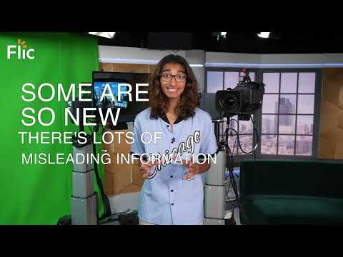
What is cryptocurrency?
Watch the video
Summarise the four key points
Video | https://youtu.be/PFKke1jDX78
Additional video resource: https://youtu.be/f7iXTyHGYX4 - play to 02:45

Slide 9
What is cryptocurrency?
Anyone can create a cryptocurrency.
Crypto can go up and down in value. Social media impacts value.
Unlike other investments: often no central control, risky.
Bitcoin is not the same as blockchain. Bitcoin is the most famous, just one type of cryptocurrency. Blockchain is the technology it’s built on.
Video | https://youtu.be/PFKke1jDX78
Additional video resource: https://youtu.be/f7iXTyHGYX4 - play to 02:45

Slide 10


Cryptocurrency vs. money
Why some are wary of cryptocurrency…
It doesn’t have the backing of a government or central bank and usually isn’t regulated
It isn't stable
It isn't accepted for buying most shopping items
…can be exactly why others prefer it
Its instability (also called volatility) allows some people to make huge gains in a short space of time, but also huge losses!
It is sometimes decentralised, meaning peer to peer trades can take place without an organisation in the middle
Notes:
An institutional body includes organisations such as banks or insurance companies.

Slide 11
Summary | What is cryptocurrency?
1.Cryptocurrencies have a limited number of coins. This limited supply gives them value. Bitcoin is limited to 21 million bitcoins. The amount of coins that exist need to be ‘mined’ by massive computers solving complicated maths problems.
2. The value of crypto is mostly based on what people believe the value of the cryptocurrency is or will be. It is not issued by the government, like the British pound or US dollar. This is why it can be very volatile - often changing in value.
3. Cryptocurrency is speculative. This means that people buy or trade crypto because they have heard it may rise in value, not because they have evidence to support a potential rise in its value. Unlike online games, like Fortnite, investments in cryptocurrency can lead to real big losses.
4. Cryptocurrencies, at the moment, are not widely accepted so can’t be used to buy a lot of items.
5. Any investment should only be made after an emergency fund has been set aside. This is an amount of money, usually 3 months worth of spending, saved in case of unforeseen events.
Notes:
Different sets of students to be given different sections to read and summarise. Students then feedback to the class.

Slide 12
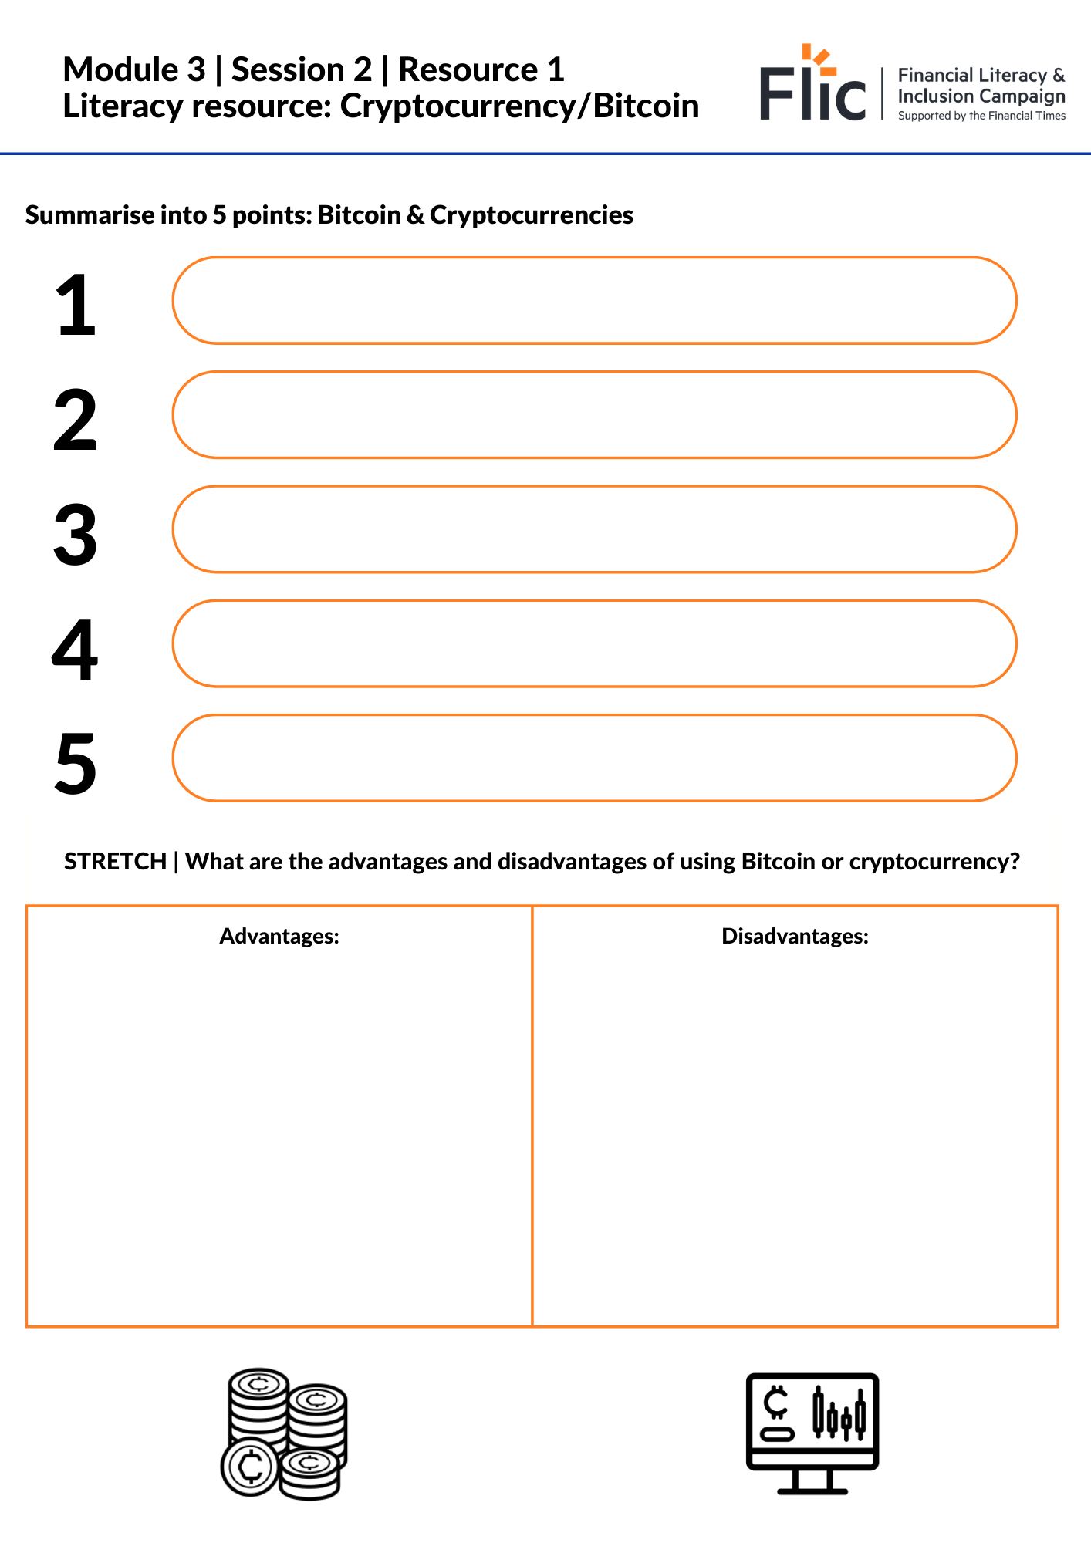
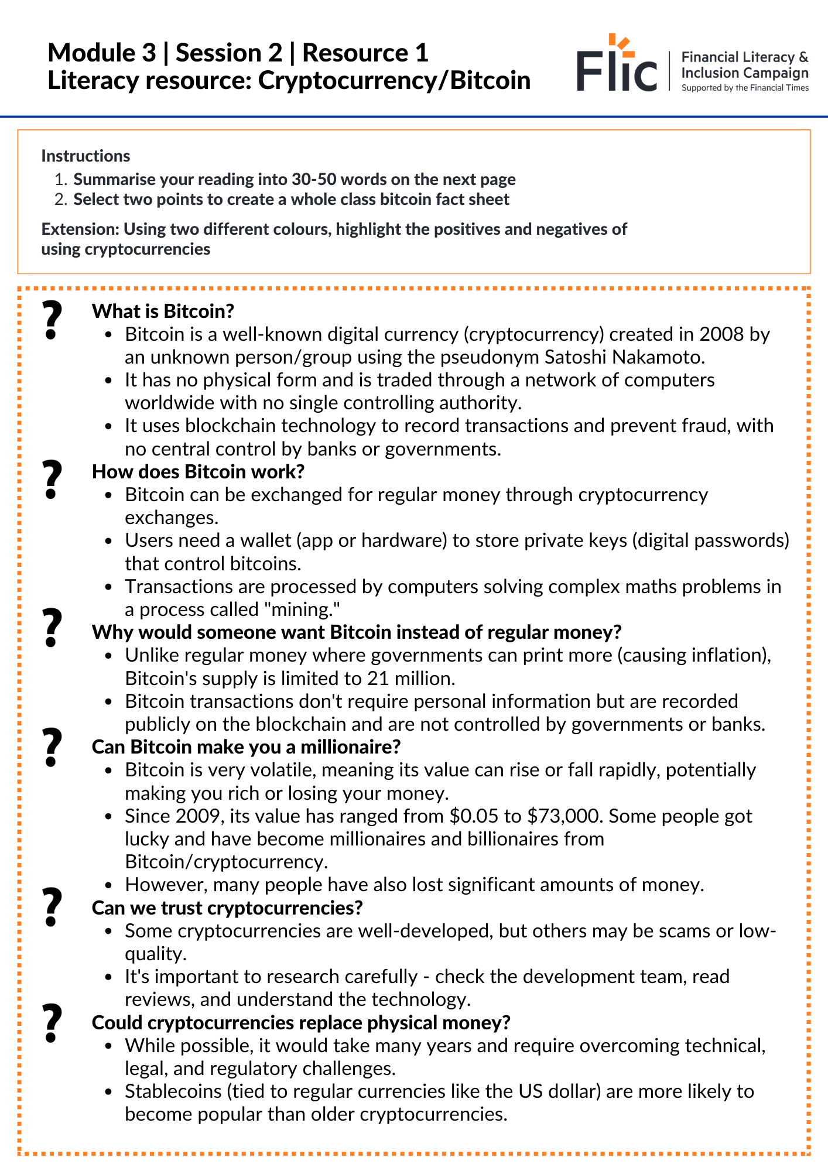
What is cryptocurrency?
Literacy resource: Cryptocurrency and bitcoin
Summarise your reading into five points
Select two points to create a whole class bitcoin fact sheet to collate on the board
Stretch: What are the positives and negatives of cryptocurrency? Fill in the table on the sheet.
Two options:
Resource 1 | Literacy Resource (1 page)
Resource 1 | Literacy Resource (Stretch)
Notes:
Suggested timing: 10 minutes on task | 6 minutes feedback
Students can be given one part of the reading or all parts. (Print two per page)
For lower ability groups or students, focus on one section of the reading or use a whole class reading strategy.
Note key summary points on the whiteboard. Students can make notes from class feedback

Slide 13
Summary | What is cryptocurrency?
Cryptocurrencies have a limited supply, giving them value—Bitcoin is capped at 21 million coins. Coins are mined using powerful computers solving complex math problems.
The value of crypto is mostly based on what people believe the value of the cryptocurrency is or will be. It is not issued by the government, like the British pound or US dollar. This is why it can be very volatile - often changing in value.
Crypto is speculative—people buy it hoping the price will rise, often without evidence. Unlike game currencies, real money can be lost.
Currently, crypto isn't widely accepted for purchases.
Investing should only happen after saving an emergency fund—at least three months' expenses for unexpected events.
Notes:
Different sets of students to be given different sections to read and summarise. Students then feedback to the class.

Slide 14
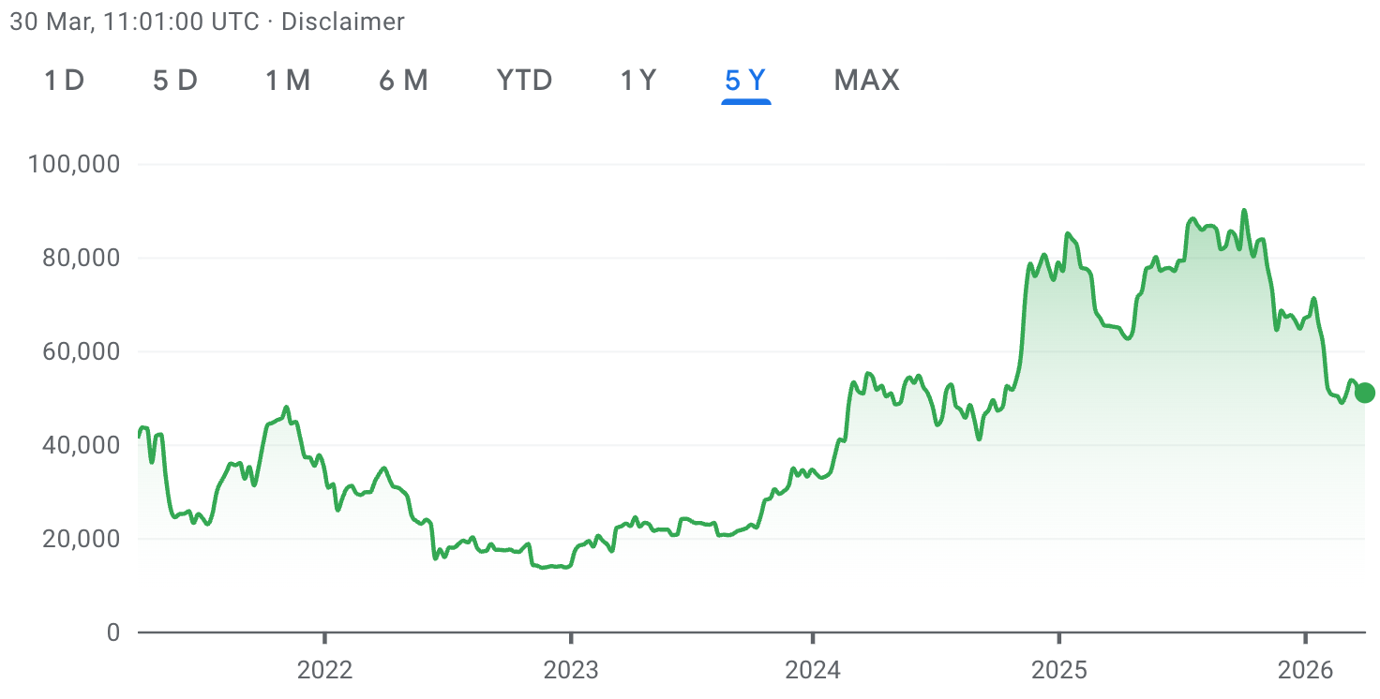
Bitcoin’s change in price: 5 years
What is Bitcoin worth in £ today? Search online or check here
In 2016, 1 Bitcoin was worth around £3
In 2025, 1 Bitcoin was worth over £90,000
Notes:
Source: https://www.google.com/finance/quote/BTC-GBP?window=5Y
Updated March 2026

Slide 15
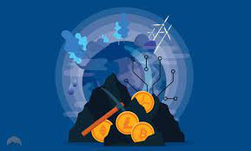
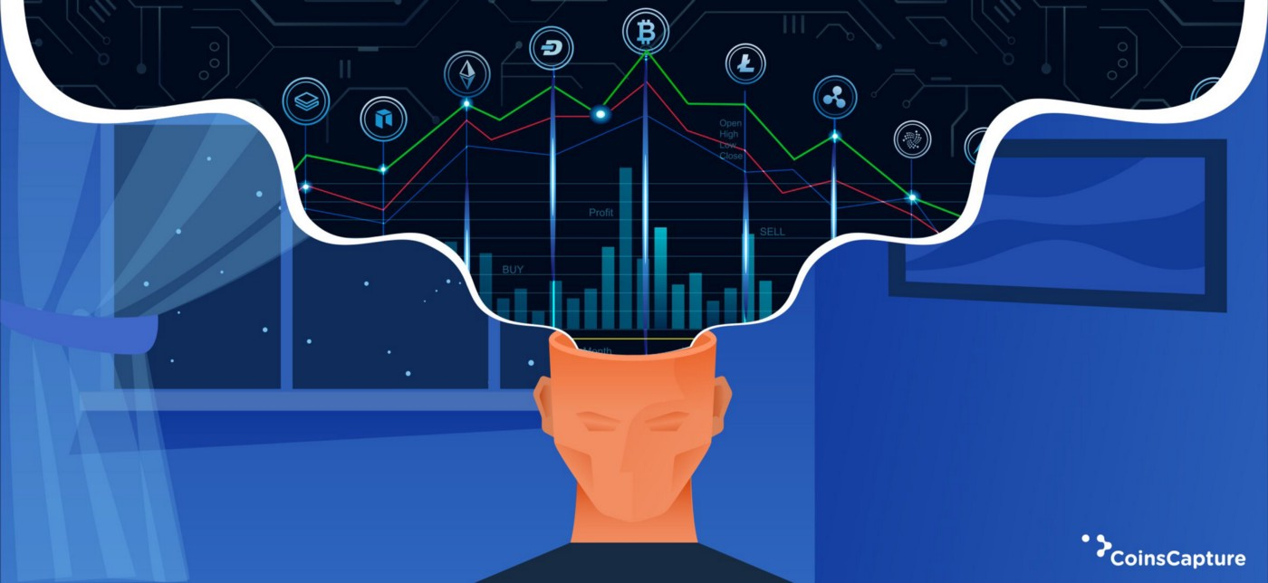
Ethical considerations
Environmental
Cryptocurrencies can be environmentally unfriendly because it takes a large amount of energy to power the technology they require. Bitcoin alone uses more energy than some entire countries!
There are increasing efforts to try to make cryptocurrencies greener.
Social
Some people get short-term happiness from their cryptocurrencies going up and down, but others can end up suffering from severe anxiety.
Some people have ended up treating it like gambling or committing crimes to fund it.
Watch the video 3:30 [optional] - https://www.ft.com/video/ce61990f-ba96-4759-8979-139dd6ccd8d9
Notes:
Further example
That is what happened to a man called Jake, who told the BBC that he had lost millions after becoming addicted to trading cryptocurrencies. Jake did not have millions to lose — he was charged with stealing £1.5mn from his employer.

Slide 16
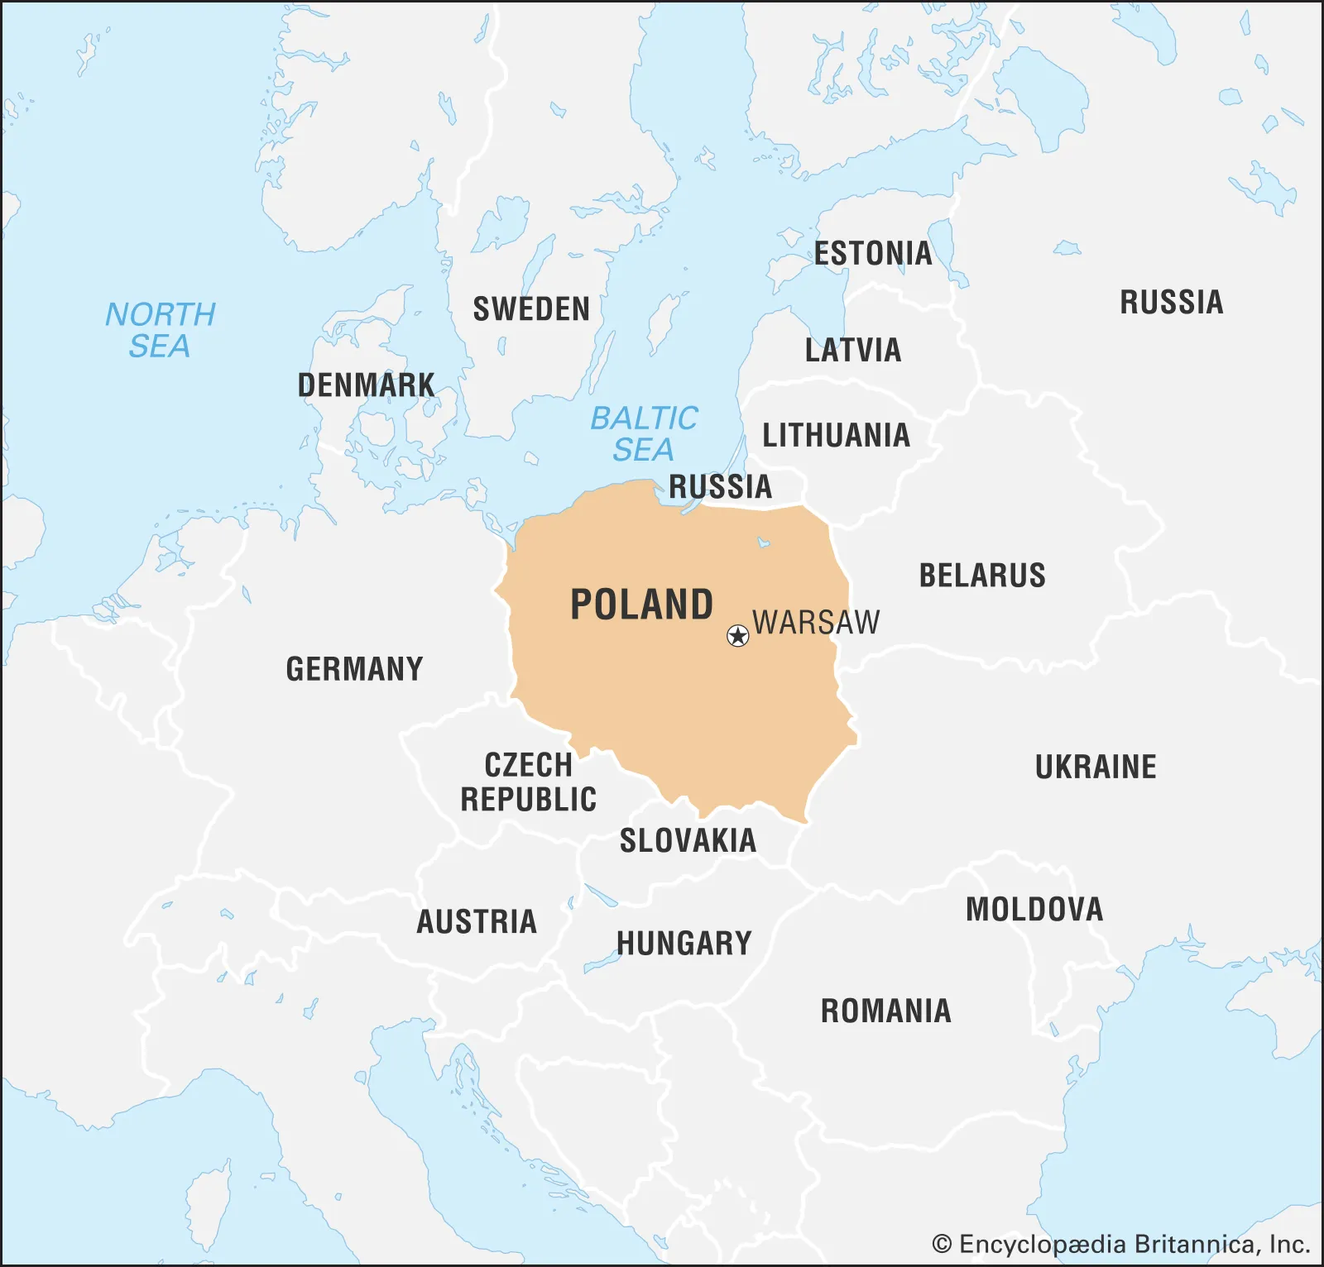
Did you know?
Bitcoin's energy consumption is similar to the whole country of Poland.
That’s about 40 million people
Notes:
https://www.bbc.co.uk/news/technology-56012952
Source: https://ccaf.io/cbnsi/cbeci/comparisons

Slide 17
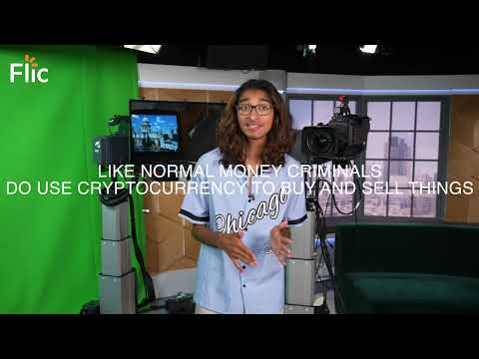
5 myths about cryptocurrency
Video | https://youtu.be/J-xEhaUxCy4
Notes:
Suggested timing: 1 minute video | 6 minutes AfL quiz

Slide 18
5 myths about cryptocurrency
These common myths are untrue:
Cryptocurrency investing will quickly make you rich
As the cost of living rises, cryptocurrencies can protect your money
You can’t spend cryptocurrency
Cryptocurrencies are transparent
Only criminals use cryptocurrencies
Video | https://youtu.be/J-xEhaUxCy4
Notes:
Suggested timing: 1 minute video | 6 minutes AfL quiz

Slide 19

Cryptocurrency - the good and the bad
What are some of the positives and negatives about Bitcoin or cryptocurrency?
Have a discussion in pairs:
One person defends cryptocurrency and the other person gives arguments against it.
Prepare to share your opinions with the class.
Notes:
Suggested timing: 8 minutes class discussion
Teacher delivery
Encourage students to consider all points from a range of perspectives i.e. a disadvantage for one, could be an advantage for another.

Slide 20
Start of optional activity:
Assessment for learning multiple choice quiz

Slide 21
Multiple choice
There are about …………….. actively used cryptocurrencies worldwide
A | B | C
750 | 7,200 | 10,000
Notes:
Source: https://www.statista.com/statistics/863917/number-crypto-coins-tokens/

Slide 22
Multiple choice
There are about …………….. actively used cryptocurrencies worldwide
A | B | C
750 | 7,200 | 10,000
Notes:
Source: https://www.statista.com/statistics/863917/number-crypto-coins-tokens/

Slide 23
Multiple choice
2. Who can own a cryptocurrency?
A | B | C
Anyone | People over the age of 16 | People that have been financially trained

Slide 24

Multiple choice
2. Who can own a cryptocurrency?
A | B | C
Anyone | People over the age of 16 | People that have been financially trained
Note that this is different to opening an account or trading. Most popular cryptocurrency exchanges, such as traditional brokerage firms, prevent anyone under 18 years of age from opening a trading account.

Slide 25
Multiple choice
3. Which of these sets of words accurately define Bitcoin?
A | B | C
High-risk and stable | Low-risk and volatile | High-risk and volatile

Slide 26
Multiple choice
3. Which of these sets of words accurately define Bitcoin?
A | B | C
High-risk and stable | Low-risk and volatile | High-risk and volatile

Slide 27
Multiple choice
4. The supply of bitcoin is…
A | B | C
Changeable because more can be created or issued | Carefully controlled and limited | Controlled by governments or banks

Slide 28
Multiple choice
4. The supply of bitcoin is…
A | B | C
Changeable because more can be created or issued | Carefully controlled and limited | Controlled by governments or banks

Slide 29
Multiple choice
5. Which of these statements is TRUE?
A | B | C
Cryptocurrencies will always make a person rich quickly | Cryptocurrencies are mostly used by thieves | There’s never a guarantee that any cryptocurrency or other investment will make someone money

Slide 30
Multiple choice
5. Which of these statements is TRUE?
A | B | C
Cryptocurrencies will always make a person rich quickly | Cryptocurrencies are mostly used by thieves | There’s never a guarantee that any cryptocurrency or other investment will make someone money

Slide 31
End of optional activity:
Assessment for learning multiple choice quiz

Slide 32
By the end of the session, I will be able to:
Explain what cryptocurrency is and how it compares with traditional money
Assess the factors that influence financial decisions
Suggest ways to engage with crypto assets while managing risk

Slide 33

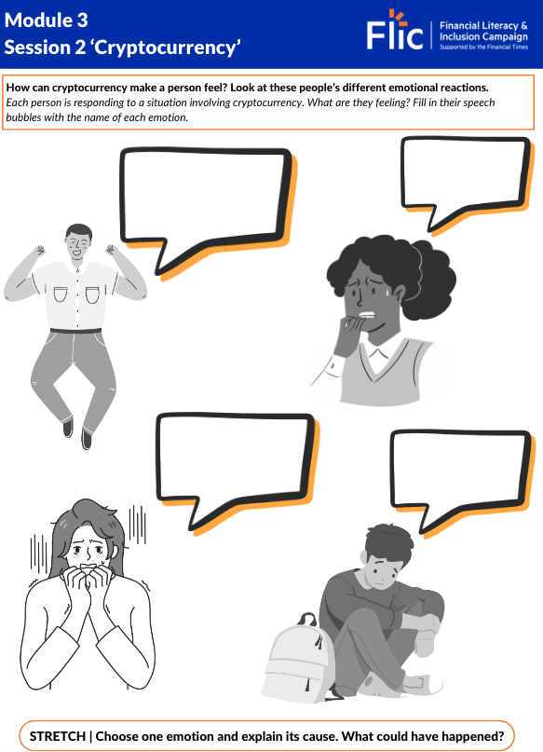
Cash or crypto?
How can cryptocurrency make a person feel?
Discussion: Think of positive and negative emotions that crypto could cause
Excited
Anxious
Powerful
Disappointed
Relevant
Frustrated
Notes:
Teacher explanation
It may be that young people might think about crypto as ‘empowering’ ‘revolutionary’ or ‘exciting’ – if this is the case, explain reasons why, although these might be feelings associated with investing in crypto, there is also a lot of anxiety, disappointment, confusion and frustration that can also be generated.

Slide 34

Who does cryptocurrency appeal to?
What are the factors that would influence this person’s decision to use cryptocurrency?
This is Zak.
Zak is 20 years old and is about to complete his last year at university studying software design. He will be living with his dad, who is a carer for his mum. He will not be able to leave home as he has not saved enough money for his own place. Zak is really interested in cryptocurrency, especially since some of his favourite influencers have recently invested. It is all his friends at university talk about.
How many factors can you identify?
Notes:
Suggested timing: 4 minutes on task
Teacher prompt questions
How do different social groups or communities approach the use of money and new financial technologies?
In what ways might economic background influence attitudes toward emerging financial tools like cryptocurrency?
How could varying levels of financial literacy or education shape someone’s understanding of digital currencies?
Are there philosophical or ethical considerations that affect how people view new forms of money?

Slide 35
Who does cryptocurrency appeal to?
How might the highlighted factors influence this person’s decision to use cryptocurrency?
This is Zak.
Zak is 20 years old and is about to complete his last year at university studying software design. He will be living with his dad, who is a carer for his mum. He will not be able to leave home as he has not saved enough money for his own place. Zak is really interested in cryptocurrency, especially since some of his favourite influencers have recently invested. It is all his friends at university talk about.
Task: Explain two factors that could influence Zak to invest in cryptocurrency
Notes:
Suggested timing: 4 minutes feedback | 8 minutes on task
The discussion is based on likelihood to engage in risk, reflect back on who is likely to invest and why?
Highlight the discussion is largely based on stereotypes and does not apply to all people in a specified group.

Slide 36

Who does cryptocurrency appeal to?
Engagement with cryptocurrency is shaped by a range of personal, social, and financial factors.
Peer pressure and influencer-driven marketing on social media platforms can lead to impulsive investment decisions, particularly among younger audiences.
Cultural attitudes toward money and risk vary significantly, meaning cryptocurrency adoption differs widely across communities and countries.

Slide 37
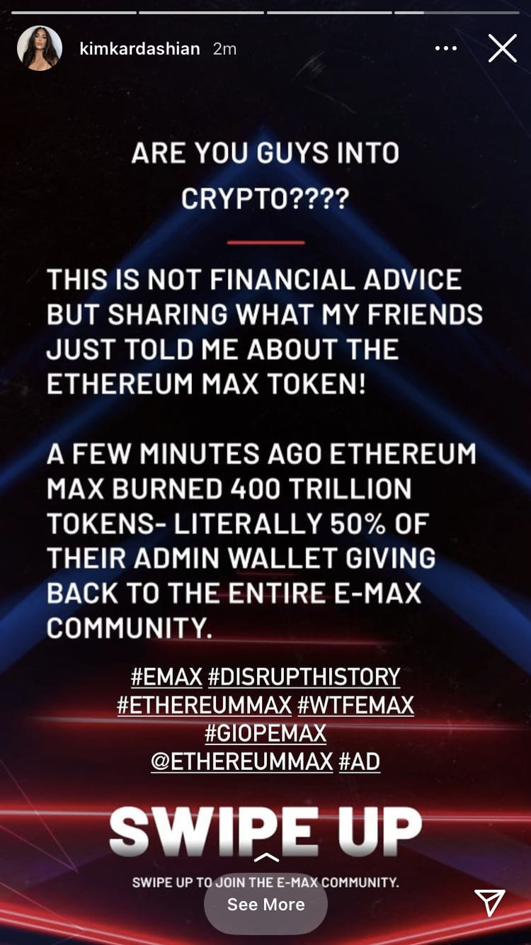

How does social media impact decision making?
Kim Kardashian promoted a cryptocurrency on her Instagram
Discussion: What do you think…
...her followers did?
...happened to the value of the coin?
Notes:
Teacher prompt questions
Why did the value of the coin decrease?
Why is that a bad thing?
Who would have been able to benefit in this scenario?
How might someone protect themselves or make the best out of this situation?

Slide 38
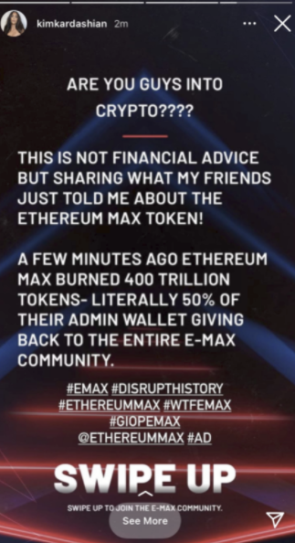
What happened next?
Kim Kardashian had to pay a $1.26 million fine for promotion of the token without disclosing that she was paid for the promotion.
The value of the company’s EthereumMax tokens increased by as much as 1,370% after the social media posts before crashing to an all-time low.
What is 1 thing you have learnt from this story?
Notes:
Guardian article
SEC Fine

Slide 39


Other red flags: ‘pump and dump’
Watch the video and list the three warning signs to watch out for
Unknown coins rising rapidly in value
Paid ads
Lots of social media activity
Play until 1:00
https://www.youtube.com/watch?v=CakdQBB5QnQ
Notes:
Alternative video: https://www.youtube.com/watch?v=YJVtgv6Zmq4

Slide 40
By the end of the session, I will be able to:
Explain what cryptocurrency is and how it compares with traditional money
Assess the factors that influence financial decisions
Suggest ways to engage with crypto assets while managing risk

Slide 41
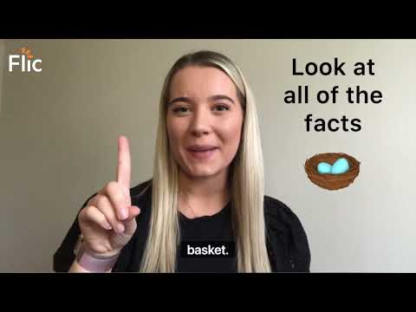
What does good research involve?
https://youtu.be/3xVMpSI1GfE
Video | https://youtu.be/3xVMpSI1GfE

Slide 42
What does good research involve?
Trusted sources
Check for red flags
Financial advice
Data and trends
Who has endorsed this coin?
Celebrity endorsement can impact how valuable a coin is perceived to be, especially if there has been hype created on social media for example.

Slide 43

Did you know
Most cryptocurrencies are not regulated by the FCA (Financial Conduct Authority), even if the firm providing the crypto is. This means people aren’t protected by the UK’s Financial Compensation Scheme.
Long story short:
Cryptocurrencies are not regulated like normal banks.
If you are scammed, you are unlikely to get your money back.
Notes:
Teacher explanation
- You can check the crypto company's registration number on Companies House to check it is a legitimate company (only applies for UK firms). You can also check the Financial Conduct Authority register.
- Most cryptocurrencies are not regulated by the FCA (even if the firm providing the crypto is) which means you won't be protected by the UK's Financial Compensation Scheme. This means that if you're scammed it is unlikely you will recover your money.

Slide 44

How to manage influences
You receive this message from a friend:
“Hey! Have you seen the price of Kattacoin?!
It’s 15% cheaper than it has been.
You should buy. I have!!!”
Use the worksheet to create a conversation in response to the message
Resource 2: Text conversation template
Notes:
Suggested timing: 8 minutes on task

Slide 45
Any questions?
?

Slide 46

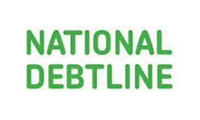

Services available for people who have concerns about their personal finances
Citizens Advice – Debt and Money – This resource contains links to advice on a number of topics, including financial difficulties, cost of living and communicating with creditors.
National Debtline – Debt and Money – a debt advice charity run by the Money Advice Trust, offering a free and confidential debt advice service.
Childline Helpline
0800 1111
At school, you can speak with an adult you trust.
This could be your form tutor, head of year or the school’s safeguarding officer.

Slide 47
Links to learn more
ARTICLES TO EXTEND LEARNING
Please visit the FLIC learning hub - Learning Hub FT FLIC for further resources
Blockchain: a clickable guide (Financial Times, 2021)
Cryptocurrency for Teens (2024)
Decrypting Crypto: Exploring Children’s Engagement with Cryptoassets (2023)

