Slide 1
Saying/Doing, Implementation Science, Systems Design, and Leadership
Ronnie Detrich
Wing Institute

Slide 2
Saying and Doing

Slide 3
Say/Do Correspondence
Reinforcing participants for doing as they said they would do.
  Keeping commitment
Saying does not necessarily predict doing.

Slide 4
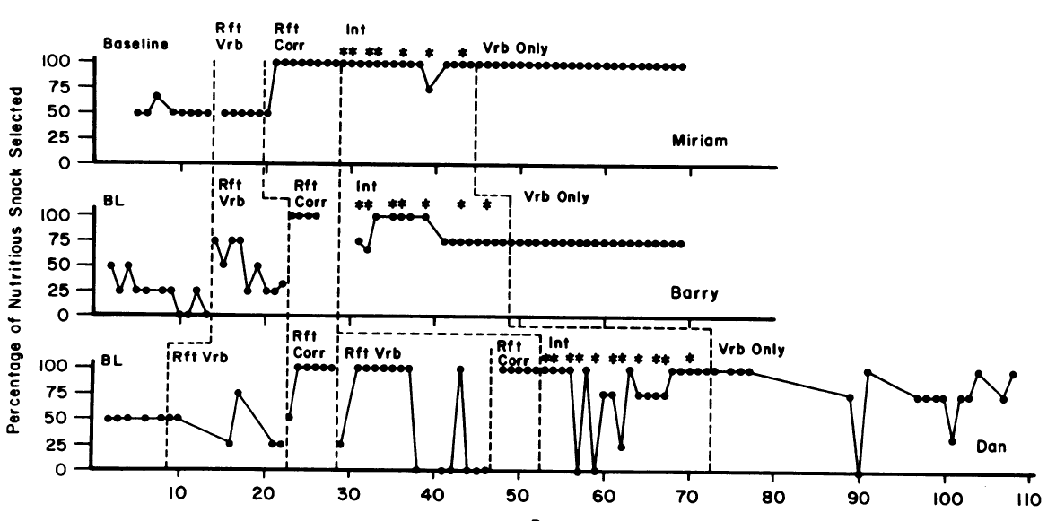
Baer, Blount, Detrich, & Stokes, (1987)

Slide 5
Implementation Science

Slide 6
After all is said and done,
a lot more will be said than done.
Author unknown
Well done is better than well said.
Benjamin Franklin

Slide 7
Implementation Science
The primary function of implementation science = getting initiatives implemented with integrity.
  “Students don’t benefit from interventions they don’t experience.” Dean Fixsen
Two challenges:
  Getting individuals to commit to implementing (saying).
  Getting individuals to actually implement (doing).
  Both require leadership.

Slide 8
Function of Educational Institutions
All students benefit from instruction

Slide 9
How is this Done?
Adopt effective practices.
Implement with integrity.
Both are complex and require leadership.

Slide 10
Leadership

Slide 11
Leadership Considered
Leadership is a construct.
  When is it invoked?
Leadership made up of two classes of behavior:
  Leading
  Following
Leadership defined by two effects:
  Following
  Effects on outcomes
    Followers but no outcomes is not leadership.
    Outcomes without following is not leading.

Slide 12
Leadership Considered
Leadership is a social relationship between two actors (leader & follower).
  Relationship maintained by exchange of reinforcers and punishers.
  Not defined by topography or nominal role of actors.

Slide 13
Leadership Considered
“Leadership is intentional influence”
Michael McKinney
Leadership can be consolidated in one person or distributed as in team-based leadership.
  Ultimate responsibilities are the same.

Slide 14
Leadership Considered
Establish vision, initiatives, goals.
Get others to commit to doing (saying).
Get others to implement with integrity (doing).

Slide 15
Leadership Considered
Maintain focus on ultimate goals (student benefit).
  Often conflict with more immediate consequences.
    Increased effort
    Increased cost
Create conditions so that others are doing what is necessary to meet goal.
Make sure the important things get done.
  Few things more important than implementing with integrity.

Slide 16
Systems Design

Slide 17
A Systems Perspective: Current Practice
Teachers are often the focus when evaluating student performance.
Principals are second most often cited as contributor to student performance.
Short-sighted.

Slide 18
A Systems Perspective
Students do well when teachers do well.
Teachers do well when they are effectively supported at the building level.
Principals are effective when they are supported by the district.
Districts perform well when they are supported State Education Agency.
Requires an aligned system.
Data about student performance and implementation.

Slide 19
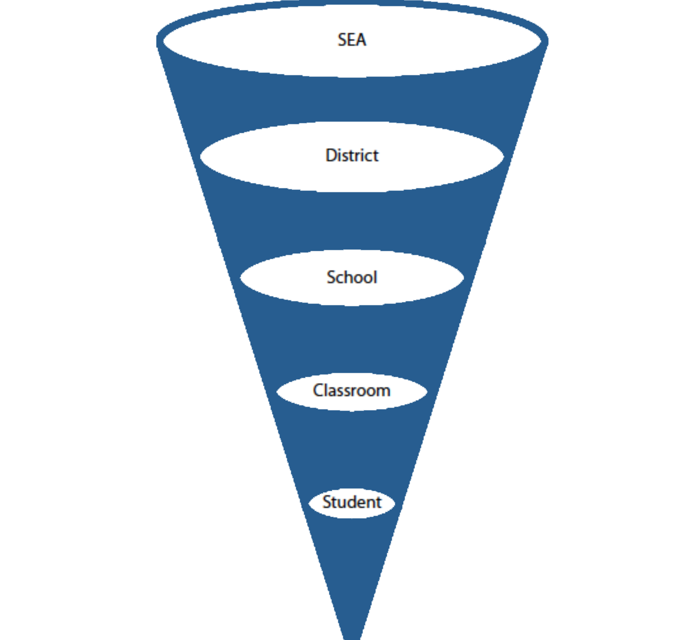



Slide 20
Interaction Between Leadership and System

Slide 21
Leader
Effective
Ineffective
Maximum Benefit for Students
Possibly Some Benefit
Aligned
System
Possibly Some Benefit
Not Aligned
No Chance

Slide 22
Leader
Effective
Ineffective
Maximum Benefit for Students
Possibly Some Benefit
Aligned
System
Possibly Some Benefit
Not Aligned
No Chance

Slide 23
Making Implementation Happen
Influencing Saying and Doing

Slide 24
Making Implementation Happen
Implementation does not happen without explicit efforts to make it happen.
Leadership is critical.
What do leaders do to facilitate implementation?

Slide 25
Establishing Motivation
Inspirational/Aspirational speakers- calls to action
  Appeals to values
  JFK
  MLK, Jr.
  Nelson Mandella
  Geoffrey Canada-Harlem Children’s Zone- “whatever it takes”

Slide 26
Establishing Motivation
Leadership teams- Distributed Leadership
  Responsibility for solution is shared.
  Allows participants to “own” the problem/solution.
    Effective for getting agreement that a problem exists and framing solutions.
    If members of the team are credible then can function as local champions for solutions with peers.
      Requires that someone ensures that team remains solution focused.
      May reduce resistance.

Slide 27
Specify Classes of Behavior
Following is difficult if followers don’t know what to do.
These are functional classes of behavior rather than topographical classes.
  Overly prescribing form narrows the range so that in many instances there is no “appropriate” response.
    The form of the behavior is not as important as the function.
      Catch ’em being good.
  SWPBS is a good model for establishing broad classes of behavior:
    Be Safe
    Be Respectful
    Be Responsible

Slide 28
Create Context for Following
Clear vision and goals.
Adequate training and coaching.
Necessary resources available.

Slide 29
Establish Stimuli for Following
Set the occasion for when following is to occur.
  Coaching
  Checklists
  Job Aids

Slide 30
Monitor and Reinforce Following
Performance feedback systems.
“Management by walking around.”
  Allows for immediate reinforcement of following.

Slide 31
Performance Feedback
Links the present to the future.
  Clarifies how performance today is affecting future outcomes.

Slide 32
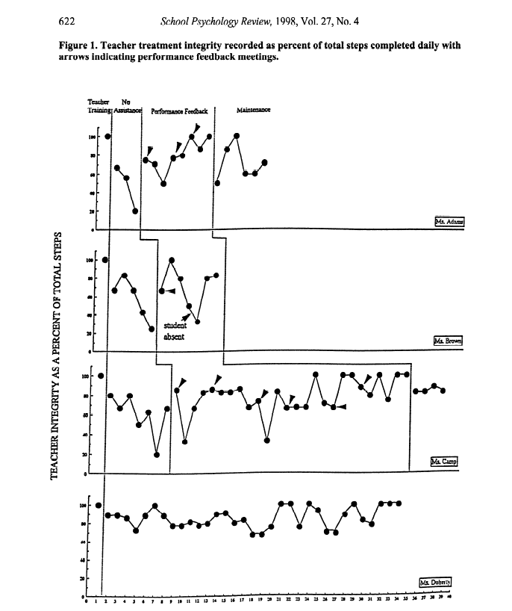
Mortenson & Witt, 1998

Slide 33
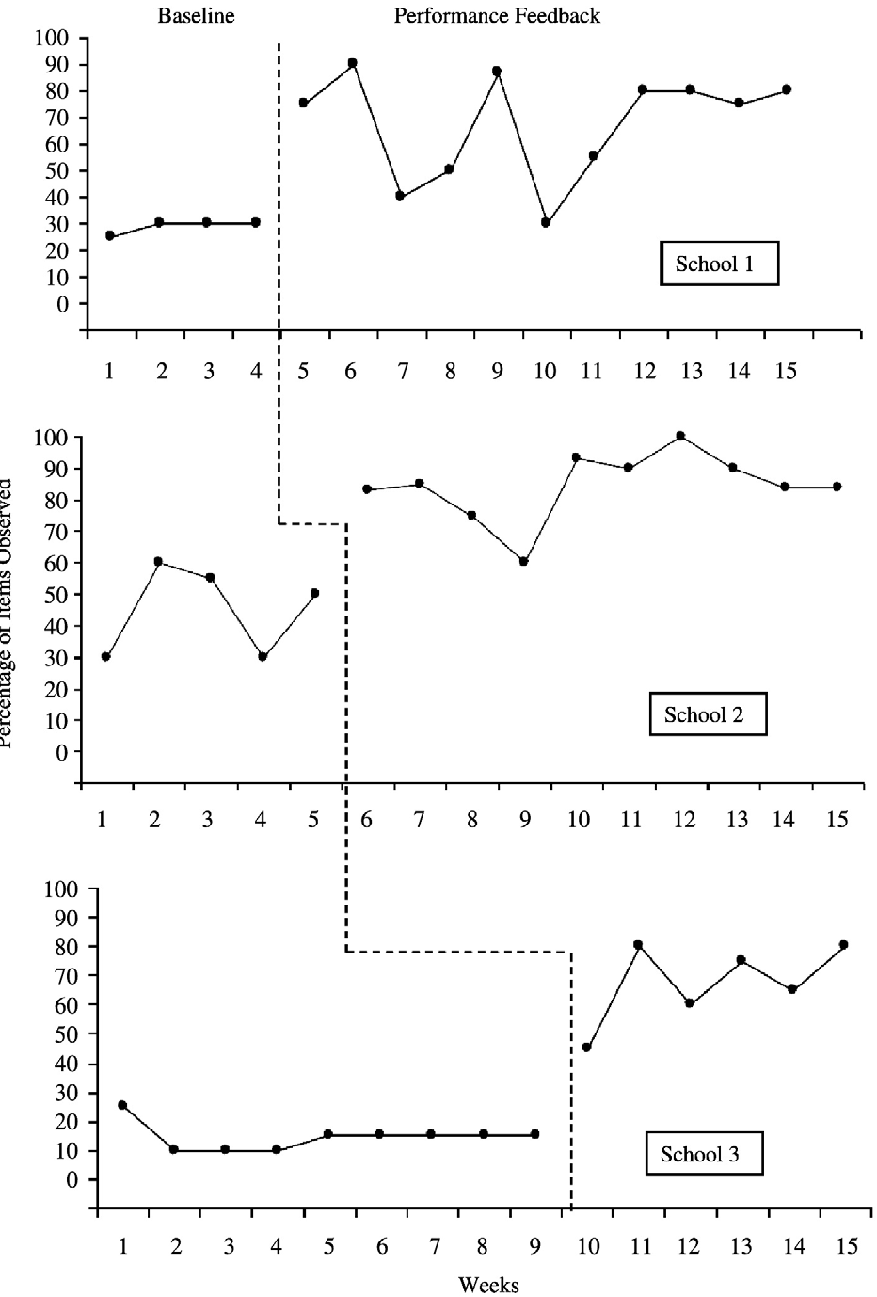
Burns, Peters, & Noell, 2008

Slide 34
Implications for Education Reform

Slide 35
Implications
Systems are not things.
  Systems= interrelationships between individuals, policies, and practices.
Leadership required to bring into alignment.

Slide 36
Implications: Aligning the System
CCSOO: “Don’t tell us what to do but make us do it.”
  Provide broad goals/outcomes and what must be in place. Let states and districts figure out the details.
  Details must meet technical requirements.
This logic can be applied across all levels of the system.

Slide 37
Implications: Aligning the System
Alignment requires a top-down/bottom-up approach.
  Leaving any level out of discussion, planning, and implementation increases probability that support and implementation will not happen.
  Higher levels must be responsive to concerns/needs of those at lower levels of the system.
  Lower levels must “buy in” to the vision and goals of the higher levels.

Slide 38
Implications: Aligning the System
In most states, Chief Operating Officer is elected or appointed by governor.
  Political position.
  If elected, may not share the governor’s vision.
Historically, SEAs have focused on compliance function rather than leading.
This will require SEAs to reorganize themselves to change function from compliance to support/partnership.

Slide 39
Aligning the System
“Politicians and policymakers need to create the conditions for others around them to succeed.”
Barber & Fullan, 2005

Slide 40
Leadership Summarized
“To lead people, walk beside them ... As for the best leaders, the people do not notice their existence. The next best, the people honor and praise. The next, the people fear; and the next, the people hate ... When the best leader's work is done the people say, 'We did it ourselves!'”
Lao Tzu

Slide 41
Thank you

